Slide 1
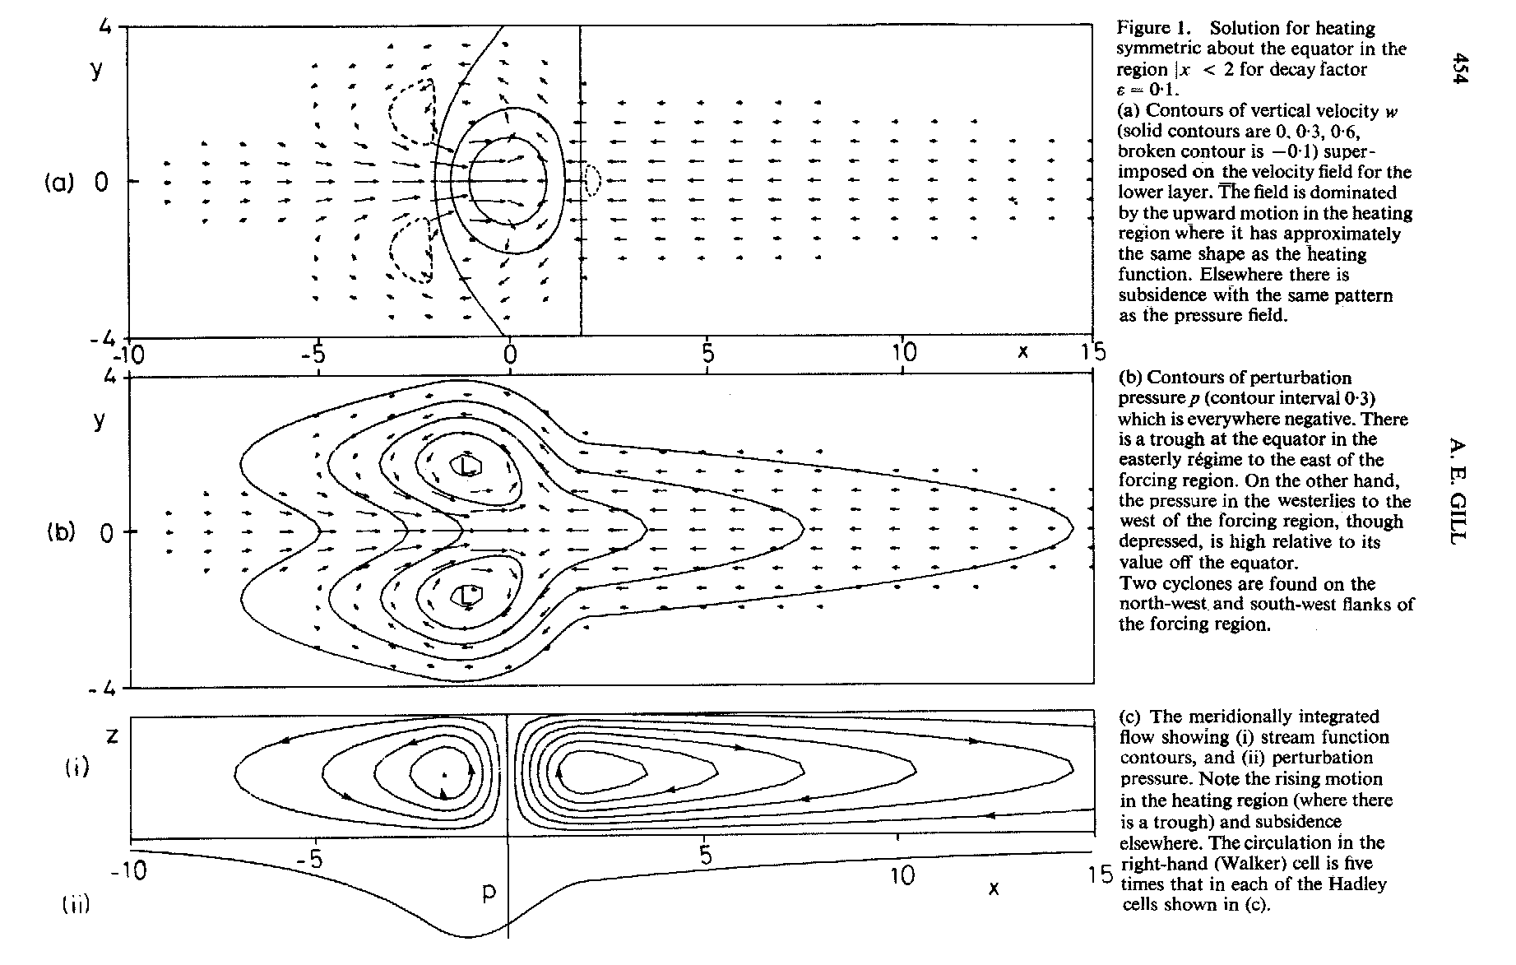
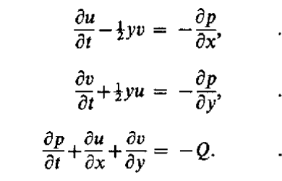

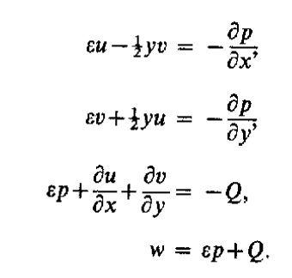
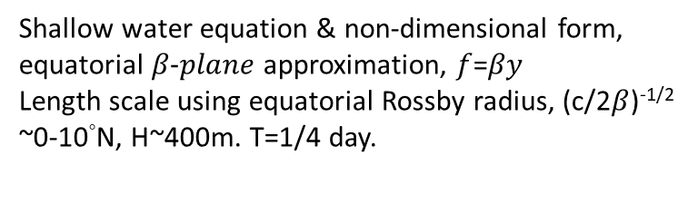
[A. E. Gill, 1980]
Local baroclinic response
& an east-west asymmetry pattern
Heating (SST warming)
y
Equator
Heating rate
Velocity field (u,v,w )
Shallow water equation & non-dimensional form, equatorial $β−plane$ approximation, $f$=$βy$
Length scale using equatorial Rossby radius, (c/2$β$)^{-1/2} ~0-10°N, H~400m. T=1/4 day.
y
Low
Equator
Low
Pressure field
Add dissipative process
Z
x

Slide 2
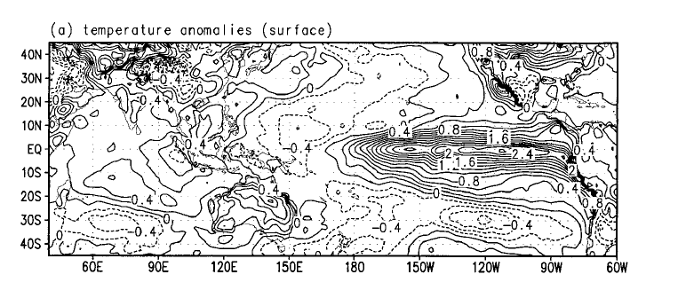
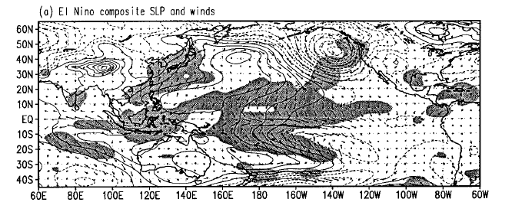
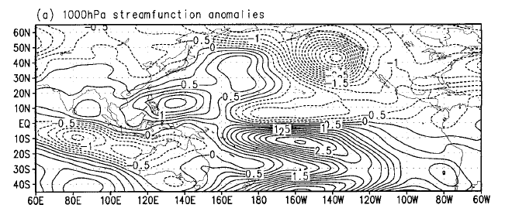
Wang, Bin, Renguang Wu, and Xiouhua Fu. "Pacific–East Asian teleconnection: how does ENSO affect East Asian climate?." Journal of Climate 13.9 (2000): 1517-1536.
The shaded areas indicate regions where the difference in surface winds between the warm and cold composite are statistically significant at 99% confidence level by t test. The contour interval for sea level pressure anomalies is 0.5 hPa. The vectors between the panels indicate the scale for wind anomalies.
The anomalous anticyclonic circulation

Slide 3
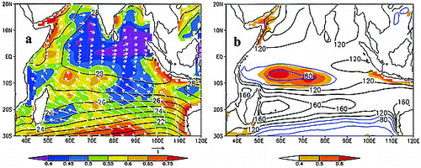
Xie, S. P., Annamalai, H., Schott, F. A., & McCreary Jr, J. P. (2002). Structure and mechanisms of South Indian Ocean climate variability. Journal of Climate, 15(8), 864-878.
The Indian Ocean is the only tropical ocean where
the annual-mean winds on the equator are westerly. As
a result of weak winds, the equatorial thermocline is
flat and deep (Fig. 1). Such an annual-mean climatology—
deep thermocline and absence of equatorial upwelling—
limits the effect of thermocline depth variability
on SST, a key element to the Bjerknes feedback,
leading to a view that the Indian Ocean cannot develop
its own interannual variability and thus has to follow
Pacific ENSO rather passively

Slide 4
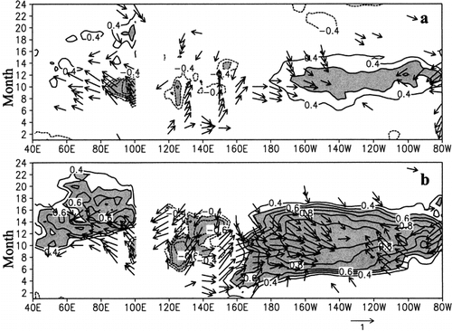
Xie et al. 2002 - “When either an El Niño or Sumatra cooling event takes place, anomalous easterlies appear in the equatorial Indian Ocean, forcing a westward-propagating downwelling Rossby wave in the SIO. In phase with this dynamic Rossby wave, there is a pronounced copropagation of SST. Moreover, a positive precipitation anomaly is found over, or just to the south of, the Rossby wave–induced positive SST anomaly, resulting in a cyclonic circulation in the surface wind field that appears to feedback onto the SST anomaly. Finally, this downwelling Rossby wave also increases tropical cyclone activity in the SIO through its SST effect.”
Fig. 9. Lagged correlations of SST (contours; |r| > 0.5 shaded) and surface wind stress (vectors), averaged in 3°S–3°N, with (a) the Sumatra and (b) the ENSO indices. The sign is reversed in (a) to facilitate comparison

Slide 5
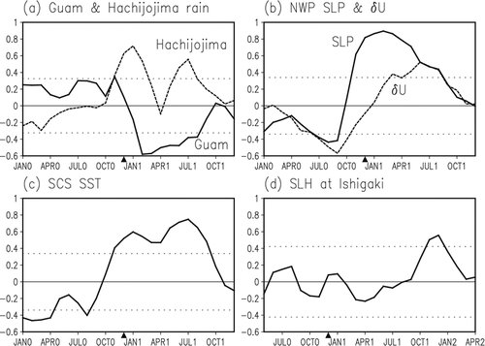
Xie, S. P., Hu, K., Hafner, J., Tokinaga, H., Du, Y., Huang, G., & Sampe, T. (2009). Indian Ocean capacitor effect on Indo–western Pacific climate during the summer following El Niño. Journal of Climate, 22(3), 730-747.

Slide 7
Convection over the SCS being suppressed
Ekman divergence
Kelvin wave

Slide 9
Li, Yuanlong, et al. "Interannual variability of the surface summertime eastward jet in the South China Sea." Journal of Geophysical Research: Oceans 119.10 (2014): 7205-7228.

Slide 10
Chu, X., Dong, C., & Qi, Y. (2017). The influence of ENSO on an oceanic eddy pair in the South China Sea. Journal of Geophysical Research: Oceans, 122(3), 1643-1652.
With weaker zonal wind, a more northward wind direction, and the disappearance of a pair of positive and negative wind stress curls, the eastward current jet turns northward along the Vietnam coast and the eddy pair
disappears.

Slide 11
Gan, J., & Qu, T. (2008). Coastal jet separation and associated flow variability in the southwest South China Sea. Deep Sea Research Part I: Oceanographic Research Papers, 55(1), 1-19.

Slide 12
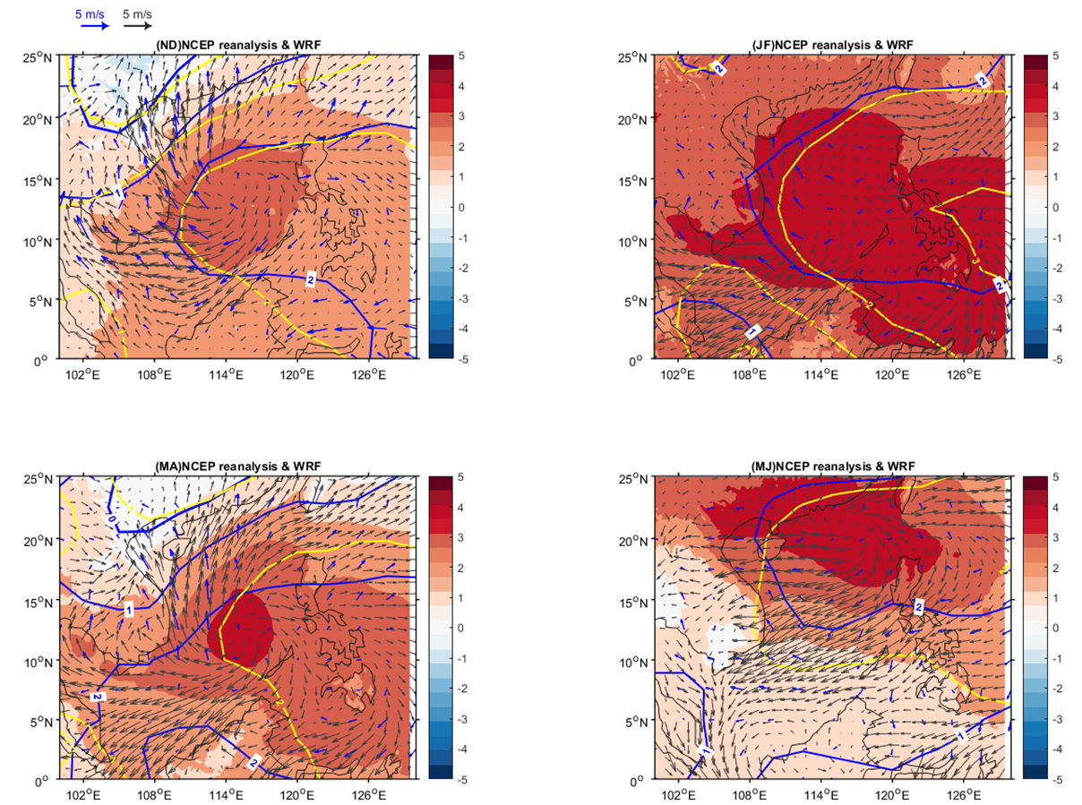
ageostrophic
pressure gradient (AGE)
Wind stress(t_{s})
adverse pressure gradient → flow separation
increasing the potential energy leads to a deceleration of the fluid.
Since the fluid in the inner part of the boundary layer is slower, it is more greatly affected by the increasing pressure gradient.
Momentum budget
Vorticity budget (squeezing of the vortex tube, advection, bottom pressure torque ?)

Slide 13
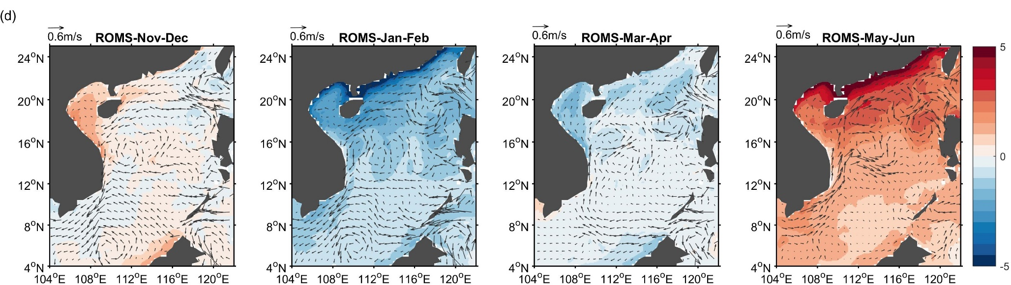
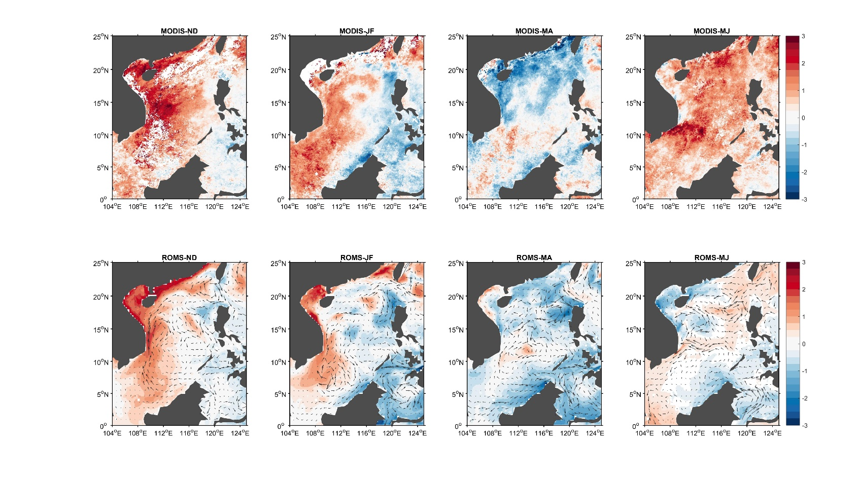
The El Nino
Deviation of the El Nino from the La Nina

Slide 14
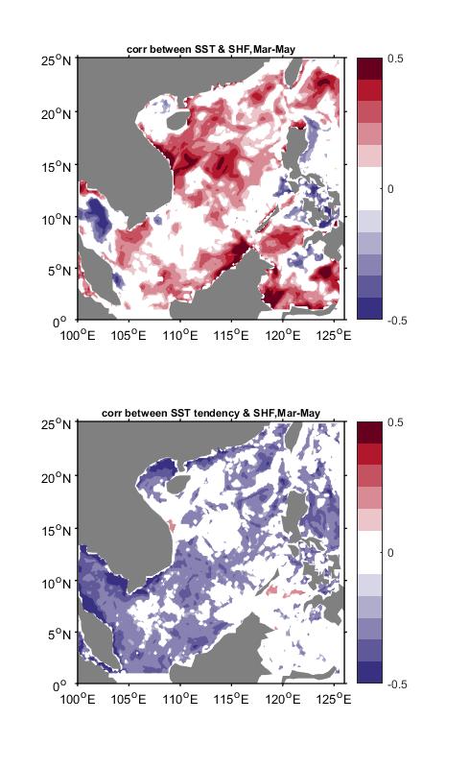
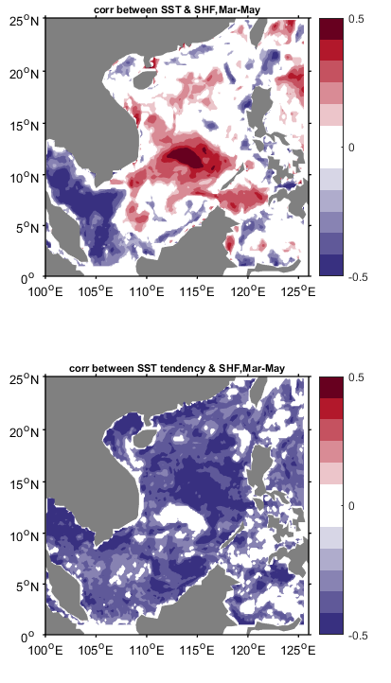

Correlation between SST/SST tendency and surface heat flux anomaly
(the monthly climatology is removed by subtracting the monthly mean observed from NCEP reanalysis during 1979-2009)
2015 El Nino
2011 La Nina
During El Nino spring, the atmosphere forcing dominates the anomalous surface heat flux variation in the northern SCS, while during La Nina spring , the SST forces the anomalous air-sea heat flux variation in the southern SCS.
2015-16
spring
2011-12
spring
SST & SHF
SST & SHF
2015-16
spring
2011-12
spring
$\frac{dSST}{dt}$ & SHF
$\frac{dSST}{dt}$ & SHF

Slide 15
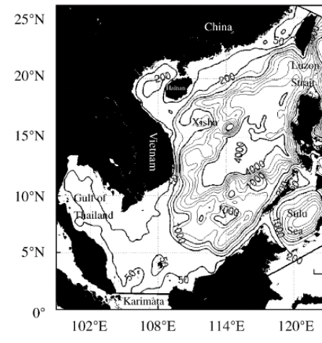
Difference between the El Nino & La Nina
Time evolution
Spatial variation
Mechanism
SST-SHF lead-lag relationship
Sea breeze
Experiment
Different spatial resolution
Different ENSO year

Slide 16
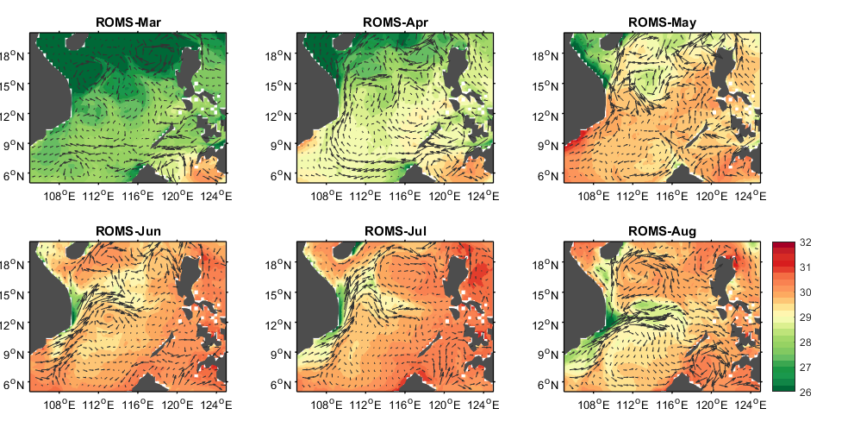
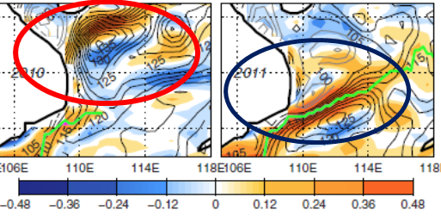
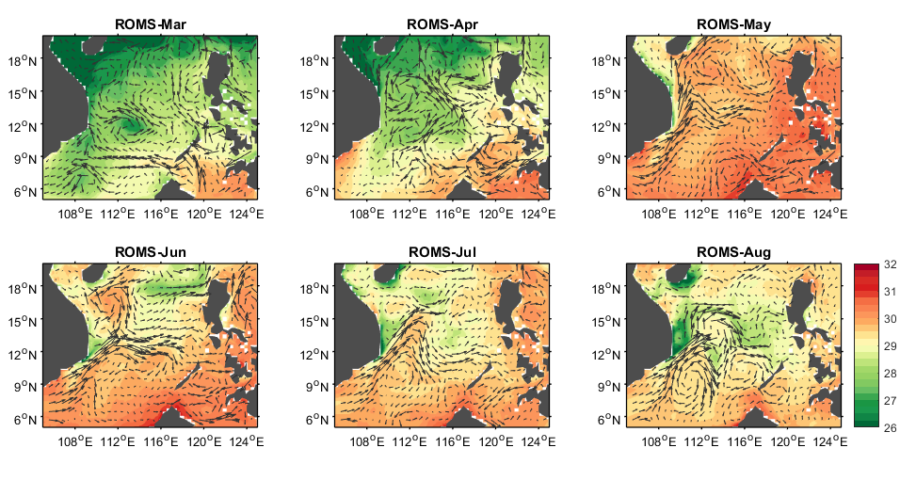
[Li, Yuanlong, et al. "Interannual variability of the surface summertime eastward jet in the South China Sea." Journal of Geophysical Research: Oceans 119.10 (2014): 7205-7228.]
vortex tube squeezing
bottom pressure torque

Slide 17
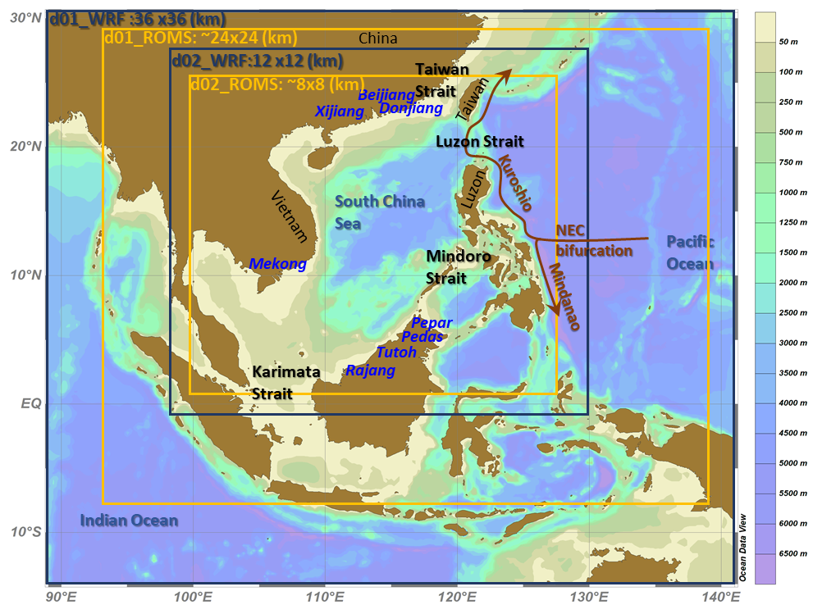
Coupled model configuration
COAWST Modeling System [Warner et al, 2008]
Weather Research and Forecasting Model (WRF)
1. Horizontal Resolution:
Domain 1 : 36x36(km)
Domain 2 : 12x12(km)
2. Vertical : 36 levels
3. Initial and lateral boundary condition :
NCEP FNL Operational Model Global Tropospheric Analyses
Regional Ocean Modeling System (ROMS)
1. Horizontal Resolution:
Domain 1 : 24x24 (km)
Domain 2 : 8x8 (km)
2. Vertical : 25 levels
3. Initial and lateral boundary condition : HYCOM + NCODA Global 1/12° Reanalysis
EXP1 2015/11-2016/6 El Niño EXP2 2011/11-2012/6 La Niña

