Slide 1
The Variability of Ocean Heat Content in Tropical Pacific Ocean
Student: Ting-En Lin
2018/9/6

Slide 2
Outline
The EOF of ocean heat content anomalies (OHCa)
(1) The different phase of PCs to define ENSO variability
(2) Interannual variability
The propagation of OHCa in North Tropical Pacific
Interannual scale anomalies field related to ENSO events
Quasidecadal scale anomalies field related to ENSO events
Summary

Slide 3
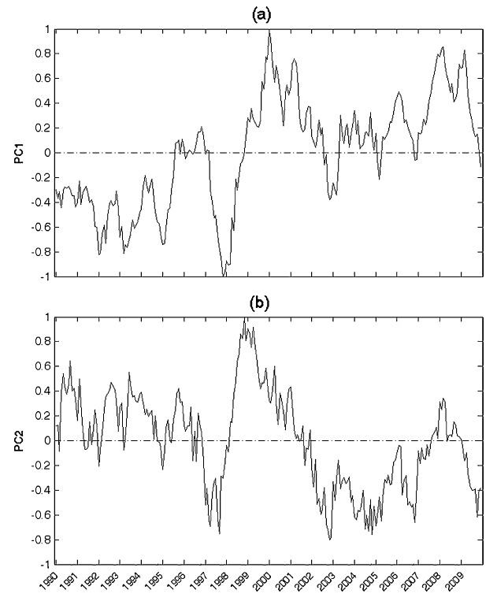
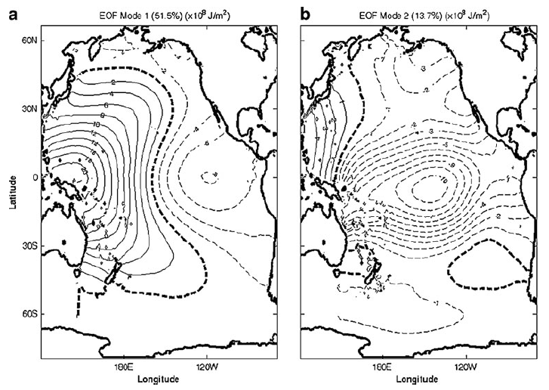


Data: Global Temperature and Salinity Profile Program (GTSPP)
During year: since 1990~2009 (20 years)
The region of EOFs: The whole Pacific Ocean (65°S~60°N)
OHCa-H300 EOFs
EOF1: Canonical $El Ni\tilde{n}o$
EOF2: Pseudo-$El Ni\tilde{n}o$
Chu et al. (2011)

Slide 4
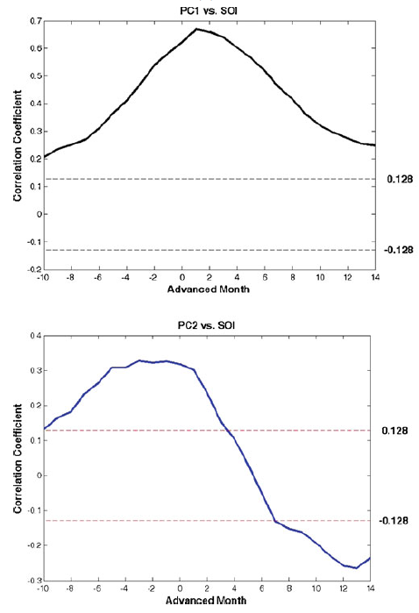
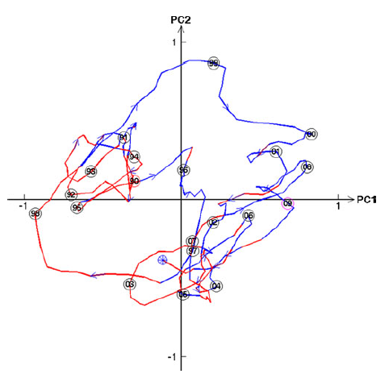

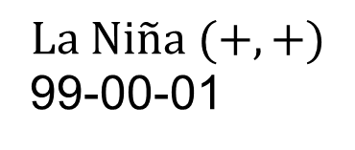
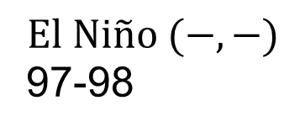
Lead-lag correlation and phase space trajectory
$$La Ni\tilde{n}a (+,+)$$
99-00-01
$$El Ni\tilde{n}o (−,−)$$
97-98
Chu et al. (2011)
Southern Oscillation index (SOI): SLP difference between Tahiti and Dawin
PC2 leads SOI 0~3-month, and SOI leads PC1 1-month.

Slide 5
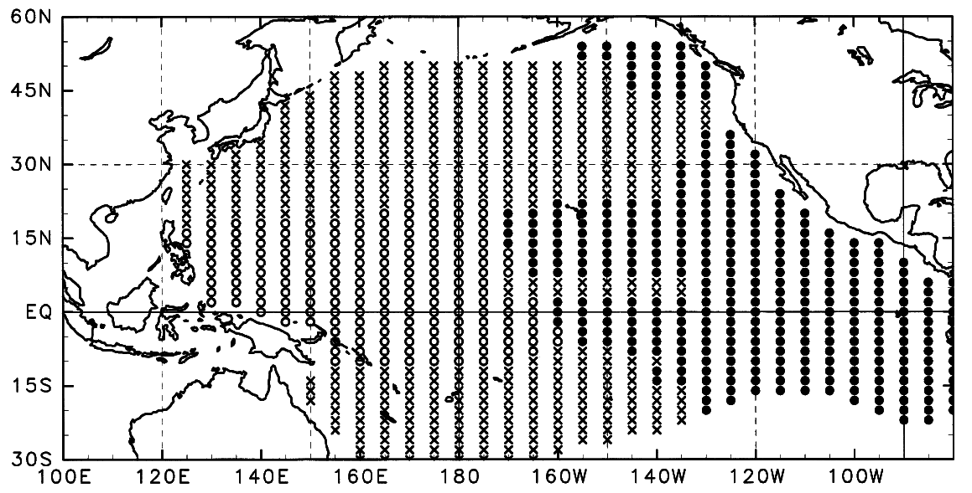
The cluster analysis of OHCa-H300 in Pacific ocean
Hasegawa and Hanawa et al. (2003)
Purpose: To investigate the dominant timescales of OHCa in Pacific basin
Eastern tropical Pacific (ETP), western tropical Pacific (WTP) and mid-to-high latitude region
Spectra analysis: Interannual variation with the period of 3~6 year is dominant in the time series of ETP and WTP.

Slide 6
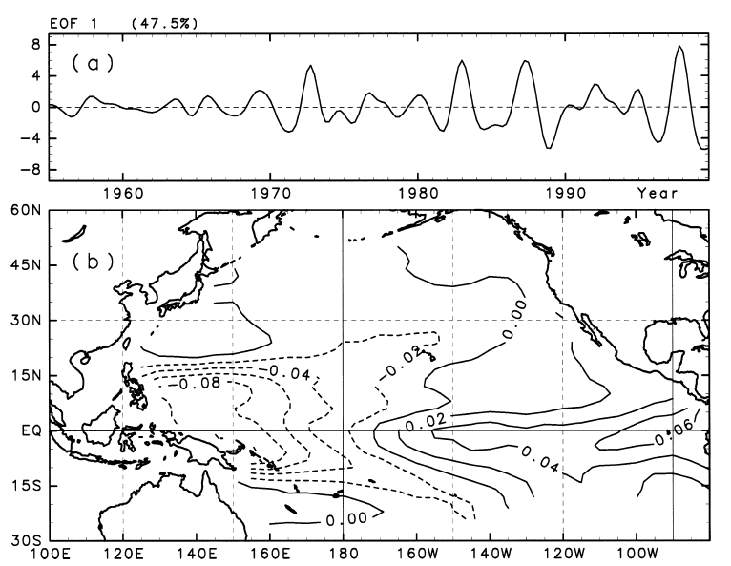
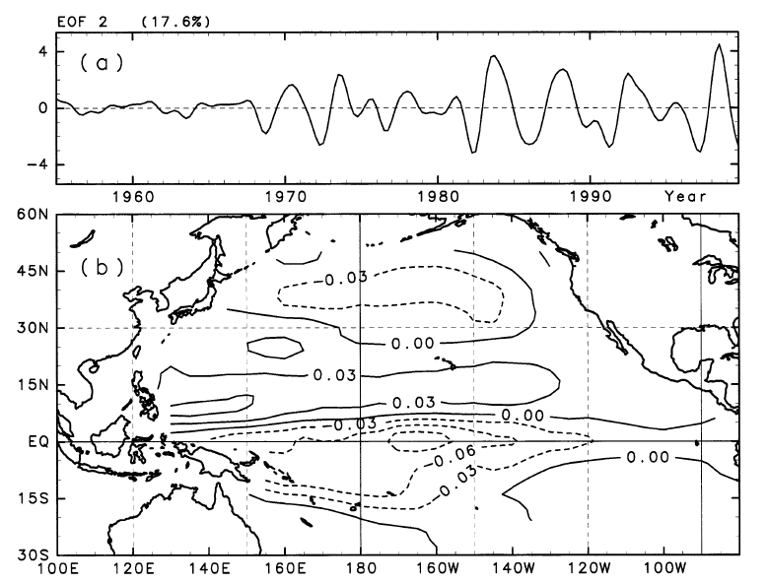
OHCa-H300 EOFs
Band-pass with 3~6yr periods
Data: XBT, CTD, DBT and TOGA TAO array
During year: since 1955~ (50 years)
The region of EOFs: Pacific ocean (30°S~60°N)
Hasegawa and Hanawa et al. (2003)
OHCa EOF1 (ENSO pattern) leads OHCa EOF2 9-month (3 seasons).
OHCa (-) in WP in EOF1 might propagate eastward and it could cover the entire equatorial Pacific (EOF2).

Slide 7
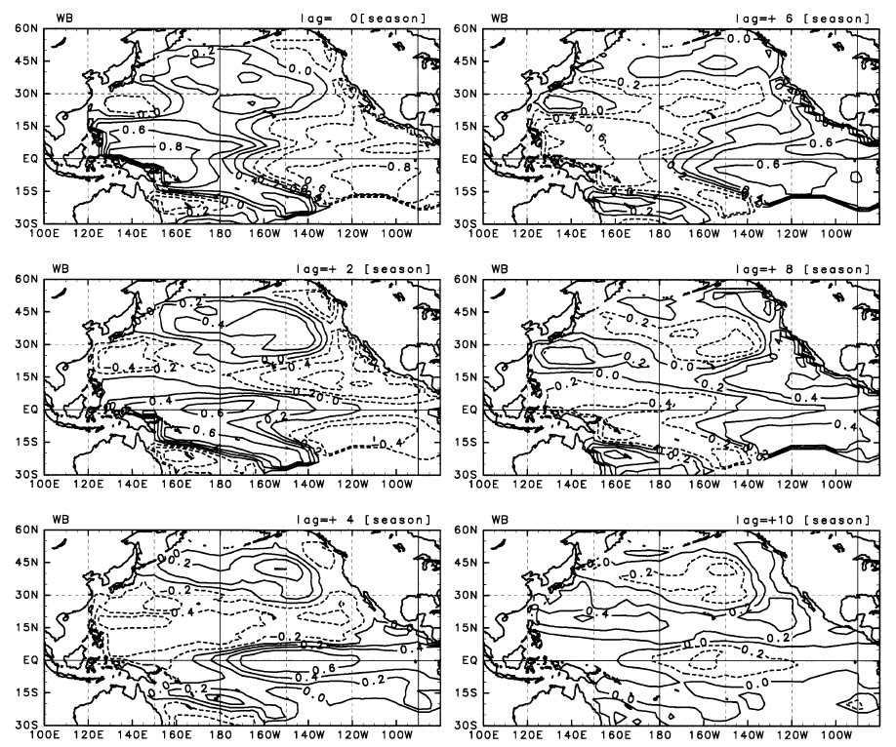
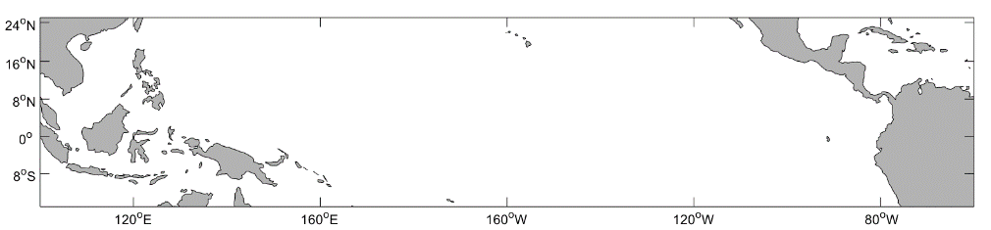
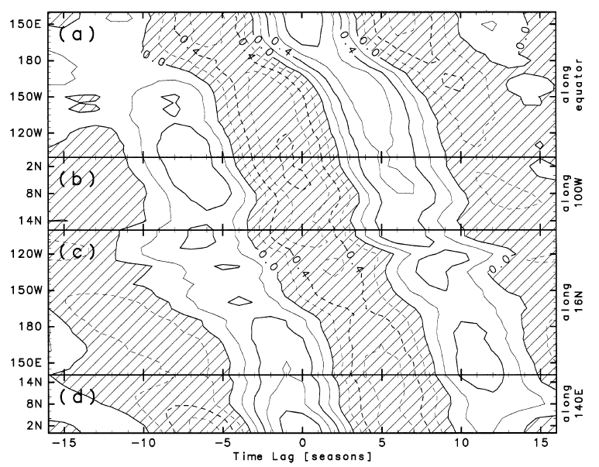
Propagation of OHCa in the North Tropical Pacific
Anticlockwise
Hasegawa and Hanawa et al. (2003)
Anticlockwise propagation of OHCa (around 12 seasons)
The exchange of OHC anomalies between the equatorial Pacific and the off-equatorial Pacific.
Notes:
Related Enso?

Slide 8
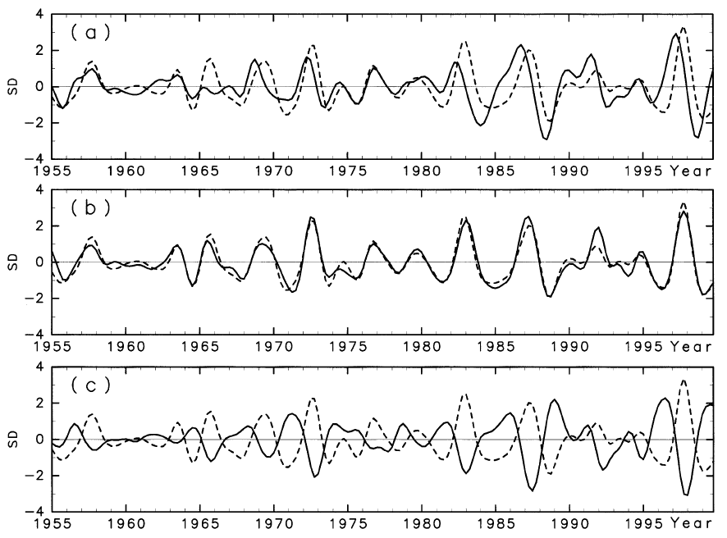
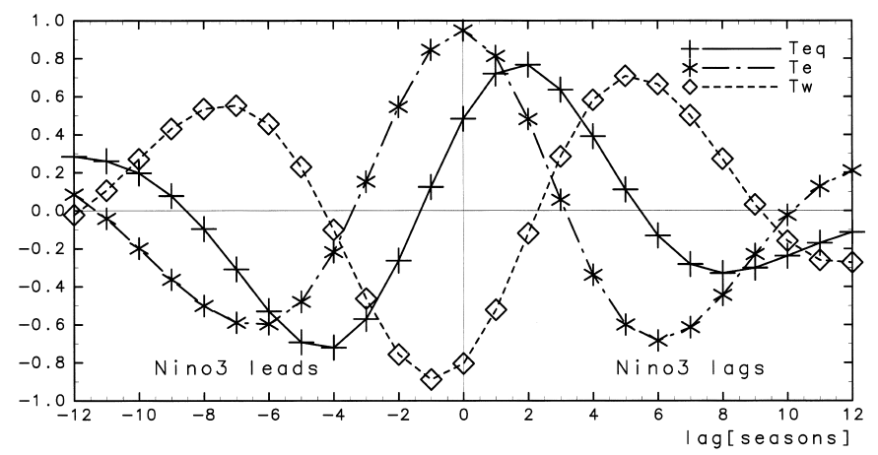



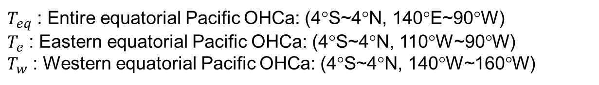
The relationship between OHCa and ENSO
$T_{eq}$ : Entire equatorial Pacific OHCa: (4°S~4°N, 140°E~90°W)
$T_{e}$ : Eastern equatorial Pacific OHCa: (4°S~4°N, 110°W~90°W)
$T_{w}$ : Western equatorial Pacific OHCa: (4°S~4°N, 140°W~160°W)
$T_{eq}$, $Ni\tilde{n}o$-3
$T_{e}$, $Ni\tilde{n}o$-3
$T_{w}$, $Ni\tilde{n}o$-3

Slide 9
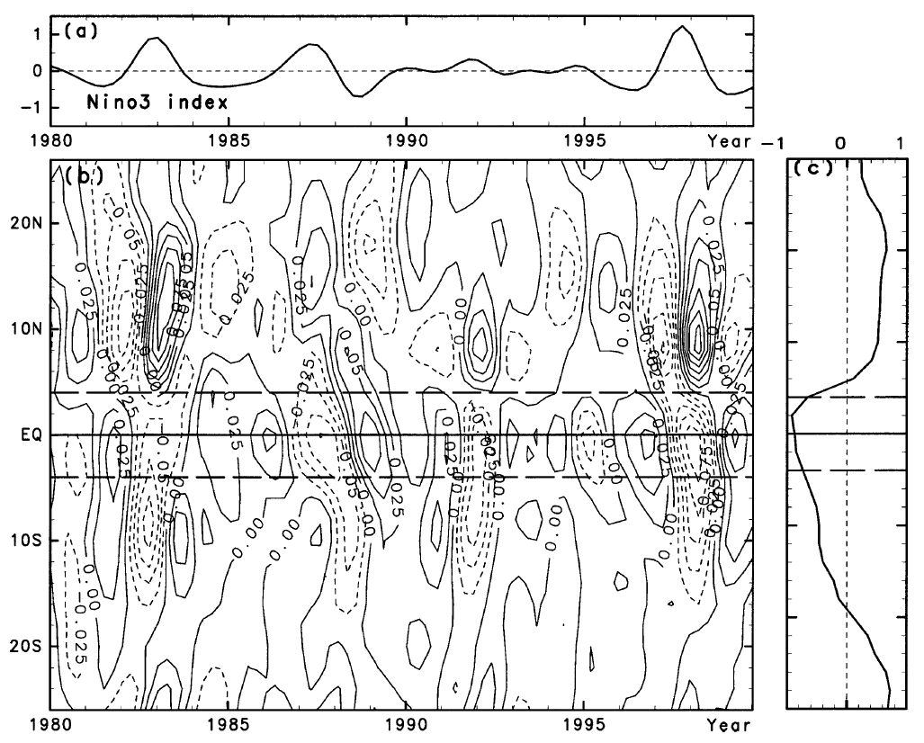
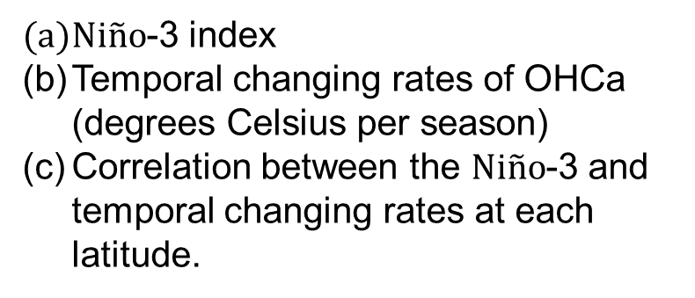
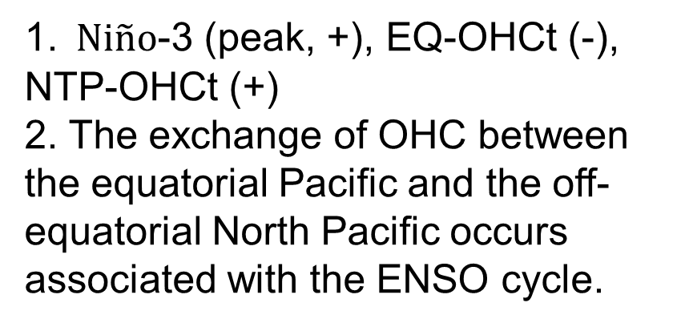
The relationship between OHCa and ENSO
$Ni\tilde{n}o$-3 index
Temporal changing rates of OHCa (degrees Celsius per season)
Correlation between the $Ni\tilde{n}o$-3 and temporal changing rates at each latitude.
1. $Ni\tilde{n}o$-3 (peak, +), EQ-OHCt (-), NTP-OHCt (+)
2. The exchange of OHC between the equatorial Pacific and the off-equatorial North Pacific occurs associated with the ENSO cycle.
Hasegawa and Hanawa et al. (2003)

Slide 10
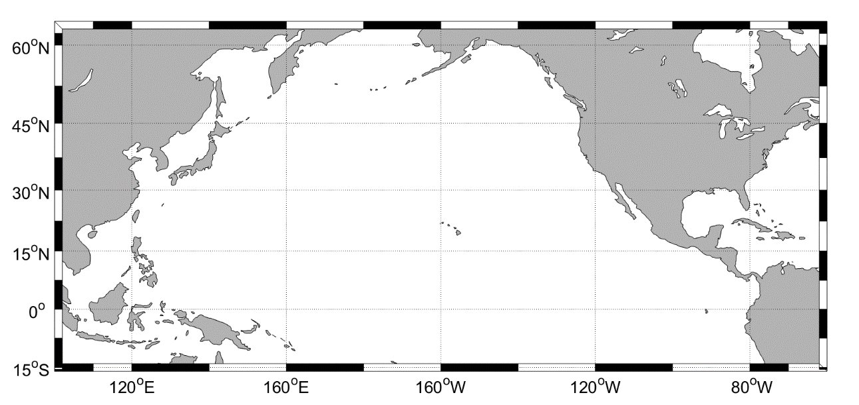
Upper Ocean Heat Content and Atmospheric Anomaly Fields in the Off-Equatorial North Pacific
Time scale: Interannual variability (band-pass with 3~6 years)
Wind stress curl (WSC) of WTP (10°N~20°N, 135°E~180°E)
(1) Basin-wide atmospheric change related to ENSO events
(2) SST and SLP locally change in WTP
3. Investigate behavior of the off-equatorial, westward propagating OHCa in the tropical North Pacific and its relation to ENSO events.
4. Data:
(1) XBT, MBT, CTD, and TOGA-TAO array
(2) NCEP/NCAR Reanalysis 1:
SLP, LHF, wind stress
OHCa in WTP is larger than east of WTP
WTP

Slide 11
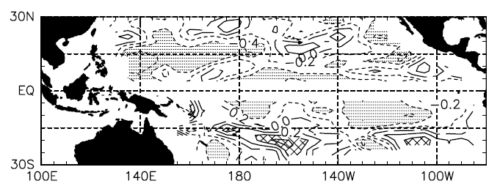
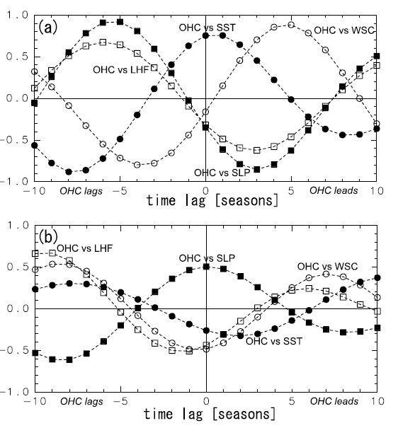
OHC, LHF and SLP in the Western Tropical Pacific (WTP)
Correlation of WSC & OHC-tendency
WTP: WSCa (-) → downwelling → OHC-t (+)
The relationship of anomaly fields in WTP:
Ocean
forcing
SSTa (+) OHCa (+)
LHFa (-)
SLPa (-)
WSCa (+)
3-season
2-season
Atmospheric
forcing
Hasegawa and Hanawa et al. (2007)
OHC-t (-)
Notes:
Oceanic anomaly fields can provide a favorable condition in advance of developing atmospheric anomaly fields.

Slide 12
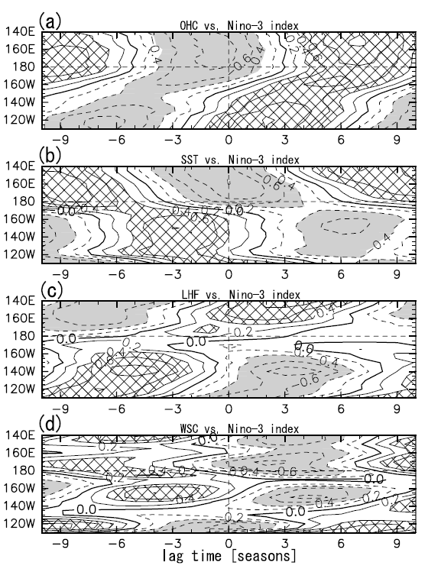
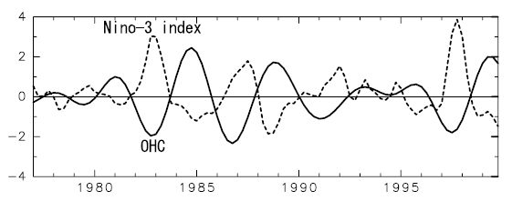

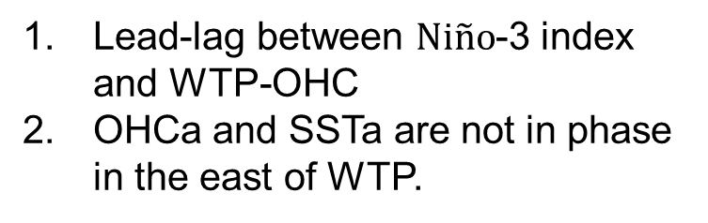
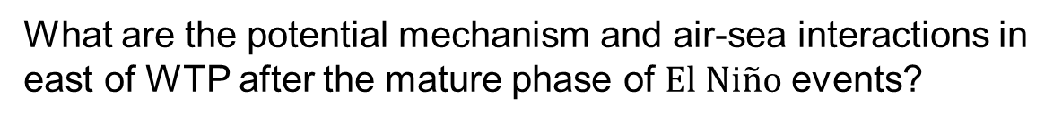
OHCa, SSTa, LHFa and WSCa in off-equatorial band (16°N)
WTP
SSTa (+), OHCa (+)
(+6 ~ +9 season)
Westward
Atmospheric forcing
Eastward
ETP SSTa (+) → (-)
Lead-lag between $Ni\tilde{n}o$-3 index and WTP-OHC
OHCa and SSTa are not in phase in the east of WTP.
ETP LHFa (-)
ETP WSCa (-)
OHCa Westward
SSTa Eastward
What are the potential mechanism and air-sea interactions in east of WTP after the mature phase of $El Ni\tilde{n}o$ events?
Hasegawa and Hanawa et al. (2007)
Notes:
1. What are the potential mechanism and air-sea interactions in east of WTP after the mature phase of $El Ni\tilde{n}o$ events?

Slide 13
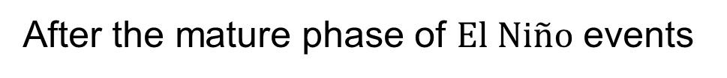
OHCa, SSTa, LHFa and WSCa in off-equatorial band (16°N)
After the mature phase of $El Ni\tilde{n}o$ events
Westward
WTP: OHCa, SSTa (-) → (+) (-1 ~ +6 season)
WTP LHFa (+)
OHCa (+7 season)
OHCa (+2 season)
begin propagating
Eastward
WSC (-)
(downwelling)
Enhance OHCa in WTP
OHCa propagate from ETP
Local air-sea interaction
Propagation of OHCa weakened
ETP LHF (-)
OHCa (+3 ~ +5 season)
ETP WSC (-)
(downwelling)
Hasegawa and Hanawa et al. (2007)

Slide 14
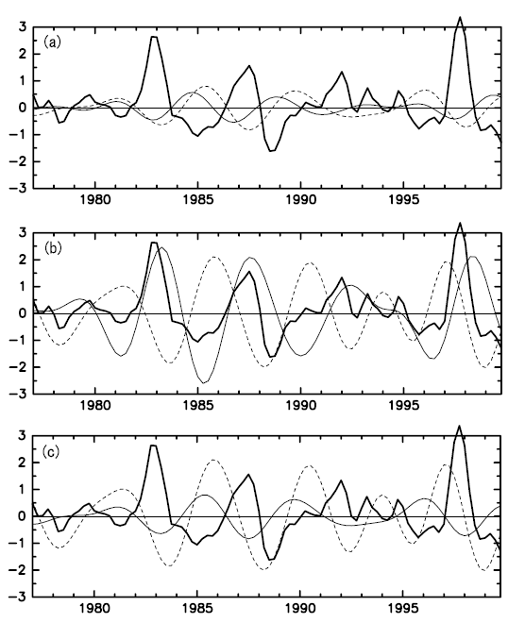

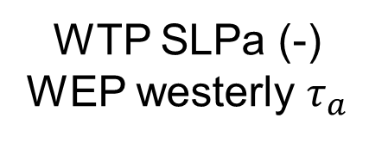



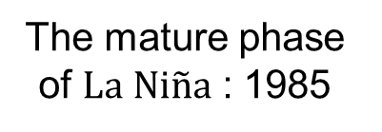

OHCa, SSTa, LHFa and ZWSa in western equatorial Pacific
WTP OHCa, WEP OHCa, $Ni\tilde{n}o$-3
WTP SLPa, WEP ZWSa, $Ni\tilde{n}o$-3
WEP OHCa, WEP ZWSa, $Ni\tilde{n}o$-3
Hasegawa and Hanawa et al. (2007)
WTP OHCa(+)
Ocean bridge
WSCa (+)
WEP OHCa (+)
Atmospheric bridge t=(1/8) T
The mature phase of $La Ni\tilde{n}a$ : 1985
Ocean
forcing
Atmospheric
forcing
Propagate
eastward
WTP SSTa (+)
OHCa (+)
WTP SLPa (-)
WEP westerly $τ_{a}$
WEP
OHCa (+)
$$El Ni\tilde{n}o$$
Notes:
Ocean bridge
Air-sea period

Slide 15
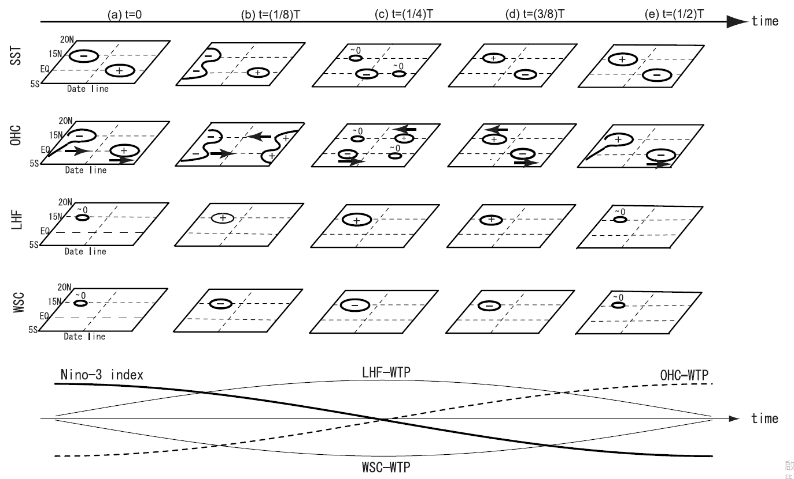
Interannual scale anomalies field related to ENSO events
Hasegawa and Hanawa et al. (2007)
WTP-OHCa are intensified by both the off-equatorial westward propagating OHCa and the local forcing due to WSCa and LHFa in the WTP.
WTP-OHCa have a potential effect on the equatorial Pacific OHCa via both the oceanic and atmospheric bridges.

Slide 16
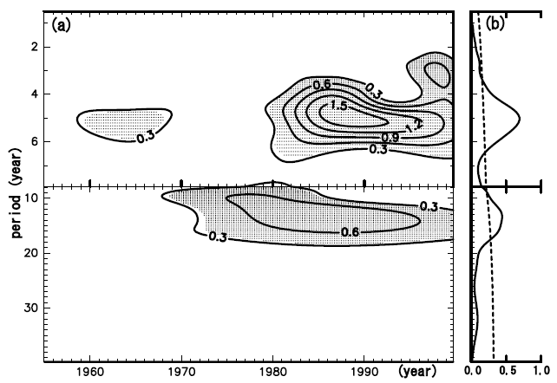
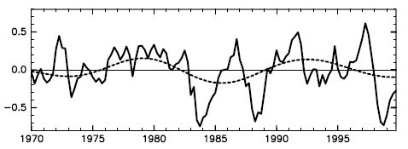
Quasidecadal scale ocean heat content in equatorial Pacific
OHC-EP region: 6°S~6°N,
130°E~80°W
Data: XBT, CTD, DBT and TOGA TAO array
During year: 1955 ~ 1999
Background: Delayed action oscillator model, Recharge-discharge oscillator model
Investigate the equatorial OHCa, SSTa and atmospheric anomaly fields in the tropical Pacific
Wavelet spectrum of OHC-EP
Quasidecadal (QD) scale: 10~18 years
OHC-EP (solid line) QD-scale OHC-EP (dashed line)
Hasegawa et al. (2007)

Slide 17
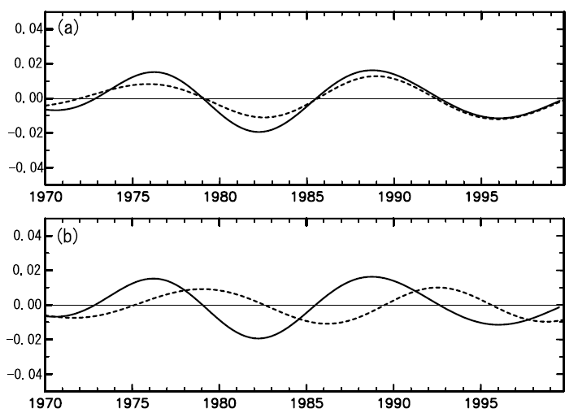
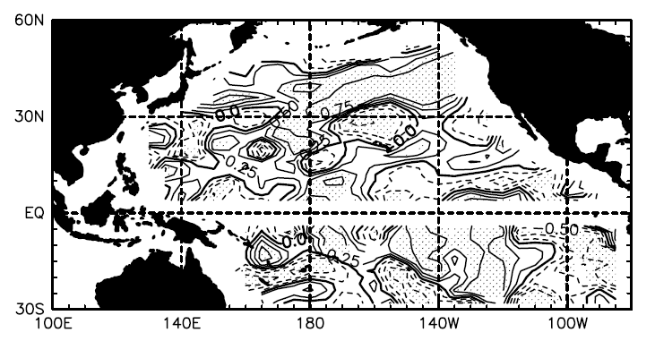
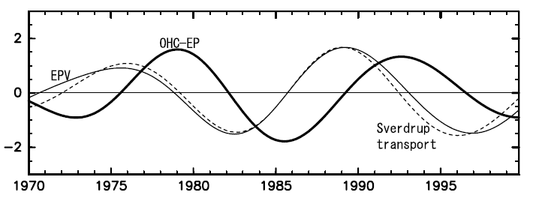
OHC-EP, Sverdrup Transport & Ekman pumping velocity (EPV)
QD scale OHC-EP & EPV corr.
South Tropical Pacific: 6°S,140°E~90°W
South Tropical Pacific (STP)
(14°S~4°N, 180°~120°W)
OHC-EP
R = 0.96
North Tropical Pacific: 6°N,140°E~90°W
R = 0.05
Solid line: OHC-EP – Tendency, Dash line: SVa - Tendency
Unit: (°C/season)
QD-scale: OHC-EP(+), STP EPV(+) - downwelling
STP EPVa (+) → SVa (equatorward) → OHC-EP (+)
STP SVa (+) → OHC-EP-Tendency ↑
STP EPV: 14°S~4°N, 180°E~120°W
Sverdrup transport: 6°S,160°E~90°W
Hasegawa et al. (2007)

Slide 18
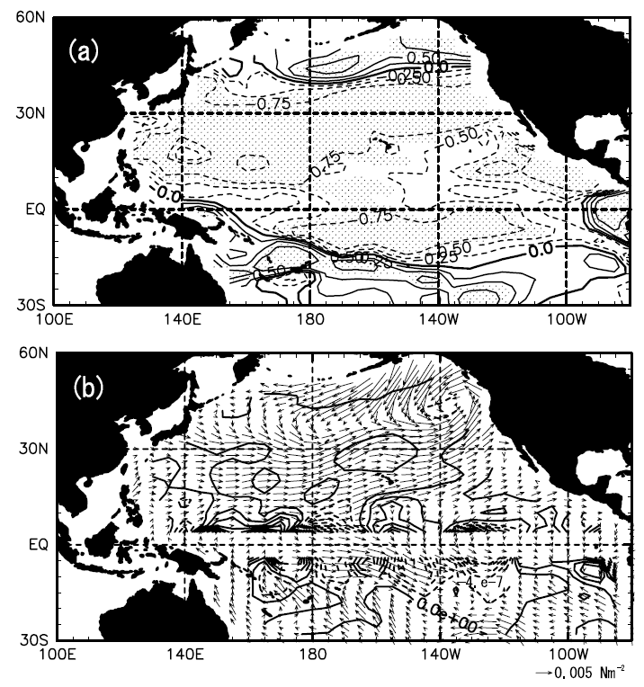
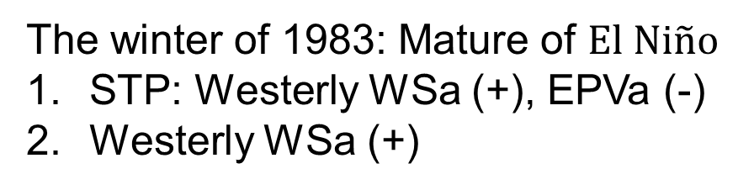
The correlation between STP EPVa and Zonally Wind Stress
QD-scale STP EPVa & QD-scale ZWSa corr.
STP EPVa (14°S~4°N, 180°~120°W)
STP: Westerly WSa (+), EPVa (-) South of 14°S: Easterly WSa (-), EPVa (-)
Cyclonic wind stress curls cause poleward Sverdrup transport.
The winter of 1983: Mature of $El Ni\tilde{n}o$
STP: Westerly WSa (+), EPVa (-)
Westerly WSa (+)
Hasegawa et al. (2007)

Slide 19
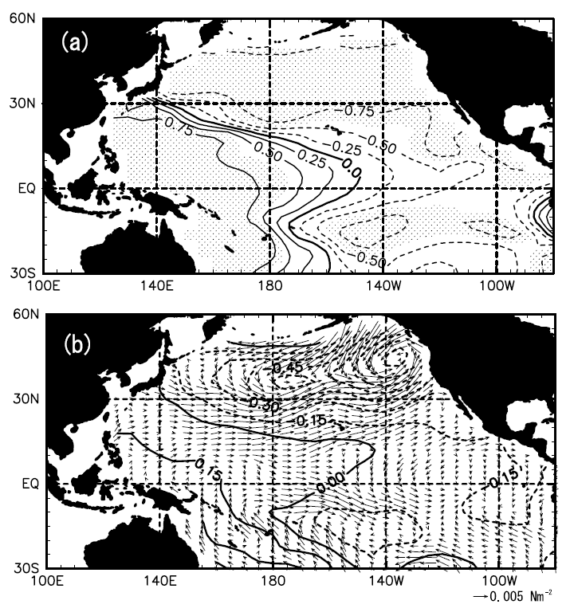
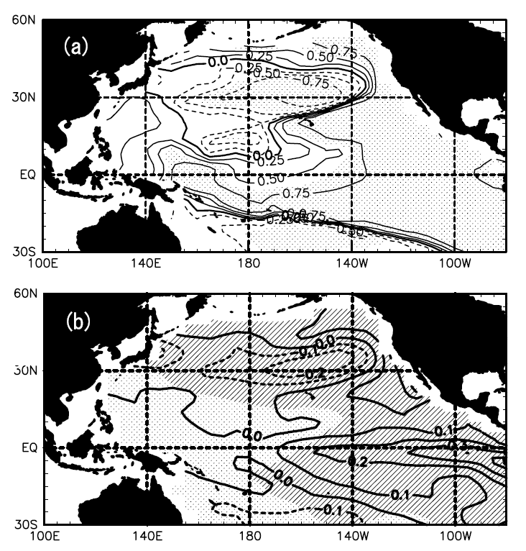

The relationship between QD-scale fields & QD-scale EPVa of STP
STP-EPVa & ZWSa Corr.
STP-ZWSa & SLPa Corr.
WTP-SLPa & SSTa Corr.
Westerly WSa (+)
EPVa (-)
Westerly WSa (+)
SLPa (+)
Westerly WSa (+)
SLPa (-)
WTP SLPa (+)
$Ni\tilde{n}o$ 3 SSTa (+)
Easterly WSa (-)
Poleward SVa
Hasegawa et al. (2007)
The winter of the year 1983: WTP-SLPa (+), around $Ni\tilde{n}o$ 3 SSTa (+)
ENSO-like with QD-scale ZWSa can generate Sverdrup transport and impact variations of OHC-EP.

Slide 20
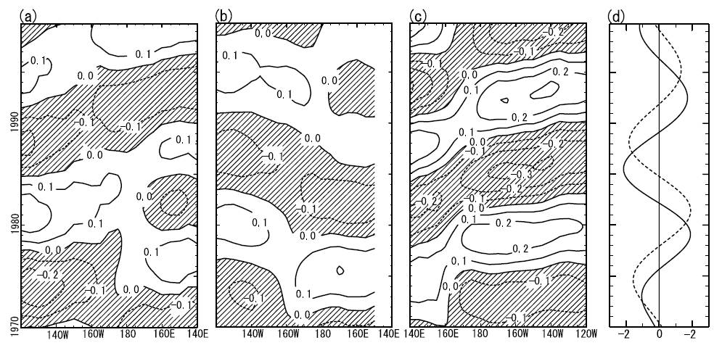
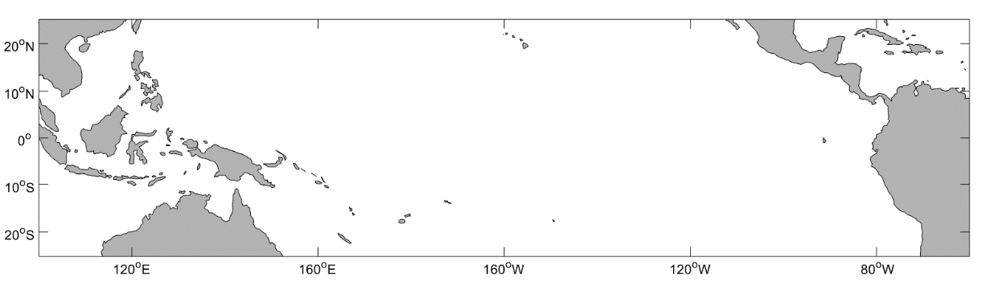
A relationship between propagating OHCa and the OHC-EP
OHCa: 14°N~16°N
OHCa: 14°S~16°S
OHCa: 6°S~6°N
OHC-EP (solid line): Equatorial Pacific
(6°S~6°N, 130°E~80°W)
SSTa (dash line): Equatorial Tropical Pacific (10°S~10°N, 140°W~100°W)
Westward
Eastward
The phase speeds:
East of 180° : -0.04 m/s
West of 180° : -0.07 m/s
Slow propagation: air-sea coupling
OHC-EP leads EEP-SSTa 3-years.
Hasegawa et al. (2007)
1980 ~ 1985
1986 ~ 1990
OHC-EP ↑
OHC-EP (+) → (-)
OHC-EP (-) → (+)
Notes:
Along the off-equatorial zonal band, the phase speeds to the east and west of the International Date Line are roughly -0.04 m/s and -0.07 m/s, respectively. Both these phase speeds are slower than that of the theoretical first-mode baroclinic Rossby
wave [Killworth et al., 1997].

Slide 21
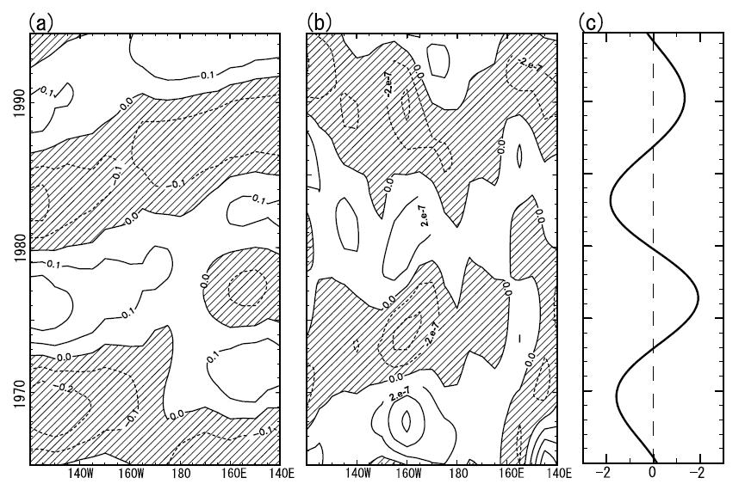
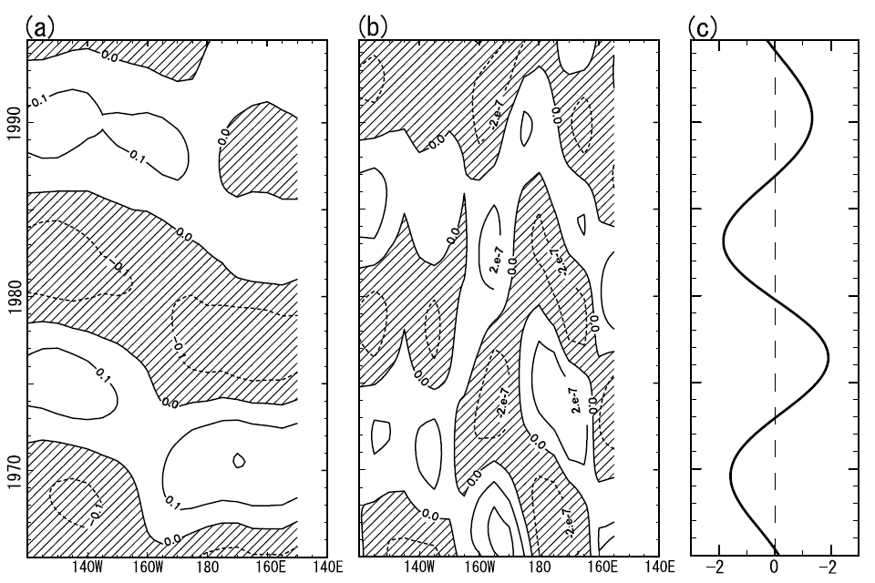
A relationship between propagating OHCa and the EPVa
OHCa: 14°N~16°N
EPVa: 14°N~16°N
ETP SSTa
OHCa: 14°S~16°S
EPVa: 14°S~16°S
ETP SSTa
Westward
Westward
1980 ~ 1985
Hasegawa et al. (2007)
WSCa (-), EPVa (+)
150°W~180°
OHC-EP ↑
WSCa (-), EPVa (+)
ETP SSTa (+) → (Delay time) central basin Pacific EPVa
What is the potential mechanism that causes WSCa and EPVa in the east of WTP after the mature phase of $El Ni\tilde{n}o$ ?

Slide 22
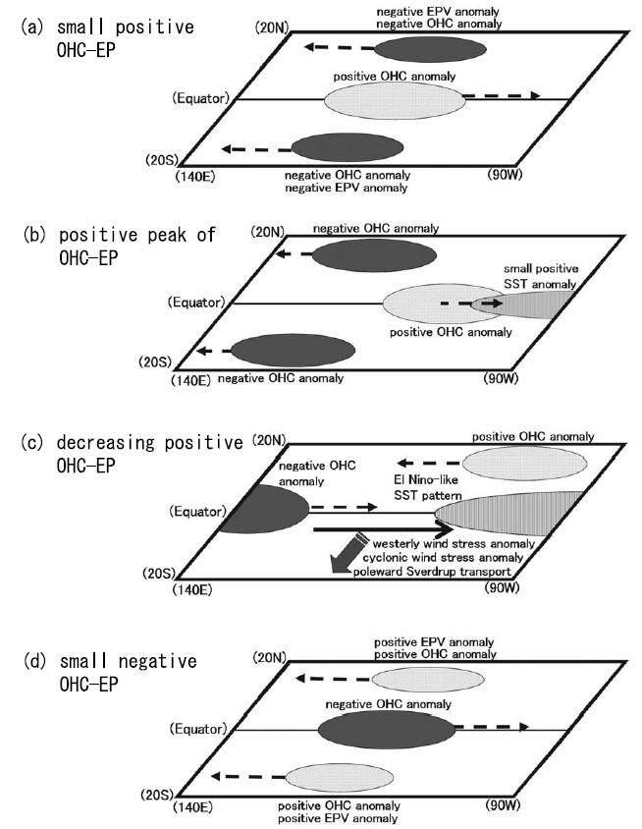
Quasidecadal scale anomalies field related to ENSO events
ETP SSTa → STP EPV (-) → STP SVa (-) → OHC-EP ↓
Hasegawa et al. (2007)
QD-scale OHCa in the equatorial Pacific can be generated not only by the Sverdrup transport variation in the STP but also by QD-scale propagating OHCa in NTP and STP.

Slide 23
Summary
OHCa EOF1: ENSO variability OHCa EOF2 needs to be clarified.
Wind stress curl anomalies is the source of generations of OHCa.
Interannual variability (3~6 years) of OHCa: wave propagation in NTP
Quasidecadal variability (10~18 years) of OHCa:
NTP: wave propagation STP: wave propagation, Sverdrup transport
Entire equatorial Pacific OHCa leads to SSTa in the central and eastern
equatorial Pacific.

Slide 24
Reference
Chu PC (2011) Global upper ocean heat content and climate variability. Ocean Dyn 61(8):1189–1204
Hasegawa, T. and K. Hanawa (2003): Heat content variability related to ENSO events in the Pacific. J. Phys. Oceanogr., 33, 407–421.
Hasegawa, T., and K. Hanawa (2007), Upper ocean heat content and atmospheric anomaly fields in the off-equatorial North Pacific related to ENSO, J. Oceanogr., 63, 561–572.
Hasegawa, T., T. Yasuda, and K. Hanawa (2007), Generation mechanism of quasidecadal variability of upper ocean heat content in the equatorial Pacific Ocean, J. Geophys. Res., 112, C08012, doi:10.1029/2006JC003755.

