Slide 1
AI weather prediction models

Slide 2
NWP (numerical weather prediction)
Classical atmospheric simulation approaches
6 hours to make prediction
Requires supercomputer

Slide 3
Pangu
39 years global weather data(ERA 5) for training
Input resolution of 1440 * 721 (longitude and latitude), formulate height(pressure levels) information into 3rd dimension
Data: 13 pressure levels + Earth’s surface
Predict: upper-air atmospheric(geopotential, specific humidity, temperature, u-component and v-component of wind speed), surface weather variables(2m temperature, u-component, v-component 10m wind speed, mean sea level pressure)
3 constant masks - topography mask, land-sea mask, soil type mask to input of surface variables
Notes:
The U and V components of wind are the eastward and northward velocity components of the wind

Slide 4
Pangu - pretrain
Download the ERA 5 dataset
Spatial resolution is 0.25⁰ * 0.25⁰
Model to predict the future weather given historical observation data
Sampling a time t from the dataset and specifying a prediction gap delta t
Notes:
ERA 5: hourly estimates of a large number of atmospheric, land and oceanic climate variables.

Slide 5
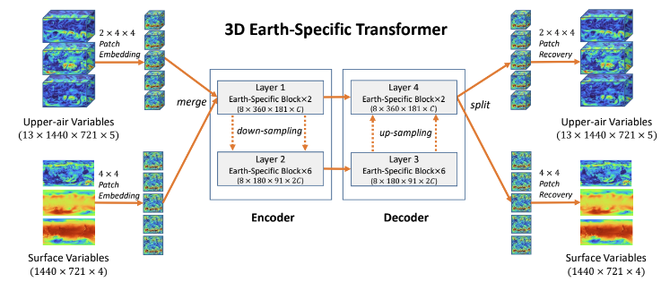
Pangu 3D Earth-Specific Transformer
Upper air variables: 13 pressure * 1440 longitude * 721 latitude * 5 atmosphere variable
Surface variables: 1440 longitude * 721 latitude * 4 surface weather variables
Dimensionality reduction for upper-air : patch size to 2 * 4 * 4. Embedded data has shape of 7* 360 *181 * C (C-dimensional latent space)
Patch size surface variables: 4 * 4. Embedded data shape: 8 * 360 * 181 * C

Slide 6
Pangu 3D Earth-Specific Transformer
8 encoder layers and 8 decoder layers, each layer is a 3D Earth-specific transformer block. First 2 encoder layers unchanged, 6 layers horizontal dimensions are / 2 and num of channels double
Implementation of Swin transformers for down and up sampling, merge 4 tokens into 1, C -> 4C, and perform linear layer to reduce dimensionality to 2C
Notes:
Swin Transformer is a vision transformer, general purpose backbone of CV, it can do image classification, object detection, semantic segmentation
downsample the input first to create lower-resolution feature mappings and later upsample them to get high-resolution feature maps

Slide 7
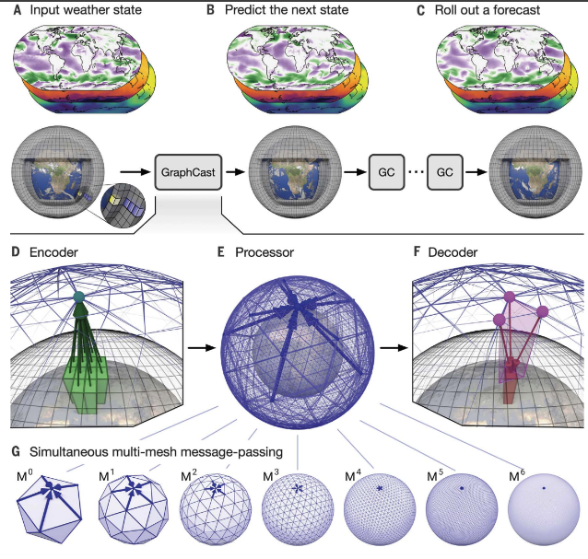
GraphCast
Based on GNNs: graph neural network
Input: latitude-longitude grid 721 * 1440, five surface variables layers, 6 atmospheric variables layers
Notes:
GNNs model interactions between nodes and edges, learning from relational data

Slide 8
GraphCast
Encoder: use single GNN layer to map variables represented as node attributes on the input grid to learned node attributes into nodes of multimesh
Processor: 16 unshared GNN layers to perform learned message-passing on the multimesh, updates each node using learned message-passing
Maps the final processor layer’s learned features back to latitude longitude grid

Slide 9
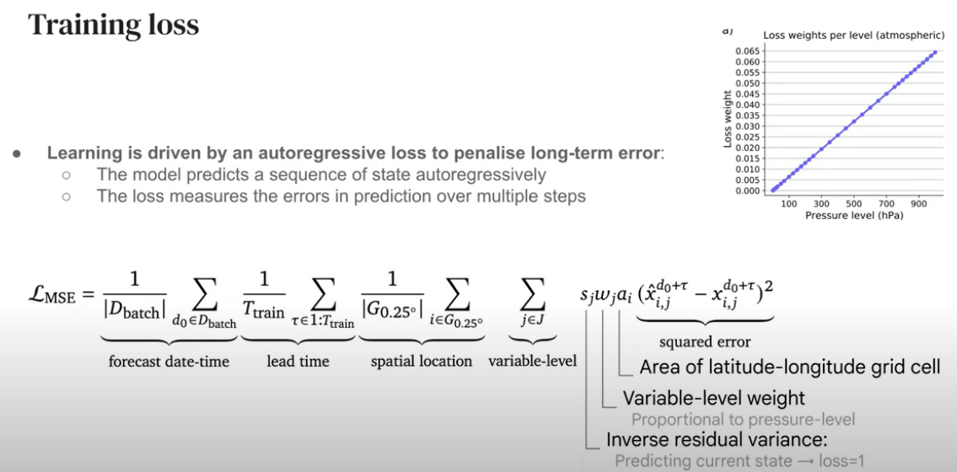
GraphCast

Slide 10
FourCastNet
Extended FNO into image transformers via AFNO architecture
Fourier Neural Operator implements global convolution via Fast Fourier Transform to solve nonlinear and chaotic PDEs (partial differential equation)
AFNO combine numerical prediction and deep learning mainly
Multi-head self-attention layers enable vision transformers (ViT) to model long-range dependencies and non-local feature dependencies
ViT backbone advantage: super resolution, image de-noising, de-blurring
ERA5 dataset
Notes:
Backbone: the feature-extracting network that processes input data into a certain feature representation

Slide 11
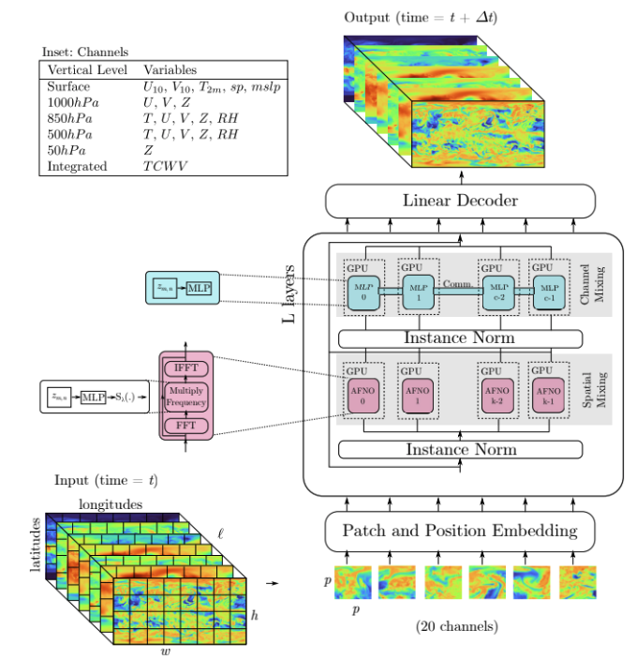
FourCastNet - AFNO transformer
Input: spatial resolution of 1440 longitudes * 720 latitude * 20 channels
Divided into sequence of patches, each with 4p * 4p * 20 pixels, yield a grid of 180*360 tokens
Those tokens(patches) embedded in a high dimensional vector, which passed to a series of transformer layers to refine the embedding
Notes:
embedding is a technique that represents objects as mathematical vectors to help machine learning models understand complex relationships in data

Slide 12
FourCastNet - AFNO transformer
MLP(multi-layer perceptron): design spatial mixing(空間融合) operation. FFT spatially mixes 180 * 360 grid of tokens, for each token 1024 channels mixed and processed in parallel and MLP weights are shared across tokens, inverse FFT to return them to spatial domain
Notes:
FFT: an algorithm that determines the discrete Fourier transform of an object faster than computing it, used to speed up training a convolutional neural network

Slide 13
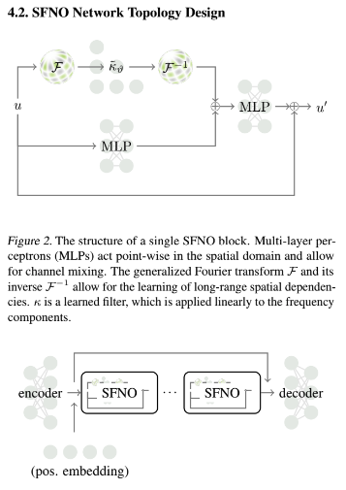
FourCastNet v2
SFNO extend FNO approach respect to spherical shape
Utilize the generalized Fourier transform on sphere using SHT
Model the Earth’s atmosphere as a dynamical system, where its state at time t and position x is represented by N-dimensional vector u(x,t)
u is vector valued inputs
Encoder and decoder MLPs inflate the channel dimension
First and last SFNO blocks perform up or down scaling,
Notes:
SHT: spherical harmonic transform

Slide 14
Microsoft Aurora
3D model of the atmosphere
Encoder: convert heterogeneous inputs into standard 3D representation of the atmosphere across space and pressure-levels
Processor evolves the representation in time.
Decoder: translates the standard 3D representation back into specific predictions
Processor is a Vision Transformer, encoder and decoder are Perceiver-based modules
Pretrain Aurora on a vast body of weather and climate data: ERA5, CMCC, IFS-HR, HRES Forecasts, GFS Analysis, GFS Forecasts
Model at 0.1º resolution

Slide 15
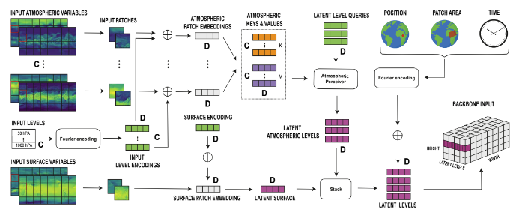
3D Perceiver encoder
3D Perceiver encoder treat all variables as H * W images on regular latitude-longitude grid, for each variable include state at the current time t and state at time t - 1, result T * H * W tensor
Static variables: local orography in the from of geopotential at the surface, land-sea mask, soil type mask
Level embeddings: ViT split each of the H * W images in p * p patches, patches at each level are then mapped into a vector in R^{D} by a linear layer, each of the level embeddings is then tagged with an additive level encoding
Notes:
C pressure levels, dimension D

Slide 16
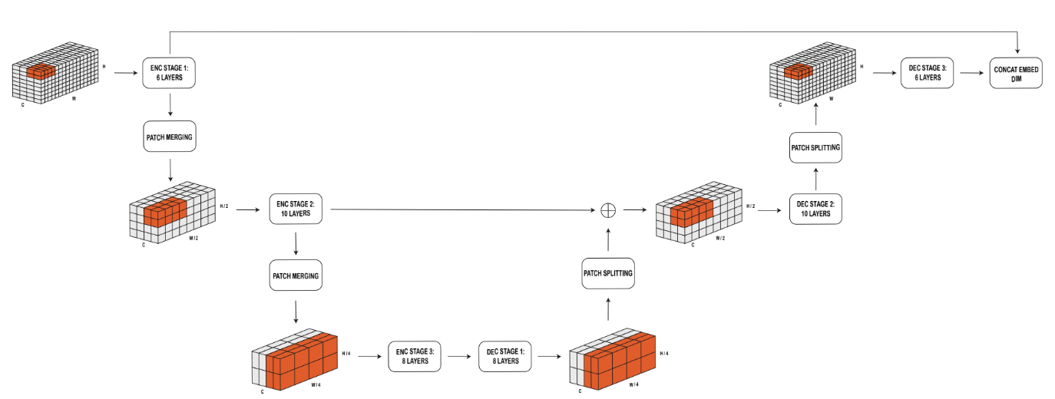
Processor
Multi-scale 3D Swin Transformer backbone can be viewed as a neural simulator
Backbone itself is also composed of an encoder and a decoder, encoder the spatial resolution of the 3D tension is halved, decoder stage the resolution is doubled and the output is combined with the corresponding outputs of the encoder
Each layer of the backbone is a 3D Swin Transformer layer performing local self-attention operations, can be seen as a form of message passing
Notes:
Self-attention allows the model to capture relationships between distant elements in a sequence, enabling it to understand complex patterns and dependencies.
LoRA: adapt a large machine learning model for specific uses without retraining the entire model

Slide 17
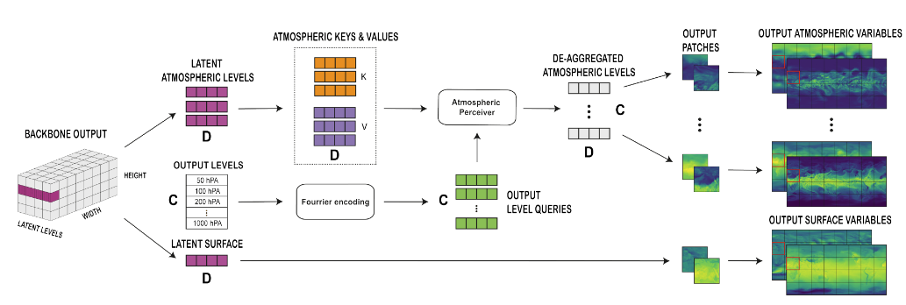
Decoder
3D Perceiver decoder: standardised outputs of the latent simulation back into images on the regular lat-lon grid. The 3 latent atmospheric pressure levels are de-aggregated into C, D dimensional embedding
Positional encoding: account for the spatial position of each token enters the Transformer backbone
Scale encoding: 2D positional encoding added to account for the physical scale of each patch token
Pressure level encoding: encode the value of the atmospheric pressure associated with each level
Absolutive time encoding: encode associated with a certain input as the number of hours since 1/1/1970

Slide 18
Comparison
 | Pangu | GraphCast | FourCastNet | FourCastNetV2 | Microsoft Aurora
Data | ERA5 | ERA5 | ERA5 |  | ERA5, CMCC, IFS-HR, HRES Forecasts, GFS Analysis, GFS Forecasts.
Training | 3DEST | GNN | AFNO | SFNO | 3D Perceiver
Resolution | 0.25 | 0.25 | 0.25 | 0.25 | 0.1
Notes:
ERA5: ECMWF Reanalysis

