Slide 1
Introduction on Earth2Studio and SFNO
2025/5/7

Slide 2
Earth-2
Introduced by Nvidia at 2024/03
https://www.nvidia.com/zh-tw/high-performance-computing/earth-2/
Has container ready for use, but requires an active Nvidia AI Enterprise subscription
Provides easy model type / parameters selection and visualization

Slide 3
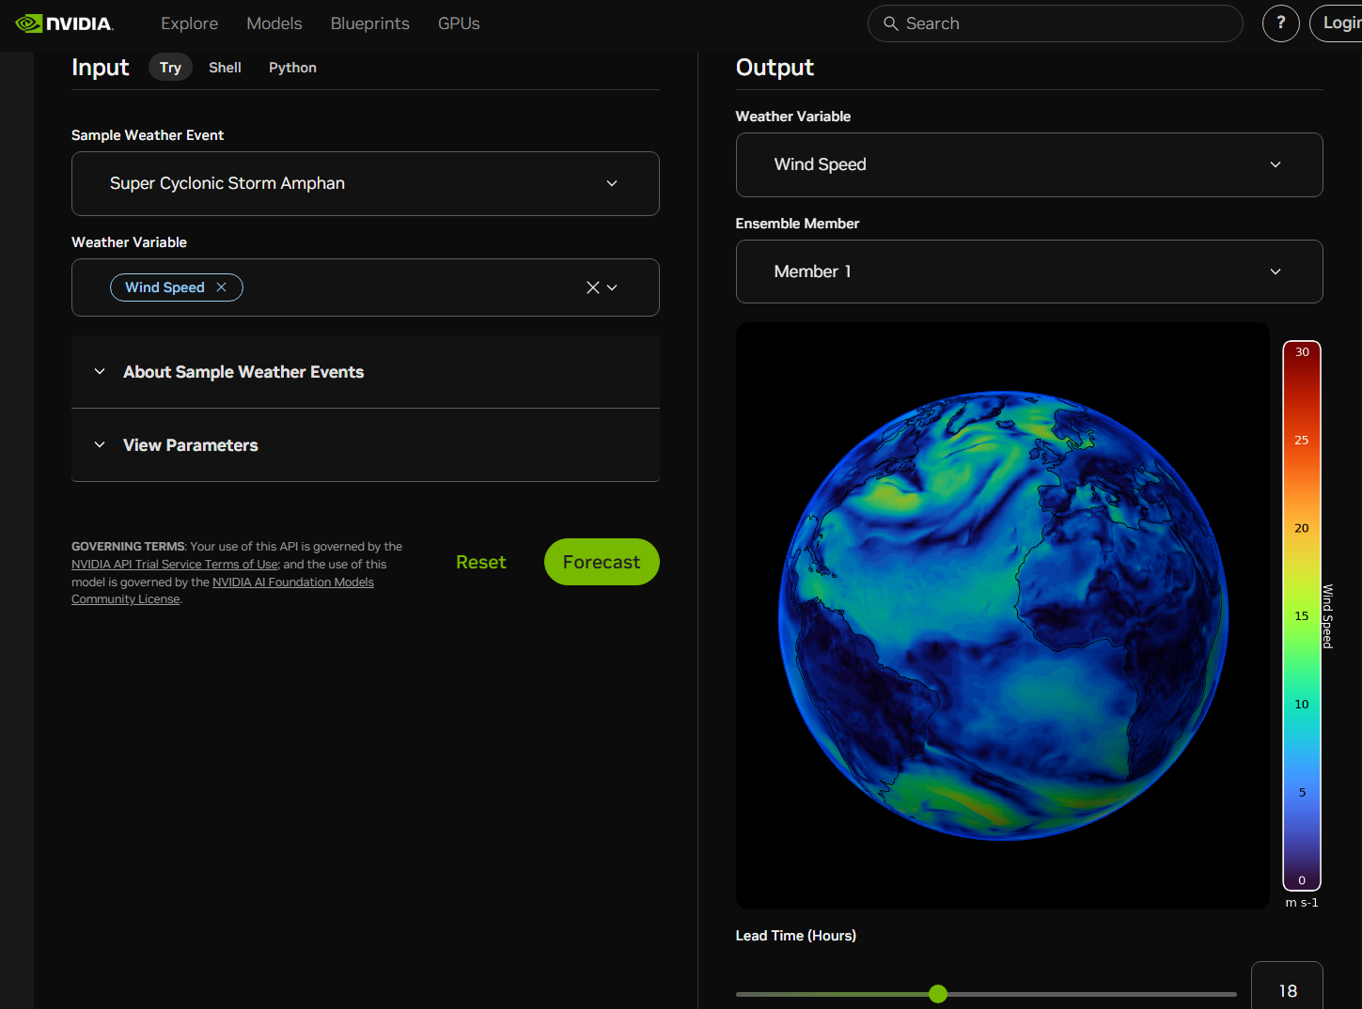
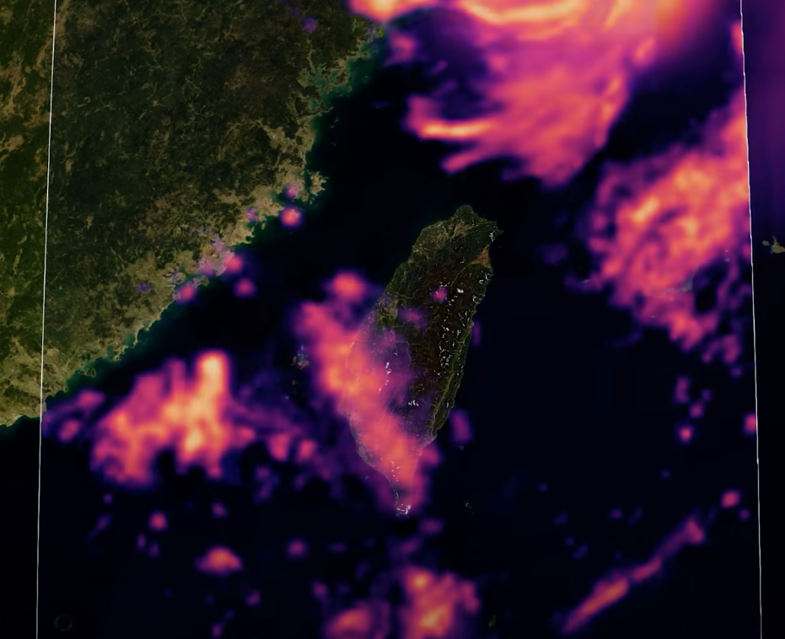
Earth-2

Slide 4
Earth2Studio
Open-source project, not as fancy as Earth-2, but can be customized for use / develop
https://github.com/NVIDIA/earth2studio
Streamlined workflow; deals with different model input parameters / data sources automatically
Some supported models: FCN, SFNO (FCNv2), Pangu… https://nvidia.github.io/earth2studio/modules/models.html#earth2studio-models-px

Slide 5
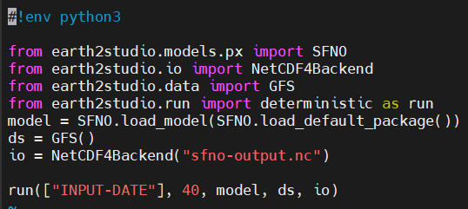
Earth2Studio
A VERY simple example

Slide 6
Earth2Studio
Already installed on NCHC T2
Running daily FCN, FCNv2 and Pangu 10-days forecast, with GFS data source (2021/02 – present, 0.25°)

Slide 7
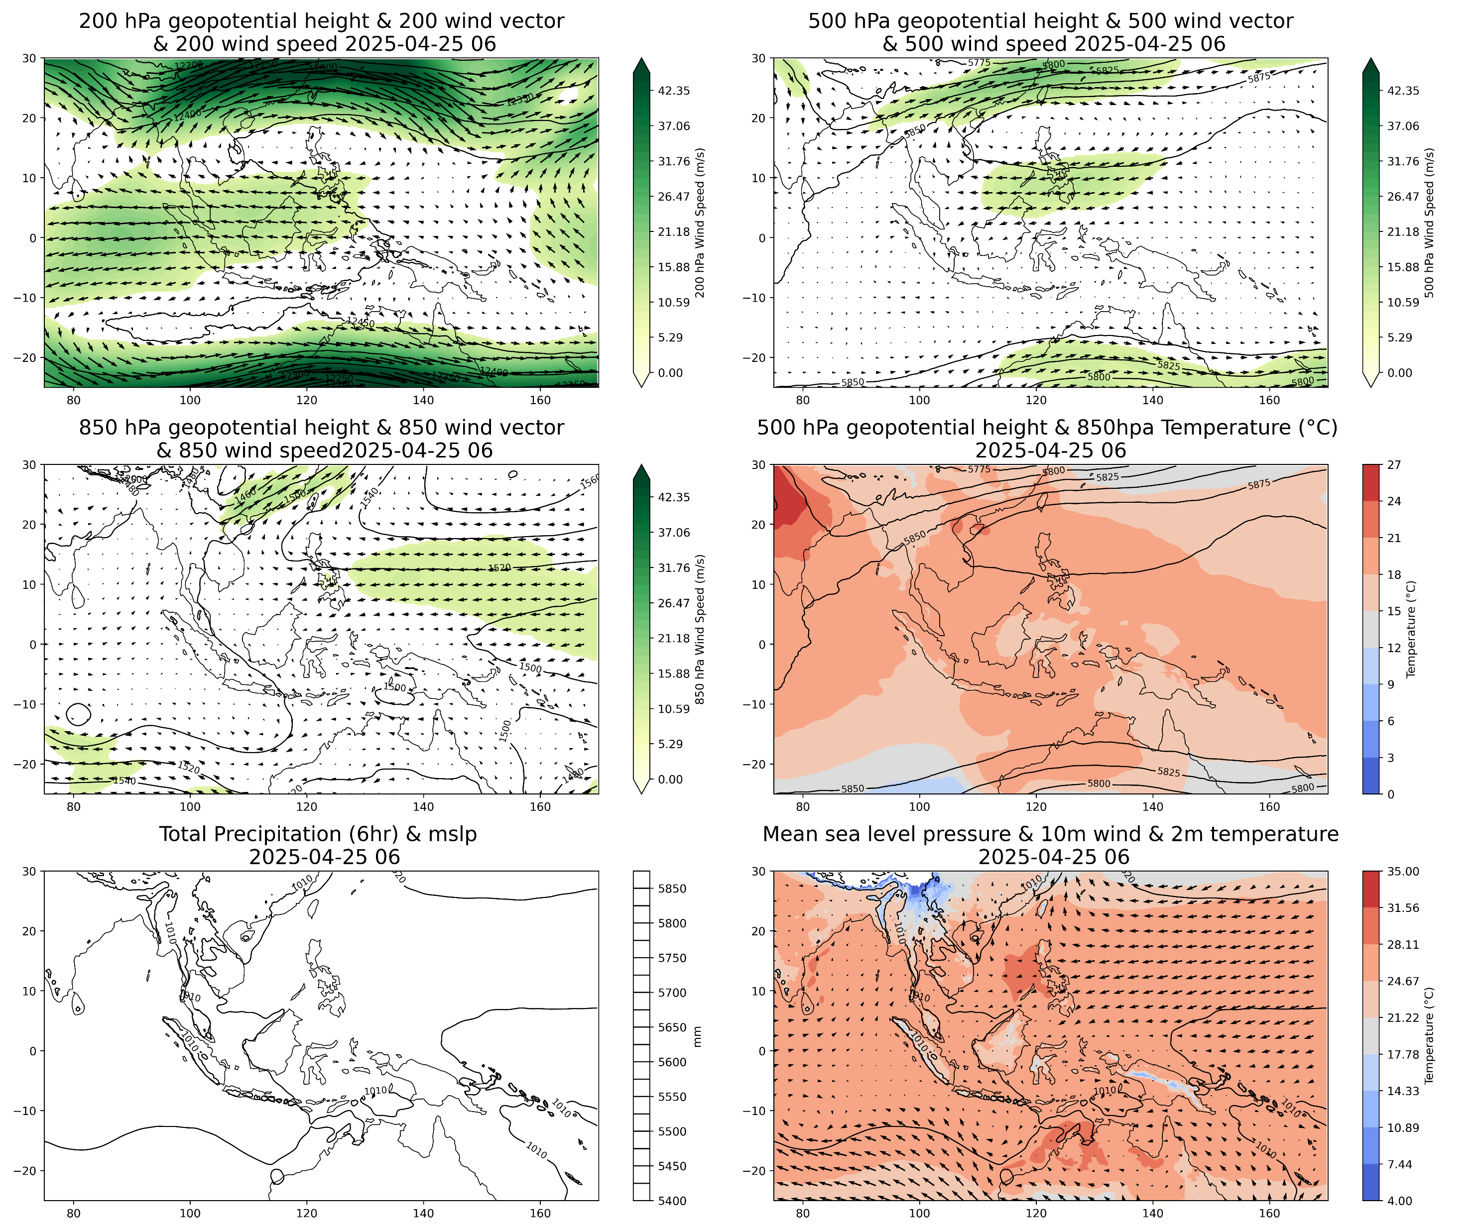
Earth2Studio
SFNO daily run on T2
Plot by Zhen-Wen Lo

Slide 8
SFNO
Model of interest: FourCastNet v2 (SFNO)
Use spherical coordinates to deal with symmetries
https://developer.nvidia.com/blog/modeling-earths-atmosphere-with-spherical-fourier-neural-operators/
Based on Torch-Harmonics and uses Modulus-Makani in training
https://github.com/NVIDIA/modulus-makani

Slide 9
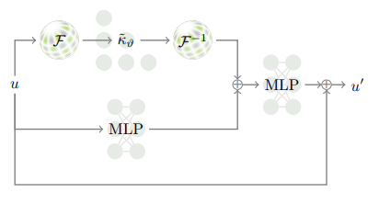
SFNO
NWP – physics laws
Fourier transform
learned filter
inverse
atmospheric state
@t=0
atmospheric state
@t=1
DWP – learned operators
multi-layer perceptions
(& channel mixing)
SFNO (used in FCNv2): Spherical Fourier Neural Operators
Extends traditional Fourier Neural Operators (FNOs used in FCNv1, on Cartesian coordinates) by incorporating spherical symmetry using spherical harmonic transform ─ convolution theorem on the sphere.

Slide 10
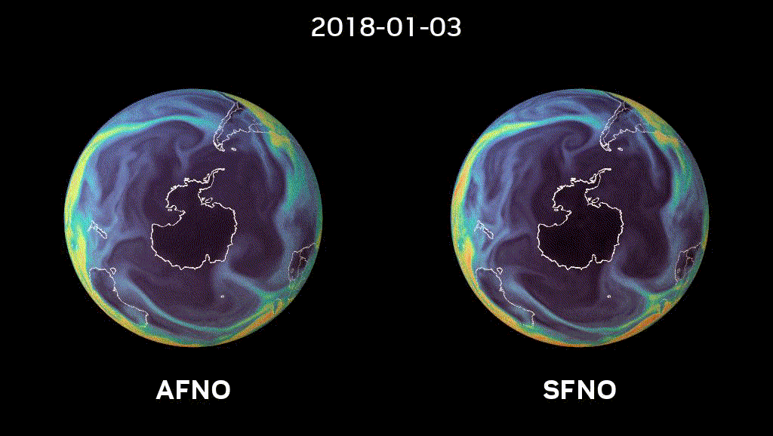
Adaptive FNO (based on Cartesian space)
suffers numerical instability emerging from the pole.
SFNO is relatively stable for long integrations.

Slide 11
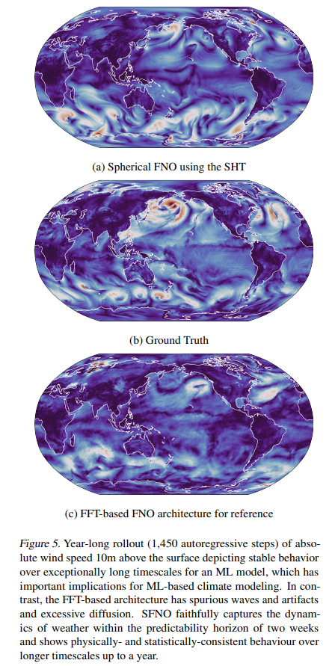
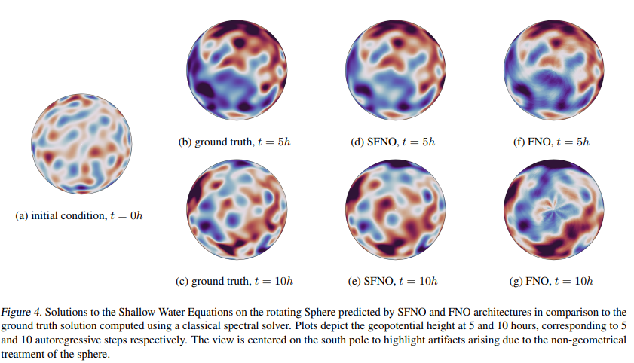
insignificant artifacts up to a year

Slide 12
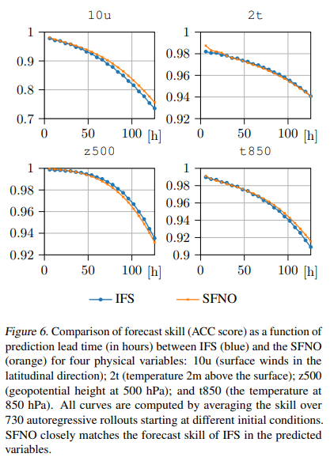
performance comparable to the state-of-the-art NWP

Slide 13
SFNO / AFNO / FourCastNets
Disambiguation: Older FourCastNet was trained with AFNO; while newer FourCastNet (sometimes called FCN v2) with SFNO
In Earth2Studio, “FCN” is the FourCastNet v1 / AFNO, while “SFNO” is the FourCastNet v2 / SFNO

Slide 14
Modulus (PhysicsNeMo)
Physics-aware AI framework
renamed to PhysicsNeMo recently
https://developer.nvidia.com/physicsnemo
An implement of PINN (physics-informed neural network)
Contains some physics formulation (fluid dynamics, etc) so one can train a model while keeping the physical knowledge
That is, to solve PDEs with AI techniques
NCHC workshop on Modulus: https://github.com/nqobu/nvidia/tree/main/20240626

Slide 15
How to improve SFNO?
SFNO currently contains NO oceanic information
No SST, SSH, etc; T2M (2m temperature) was used
We’re planning to add SST and SSH to train the SFNO, and aims to improve on longer term model performance
Conducting preliminary training test, based on Modulus-Makani, on NCHC T2 / Nano5

Slide 16
Questions?
Contact: Dr. YH Tseng tsengyh@ntu.edu.tw
Training: Chung-Wei Lee cwleetaiwan@gmail.com
Technical (dirty?) works: Mike Chen mike.scchen@gmail.com

