Slide 1
How to make SST file and nudging region file?
SST (nudging SST file)
NOTE1: Needs daily NC file, one NC file per day, no leap year.
NOTE2: You can nudge the SST to (obs anomaly+obs climatology) or (obs anomaly+model climatology).
sst_anom.ncl → calculate anomaly SST from HadISST. (Or just the total SST field if you want to nudge to obs total SST.)
cdo_sst.csh → interpolate SST file into daily resolution and remove Feb29th.
jls_add_sstanomaly_modclm.ncl → output SST file into one file per day, the file name needs to be specified as the script. (obs anomaly+model climatology, you can also do obs anomaly+obs climatology)
SPC (nudging region file)
NOTE: Needs daily NC file, one NC file per day.
ncl construct_PAC_forcing.ncl
cd day
sh spc.sh

Slide 2
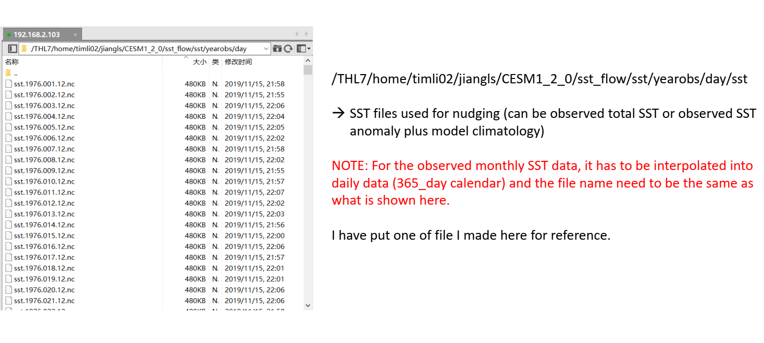

Slide 3
