Slide 1



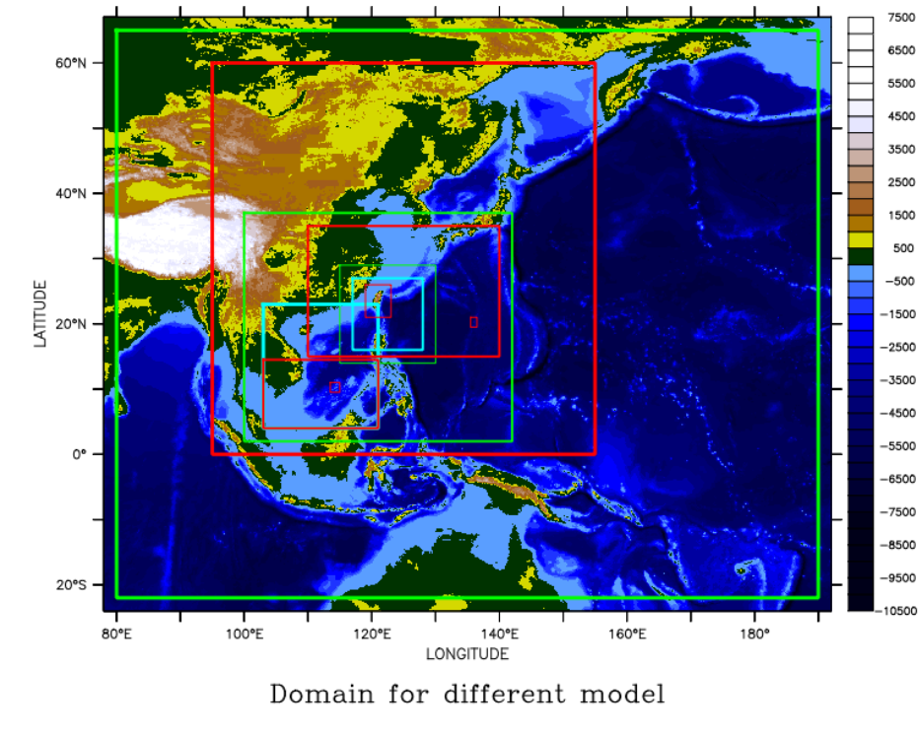
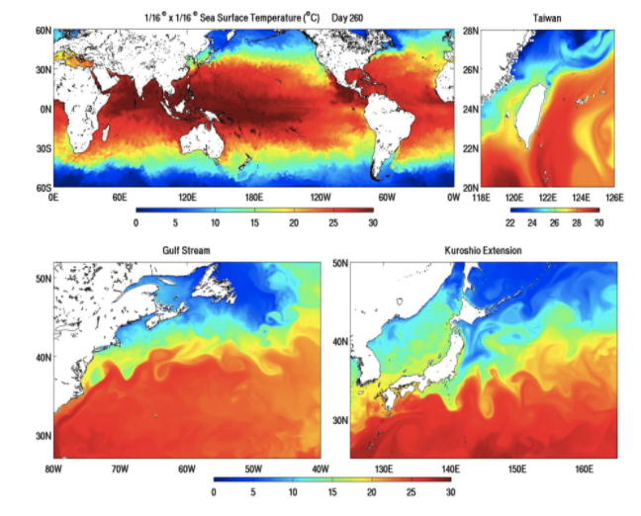
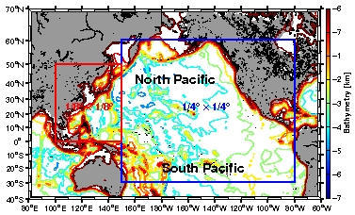
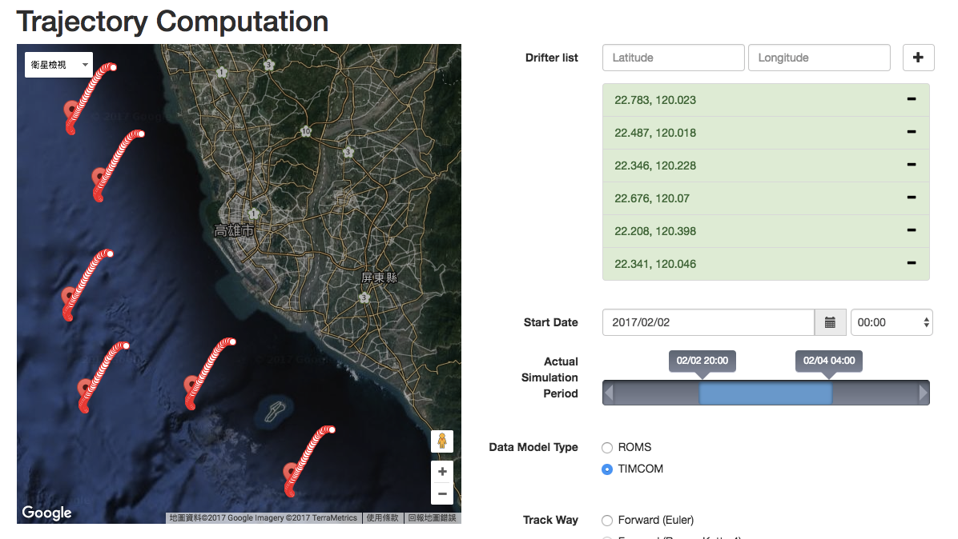
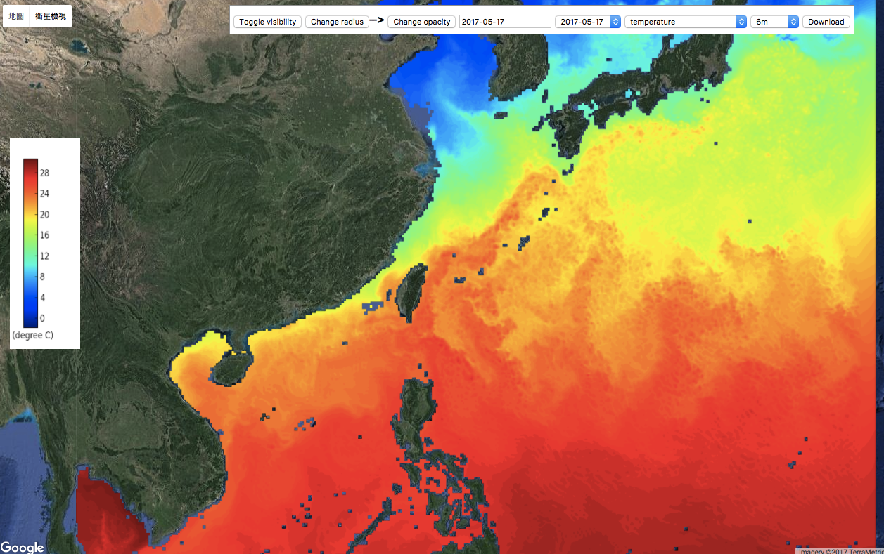
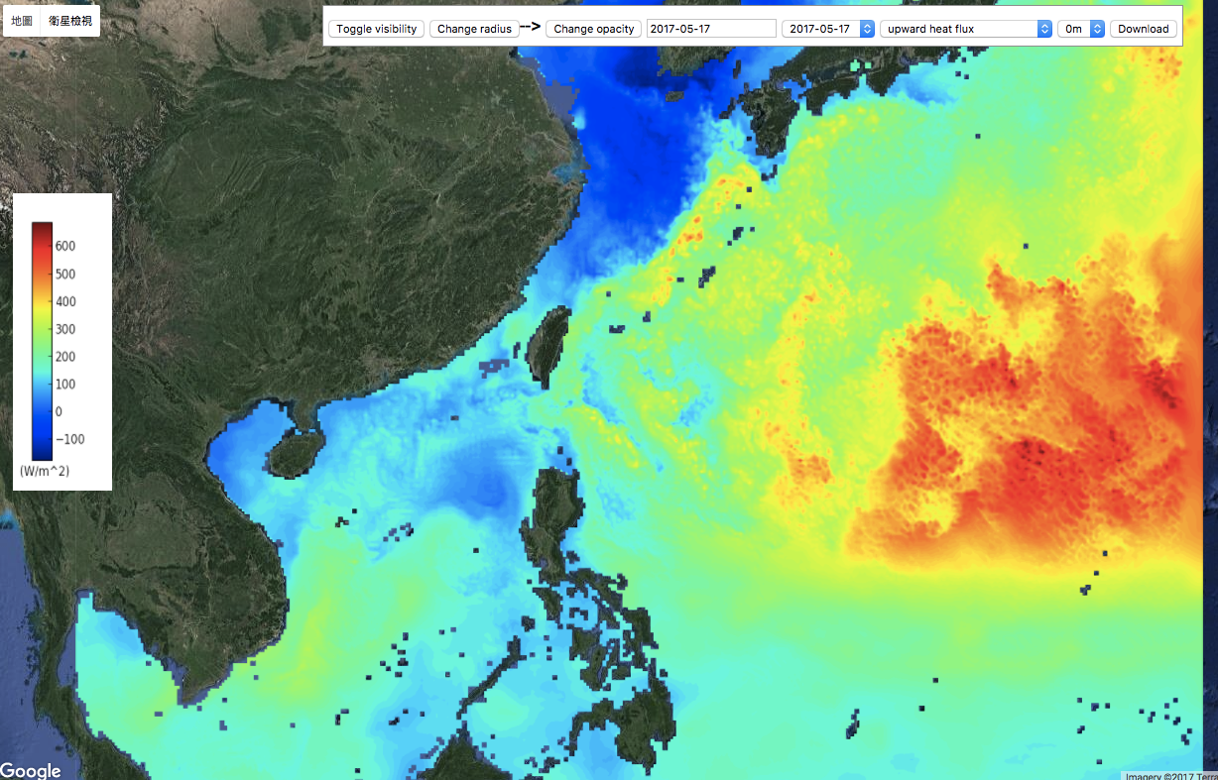
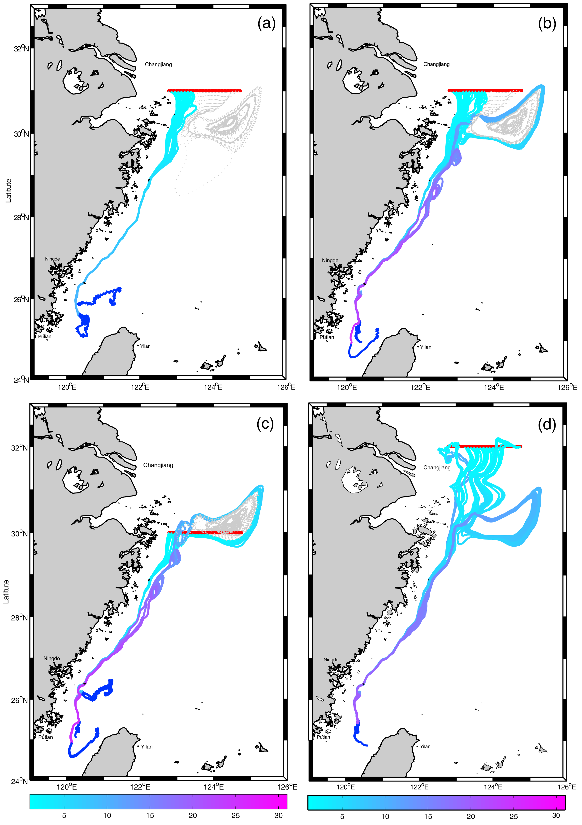
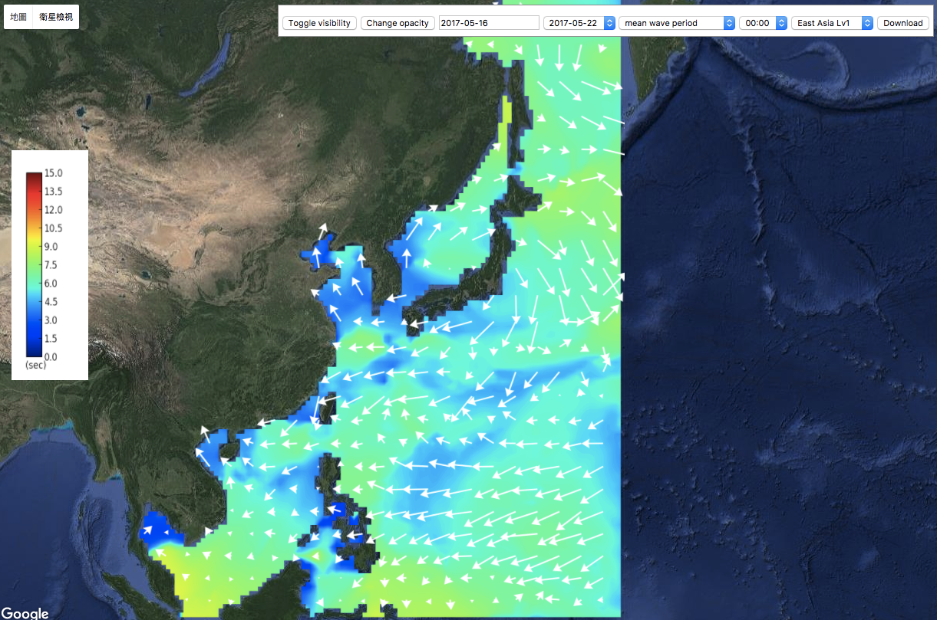
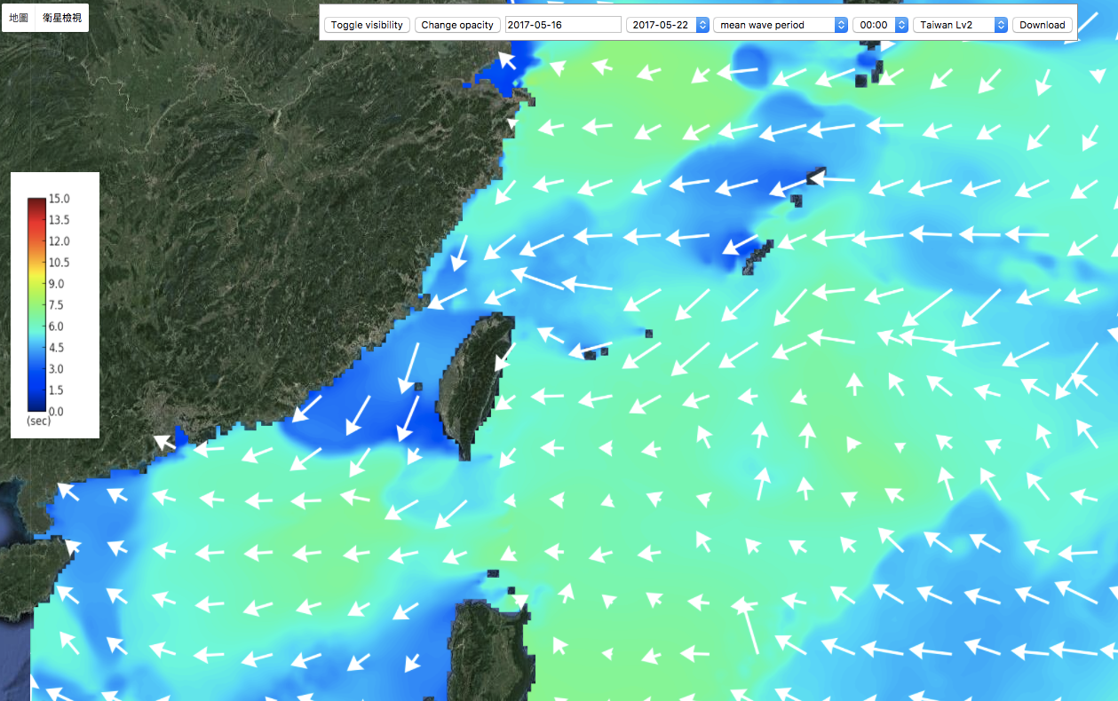
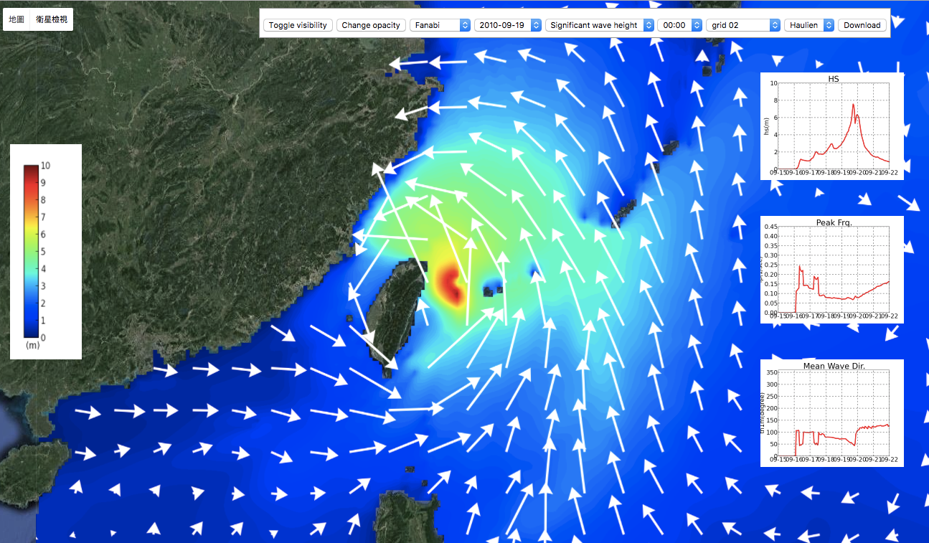
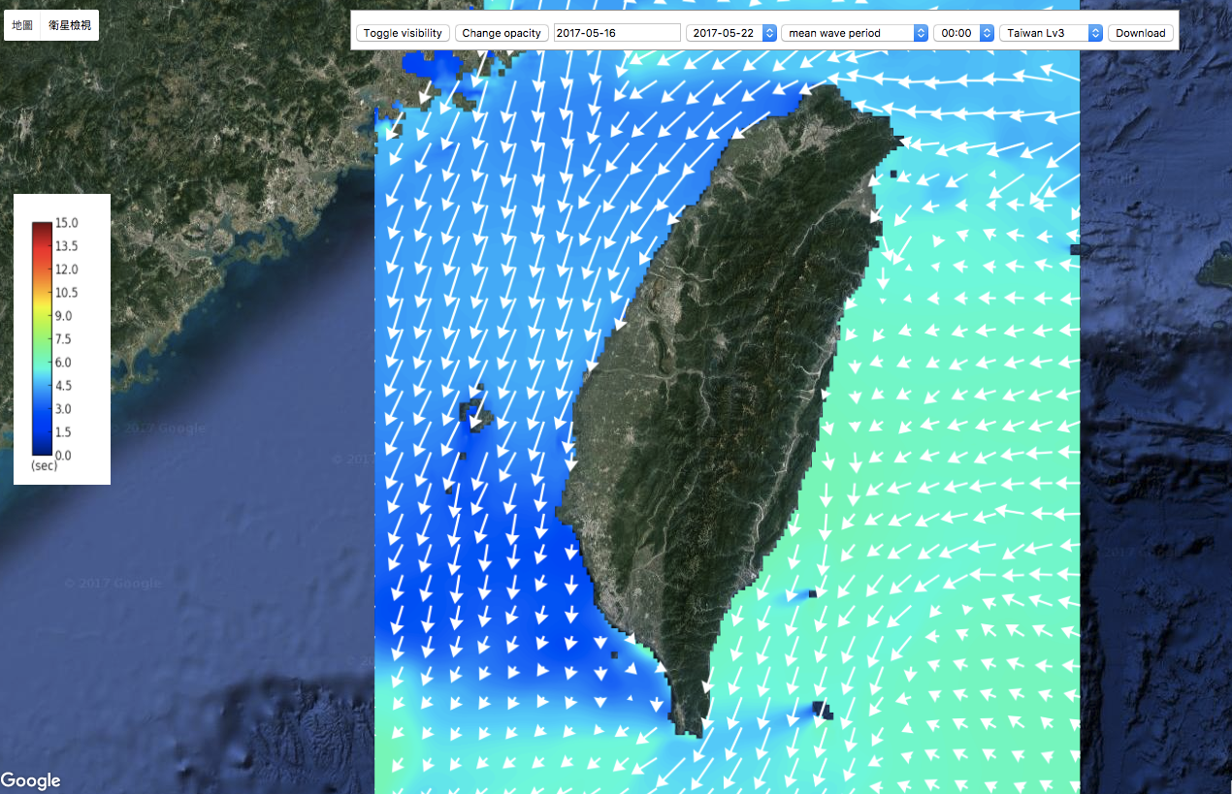
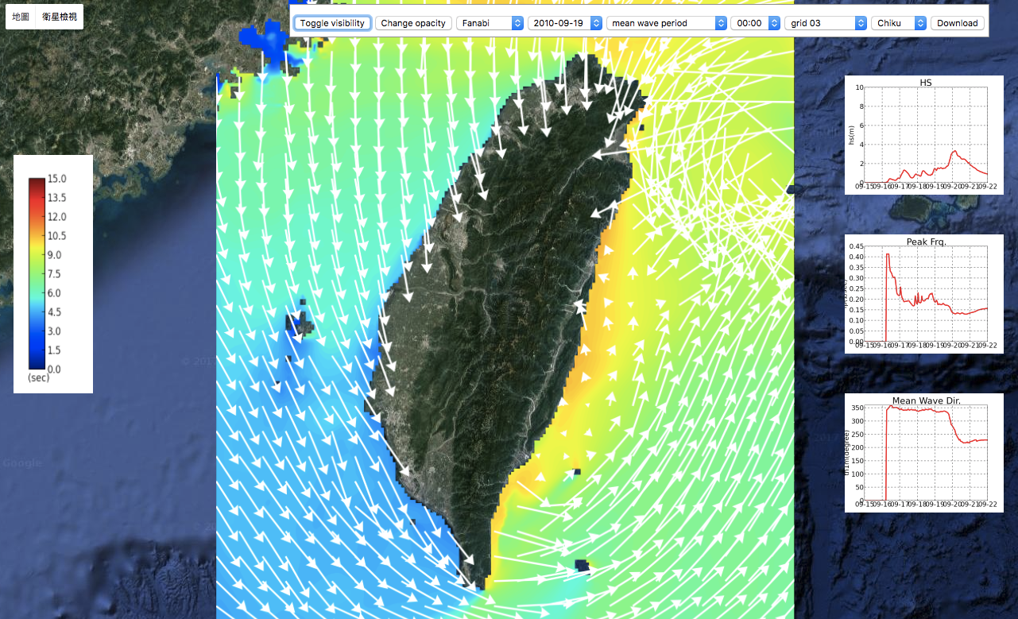
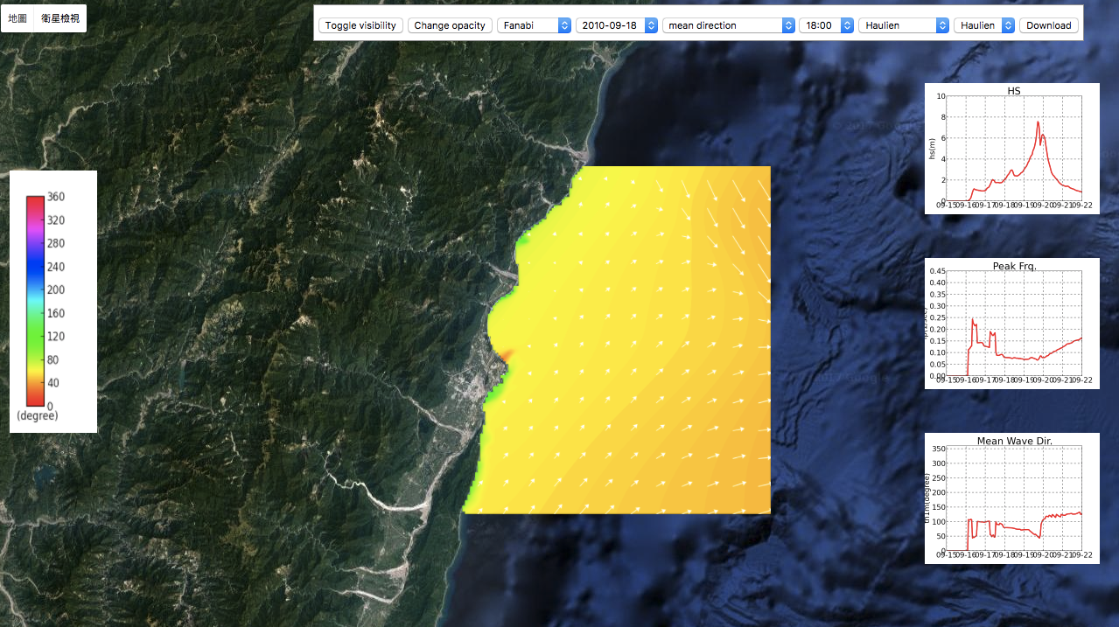
operational ocean forecast system and the next generation ocean model development
Real-time integrated operational ocean forecasting
Taiwan Multi-scale Community Ocean Model (TIMCOM)
WRF
27/9/3 km
CWB-GFS driven
NCOM
0.027 deg
HYCOM driven
Meteo forcing: WRF/MSM
NWW3
0.5/0.1/0.02 deg
2-way nesting
WRF/RSM/MSM driven
SWAN
Local select
WRF/MSM driven
Taiwan Multi-scale Community Ocean Model (TIMCOM) was developed to provide a flexible and efficient community ocean model for simulating a variety of idealized and real ocean flows over a wide range of scales and boundary conditions. The model is particularly targeted at resolving multi-scale dynamics in the ocean environment, ranging from small scale turbulence to the global circulation gyres. It is now integrated within the CESM framework to participate the Coupled Model Intercomparison Project 6 (CMIP6).
Two-way multi-scale coupled ocean circulation model
TIMCOM
0.25 deg
HYCOM driven
CWB-GFS driven
TIMCOM
0.125 deg
HYCOM driven
CWB-GFS driven
Applications:
Lagrangian trajectory of the particle released at southern Taiwan.
Particle tracking for search and rescue operation
Nowcasted ocean circulation and wave dynamics
Tracer trajectories of step-wise swimming schemes in both runs (control- a, standard- b) and the sensitivity analyses on different initial locations: (c) 30˚N and (d) 32˚N. The color scale from cyan to magenta represents the simulation days from 1 to 31, while the blue line denoted the period when tracers move toward optimal spawning temperature. The gray dotted lines represent the tracers remained at the ECS.
Forecasted mean wave period in the nested grid domain
Interactive trajectory computation interface
Fish migration and recruitment analysis
Significant wave heights in domain 2
Hindcasted wave dynamic during the passage of typhoons
The main current system of western North Pacific. The modeled annual-averaged upper layer: velocity vectors and SST.
Regional ocean circulation and ocean-atmosphere interaction
Mean wave periods in domain 3
Significant wave heights in domain 2.

