Slide 1
Evaluation of the equatorial current system in the POP simulations based on different wind forcings
Yu-heng Tseng¹, Zhikuo Sun^{2,3}, Hailong Liu^{2,3}, Pengfei Lin^{2,3} , Justin Small⁴ , Frank Bryan⁴
¹Institute of Oceanography, National Taiwan University, Taiwan
²State Key Laboratory of Numerical Modeling for Atmospheric Sciences and Geophysical Fluid Dynamics, Institute of Atmospheric Physics, Chinese Academy of Sciences, China
³ College of Earth Sciences, University of Chinese Academy of Sciences, China
⁴Climate and Global Dynamics Laboratory, National Center for Atmospheric Research, USA
Acknowledgement: Who Kim, Hiroyuki Tsujino, EASM-3: Collaborative Research: Quantifying Predictability Limits, Uncertainties, Mechanisms, and Regional Impacts of Pacific Decadal Climate Variability

Slide 2
Motivation
Model experiments
Results
Zonal transport and Sverdrup transport
Impacts of wind stress curl
contributions
Conclusion

Slide 3
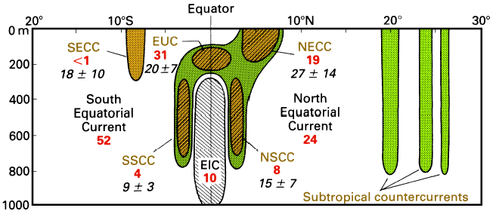
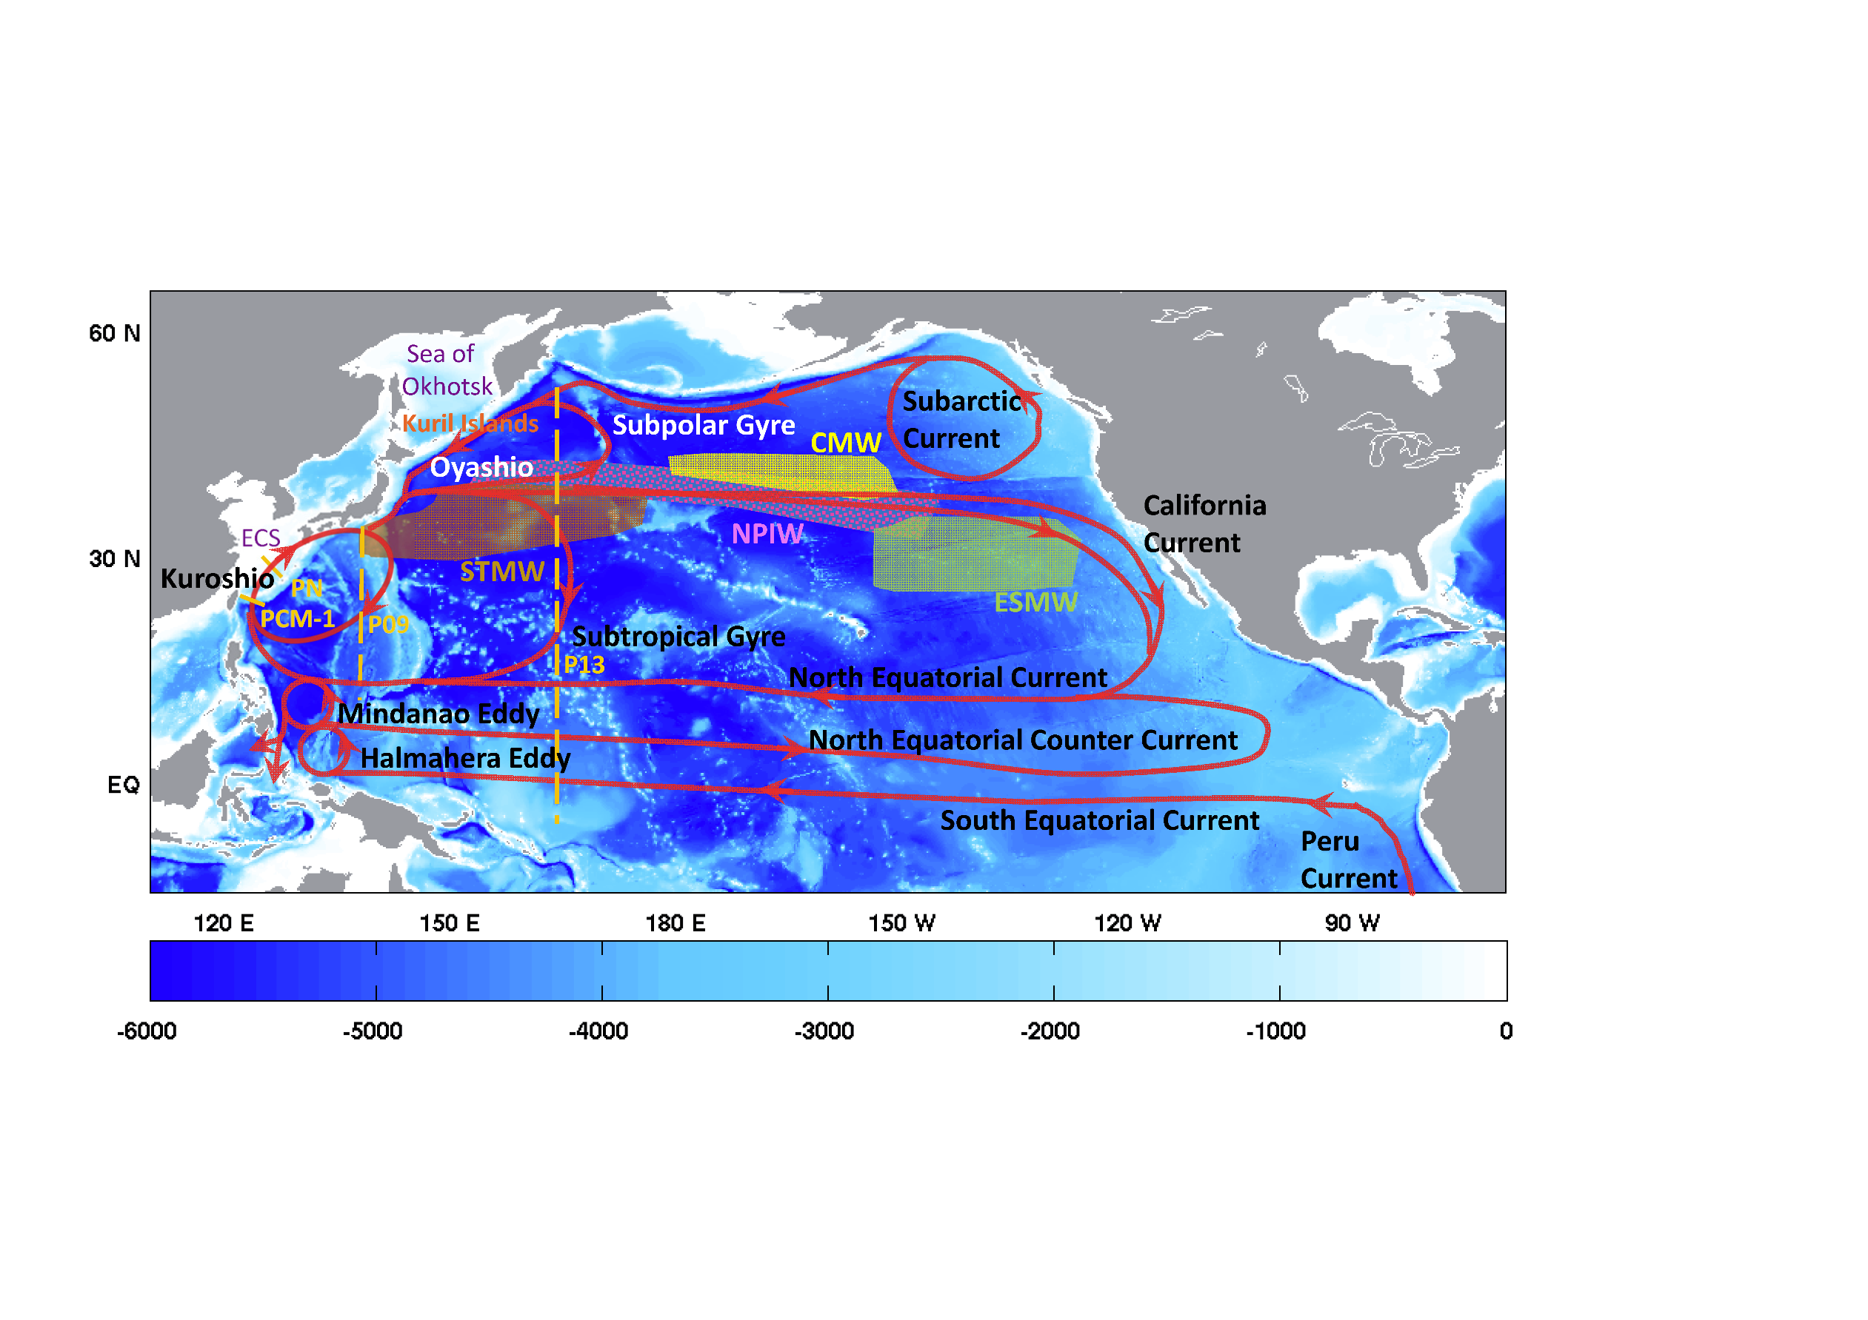
Overview of equatorial currents
Tseng et al. (2016)
Notes:
Meridional section of the upper Pacific ocean (dark shading = eastward; light shading is westward)
All westward flow north of 5°N constitutes the North Equatorial Current, westward flow south of 5°N outside the EIC represents the South Equatorial Current. EUC = Equatorial Undercurrent, EIC = Equatorial Intermediate Current, NECC and SECC = North and South Equatorial Countercurrents, NSCC and SSCC = North and South Subsurface Countercurrents. Transports in Sverdrups are given for 155°W (bold figures; based on observations from April 1979 - March 1980) and 165°E (italics, based on January 1984 - June 1986).

Slide 4
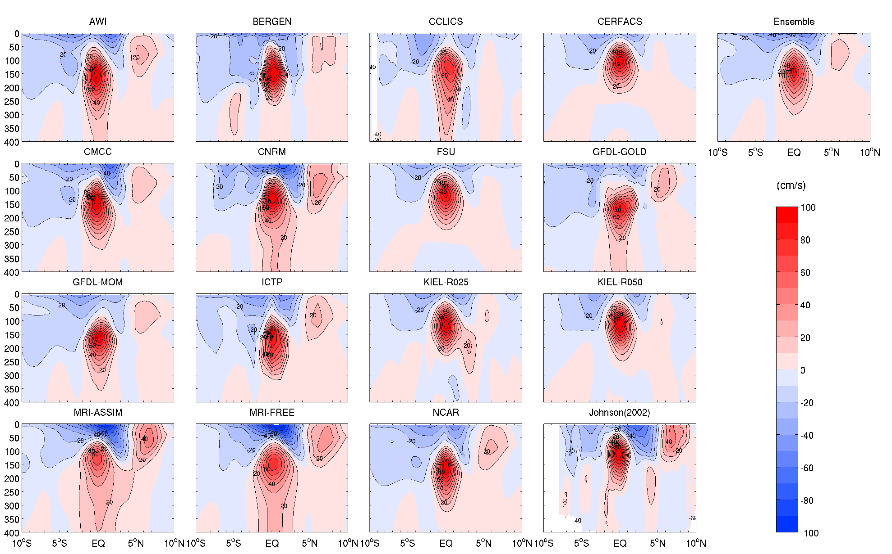
Mean zonal velocity along 140°W in the CORE-II experiments
NECC is generally too weak in all models
SEC
NECC
EUC

Slide 5
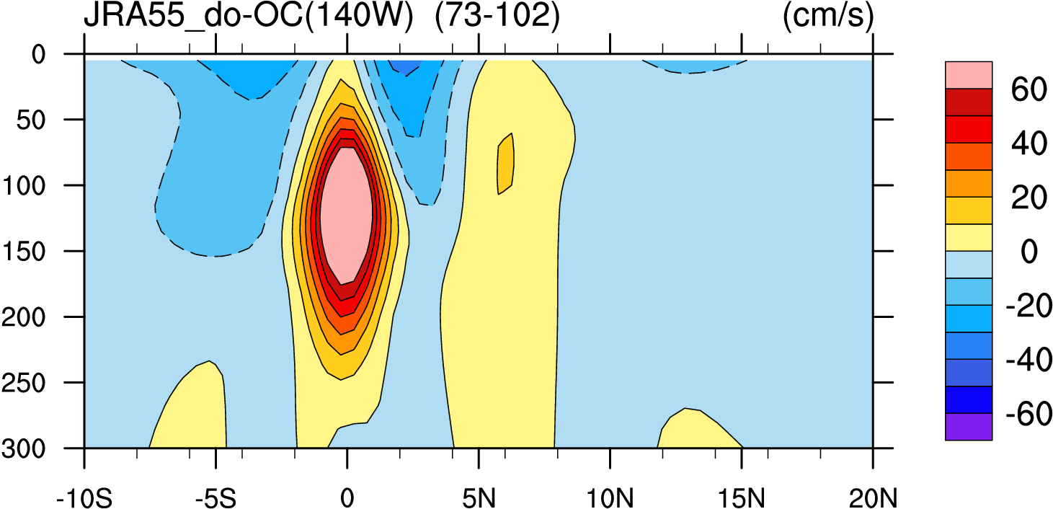
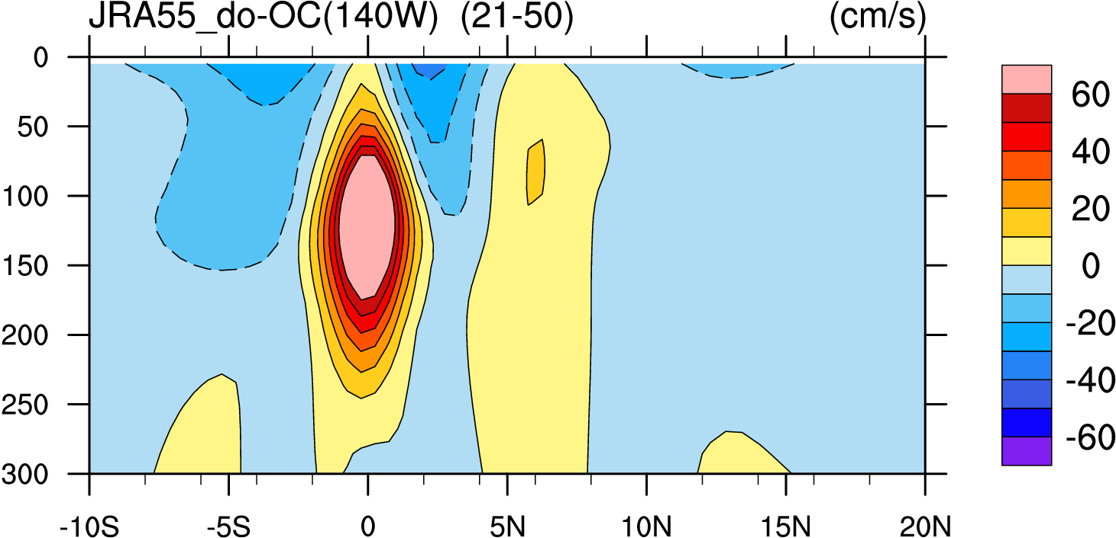
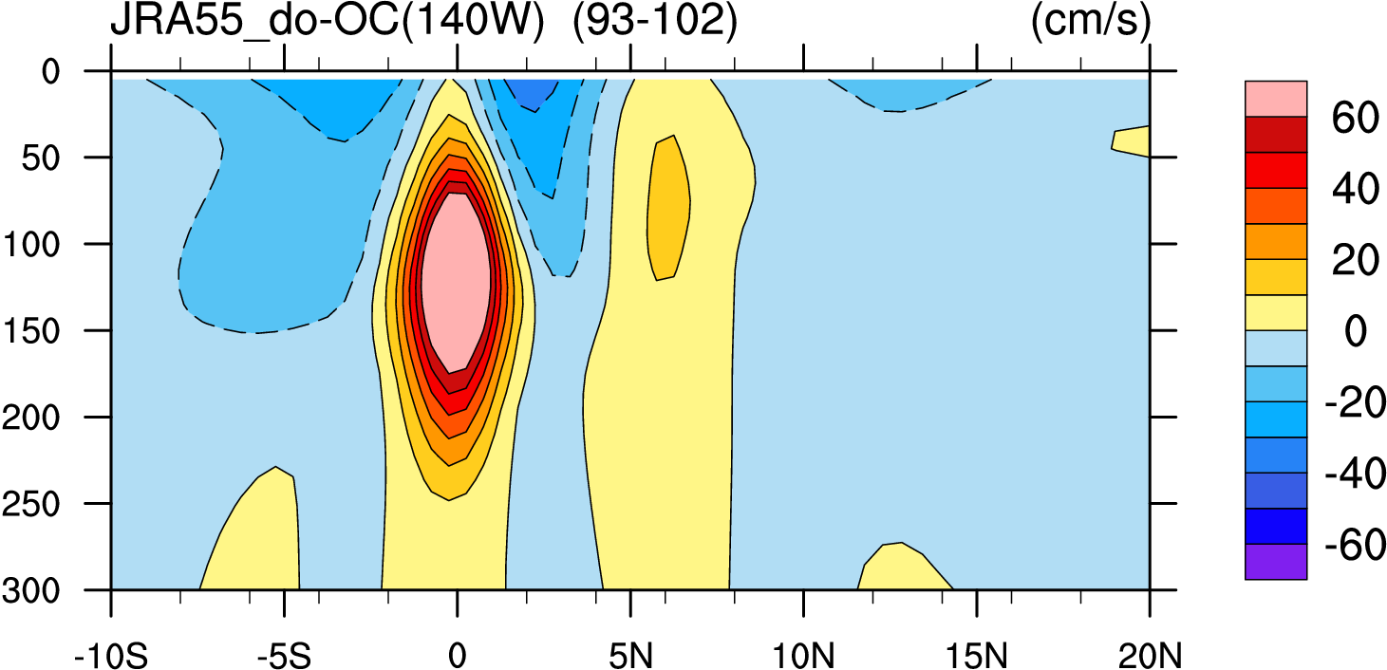
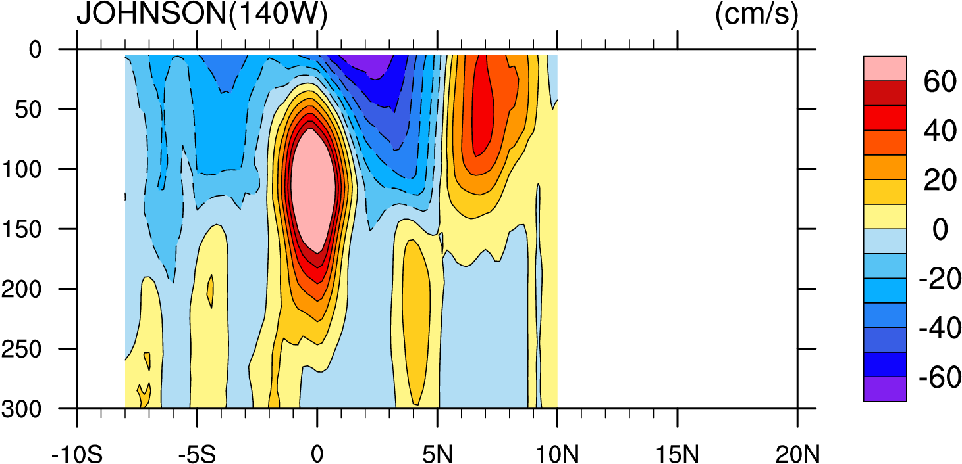
model and data
OBS: Johnson et al. (2002)
Model | Test name | Forcing | Used time
POP | JRA55_raw-OC (S06) | JRA55 | 1978-2007(73-102)
POP | JRA55_raw-NC (S07) | JRA55 | 1978-2007(73-102)
POP | JRA55_do-OC (T03) | JRA55 | 1978-2007(73-102)
POP | JRA55_do-NC (T07) | JRA55 | 1978-2007(73-102)
POP | POP | COREII | 1978-2007(271-300)
JRA55_do-OC (73-102)
JRA55_do-OC (21-50)
JRA55_do-OC (93-102)
Johnson (271-300)
(shaded interval : 10 cm/s)
Notes:
1958-2009(52years) So year 80-102 is 1985-2007
Data download path:
JRA55： /glade/p/work/linpf/JRA55
POP ： /glade/p/cgd/oce/people/bates/Data_CCSM4_special/g40.000/monthly

Slide 6
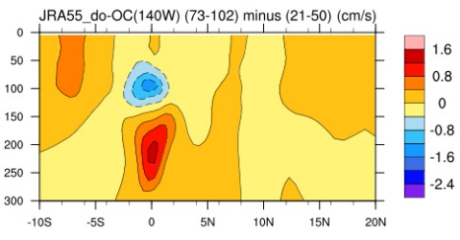
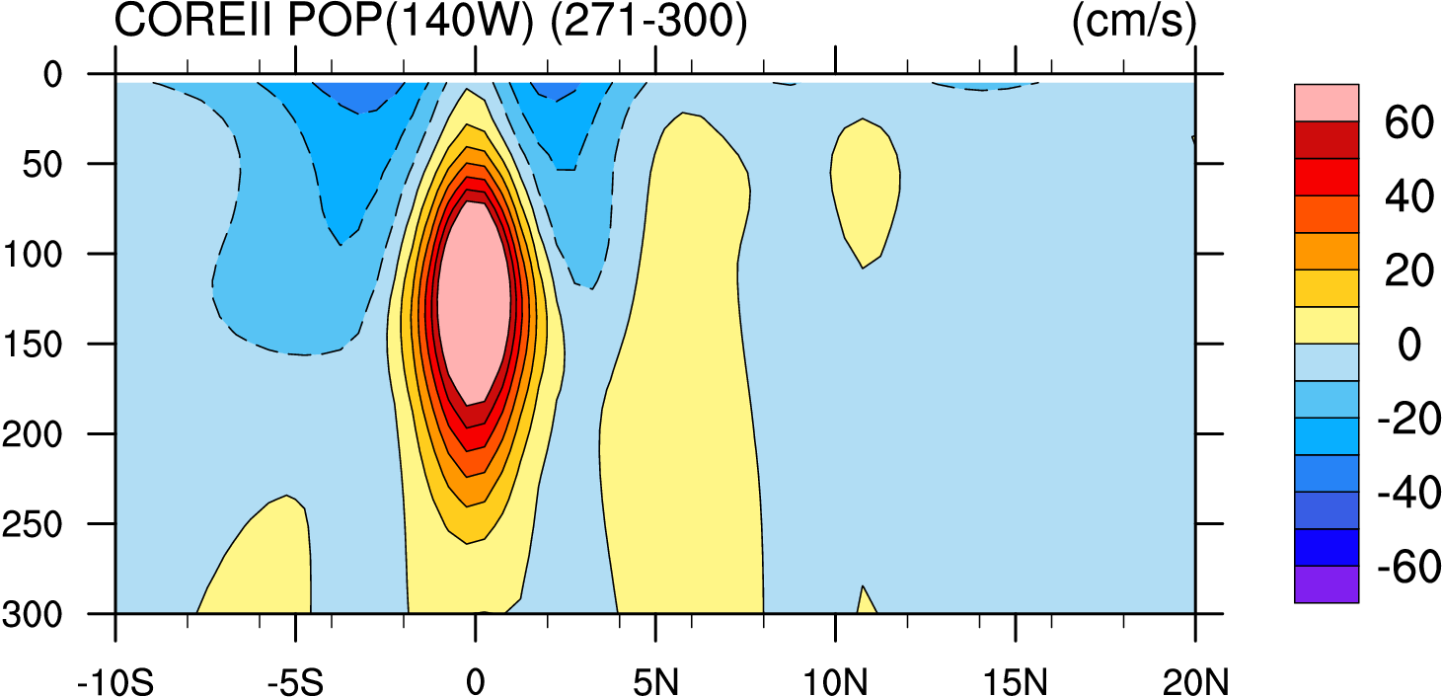
COREII POP (271-300)
This plot just foe check the different between (73-102) and (21-50)

Slide 7
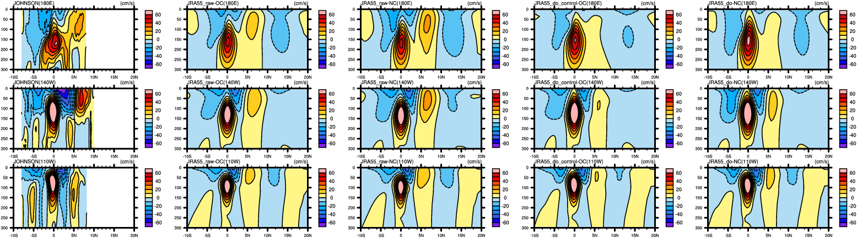
Meridional-vertical sections of mean zonal current
Johnson
JRA55_raw-OC
JRA55_raw-NC
JRA55_do-OC
JRA55_do-NC
180E
140W
110W
(shaded interval : 10 cm/s)
NECC is generally stronger in NC runs
NECC is stronger in raw data (without wind correction)
EUC extends to the surface in the wind corrected runs
Notes:
FIG. Meridional-vertical sections of mean zonal currents at three representative longitudes: 180E, 140W, 110W.
230:
/ldata4/sunzk/JRA55/after-discussion-data
uu-tt.ncl

Slide 8
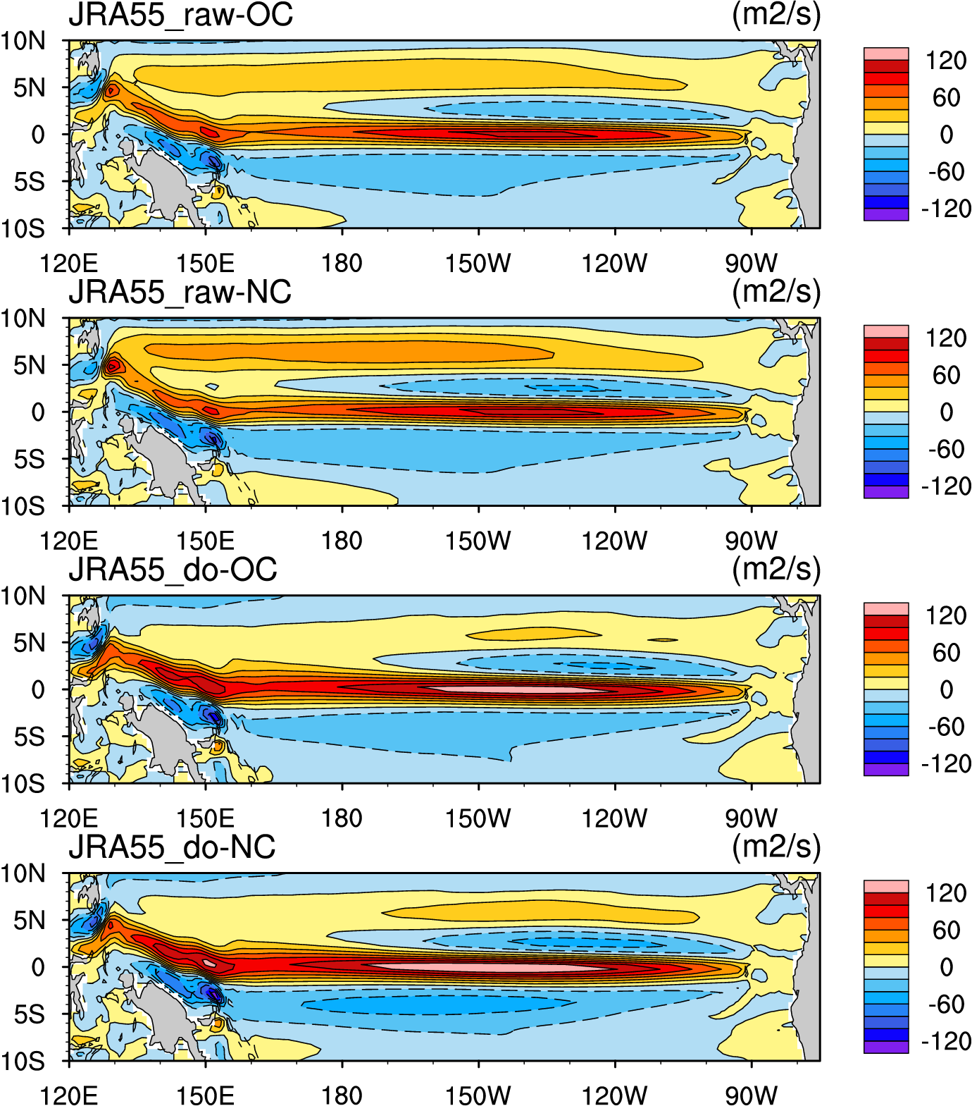
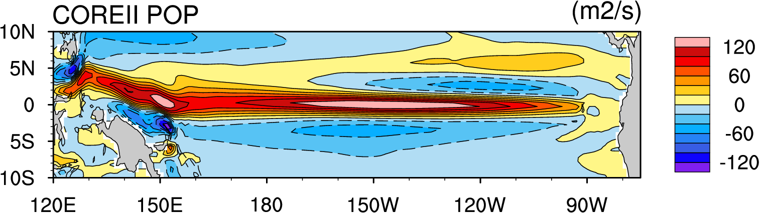
Vertically integrated zonal transport
Stronger NECC transport in JRA55
Stronger in raw data
Stronger in the NC run
Stronger EUC in the wind corrected run
Maximum velocity depth differs
sensitive to the NC/OC
Notes:
(shaded interval : 20 m²s⁻¹)
230:
/ldata4/sunzk/JRA55/after-discussion-data
U-400m-integral.ncl
wind-sverdrup-transport.ncl 得到wind-Sverdrup.nc
NECC-transport-integration.ncl

Slide 9

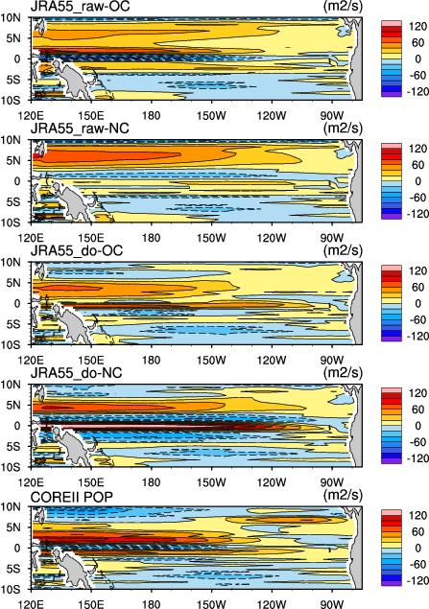
Vertically integrated zonal transport
Zonal Sverdrup transport
Notes:
(shaded interval : 20 m²s⁻¹)
230:
/ldata4/sunzk/JRA55/after-discussion-data
U-400m-integral.ncl
wind-sverdrup-transport.ncl 得到wind-Sverdrup.nc
NECC-transport-integration.ncl

Slide 10
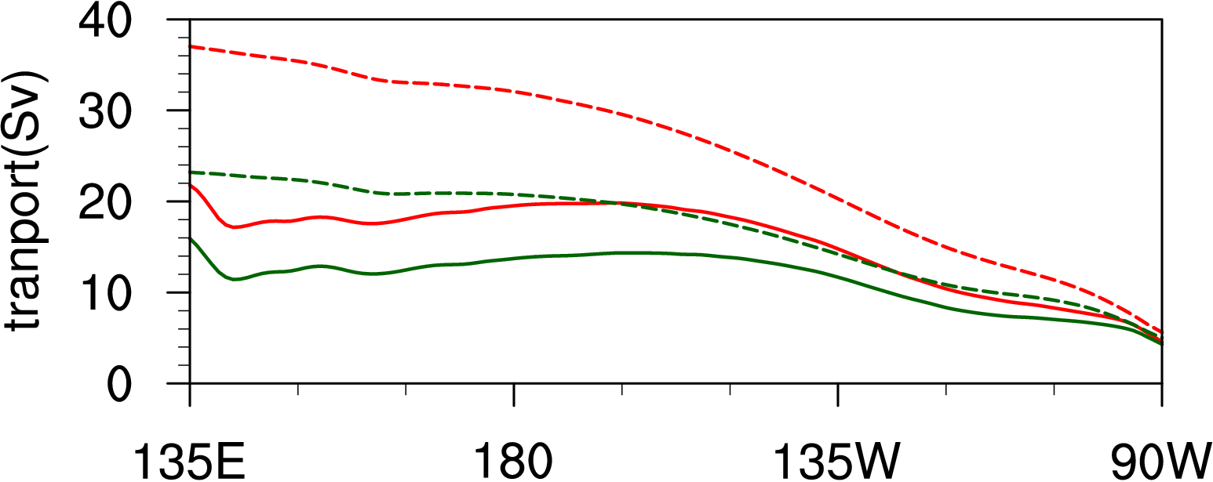
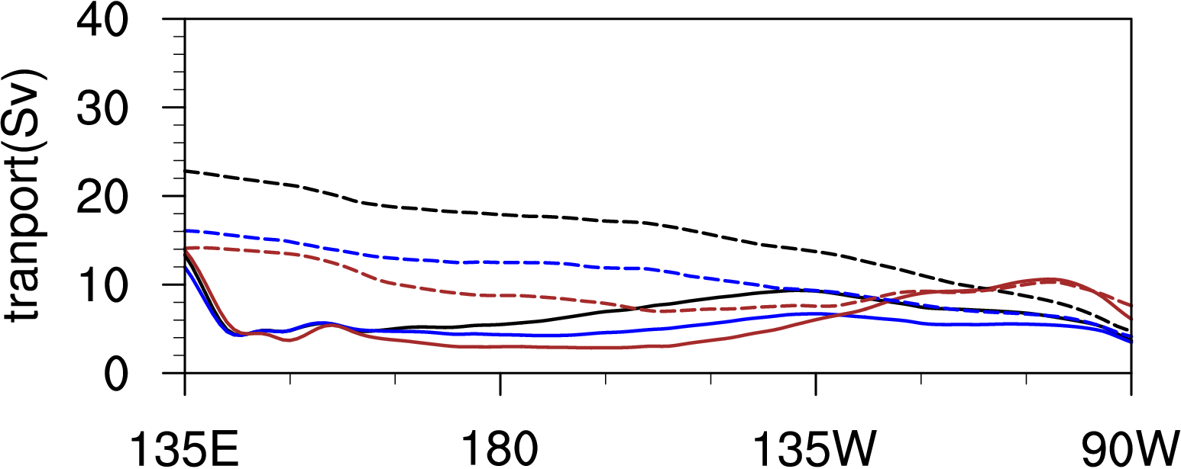
Zonal Sverdrup transport (ZST) vs modeled transport
NECC: 3-10N
J_raw-OC
J_raw-NC
ZST(OC)
ZST(NC)
J_do-OC
J_do-NC
COREII POP
ZST(OC)
ZST(NC)
ZST(COREII)
Similar
ZST is overestimated in JRA
In COREII POP, ZST is overestimated west of 120W only
Notes:
230:
/ldata4/sunzk/JRA55/after-discussion-data
sverdrup_JRA55.ncl
sverdrup_SCOW.ncl

Slide 11
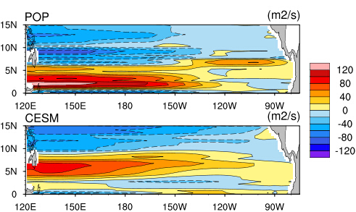

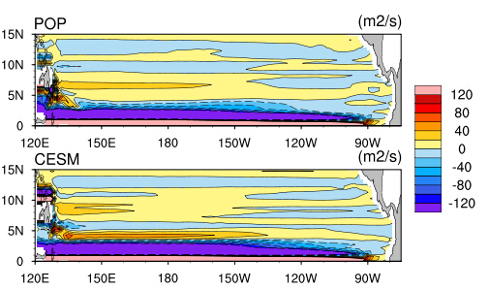
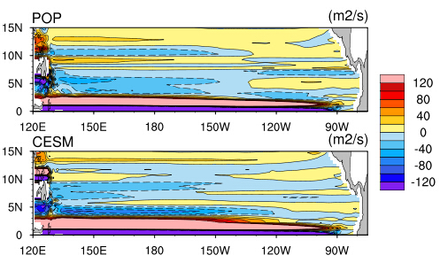
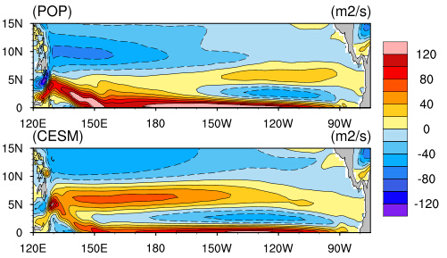




(a)
(b)
Fig.3
$$τ=Wind Stress$$
$$τ^{′}=\int{−∇∙(\overset{⃑}{u}h\overset{⃑}{u})}$$
(c)
(d)
$$τ^{′′}=\int{\left(Friction\right)dz}$$
(e)
(f)
(g)
(h)
$$τ^{∗}=Total$$
FIG.3. Zonal ‘transport’ (m²s⁻²) for the elements of the different stresses. Red colors indicate eastward transport; Blue colors indicates westward transport. Here $τ=wind stress$ for POP (a) and CESM (b); $τ^{′}=advection terms \text{for} \text{POP}\text{ (}\text{c}\text{) }\text{and} \text{CESM}\text{ (}\text{d}\text{)}$; $τ^{′′}=model friction \text{for} \text{POP}\text{ (}\text{e}\text{) }\text{and} \text{CESM} ($f); total (sums of three upper panels) $\text{for} \text{POP}\text{ (}\text{g}\text{) }\text{and} \text{CESM} (\text{h}\text{)}$.
Notes:
230:
/ldata4/sunzk/CESM
U-400m-integral.ncl
advective-curl.ncl 生成nc文件
sverdrup_anomoly.ncl
sverdrup_friction.ncl

Slide 12
Vertically integrated zonal transport (~408m depth)
(shaded interval : 20 m²s⁻¹)
J_raw-OC
J_raw-NC
ZST(OC)
ZST(NC)
J_do-OC
J_do-NC
COREII POP
ZST(OC)
ZST(NC)
ZST(COREII)
Notes:
230:
/ldata4/sunzk/JRA55/after-discussion-data
U-400m-integral.ncl
wind-sverdrup-transport.ncl 得到wind-Sverdrup.nc
NECC-transport-integration.ncl

Slide 13
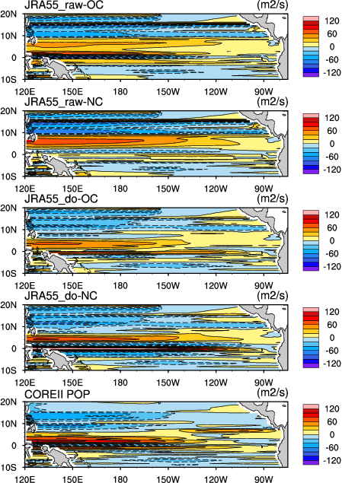
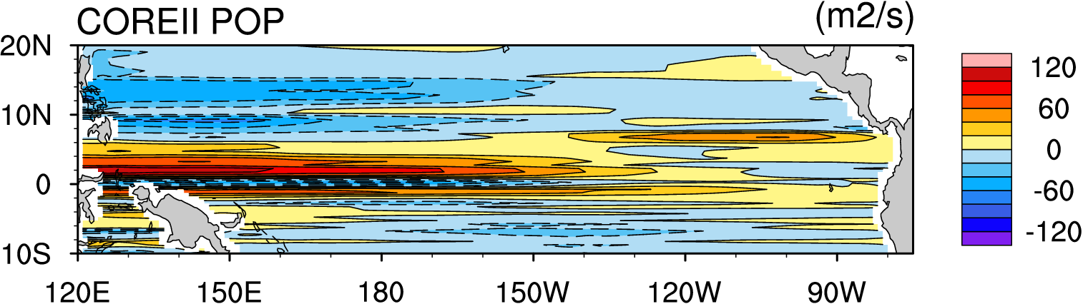
Zonal Sverdrup transport
Notes:
230:
/ldata4/sunzk/JRA55/after-discussion-data
sverdrup_JRA55.ncl
sverdrup_SCOW.ncl

Slide 14
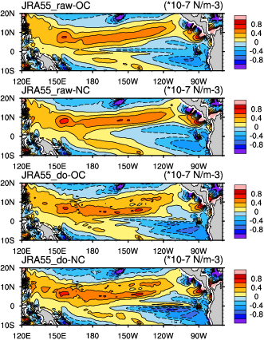
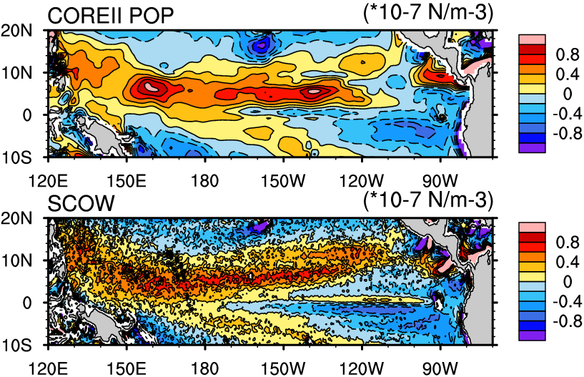
Mean wind stress curl (WSC)
(shaded interval : 0.2*10⁻⁷ N m⁻²)
Notes:
230:
/ldata4/sunzk/JRA55/after-discussion-data
windstress-curl-vector-JRA55.ncl

Slide 15
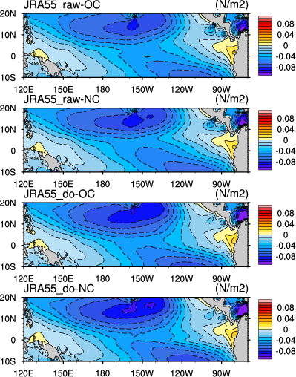
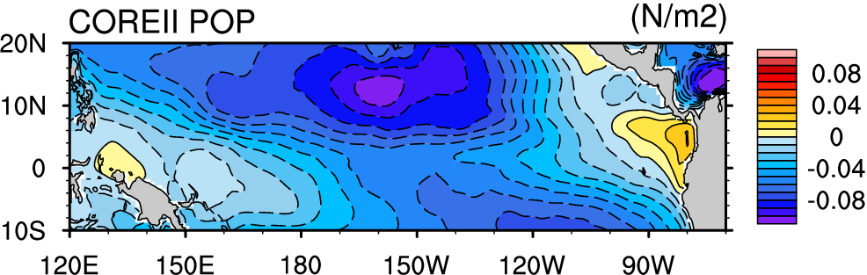
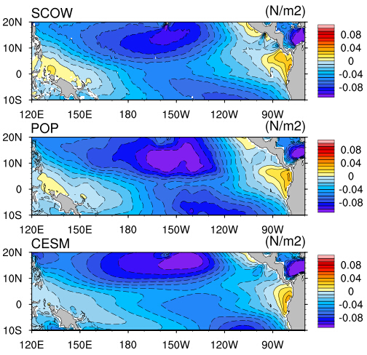
Mean zonal wind stress
(shaded interval is 0.01 N m⁻²)
Large differences in zonal winds
Notes:
230:
/ldata4/sunzk/JRA55/after-discussion-data
taux-JRA55-SCOW.ncl

Slide 16
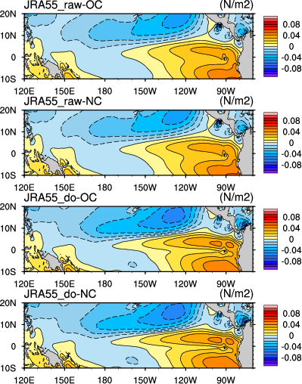
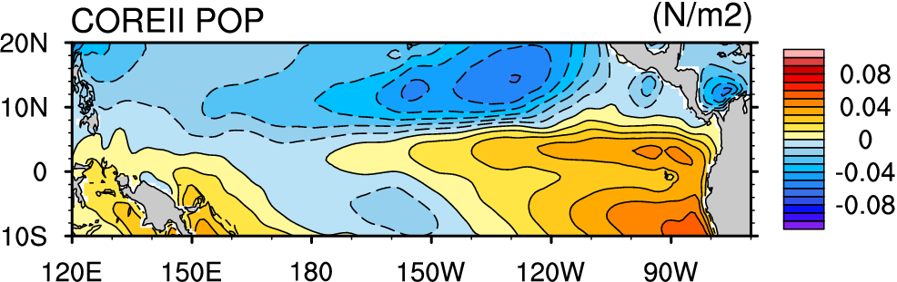
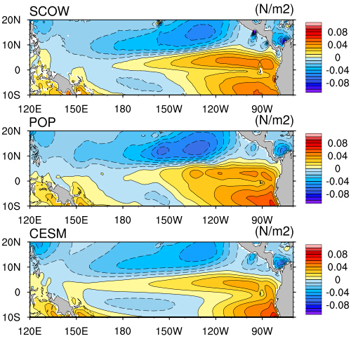
Mean meridional wind stress
(The shaded interval is 0.01 N m⁻²)
Differences are smaller in meridional winds
Notes:
230:
/ldata4/sunzk/JRA55/after-discussion-data
taux-JRA55-SCOW.ncl

Slide 17
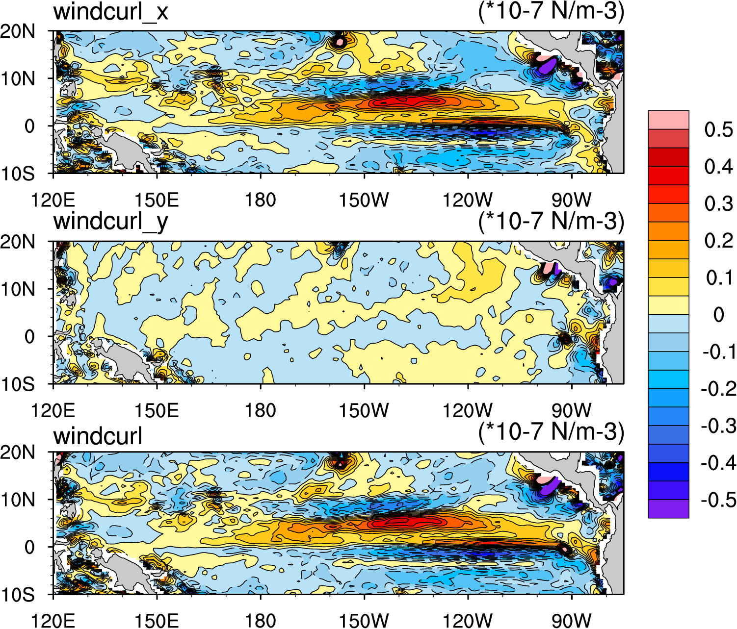
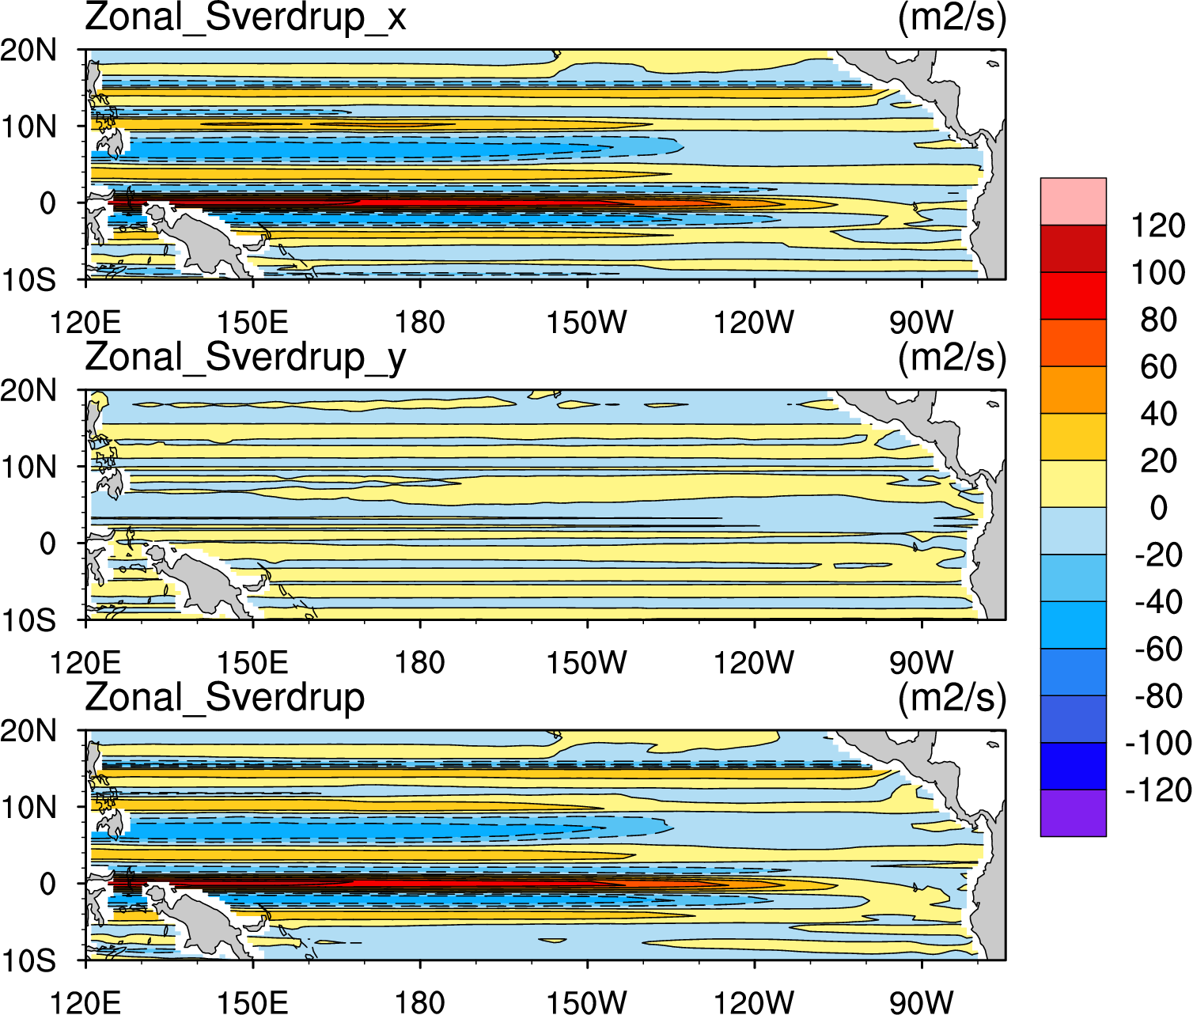



Impact of wind correction
JRA55_do-OC - JRA55_raw-OC
WSC component
Resulting Sverdrup transport
$$−\frac{∂τ_{x}}{∂y}$$
$$\frac{∂τ_{y}}{∂x}$$
$$\frac{∂τ_{y}}{∂x}−\frac{∂τ_{x}}{∂y}$$
Wind speed correction offset
Notes:
Note the large corrections done to JRA55 in Equatorial Pacific (slide 2, top panel). It may be related to surface ocean current, or surface stability, or precip ...
230:
/ldata4/sunzk/JRA55/after-discussion-data
anomoly-wind-correction.ncl
anomoly-sverdrup-correction.ncl
比较correction和uncorrection的影响

Slide 18
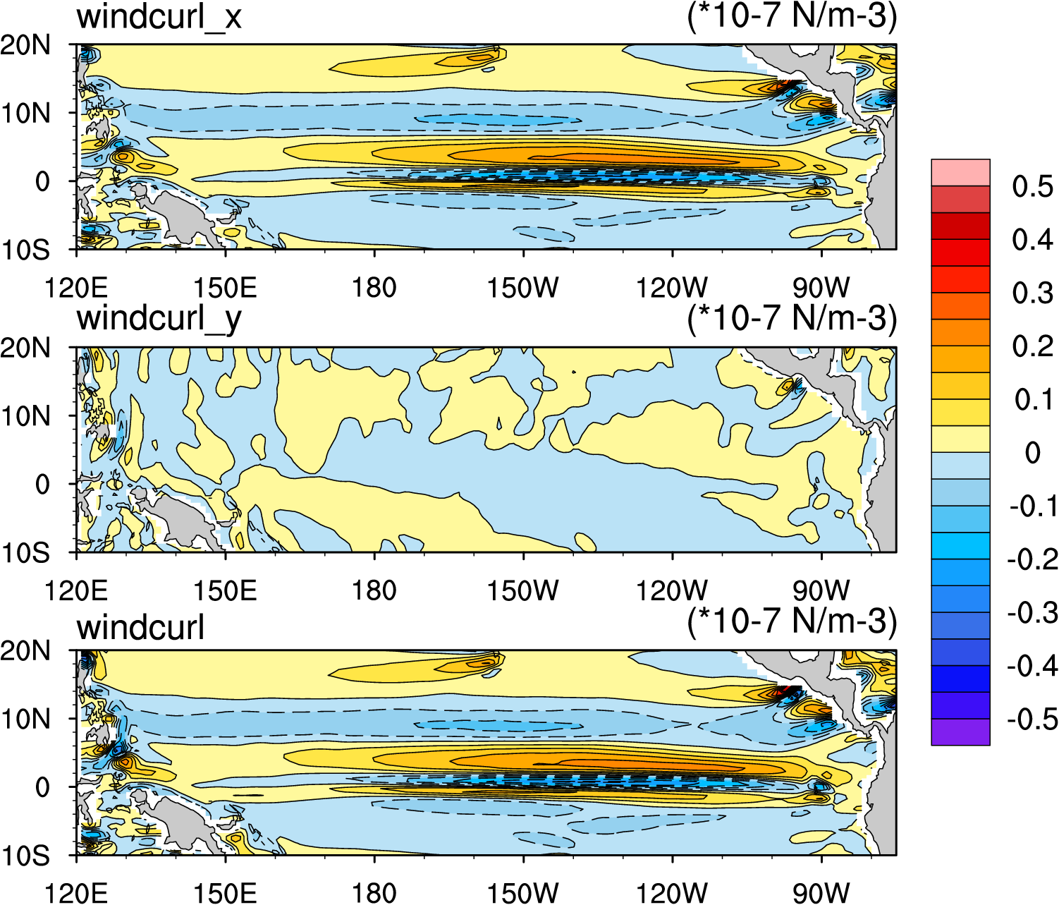
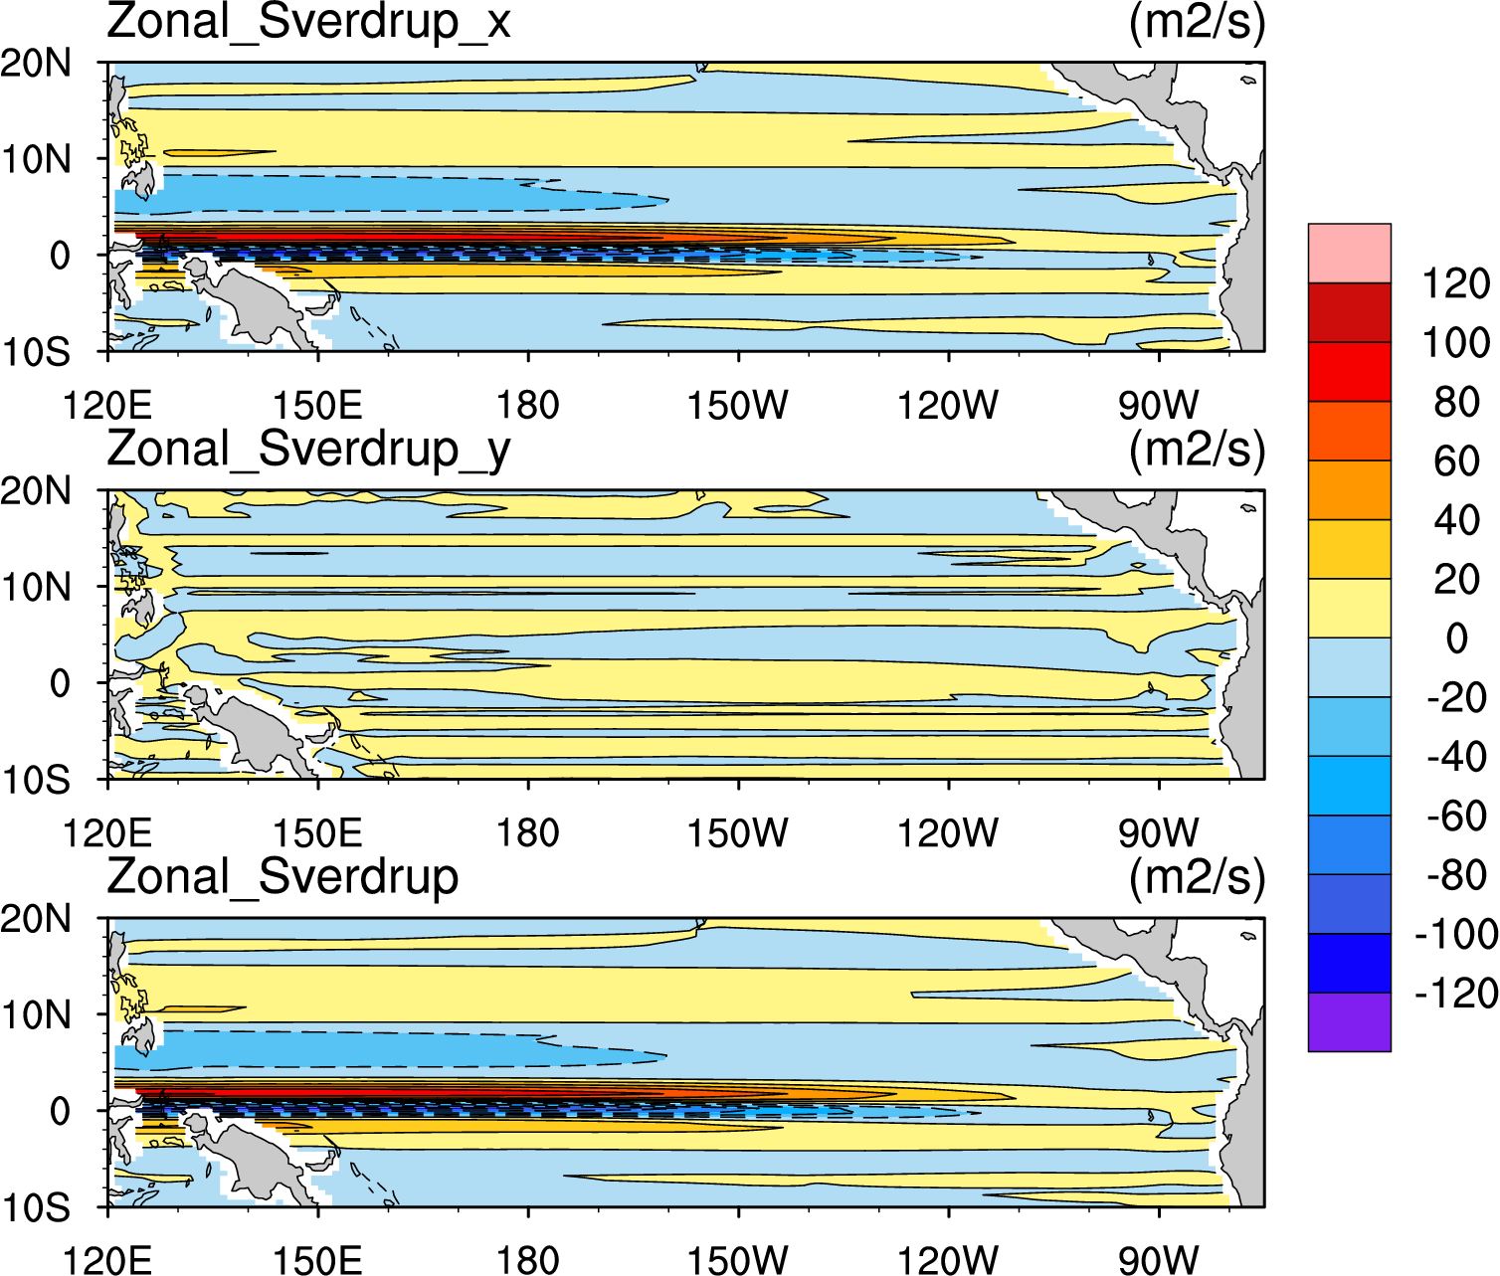



Impact of including ocean currents
JRA55_raw-OC - JRA55_raw-NC
WSC component
Resulting Sverdrup transport
$$−\frac{∂τ_{x}}{∂y}$$
$$\frac{∂τ_{y}}{∂x}$$
$$\frac{∂τ_{y}}{∂x}−\frac{∂τ_{x}}{∂y}$$
Notes:
230:
/ldata4/sunzk/JRA55/after-discussion-data
anomoly-wind-current.ncl
anomoly-sverdrup-current.ncl
比较OC和NC的影响

Slide 19
Conclusion
JRA55 corrected wind has a much closer spatial distribution of WSC to the observed wind fields (regardless of OC/NC).
Differences mainly from the zonal winds
Linear: WSC + non-linear: advection/friction
Wind correction:
transport is stronger in the raw wind (magnitude is larger)
NECC is better but EUC extends to the surface in wind correction runs
NC vs OC:
NECC transport is stronger in the NC (magnitude is smaller)
Surface currents may be counted twice in OC runs

Slide 20
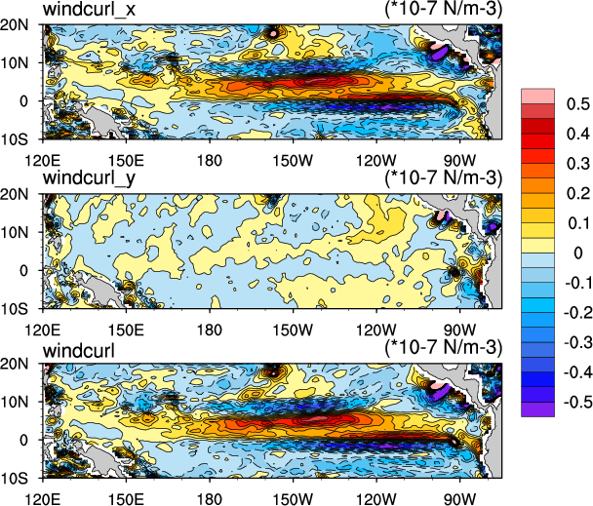
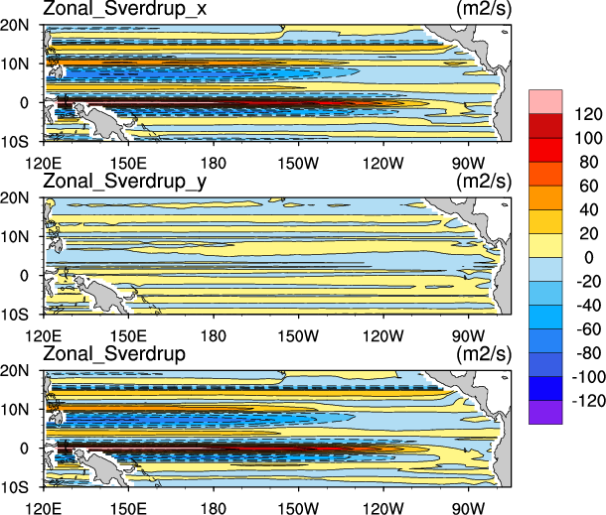



Impact of wind correction
JRA55_do-NC - JRA55_raw-NC
WSC component
Resulting Sverdrup transport
$$−\frac{∂τ_{x}}{∂y}$$
$$\frac{∂τ_{y}}{∂x}$$
$$\frac{∂τ_{y}}{∂x}−\frac{∂τ_{x}}{∂y}$$
Notes:
230:
/ldata4/sunzk/JRA55/after-discussion-data
anomoly-wind-correction.ncl
anomoly-sverdrup-correction.ncl
比较correction和uncorrection的影响

Slide 21
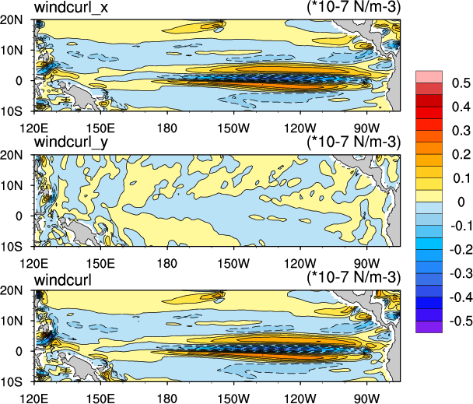
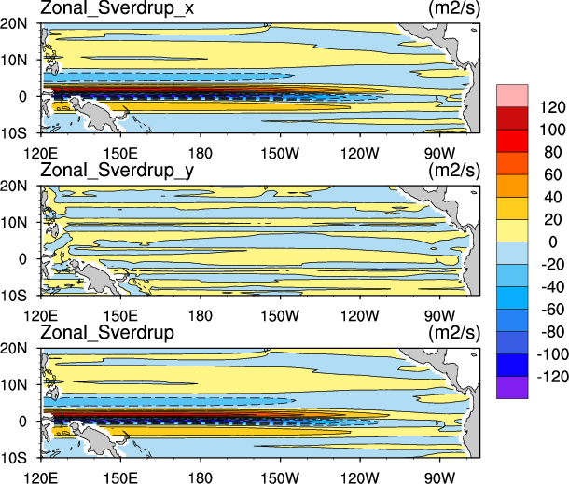
JRA55_do-OC - JRA55_do-NC
WSC component
Resulting Sverdrup transport
Notes:
230:
/ldata4/sunzk/JRA55/after-discussion-data
anomoly-wind-current.ncl
anomoly-sverdrup-current.ncl
比较OC和NC的影响

