Slide 1
Modeling of the north equatorial countercurrent in the Community Earth System Model and its oceanic component
Yu-heng Tseng¹, Zhikuo Sun^{2,3}, Hailong Liu^{2,3}, Pengfei Lin^{2,3} , Justin Small⁴ , Frank Bryan⁴
¹Institute of Oceanography, National Taiwan University, Taiwan
²State Key Laboratory of Numerical Modeling for Atmospheric Sciences and Geophysical Fluid Dynamics, Institute of Atmospheric Physics, Chinese Academy of Sciences, China
³ College of Earth Sciences, University of Chinese Academy of Sciences, China
⁴Climate and Global Dynamics Laboratory, National Center for Atmospheric Research, USA

Slide 2
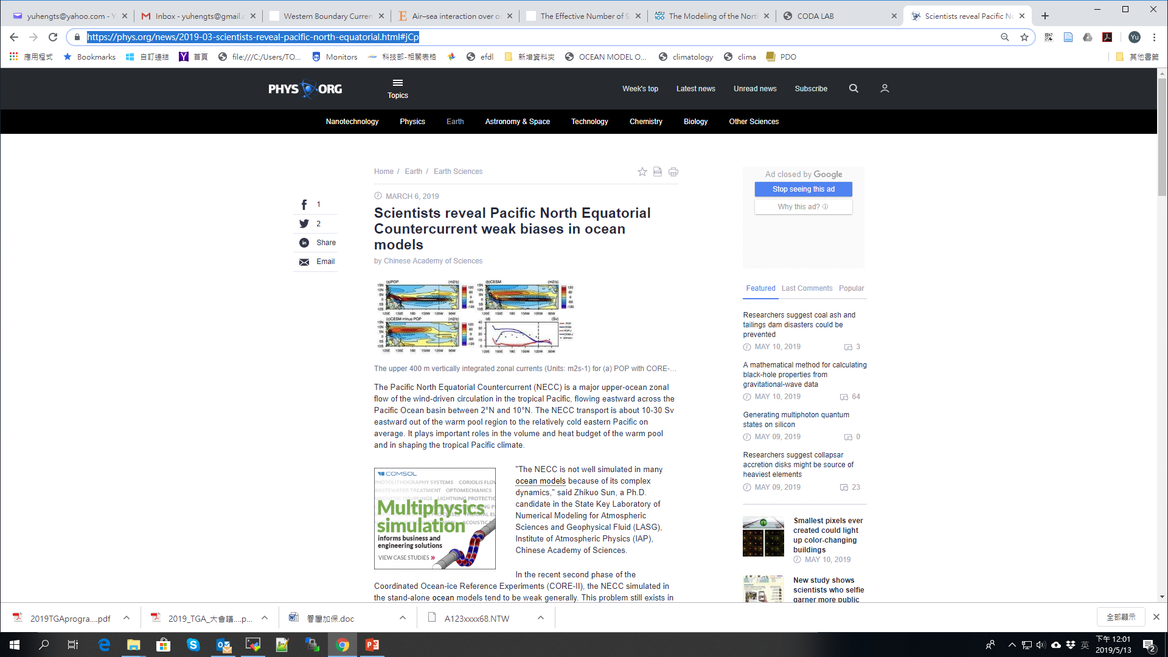
Motivation
Model experiments
Modeled biases in simulating the NECC
Contributions to the biases
Impacts of wind stress
Impacts of wind stress curl (WSC)
Effects of wind correction in CORE‐II data
Conclusion
Phys.org
https://phys.org/news/2019-03-scientists-reveal-pacific-north-equatorial.html#jCp

Slide 3
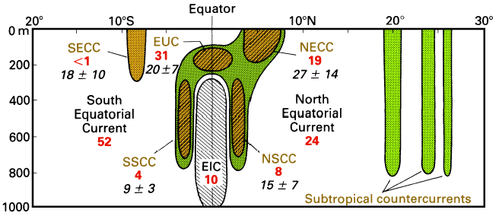
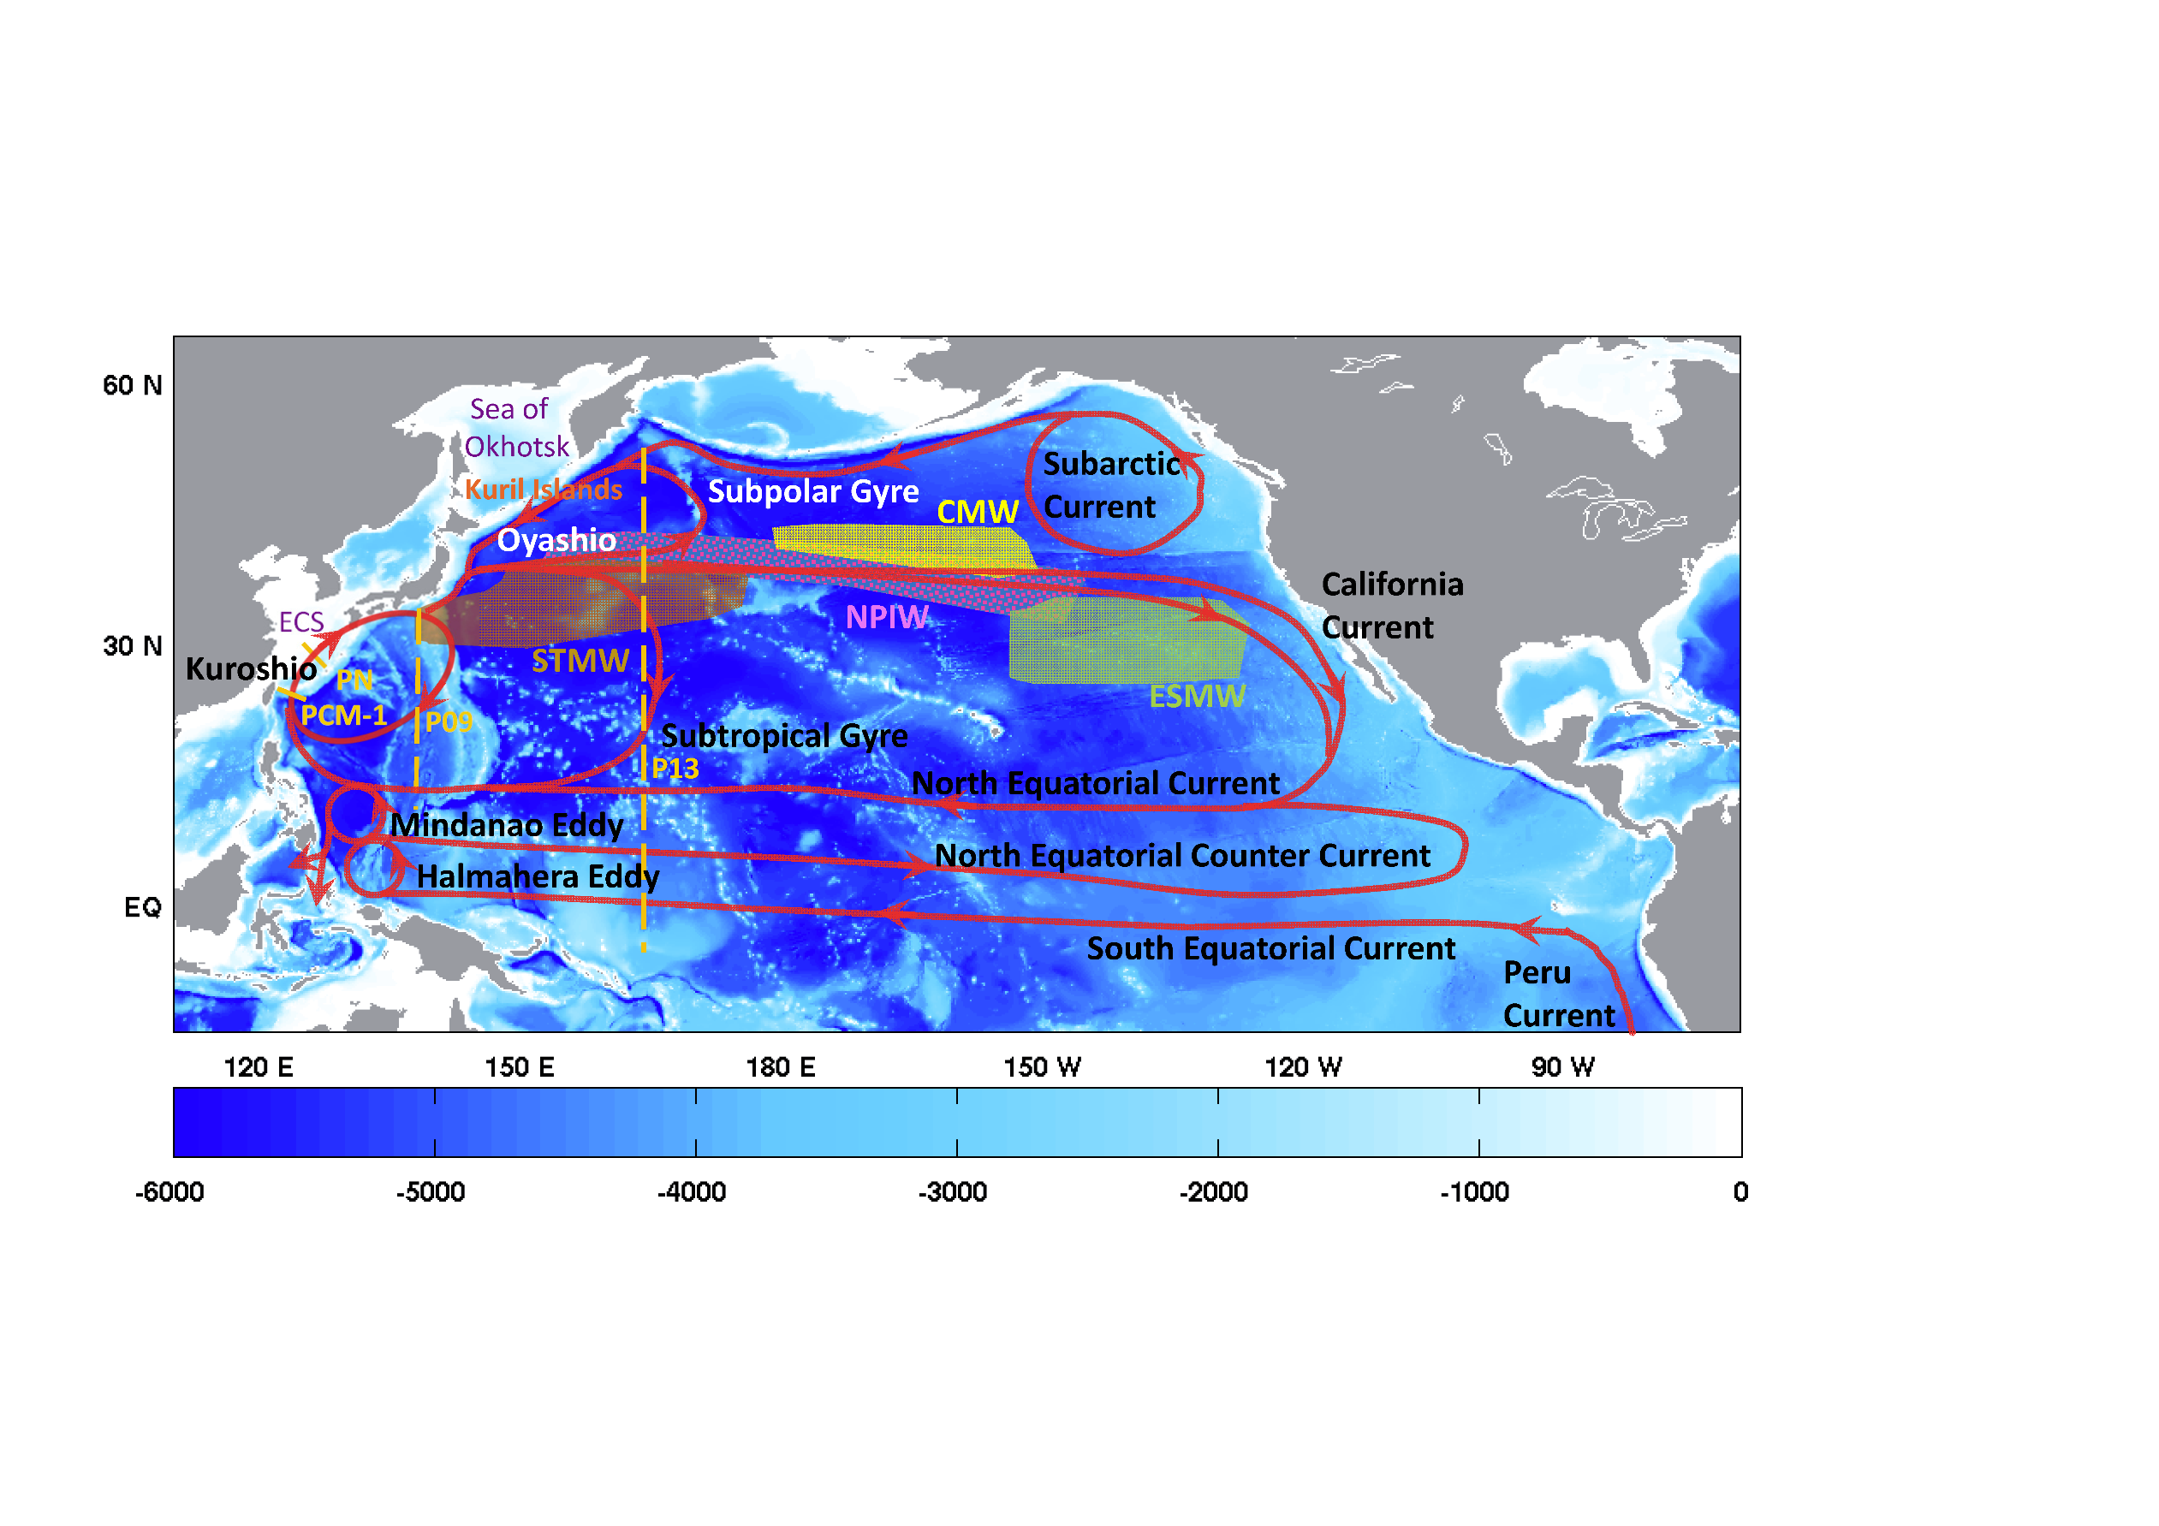
Overview of equatorial currents
Tseng et al. (2016)
Notes:
Meridional section of the upper Pacific ocean (dark shading = eastward; light shading is westward)
All westward flow north of 5°N constitutes the North Equatorial Current, westward flow south of 5°N outside the EIC represents the South Equatorial Current. EUC = Equatorial Undercurrent, EIC = Equatorial Intermediate Current, NECC and SECC = North and South Equatorial Countercurrents, NSCC and SSCC = North and South Subsurface Countercurrents. Transports in Sverdrups are given for 155°W (bold figures; based on observations from April 1979 - March 1980) and 165°E (italics, based on January 1984 - June 1986).

Slide 4
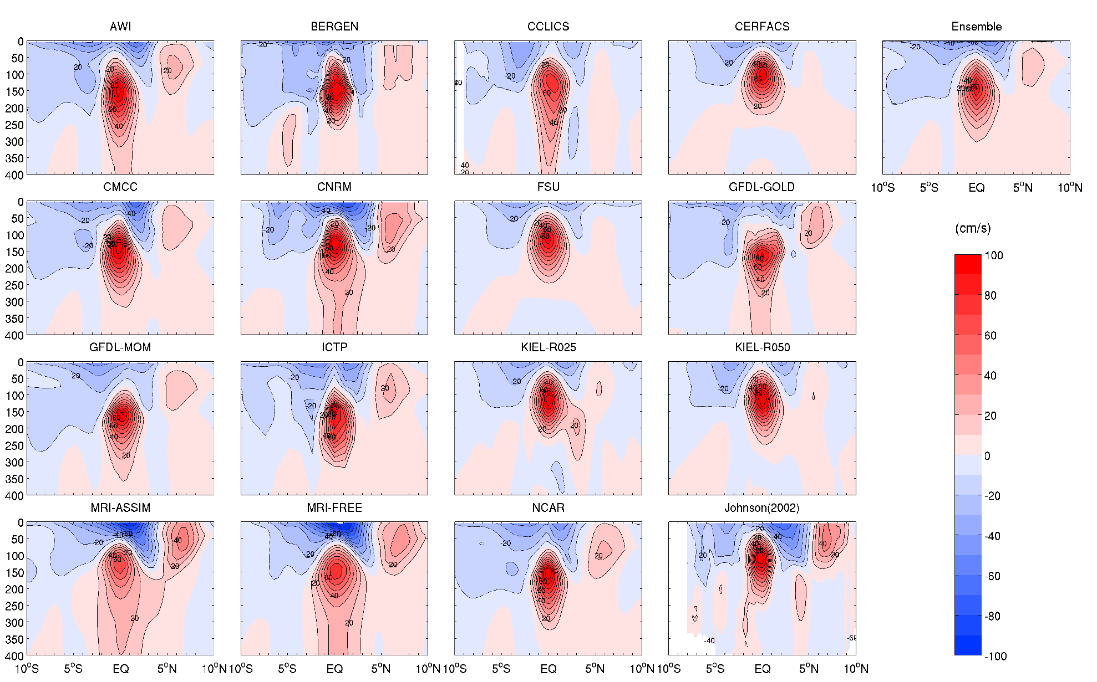
Mean zonal velocity along 140°W in the CORE-II experiments
NECC is generally too weak in all models
SEC
NECC
EUC
Tseng et al. (2016)

Slide 5
Model experiments
Model | Forcing | Integration Time | Used time
CESM(POP-CAM5) | piControl | 2200 | (2141-2200)
POP | COREII (6hr) | 300 | 1978-2007 (271-300)
POP-UNCO | COREII (6hr) without QuikSCAT correction | 300 | 1978-2007

Slide 6
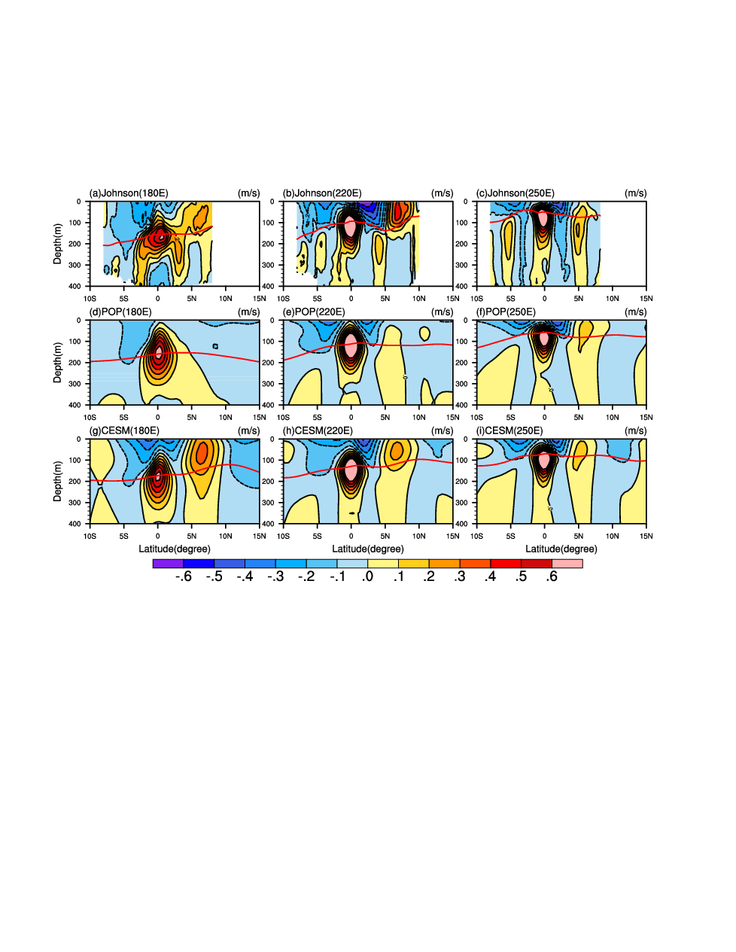
Meridional-vertical sections of mean zonal currents
180E 140W 70W
OBS
POP
NECC is much weaker
CESM
Notes:
Figure 1. Meridional-vertical sections of annual mean zonal currents at (a) 180°E, (b) 220°E and (c) 250°E for Jonhson et al. (2002) observation. d-f and g-i are the same as a-c, but for the POP and CESM, respectively. The contour interval for all panels is 0.1 m s⁻¹. Eastward (westward) velocities are shown as solid (dashed) lines. The red curves are 20°C isotherms. Unit: m s⁻¹

Slide 7
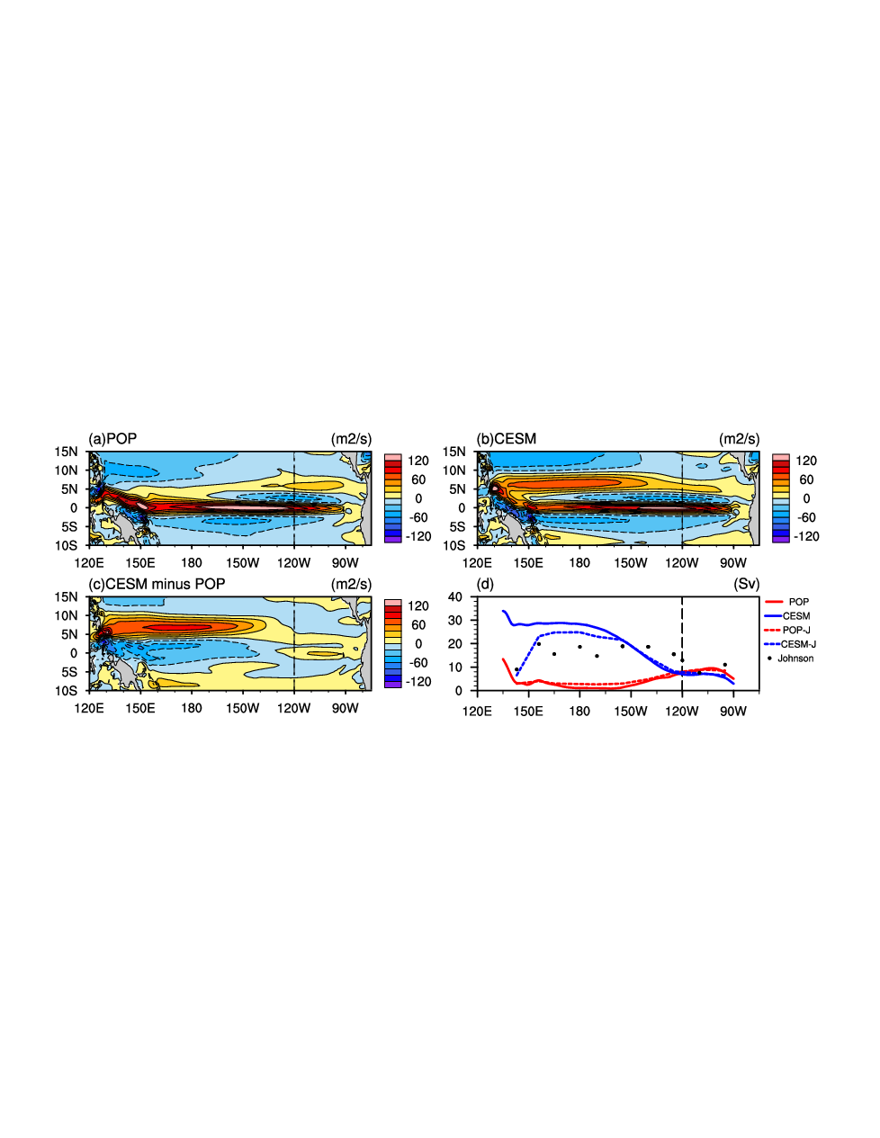
upper 400 m vertically integrated zonal currents
POP
CESM
3°N-10°N
NECC is much weaker in POP
weaker in CESM
Notes:
Figure 2. The upper 400 m vertically integrated zonal currents (Units: m²s⁻¹) for (a) POP with CORE-II forcing, and (b) CESM in the equatorial Pacific. (c) The upper 400 m vertically integrated zonal current difference between CESM and POP. (d) The volume transports of NECC (Unit: Sv), which are defined as the meridionally integrated eastward transport between 3°N-10°N, for POP forced with CORE-II (red solid), CESM (blue solid) and Johnson et al. (2002) observation (black dots). The transports of the NECC masked by the observational sampling are also computed for both POP (red dash) and CESM (blue dash), donated as POP-J and CESM-J.

Slide 8


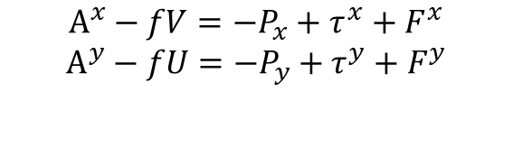




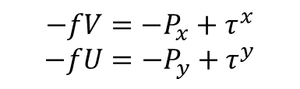
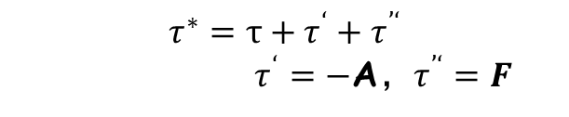
Sverdrup balance Non-linear dynamics
The vertically integrated, time-mean momentum equation：
The advective (A) and friction (F) terms appears as analogs to forcing terms:
$$A^{x}−fV=−P_{x}+τ^{x}+F^{x}$$
$$A^{y}−fU=−P_{y}+τ^{y}+F^{y}$$
$$−fV=−P_{x}+τ^{∗x}$$
$$−fU=−P_{y}+τ^{∗y}$$
Simplified equation (linearization):
defined as a generalized stress:
$$−fV=−P_{x}+τ^{x}$$
$$−fU=−P_{y}+τ^{y}$$
$$τ^{∗}=τ+τ^{‘}+τ^{’‘}$$
$τ^{‘}$ $=−$A，$τ^{’‘}=F$
The vertically integrated mean continuity equation:
The derived Sverdrup balance formula:
Sverdrup balance：
$$βV^{∗}=curl\left(τ^{∗}\right)$$
$β$V=curl($τ$)
The Sverdrup zonal transport:
The Sverdrup zonal transport：
$$U^{∗}=U+U^{′}+U^{′′}$$
$$U=−\frac{1}{β}\int_{EB}^{x}{{curl(τ)}_{y}dx+U_{EB}(y)}$$
quantitatively diagnoses the individual contributions
(Kessler et al., 2003)
Notes:
Now I introduce a mrthod proposed by Kessler et al in the year of 2003.
In the open ocean, The advective term and horizontal turbulent viscosity term is omitted as small terms.(大洋内区，平流项和水平湍流粘性项为小项被省略)
This a classic derivation of Sverdrup balance formula, but Kessler made some adjustments in the derivation of equation. $τ^{∗}$is the sum of three forcing terms.

Slide 9
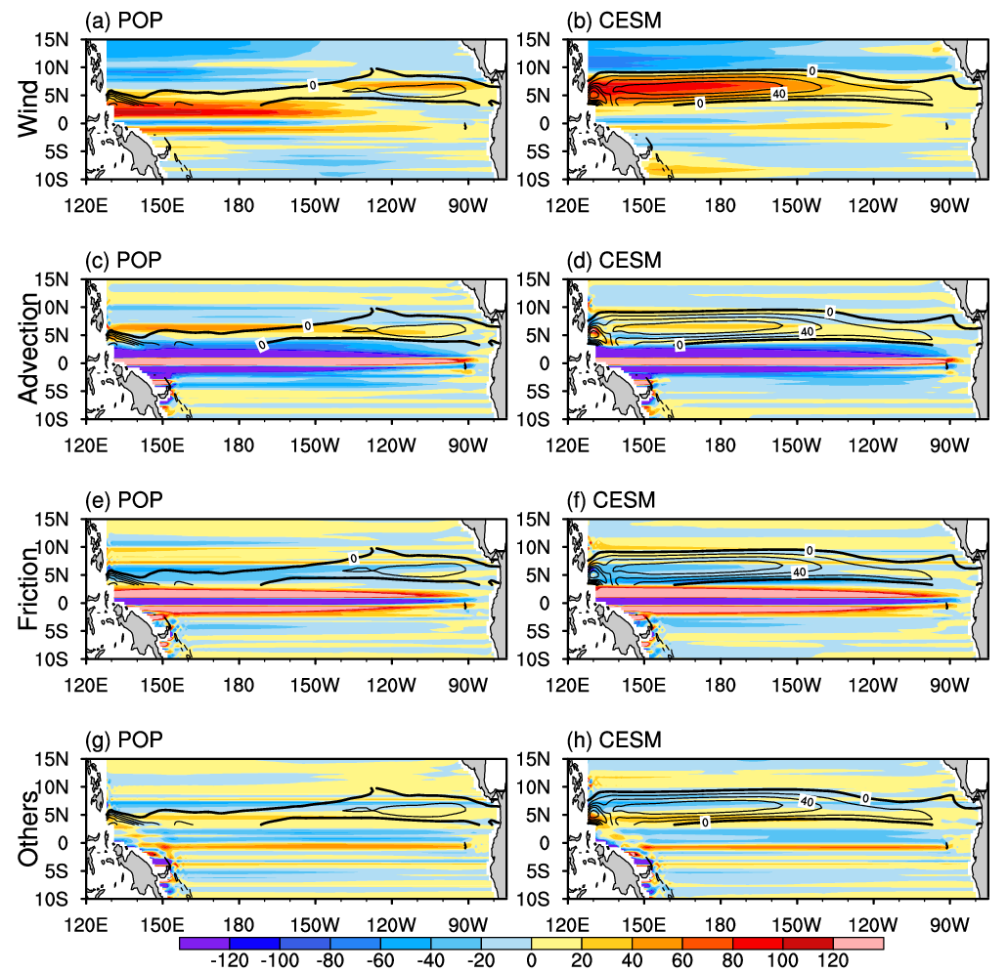
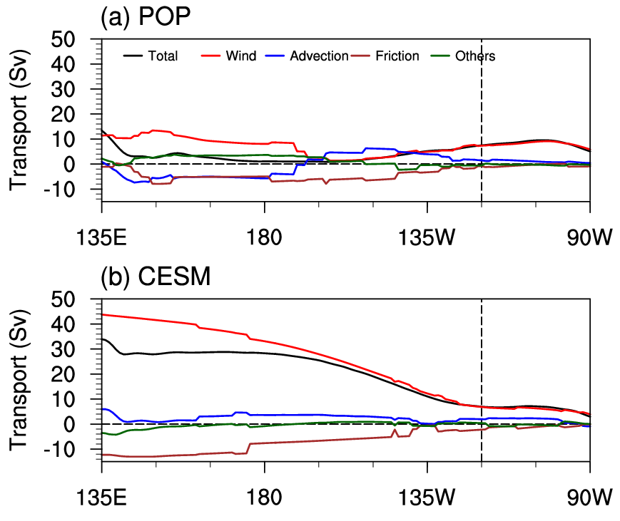




zonal transport (m²/s) due to different terms
POP
CESM
$τ^{}$ = wind stress
NECC is dominated by the wind stress (larger than the total)
$τ^{′}$ = advection
$τ^{′}$’ = friction
$τ^{′′′}$ = others
Notes:
Figure 3. The zonal transport per grid due to (a) wind stress, (c) advection, (e) friction and (g) other terms in the tropical Pacific for POP. (b), (d), (f) and (h) are the same as (a), (c), (e) and (g), but for CESM. Unit: m²s⁻¹. The contours are the eastward ocean current between 3°N-10°N for total transport which is shown in Figure 2a (for POP) and 2b (for CESM). The contour interval is 20 m²s⁻¹. The zero line is bolded.
For both CORE‐II forced and coupled experiments, the patterns and magnitudes look similar between the wind stress term (Figures 3a and 3b) and the total transport (Figures 2a and 2b), confirming the key role of the wind stress on the NECC simulation. However, there are evident differences. The maximum zonal Sverdrup transport of the NECC due to wind stress is larger than that of the total transport for both experiments, 40 Sv (wind) versus 20 Sv (total) for POP and 80 Sv (wind) versus 60 Sv (total) for CESM. We also find that the eastward transport resulting from the WSC exists in the western equatorial Pacific in the POP experiment (Figure 3a), but the location is too far south and close to the equator.

Slide 10
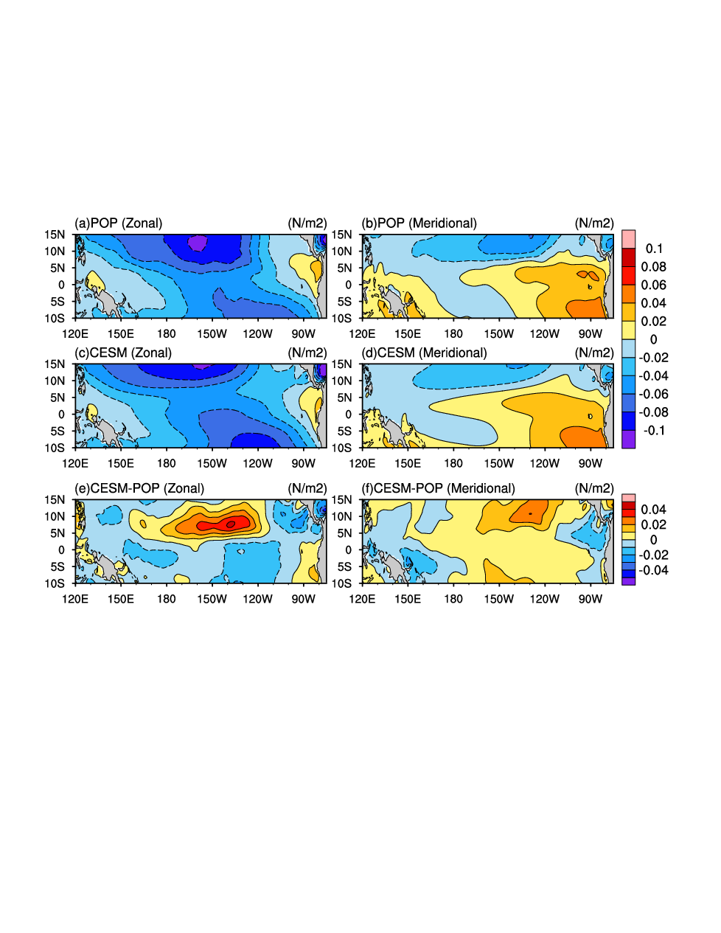
Differences between CESM and POP
Mean zonal wind stress
Small structure differences
easterly trade winds are much stronger
Notes:
Figure 5. Mean zonal wind stress for (a) POP, (c) CESM and (e) the different between CESM and POP (CESM-POP). (b)(d)(f) are the same as (a)(c)(e), but for meridional wind stress. Unit: N m⁻²
There are some small structures along the coast of the Central America in the CESM experiment around 10°N (Figure 5c), which are absent in the POP experiment. This relates to the winds from the Atlantic to the Pacific through the three major gaps of the Central American cordillera: at the isthmus of Tehuantepec, over Lake Nicaragua, and at Panama (Xie et al., 2005).

Slide 11
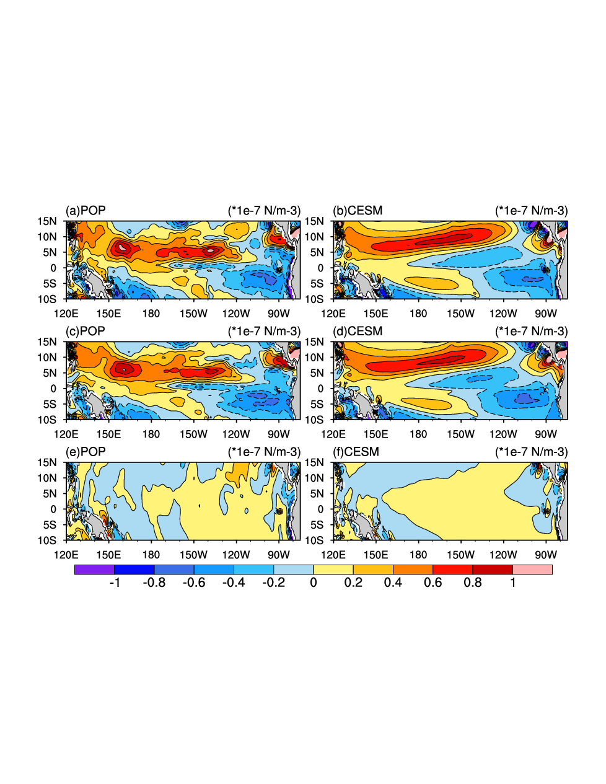
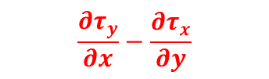


Contribution to the biases: west of 120°W
Climatological WSC and its components
$$\frac{∂τ_{y}}{∂x}−\frac{∂τ_{x}}{∂y}$$
$$−\frac{∂τ_{x}}{∂y}$$
Dominant by the zonal component
$$\frac{∂τ_{y}}{∂x}$$
Meridional component important in eastern and western boundaries
Notes:
Figure 6. Mean (a) WSC, the WSC due to (c) the zonal ($−\frac{∂τ_{x}}{∂y}$) and (e) the meridional ($\frac{∂τ_{y}}{∂x}$) wind stresses for POP. (b)(d)(f) are the same as (a)(c)(e), but for CESM. Unit: 10⁻⁷ N m⁻³
According to equation 5, the meridional derivative of the WSC, curl(τ)_{y}, is the dominant term for the zonal Sverdrup transport. Therefore, the positive values of curl(τ)_{y} follows the southern edge of the positive WSC belt in Figure 6, which may contribute to the large zonal transport differences west of 120°W.

Slide 12
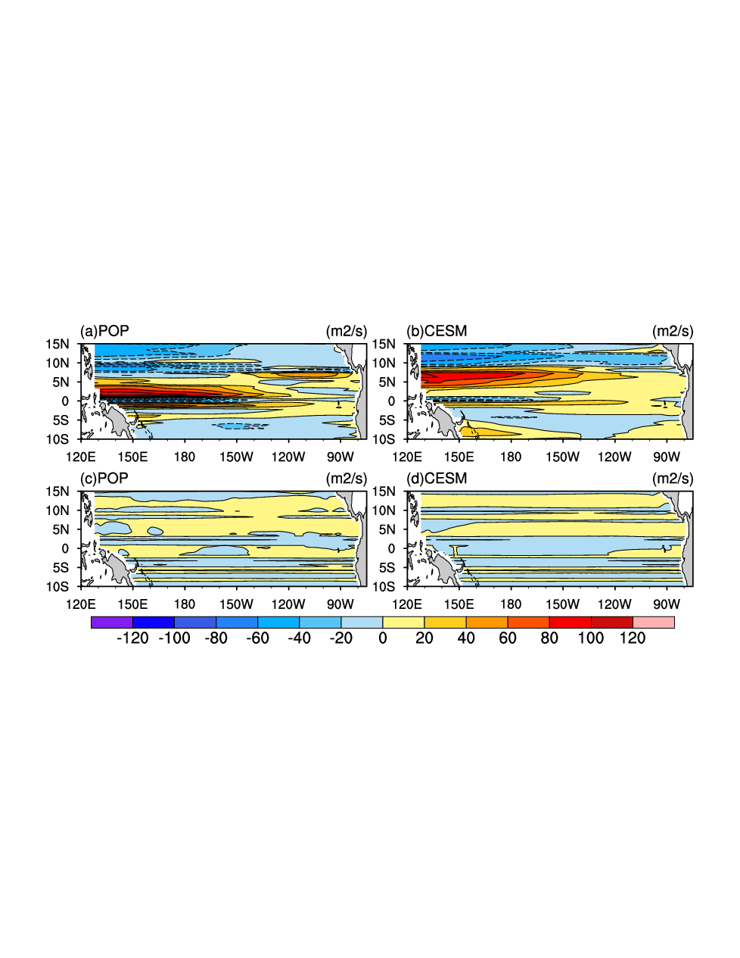


Contribution to the biases: west of 120°W
The zonal Sverdrup transport due to different wind stress components
Dominated by the zonal component
$$−\frac{∂τ_{x}}{∂y}$$
$$\frac{∂τ_{y}}{∂x}$$
Notes:
Figure 7. The zonal Sverdrup transport due to (a) zonal ($−\frac{∂τ_{x}}{∂y}$) and (c) meridional ($\frac{∂τ_{y}}{∂x}$) wind stresses for POP. (b)(d) are same as (a)(c), but for CESM. Unit: m² s⁻¹

Slide 13
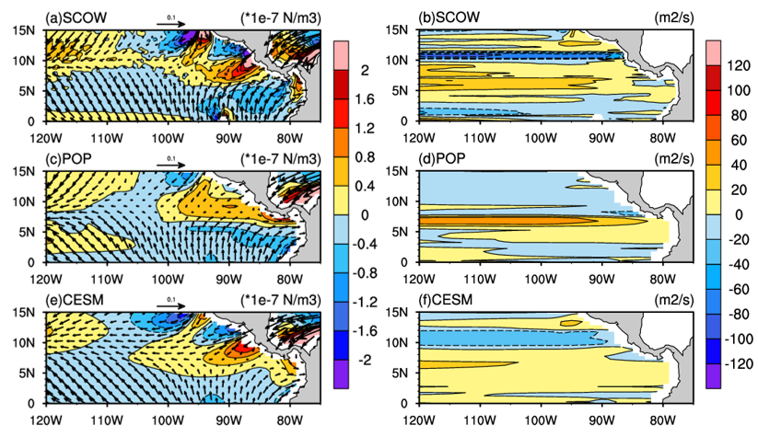
Contribution to the biases: east of 120°W
Wind stress+WSC
Zonal Sverdrup transport
+/-WSC formed on the south/north of the northeasterly jets.
Poorly resolved gap winds in COREII data
More realistic WSC (but still weaker)
Weaker southerly wind results in a small WSC gradient
steady westward accumulation of curl(τ)_{y}
Notes:
Figure 8 (a) the wind stress (vector), the WSC (shade), and (b) the associated zonal Sverdrup transport in the eastern equatorial Pacific for SCOW. (c)(d) are same as (a)(b), but for POP. (e)(f) for CESM. The units are N/m², 10⁻⁷ N/m³ and m²/s for the wind stress, WSC and the Sverdrup transport, respectively.
Due to the northeasterly gap winds crossing the Central America and southerly winds crossing the equator, the biases east of 120°W are different from its western side.
Negative (positive) WSC is formed on the northside (southside) of the northeasterly jets. The offshore positive WSC over 5°–10°N results from the competition between the northeasterly winds through the middle passage over Lake Nicaragua, and the southerly winds crossing the equator.
the gap winds are poorly resolved in the CORE‐II product, based on NCEP/NCAR reanalysis winds (resolution: 2.5°) and the WSC formed on the two sides of the northeasterly jets is very different to SCOW: the strength of WSC is weak and the direction of positive WSC is zonal. The CESM coupled model has higher resolution of these features than CORE‐II forcing data and has gap wind and WSC pattern more similar to SCOW, but the magnitude is still weaker, which may be attributed to the unrealistic topography of the Central American cordillera. At the same time, the relatively weak cross‐equatorial wind in CESM results in a small WSC gradient and thus the weak NECC in this region. The difference of gap wind and WSC pattern between the POP experiment and SCOW is bigger than between the CESM experiment and SCOW. The stronger Sverdrup transport of the POP experiment is a consequence of the steady westward accumulation of curl(τ)_{y} with longitude at around 7°N which is not physically realistic.

Slide 14
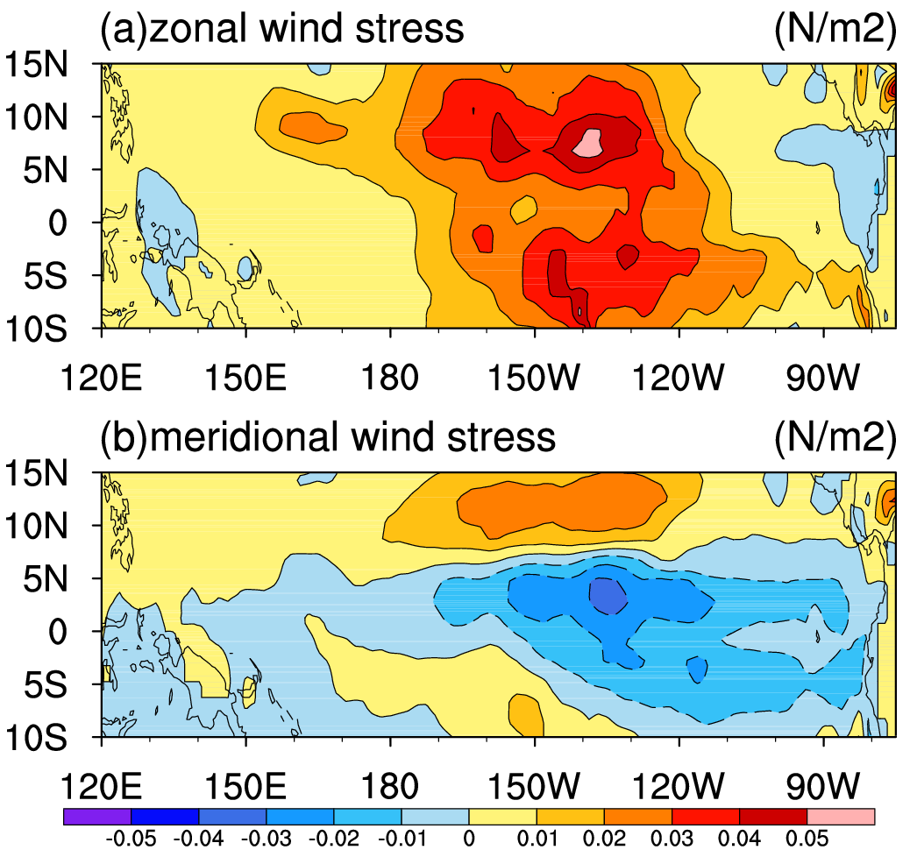
Differences of wind stress between the uncorrected and corrected COREv2 data (uncorrected minus corrected).
Zonal
ρ_{a} is the atm density, C_{DN} is the neutral 10m drag coefficient
10m neutral winds: the winds that would have occurred for a given stress if the air‐sea interface was neutrally stable (no buoyancy stratification at surface: e.g., no air‐sea potential temperature difference, and air humidity equal to saturated humidity at the sea surface temperature).
Meridional
Wind speed correction offset
Notes:
Figure 9 The differences of (a) zonal and (b) meridional wind stress between the uncorrected and corrected COREv2 data (uncorrected minus corrected). Unit: 10⁻² N m⁻²
QuikSCAT estimates the equivalent 10m neutral wind (Chelton et al., 2001; Liu & Tang, 1996; Wentz & Smith, 1999), and so a possible source of error is that in CORE the NCEP/NCAR actual 10m winds are corrected toward QuikSCAT equivalent neutral 10m winds. Equivalent neutral 10m winds ( ) are most commonly defined as the winds that would have occurred for a given stress if the air‐sea interface was neutrally stable (no buoyancy stratification at surface: e.g., no air‐sea potential temperature difference, and air humidity equal to saturated humidity at the sea surface temperature, see, e.g. Liu & Tang, 1996). The rationale for providing equivalent neutral 10m winds from satellite scatterometer is as follows: the scatterometer measures backscatter from surface capillary waves which closely depend on the surface stress; and equivalent neutral 10m winds have a direct, one‐to‐one relationship with surface stress (Kelly et al., 2001; Liu & Tang, 1996).
Hence, QuikSCAT measurements are affected by the difference between wind and ocean current. Further, many ocean models, including POP in these experiments, feed their surface current into the surface bulk flux calculations, and if the QuikSCAT data are used to correct the NCEP/NCAR 10m winds used for forcing, the ocean surface current effect on surface stress will be double counted.
In regions of an unstable air‐sea interface, including much of the global ocean, particularly in the Tropics (e.g., Warm Pool) and western boundary currents in winter, the equivalent neutral 10m winds are stronger than the actual winds, typically by a few tens of centimeters per second (Liu & Tang, 1996), but with stronger effects at very low wind speeds. Thus, by adjusting the NCEP/NCAR reanalysis actual winds toward the QuikSCAT neutral 10m wind product, the wind speed is spuriously increased in these unstable regions. The corrected winds are treated as “actual winds” when forcing ocean models, and thus may be too strong in these regions.

Slide 15
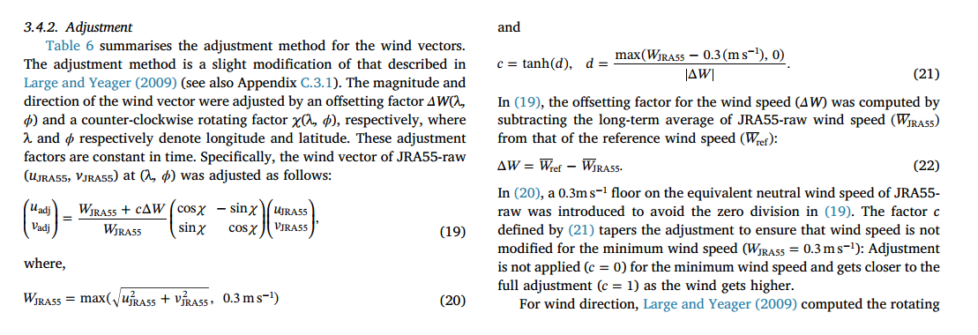
(Tsujino et al., 2018)

Slide 16
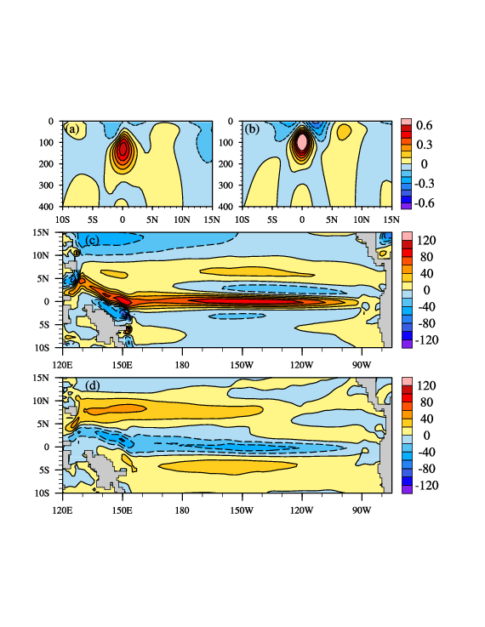
Sensitivity of uncorrected winds
POP-UNCO
180E 140W
zonal currents (upper 400m)
Stronger NECC
Enhanced NECC strength
Notes:
Figure 10. (a) Meridional-vertical sections of annual mean zonal currents at (a) 180°E, (b) 220°E for POP-UNCO, respectively. The contour interval for all panels is 0.1 m s⁻¹. Eastward (westward) velocities are shown as solid (dashed) lines. Unit: m/s. (c) The upper 400 m integrated zonal currents (Units: m² s⁻¹) for POP-UNCO. (d) The upper 400 m integrated zonal currents difference between POP-UNCO and POP. Unit: m² s⁻¹.

Slide 17

Conclusion
Different model biases at the west/east of 120°W in simulating the NECC between the POP (ocean only) and CESM (coupled).
West of 120°W: NECC transport is underestimated in POP
East of 120°W: NECC transport is underestimated in CESM
West of 120°W: biases in the POP attributed to the southward movement of the maximum easterly trade winds in the NH
comes mainly from the correction of NCEP/NCAR data to QuikSCAT equivalent neutral 10m winds
East of 120°W: biases in the CESM attributed to the weak cross‐equatorial southerly winds and northeasterly gap winds.
For POP, the strong eastward transport results from a wrong reason

Slide 18
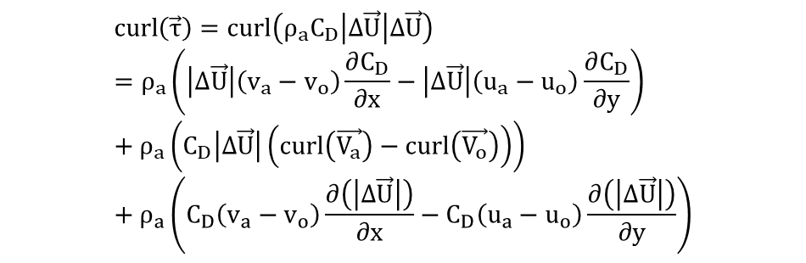

The data I use:
The average of 2006-01-01 ~ 2006-01-05 (5 days) of these three data
Raw JRA-55 (u_10,v_10,q_10,t_10,slp)
OSCAR surface current (Uo, Vo)
(3) OISST (SST)
Because the time resolutions of JRA-55, OSCAR and OISST are 3 hours, 5 day and 1 day.
So I process the JRA-55 and OISST to 5 days average.
$$curl\left(\vec{τ}\right)=curl\left(ρ_{a}C_{D}\left|∆\vec{U}\right|∆\vec{U}\right)=ρ_{a}\left(\left|∆\vec{U}\right|\left(v_{a}−v_{o}\right)\frac{∂C_{D}}{∂x}−\left|∆\vec{U}\right|\left(u_{a}−u_{o}\right)\frac{∂C_{D}}{∂y}\right)+ρ_{a}\left(C_{D}\left|∆\vec{U}\right|\left(curl\left(\vec{V_{a}}\right)−curl\left(\vec{V_{o}}\right)\right)\right) +ρ_{a}\left(C_{D}\left(v_{a}−v_{o}\right)\frac{∂\left(\left|∆\vec{U}\right|\right)}{∂x}−C_{D}\left(u_{a}−u_{o}\right)\frac{∂\left(\left|∆\vec{U}\right|\right)}{∂y}\right)$$
A term
B term
C term = ${− ρ}_{a}C_{D}$curl$\left(\vec{V_{o}}\right)$
D term
Notes:
NCAR
/glade/u/home/zhikuos/data/code
3hour_to_month.sh 把JRA数据、OSCAR都处理成月数据
OISST数据来自于230服务器：/ndata3/OBS_data/OBS/OISST_daily/ 先处理成月数据，再进行传输。
TAU_CD_calculate-1.ncl 画图

