Slide 1
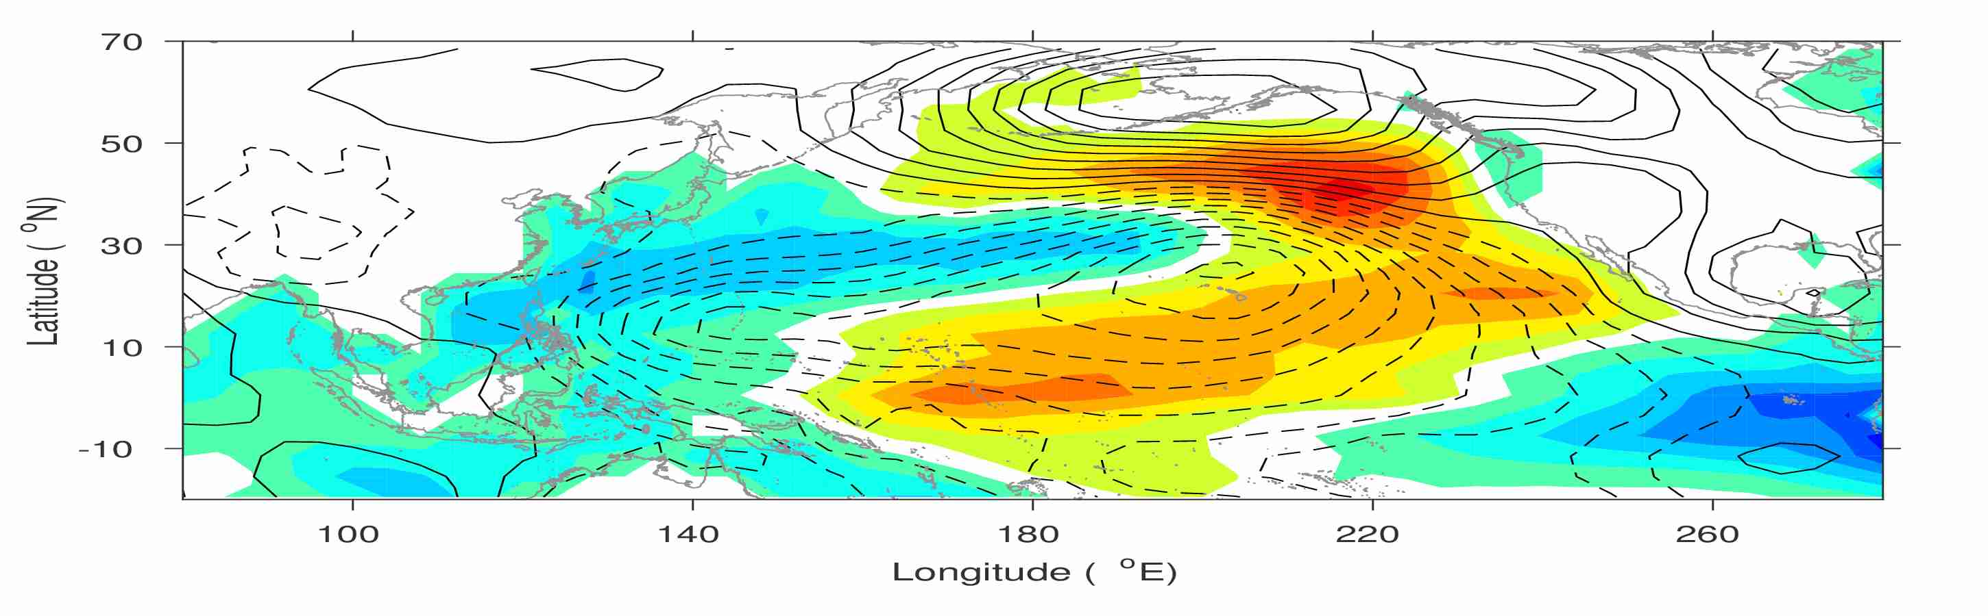
Yu-heng Tseng
Institute of Oceanography, National Taiwan University
New North Pacific climate paradigm
Miller et al. (2017)

Slide 2
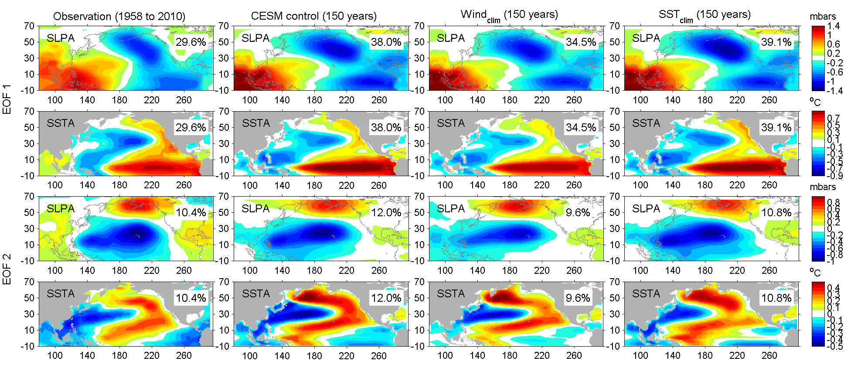
The dominant surface pattern and variability in the North Pacific-1st mode
The covariability mode of SLP and SST anomalies from the CEOF1 analysis
Obs: NCEP reanalysis,
ERSST (1958-2010),
Model: CESM1.0.5 (150 yr)
Aleutian Low (AL)
PDO/ENSO
Miller et al. (2017)
Notes:
the Seasonal Footprinting Mechanism: boreal winter-time variability in the NPO drives warm SST anomalies in the North Pacific that propagate into the central tropical Pacific by end of spring/summer through the wind/evaporation/SST (WES) feedback.
Both PDO and NPGO are to 1st order the oceanic expressions of the atm. Forcing associated with AL and NPO.
EPW->AL->PDO (Alexander 1992; 2002; Newman et al., 2003).
CPW->NPO->NPGO (Di Lorenzo 2010)

Slide 3
The dominant surface pattern and variability in the North Pacific-2nd mode
The covariability mode of SLP and SST anomalies from the CEOF2 analysis
North Pacific Oscillation (NPO)
Victoria Mode (VM) or NPGO
Miller et al. (2017)
Notes:
CEOF for the SLP and SST

Slide 4
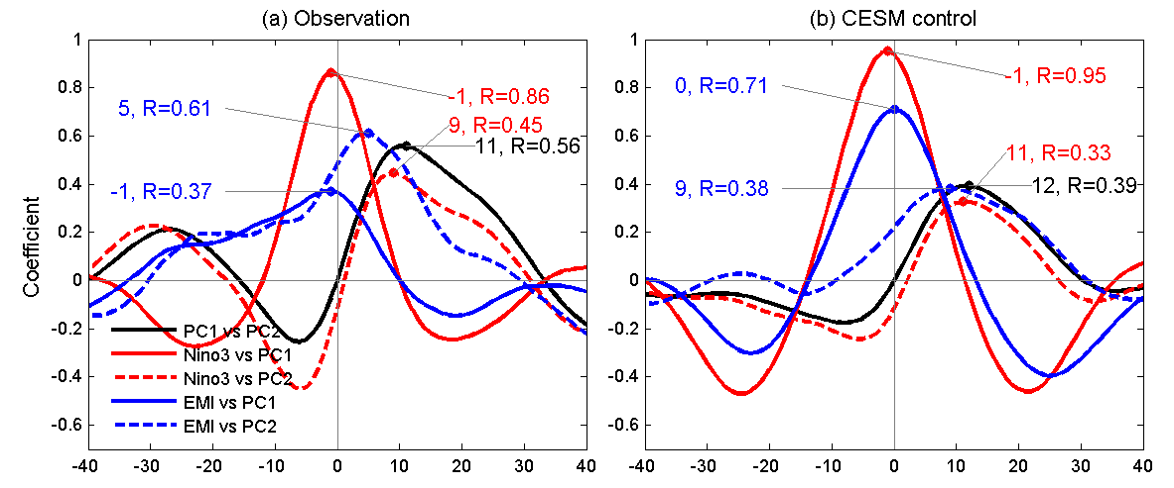
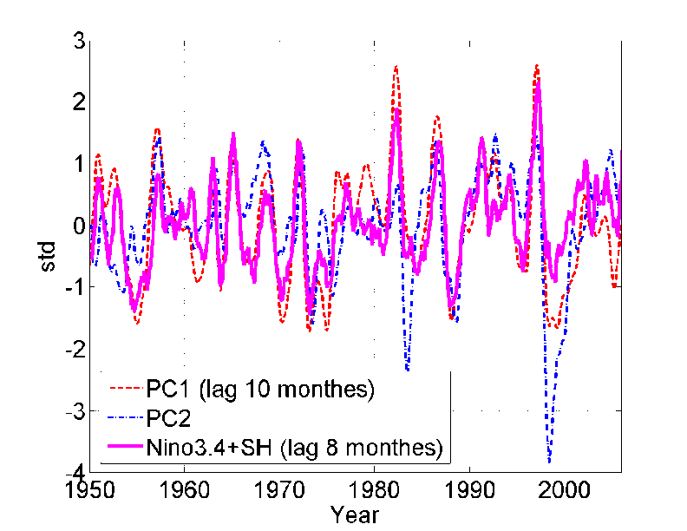
Links between the two dominant CEOF modes
Lag-correlation between Niño3 (and EMI index) and PC1/PC2 of the CEOF
PC1 is essentially ENSO
PC2 leads PC1/Nino3 by 9-11 months
PC2 leads EMI by 5 months
PC2 (NPO/VM): important ENSO precursor

Slide 5
Yu-heng Tseng
Institute of Oceanography, National Taiwan University
New North Pacific climate paradigm
Miller et al. (2017)
Hu et al. (2017a; 2017b)
Chen et al. (2015, 2018); Tseng et al. (2017a);

Slide 6
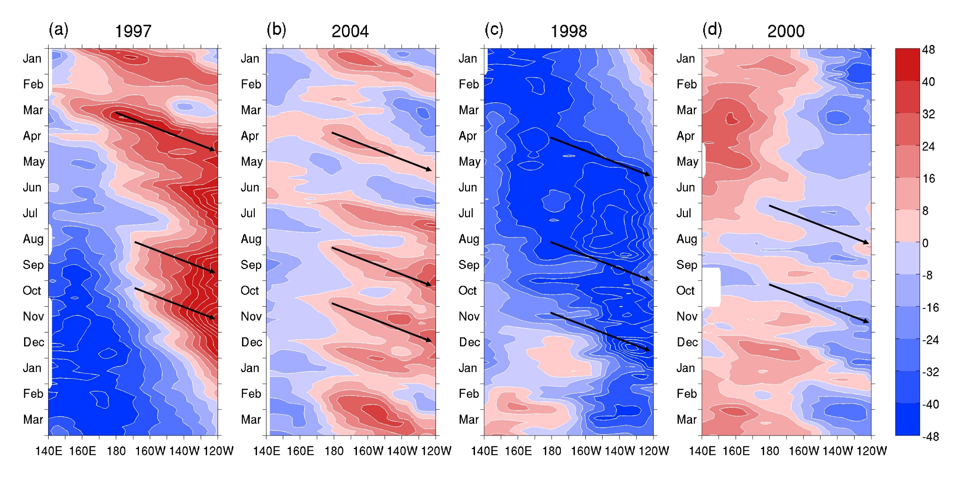
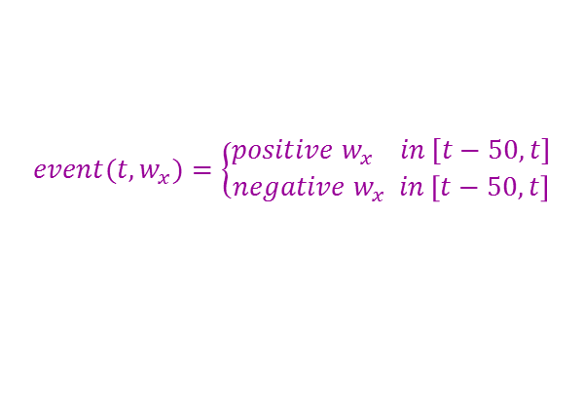
Simple ENSO prediction scheme
$$nEPI(t)={αnEPI}_{WWV}\left(t\right)+βn{EPI}_{O−A}(t)$$
(Tseng et al. , 2017a)
$${nEPI}_{WWV}(t)=\text{α}\text{1}D20a\text{180˚(}\text{t}\text{−}\text{25)}+\text{α}\text{2}D20a\text{170˚}\text{W}\text{(}\text{t}\text{−}\text{15)}+\text{α}\text{3}D20a\text{155˚}\text{W}\text{(}\text{t}\text{)}$$
$${nEPI}_{O−A}\left(t,{nEPI}_{WWW}, w_{x}\right)=sign\left(event\left(t,w_{x}\right)\right)∙dH(t,{nEPI}_{wwv})$$
$$event(t,w_{x})=\left\{\begin{aligned}positive w_{x} in [t−50,t] \\ negative w_{x} in \left[t−50,t\right]\end{aligned}\right.$$
$$dH\left(t,{nEPI}_{wwv}\right)=\left\{\begin{aligned}\frac{[\left\|{nEPI}_{wwv}\left(t\right)−{nEPI}_{wwv}\left(t−5\right)\right\|+\left\|{nEPI}_{wwv}\left(t−5\right)−{nEPI}_{wwv}\left(t−10\right)\right\|]}{2}, 1/2≤P(event(t,w_{x})) \\ 0 , P\left(event(t,w_{x})\right)<1/2\end{aligned}\right.$$
Notes:
Figure 1: Evolution of D20a for (a) 1997/1998 (strong El Niño), (b) 2004/2005 (weak El Niño), (c) 1998/1999 (strong La Niña), and (d) 2000/2001 (weak La Niña) based on the observed pentad mean TAO data. The arrows indicate some events of eastward propagating Kelvin waves (the slope shown is 40˚/month for reference).

Slide 7
Hindcast skills
Multi-model ensemble mean skill (Barnston et al., 2012)
Lead time | Data source | Year | Correlation |  | Normalized RMSEs
 |  |  | nEPI | WWV | nEPI | WWV
four-month | TAO | 1994-2015 | 0.75 | 0.70 | 0.66 | 0.72
six-month | TAO | 1994-2015 | 0.67 | 0.62 | 0.75 | 0.78
 | TAO | 2002-2011 | 0.59 (0.42) |  | 0.81
 | GODAS | 1980-2015 | 0.64 |  | 0.77
 | GODAS | 1981-2010 | 0.68 (0.65) |  | 0.73
eight-month | TAO | 1994-2015 | 0.57 | 0.49 | 0.82 | 0.87
 | GODAS | 1980-2015 | 0.58 |  | 0.79
Percent correct of six-month ENSO forecast
ENSO index threshold | Percent correct 1994-2015 (TAO) | Percent correct 1980-2015 (GODAS)
+ Niño3.4 index | 100% (67%) | 68%
− Niño3.4 index | 83% (75%) | 87%
upper tercile Niño3.4 index (El Niño) | 86% (57%) | 73%
lower tercile Niño3.4 index (La Niña) | 86% (71%) | 82%
(Larson and Kirtman, 2014)
Using WWV
Notes:
Table 1: The hindcast skills (correlation and normalized RMSE) using the monthly data based on the linear regression model and the WWV, respectively. Values in parentheses are the ensemble-mean skill in Barnston et al. (2012).
Table 2: Percent correct of six-month ENSO forecast (see Larson and Kirtman, 2014 for the metric definition). Values in parentheses are the percent correct predicted by the WWV.

Slide 8
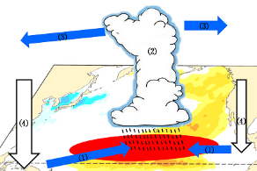
Yu-heng Tseng
Institute of Oceanography, National Taiwan University
New North Pacific climate paradigm
Miller et al. (2017)
Ding et al. (2015a); Tseng et al. (2017b)
Tropical-extratropical interaction
Ding et al. (2015b)
Hu et al. (2017a; 2017b)
SFM
Chen et al. (2015, 2018); Tseng et al. (2017a);

Slide 9
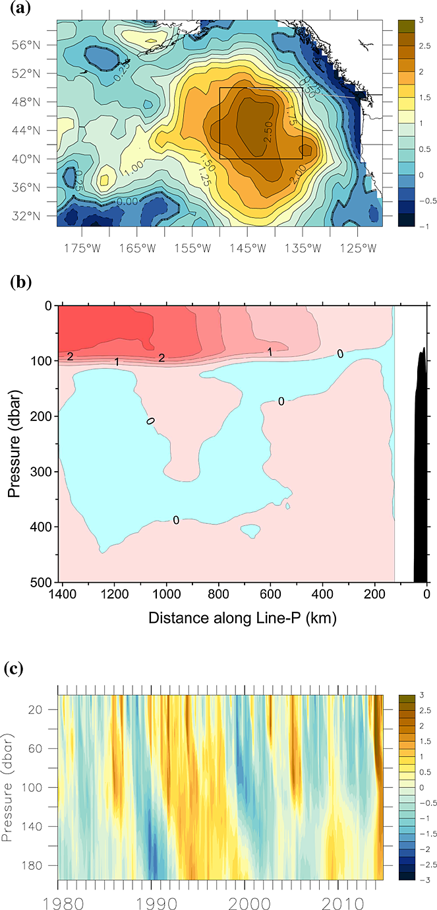
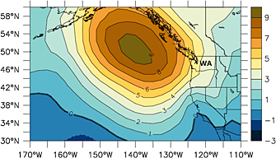
Warm Blob in the Northeastern Pacific after late 2013
Mean SLPa (hPa) in the NE Pacific Ocean for 2013/10-2014/1
SSTa (°C) in NE Pacific Ocean for Feb. 2014
Normalized monthly T_{anom.}
Upper ocean T_{anom.} along “Line P”
Great impacts on the ocean ecosystem and U.S. climate
Bond et al. (2015)
Notes:
An extremely warm ocean sea surface temperature (SST) event has been observed in the northeastern Pacific since late 2013. The warm SST anomaly, named “the Blob”, reaches 2.5 °C higher temperature than the climatological mean SST in a few extratropical regions of the North Pacific and is prominent in the south of the Gulf of Alaska. The warm Blob has drawn much attention. The 2014-2015 Pacific Anomalies Workshop (http://sccoos.org/projects/anomalies_workshop/) and a specific session at the 2016 Ocean Science Meeting were held at the Scripps Institution of Oceanography, La Jolla, CA and in New Orleans, LA, respectively, to discuss the associated causes, dynamics and extensive impacts of the Blob. Bond et al. [2015] attributed the development of the Blob to strongly positive Sea Level Pressure (SLP) anomalies above the Gulf of Alaska, which suppress the local ocean heat loss in the atmosphere. As we will show later, the described mechanism resembles the typical strengthened northern lobe of the North Pacific Oscillation/West Pacific (NPO/WP) [Rogers, 1981; Linkin and Nigam, 2008; Baxter and Nigam, 2015] on the northeastern Pacific. Hereafter, seasons refer to those of the Northern Hemisphere.

Slide 10
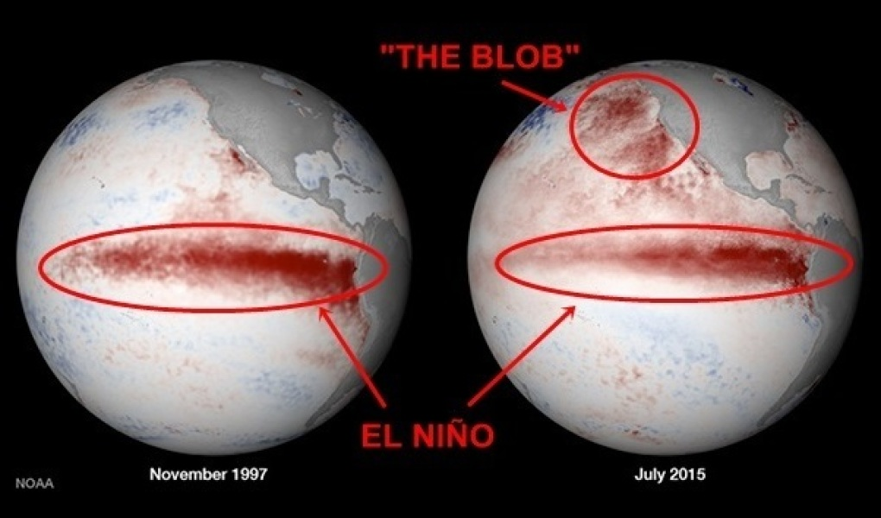
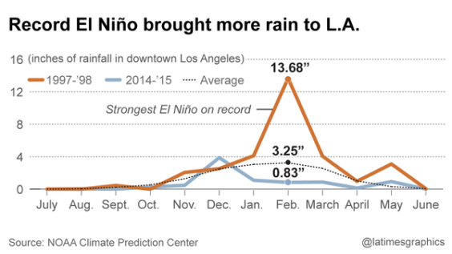
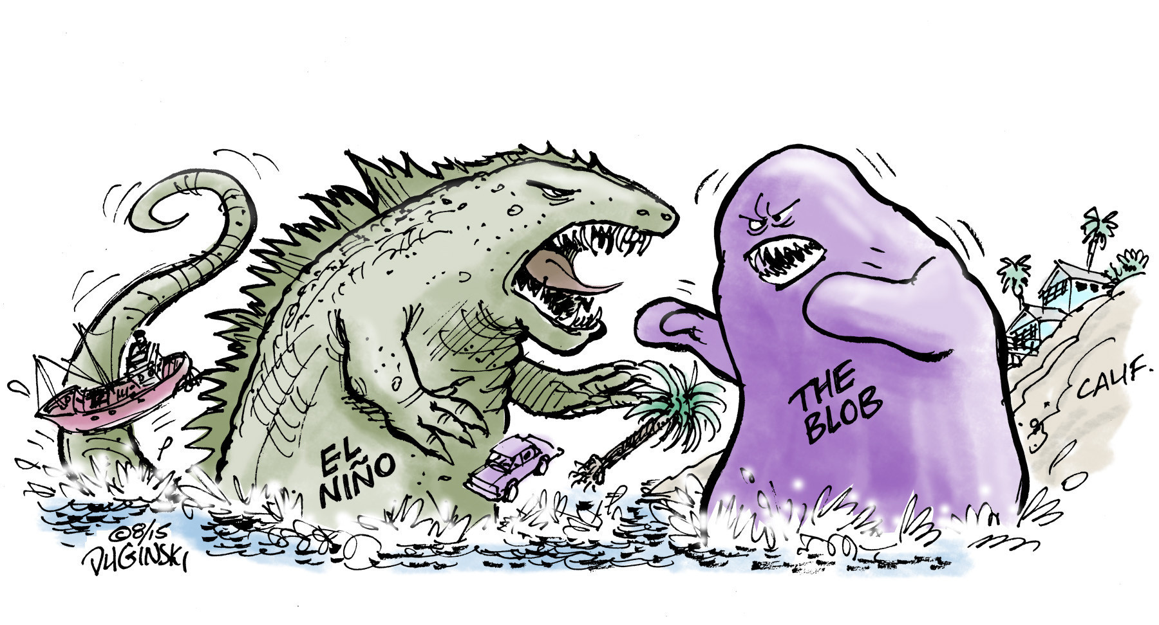
Ski Utah
https://www.skiutah.com/blog/authors/yeti/el-ni-o-vs-the-blob
LA Times
http://www.latimes.com/local/lanow/la-me-ln-godzilla-el-nino-winter-california-20150821-htmlstory.html

Slide 11
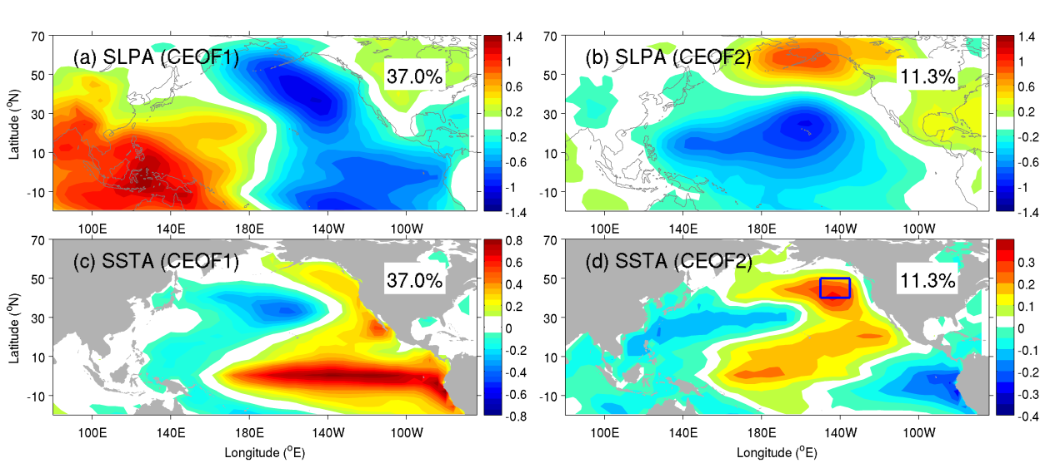
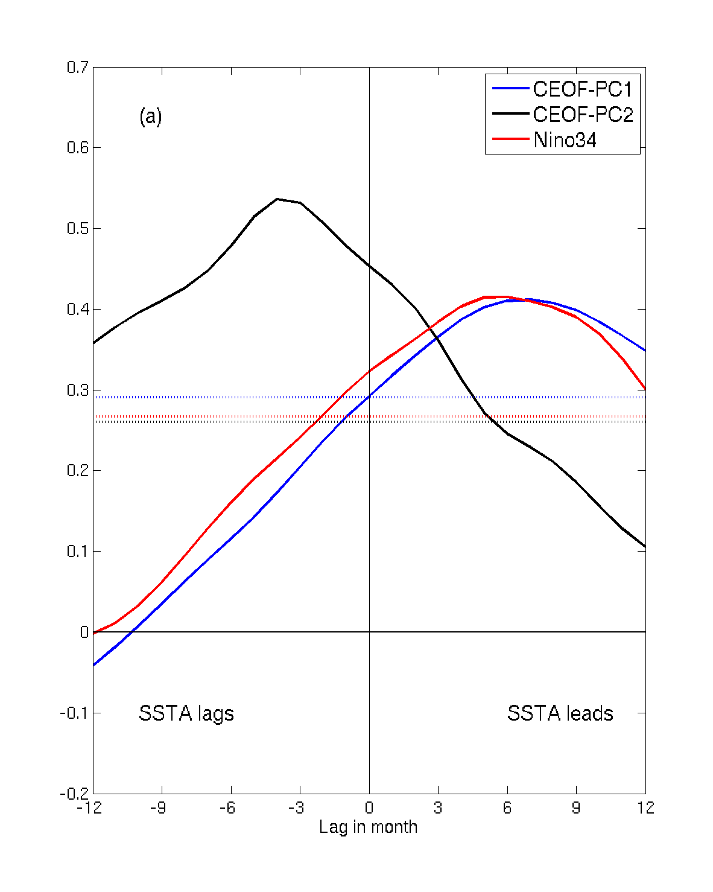
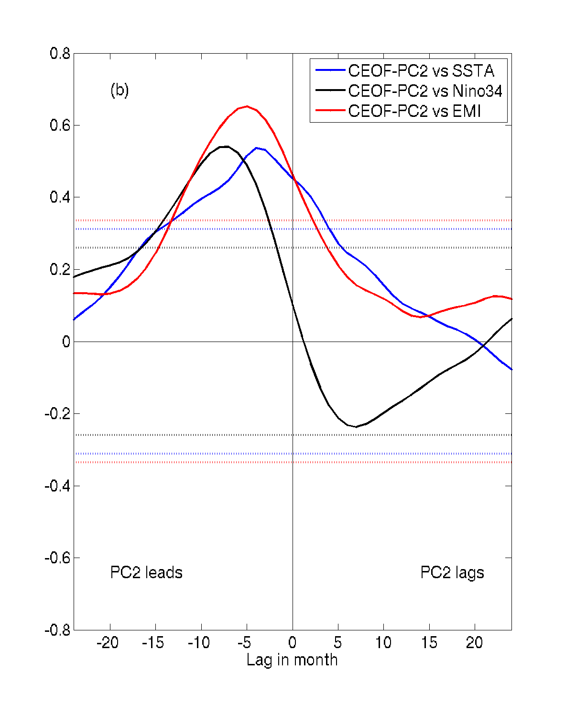
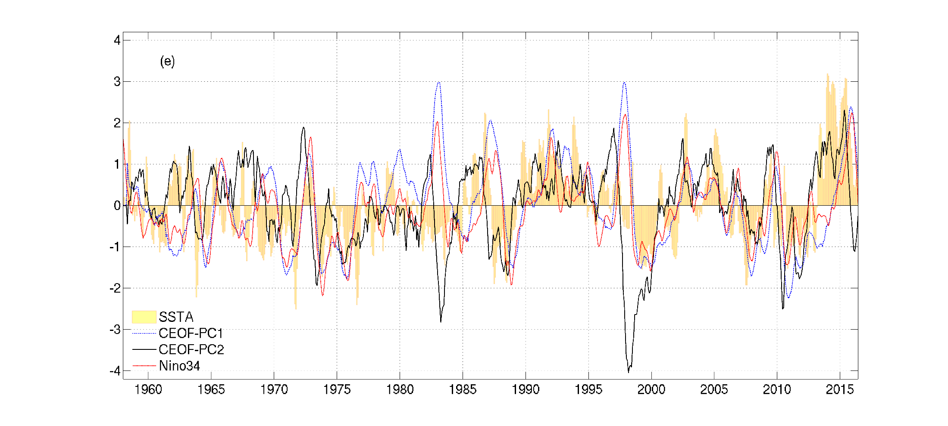
SSTa lag PC2 ~2-4 mon
PC2 lead ENSO ~5-8 mon
Tseng et al. (2017)

Slide 12
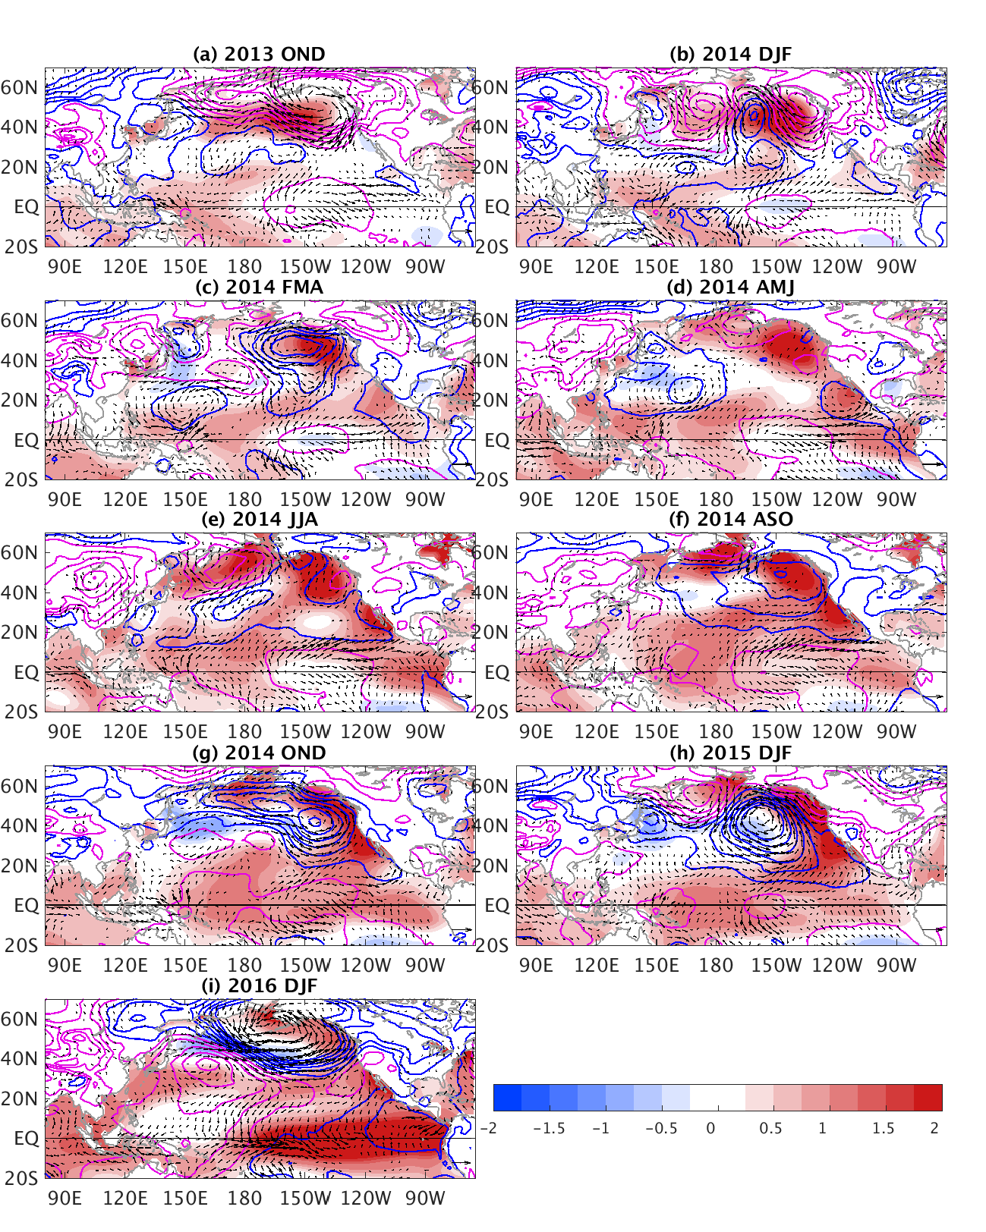

NPO develops
3-mon-averaged
SST (shaded),
SLP (contours) and
surface wind anomalies in 2014.
NPO ->VM
PMM
Warm Blob and El Niño are related!
Medium to strong ENSO events (bold: the SSTa in the Blob region >1std preceding the ENSO)
El Niño | 1965/66, 1972/73,1982/83,1986/87, 1987/88, 1991/92, 1997/98, 2002/03, 2009/10, 2015/16
La Niña | 1970/71, 1973/74, 1975/76, 1988/89, 1998/99. 1999/00, 2007/08, 2010/11
Notes:
Figure 1: Three-month averaged SST (shading), SLP (contours), and the near-surface wind vector anomalies after 2013 November. The interval is 0.2˚C for SST, and 1 hPa for SLP (magenta is positive and blue is negative). The anomalous wind has the unit of m s⁻¹.

Slide 13
Yu-heng Tseng
Institute of Oceanography, National Taiwan University
New North Pacific climate paradigm
Miller et al. (2017)
Ding et al. (2017a)
Ding et al. (2015a); Tseng et al. (2017b)
Tropical-extratropical interaction
Ding et al. (2015b)
Hu et al. (2017a; 2017b)
SFM
Chen et al. (2015, 2018); Tseng et al. (2017a);
Tropical-extratropical interaction
Ding et al. (2015c); Ding et al. (2016)

Slide 14
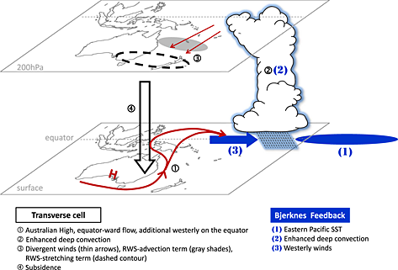
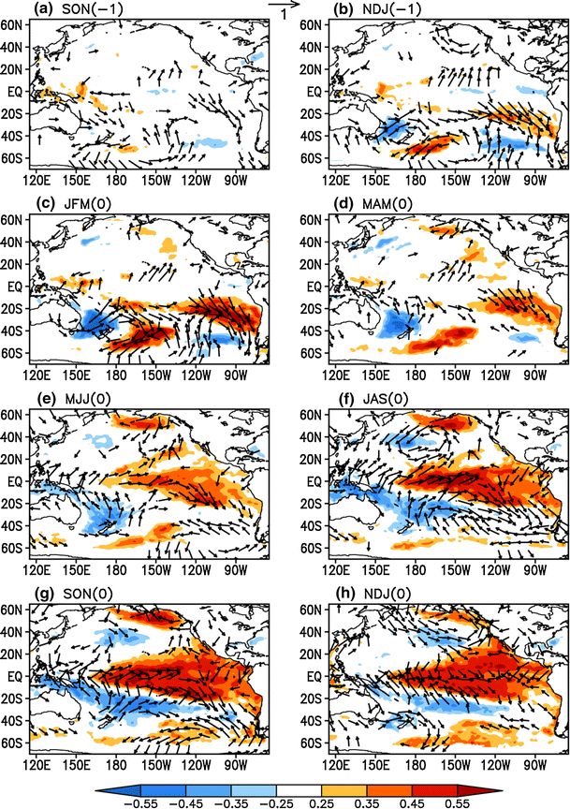
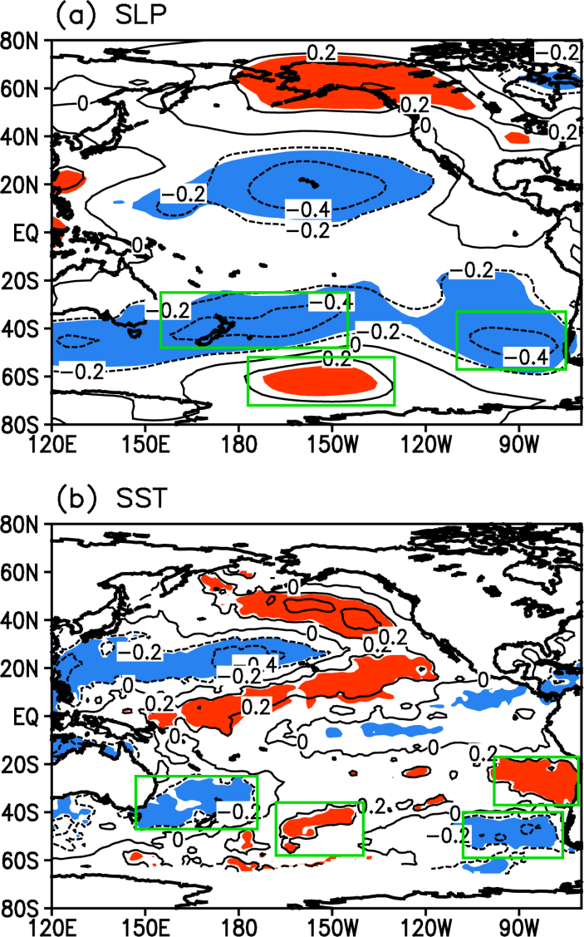
Southern hemisphere pathway
Zhang et al. (2014a,b), Ding et al. (2015c)
Super El Nino development: Hong et al. (2014) GRL
Notes:
Fig. 1Spatial pattern of the austral summer [November–April (NDJFMA)] averaged a SLP (mb) and b SST (°C) anomalies regressed against the austral summer (NDJFMA-averaged) cold tongue index (CTI) during the following year [the CTI is defined as SST averaged over (180°–90°W, 6°S–6°N) and is a commonly used index of ENSO variability]. Positive (red) and negative (blue) SLP and SST anomalies, with regression coefficients significant at the 0.05 level, are shaded. In (a), three green boxes [positive regression box: (177°–130°W, 72°–52°S); negative regression boxes: (155°E–145°W, 48°–25°S) and (110°–75°W, 57°–33°S)] indicate the locations of three action centers of the PSA, respectively. In (b), four green boxes [from left to right: (142°E–179°W, 47°–25°S); (173°–145°W, 58°–36°S); (113°–81°W, 59°–40°S); and (103°–76°W, 37°–17°S)] define the locations of the four poles of the SPQ

Slide 15
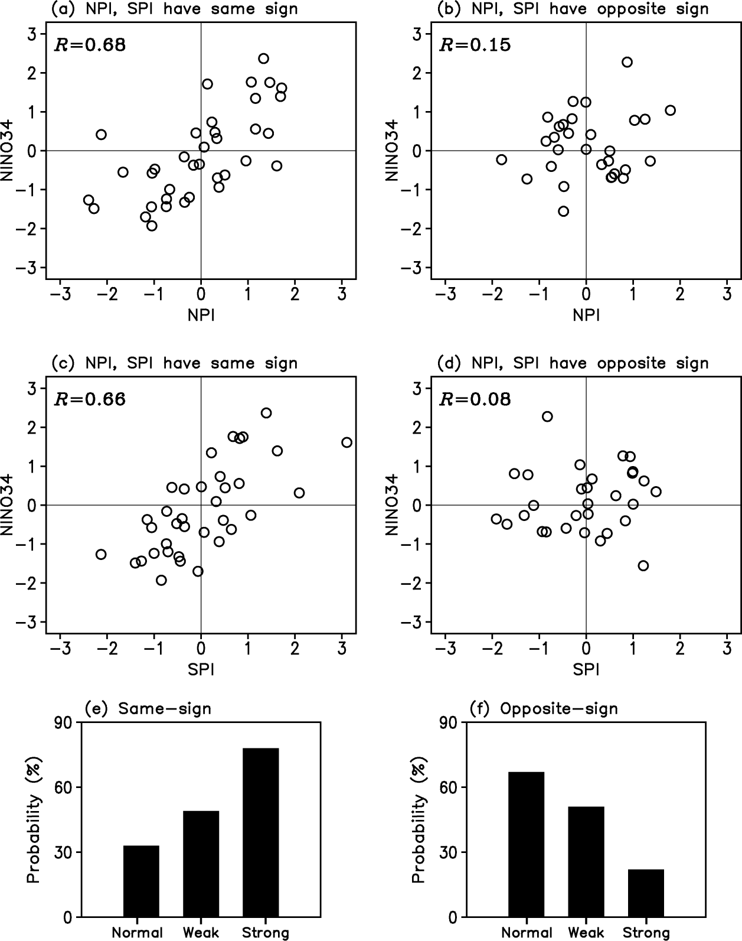
Yu-heng Tseng
Institute of Oceanography, National Taiwan University
New North Pacific climate paradigm
Miller et al. (2017)
Ding et al. (2017a)
Ding et al. (2015a); Tseng et al. (2017b)
Tropical-extratropical interaction
Ding et al. (2015b)
Hu et al. (2017a; 2017b)
SFM
Chen et al. (2015, 2018); Tseng et al. (2017a);
Ding et al. (2017b)
Tropical-extratropical interaction
Ding et al. (2015c); Ding et al. (2016)

Slide 16

Ding, R., Li, J., Tseng, Y.H., Sun, C. and Zheng F. (2017b), Linking a sea level pressure anomaly dipole over the North America to the central Pacific El Niño, Clim. Dyn.. 49, 1321-1339.
Ding, R., Li, J., Tseng, Y.H., Sun, C. and Xie F. (2017a), Joint impact of North and South Pacific extratropical atmospheric variability on the onset of ENSO events, J. Geophys. Res.-atmos, 122, 279-298.
Ding, R., Tseng, Y.H., Ha, K.J., Lee, J.Y. and Li, J. (2016), Interdecadal change in the lagged relationship between the Pacific-South American pattern and ENSO, Clim. Dyn., 47, 2867-2884.
Chen, H.C., Sui, C.H., Tseng, Y.H. and Huang, B.H. (2015), An analysis of the linkage of Pacific subtropical cells with the Recharge-Discharge processes in ENSO evolution, J. Clim., 28, 3786-3805.
Ding, R., Li, J., Tseng, Y.H., Sun, C. and Guo, Y. (2015), The Victoria mode in the North Pacific linking extratropical sea level pressure variations to ENSO, J. Geophys. Res., 120, 27-45.
Ding, R., Li, J., Tseng, Y.H. and Ruan, C. (2015), Influence of the North Pacific Victoria mode on the Pacific ITCZ summer precipitation, J. Geophys. Res., 120, 964-979.
Ding, R., Li, J. and Tseng, Y.H. (2015), The impact of south Pacific extratropical forcing on ENSO and comparisons with the North Pacific, Clim. Dyn., 44, 2017-2034.
Hu, Z.Z., Humar, A., Zhu, J., Huang, B., Tseng, Y.H., Wang, X. (2017a), On the shortening of the lead time of ocean warm water volume to ENSO SST since 2000 Sci. Rep., 7, 4294.
Hu, Z.Z., Huang, B., Tseng. Y.H., Wang, W., Kumar, A. Zhu, J. and Jha, B. (2017b), Does vertical temperature gradient of the atmosphere matter for El Nino development? Clim. Dyn., 48, 1413-1429.
Miller, A. J. et al. (2017), Coupled ocean-atmosphere modeling and predictions, J. Marine Res., 75, 361-402.
Tseng, Y.H., Ding, R. and Huang, X.-M. (2017a), The warm blob in the northeastern Pacific-the bridge leading to the 2015/16 El Niño, Environ. Res. Lett., 12, 054019.
Tseng, Y.H., Hu, Z.Z., Ding, R. and Chen, H.C. (2017b), An ENSO prediction approach based on ocean conditions and ocean-atmosphere coupling, Clim. Dyn. 48, 2025-2044.

Slide 17
Yu-heng Tseng
Institute of Oceanography, National Taiwan University
New North Pacific climate paradigm
Miller et al. (2017)
Ding et al. (2017a)
Ding et al. (2015a); Tseng et al. (2017b)
Tropical-extratropical interaction
Ding et al. (2015b)
Hu et al. (2017a; 2017b)
SFM
Chen et al. (2015, 2018); Tseng et al. (2017a);
Ding et al. (2017b)
Tropical-extratropical interaction
Ding et al. (2015c); Ding et al. (2016)

