Slide 1
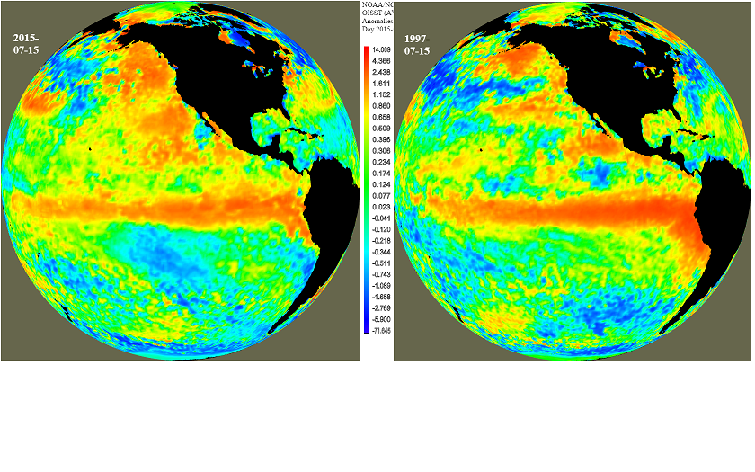
A new North Pacific climate paradigm and its implication on the 2015 El Niño and ENSO prediction
Yu-heng Tseng
Institute of Oceanography, National Taiwan University
Acknowledgments: Ruiqiang Ding, Zeng-Zhen Hu, Han-ching Chen ,Jiangping Li, Xiaomeng Huang, Art Miller
Notes:
NSF EASM-3: Collaborative Research: Quantifying Predictability Limits, Uncertainties, Mechanisms, and Regional Impacts of Pacific Decadal Climate Variability

Slide 2
OUTLINES
Reviews of the proposed North Pacific climate paradigm
Pacific Subtropical Cell and tropical variability
Interannual variability in Pacific
Extratropical impacts on the ENSO
Implication on the 2015 El Niño
Implication on the ENSO prediction
Conclusions and future work

Slide 3
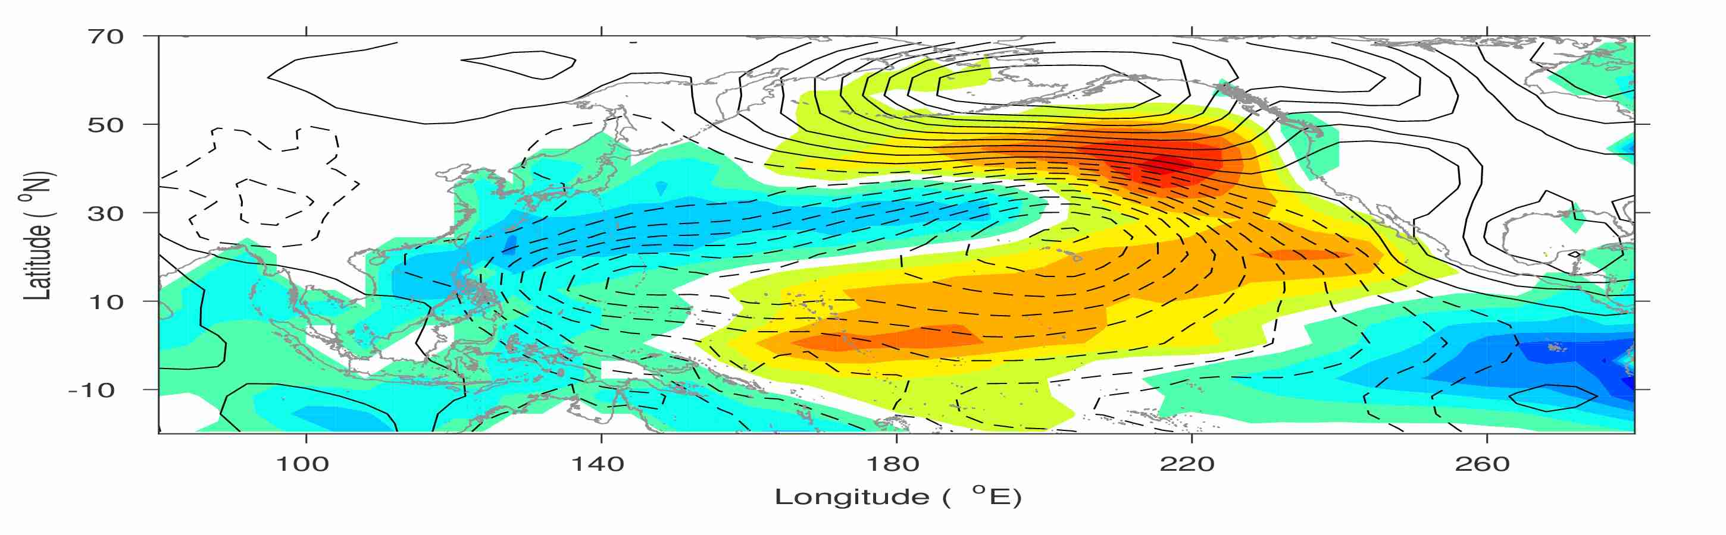
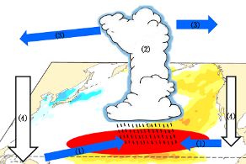
Yu-heng Tseng
Institute of Oceanography, National Taiwan University
New North Pacific climate paradigm
Miller et al. (2017)
Ding et al. (2017a)
Ding et al. (2015a); Tseng et al. (2017b)
Tropical-extratropical interaction
Ding et al. (2015b)
Hu et al. (2017a; 2017b)
SFM
Chen et al. (2015, 2018); Tseng et al. (2017a);
Ding et al. (2017b)
Tropical-extratropical interaction
Ding et al. (2015c); Ding et al. (2016)

Slide 4
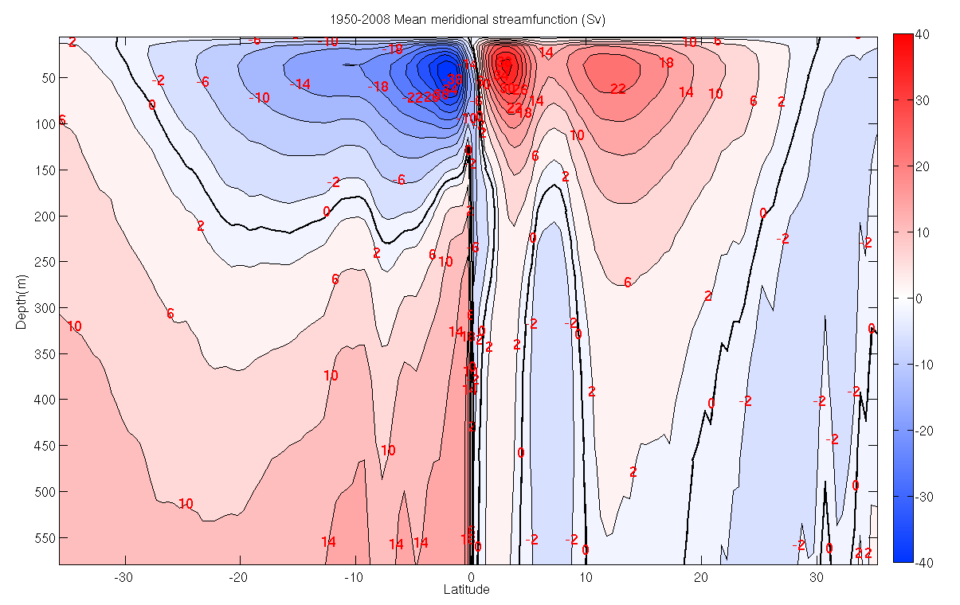
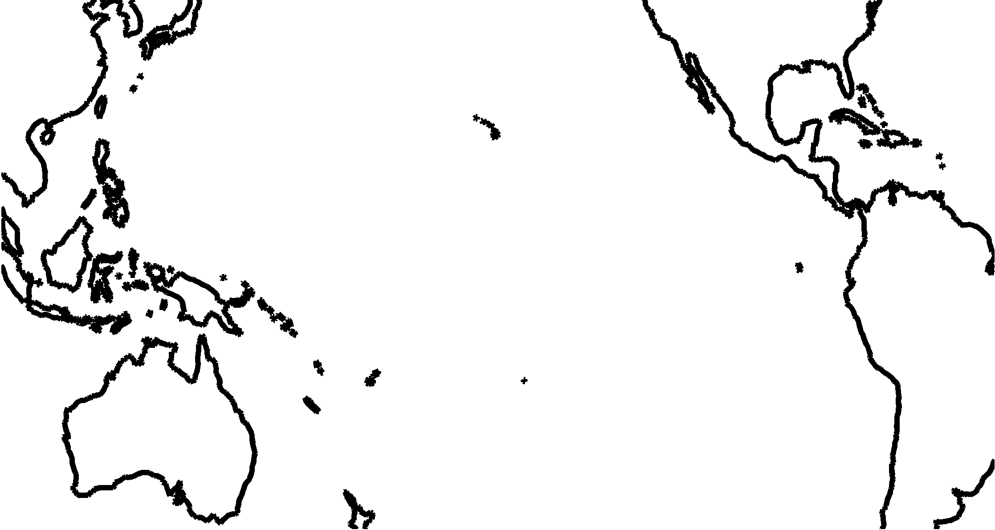
Subtropical Cells (STCs)
Mean meridional streamfunction
shallow meridional overturning circulations
Ekman transport
Equatorial
Undercurrent
Interior pycnocline transport
Notes:
STC is mainly driven by surface wind forcing.
Subtropical water mass subducts in the E Pac, flows westward and equatorward in the upper pycnocline layers through WB and interior STCs, feeds into the equatorial undercurrent and upwells into surface euqtorial water before returning to the subtropics in the surface Ekman layer.

Slide 5
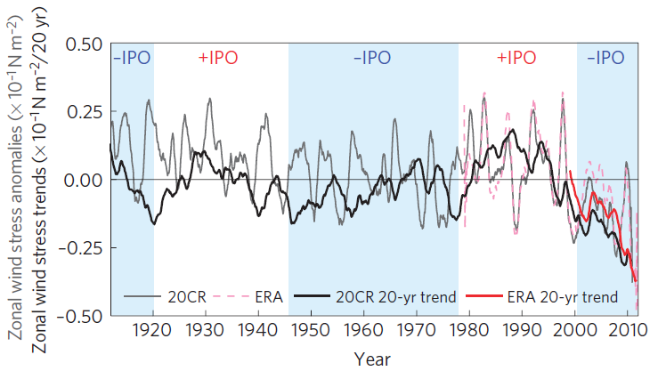
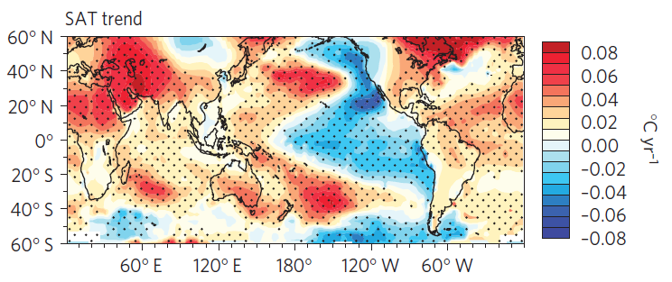
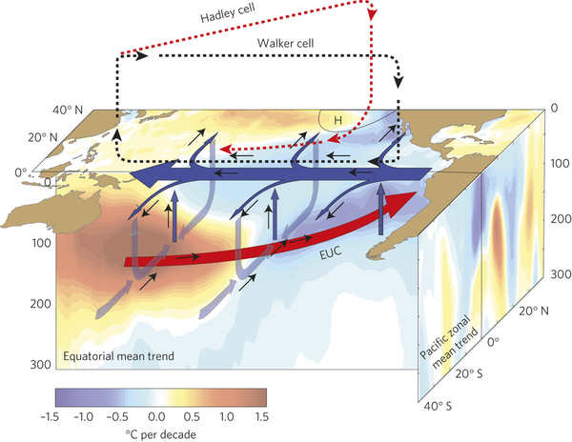
Zonal wind stress and trends
Trend during 1992-2011
=>Increased trade wind
=>Strengthened STG and Ekman pumping
=>Spin-up STC
=>Enhanced EUC
=>Increased equatorial upwelling
=>Negative SSTA (warming hiatus)
England et al. (2014)
Notes:
However, it is possible that the STC is just a part of the ocn-atm interaction.
Also, STC is directly correlated with equatorial SST changes at both interannual and decadal scales.
Jerry talked about the decadal changes. Here, we want to emphasize on the interannual scale.
The structure of the STCs can be an important factor that controls ENSO.

Slide 6

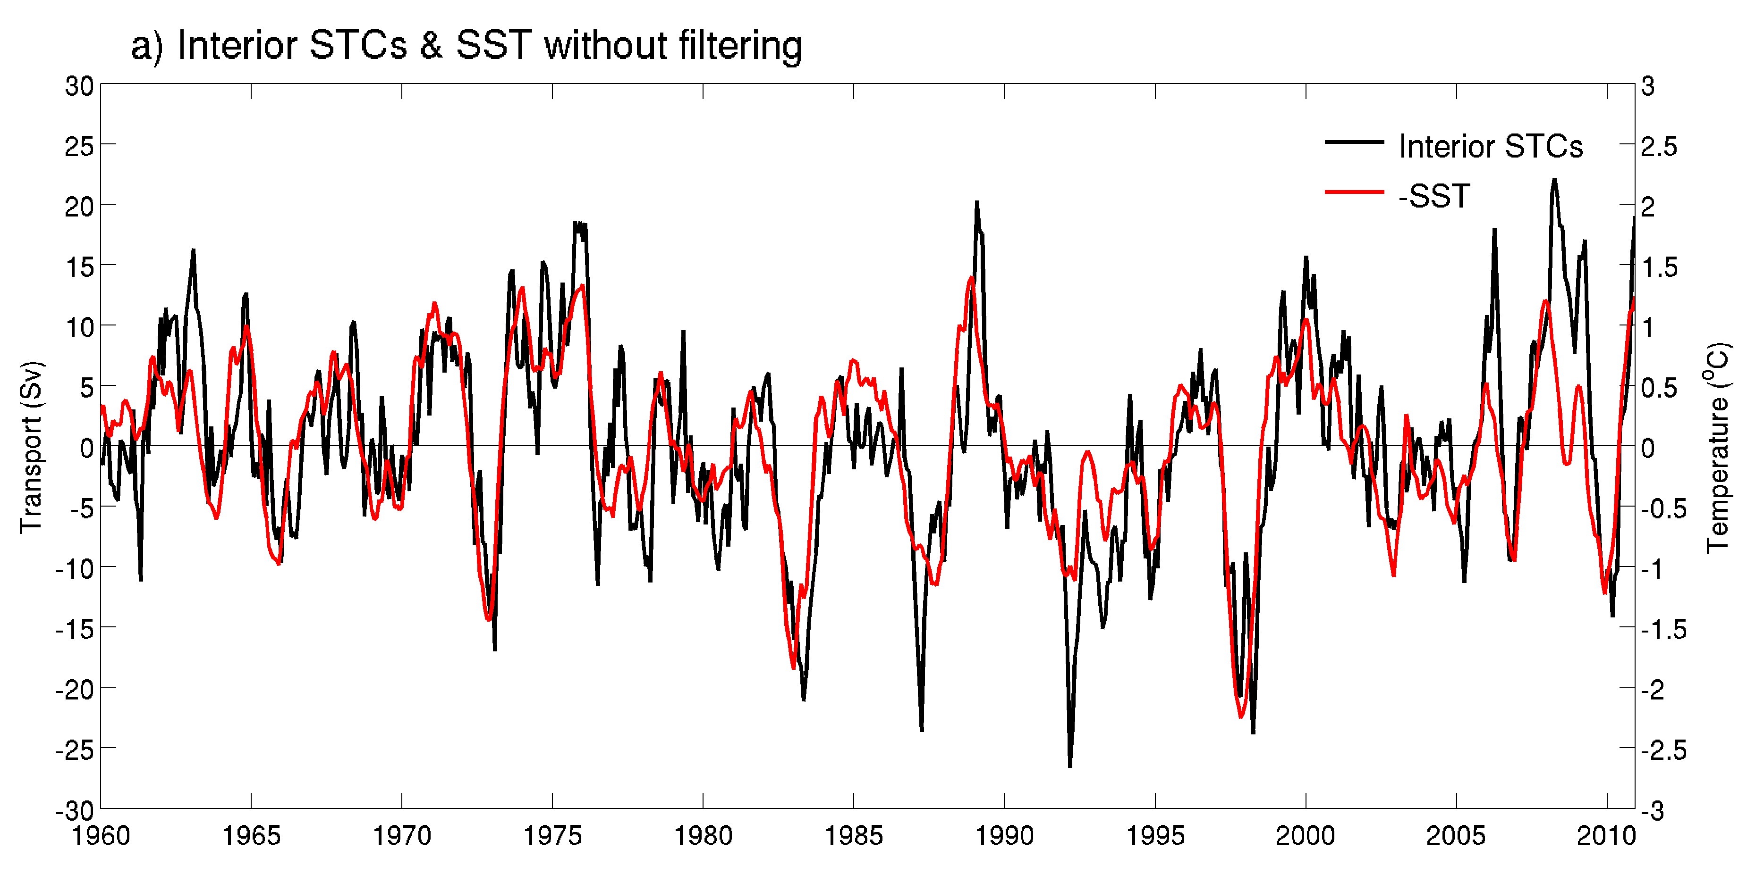
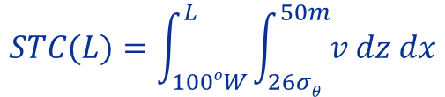
Interior STC transport
Ekman transport
$$STC(L)=\int_{100oW}^{L}{\int_{26σθ}^{50m}{v dz dx}}$$
Equatorial
Undercurrent
Interior pycnocline transport
Chen et al. (2015)
Notes:
SODA. Time series of the interior STC convergence anomaly is compared with the averaged SSTa over the central and E Pac. where upwelling is intense (consistent with Nino3.4).
STC and SST are anticorrelated, indicating the stronger (weaker) convergence of STC is associated with lower (higher) SST.
1Sv net STC convergence corresponds to 0.1 C SST change.
SST leads the interior STC by 2 month at interannual scale.

Slide 7
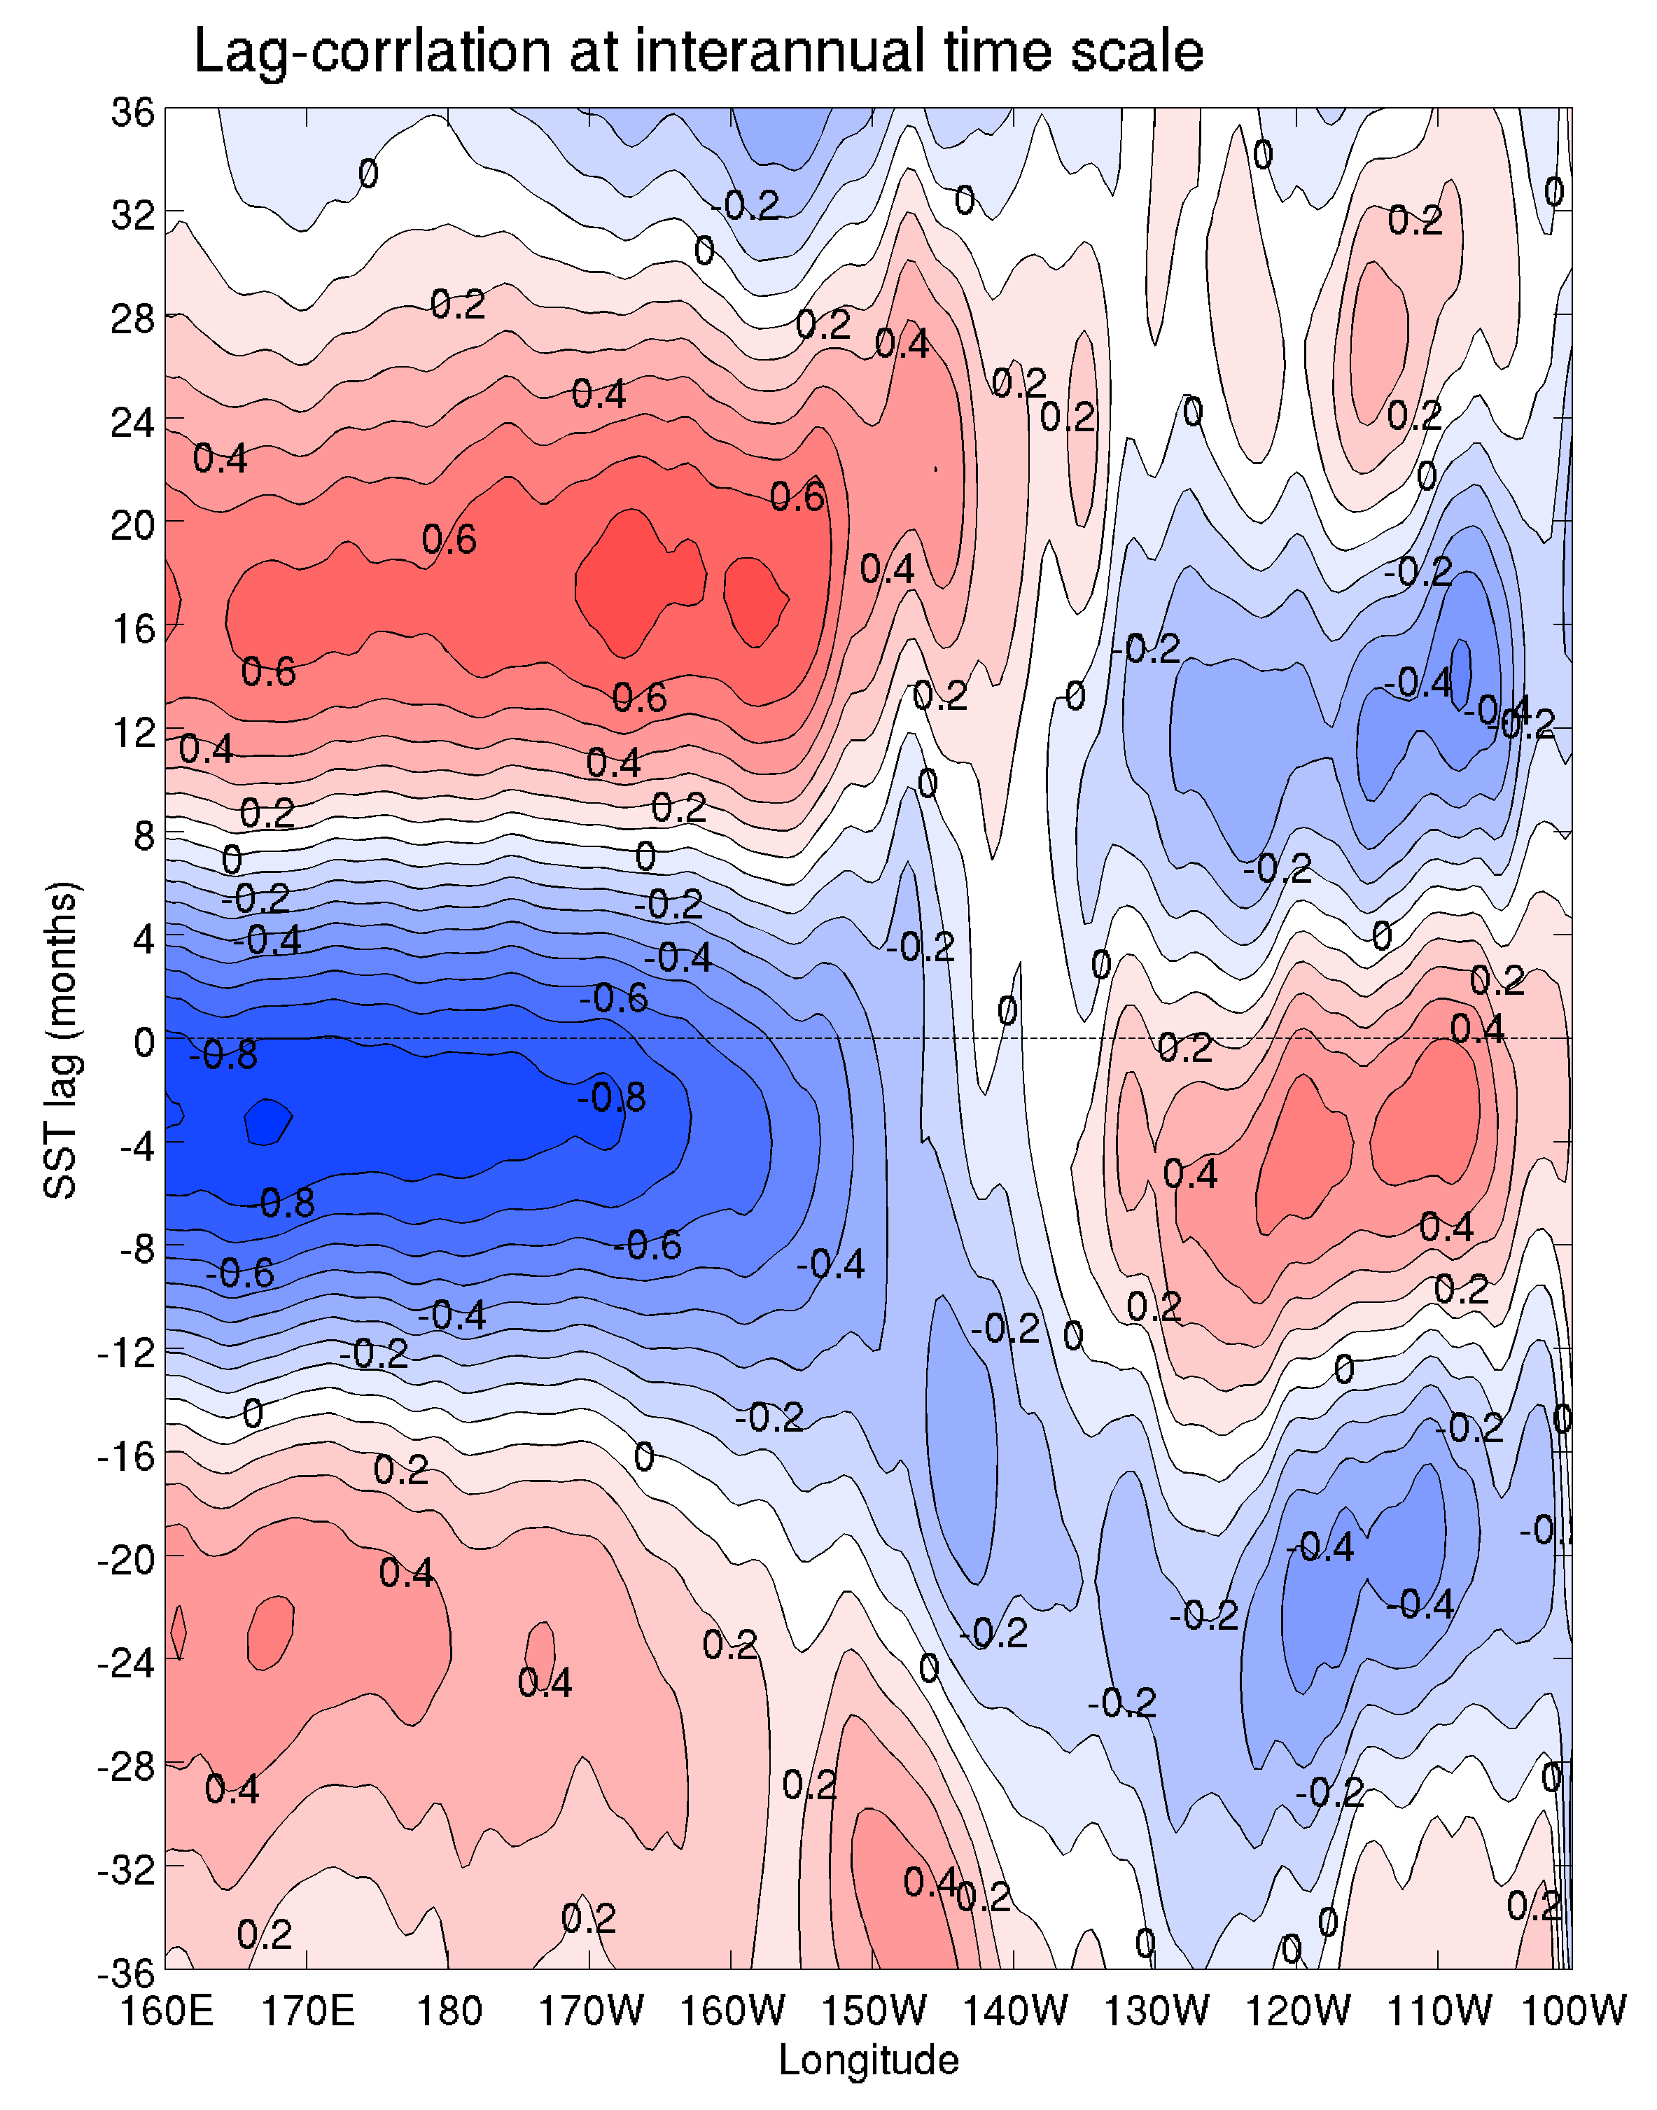
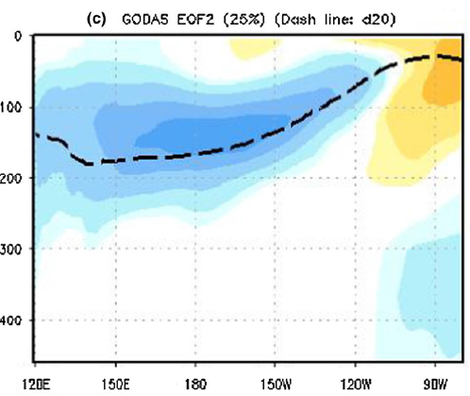
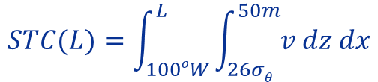
SST and STCs lag-correlation
SST: 180°-90°W, 9°S-9°N
SST lag STC
3.3 y
$$STC(L)=\int_{100oW}^{L}{\int_{26σθ}^{50m}{v dz dx}}$$
SST lead STC
Kumar and Hu (2014)
Chen et al. (2015)
Notes:
Further examine the lag-correlation between SSTa and the STC convergence in the interior pycnocline zonally accumulated from 100ºW westward to varying longitudes.
Positive lags mean SST lags the STCs, and negative lags mean SST lead STC.
interannually, the maximum negative correlation appears when the STC is zonally averaged across the basin with negative lag values (3-4 month). In the eastern part, the STC is positively correlated with SST. We separate this two different response by 130W. Western part as 160E-130W and eastern part as 130W-100W.
Significant correlation occurs in western part of transport not in the Eastern Part. Western STC transport is highly correlated with ENSO SST pattern.
The difference between W&E results from the opposite sign of the wind anomaly during ENSO events.
At decadal time scale, the maximum negative correlation appears uniformly from west to the east.

Slide 8
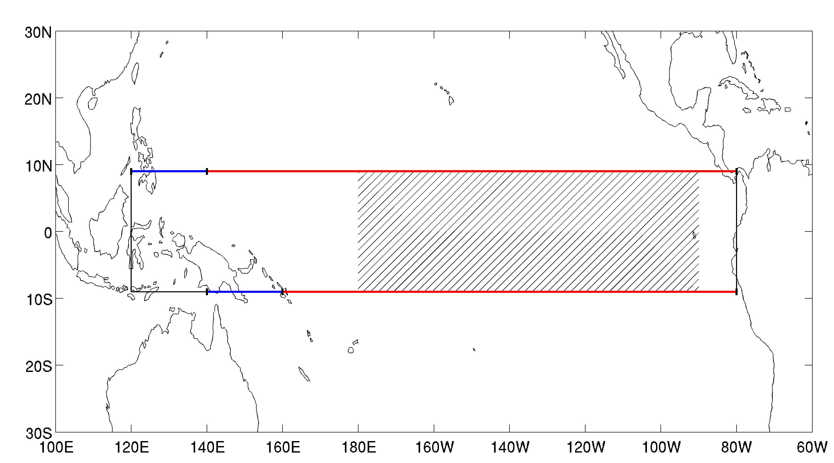
Causal relation between the interior transport and SST in the tropical Pacific
Interior STCs (Red line)
140°E-80°W, 9°N
160°E-80°W, 9°S
50m–26isopycnal
WB (Blue line)
120°E-140°E, 9°N
140°E-160°E, 9°S
50m–26isopycnal
WWV
120°E-80°W, 9°S-9°N
Surface–26isopycnal
SST
180°-90°W, 9°S-9°N,
Zonal Wind Stress Curl
140°E-80°W, 5-9°N
160°E-80°W, 5-9°S
Notes:
We using SODA data to analyze STCs.

Slide 9
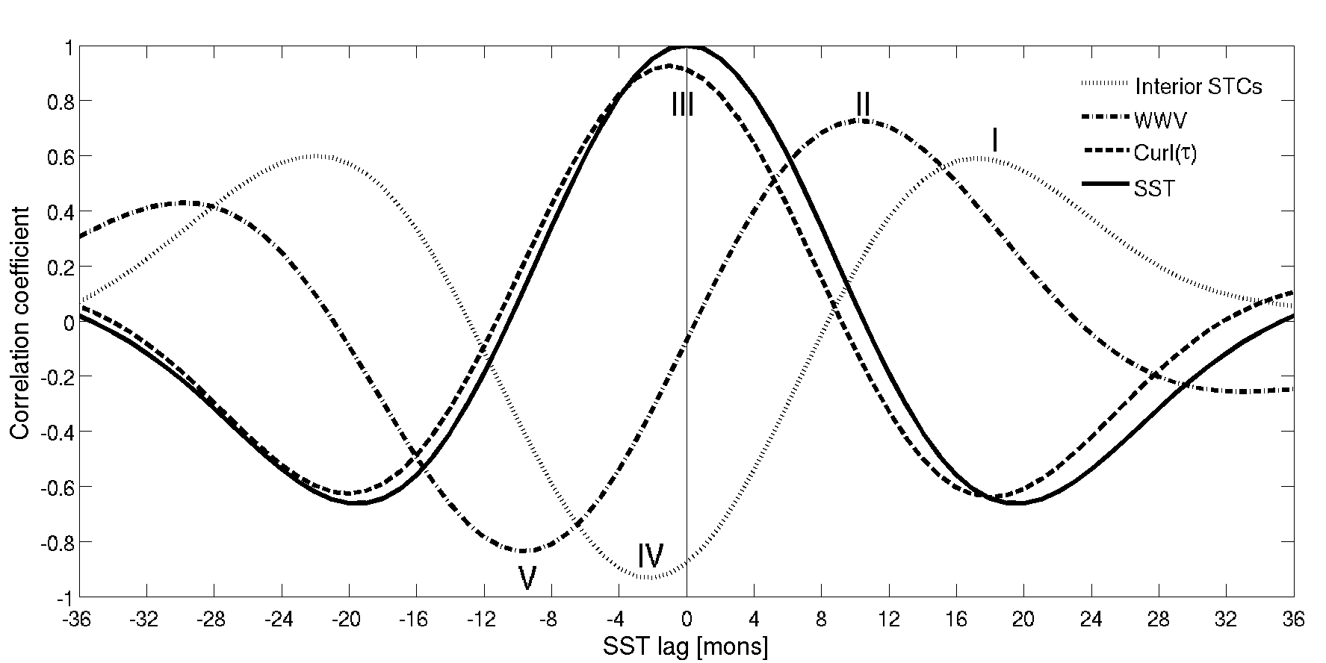
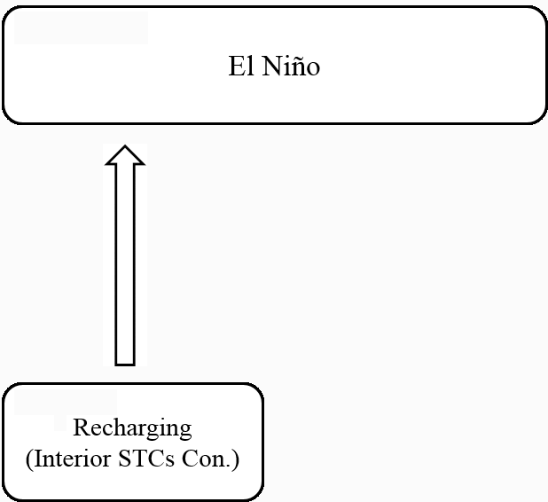
Geostrophic
τ_{a}
SSTa(-)
Depth anomaly
18
SST lead
SST lag
18
Notes:
So the connection of STC and SSTa seems to be an oscillated process where we can explain using the recharge-discharge process. 18 month before the matured El Nino, an enhanced STC convergence charges the equatorial upper ocean with warm water to produce a peak WWV after 8 month.

Slide 10
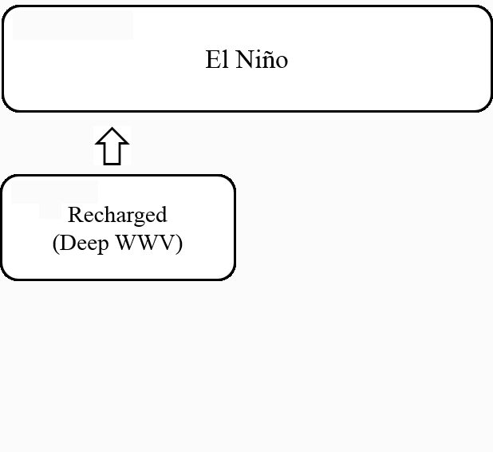
τ_{a} ~ 0
SSTa ~0
Depth anomaly
10
SST lead
SST lag
10
Notes:
A changed WWV initiates the surface warming in the CP & EP and a warmest SST is reached 10 month later.

Slide 11
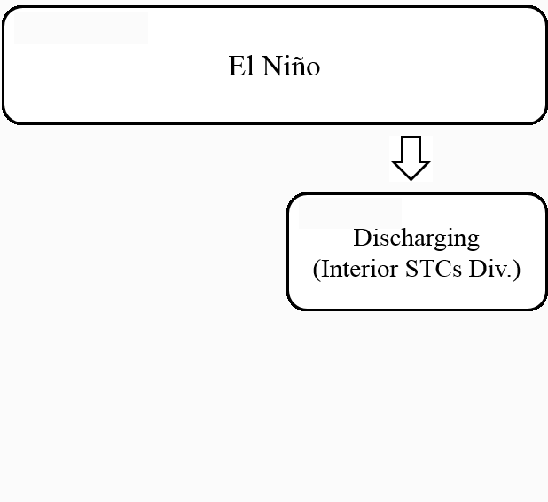
Geostrophic
τ_{a}
SSTa(+)
Depth anomaly
-2
SST lead
SST lag
2
Notes:
Atmospheric responses to convective heating over warm SST anomalies result in equatorial Windano and the off-equatorial cyclonic wind stress in the WP and CP that produce divergence of STC transport. So

Slide 12
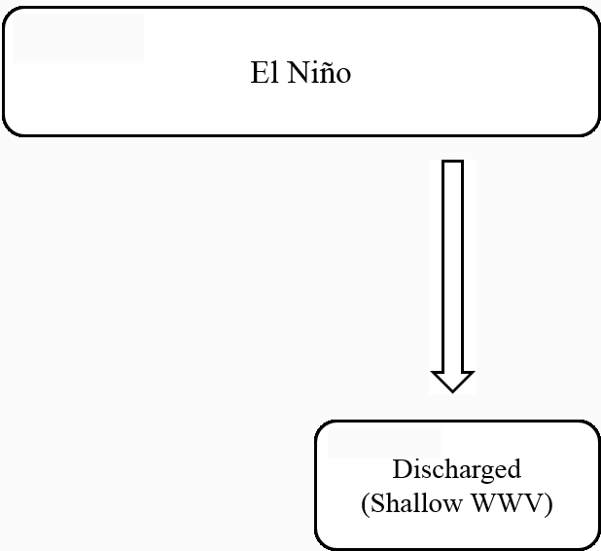
τ_{a} ~ 0
SSTa ~0
Depth anomaly
-10
SST lead
SST lag
10
Notes:
A diverging STC transport discharges equatorial warm water, so that a minimum WWV is reached after 8 month.

Slide 13
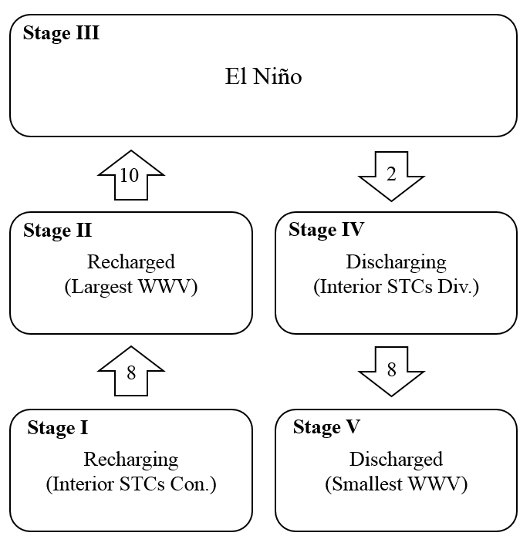
The corresponding timescales for the completed process (from a recharging stage to a discharged stage) are 8, 10, 2 and 8 months, respectively.
Notes:
The composite evolution of different ENSO events also support the recharge-discharge processes.
The evolution of the El Nino events starts from the recharging stage (maximum interior STC convergence stage I), develops to the recharged stage (maximum WWV; stage II), peaks at the warmest SST (stage III), is followed by the discharging stage (maximum interior STC divergence; stage IV), and finally reaches the discharged stage (minimum WWV; stage V).
The time intervals can be determined by the adjustment time of tropical Pacific oceanic waves. The evolution WWV is explained by the off-equatorial Sverdrup transport associated with the Rossby waves (jin, 1997).
Observed equatorial Rossby waves were responsible for changing the basin-scale zonal pressure gradient and consequently the anomalous meridional geostrophic transport. Bosc and Delcroix (2008).
Zonal mean thermocline depth leads the SST by a ¼ cycle but also lags the SST by a ¼ cycle. Interior STC leads SST by 150° and also lags SST by 20°° An and Kang (2000).
Asymmetry of interior STC also exists.

Slide 14
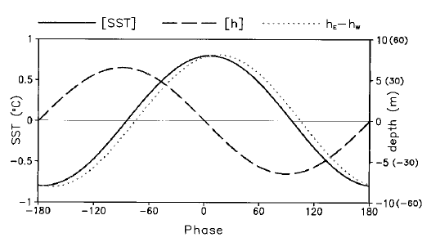
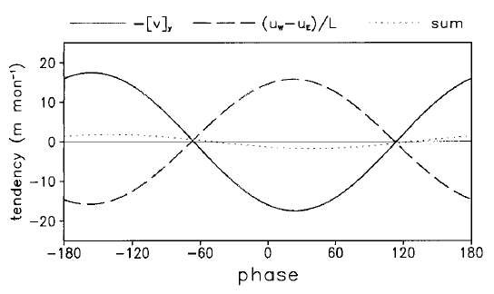
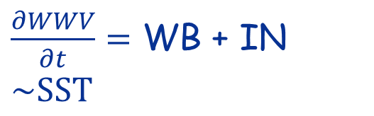
-90º => 10 months
+90º => 10 months
$\frac{∂WWV}{∂t}=$ WB + IN $\sim SST$
-160º => 17.7 months
+20º => 2 months
An and Kang (2000)

Slide 15

Questions:
Is this the whole story?
WWV and STC tell us ONLY the interannual variability

Slide 16
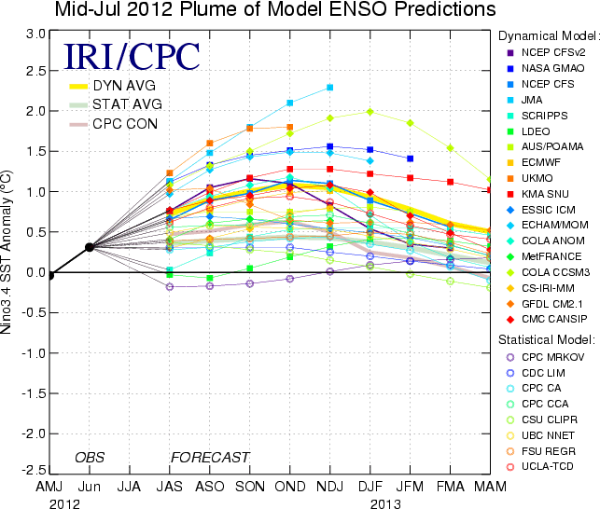
Questions:
Is this the whole story?
Why do we still have the spring barrier and why the current models give the false alarm in 2012?

Slide 17
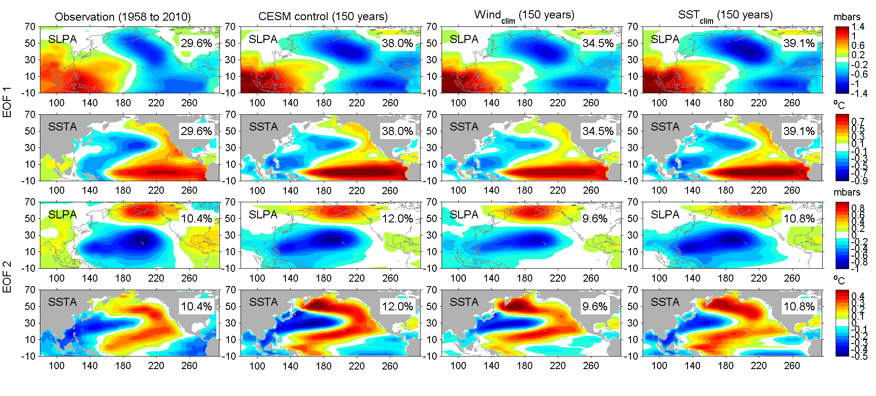
The dominant surface pattern and variability in the North Pacific-1st mode
The covariability mode of SLP and SST anomalies from the CEOF1 analysis
Obs: NCEP reanalysis,
ERSST (1958-2010),
Model: CESM1.0.5 (150 yr)
Aleutian Low (AL)
PDO/ENSO
Miller et al. (2017)
Notes:
the Seasonal Footprinting Mechanism: boreal winter-time variability in the NPO drives warm SST anomalies in the North Pacific that propagate into the central tropical Pacific by end of spring/summer through the wind/evaporation/SST (WES) feedback.
Both PDO and NPGO are to 1st order the oceanic expressions of the atm. Forcing associated with AL and NPO.
EPW->AL->PDO (Alexander 1992; 2002; Newman et al., 2003).
CPW->NPO->NPGO (Di Lorenzo 2010)

Slide 18
The dominant surface pattern and variability in the North Pacific-2nd mode
The covariability mode of SLP and SST anomalies from the CEOF2 analysis
North Pacific Oscillation (NPO)
Victoria Mode (VM) or NPGO
Miller et al. (2017)
Notes:
CEOF for the SLP and SST

Slide 19
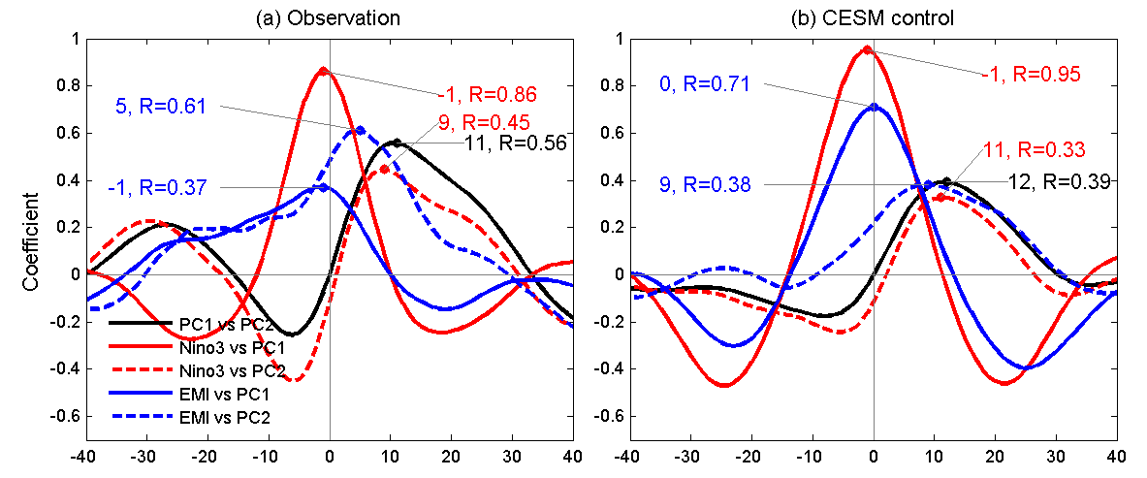
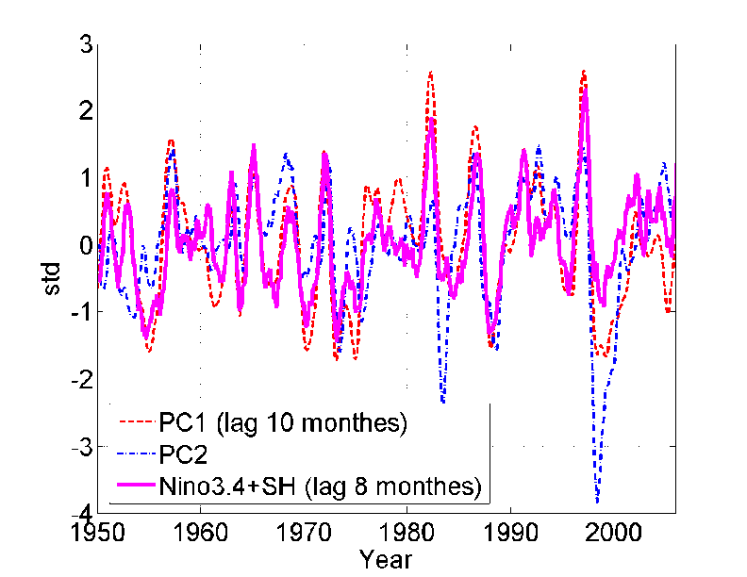
Links between the two dominant CEOF modes
Lag-correlation between Niño3 (and EMI index) and PC1/PC2 of the CEOF
PC1 is essentially ENSO
PC2 leads PC1/Nino3 by 9-11 months
PC2 leads EMI by 5 months
PC2 (NPO/VM): important ENSO precursor

Slide 20
Short Summary
Two dominant modes of NPCV are linked
ENSO/PDO: the zonal variability in tropic and mid-latitude
NPO/VM: a footprint of the meridional variability through the tropic-extratropical teleconnection
The two dominant modes of NPCV are non-stationary and correlated with each other in both obs. and models.
What about the dynamical process?

Slide 21
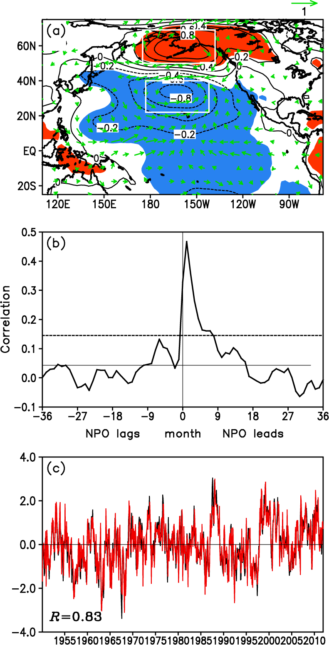
The VM is forced by the NPO
Ding et al. (2015a)
Pacific SLP and surface wind anomalies regressed on the VM
Reconstructing VM using NPO (AR1):
VM_{t+1}=α NPO_{t} +βVM_{t}+η_{t}
A significant fraction (~69%) of the VM variability can be interpreted as the integrated response of the ocean to atmospheric forcing.
Notes:
Quantifying the oceanic response of the VM to atmospheric forcing
(a) Pacific SLP and surface wind anomalies regressed on the VMI.
the SLP pattern associated with the VM exhibits a meridional dipole structure, characterized by out-of-phase SLP variations over the northern and southern poles with a nodal point near 45°N. The SLP anomalies associated with the VM are consistent with surface wind anomalies.
(b) lead-lag correlations between the VM and NPO indices. The strongest correlation (R = 0.47) occurs when the NPO leads the VM by 1 month, indicating a significant influence of the ATM on OCN. Anomalous surface wind associated with the NPO can force a tripole-like pattern of the surface heat flux anomalies in the North Pacific, which in turn induces a tripole SSTA pattern there (including a dipole SSTA pattern of the VM in the North Pacific poleward of 20°N, along with a subtropical pole of positive SSTAs located in the central eastern North Pacific).
autoregressive model of order 1 (AR1):
where the 1st and 2nd terms on the right-hand side represent the NPO and the damping term and η_{t} is uncorrelated noise. The coefficients α = 0.47 and β = 0.68 are obtained from observations by regressing the VM against the previous month's NPO, removing the NPO term, then regressing the residual against the previous month's VM. The reconstructed monthly VMI and the raw monthly VMI show almost the same variability; both have a strong correlation (R = 0.83). This suggests that the NPO may account for a large fraction (> 60%) of the VM variability.

Slide 22
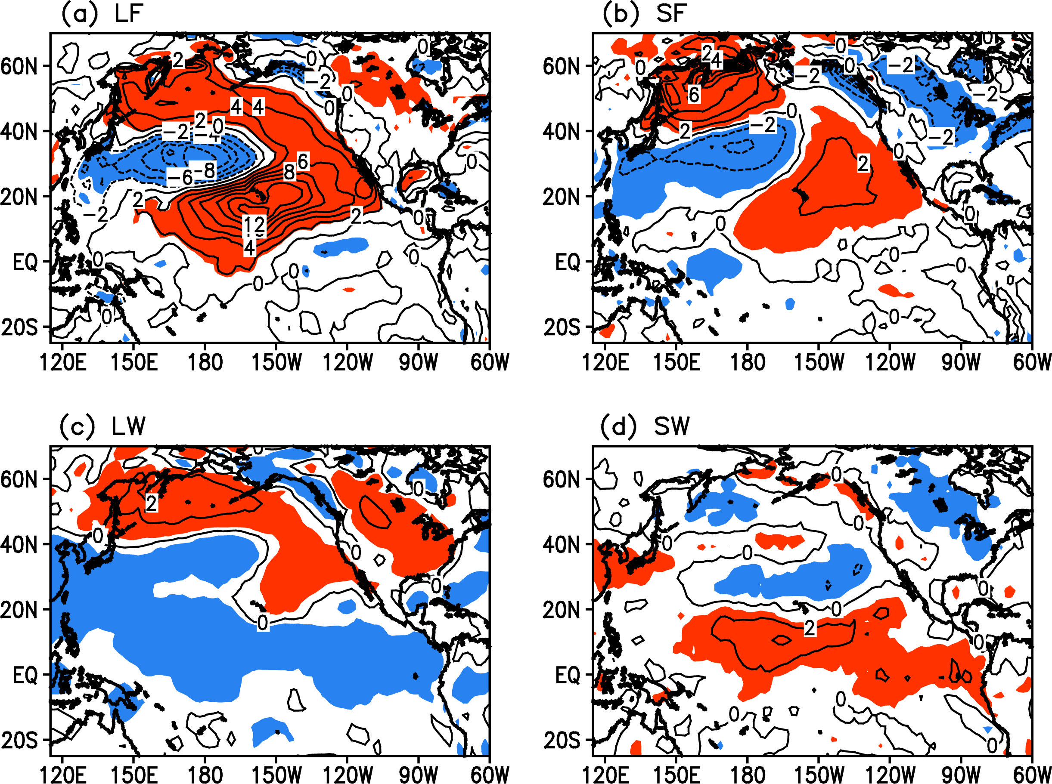
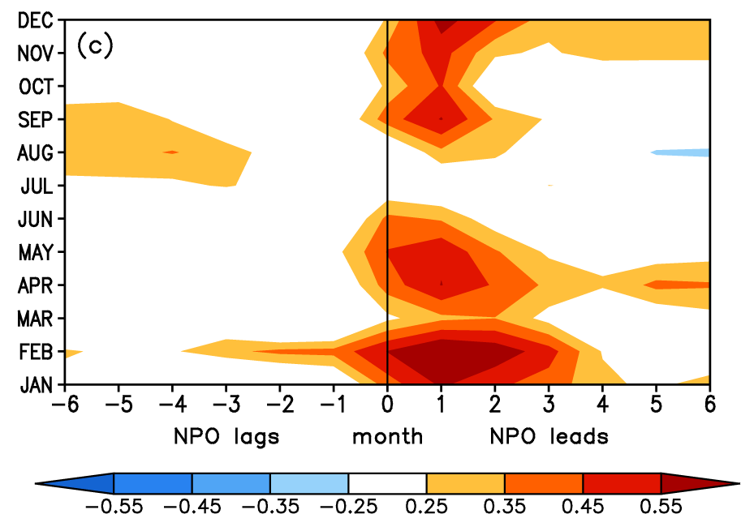
Surface wind anomalies associated with the NPO force a tripole-like pattern of the heat flux anomalies
VM lags NPO by 1~2 months
NPO [DJF]->VM [FMA]
Impact on VM is confined in winter
Notes:
The strong VM during FMA is a delayed (by about 1–2 months) response to the forcing of the DJF NPO. In addition, we note that the variance of the VM shows a small change from February to August, and the VM still shows a relatively marked variance in summer (June–August (JJA)).
(c) for lead times of 1–2 months, the NPO has strong correlations with the VM throughout the year, except during summer months (JJA) when the NPO is weakest. The results suggest that the influence of the NPO on the VM is relatively weak in summer, while this influence is mainly confined to the other three seasons. The marked variance of the summer VM may be mainly due to the influence of the seasonal variation of the ocean mixed layer depth (MLD) in the extratropical North Pacific.

Slide 23
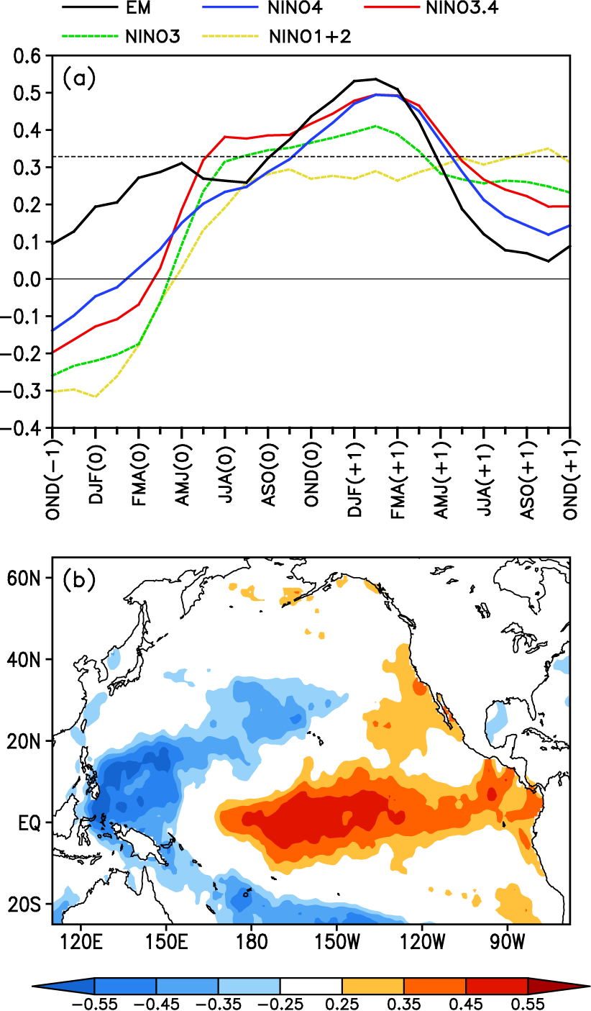
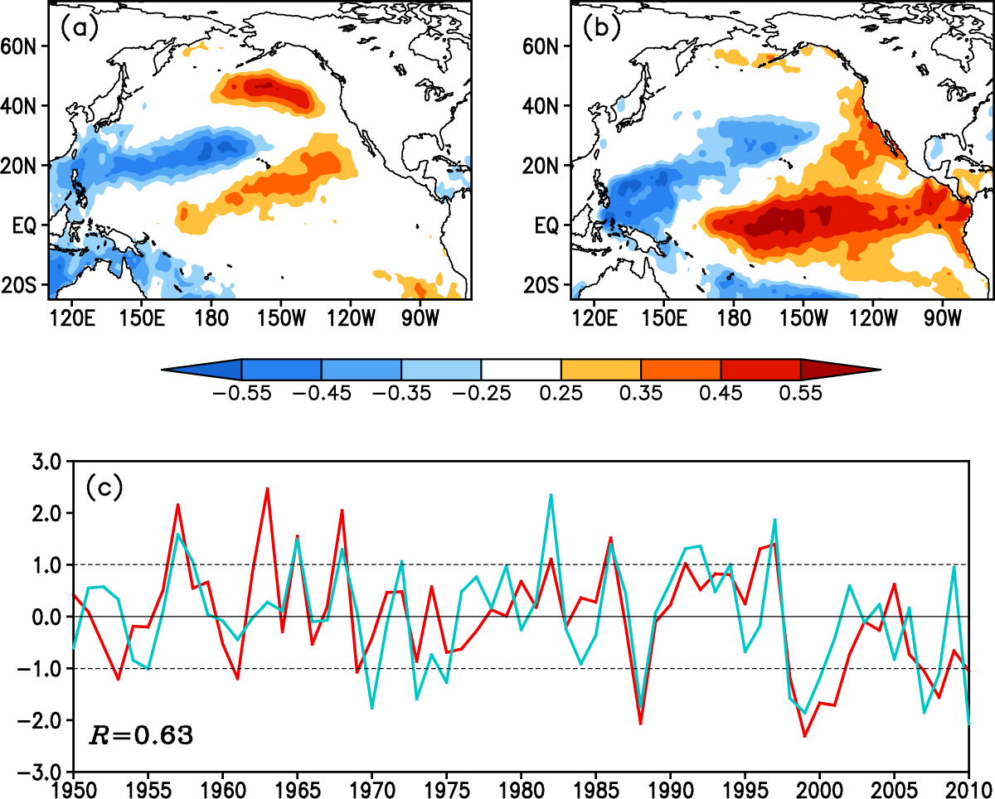
Linking between VM and ENSO
MCA mode for the FMA(0) North Pacific SSTA field and the following JFM(+1) tropical Pacific SSTA field
> the impact of NPO on ENSO
Ding et al. (2015a)
Notes:
Above VM is a direct oceanic response to the atmospheric forcing of the NPO. We now turn to the relationships between the VM and ENSO which were not addressed previously.
Right: Considering that the NPO peaks in winter and the SST footprint forced by the NPO (i.e., the VM) is strongest in late winter and early spring (FMA), we compute lead-lag correlations between the FMA-averaged VMI and 3 month averaged ENSO indices. We denote the year in which the VM peaks in FMA as year 0 and the preceding and following years as year –1 and +1, respectively.
The peak correlations VM-Niño3.4 and VM-Niño4 are very close, both of which are higher than VM-Niño3.
For lead times of a few months to more than a year, the VMI shows much weaker correlations with the Niño1+2 than those with other ENSO indices.
(b) Correlation maps of the FMA(0)-averaged VMI with the following JFM(+1) SSTAs. indicate that the warming center related to the VM is located in the CP, covering the eastern part of the Niño4 region and almost the entire Niño3.4 region. In contrast, there is relatively weak warming related to the VM in the eastern tropical Pacific, especially in the Niño1 + 2 region, consistent with a.
Right: a Maximum Covariance Analysis (MCA) is applied to the cross-covariance matrix between the FMA(0) North Pacific SSTA and the following JFM(+1) tropical Pacific SSTAs.
Spatial properties of the leading MCA mode for (a) the FMA(0) North Pacific SSTA field and (b) the following JFM(+1) tropical Pacific SSTA field, shown as correlation maps of the respective heterogeneous SSTA field with the MCA leading normalized expansion coefficients.
The leading MCA mode explains 69% of the total squared covariance.
The leading pair of heterogeneous patterns, which are generated by correlating the respective heterogeneous SSTA field with the MCA leading normalized expansion coefficients. The FMA(0) North Pacific is dominated by a tripole SSTA pattern (including a dipole SSTA pattern of the VM in the North Pacific poleward of 20°N, along with a subtropical pole of positive SSTA located in the central eastern North Pacific).
During the following winter, the tropical Pacific SSTA pattern bears a strong resemblance to the correlation map in Figure 5b, with maximum warming in the central tropical Pacific, almost symmetrical about the equator. These patterns suggest that a strong VM event in later winter and early spring tends to be followed by a strong ENSO event during the following winter.
(c) The MCA leading normalized expansion coefficients of the FMA(0) North Pacific SSTA (red line) and the following JFM(+1) tropical Pacific SSTA field (light blue line).
The expansion coefficients of the FMA(0) North Pacific and JFM(+1) tropical Pacific SSTAs have strong correlations of 0.98 and 0.95, respectively, with the FMA(0) VMI and JFM(+1) Niño3.4 index. This indicates that two MCA time series may be used to represent the VM and ENSO variability, respectively.
VM-ENSO relation is more robust than the direct NPO-ENSO relationship. VM has stronger and more significant correlations with various ENSO indices than does the NPO for lead times of a few months to more than a year (not shown). The peak correlation (0.37) between the FMA(0) NPO and JFM(+1) Niño3.4 indices is lower than that (0.49) between the FMA(0) VM and JFM(+1) Niño3.4 indices. This result might be expected, considering that an index based on atmospheric variables like the NPO is likely much noisier than the one based on oceanic variables like the VM. This finding is consistent with the idea that the NPO may provide an important source of atmospheric forcing to excite the VM (i.e., the SST footprint); however, the VM, as an ocean bridge (or conduit) linking the NPO to ENSO, is more directly linked to ENSO than the atmospheric forcing itself. The southern pole of the NPO—which represents a separate but related center of action with regard to its northern counterpart [Furtado et al., 2012]—most likely results in more substantial correlations with ENSO than the full NPO index [Anderson, 2003].

Slide 24
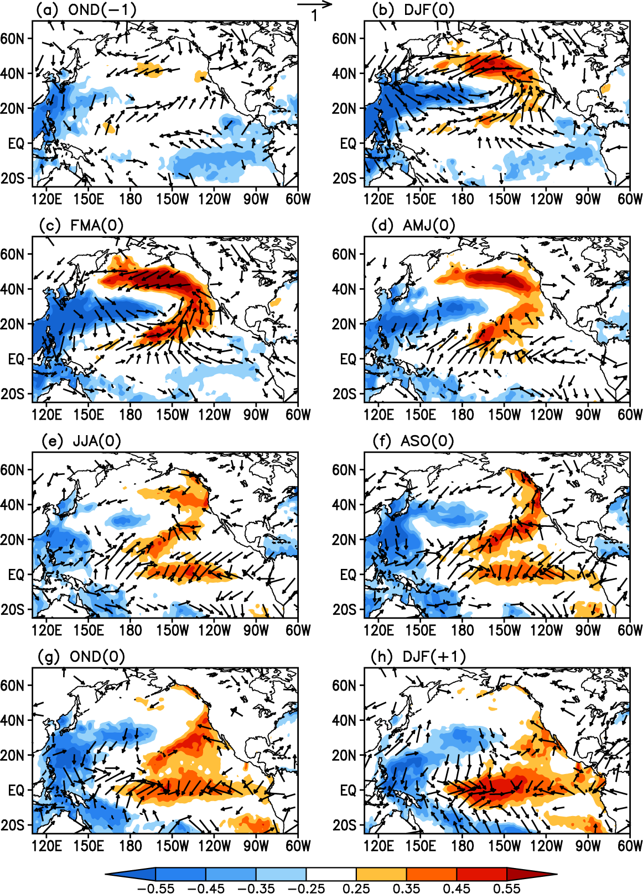
NPO develops
How VM affects ENSO?
Corr. maps of the FMA(0)-averaged VMI with averaged SST and surface wind anomalies
NPO ->VM
PMM
Previous proposed mechanisms
SFM
PMM
TWC
Zonal tropical SST grad increases -> WWB
-> Bjerknes feedback
Ding et al. (2015a)
Notes:
SFM: SST footprint induced by winter NPO persists until late spring and summer when its subtropical portion (0-20N) forces the overlying atmosphere, resulting in zonal wind stress anomalies that favor the ENSO initiation (Vimont et al., 2001; 2003a,b)
PMM: anomalous north-south SST gradient and anomalous surface circulation in the northeasterly trade regime force energetic equatorially trapped oceanic waves to occur in Central Western Pacific through thermodynamic air-sea coupling (Chiang and Vimont, 2004; Chang et al., 2007)
TWC: trade wind charging mechanism: NPO-induced variations in NP trade winds can force subsurface temperature anomalies across the central equatorial Pacific that are conducive to ENSO initiation.
The strengthened NPO can then force a dipole-like SSTA pattern in the North Pacific N of 20°N and a subtropical positive SSTA band lying in 5°-20°N. During DJF(0), ~2 months before the VM peaks, a meridional tripole-like SSTA pattern can be clearly seen in the NP N of 5°N (Figure 7b). As expected, this tripole-like SSTA pattern reaches a peak during FMA(0) (Figure 7c). At this time the SSTA pattern associated with the VM in the tropical central–eastern Pacific closely resembles a PMM pattern [Chiang and Vimont, 2004; Chang et al., 2007], with positive SSTAs in the subtropical central–eastern North Pacific (10°−30°N) and negative SSTAs in the tropical eastern Pacific. Note that in addition to the PMM pattern, there are significant negative SSTAs associated with the VM in the WNP.
As the VM peaks during FMA(0), the significant positive SSTA band in the subtropical central–eastern NP extends toward the central equatorial Pacific (Figure 7c). At the same time, anomalous surface wind associated with the VM also extend across the entire equatorial Pacific. Anomalous southeasterlies occur in the tropical eastern Pacific, while anomalous southwesterlies occur in the tropical western Pacific. The westerly (easterly) component of anomalous southwesterlies (southeasterlies) causes convergence in the central equatorial Pacific, favoring the development of positive SSTAs there. During AMJ(0), significant positive SSTAs begin to establish in the central equatorial Pacific (Figure 7d). At this time, significant positive and negative SSTAs still persist in the subtropical central–eastern North Pacific and WNP, respectively. The positive SSTAs in the subtropical central–eastern North Pacific and central equatorial Pacific, combined with negative SSTAs in the WNP, lead to an increase in the zonal SST gradient across the western–central tropical Pacific, which then strengthens the anomalous westerlies over the western–central equatorial Pacific. After JJA(0), air–sea interaction through a positive feedback process in turn amplifies the zonal wind and SST anomalies along the equator [Bjerknes, 1969], driving continued growth of these anomalies. During DJF(+1), about 10 months after the VM peaks, a warming pattern is well developed in the central–eastern equatorial Pacific (Figure 7h).
Different from SFM: different lag response of the equatorial wind and SSTA to the NP extratropical forcing.
SFM: significant SSTAs induced by the NPO persist until late spring and summer when they subsequently influence the equatorial wind fields and hence the underlying SSTs
VM: anomalous surface winds associated with the VM extend across the entire equatorial Pacific in late winter and early spring [FMA(0), see Figure 7c], which subsequently play an important role in triggering the warming in the central equatorial Pacific. They extend further toward the equator than those with NPO.
Consequently, the SST and surface wind responses in the equatorial Pacific to the VM are stronger and more immediate.
At this point, the VM is similar to the PMM, which also peaks in late winter and spring and affects the SST and surface winds in the tropical Pacific immediately at its peak phase. However, as mentioned above, the VM, as a basin-scale North Pacific SST pattern, combines the active role of SSTAs in both the central–eastern North Pacific and the WNP, different from the PMM pattern that mainly emphasizes the critical role of SSTAs in the central–eastern North Pacific as a precursor to ENSO but considers less the independent contribution of SSTAs in the WNP to the initiation of ENSO events.

Slide 25
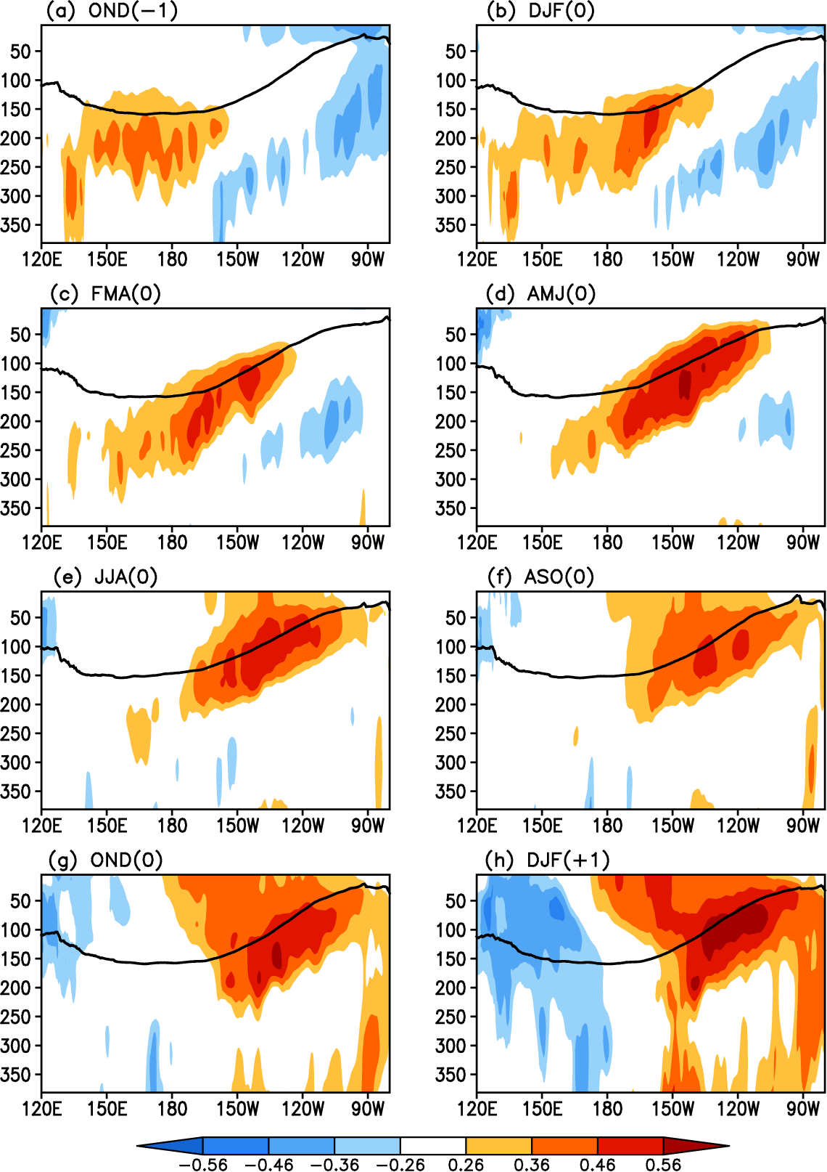
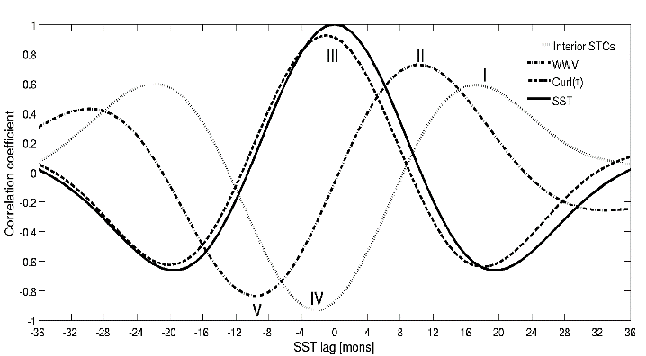
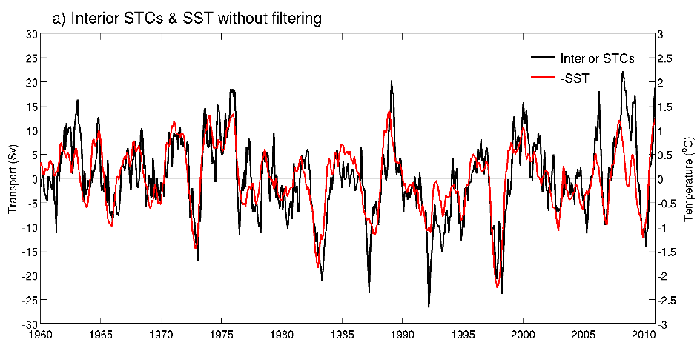
5°S–5°N
VM is associated with subsurface warming
Corr. maps of the FMA(0)-averaged VMI with averaged ocean temp. anomalies
Different from SFM/PMM
Consistent with the peak of WWV and STC contrib
Chen et al. (2015)
Notes:
During OND(–1), significant positive subsurface temperature anomalies form in the western–central equatorial Pacific (between 130°E and 150°W) at around 100–300 m depth (Figure 8a). Afterwards these positive subsurface temperature anomalies propagate eastward and upward along the thermocline (Figure 8b–e), reaching the eastern equatorial Pacific during JJA(0), when they start to warm the surface waters. In this case, there is significant warming over the central–eastern equatorial Pacific (between 150°W and 120°W), despite the fact that in the eastern equatorial Pacific anomalous easterlies tend to enhance upwelling and cool the surface. These results indicate that the evolution of subsurface ocean temperature anomalies associated with the VM is important for the initiation of ENSO events.
The mechanism responsible for such evolution of subsurface ocean temperature anomalies is fundamentally different from the SFM, which does not influence the structure of the subsurface equatorial Pacific until the following late spring and summer. They hypothesized that the equatorial Pacific subsurface temperature anomalies are a response to SLP-generated variations in the North Pacific trade winds, which they term the TWC mechanism of the equatorial Pacific.

Slide 26
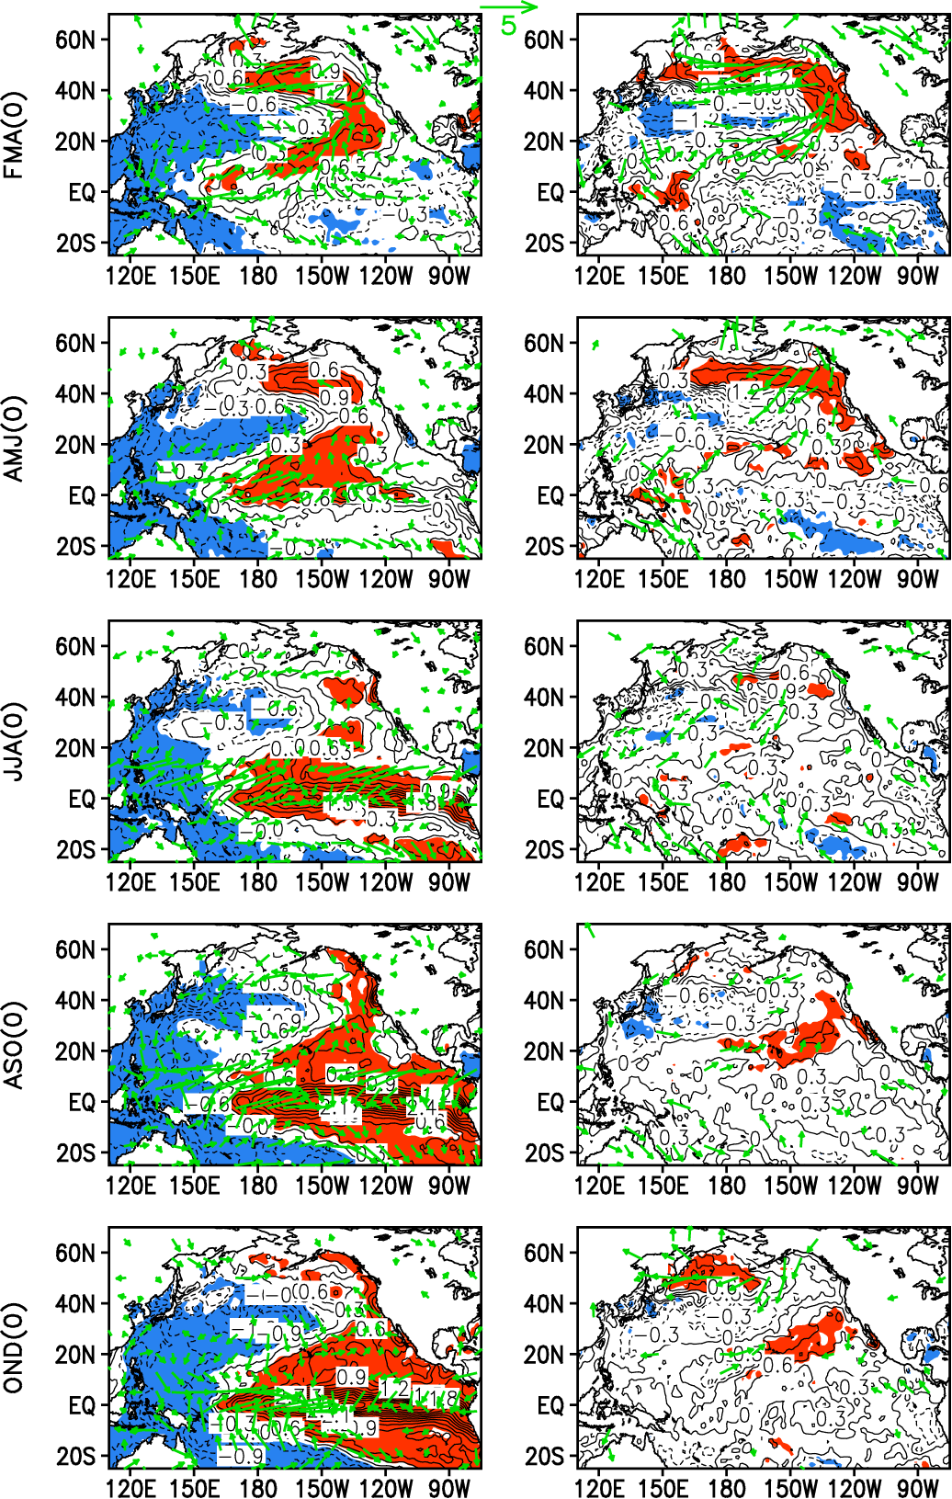
Why cannot some VM excite ENSO?
Composite diff. of the 3-month averaged SST and surface wind anomalies between VM followed by ENSO (14) and VM not followed by ENSO (6).
VM->ENSO
VM only
Notes:
Not every positive or negative VM event is followed by El Niño or La Niña event (same as the definition of a VM event). The question naturally arises as to why some VM events can excite ENSO while some cannot.
Composite differences of the 3 month averaged SST and surface wind anomalies between positive VM-El Niño and negative VM-La Niña (left panel), and between positive VM only and negative VM only (right panel) for FMA(0), AMJ(0), JJA(0), ASO(0), and OND(0). SST and surface wind anomalies in VM-ENSO and VM only are almost identical in the North Pacific poleward of 20°N, and the major difference between both groups mainly lies in the tropics.
For VM-ENSO, significant SST and surface winda associated with the VM extend farther across the equator, and by AMJ(0) the warming has established in the equatorial Pacific, with maximum warming in the central eastern equatorial Pacific.
In contrast, for VM only, SST and surface wind anomalies associated with the VM have large amplitudes mainly confined north of 20°N and do not extend sufficiently into the equator. As a result, both processes of surface air-sea coupling and subsurface ocean temperature evolution (not shown) along the equator are weak in VM only, and the warming in the central eastern equatorial Pacific does not start until JJA(0). These results suggest that although the VM events have a similar condition in the North Pacific poleward of 20°N (the domain over which the VM is defined), the condition alone does not ensure the development of an ENSO event.
Therefore, in order to better judge whether or not a VM event is followed by an ENSO event, it is also important to consider the subtropical/tropical conditions associated with the VM. If SST and surface wind anomalies associated with the VM extend sufficiently into the equator during the late winter and early spring, it is very likely that the VM can induce an ENSO event in the following winter. Consistent with surface wind anomalies, significant SLP anomalies associated with the VM also extend less far toward the equator in VM-ENSO than in VM only (not shown). This finding is generally consistent with the view that ENSO is correlated most closely with the southern pole of the NPO, not so much with the northern one [Anderson, 2003].
In addition, it is important to point out that some ENSO events (8 out of 22 events according to Figure 6c) are not preceded by VM events (hereafter ENSO only). Considering that the VM works as an ocean bridge (or conduit) for the extratropical influence on ENSO, it is very likely that some tropical phenomena, such as the Madden–Julian oscillation (MJO) [Madden and Julian, 1994] and westerly wind bursts (WWBs) [McPhaden et al., 1992; McPhaden, 1999], play an important role in triggering the onset of El Niño or La Niña events in ENSO only.

Slide 27
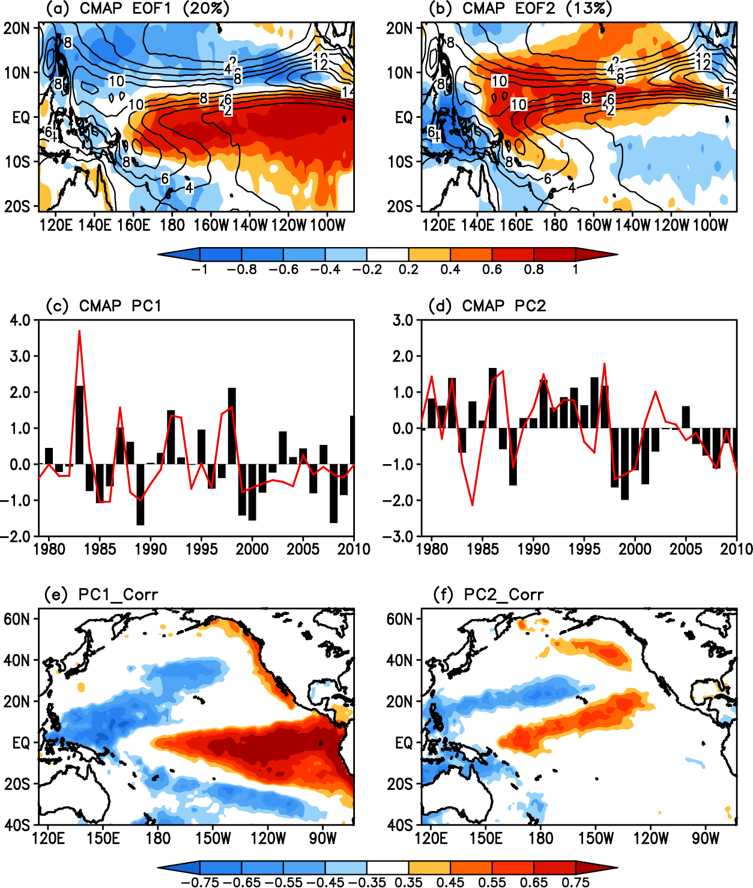
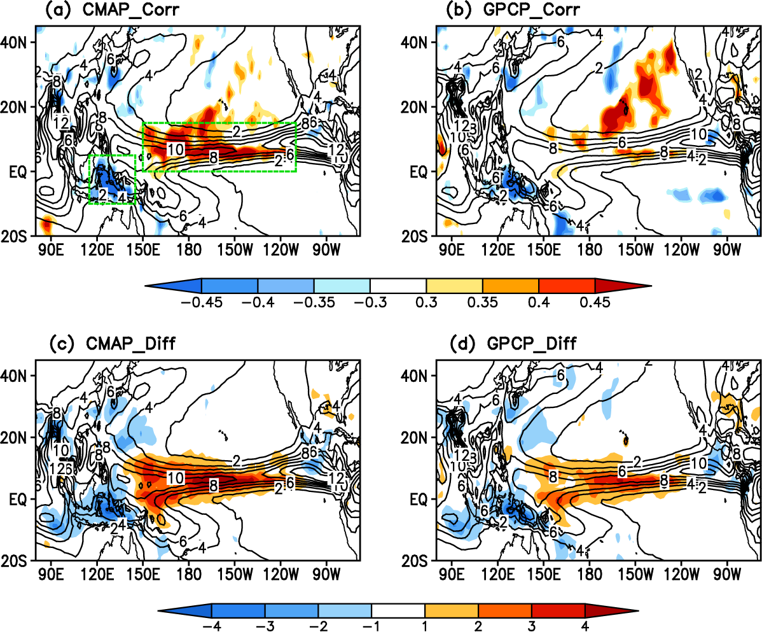
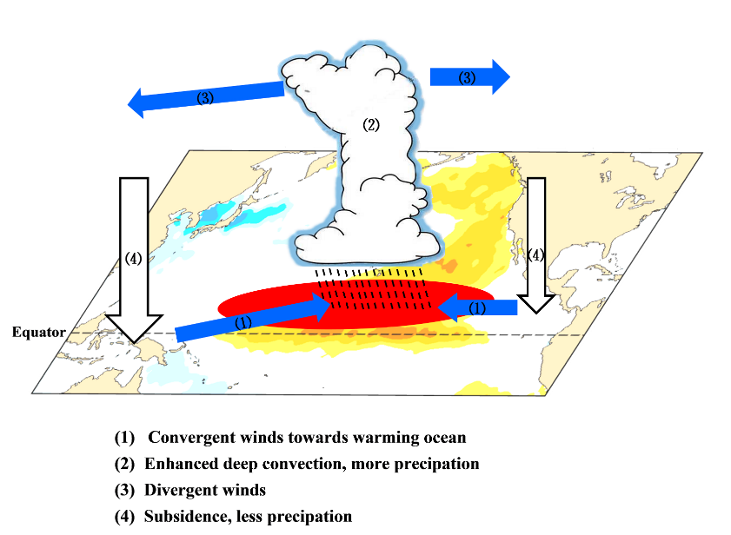
Impact of VM on summer tropical precip.
strong positive VM are followed by positive precip. anom. over the central–eastern Pacific ITCZ.
PC1(0) v.s. Nino3.4(-1)_{DJF}
PC2(0) v.s. VM(0)_{FMA}
Ding et al. (2015b)
Notes:
Figure 1. (left) (a) Correlation maps of the spring VM index with the Pacific summer precipitation anomalies based on the CMAP dataset and (c) Composite differences in tropical Pacific summer precipitation anomalies (mm day⁻¹) between strongly positive and negative VM cases. (right) (b) and (d) As for (a) and (c), respectively, but based on the GPCP dataset. In (a) and (b), areas with correlation coefficients significant at the 90% level are shaded. In (c) and (d), areas with precipitation anomalies greater than 1 mm day⁻¹ or less than –1 mm day⁻¹ are shaded. In (a)–(d), the climatological (1979–2010) summer mean precipitation is superposed as contours. In (a), the two green boxes are the positive correlation box (0°N–15°N, 150°E–110°W), and the negative correlation box (10°S–5°N, 115°E–145°E), which indicate the locations of the CI and WI regions, respectively.
Figure 2. Spatial patterns of the (a) EOF1 and (b) EOF2 of the MJJ-averaged normalized precipitation anomalies (mm day⁻¹) in the tropical Pacific (21.25°S–21.25°N, 111.25°E–86.25°W) based on the CMAP dataset. Areas with precipitation anomalies greater than 0.2 mm day⁻¹ or less than -0.2 mm day⁻¹ are shaded. The climatological (1979–2010) summer mean precipitation is superposed as contours. (c) Time series of the PC1 (red line) overlaid with the previous winter (DJF) Nino3.4 index (black bars). (d) Time series of the PC2 (red line) overlaid with the previous spring (FMA) VM index (black bars). (e) Correlation maps of the PC1 time series with the previous winter Pacific SSTAs. (f) Correlation maps of the PC2 time series with the previous spring Pacific SSTAs. In (e) and (f), areas with the correlation coefficients significant at the 95% level are shaded.

Slide 28
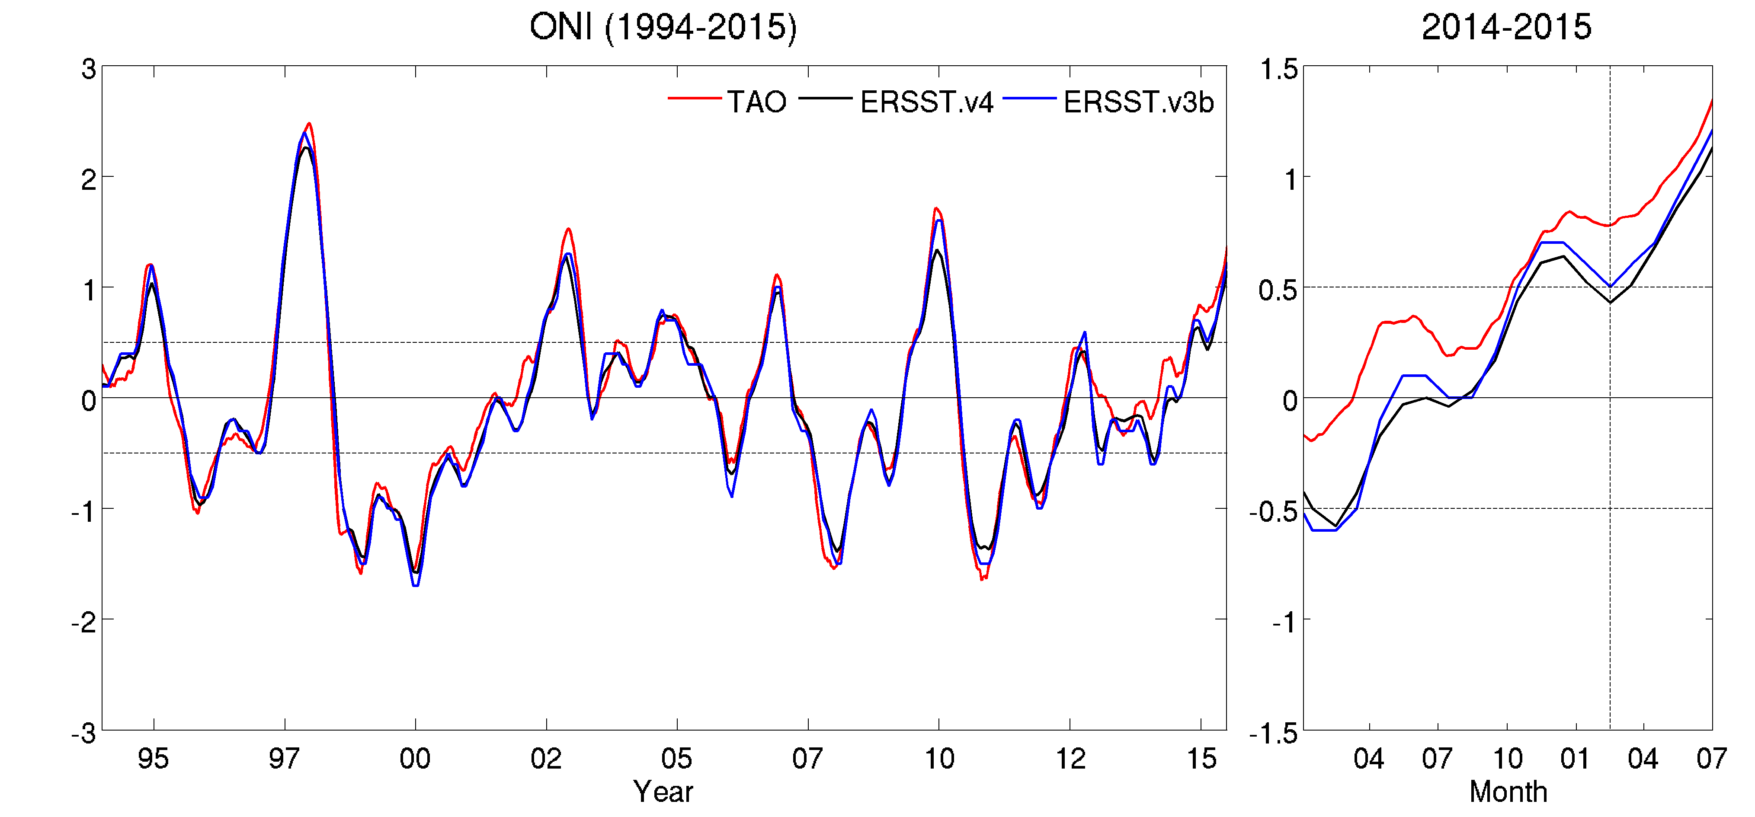
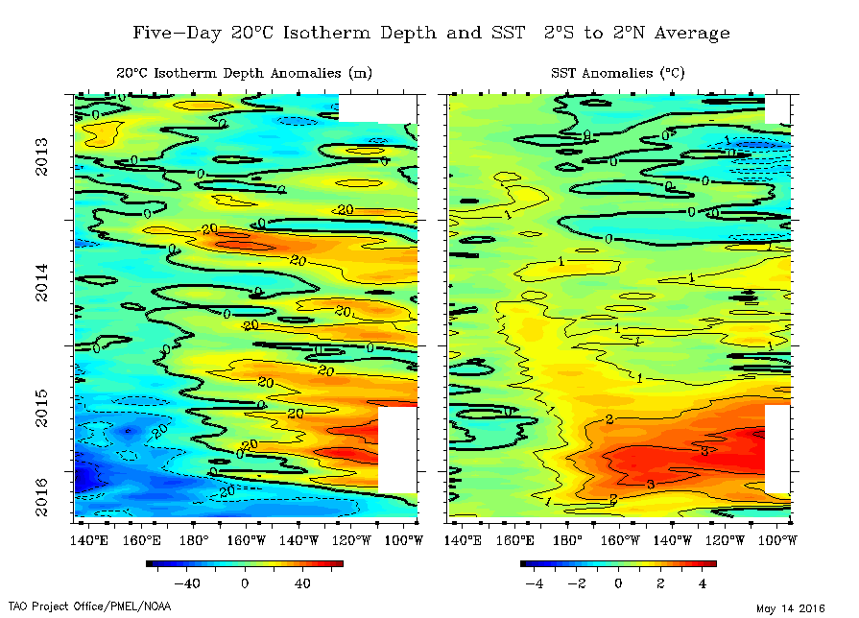
Implication on the 2015 El Niño
Nino3.4 SSTa
Define 2015 El Niño as a long El Niño started from the end of 2014
http://www.pmel.noaa.gov/tao/jsdisplay/

Slide 29
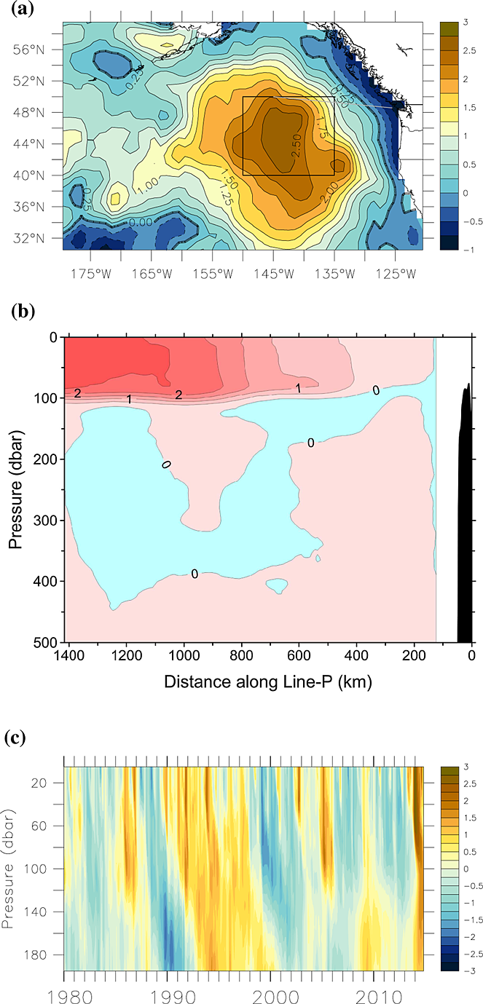
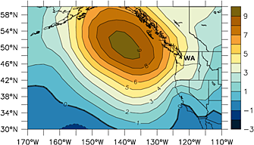
Warm Blob in the Northeastern Pacific after late 2013
Mean SLPa (hPa) in the NE Pacific Ocean for 2013/10-2014/1
SSTa (°C) in NE Pacific Ocean for Feb. 2014
Normalized monthly T_{anom.}
Upper ocean T_{anom.} along “Line P”
Great impacts on the ocean ecosystem and U.S. climate
Bond et al. (2015)
Notes:
An extremely warm ocean sea surface temperature (SST) event has been observed in the northeastern Pacific since late 2013. The warm SST anomaly, named “the Blob”, reaches 2.5 °C higher temperature than the climatological mean SST in a few extratropical regions of the North Pacific and is prominent in the south of the Gulf of Alaska. The warm Blob has drawn much attention. The 2014-2015 Pacific Anomalies Workshop (http://sccoos.org/projects/anomalies_workshop/) and a specific session at the 2016 Ocean Science Meeting were held at the Scripps Institution of Oceanography, La Jolla, CA and in New Orleans, LA, respectively, to discuss the associated causes, dynamics and extensive impacts of the Blob. Bond et al. [2015] attributed the development of the Blob to strongly positive Sea Level Pressure (SLP) anomalies above the Gulf of Alaska, which suppress the local ocean heat loss in the atmosphere. As we will show later, the described mechanism resembles the typical strengthened northern lobe of the North Pacific Oscillation/West Pacific (NPO/WP) [Rogers, 1981; Linkin and Nigam, 2008; Baxter and Nigam, 2015] on the northeastern Pacific. Hereafter, seasons refer to those of the Northern Hemisphere.

Slide 30
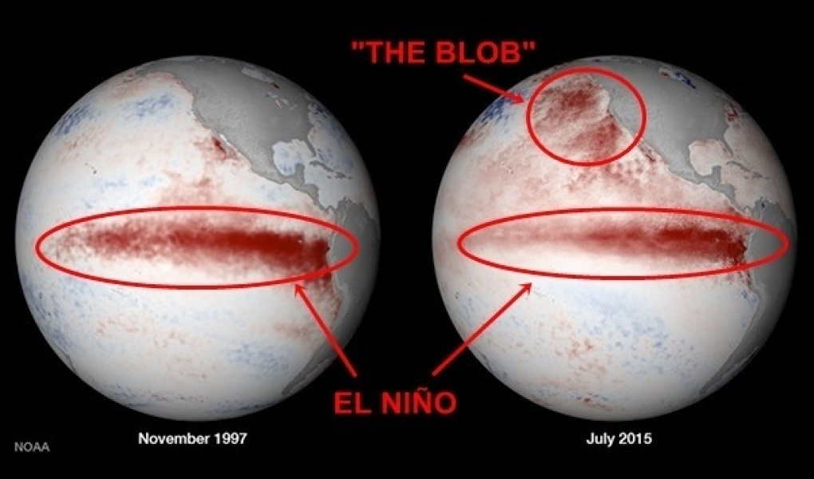
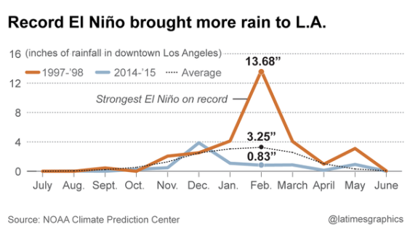
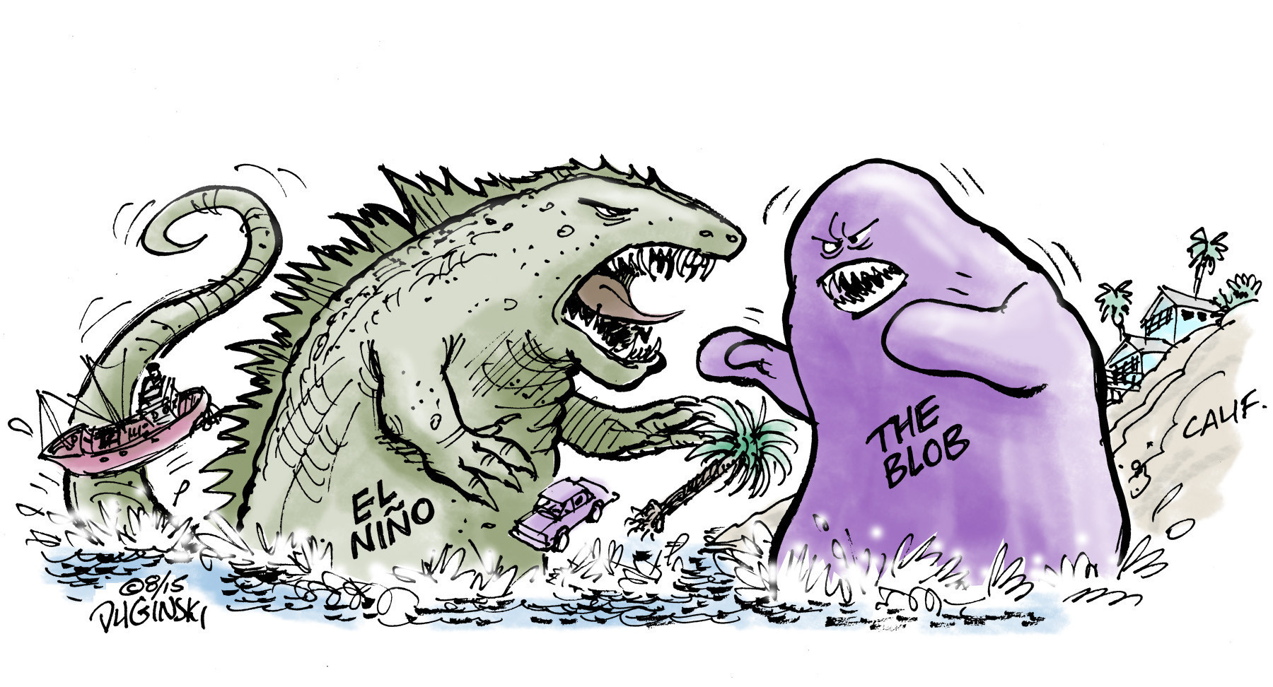
Ski Utah
https://www.skiutah.com/blog/authors/yeti/el-ni-o-vs-the-blob
LA Times
http://www.latimes.com/local/lanow/la-me-ln-godzilla-el-nino-winter-california-20150821-htmlstory.html

Slide 31
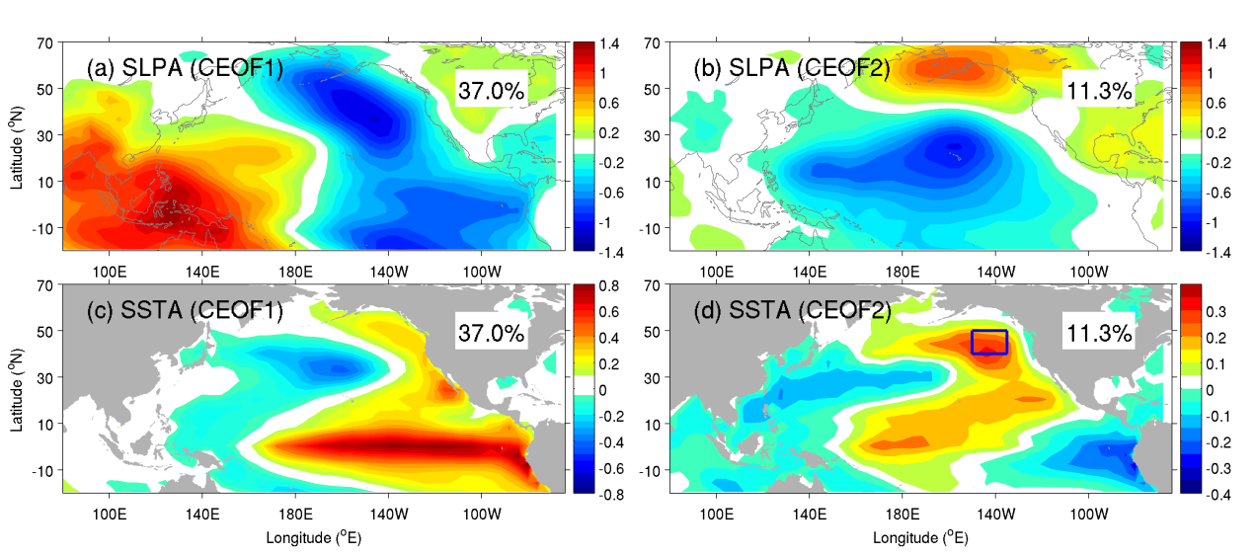
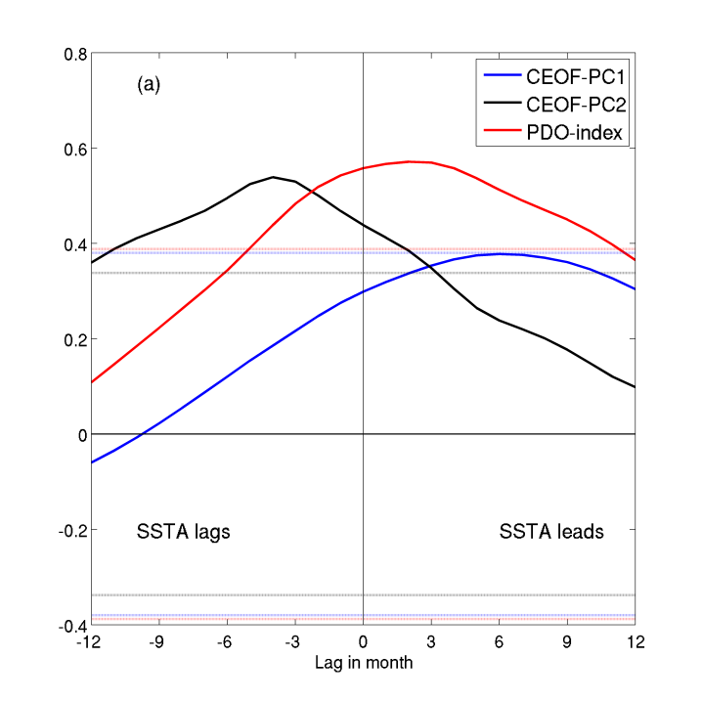
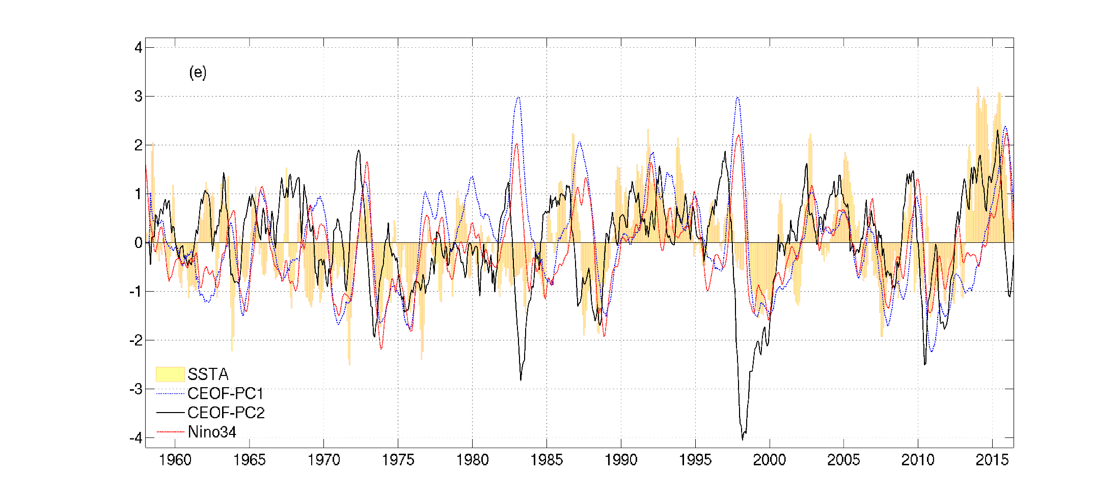

SSTa lag PC2 ~2-4 mon
SSTa lead PDO ~2-3 mon
PC2 lead ENSO ~5-8 mon

Slide 32


SSTa lag PC2 ~2-4 mon
PC2 lead ENSO ~5-8 mon
Tseng et al. (2017)

Slide 33


3-mon-averaged
SST (shaded),
SLP (contours) and
surface wind anomalies in 2014.
Warm Blob and El Niño are related!
Medium to strong ENSO events (bold: the SSTa in the Blob region >1std preceding the ENSO)
El Niño | 1965/66, 1972/73,1982/83,1986/87, 1987/88, 1991/92, 1997/98, 2002/03, 2009/10, 2015/16
La Niña | 1970/71, 1973/74, 1975/76, 1988/89, 1998/99. 1999/00, 2007/08, 2010/11
Notes:
Figure 1: Three-month averaged SST (shading), SLP (contours), and the near-surface wind vector anomalies after 2013 November. The interval is 0.2˚C for SST, and 1 hPa for SLP (magenta is positive and blue is negative). The anomalous wind has the unit of m s⁻¹.

Slide 34

Can we enhance our ENSO prediction skills?

Slide 35


Simple ENSO prediction scheme
$$nEPI(t)={αnEPI}_{WWV}\left(t\right)+βn{EPI}_{O−A}(t)$$
(Tseng et al. , 2017a)
$${nEPI}_{WWV}(t)=\text{α}\text{1}D20a\text{180˚(}\text{t}\text{−}\text{25)}+\text{α}\text{2}D20a\text{170˚}\text{W}\text{(}\text{t}\text{−}\text{15)}+\text{α}\text{3}D20a\text{155˚}\text{W}\text{(}\text{t}\text{)}$$
$${nEPI}_{O−A}\left(t,{nEPI}_{WWW}, w_{x}\right)=sign\left(event\left(t,w_{x}\right)\right)∙dH(t,{nEPI}_{wwv})$$
$$event(t,w_{x})=\left\{\begin{aligned}positive w_{x} in [t−50,t] \\ negative w_{x} in \left[t−50,t\right]\end{aligned}\right.$$
$$dH\left(t,{nEPI}_{wwv}\right)=\left\{\begin{aligned}\frac{[\left\|{nEPI}_{wwv}\left(t\right)−{nEPI}_{wwv}\left(t−5\right)\right\|+\left\|{nEPI}_{wwv}\left(t−5\right)−{nEPI}_{wwv}\left(t−10\right)\right\|]}{2}, 1/2≤P(event(t,w_{x})) \\ 0 , P\left(event(t,w_{x})\right)<1/2\end{aligned}\right.$$
Notes:
Figure 1: Evolution of D20a for (a) 1997/1998 (strong El Niño), (b) 2004/2005 (weak El Niño), (c) 1998/1999 (strong La Niña), and (d) 2000/2001 (weak La Niña) based on the observed pentad mean TAO data. The arrows indicate some events of eastward propagating Kelvin waves (the slope shown is 40˚/month for reference).

Slide 36


Linear regression model -6month lead time
Notes:
Figure 3: Lead-lag correlation of Niño3.4 index with (a) nEPI based on TAO (1994-2015), (b) nEPI based on GODAS (1994-2015), (c) nEPI based on GODAS (1980-2015) and (d) WWV index (1994-2015). Bar represents the correlation in 1994-2015 in (a, b, d), and 1980-2015 in (c); black line is the correlation in 1994-2003 in (a, b, d), and 1980-1993 in (c); and green line is the correlation in 2004-2015 in (a, b, d). 99.9% significance levels for 1994-2003 and 2004-2015 are indicated with dashed lines in (a, b, d). The same significance level for 1980-1993 is also indicated in (c). The bar in (a) is superimposed in (d) as a grey dashed line for comparison.

Slide 37

Hovmöller diagram of D20a and zonal wind anomaly (2ºS-2ºN)
El Niños
strong weak
La Niñas
strong weak
Neutral years
Notes:
Figure 9: Hovmöller diagram of D20a (contours) along the equator superimposed by the surface zonal wind anomalies (shaded) averaged between 2ºS-2ºN for two El Niños (strong: 1997, weak: 2004), two La Niñas (strong: 1998, weak: 2000) and two neutral years (2001 and 2012). Contour interval is 8 m.
2012 is a year in which the tropical Pacific warming in the spring failed to develop into an “El Niño” due to a sudden decay of SST in summer and fall. The D20a at 180˚E in January to April 2012 was more than 20 m deeper than the climatology, and the eastern Pacific SSTa even exceeded 1˚C in July 2012. Most state-of-the-art models gave a false alarm of an El Niño by predicting its occurrence at the end of 2012. However, there was no eastward propagation of a positive WWV anomaly since May 2012 (Fig. 9), resulting in the better hindcast of neutral SSTa using the proposed statistical model rather than the WWV (Fig. 7).
However, we can see the existence of a sequence of eastward propagation associated with strong WWEs in both years. Only a very weak and even shoaling D20a propagation signal can be detected after May 2012.

Slide 38
Hindcast skills
Multi-model ensemble mean skill (Barnston et al., 2012)
Lead time | Data source | Year | Correlation |  | Normalized RMSEs
 |  |  | nEPI | WWV | nEPI | WWV
four-month | TAO | 1994-2015 | 0.75 | 0.70 | 0.66 | 0.72
six-month | TAO | 1994-2015 | 0.67 | 0.62 | 0.75 | 0.78
 | TAO | 2002-2011 | 0.59 (0.42) |  | 0.81
 | GODAS | 1980-2015 | 0.64 |  | 0.77
 | GODAS | 1981-2010 | 0.68 (0.65) |  | 0.73
eight-month | TAO | 1994-2015 | 0.57 | 0.49 | 0.82 | 0.87
 | GODAS | 1980-2015 | 0.58 |  | 0.79
Percent correct of six-month ENSO forecast
ENSO index threshold | Percent correct 1994-2015 (TAO) | Percent correct 1980-2015 (GODAS)
+ Niño3.4 index | 100% (67%) | 68%
− Niño3.4 index | 83% (75%) | 87%
upper tercile Niño3.4 index (El Niño) | 86% (57%) | 73%
lower tercile Niño3.4 index (La Niña) | 86% (71%) | 82%
(Larson and Kirtman, 2014)
Using WWV
Notes:
Table 1: The hindcast skills (correlation and normalized RMSE) using the monthly data based on the linear regression model and the WWV, respectively. Values in parentheses are the ensemble-mean skill in Barnston et al. (2012).
Table 2: Percent correct of six-month ENSO forecast (see Larson and Kirtman, 2014 for the metric definition). Values in parentheses are the percent correct predicted by the WWV.

Slide 39
The only missed event: 2000/01 La Niña
Notes:
Figure 3: Lead-lag correlation of Niño3.4 index with (a) nEPI based on TAO (1994-2015), (b) nEPI based on GODAS (1994-2015), (c) nEPI based on GODAS (1980-2015) and (d) WWV index (1994-2015). Bar represents the correlation in 1994-2015 in (a, b, d), and 1980-2015 in (c); black line is the correlation in 1994-2003 in (a, b, d), and 1980-1993 in (c); and green line is the correlation in 2004-2015 in (a, b, d). 99.9% significance levels for 1994-2003 and 2004-2015 are indicated with dashed lines in (a, b, d). The same significance level for 1980-1993 is also indicated in (c). The bar in (a) is superimposed in (d) as a grey dashed line for comparison.

Slide 40



The only missed 2000/01 La Niña
Hu et al. (2014)
WWV index (curve) and its tendency (shading)
Extensive cold SST in the tropic and subtropics
Meridional temp. advection 5–205 m, 170°–120°W
Notes:
monthly mean WWV index (curve) and its tendency (shading). The y-axis in the left represents the WWV and in the right is the WWV tendency. The unit is m for the index and m/month for the tendency
Meridional ocean temperature advection averaged in 5–205 m and 170°–120°W with unit of °C/month during a Jan 1988–Apr 1990; b Jan 1999–Apr 2001; c Jan 2007–Apr 2008; and d Jan 2010–Apr 2012. Dashed green lines represent the equator

Slide 41
Why 2014/15 boreal winter is a neutral state or weak El Niño (ERSST.v3b/TAO,ERSSTv4)?
Notes:
Figure 3: Lead-lag correlation of Niño3.4 index with (a) nEPI based on TAO (1994-2015), (b) nEPI based on GODAS (1994-2015), (c) nEPI based on GODAS (1980-2015) and (d) WWV index (1994-2015). Bar represents the correlation in 1994-2015 in (a, b, d), and 1980-2015 in (c); black line is the correlation in 1994-2003 in (a, b, d), and 1980-1993 in (c); and green line is the correlation in 2004-2015 in (a, b, d). 99.9% significance levels for 1994-2003 and 2004-2015 are indicated with dashed lines in (a, b, d). The same significance level for 1980-1993 is also indicated in (c). The bar in (a) is superimposed in (d) as a grey dashed line for comparison.

Slide 42


Southern hemisphere Suppression in 2014
Min et al., 2015; Zhu et al., 2016; Tseng et al. 2016b
Notes:
Figure 10: Two-monthly averaged SSTa (shading), anomalous precipitation (contours), and the near-surface anomalous wind vector during 2000. The interval is 0.25˚C for SSTa, and 1.5 mm/day for anomalous precipitation (blue is positive and red is negative). The anomalous wind has the unit of m s⁻¹.
Figure 12: (a) Same as Fig. 9 but for 2014. (b)-(d) The evolution of SSTa at three different latitudes in 2014.
In 2014 June, eastern Pacific south of the equator, the observed anomalies were below -0.5C.

Slide 43


Attribute 40% ensemble error
Impacts of SE Pacific SSTa on the ensemble CFSv2
Zhu et al. (2016)
SE: obs. cold SSTa in April
SE3: triple obs. cold SSTa in April
SEpTNWP: obs. cold SSTa in April+ observed wnp warm SSTa
Notes:
CFSv2: discrepancy in representing the WES and stratus-SST feedbacks.
SE: observed cold SSTa in the SE Pacific was added.
SE3: same anomaly with triple the magnitude was added.
SEpTNWP, same anomaly together with the warm anomaly in the tropical northwestern Pacific was added.
The improvement in SE is related to the surface wind differences initiated by the negative SSTa. The ITCZ convergence located to the north of the equator was enhanced throughout the basin (a,b), driven by the strengthened southeast trade winds. The dynamic is similar to the atmospheric response of PMM. Stronger meridional cross-equatorial flows in the eastern Pacific and stronger easterly wind. Postive WEP feedback.
SE3: story is different at longer lead times. After the initial strengthening of the easterlies, strong SSTa generated so large a meridional gradient that they could trigger very strong meridional winds without further accelerating the easterlies. This forced the ITCZ northward and weakend the trade winds in the northern tropical Pacific. The weakened northeast trade winds in turn warmed the local SST in the northern tropical Pacific as a result of the WES (4e), resembled the PMM. Because of the positive WES, the cross-equatorial pattern develops further.
SE and SE3 suggests the cross-equatorial mode might not be evoked unless the SSTa in SE Pacific are strong enough to exert influence in the northenrn hemisphere.
Due to the stronger merdional orientation of the surface wind anomalies in SE3, the surface winds in June were featured by somewhat weaker easterly anomalies in SE3 than in SE throughout the eq. and much stronger meridional winds in EP in SE3. The local meridional and zonal winds in the EP exerted opposite effects on ENSO evolutions by modulating the local upwelling, with the former (the latter) favoring a weaker (stronger) El Nino in SE3.
Multiple competing factors influence the response in SE3 to the amplification of the added negative SSTa.
SEpTNWP: the amplitude increase over SE/SE3 was related to anomalous equatorial westerly winds over the far western Pacific, which were generated by the positive SST anomalies in the tropical WNP. The WWB triggered Kelvin waves. Therefore, the role of the SSTa in the SE was offset by these downwelling Kelvin waves, resulting in a stronger El Nino.

Slide 44


Impacts of WWEs in 2014
NOWWE: no WWEs
1997WWE: all WWEs 1997 added
1997
eastern edge of the warm pool (EEWP)
2014
Menkes et al. (2014)
Notes:
Time series of (a) equatorial Pacific heat content anomalies (HCA), (b) Niño3 sea surface temperature anomalies (SSTA), and (c) Niño3 sea level anomaly (SLA) over the 1993–2014 period for the observations (continuous lines) and REF experiment (dotted lines). The Pearson correlation (p < 0.01) between modeled and observed time series is indicated on the upper right of each panel. Red bars normalized to their 1993–2014 maximum (the march 1997 WWE) in Figure 1a indicate WWEs, with the length of the bar proportional to the space-time integral of WWE zonal stress anomalies (this a good measure of the equatorial wind effects on the ocean dynamics in the 3°S–3°N band [Kessler et al., [1]]). The bar widths are proportional to the WWE durations. The March 1997 WWE is indicated in blue and the February–March 2014 WWE is indicated in green. The pink shading illustrates the periods considered as El Niños based on
January–July 1997 3°N–3°S zonal time section of (a) zonal wind stress referred to as TAUX anomalies (colors with observations (OBS) referring to the NCEP2 model forcing) and WWEs (contours) and SST (color), surface currents (thin black contours) anomalies for (b) observations, (c) REF experiment, and (d) REF minus NOWWE experiments. (e–h) Same as Figures 2a–2d but for 2014. Plain blue lines indicate the EEWP position defined as the longitudinal position of the 28.5°C isotherm in the 3°S–3°N band. Plain grey lines indicate the climatological position of the EEWP. In Figure 2d, the dashed blue (respectively, dash-dotted purple) line indicates the EEWP position for the NOWWE (respectively, MarWWE) experiments. In Figures 2f and 2g, the EEWP is indicated in blue for 1997 and in red for 2014. In Figure 2h, the dashed red (respectively, dash-dotted purple) line indicates the EEWP position for the NOWWE (respectively, 1997WWE) experiments. Labels of the experiment EEWP are added for clarity on each panel.
Fig. 2 show the observed equatorial pacific evolution during the onset and growth of 1997 and 2014. 1997 WWE is followed by a rapid eastward displacement of the eastern edge of the warm pool (EEWP). This WWE initiates a strong downwelling Kelvin wave, reaches the EP in May. This WWE is followed by other WWEs from April to June, with intense surface jets over the warm pool and sustained SSTa in CP,EP.
EEWP only reach 155W in 2014, but 140W in 1997.
Warming in CP/EP in 2014 is 2/1 of 1997.
No other WWEs after 2014 March.
NOWWE: zeroing the WWE regions in the stress seasonal anomaly field (keep only the seasonal cycle within WWEs).
1997WWEs: all WWEs of 1997 were added to the NOWWE stress in 2014.

Slide 45



Southern hemisphere pathway
Zhang et al. (2014a,b), Ding et al. (2015c)
Super El Nino development: Hong et al. (2014) GRL
Notes:
Fig. 1Spatial pattern of the austral summer [November–April (NDJFMA)] averaged a SLP (mb) and b SST (°C) anomalies regressed against the austral summer (NDJFMA-averaged) cold tongue index (CTI) during the following year [the CTI is defined as SST averaged over (180°–90°W, 6°S–6°N) and is a commonly used index of ENSO variability]. Positive (red) and negative (blue) SLP and SST anomalies, with regression coefficients significant at the 0.05 level, are shaded. In (a), three green boxes [positive regression box: (177°–130°W, 72°–52°S); negative regression boxes: (155°E–145°W, 48°–25°S) and (110°–75°W, 57°–33°S)] indicate the locations of three action centers of the PSA, respectively. In (b), four green boxes [from left to right: (142°E–179°W, 47°–25°S); (173°–145°W, 58°–36°S); (113°–81°W, 59°–40°S); and (103°–76°W, 37°–17°S)] define the locations of the four poles of the SPQ

Slide 46




Joint impact of North/South Pacific extratropical forcing
Ding et al. (2016)
Notes:
Figure 1. (a) Correlation maps of the boreal winter [November–March (NDJFM)] SLP anomalies correlated with the Niño3.4 index during the following boreal winter. Areas with a correlation significant at or above the 90% confidence level are shaded. The two green boxes [positive correlation box: (175°–117°W, 50°–74°N); and negative correlation box: (179°E–135°W, 8°–31°N)] are used to define the NPI, while the two magenta boxes with significant negative correlations [from left to right: (162°E–140°W, 46°–24°S); and (107°–75°W, 59°–38°S)] are used to define the SPI. (b) Time series of the boreal winter NPI (red line) and SPI (dashed green line) overlaid with the Niño3.4 index (black bars) during the following boreal winter. All indices are standardized, and the correlations of the boreal winter NPI and SPI with the Niño3.4 index a year later are given in the lower left corner.
Figure 2. (a) Scatterplot of the boreal winter (NDJFM) NPI versus the Niño3.4 index a year later, plotted only for those years in which the NPI has the same sign as the SPI. (b) As for (a) but for only those years in which the NPI has the opposite sign as the SPI. (c) Scatterplot of the boreal winter (NDJFM) SPI versus the Niño3.4 index a year later, plotted only for those years in which the NPI has the same sign as the SPI. (d) As for (c) but for only those years in which the NPI has the opposite sign as the SPI. (e) Probability (given in percentile) of strong, weak, and normal ENSO events preceded by the same-sign NPI and SPI. (f) As for (e) but for probability of strong, weak, and normal ENSO events preceded by the opposite-sign NPI and SPI. In (a)–(d), the correlation coefficient between the boreal winter NPI or SPI index with the Niño4 index a year later is given in the upper left corner.

Slide 47


Notes:
Supplementary Figure 1. Correlation maps of the DJF NPI (left panel) and SPI (right panel) with the 3-month averaged SST (shading) and surface wind (vectors) anomalies for several lead times (MAM, JJA, SON, and DJF). Positive (red) and negative (blue) SST anomalies with correlations significant at or above the 90% confidence level are shaded. Only surface wind vectors significant at the 90% confidence level are shown.
Supplementary Figure 2. As in Figure 3, but for lagged regressions of the 3-month averaged SST (°C; shading) and surface wind (m s^{‒1}; vectors) anomalies, calculated against the DJF SPI for years in which the NPI and SPI have the same (left panel) and opposite (right panel) sign.
Supplementary Figure 3. Time series of the observed boreal winter Niño3.4 index (black bars), and the cross-validated hindcasts of the boreal winter Niño3.4 index generated by empirical model (1) using both the combined NPI and SPI (dashed green line), using the NPI alone (red line), and using the SPI alone (blue line). The correlations between various time series are given in the lower left corner.

Slide 48
The VM: an ocean bridge connecting the NPO and ENSO
Ocean Bridge
What dynamics trigger these?
SFM
LF
NPO [winter(0)]
VM [FMA(+1)]
El Nino [winter(+1)]
SF

Slide 49

Origin of NPCV patterns
Lead-lag corr of U_{wind} in WNP and PC1
Lead-lag corr of -V_{wind} in WNP and PC2

Slide 50

Time series of NDJ-averaged -V_{10ps}, JAS-averaged U_{10ps}
Notes:
Time series of NDJ-averaged -V_{10ps}, JAS-averaged U_{10ps} in PAMS (superimposed by their associated JFM-averaged PC2 and DJF-averaged PC1 with maximum correlations in Figs. 8a and 8b, respectively). All time series are aligned with their corresponding months. Black solid (dashed) lines label the El Niño (La Niña) years in December.

Slide 51
Summary
A modified North Pacific climate paradigm connects and explains the observed ENSO and its precursor
Two dominant modes of NPCV are linked
ENSO/PDO: the zonal variability in tropic and mid-latitude
NPO/VM: a footprint of the meridional variability through the tropic-extratropical teleconnection
VM, forced by NPO, is closely linked to the development of ENSO (ocean bridge)
Warm Blob after 2013 is an example leading to 2015 El Niño
Subtropical SSTa can enhance/suppress the ENSO development (affecting the O-A coupling)
WWV+O-A interaction can enhance the ENSO predictability

Slide 52
New North Pacific climate paradigm
Warm Blob-the ocean expression of the 2nd O-A mode variability (NPO/VM)
Ding et al. (2017a)
Ding et al. (2015a); Tseng et al. (2017b)
Tropical-extratropical interaction
Ding et al. (2015b)
SFM (Vimont et al.,2003)
Chen et al. (2015); Tseng et al. (2017a)
Enhance ENSO prediction skill: WWV+WWE
Tropical-extratropical interaction
Ding et al. (2015c); Ding et al. (2016), Zhang et al. (2014a,b)

Slide 53
Future work
Enhance the prediction skill by further including the extratropical signals
How the interannual variation of NPO/WP is modified?
Indo-Pacific Warm Pool (O-A interaction from maritime continent, MC)
Impacts from the North Atlantic
How are the STCs connected with the Pacific decadal and multi-decadal Variability? What force the STC variability? Can we enhance the decadal predictability?

Slide 54

Ding, R., Li, J., Tseng, Y.H., Sun, C. and Zheng F. (2017b), Linking a sea level pressure anomaly dipole over the North America to the central Pacific El Niño, Clim. Dyn.. 49, 1321-1339.
Ding, R., Li, J., Tseng, Y.H., Sun, C. and Xie F. (2017a), Joint impact of North and South Pacific extratropical atmospheric variability on the onset of ENSO events, J. Geophys. Res.-atmos, 122, 279-298.
Ding, R., Tseng, Y.H., Ha, K.J., Lee, J.Y. and Li, J. (2016), Interdecadal change in the lagged relationship between the Pacific-South American pattern and ENSO, Clim. Dyn., 47, 2867-2884.
Chen, H.C., Sui, C.H., Tseng, Y.H. and Huang, B.H. (2015), An analysis of the linkage of Pacific subtropical cells with the Recharge-Discharge processes in ENSO evolution, J. Clim., 28, 3786-3805.
Ding, R., Li, J., Tseng, Y.H., Sun, C. and Guo, Y. (2015), The Victoria mode in the North Pacific linking extratropical sea level pressure variations to ENSO, J. Geophys. Res., 120, 27-45.
Ding, R., Li, J., Tseng, Y.H. and Ruan, C. (2015), Influence of the North Pacific Victoria mode on the Pacific ITCZ summer precipitation, J. Geophys. Res., 120, 964-979.
Ding, R., Li, J. and Tseng, Y.H. (2015), The impact of south Pacific extratropical forcing on ENSO and comparisons with the North Pacific, Clim. Dyn., 44, 2017-2034.
Hu, Z.Z., Humar, A., Zhu, J., Huang, B., Tseng, Y.H., Wang, X. (2017a), On the shortening of the lead time of ocean warm water volume to ENSO SST since 2000 Sci. Rep., 7, 4294.
Hu, Z.Z., Huang, B., Tseng. Y.H., Wang, W., Kumar, A. Zhu, J. and Jha, B. (2017b), Does vertical temperature gradient of the atmosphere matter for El Nino development? Clim. Dyn., 48, 1413-1429.
Miller, A. J. et al. (2017), Coupled ocean-atmosphere modeling and predictions, J. Marine Res., 75, 361-402.
Tseng, Y.H., Ding, R. and Huang, X.-M. (2017a), The warm blob in the northeastern Pacific-the bridge leading to the 2015/16 El Niño, Environ. Res. Lett., 12, 054019.
Tseng, Y.H., Hu, Z.Z., Ding, R. and Chen, H.C. (2017b), An ENSO prediction approach based on ocean conditions and ocean-atmosphere coupling, Clim. Dyn. 48, 2025-2044.

Slide 55
Yu-heng Tseng
Institute of Oceanography, National Taiwan University
New North Pacific climate paradigm
Miller et al. (2017)
Ding et al. (2017a)
Ding et al. (2015a); Tseng et al. (2017b)
Tropical-extratropical interaction
Ding et al. (2015b)
Hu et al. (2017a; 2017b)
SFM
Chen et al. (2015, 2018); Tseng et al. (2017a);
Ding et al. (2017b)
Tropical-extratropical interaction
Ding et al. (2015c); Ding et al. (2016)

Slide 56
An ENSO prediction approach based on ocean conditions and ocean-atmosphere coupling
Implication of a new North Pacific climate paradigm on the 2015 El Niño and ENSO prediction
Yu-heng Tseng
Institute of Oceanography, National Taiwan University
Ruiqiang Ding
LASG, Institute of Atmospheric Physics, Chinese Academy of Sciences
Acknowledgments: Hen-ching Chen, Zeng-Zhen Hu, Jiangping Li, Xiaomeng Huang, Art Miller
NSF EASM-3: Collaborative Research: Quantifying Predictability Limits, Uncertainties, Mechanisms, and Regional Impacts of Pacific Decadal Climate Variability
Notes:
RCEC, Academia Sinica, Taiwan; Ruiqiang Ding: Institute of Atmospheric Physics, Chinese Academy of Sciences, Beijing, China; Jiangping Li: GCESS, Beijing Normal University, Beijing, China
Zeng-Zhen Hu, CPC NCEP
A new Pacific climate paradigm was recently proposed based on the two dominant coupled ocean-atmosphere (O–A) modes of surface variability and equatorial dynamics. These two leading modes can explain most of the North Pacific climate variability and are linked with each other. The second O–A mode reflects the footprint of the meridional variability associated with North Pacific Oscillation through the tropical–extratropical teleconnection and commonly evolves into the El Niño–Southern Oscillation (ENSO) phase. This is confirmed by the occurrence of the warm Blob that developed after late 2013 in the northeastern Pacific, leading to the 2015 El Niño. Based on the new paradigm, a simple statistical model is derived to enhance the ENSO prediction through the evolution of the ocean heat condition and the oceanic Kelvin wave propagation associated with westerly wind events and easterly wind surges in the tropical Pacific. The hindcast skill of the proposed model is better than that based on the Warm Water Volume index in terms of the monthly correlation, normalized RMSEs and ENSO occurrences, The hindcast skill is also comparable to the predictions using other dynamical and statistical models, indicating that these processes are the keys to ENSO development.

