Slide 1
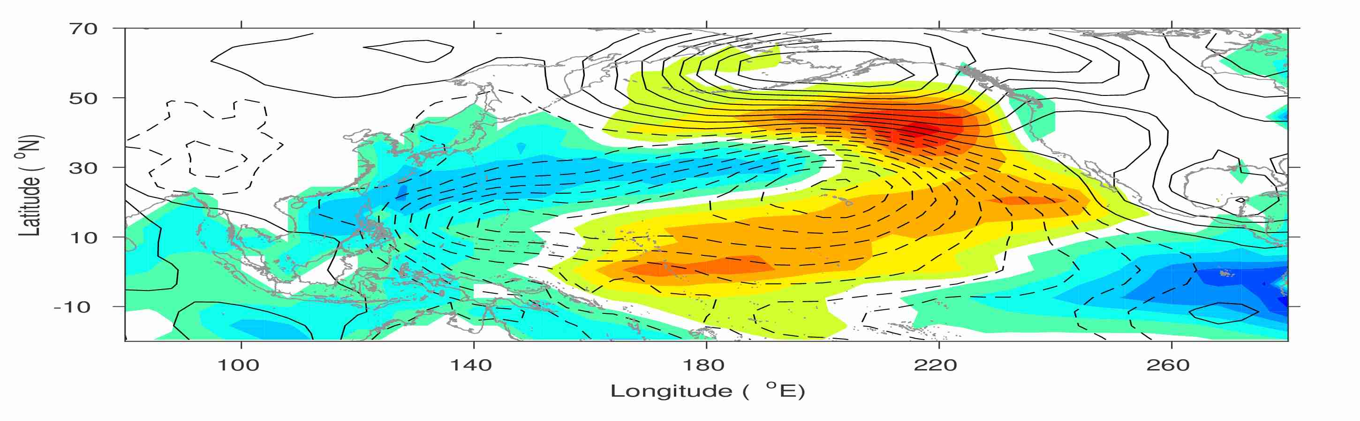
Could the North Pacific Oscillation Be Modified by the Initiation of East Asian Winter Monsoon?
Yu-heng Tseng¹, Ruiqiang Ding², Sen Zhao³, Yi-Chun Kuo¹
¹Institute of Oceanography, National Taiwan University, Taiwan
²Institute of Atmospheric Physics, Chinese Academy of Sciences, China
³U. Hawaii, Manoa, USA
Notes:
Good morning, thank you very much for your coming for the first talk today!
What I am going to present is
Yu-chiao Liang⁴

Slide 2
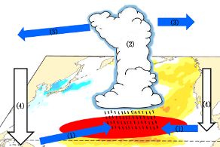
New North Pacific climate paradigm
Miller et al. (2017)
Ding et al. (2017a)
Ding et al. (2015a); Tseng et al. (2017b)
Tropical-extratropical interaction
?
Ding et al. (2015b)
Hu et al. (2017a; 2017b)
SFM
Chen et al. (2015, 2018); Tseng et al. (2017a);
Ding et al. (2017b)
Tropical-extratropical interaction
Ding et al. (2015c); Ding et al. (2016)

Slide 3
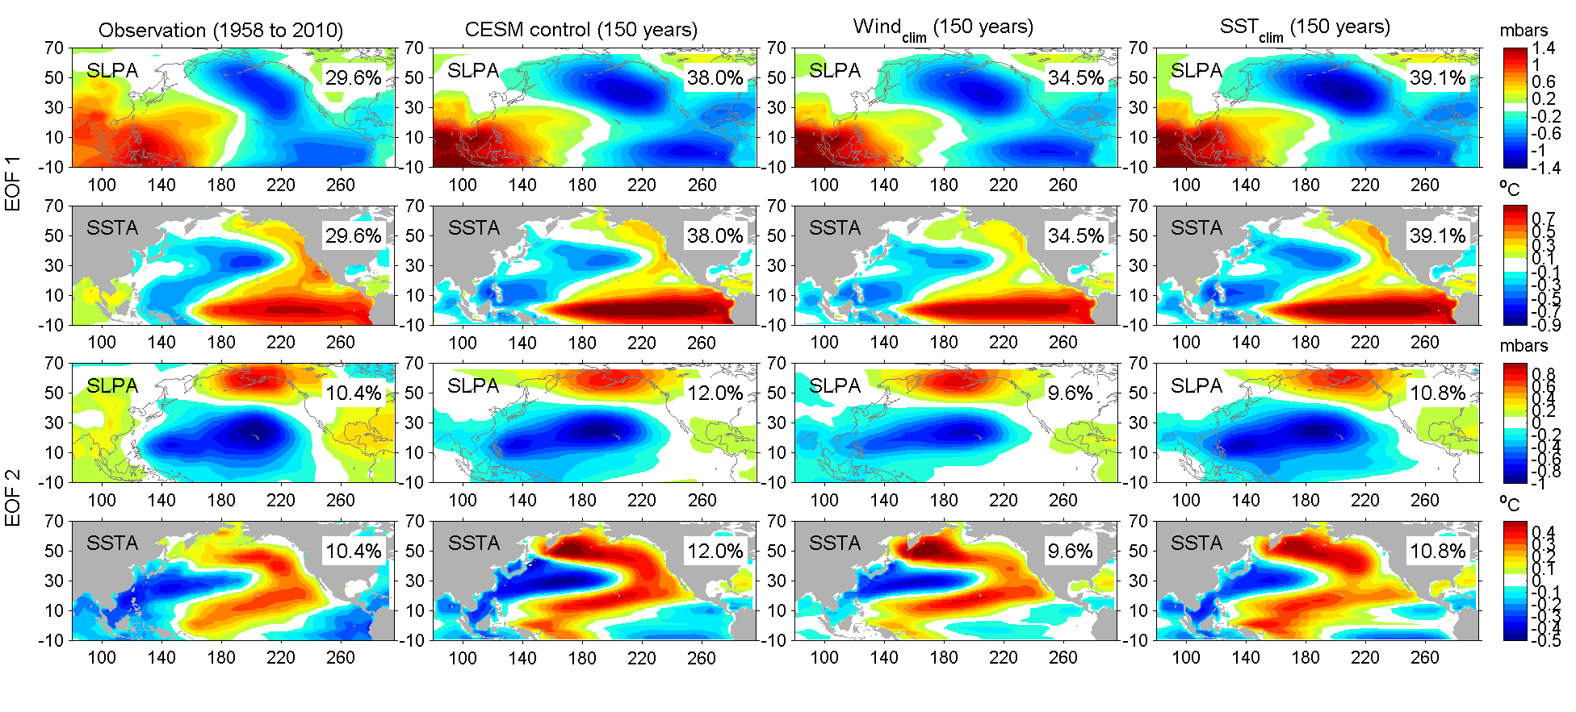
The dominant surface pattern and variability in the North Pacific-2nd mode
Covariability mode of SLP and SST anomalies from CEOF2 (1948-2012)
North Pacific Oscillation (NPO)
NPO itself is a stochastic mode of variability (e.g., Rogers 1981)
However, a portion of the NPO (southern node) is dynamically linked to the CPW variability (Di Lorenzo, 2010; Furtado et al., 2012).
Here, we will show the development of NPO can also be initialized by the EAWM
Victoria Mode (VM) or NPGO (or PMM)
Miller et al. (2017)
Notes:
CEOF for the SLP and SST

Slide 4
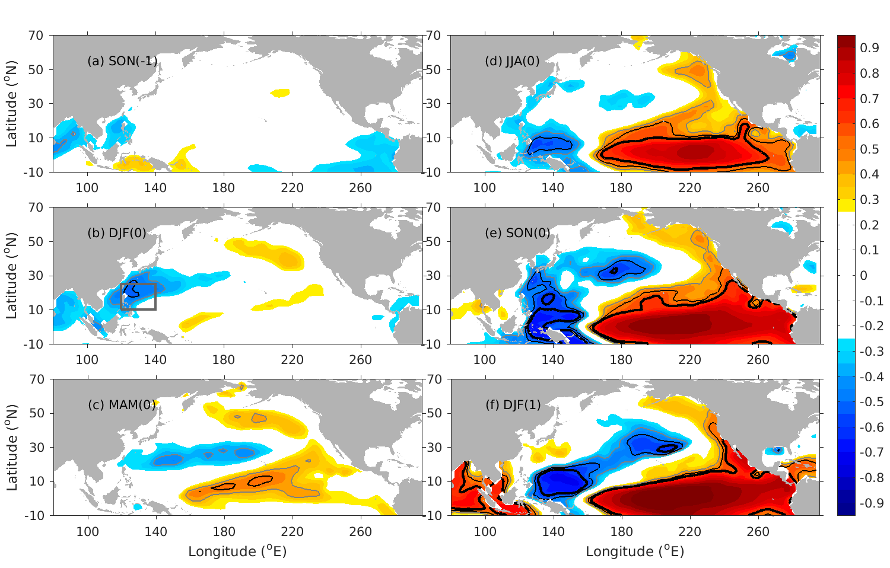
Western North Pacific-Basin scale
Correlation of Pacific SSTa (3-month running mean) and Jan.(1) Niño3.4 at different lags from 1948–2012
Tseng et al. (2017)

Slide 5
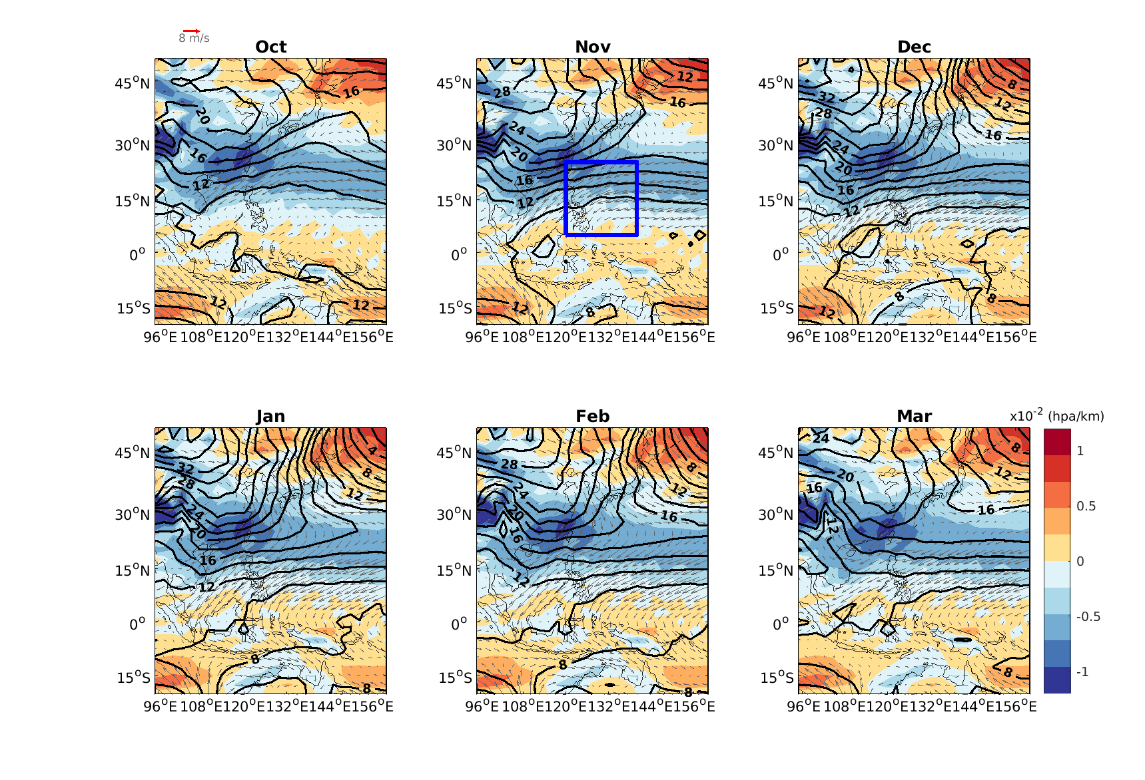
East Asian Winter Monsoon (EAWM)
characterized by strong NW (NE) winds and cold temp. over the northern China (southern PAMS) region
SH source
Land/ocean contract
Shading: dSLP/dy
EAWMI=averaged -V_{120-140E,5-25N} (similar to Chen et al., 2000)
Notes:
The EAWM index (EAWMI) is defined as the negative mean geopotential height at 500 hPa within 25°–45°N and 110°–145°E, where the East Asian trough is located; this area reflects the variations in the EAWM-related circulation (Sun and Li 1997; Wang et al. 2009b; Wang and He 2012). Wang and He 2012). In this paper, the December-January–February mean represents the boreal winter. For example, the winter of 1949 refers to the average of December 1948, January 1949 and February 1949.
characterized by strong NW winds and cold temperatures over the northern China region.
The source of the cold air outflow is the Siberian cold dome, maintained by strong radiative cooling and subsidence by the SH as well as the topological effect of the Tibetan Plateau
The NW cold surge itself is governed by the differential heating between the land and ocean. Also, the intensity of the cold surge has strong relations with the tropical convection and is a stage of a tropical-extratropical interaction through the existence of a local Hadley cell near the Philippines and the descent near the SH.

Slide 6
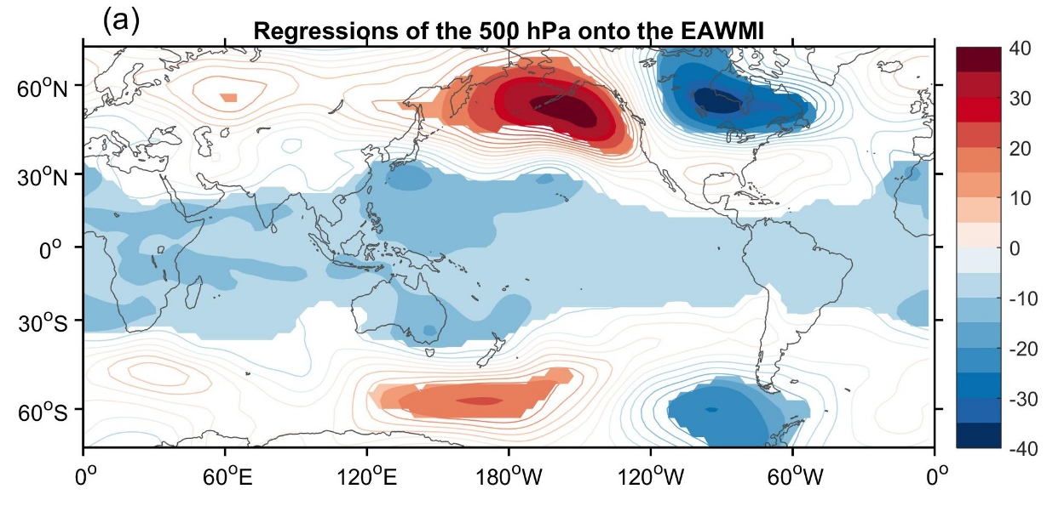
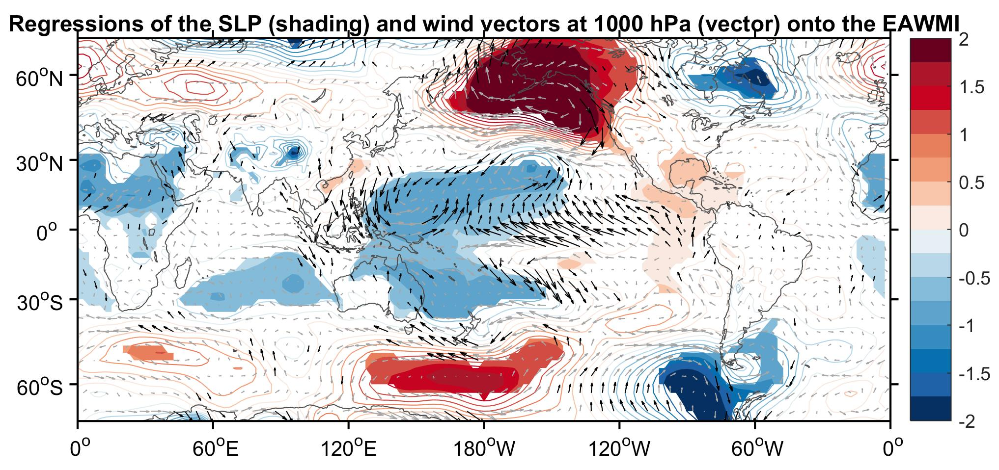
Notes:
During strong EAWM the northeasterlies are enhanced along East Asia coast and extend to equatorial latitudes. During strong EAWM, an anomalous cyclonic circulation appears in the Philippine Sea. There is a strong confluence over the maritime continent and a strong divergence over the eastern tropical Pacific. The correlations are statistically significant at 90% level. The regression shows the obvious contrast between East Asian continent and the adjacent ocean. SLP: In the East Asian continent the two key areas are Siberia and the northern China where the pressure becomes higher. Over the tropical Pacific, negative anomalies can be found over the western Pacific and positive anomalies over the eastern Pacific. These correspond well to the difference of surface circulation with strong confluence over the maritime continent and weak divergence over the eastern Pacific. 500hPa: the East Asian trough at 500hPa is much deepened in strong EAWM. The most striking feature is the negative anomalies of geopotential height appearing over the whole tropics with the maximum values ove r …. There is also a remarkable teleconnection in the negative phase of the PNA pattern (with negative height anomalies over the tropical eastern Pacific and North America, and positive anomalies over the northern Pacific. Thus, the EAWM indicates that a strong EAWM corresponds to strong northerly winds along coastal East Asia, cold East Asian continent and surrounding sea and warm ocean from the subtropical central Pacific to the tropical western Pacific. The feature of a strong EAWM also include high pressure in East Asian continent, low pressure in the adjacent ocean and much deep East Asian trough. The results also suggest that there are marked differences in the global scale which are closely associated with, but not necessarily all due to, the interannual variability of EAWM.

Slide 7
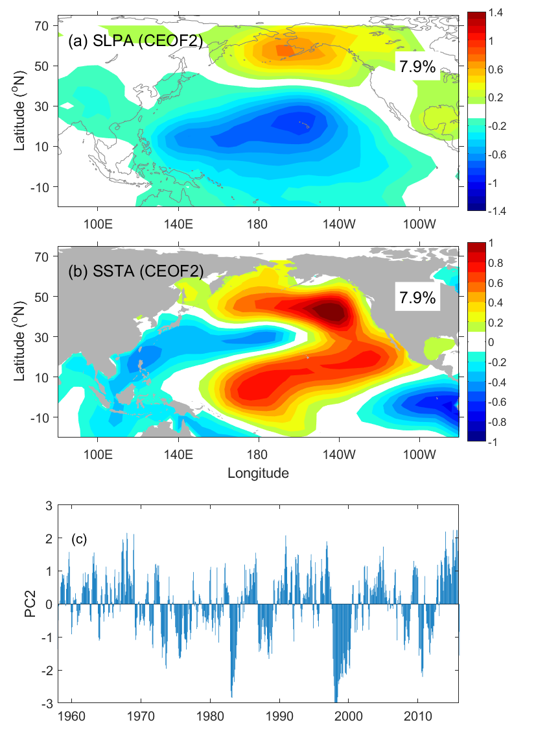
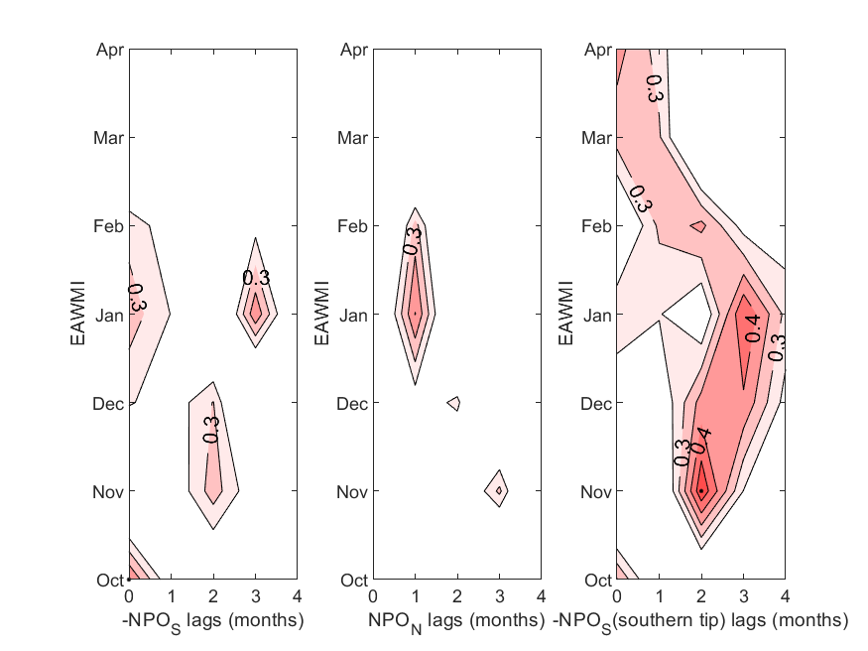
Lag-relation between EAWMI and NPO poles
(1958-2017)
The correlation is not very high except the southern tip of the south pole (southern branch of the VM)
LF
NPO [winter(0)]
VM [FMA(+1)]
SF
SFM
El Nino [winter(+1)]
Notes:
%define PAMS domain
x1v=120; x2v=140; y1v=5; y2v=25;
%define NPO northern pole
x1=180; x2=210; y1=55; y2=65;
%define NPO south pole
x1=180;x2=220;y1=15;y2=30;
%NPO south pole southern tip
x1=190;x2=210;y1=5;y2=20;

Slide 8
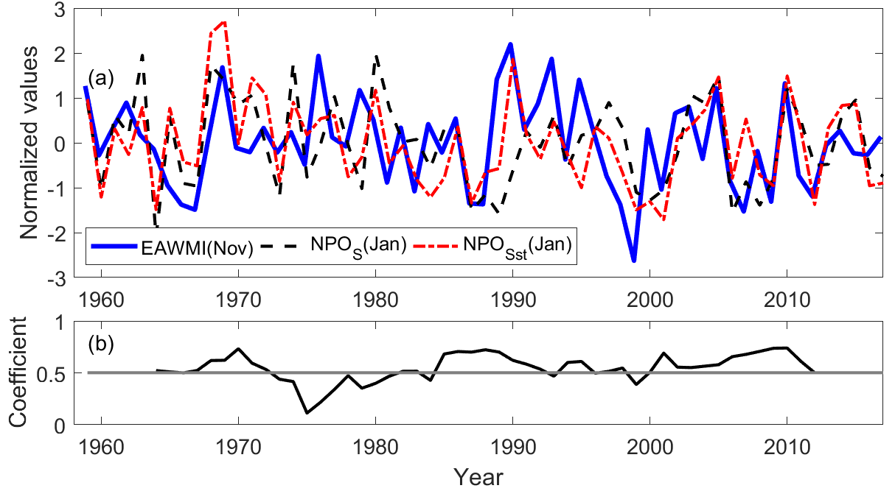
Time series of Nov. EAWM and Jan. NPO index
Correlation between Nov. EAWM and Jan. NPO_{S} (southern tip) >0.5
9-year running mean
Unsteady relation but increases after 1980

Slide 9
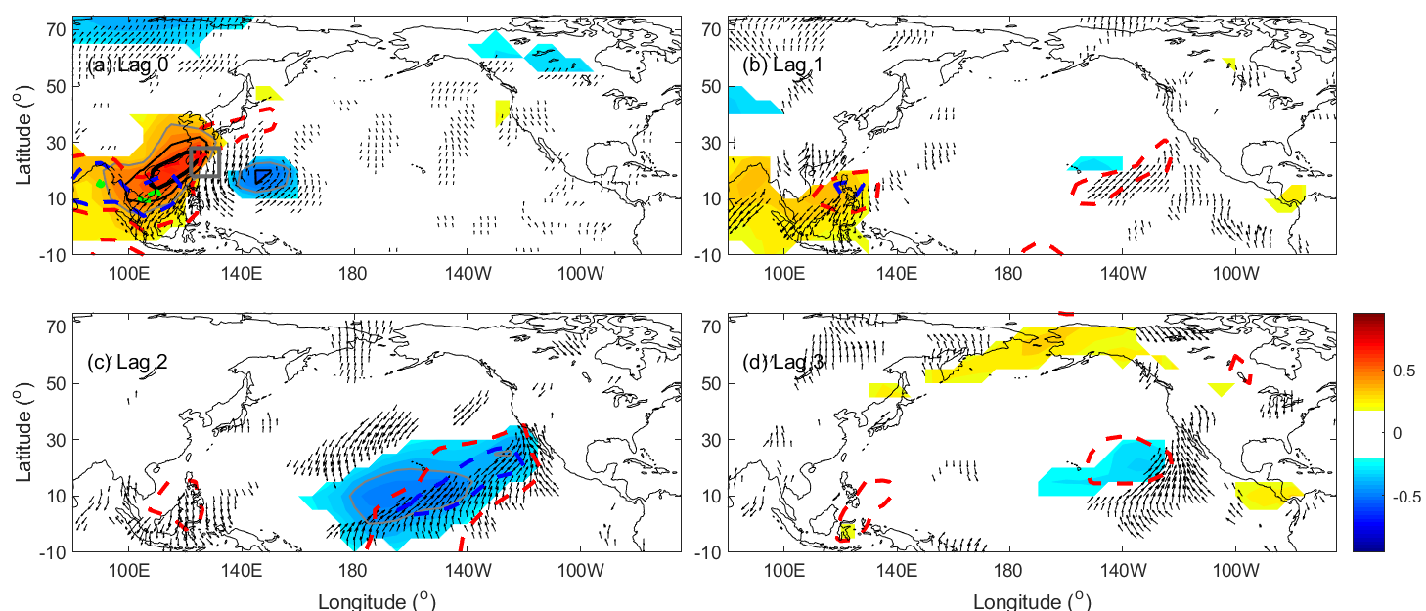
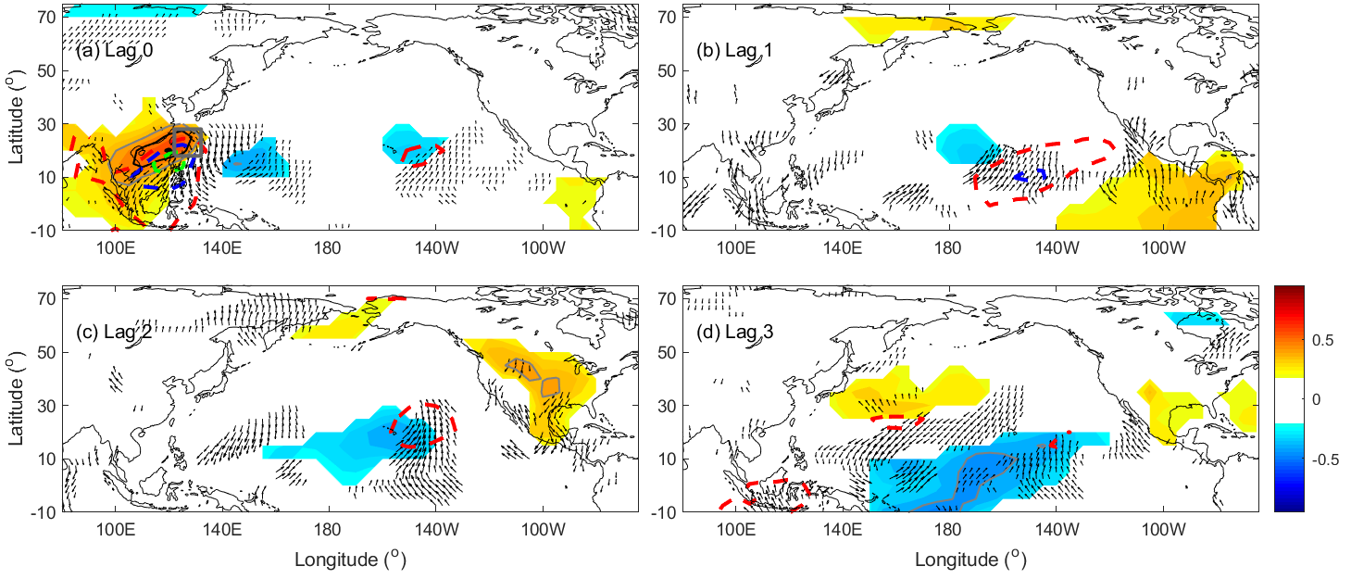
Lag correlation of SLPa with Nov. and Dec. EAWMI
Nov.
Modifying the southern pole
Dec.

Slide 10
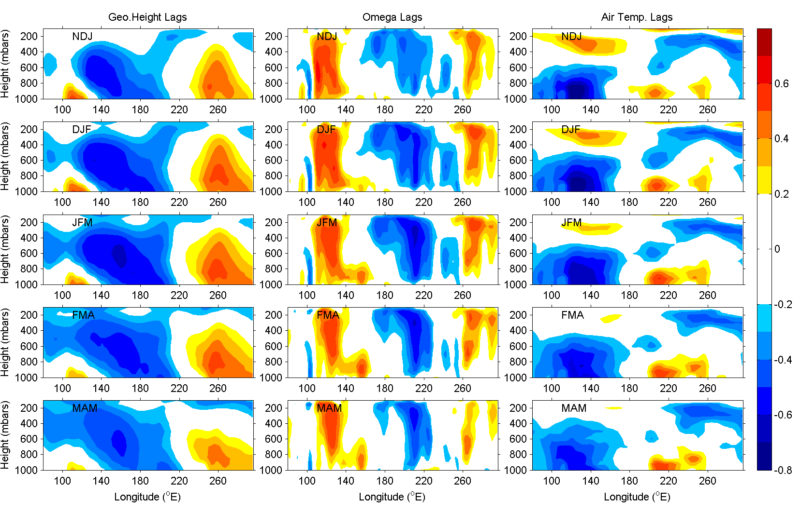
Vertical structure
Correlation of NDJ EAWMI with several lags of GH, Ω and T_{air} (25˚N)
Southern lobe of the NPO (180-220E)
Notes:
Eastward propagation in troposphere (around 500mb). Reach maximum DJF-JFM.
Omega downward in 100-140E. Enhanced in 220E. Also 140-180E a downward signal.

Slide 11
Verified by the Rossby Wave Ray
Dispersion relation
Perturbed wave sources in the WNP (Zhao et al., 2015 J. Clim.;
Li et al., 2015 JAS)

Slide 12
Rossby wave ray tracing
Near surface
mid-troposphere

Slide 13
Rossby wave ray tracing
250 hPa
mid-troposphere
Notes:
Fig. 5. The stationary Rossby wave ray trajectories (green curves) with initialed zonal wavenumber k = 2, 4, 6 (upper, middle, bottom) under the NDJ (right panels) 500-hPa climatological flows (gray vectors) for the period of 1965-2012. Red forks over pink shadings denote wave source arrays over the PAMS region (110°E-140°E, 5°N-30°N).
Fig. 7. Same as Fig.5, but for the 250-hPa climatological flows

Slide 14
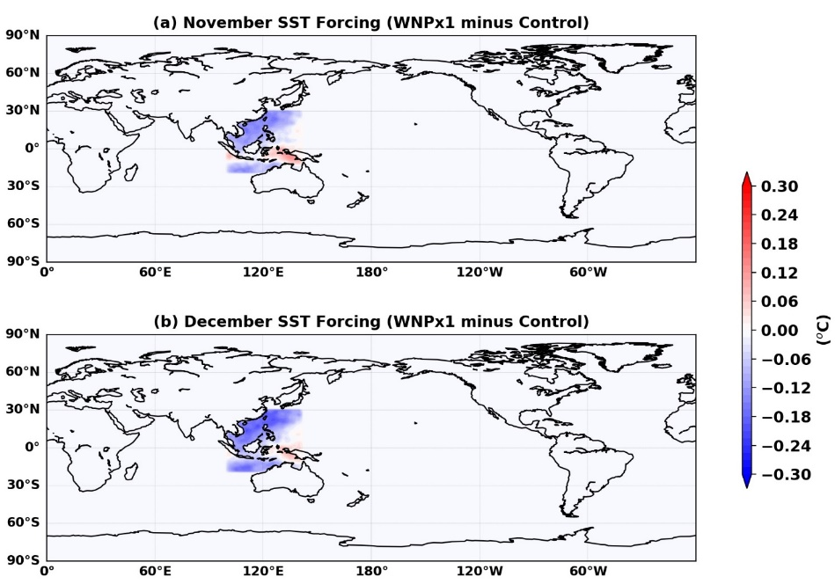
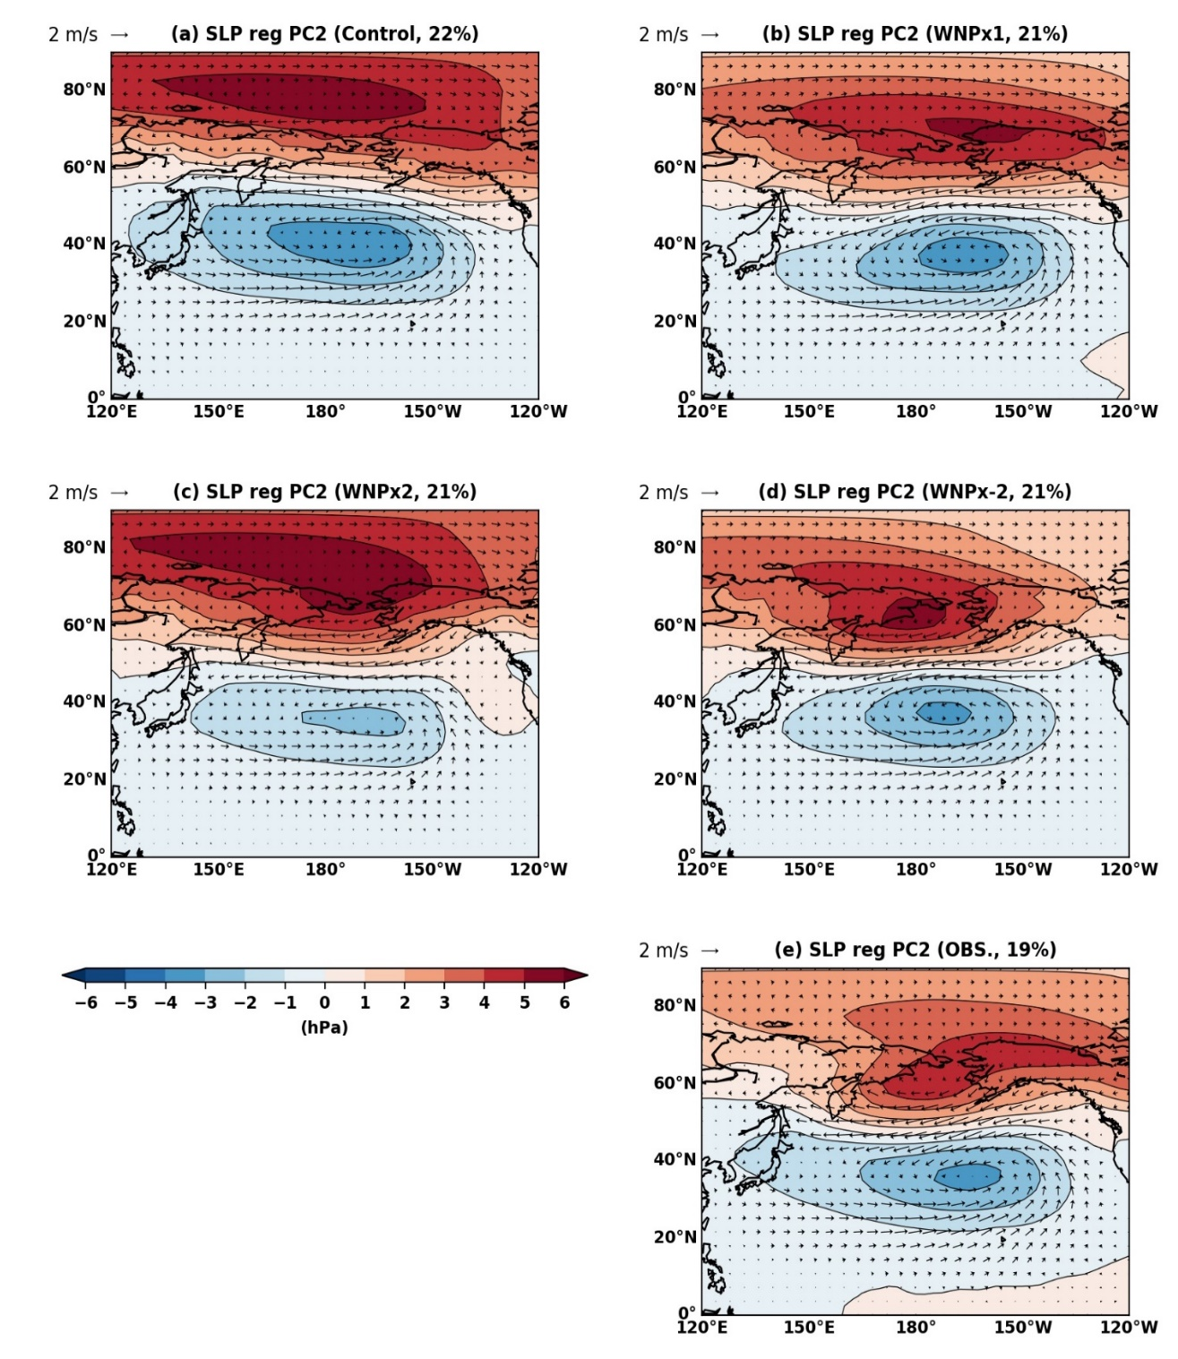
AGCM forcing sensitivity
Numerical experiments:
Year 2000 (control, 20 years after quasi equilibrium)
SST forcing x1
SST forcing x2
SST forcing x(-2)
NPO magnitudes are modified

Slide 15

Conclusion
NPO/VM: a important footprint of the meridional variability through the tropic-extratropical teleconnection (precursor of ENSO/PDO)
The initialization of EAWM (Nov.) influences the development of NPO (from the south pole specifically)
The south pole of NPO directly connects to the VM evolution into the tropics
The vertical structure is also consistent with the Rossby wave ray trajectories
Model analysis confirms the modification of NPO, further ensemble experiments and wave-activity flux analysis will be done

