Slide 1


An ENSO Prediction Approach Based on Ocean Conditions and Ocean-atmosphere Coupling
Yu‑heng Tseng¹ · Han‑ching Chen²· Zeng‑Zhen Hu³ · Ruiqiang Ding⁴
¹ Institute of Oceanography, National Taiwan University, Taipei, Taiwan
² Department of Atmospheric Sciences, National Taiwan University, Taipei, Taiwan
³ Climate Prediction Center, NCEP/NWS/NOAA, College Park, MD, USA
⁴ LASG, Institute of Atmospheric Physics, Chinese Academy of Sciences, Beijing, China
AOGS, Honolulu, Hawaii | 3-8 Jun 2018
AS34-A025

Slide 2
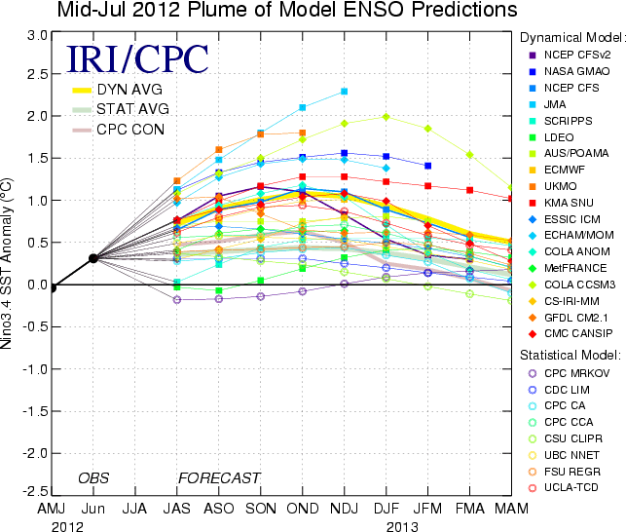
ENSO prediction skills
It appears that the hindcast skill has been reduced in recent years 2012/13 and 2014/15 are good examples.
Why do we still have the spring barrier and why the current models give the false alarm in 2012?
Can we enhance our ENSO prediction skills?

Slide 3
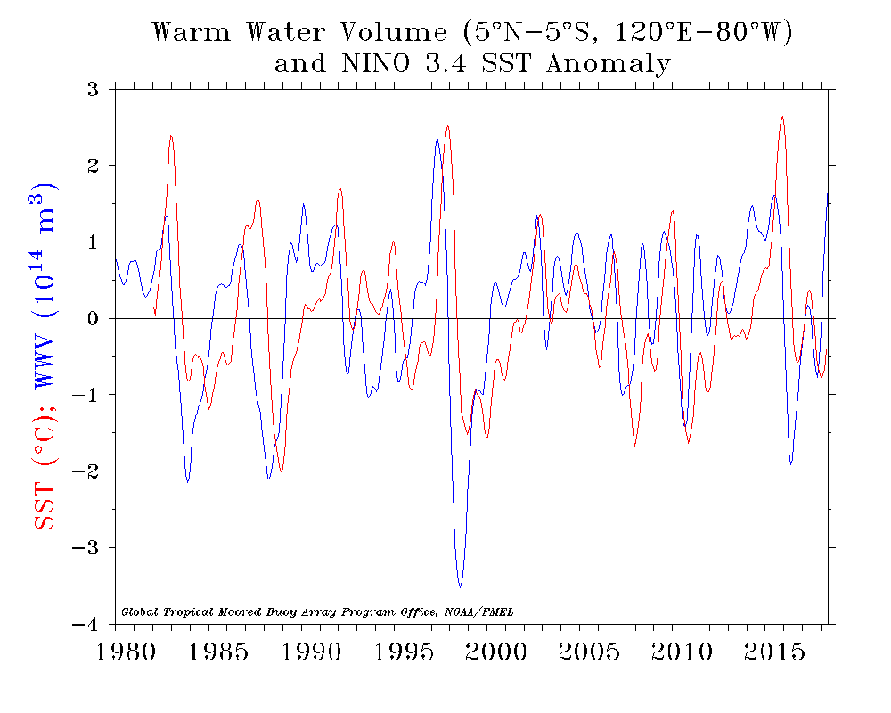
Upper Ocean Heat Content
The predictability of ENSO likewise derives from the wind-driven ocean dynamics that govern the slowly evolving heat content of the upper ocean (Latif et al, 1998).
Inclusion of upper ocean temperature data in ENSO prediction schemes significantly improves forecast skill.
https://www.pmel.noaa.gov/elnino/upper-ocean-heat-content-and-enso
There are other factors would influence the evolution of ENSO

Slide 4
A simple statistical model
Normalized ENSO Prediction Index (nEPI)
ENSO Prediction
Heat content evolution
Ocean-Atm couple
Extra-tropical forcing

Slide 5
Data
Period: 1980-2018 Pentad data
NCEP/NCAR Reanalysis 1
Near-Surface wind (.995 sigma level)
Sea Level Pressure (SLP)
2º×2º
Global Ocean Data Assimilation System (GODAS) Ocean Temperature, Heat Content (D20)
0.333º × 1.0º
Notes:
The data is from 1980 to 2015. We use NCEP R1 surface wind, HadISST and GODAS

Slide 6

Simple ENSO prediction scheme
Normalized ENSO Prediction Index (nEPI)
- WWV propagation
- ocean-atmosphere couple
- Extra-tropical forcing
$$nEPI=β_{1}{nEPI}_{WWV}+β_{2}{nEPI}_{O−A}{+β}_{3}{nEPI}_{EX}$$
$β_{1}, { β}_{2}$ and${ β}_{2}$ are defined by a linear regression model
$${nEPI}_{WWV}=α_{1}{D20a}_{180°(t−25)}+α_{2}{D20a}_{170°w(t−15)}+α_{3}{D20a}_{155°w(t)}$$
$${nEPI}_{O−A}=sign(event)∙dH({nEPI}_{WWV})$$
${nEPI}_{EX}=$ NPI + SPI

Slide 7
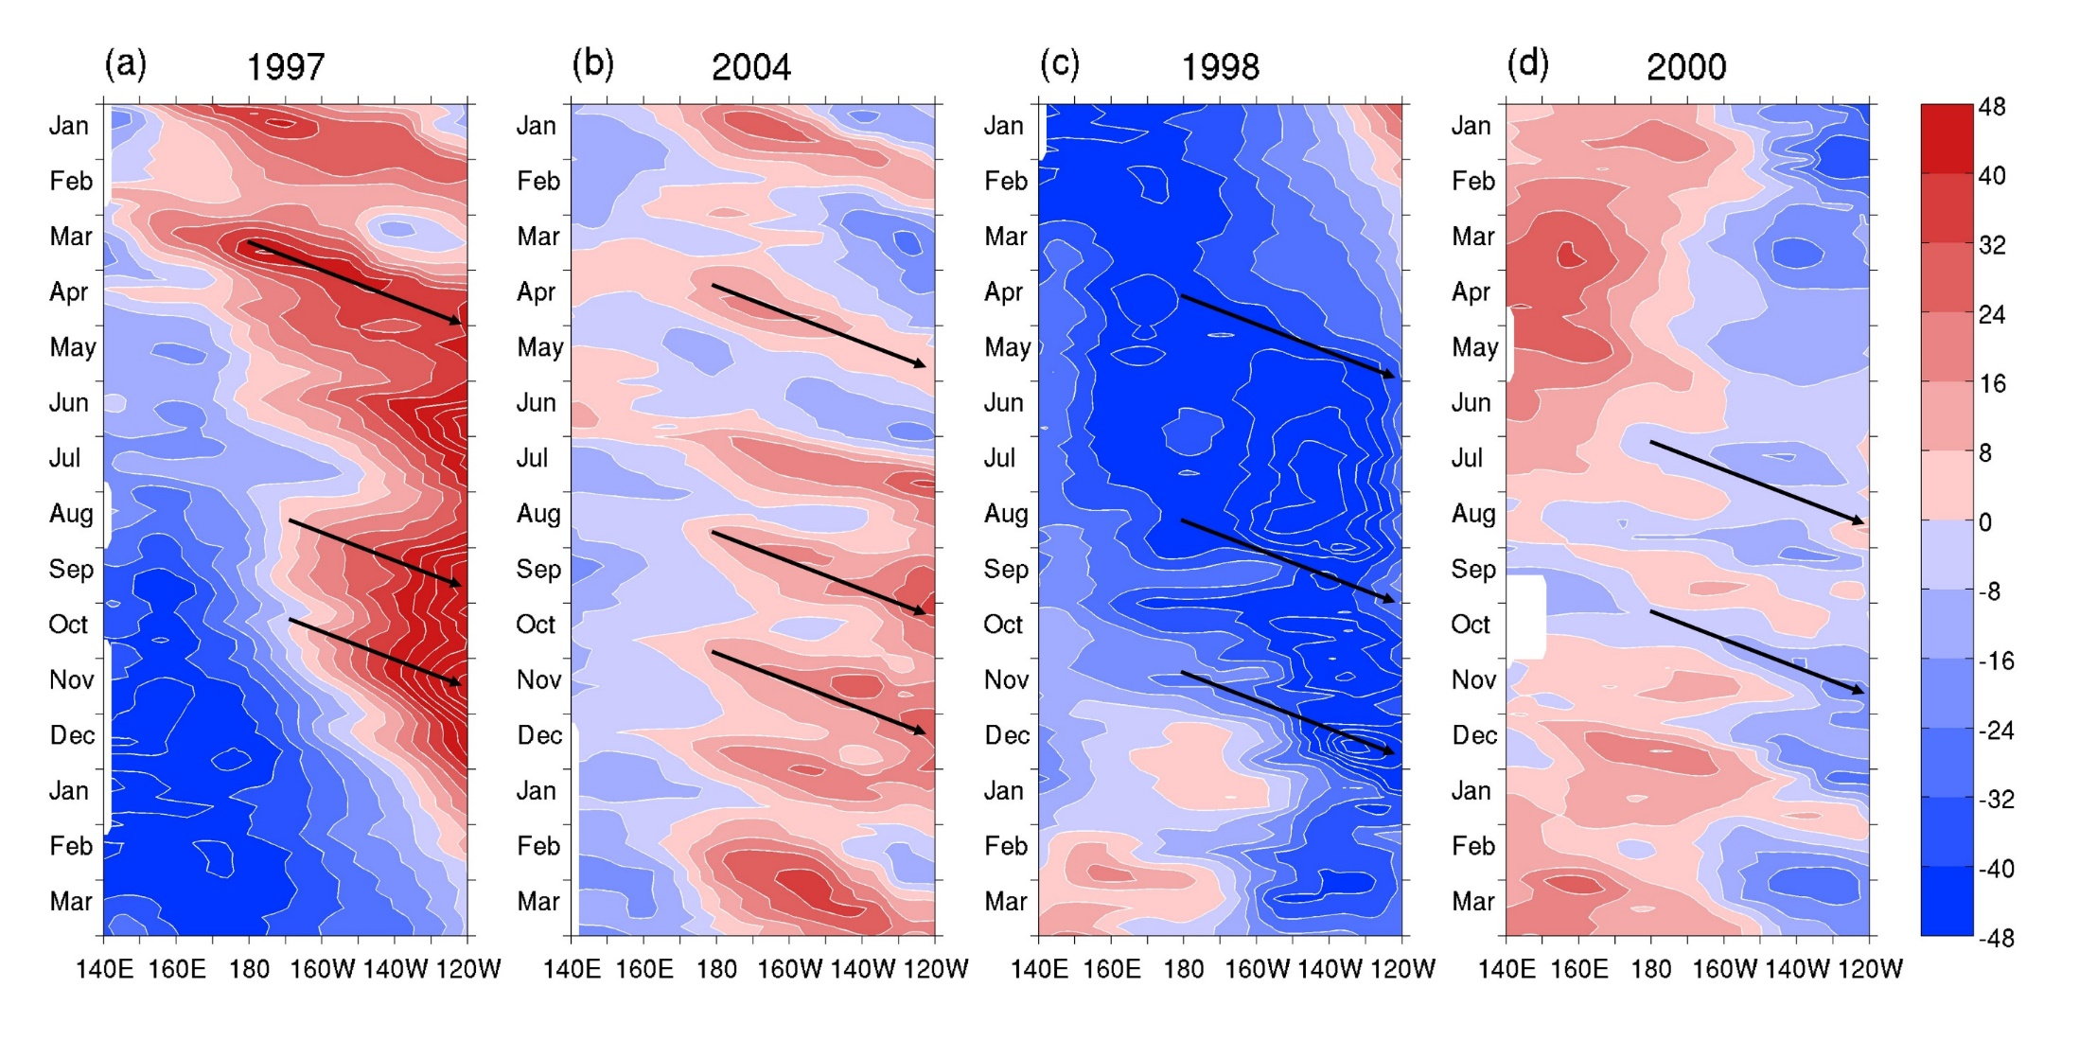
WWV propagation
D20 anomaly
Strong El Niño
Weak El Niño
Strong La Niña
Weak La Niña
An evident thermocline anomaly deepening (or shoaling) toward the east over time, indicating the pronounced positive (or negative) ocean heat content anomalies propagating eastward along the equator in the El Nino (or La Nina).
We can use this signature to predict ENSO

Slide 8

WWV propagation
D20a
$${nEPI}_{WWV}=α_{1}{D20a}_{180°(t−25)}+α_{2}{D20a}_{170°w(t−15)}+α_{3}{D20a}_{155°w(t)}$$
The chosen longitudes and timings in the nEPIWWV trace the influence of the eastward Kelvin wave propagation linking to the propagation of WWV at approximately 30°/month.
Phase speed: 30º/month
180º
170ºW
155ºW
t-25
t-15
t
α₁–α₃ are defined as the climatologically mean thermocline depth differences between these three longitudes and the thermocline base at 175°E

Slide 9
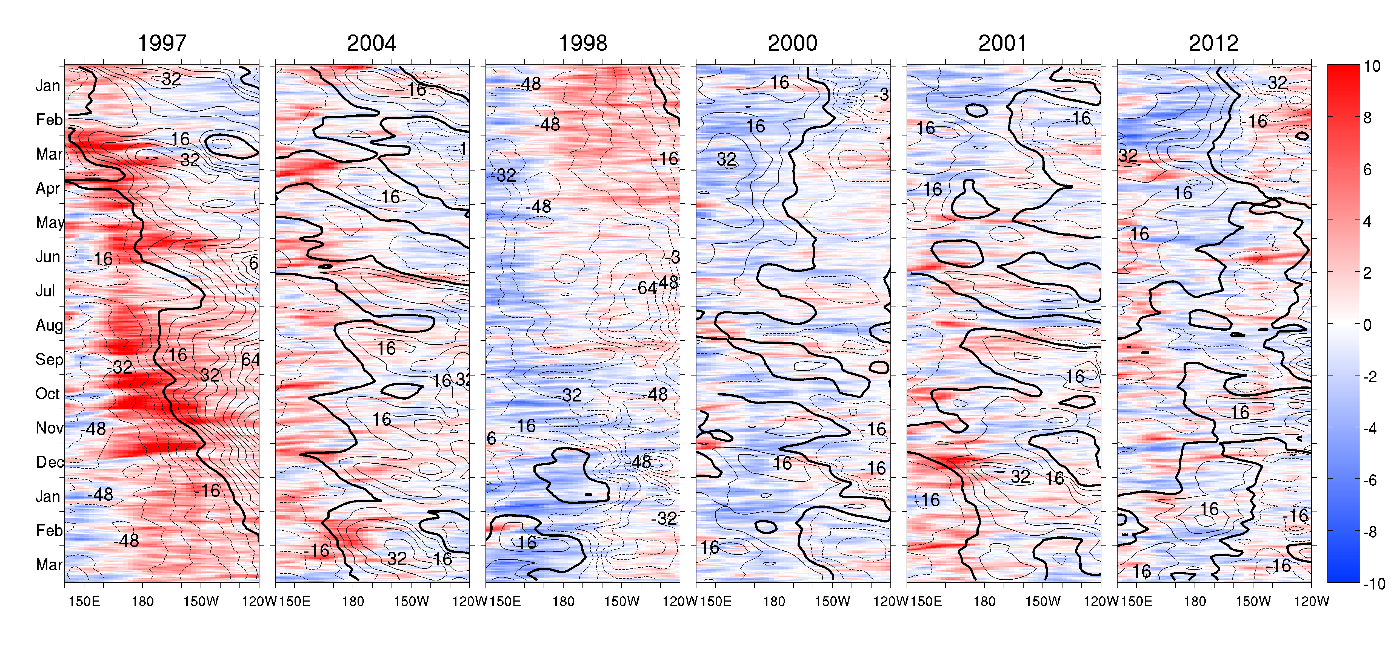


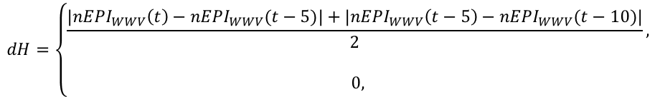

Ocean-atmosphere couple
nEPIO–A is to assume that the ocean–atmosphere coupled feedback can amplify or reduce the magnitude change of nEPIwwv according to the events of WWEs/EWSs.
Wind
$${nEPI}_{O−A}=sign(event)∙dH({nEPI}_{WWV})$$
$$event=w_{x} in [t−50,t]$$
Gebbie and Tzoperman (2009)
Occurrence of more than 50 % probability WWEs/EWSs events during a continuous period of 50 days can have potential impacts modulating the ENSO prediction
$$dH=\left\{\begin{aligned}\frac{|{nEPI}_{WWV}\left(t\right)−{nEPI}_{WWV}(t−5)|+|{nEPI}_{WWV}\left(t−5\right)−{nEPI}_{WWV}(t−10)|}{2}, \\ \\ 0, \end{aligned}\right.$$
$$25 days<event$$
$$event<25 days$$
Only when the nEPIwwv changes dramatically, the large nEPIO−A occurs to amplify the prediction model.

Slide 10
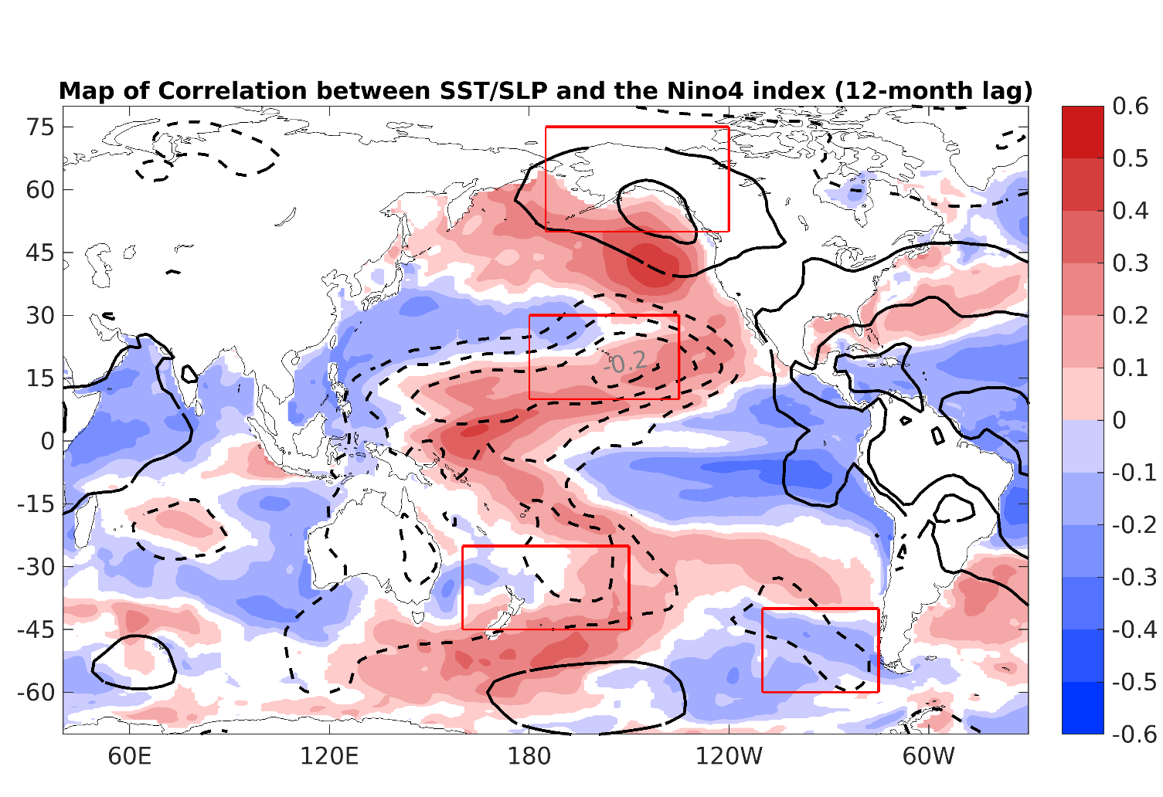
Extra-tropical forcing
${nEPI}_{EX}=$ $−$[($−$NSLP₁ + NSLP₂)+ (SSLP₁ + SSLP₂)]
NSLP₁
NSLP₁
185°–120°W, 50°–75°N
NSLP₂
NSLP₂
180°–135°W, 10°–30°N
SSLP₁
SSLP₁
160°E–150°W, 25°–45°S
SSLP₂
SSLP₂
110°–75°W, 40°–60°S
The boreal winter subtropical and extratropical sea surface pressure (SLP) anomalies over both the North and South Pacific are significantly related to the ENSO state in the following boreal winter (Ding et al. 2016)

Slide 11
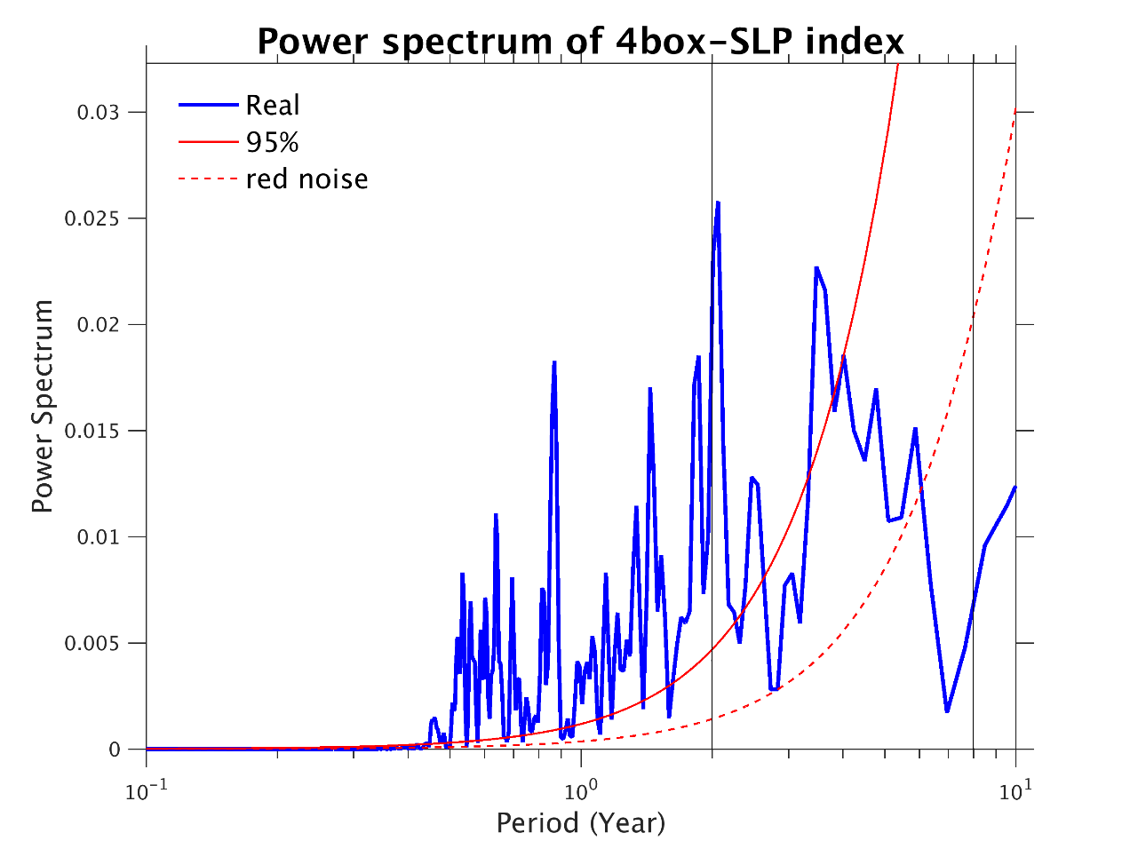
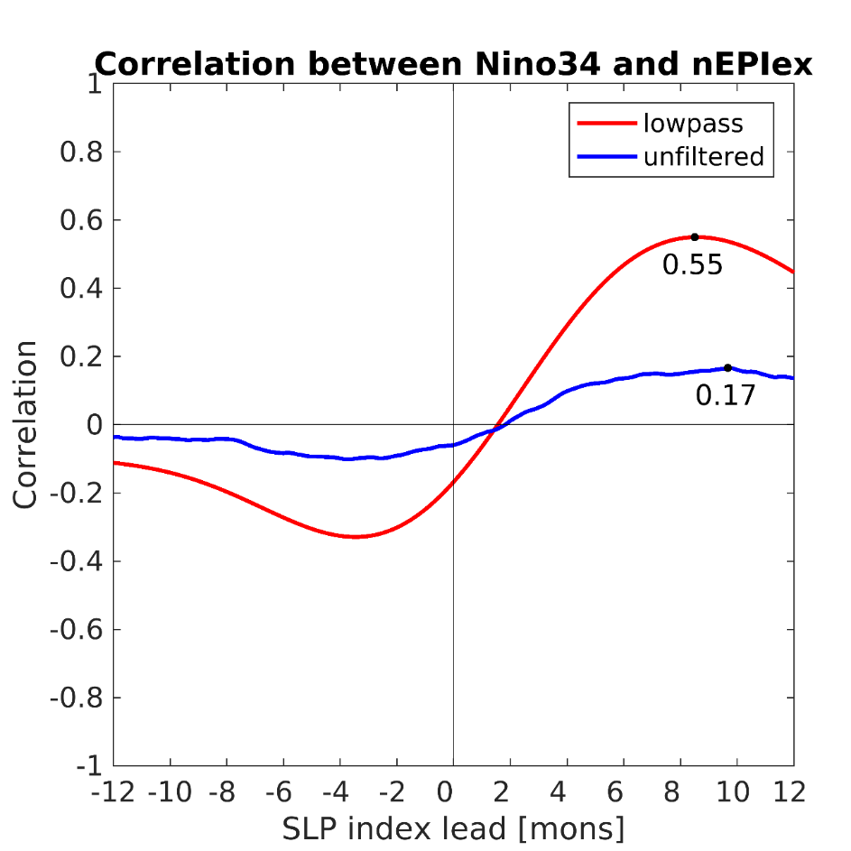
Extra-tropical forcing
${nEPI}_{EX}=$ $−$[($−$NSLP₁ + NSLP₂)+ (SSLP₁ + SSLP₂)]
10-months lowpass filter is added to remove the high frequency noise and keep the interannual variability associated with ENSO
The relationship between Niño34 and nEPIex is better after lowpass filter

Slide 12
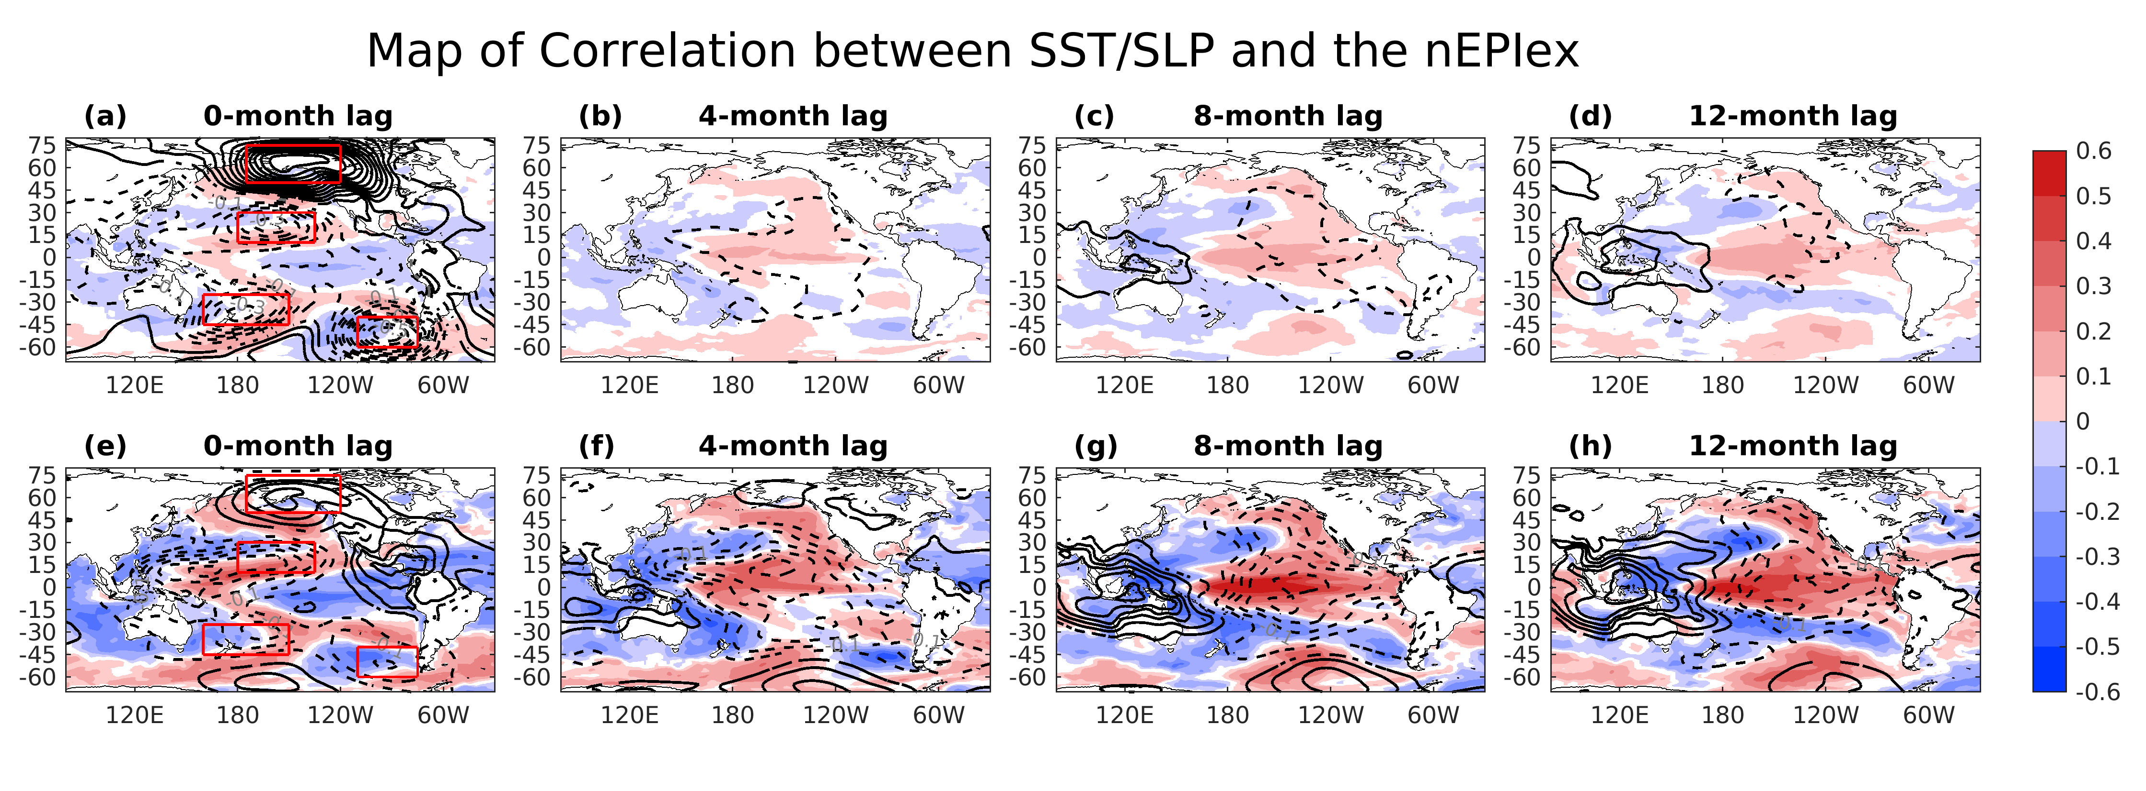
Extra-tropical forcing
${nEPI}_{EX}=$ $−$[($−$NSLP₁ + NSLP₂)+ (SSLP₁ + SSLP₂)]
The correlation map of SST/SLP with nEPI_{EX}
Unfiltered nEPI_{EX}
Lowpassed nEPI_{EX}

Slide 13
Simple ENSO prediction scheme
Normalized ENSO Prediction Index (nEPI)
- WWV propagation
- ocean-atmosphere couple
- Extra-tropical forcing
$$nEPI=β_{1}{nEPI}_{WWV}+β_{2}{nEPI}_{O−A}{+β}_{3}{nEPI}_{EX}$$
$β_{1}, { β}_{2}$ and${ β}_{2}$ are defined by a linear regression model
$${nEPI}_{WWV}=α_{1}{D20a}_{180°(t−25)}+α_{2}{D20a}_{170°w(t−15)}+α_{3}{D20a}_{155°w(t)}$$
$${nEPI}_{O−A}=sign(event)∙dH({nEPI}_{WWV})$$
${nEPI}_{EX}=$ NPI + SPI

Slide 14
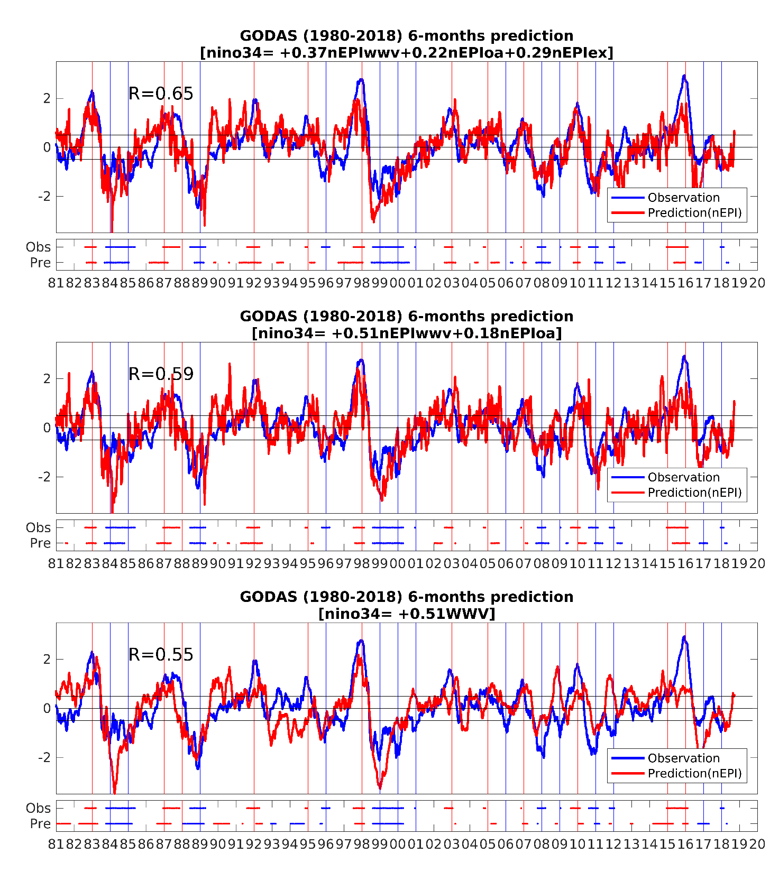
Linear regression model
6-months lead time
nEPI
(WWV+OA+EX)
Events: 5 consecutive overlapping 3-month periods at or above the half standard deviation of index
nEPI
(WWV+OA)
WWV
Notes:
Figure 3: Lead-lag correlation of Niño3.4 index with (a) nEPI based on TAO (1994-2015), (b) nEPI based on GODAS (1994-2015), (c) nEPI based on GODAS (1980-2015) and (d) WWV index (1994-2015). Bar represents the correlation in 1994-2015 in (a, b, d), and 1980-2015 in (c); black line is the correlation in 1994-2003 in (a, b, d), and 1980-1993 in (c); and green line is the correlation in 2004-2015 in (a, b, d). 99.9% significance levels for 1994-2003 and 2004-2015 are indicated with dashed lines in (a, b, d). The same significance level for 1980-1993 is also indicated in (c). The bar in (a) is superimposed in (d) as a grey dashed line for comparison.

Slide 15
Hindcast skills
1980-2018
Lead time | Correlation
 | nEPI (WWV+OA+EX) | nEPI (WWV+OA) | WWV
Six-month | 0.65 (0.71) | 0.59 (0.67) | 0.55 (0.57)
Eight-month | 0.63 (0.67) | 0.52 (0.58) | 0.48 (0.51)
Ten-month | 0.57 (0.60) | 0.44 (0.49) | 0.41 (0.44)
pentad (monthly)
Percent correct of six-month ENSO forecast
Lead time | Percent correct |  |  | False alarm
 | nEPI (WWV+OA+EX) | nEPI (WWV+OA) | WWV | nEPI (WWV+OA+EX) | nEPI (WWV+OA) | WWV
El Niño | 83% (83%) | 83% (83%) | 67% (75%) | 2 (2) | 2 (3) | 3 (3)
La Niña | 75% (82%) | 82% (91%) | 75% (82%) | 0 (1) | 0 (2) | 2 (3)
For nEPI_{(WWV+OA+EX)}, Nino 3.4 SSTa hindcast skill based on the linear regression model is generally better in terms of the monthly correlation.
Notes:
Table 1: The hindcast skills (correlation and normalized RMSE) using the monthly data based on the linear regression model and the WWV, respectively. Values in parentheses are the ensemble-mean skill in Barnston et al. (2012).
Table 2: Percent correct of six-month ENSO forecast (see Larson and Kirtman, 2014 for the metric definition). Values in parentheses are the percent correct predicted by the WWV.

Slide 16
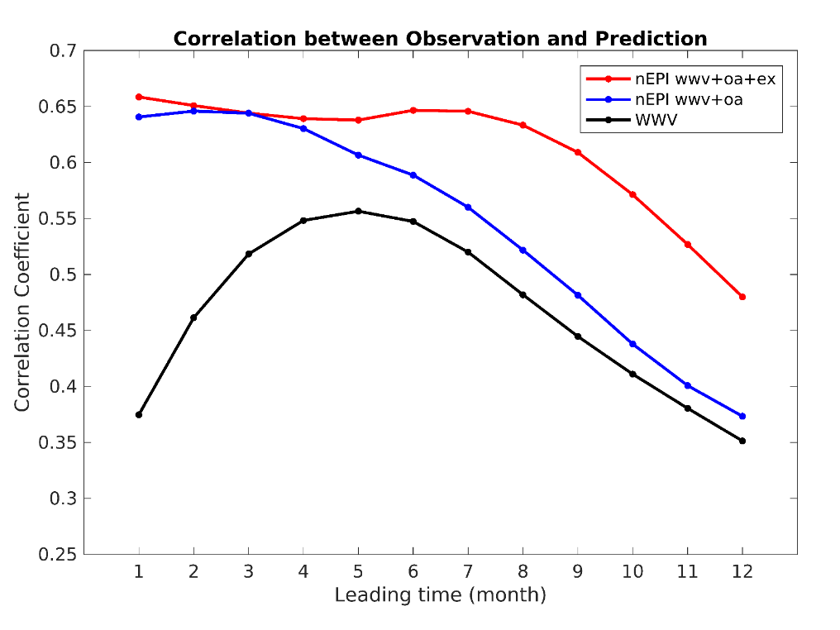
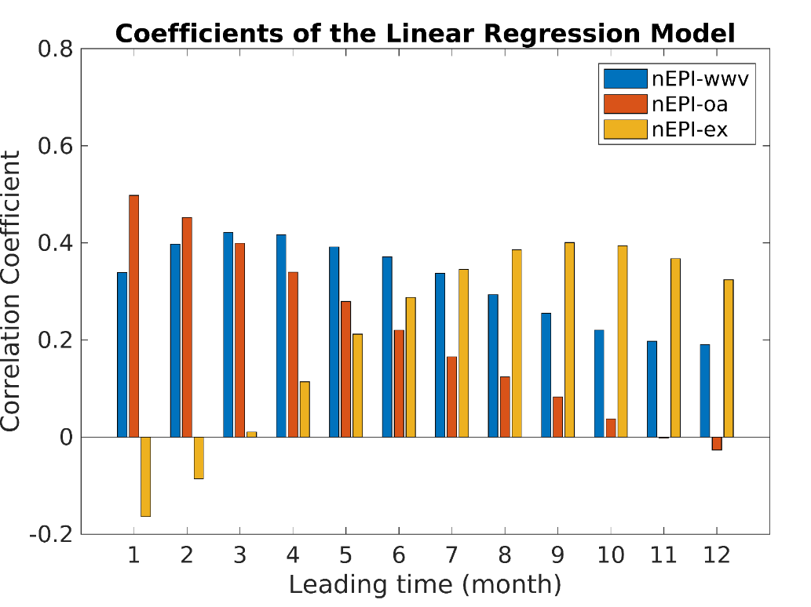
Summary
The hindcast skill of SSTa is generally better than the commonly used WWV index in terms
of the monthly correlation due to accounting the additional information of the Kelvin wave propagation resulting from the ocean–atmosphere coupling in the central Pacific.
The extratropical atmospheric forcing over both the North and South Pacific can improve the hindcast skill with 6- to 10-months lead time.

Slide 17
Thanks for your attention

