Slide 1
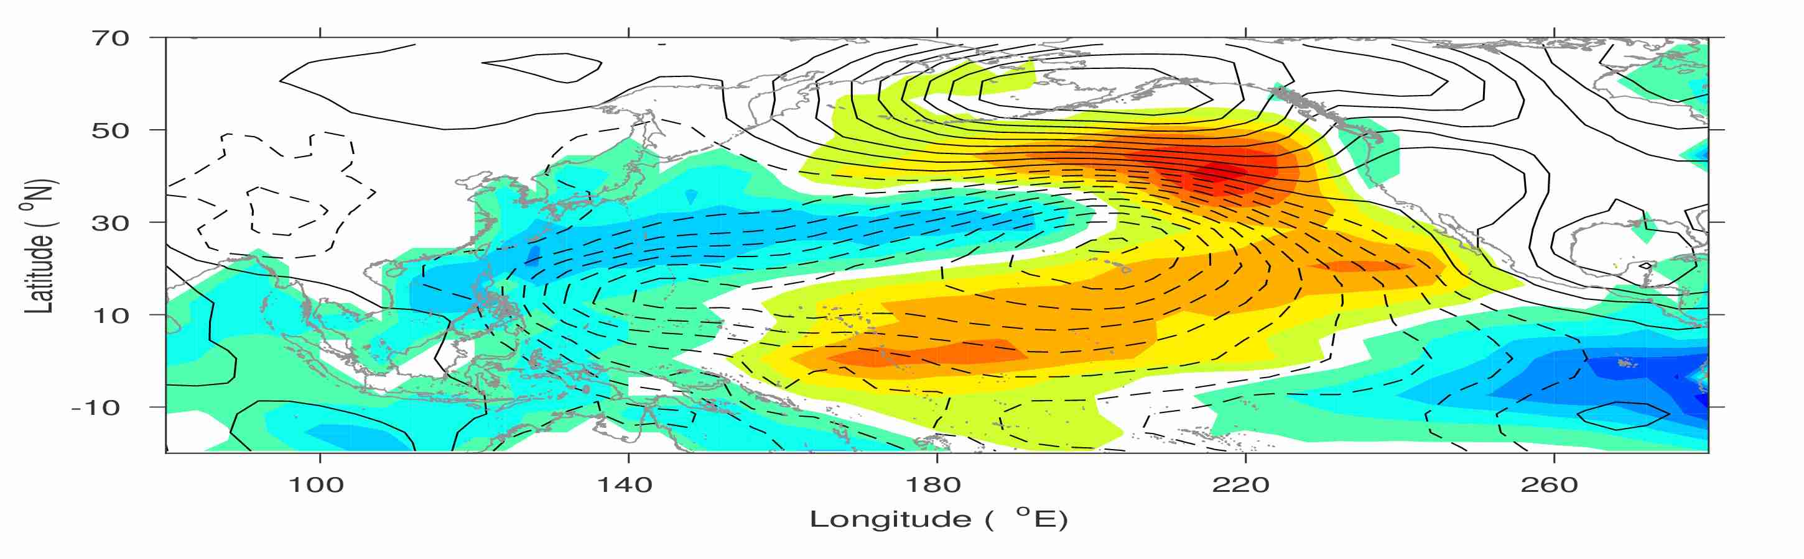
Is El Niño coming again at the end of 2018?
-An improved ENSO prediction implicated by a new Pacific climate paradigm
Yu‑heng Tseng¹ Han‑ching Chen² Ruiqiang Ding³
Zeng‑Zhen Hu⁴
¹Institute of Oceanography, National Taiwan University, Taiwan
²U. Hawaii at Monoa, USA
³LASG, Institute of Atmospheric Physics, Chinese Academy of Sciences, China
⁴Climate Prediction Center, NCEP/NWS/NOAA, USA
Notes:
Good morning, thank you very much for your coming for the first talk today!
What I am going to present is

Slide 2
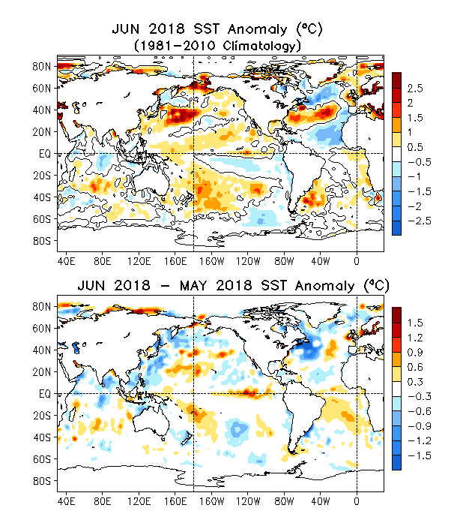
2018 June Global SST Anomaly and Anomaly Tendency
Positive (negative) SSTAs presented along the eq. Pacific, the northeast and southwest Pacific (southeast Pacific).
Strong positive SSTAs presented in the western N. Pacific.
Horseshoe/tripole-like SSTA pattern presented in the N. Atlantic.
Positive SSTA tendencies were observed in the central-eastern equatorial Pacific.
Negative SSTA tendencies were seen in the NW Pacific and NW Atlantic.
Notes:
Fig. G1. Sea surface temperature anomalies (top) and anomaly tendency (bottom). Data are derived from the NCEP OI SST analysis, and anomalies are departures from the 1981-2010 base period means.

Slide 3
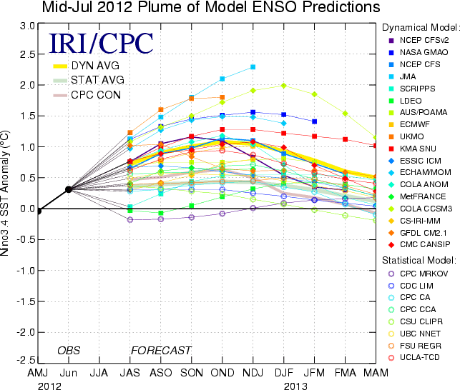
Challenge of ENSO prediction
It appears that the hindcast skill has been reduced in recent years 2012/13 and 2014/15 are good examples.
Why do we still have the spring barrier and why the current models give the false alarm in 2012?
Can we enhance our ENSO prediction skills?

Slide 4
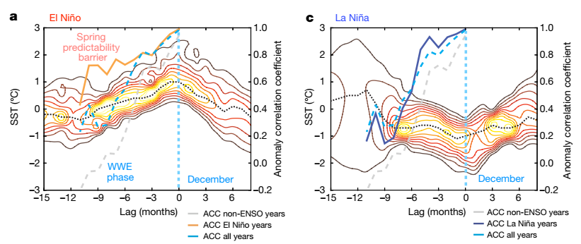
Challenge of ENSO prediction
1958-2016 Monthly SSTA Probability Density Composite
NINO3.4
SSTA
La Niña only
El Niño only
All years
1980-2015 Prediction Skill
All years
Neutral Only
Neutral Only
probability density, cint = 0.005
black dashed: maximum
Timmermann et al. (2018)

Slide 5
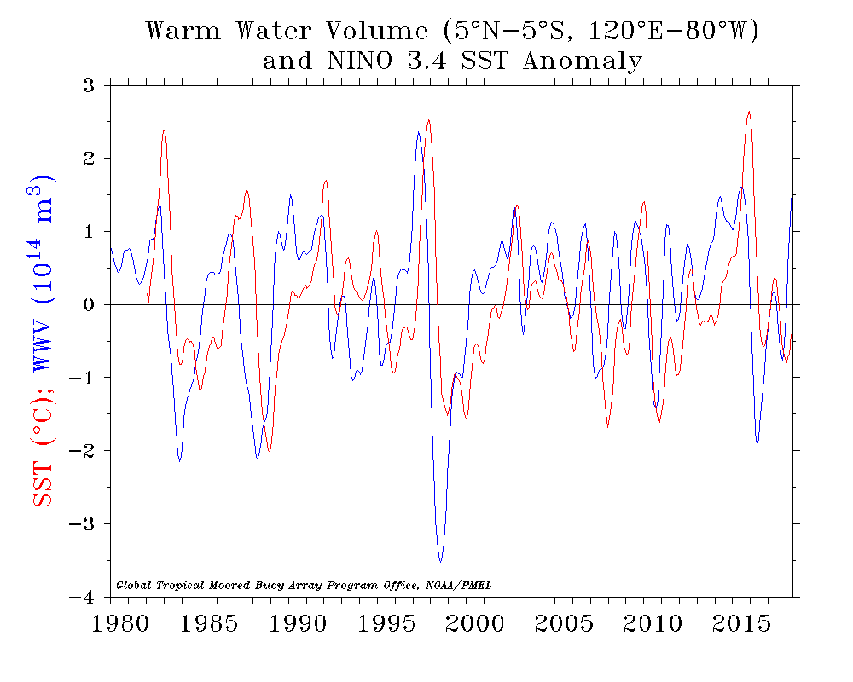
Upper Ocean Heat Content
https://www.pmel.noaa.gov/elnino/upper-ocean-heat-content-and-enso
The predictability of ENSO likewise derives from the wind-driven ocean dynamics that govern the slowly evolving heat content of the upper ocean (Latif et al, 1998).
Inclusion of upper ocean temperature data in ENSO prediction schemes significantly improves forecast skill.
There are other factors would influence the evolution of ENSO

Slide 6
A simple statistical model
Normalized ENSO Prediction Index (nEPI)
Ocean-Atm coupling
Heat content evolution
ENSO Prediction
Tseng et al. (2016)

Slide 7
Hindcast skills
Multi-model ensemble mean skill (Barnston et al., 2012)
Lead time | Data source | Year | Correlation |  | Normalized RMSEs
 |  |  | nEPI | WWV | nEPI | WWV
four-month | TAO | 1994-2015 | 0.75 | 0.70 | 0.66 | 0.72
six-month | TAO | 1994-2015 | 0.67 | 0.62 | 0.75 | 0.78
 | TAO | 2002-2011 | 0.59 (0.42) |  | 0.81
 | GODAS | 1980-2015 | 0.64 |  | 0.77
 | GODAS | 1981-2010 | 0.68 (0.65) |  | 0.73
eight-month | TAO | 1994-2015 | 0.57 | 0.49 | 0.82 | 0.87
 | GODAS | 1980-2015 | 0.58 |  | 0.79
Percent correct of six-month ENSO forecast
ENSO index threshold | Percent correct 1994-2015 (TAO) | Percent correct 1980-2015 (GODAS)
+ Niño3.4 index | 100% (67%) | 68%
− Niño3.4 index | 83% (75%) | 87%
upper tercile Niño3.4 index (El Niño) | 86% (57%) | 73%
lower tercile Niño3.4 index (La Niña) | 86% (71%) | 82%
(Larson and Kirtman, 2014)
Using WWV
Notes:
Table 1: The hindcast skills (correlation and normalized RMSE) using the monthly data based on the linear regression model and the WWV, respectively. Values in parentheses are the ensemble-mean skill in Barnston et al. (2012).
Table 2: Percent correct of six-month ENSO forecast (see Larson and Kirtman, 2014 for the metric definition). Values in parentheses are the percent correct predicted by the WWV.

Slide 8
A modified statistical model
Normalized ENSO Prediction Index (nEPI)
Ocean-Atm coupling
Heat content evolution
Extra-tropical forcing
ENSO Prediction
Tseng et al. (2016)

Slide 9
Data
Period: 1980-2018 Pentad data
NCEP/NCAR Reanalysis 1
Near-Surface wind (.995 sigma level)
Sea Level Pressure (SLP)
2º×2º
Global Ocean Data Assimilation System (GODAS) Ocean Temperature, Heat Content (D20)
0.333º × 1.0º
Notes:
The data is from 1980 to 2015. We use NCEP R1 surface wind, HadISST and GODAS

Slide 10

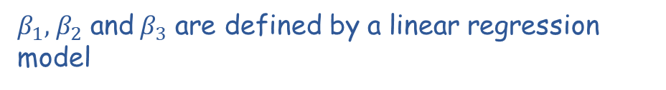
Simple ENSO prediction scheme
Normalized ENSO Prediction Index (nEPI)
- WWV propagation
- ocean-atmosphere couple
- Extra-tropical forcing
$$nEPI=β_{1}{nEPI}_{WWV}+β_{2}{nEPI}_{O−A}{+β}_{3}{nEPI}_{EX}$$
$β_{1}, { β}_{2}$ and${ β}_{3}$ are defined by a linear regression model
$${nEPI}_{WWV}=α_{1}{D20a}_{180°(t−25)}+α_{2}{D20a}_{170°w(t−15)}+α_{3}{D20a}_{155°w(t)}$$
$${nEPI}_{O−A}=sign(event)∙dH({nEPI}_{WWV})$$
${nEPI}_{EX}=$ NPI + SPI

Slide 11
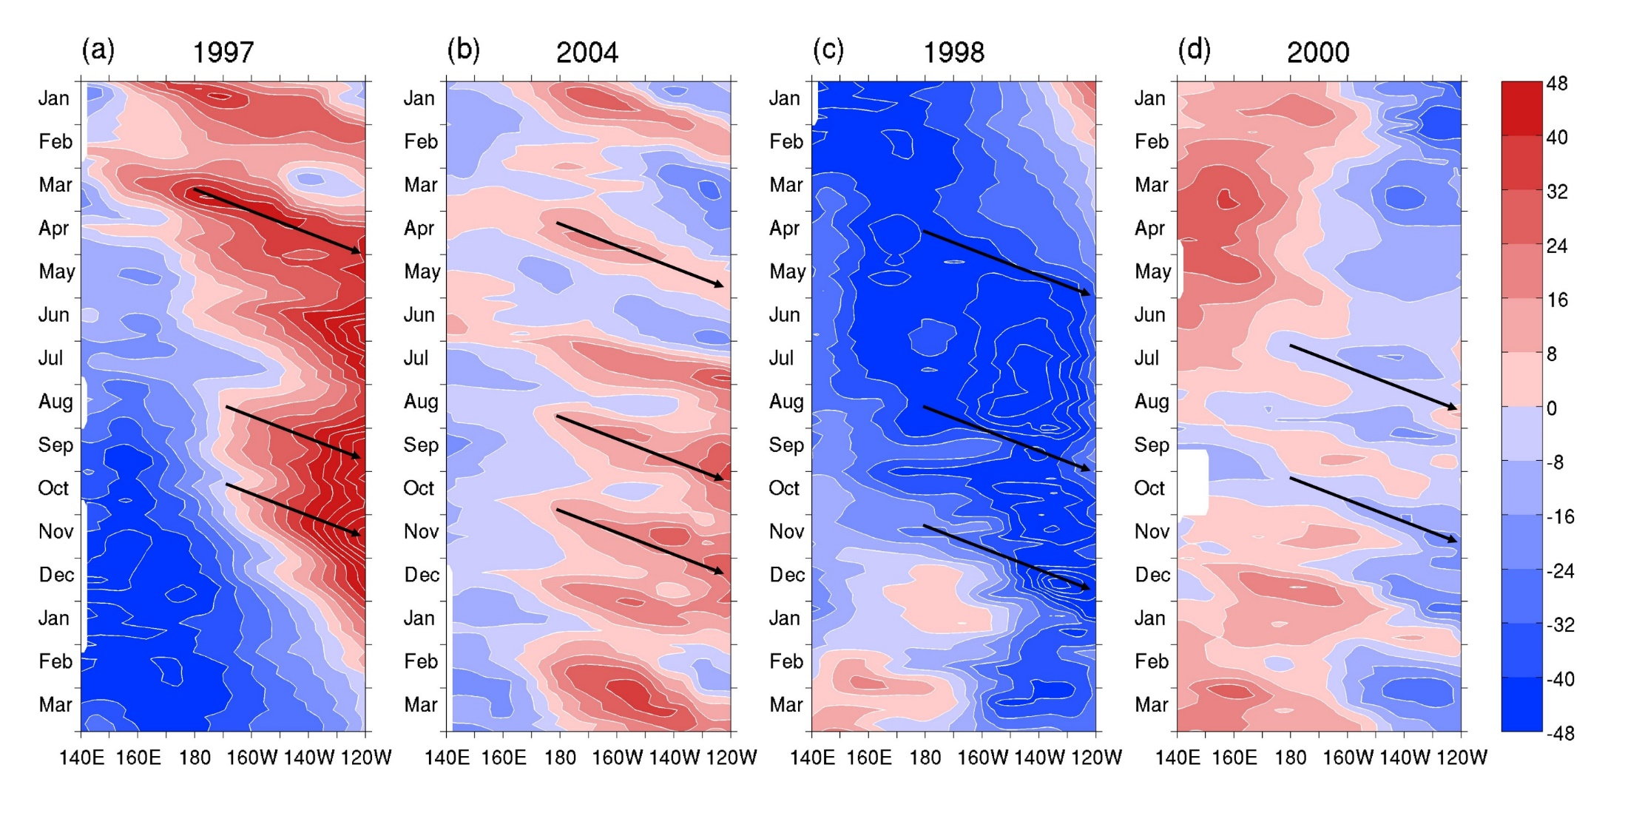
WWV propagation
D20 anomaly
Strong El Niño
Weak El Niño
Strong La Niña
Weak La Niña
We can use this signature to predict ENSO
Notes:
An evident thermocline anomaly deepening (or shoaling) toward the east over time, indicating the pronounced positive (or negative) OHCa propagating eastward along the equator in the El Nino (or La Nina).

Slide 12

WWV propagation
D20a
$${nEPI}_{WWV}=α_{1}{D20a}_{180°(t−25)}+α_{2}{D20a}_{170°w(t−15)}+α_{3}{D20a}_{155°w(t)}$$
The chosen longitudes and timings in the nEPIWWV trace the influence of the eastward Kelvin wave propagation linking to the propagation of WWV at approximately 30°/month.
Phase speed: 30º/month
180º
170ºW
155ºW
t-25
t-15
t
α₁–α₃ are defined as the climatologically mean thermocline depth differences between these three longitudes and the thermocline base at 180°E

Slide 13
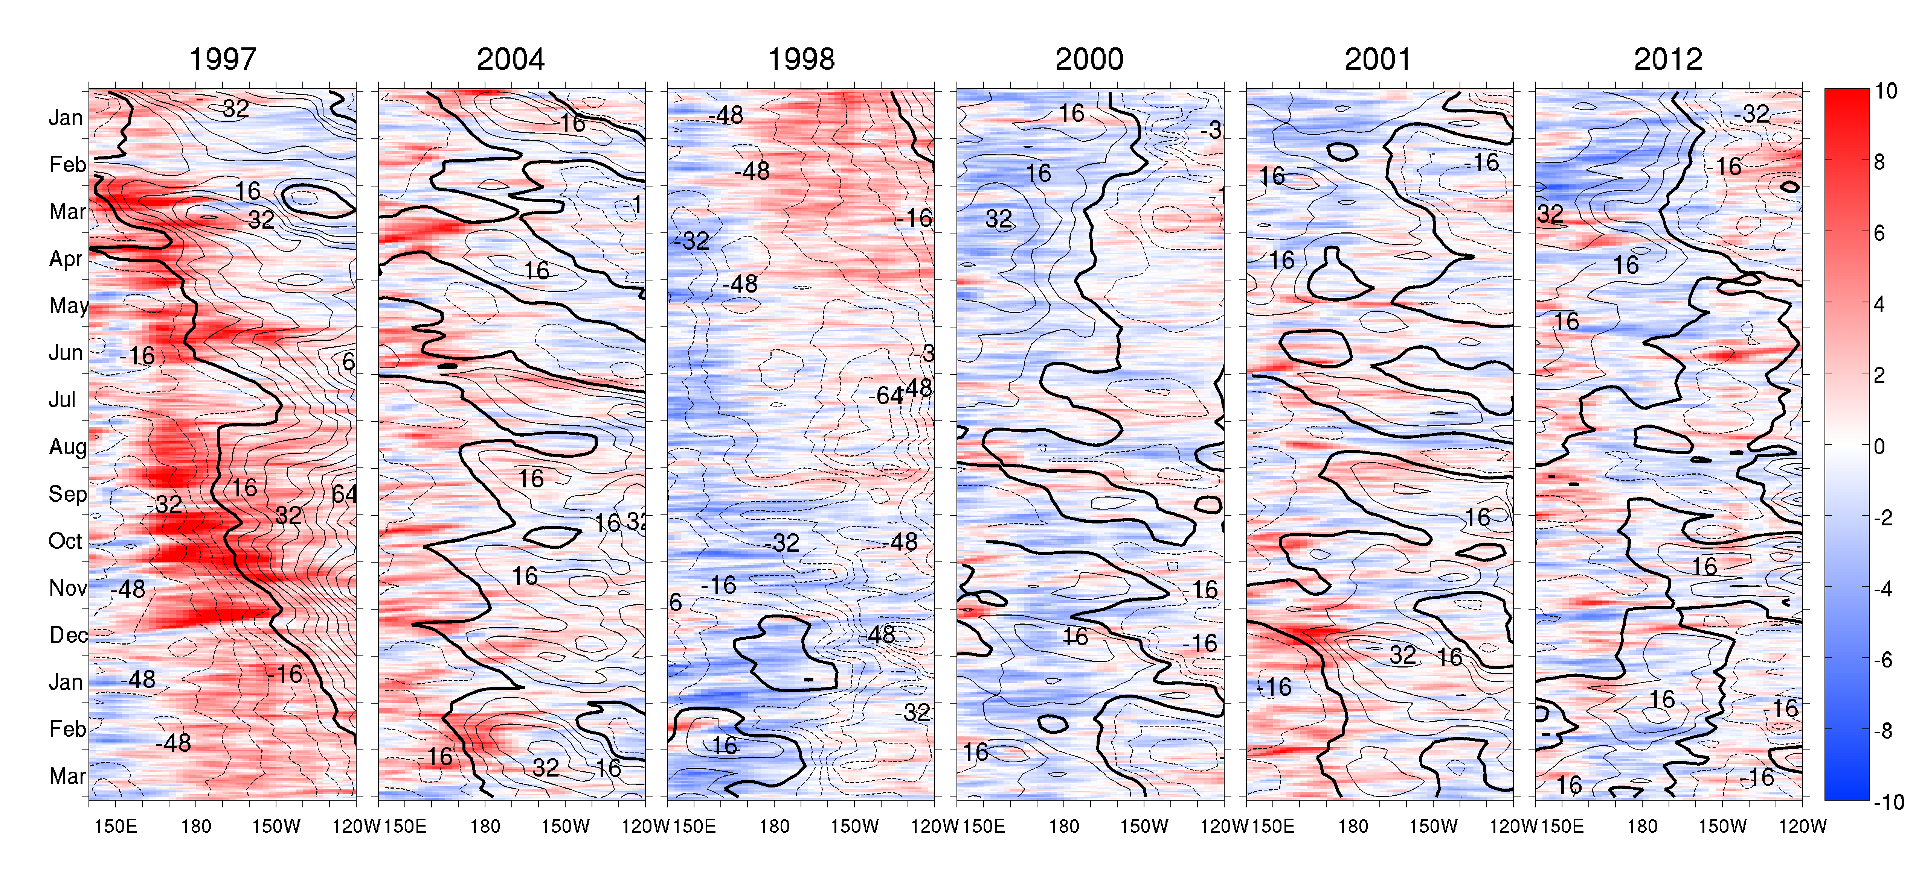


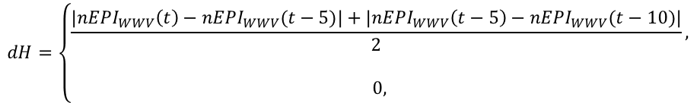

Ocean-atmosphere coupling
nEPIO–A is to assume that the ocean–atmosphere coupled feedback can amplify or reduce the magnitude change of nEPIwwv according to the events of WWEs/EWSs.
Wind
$${nEPI}_{O−A}=sign(event)∙dH({nEPI}_{WWV})$$
$$event=w_{x} in [t−50,t]$$
Gebbie and Tzoperman (2009)
Occurrence of more than 50 % probability WWEs/EWSs events during a continuous period of 50 days can have potential impacts modulating the ENSO prediction
$$dH=\left\{\begin{aligned}\frac{|{nEPI}_{WWV}\left(t\right)−{nEPI}_{WWV}(t−5)|+|{nEPI}_{WWV}\left(t−5\right)−{nEPI}_{WWV}(t−10)|}{2}, \\ \\ 0, \end{aligned}\right.$$
$$25 days<event$$
$$event<25 days$$
Only when the nEPIwwv changes dramatically, the large nEPIO−A occurs to amplify the prediction model.

Slide 14
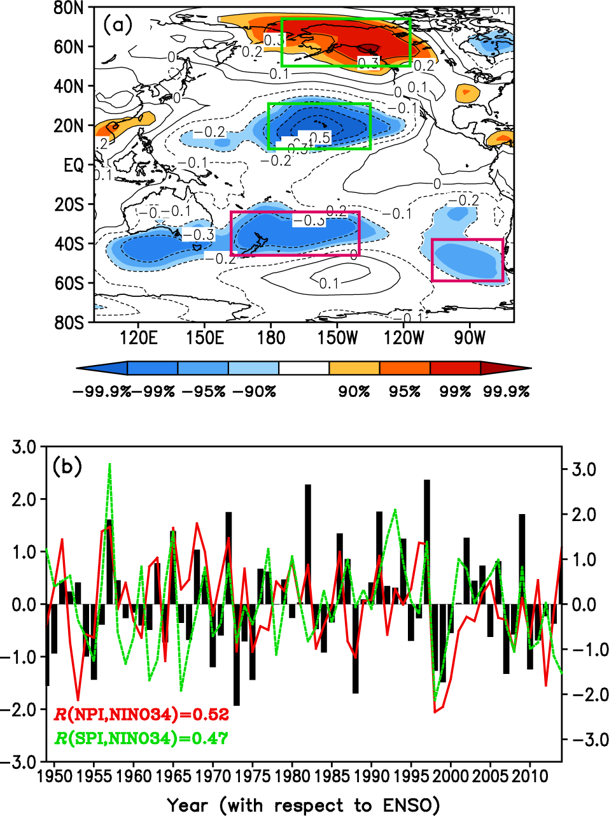
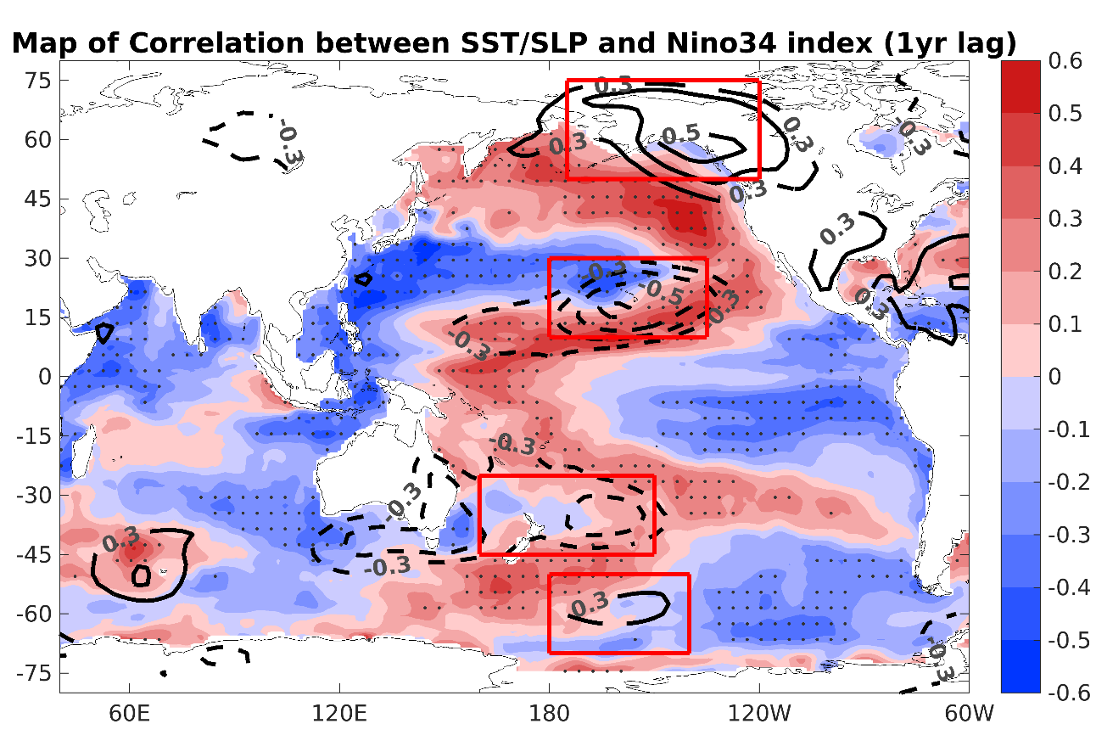
Extra-tropical forcing
${nEPI}_{EX}=$ $−$[($−n$SLP₁ + nSLP₂)+ (sSLP₁ + sSLP₂)]
nSLP₁
nSLP₂
sSLP₁
sSLP₂
Ding et al. (2016)
The boreal winter subtropical and extratropical SLPa over both the North/South Pacific are significantly related to the ENSO state in the following boreal winter
Notes:
nSLP1: 185°–120°W, 50°–75°N
nSLP2: 180°–135°W, 10°–30°N
sSLP1: 160°E–150°W, 25°–45°S
sSLP2: 110°–75°W, 40°–60°S

Slide 15
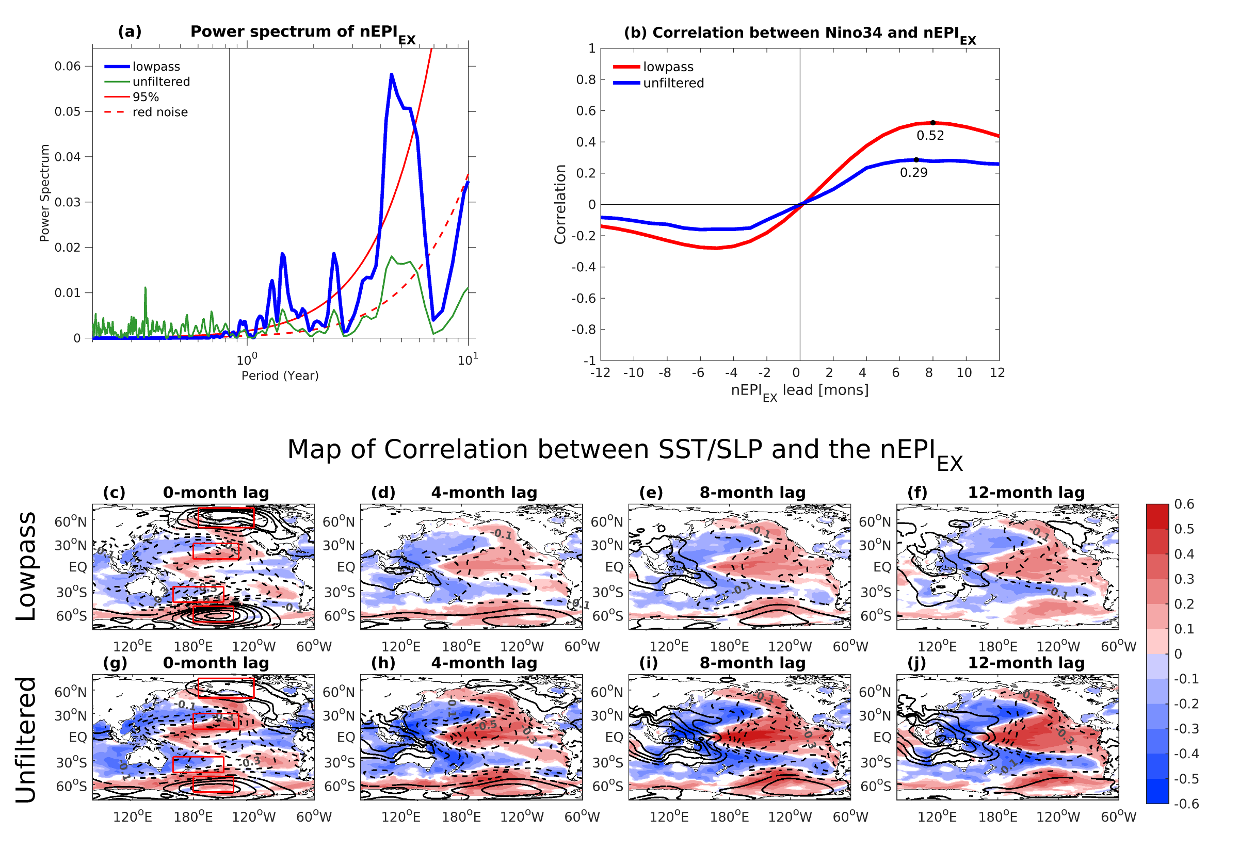
Extra-tropical forcing
${nEPI}_{EX}=$ $−$[($−n$SLP₁ + nSLP₂)+ (sSLP₁ + sSLP₂)]
10-months lowpass filter removes the high frequency noise and keep the interannual variability associated with ENSO
Better relation between Niño34 and nEPIex after the filtering due to the robust tropical-extratropical teleconnection

Slide 16
Extra-tropical forcing
${nEPI}_{EX}=$ $−$[($−n$SLP₁ + nSLP₂)+ (sSLP₁ + sSLP₂)]
The correlation map of SST/SLP with nEPI_{EX}
Unfiltered nEPI_{EX}
Lowpassed nEPI_{EX}

Slide 17
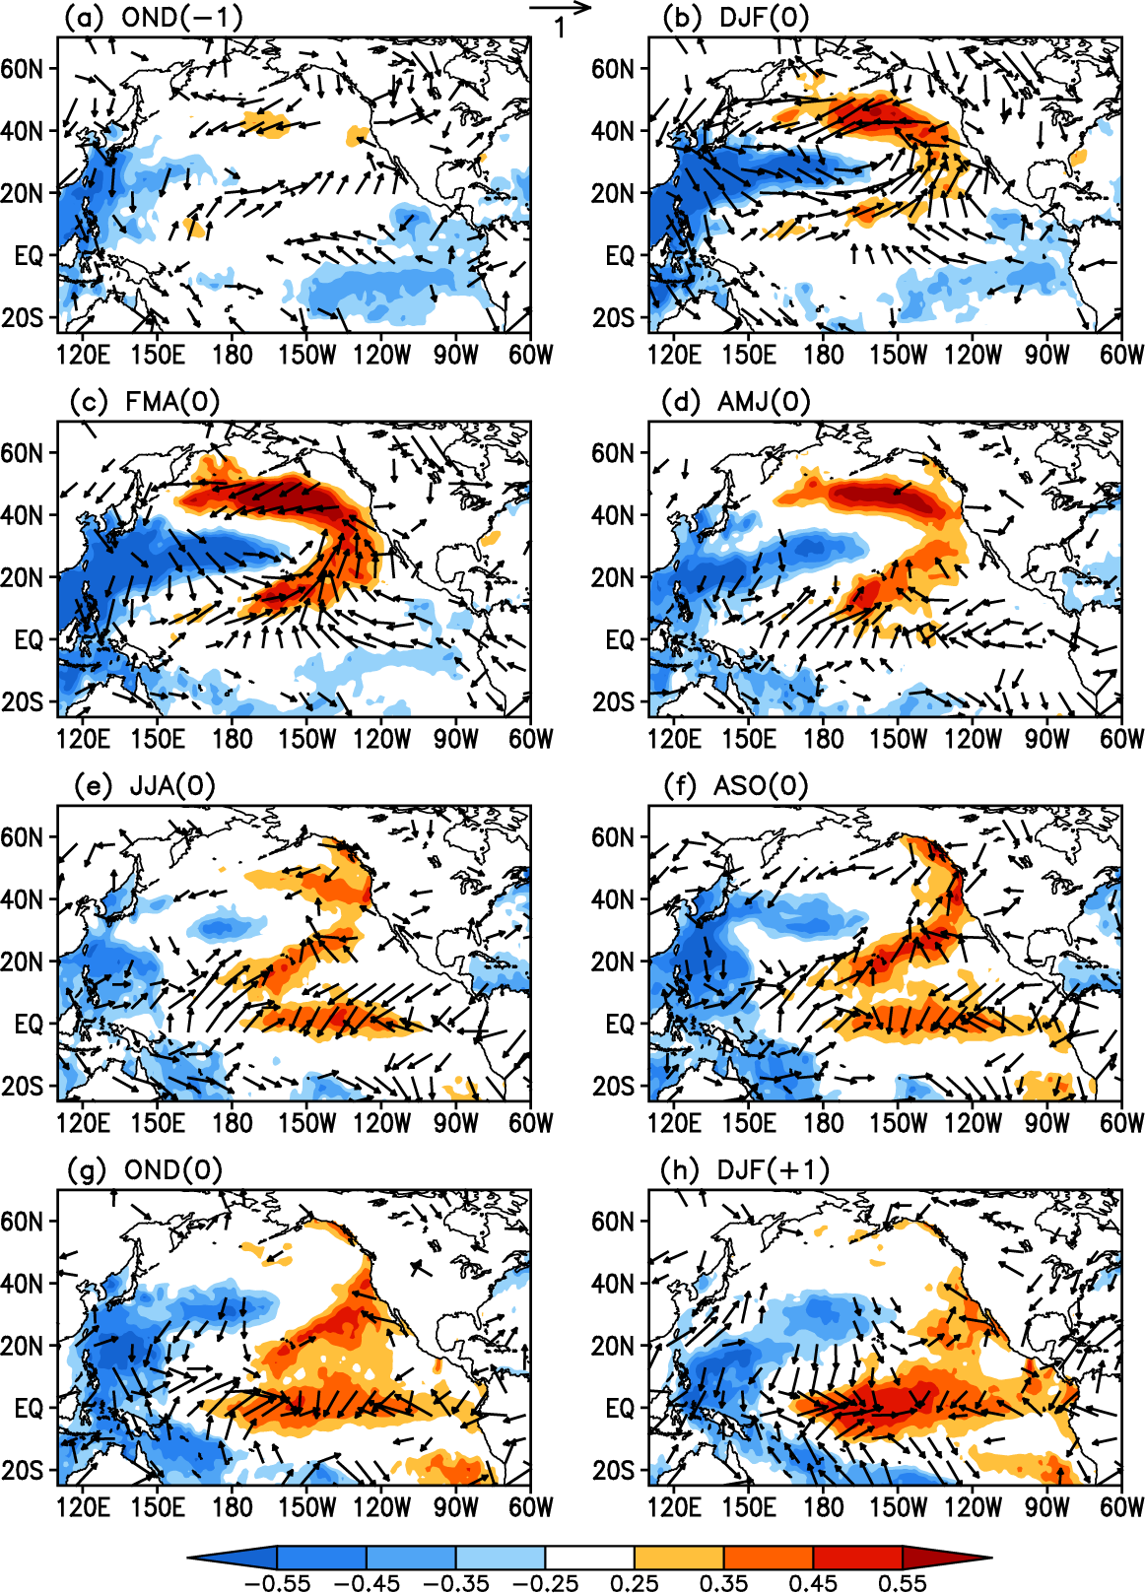
NPO develops
How VM affects ENSO?
Corr. maps of the FMA(0)-averaged VMI with averaged SST and surface wind anomalies
NPO ->VM
PMM
Previous proposed mechanisms
SFM
PMM
TWC
Zonal tropical SST grad increases -> WWB
-> Bjerknes feedback
Ding et al. (2015a)
Notes:
SFM: SST footprint induced by winter NPO persists until late spring and summer when its subtropical portion (0-20N) forces the overlying atmosphere, resulting in zonal wind stress anomalies that favor the ENSO initiation (Vimont et al., 2001; 2003a,b)
PMM: anomalous north-south SST gradient and anomalous surface circulation in the northeasterly trade regime force energetic equatorially trapped oceanic waves to occur in Central Western Pacific through thermodynamic air-sea coupling (Chiang and Vimont, 2004; Chang et al., 2007)
TWC: trade wind charging mechanism: NPO-induced variations in NP trade winds can force subsurface temperature anomalies across the central equatorial Pacific that are conducive to ENSO initiation.
The strengthened NPO can then force a dipole-like SSTA pattern in the North Pacific N of 20°N and a subtropical positive SSTA band lying in 5°-20°N. During DJF(0), ~2 months before the VM peaks, a meridional tripole-like SSTA pattern can be clearly seen in the NP N of 5°N (Figure 7b). As expected, this tripole-like SSTA pattern reaches a peak during FMA(0) (Figure 7c). At this time the SSTA pattern associated with the VM in the tropical central–eastern Pacific closely resembles a PMM pattern [Chiang and Vimont, 2004; Chang et al., 2007], with positive SSTAs in the subtropical central–eastern North Pacific (10°−30°N) and negative SSTAs in the tropical eastern Pacific. Note that in addition to the PMM pattern, there are significant negative SSTAs associated with the VM in the WNP.
As the VM peaks during FMA(0), the significant positive SSTA band in the subtropical central–eastern NP extends toward the central equatorial Pacific (Figure 7c). At the same time, anomalous surface wind associated with the VM also extend across the entire equatorial Pacific. Anomalous southeasterlies occur in the tropical eastern Pacific, while anomalous southwesterlies occur in the tropical western Pacific. The westerly (easterly) component of anomalous southwesterlies (southeasterlies) causes convergence in the central equatorial Pacific, favoring the development of positive SSTAs there. During AMJ(0), significant positive SSTAs begin to establish in the central equatorial Pacific (Figure 7d). At this time, significant positive and negative SSTAs still persist in the subtropical central–eastern North Pacific and WNP, respectively. The positive SSTAs in the subtropical central–eastern North Pacific and central equatorial Pacific, combined with negative SSTAs in the WNP, lead to an increase in the zonal SST gradient across the western–central tropical Pacific, which then strengthens the anomalous westerlies over the western–central equatorial Pacific. After JJA(0), air–sea interaction through a positive feedback process in turn amplifies the zonal wind and SST anomalies along the equator [Bjerknes, 1969], driving continued growth of these anomalies. During DJF(+1), about 10 months after the VM peaks, a warming pattern is well developed in the central–eastern equatorial Pacific (Figure 7h).
Different from SFM: different lag response of the equatorial wind and SSTA to the NP extratropical forcing.
SFM: significant SSTAs induced by the NPO persist until late spring and summer when they subsequently influence the equatorial wind fields and hence the underlying SSTs
VM: anomalous surface winds associated with the VM extend across the entire equatorial Pacific in late winter and early spring [FMA(0), see Figure 7c], which subsequently play an important role in triggering the warming in the central equatorial Pacific. They extend further toward the equator than those with NPO.
Consequently, the SST and surface wind responses in the equatorial Pacific to the VM are stronger and more immediate.
At this point, the VM is similar to the PMM, which also peaks in late winter and spring and affects the SST and surface winds in the tropical Pacific immediately at its peak phase. However, as mentioned above, the VM, as a basin-scale North Pacific SST pattern, combines the active role of SSTAs in both the central–eastern North Pacific and the WNP, different from the PMM pattern that mainly emphasizes the critical role of SSTAs in the central–eastern North Pacific as a precursor to ENSO but considers less the independent contribution of SSTAs in the WNP to the initiation of ENSO events.

Slide 18
Simple ENSO prediction scheme
Normalized ENSO Prediction Index (nEPI)
- WWV propagation
- ocean-atmosphere couple
- Extra-tropical forcing
$$nEPI=β_{1}{nEPI}_{WWV}+β_{2}{nEPI}_{O−A}{+β}_{3}{nEPI}_{EX}$$
$β_{1}, { β}_{2}$ and${ β}_{3}$ are defined by a linear regression model
$${nEPI}_{WWV}=α_{1}{D20a}_{180°(t−25)}+α_{2}{D20a}_{170°w(t−15)}+α_{3}{D20a}_{155°w(t)}$$
$${nEPI}_{O−A}=sign(event)∙dH({nEPI}_{WWV})$$
${nEPI}_{EX}=$ NPI + SPI

Slide 19
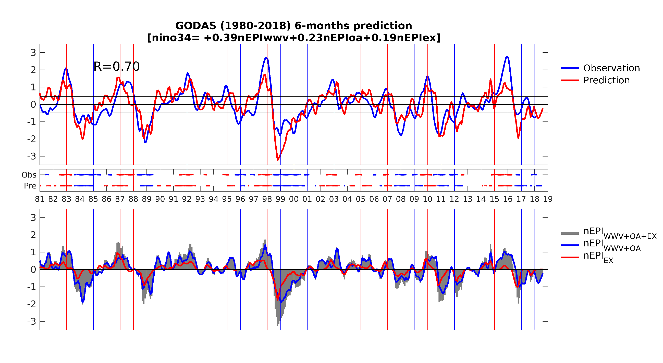
Linear regression model
6-months lead time
Extratropical forcing dominates
WWV dominates

Slide 20
1981-2010 Multi-model ensemble mean skill: 0.65 6-month lead
Hindcast skills (1980-2018)
Lead time | Correlation pentad (monthly)
 | nEPI (WWV+OA+EX) | nEPI (WWV+OA) | WWV
Six-month | 0.65 (0.71) | 0.59 (0.67) | 0.55 (0.57)
Eight-month | 0.63 (0.67) | 0.52 (0.58) | 0.48 (0.51)
Ten-month | 0.57 (0.60) | 0.44 (0.49) | 0.41 (0.44)
For nEPI_{(WWV+OA+EX)}, Nino 3.4 SSTa hindcast skill based on the linear regression model is generally better in terms of the monthly correlation.
Also, significantly increased for 10-month forecast
Notes:
Table 1: The hindcast skills (correlation and normalized RMSE) using the monthly data based on the linear regression model and the WWV, respectively. Values in parentheses are the ensemble-mean skill in Barnston et al. (2012).
Table 2: Percent correct of six-month ENSO forecast (see Larson and Kirtman, 2014 for the metric definition). Values in parentheses are the percent correct predicted by the WWV.

Slide 21
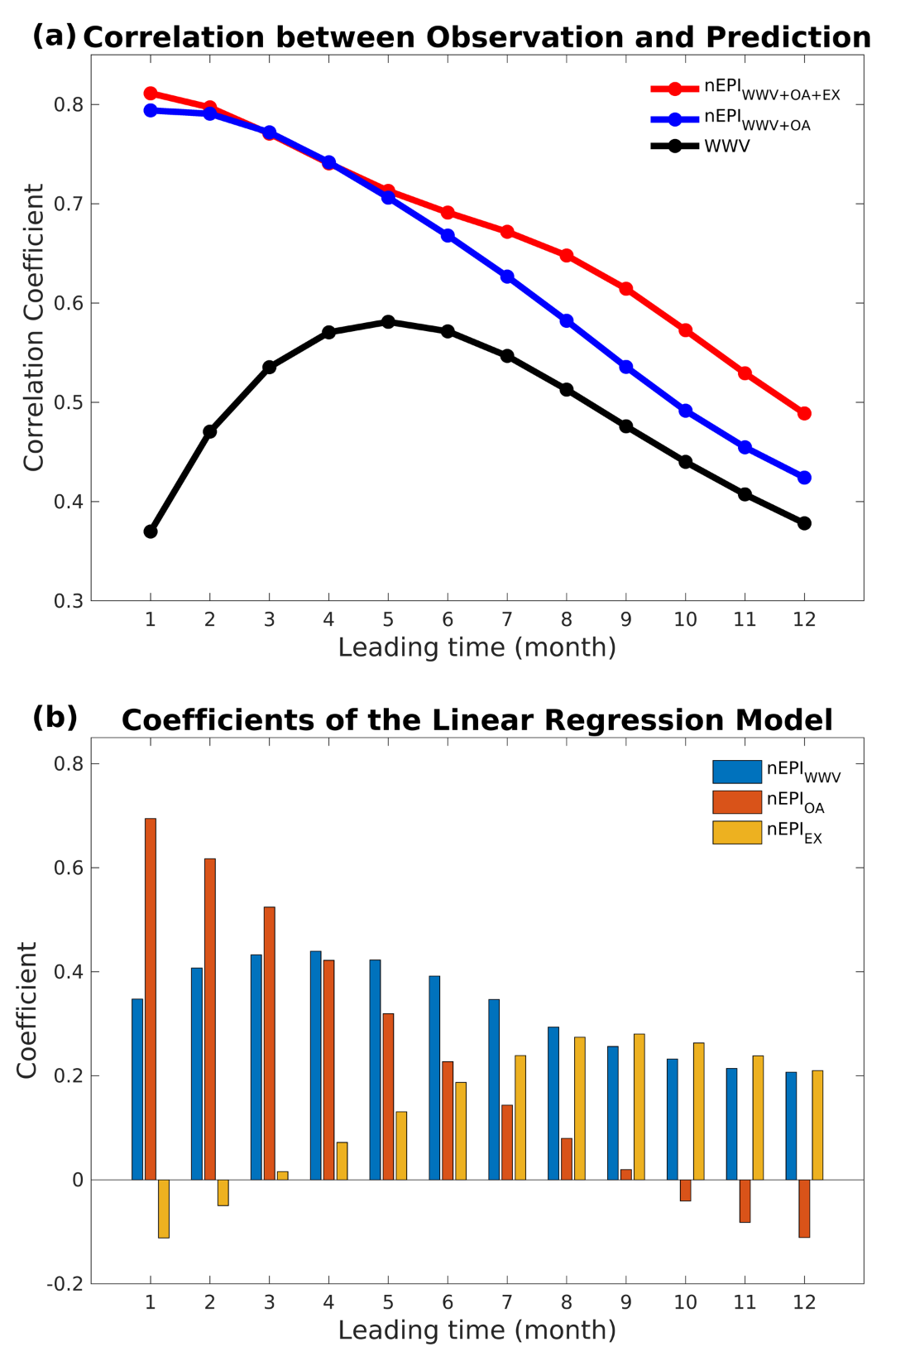
Role of individual terms
Strong O-A coupling
WWV+OA+EX
WWV+OA
Correlation is not degraded too much at 6-month lead-time or longer
WWV
WWV is ¼ phase lead
Extratropical forcing weights increase for the longer lead-time

Slide 22
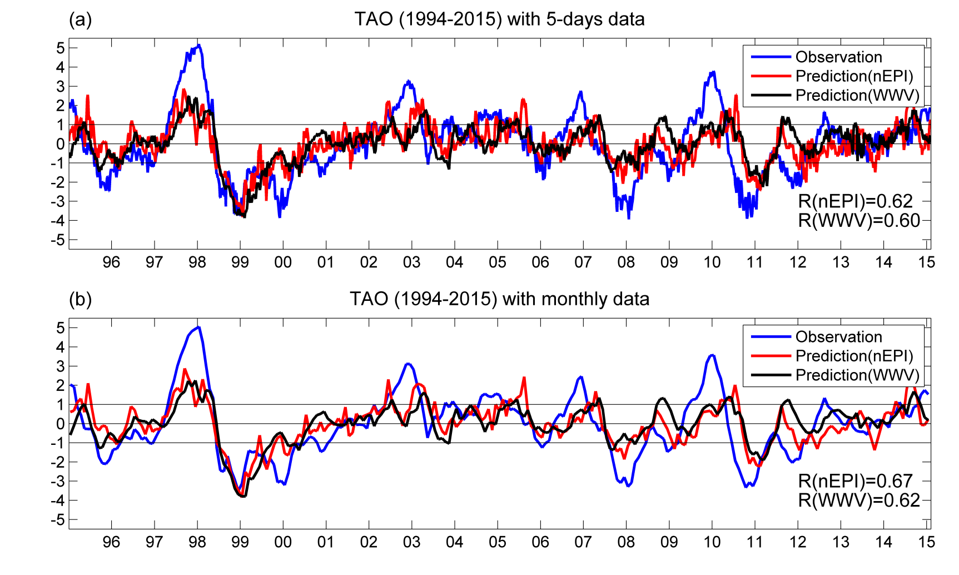
The only missed event: 2000/01 La Niña
Notes:
Figure 3: Lead-lag correlation of Niño3.4 index with (a) nEPI based on TAO (1994-2015), (b) nEPI based on GODAS (1994-2015), (c) nEPI based on GODAS (1980-2015) and (d) WWV index (1994-2015). Bar represents the correlation in 1994-2015 in (a, b, d), and 1980-2015 in (c); black line is the correlation in 1994-2003 in (a, b, d), and 1980-1993 in (c); and green line is the correlation in 2004-2015 in (a, b, d). 99.9% significance levels for 1994-2003 and 2004-2015 are indicated with dashed lines in (a, b, d). The same significance level for 1980-1993 is also indicated in (c). The bar in (a) is superimposed in (d) as a grey dashed line for comparison.

Slide 23
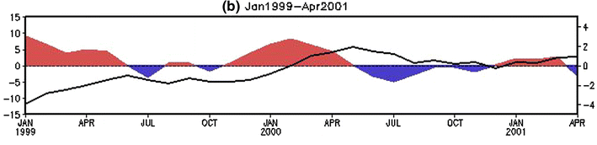
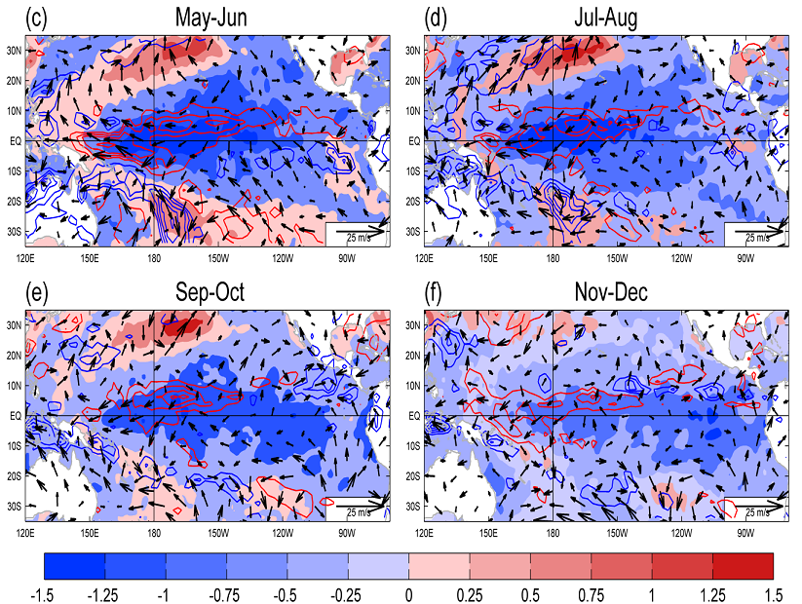
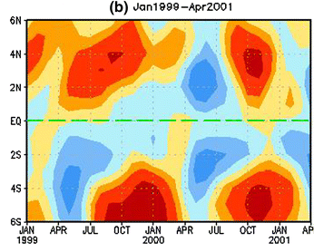
The only missed 2000/01 La Niña
Hu et al. (2014)
WWV index (curve) and its tendency (shading)
Extensive cold SST in the tropic and subtropics
Meridional temp. advection 5–205 m, 170°–120°W
Notes:
monthly mean WWV index (curve) and its tendency (shading). The y-axis in the left represents the WWV and in the right is the WWV tendency. The unit is m for the index and m/month for the tendency
Meridional ocean temperature advection averaged in 5–205 m and 170°–120°W with unit of °C/month during a Jan 1988–Apr 1990; b Jan 1999–Apr 2001; c Jan 2007–Apr 2008; and d Jan 2010–Apr 2012. Dashed green lines represent the equator

Slide 24
Linear regression model
6-months lead time
Extratropical forcing dominates
WWV dominates

Slide 25
What happens in 2018?

Slide 26
2018 June Global SST Anomaly (0C) and Anomaly Tendency
Positive (negative) SSTAs presented along the eq. Pacific, the northeast and southwest Pacific (southeast Pacific).
Strong positive SSTAs presented in the western N. Pacific.
Horseshoe/tripole-like SSTA pattern presented in the N. Atlantic.
Positive SSTA tendencies were observed in the central-eastern equatorial Pacific.
Negative SSTA tendencies were seen in the NW Pacific and NW Atlantic.
Notes:
Fig. G1. Sea surface temperature anomalies (top) and anomaly tendency (bottom). Data are derived from the NCEP OI SST analysis, and anomalies are departures from the 1981-2010 base period means.

Slide 27
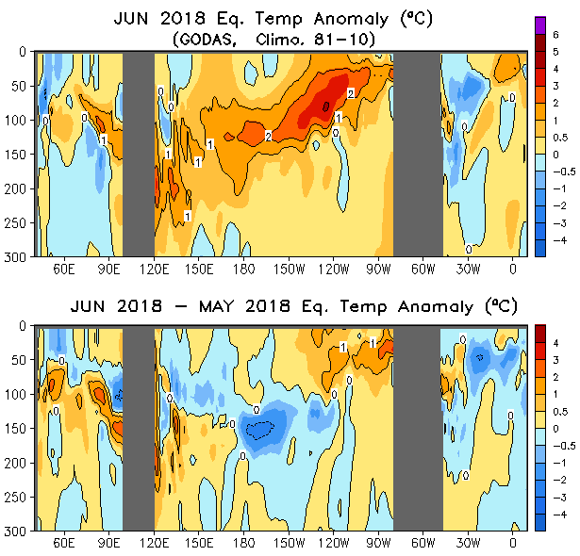
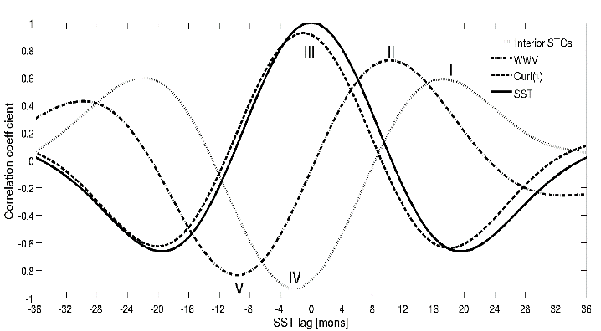
Temperature Anomaly/Anomaly Tendency 2OS-2ON
Positive temperature anomalies presented along the thermocline in the equatorial Pacific.
Tripole tendency pattern in the Pacific: positive in the west and east, and negative in the central.
Notes:
Fig. G3. Equatorial depth-longitude section of ocean temperature anomalies (top) and anomaly tendency (bottom). Data are derived from the NCEP's global ocean data assimilation system which assimilates oceanic observations into an oceanic GCM. Anomalies are departures from the 1981-2010 base period means.

Slide 28
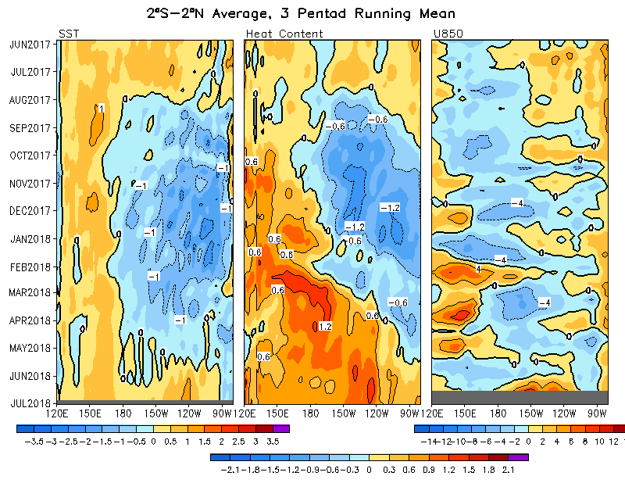
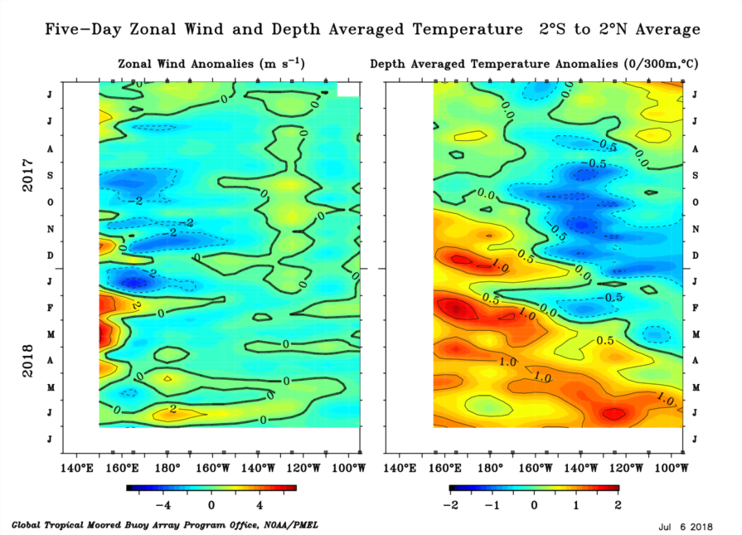
Equatorial SST, Surface Zonal and HC300 Anomalies
Switch to positive in late May
WWB+WWV propagation

Slide 29
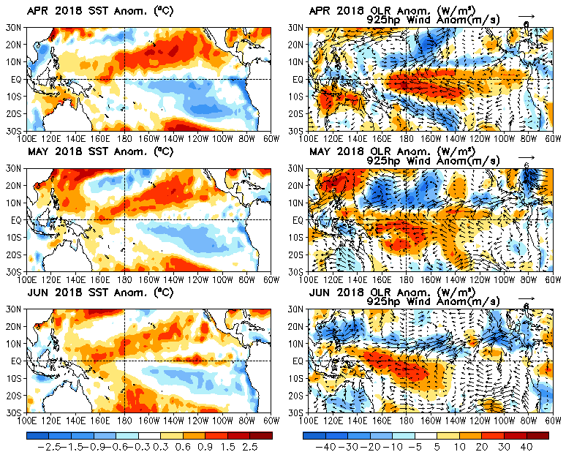
Typical VM in April to June
north-south SSTA dipole
cross equatorial wind anomalies
enhanced (suppressed) convection north of the equator (on the equator).
Notes:
The patterns of SST, surface winds and OLR anomalies largely persisted in Apr-Jun 2018, and resemble the North Pacific Meridional Mode (NPMM) that are characterized by north-south SSTA dipole, cross equatorial wind anomalies, and enhanced (suppressed) convection north of the equator (on the equator).

Slide 30
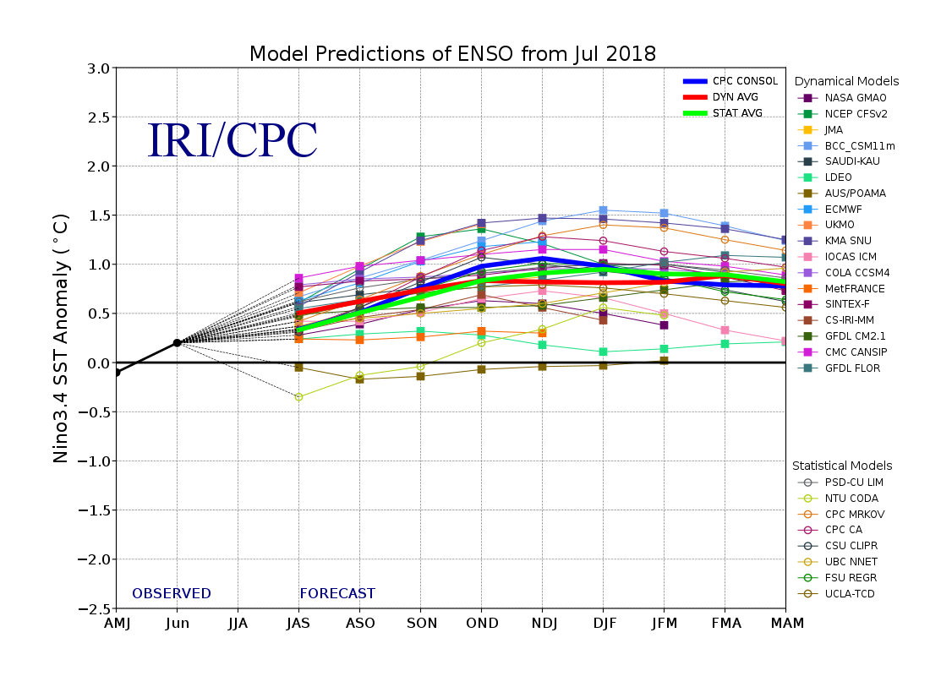
IRI ENSO plume prediction in July
NTU CODA

Slide 31
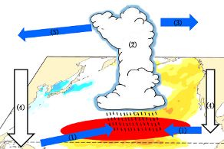
New North Pacific climate paradigm
Miller et al. (2017)
Ding et al. (2017a)
Ding et al. (2015a); Tseng et al. (2017b)
Tropical-extratropical interaction
Ding et al. (2015b)
Hu et al. (2017a; 2017b)
SFM
Chen et al. (2015, 2018); Tseng et al. (2017a);
Ding et al. (2018)
Ding et al. (2017b)
Tropical-extratropical interaction
Ding et al. (2015c); Ding et al. (2016)

Slide 32

Conclusion
El Niño “is” coming this winter, our improved prediction model suggests it will not be a strong one
Hindcast skill of SSTa is generally better than the commonly used WWV index and all other prediction models in terms of the monthly correlation
WWV propagation+O-A coupling greatly improves the ENSO prediction skill
6 to 10 months lead time hindcast skill can be even enhanced by further incorporating the extratropical North/South Pacific forcing (Spring barrier may not be an issue)

Slide 33
Change the coefficients for El Nino/La Nina
Sepearte South Pacific/North Pacific

