Slide 1
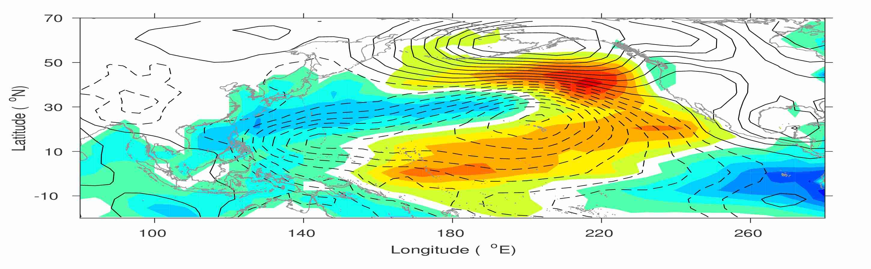
Another El Niño at the end of 2019: Is an ENSO Diversity Emerging?
Yu‑heng Tseng
Institute of Oceanography, National Taiwan University, Taiwan
Acknowledgments: Wayne Lee, Chung-Hsiung Sui, Fei Zheng, Xianghui Fang, Jin-yi Yu
Notes:
Good morning, thank you very much for your coming for the first talk today!
Pacific climate variability and the ENSO prediction

Slide 2
Refreshing the ENSO cycle/theory
(recharge-discharged mechanism)

Slide 3
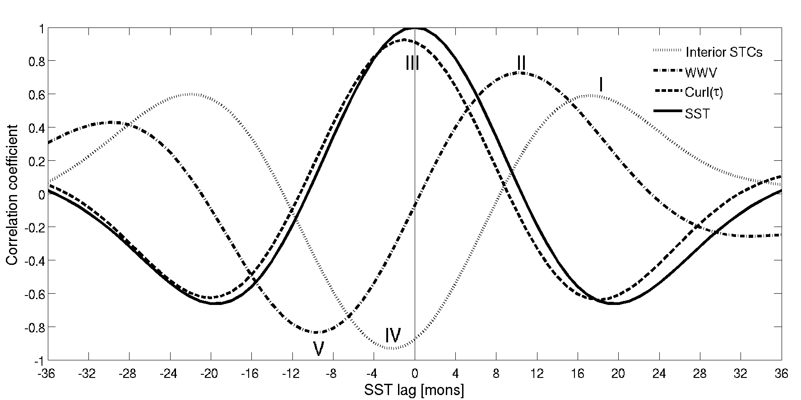
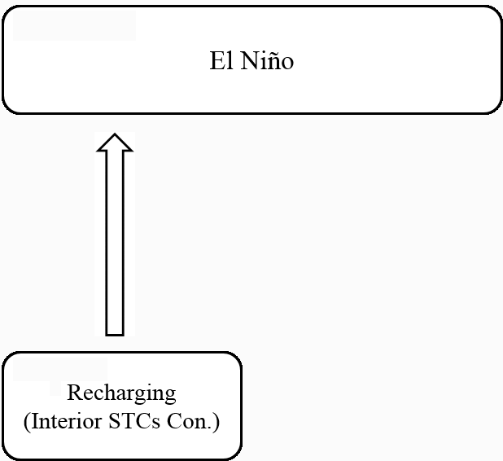
Geostrophic
τ_{a}
SSTa(-)
Depth anomaly
18
SST lead
SST lag
18
Notes:
So the connection of STC and SSTa seems to be an oscillated process where we can explain using the recharge-discharge process. 18 month before the matured El Nino, an enhanced STC convergence charges the equatorial upper ocean with warm water to produce a peak WWV after 8 month.

Slide 4
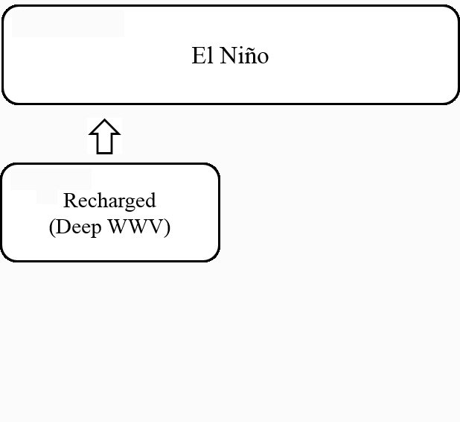
τ_{a} ~ 0
SSTa ~0
Depth anomaly
10
SST lead
SST lag
10
Notes:
A changed WWV initiates the surface warming in the CP & EP and a warmest SST is reached 10 month later.

Slide 5
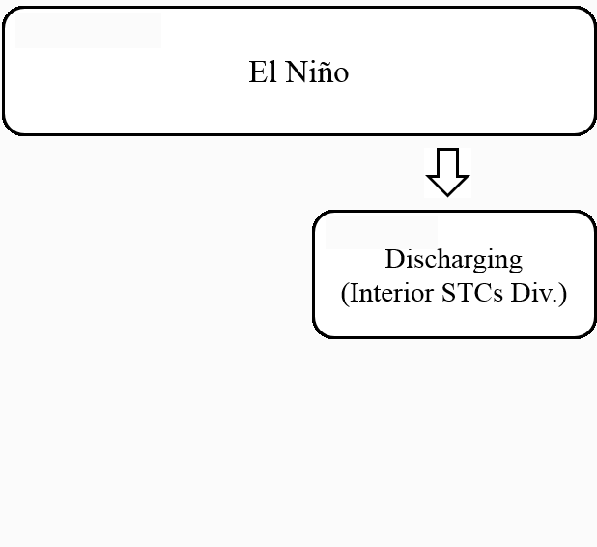
Geostrophic
τ_{a}
SSTa(+)
Depth anomaly
-2
SST lead
SST lag
2
Notes:
Atmospheric responses to convective heating over warm SST anomalies result in equatorial Windano and the off-equatorial cyclonic wind stress in the WP and CP that produce divergence of STC transport. So

Slide 6
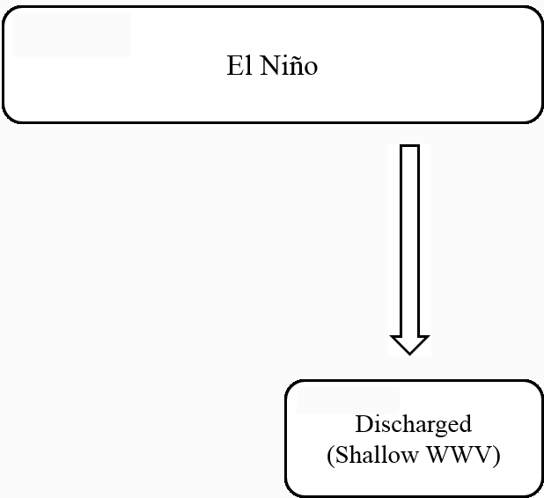
τ_{a} ~ 0
SSTa ~0
Depth anomaly
-10
SST lead
SST lag
10
Notes:
A diverging STC transport discharges equatorial warm water, so that a minimum WWV is reached after 8 month.

Slide 7
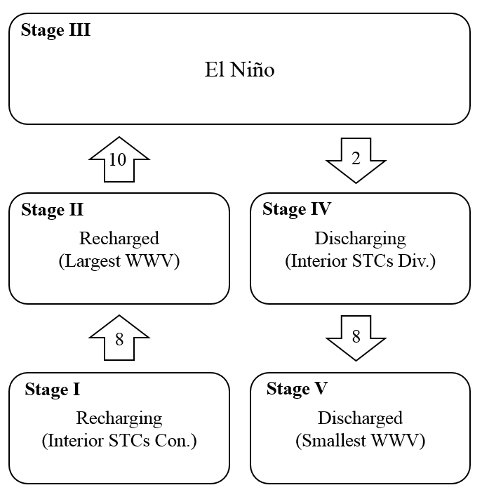
The corresponding timescales for the completed process (from a recharging stage to a discharged stage) are 8, 10, 2 and 8 months, respectively.
But this is only based on the statistical analysis!
Notes:
The composite evolution of different ENSO events also support the recharge-discharge processes.
The evolution of the El Nino events starts from the recharging stage (maximum interior STC convergence stage I), develops to the recharged stage (maximum WWV; stage II), peaks at the warmest SST (stage III), is followed by the discharging stage (maximum interior STC divergence; stage IV), and finally reaches the discharged stage (minimum WWV; stage V).
The time intervals can be determined by the adjustment time of tropical Pacific oceanic waves. The evolution WWV is explained by the off-equatorial Sverdrup transport associated with the Rossby waves (jin, 1997).
Observed equatorial Rossby waves were responsible for changing the basin-scale zonal pressure gradient and consequently the anomalous meridional geostrophic transport. Bosc and Delcroix (2008).
Zonal mean thermocline depth leads the SST by a ¼ cycle but also lags the SST by a ¼ cycle. Interior STC leads SST by 150° and also lags SST by 20°° An and Kang (2000).
Asymmetry of interior STC also exists.

Slide 8
What’s the latest tropical ocean status?

Slide 9
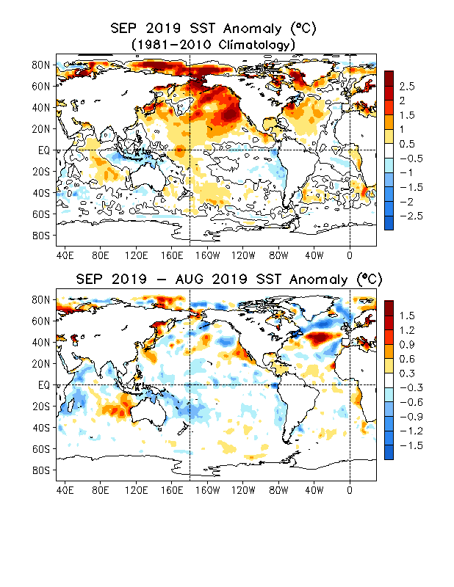
Global SST Anomaly (⁰C) and Anomaly Tendency
SSTs near normal in the tropical Pacific with small positive (negative) anomalies in the west (east); A PMM structure.
Strong positive SSTAs persisted in the NE Pacific.
Positive SSTAs dominated in the North Atlantic.
Indian Ocean, SSTAs were positive in the west and central and negative in the far east, featuring the positive IOD structure.
Negative SSTA tendencies dominated in the whole tropical Pacific.
Horseshoe/tripole-like SSTA tendencies were present in the North Atlantic.
Negative (positive) SSTA tendencies were in the western (southeastern) Indian, indicating a weakening of IOD
NCEP OI SST
Notes:
https://origin.cpc.ncep.noaa.gov/products/GODAS/ocean_briefing_new/mnth_sst_sstdiff_glb_xy.gif

Slide 10
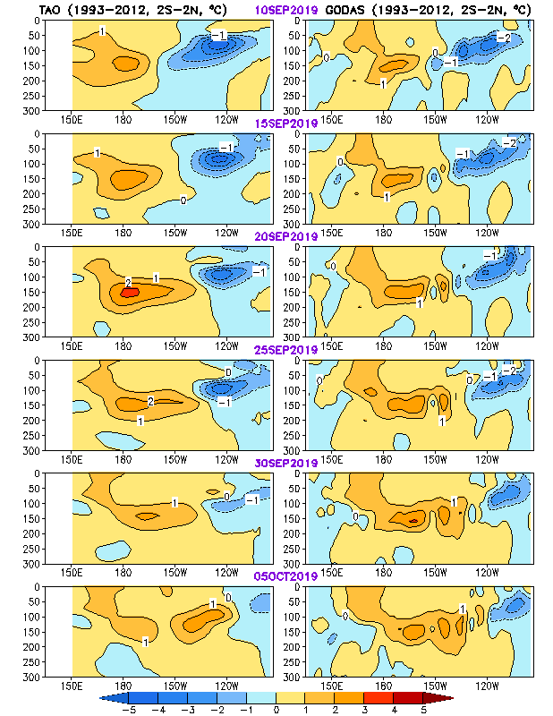
Equatorial Pacific Ocean Temperature Pentad Mean Anomaly
TAO
GODAS
Positive ocean temperature anomalies propagated eastward.
The features of the ocean temperature anomalies were similar between GODAS and TAO analysis.
Notes:
https://origin.cpc.ncep.noaa.gov/products/people/zzhu/HU_YAN_tao_godas_pent.gif

Slide 11
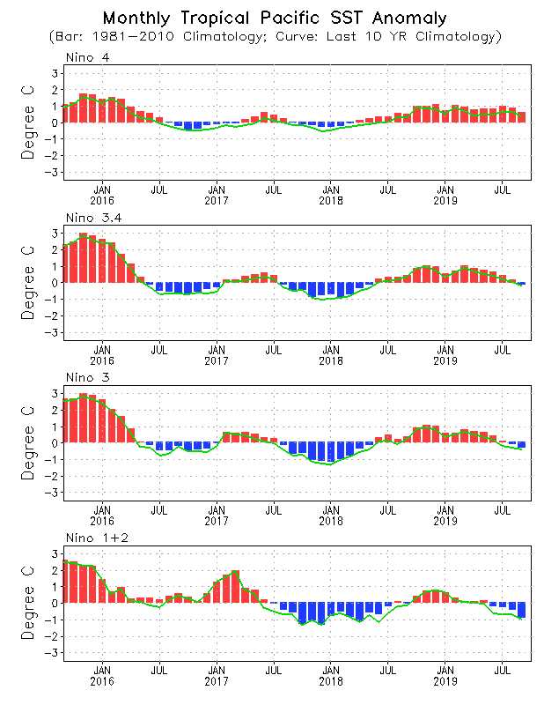
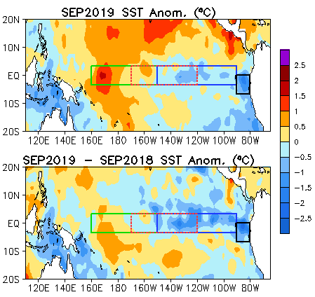



Evolution of Pacific NINO SST Indices
All indices decreased, with Nino3.4, Nino3 and Nino1+2 negative in Sep 2019.
Nino3.4 = -0.02C in Sep 2019.
Compared with Sep 2018, the central and eastern equatorial Pacific was cooler in Sep 2019.
NCEP OI SST (1981-2010 clim)
Notes:
https://origin.cpc.ncep.noaa.gov/products/GODAS/ocean_briefing_new/mnth_sst_pac_xy_box.gif
https://origin.cpc.ncep.noaa.gov/products/people/zzhu/HU_mnth_Nino_Index_10yr.gif
https://origin.cpc.ncep.noaa.gov/products/GODAS/ocean_briefing_new/mnth_nino_4yr.gif
http://www.cpc.ncep.noaa.gov/data/indices/sstoi.indices

Slide 12
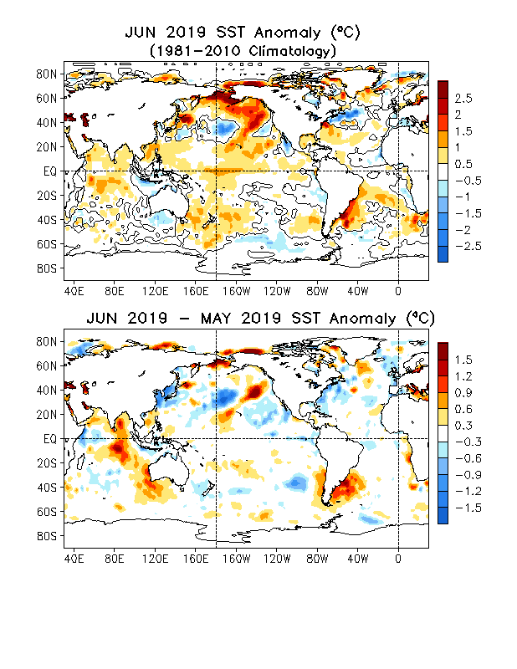
Global SST Anomaly (⁰C) and Anomaly Tendency
Positive SSTAs persisted in the central tropical Pacific, consistent with El Nino conditions.
SSTAs were positive in the North Pacific.
Horseshoe/tripole-like SSTA pattern was observed in the North Atlantic.
In the Indian Ocean, SSTAs were positive in the west and central and negative in the far east.
SSTA tendencies were small negative in the eastern tropical Pacific.
SSTA tendencies in the Indian Ocean were positive in the central and east.
NCEP OI SST
Notes:
https://origin.cpc.ncep.noaa.gov/products/GODAS/ocean_briefing_new/mnth_sst_sstdiff_glb_xy.gif
Fig. G1. Sea surface temperature anomalies (top) and anomaly tendency (bottom). Data are derived from the NCEP OI SST analysis, and anomalies are departures from the 1981-2010 base period means.

Slide 13
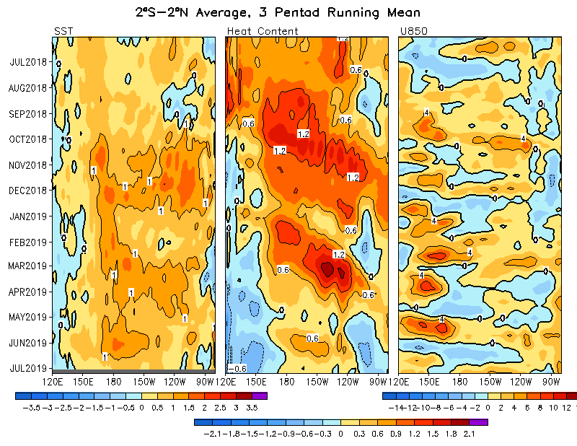
Equatorial Pacific SST (ºC), HC300 (ºC), u850 (m/s)lies
Positive SSTA in the central and eastern Pacific weakened in the last month.
Negative HC300A presented in the western and far-eastern Pacific and positive in between in Jun 2019.
Notes:
https://origin.cpc.ncep.noaa.gov/products/GODAS/ocean_briefing_new/pent_oisst_heat_u850_pac_eq_xt.gif

Slide 14
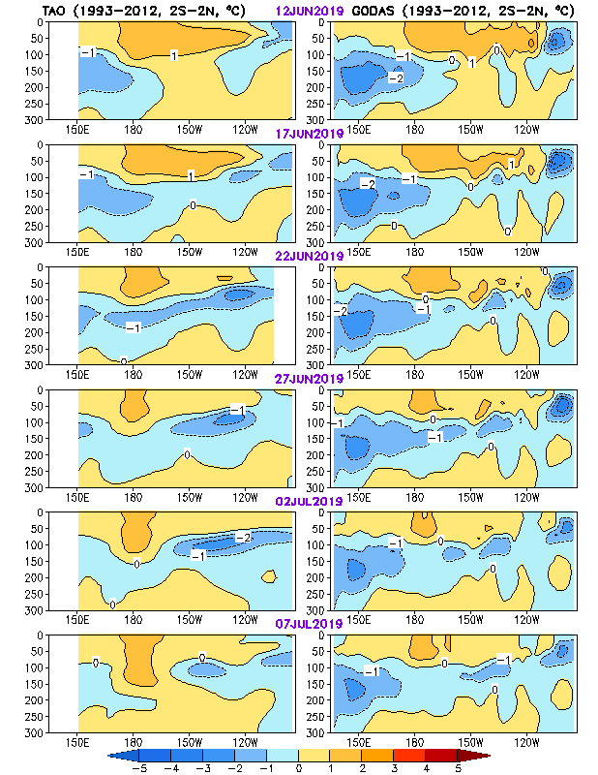
Equatorial Pacific Ocean Temperature Pentad Mean Anomaly
TAO
GODAS
Negative ocean temperature anomalies presented during the last few months, and propagated eastward.
The patterns of the ocean temperature anomalies between GODAS and TAO were similar.
Notes:
https://origin.cpc.ncep.noaa.gov/products/people/zzhu/HU_YAN_tao_godas_pent.gif

Slide 15
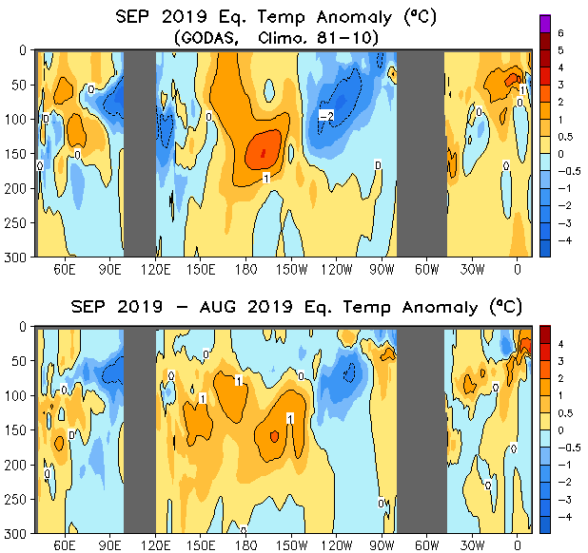
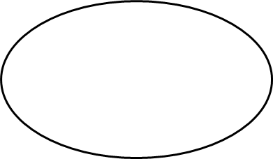

Longitude-Depth Temperature Anomaly and
Anomaly Tendency in 2^{O}S-2^{O}N
Positive (negative) temperature anomalies presented in the central (western and eastern) equatorial Pacific.
Positive temperature anomalies were present along the thermocline in the Atlantic Ocean.
Temperature anomaly tendency was positive (negative) in the western and central (eastern) Pacific.
Equatorial depth-longitude section of ocean temperature anomalies (top) and anomaly tendency (bottom). Data are derived from the NCEP's global ocean data assimilation system which assimilates oceanic observations into an oceanic GCM. 1981-2010 clim.
Notes:
https://origin.cpc.ncep.noaa.gov/products/GODAS/ocean_briefing_new/mnth_temp_tempdiff_glb_eq_xz.gif

Slide 16
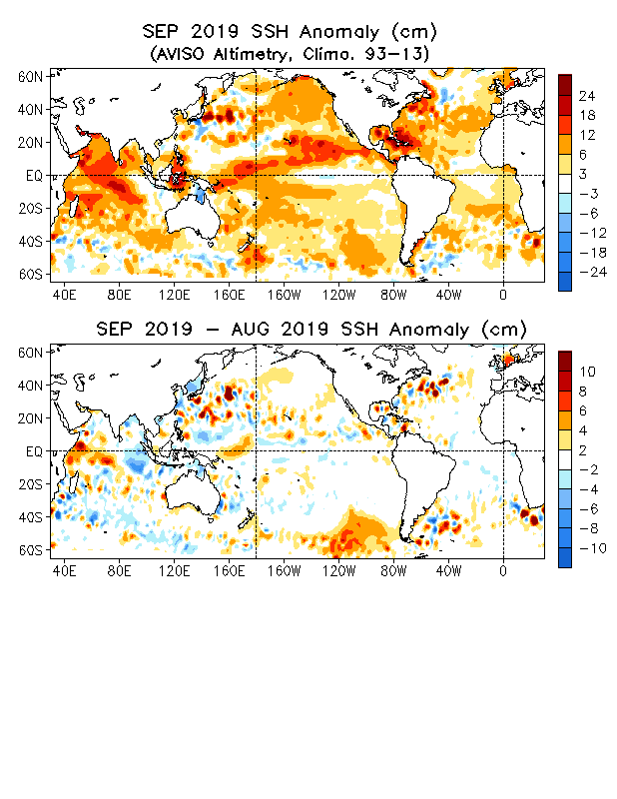
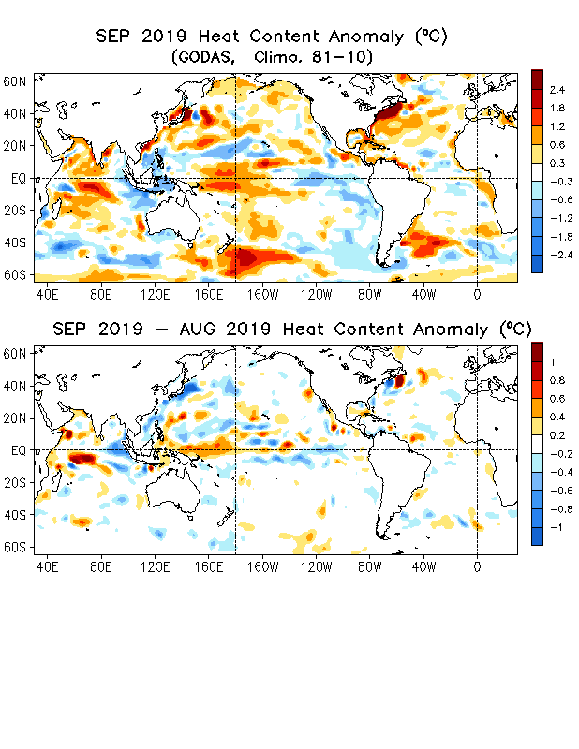
Global SSH and HC300 Anomaly & Anomaly Tendency
The SSHA pattern was overall consistent with the HC300A pattern.
Both SSHA and HC300A in the tropical Indian were consistent with the positive IOD state.
- Tendencies of SSHA and HC300A include many small scale anomalies (e.g., mesoscale eddies).
Notes:
https://origin.cpc.ncep.noaa.gov/products/GODAS/ocean_briefing_new/mnth_ssh_sshdiff_glb_xy.gif
https://origin.cpc.ncep.noaa.gov/products/GODAS/ocean_briefing_new/mnth_hc_hcdiff_glb_xy.gif

Slide 17
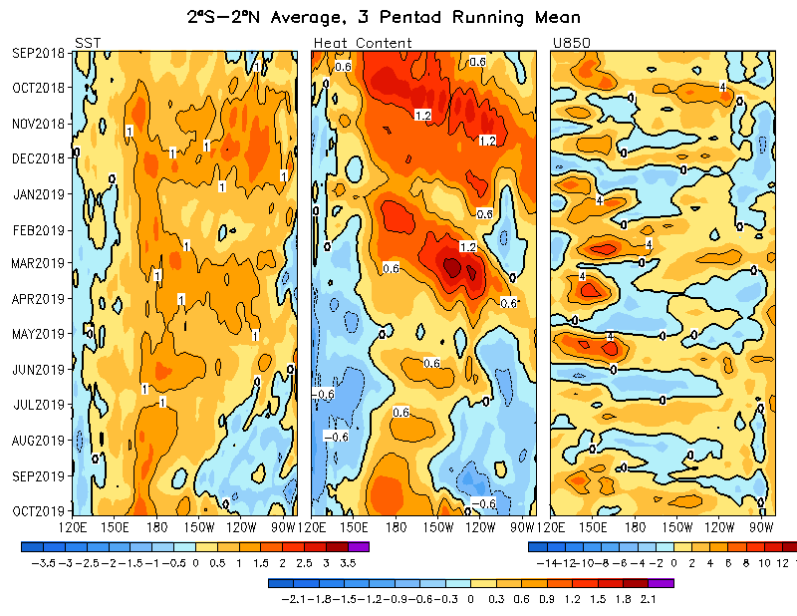
Equatorial Pacific SST (ºC), HC300 (ºC), u850 (m/s) Anomalies
SSTAs were positive (negative) in the western and central (eastern) Pacific Sep 2019
Positive HC300A propagated from the western to eastern Pacific, consistent with low-level anomalous westerlies.
Notes:
https://origin.cpc.ncep.noaa.gov/products/GODAS/ocean_briefing_new/pent_oisst_heat_u850_pac_eq_xt.gif

Slide 18
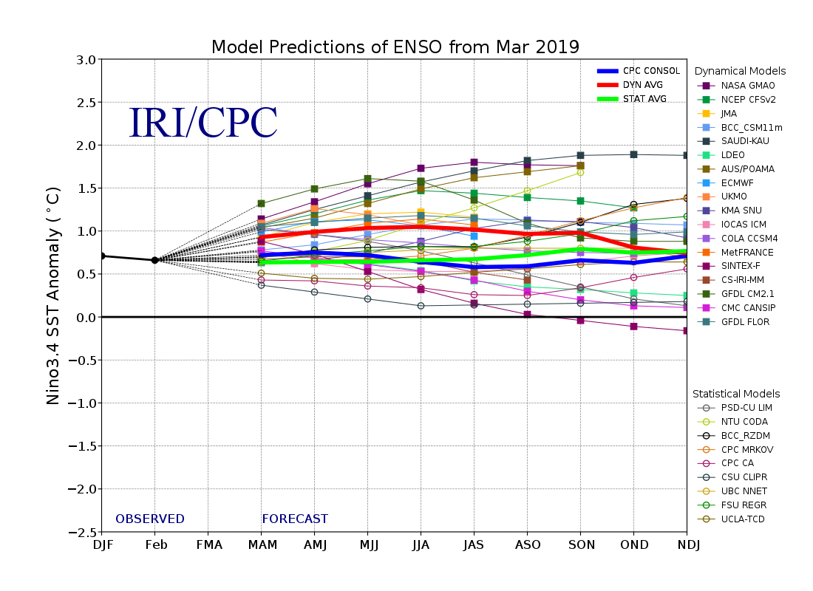
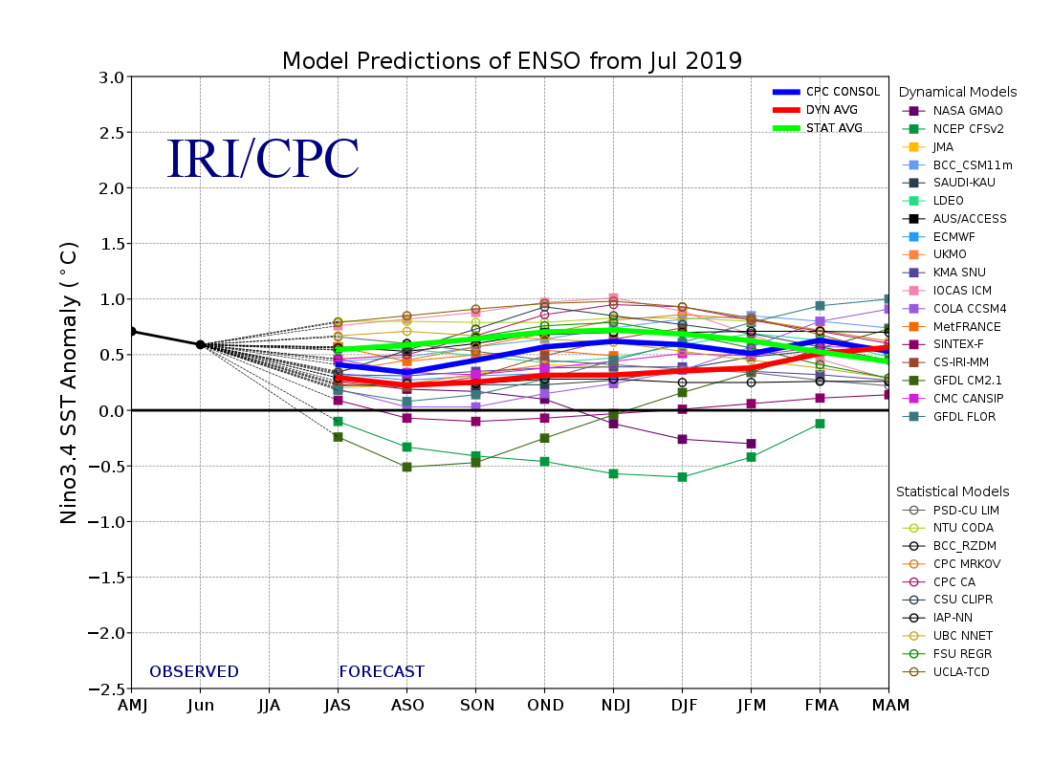
IRI ENSO plume prediction in July
NTU CODA
https://iri.columbia.edu/our-expertise/climate/forecasts/enso/current/

Slide 19
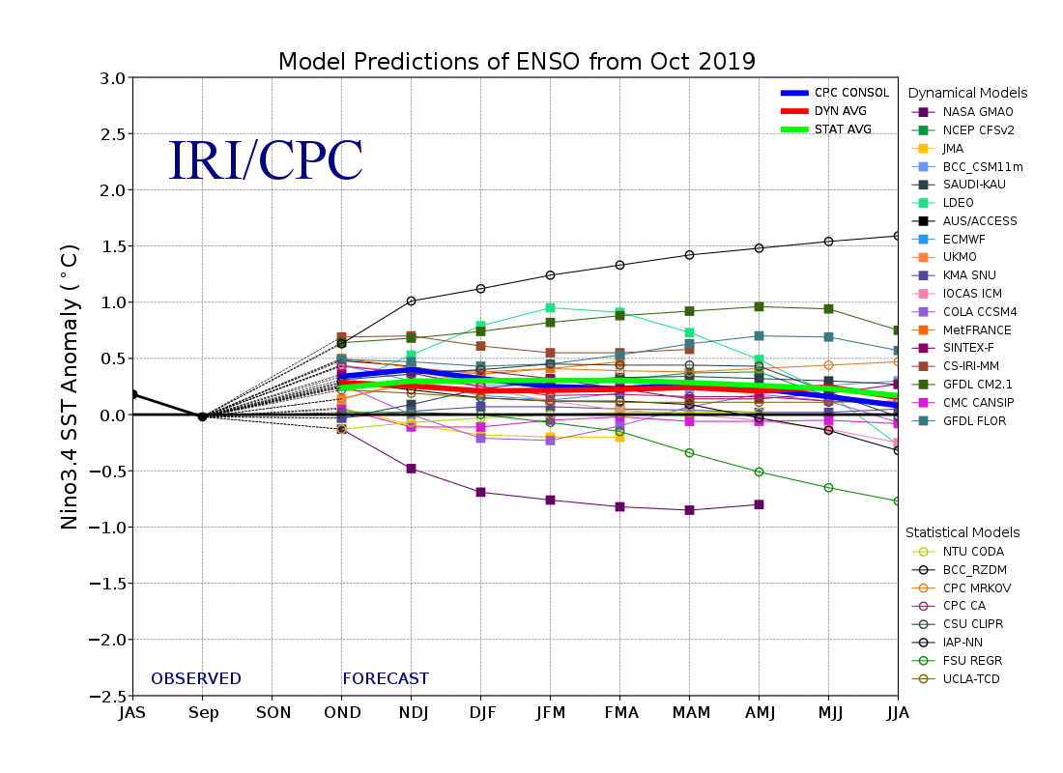
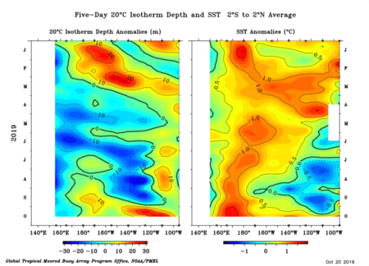
IRI ENSO plume prediction in Oct
NTU CODA
https://iri.columbia.edu/our-expertise/climate/forecasts/enso/current/

Slide 20

Questions:
Is the 2017/18 El Niño continuous?
Is this two-winter El Niño common?
A new ENSO diversity?

Slide 21
1/4 El Niño since 1960 belongs to the two-winter type
17 El Niño
One-Winter 12 | Two-Winter 4 (5)
1963-64 | 1968-69-70
1965-66 | 1976-77-78
1972-73 | 1986-87-88
1979-80 | 2014-15-16
1982-83 | 2018-(19-20)
1991-92
1994-95
1997-98
2002-03
2004-05 | Weak (0.5-1°C)
2006-07 | Moderate (1-1.5°C)
2009-10 | Strong (>2°C)
SST: NOAA ERSSTv5
PREC: GPCP v2.3
ATM: ERA-Interim
OCN: GODAS
If a new ENSO diversity, what characteristics?

Slide 22
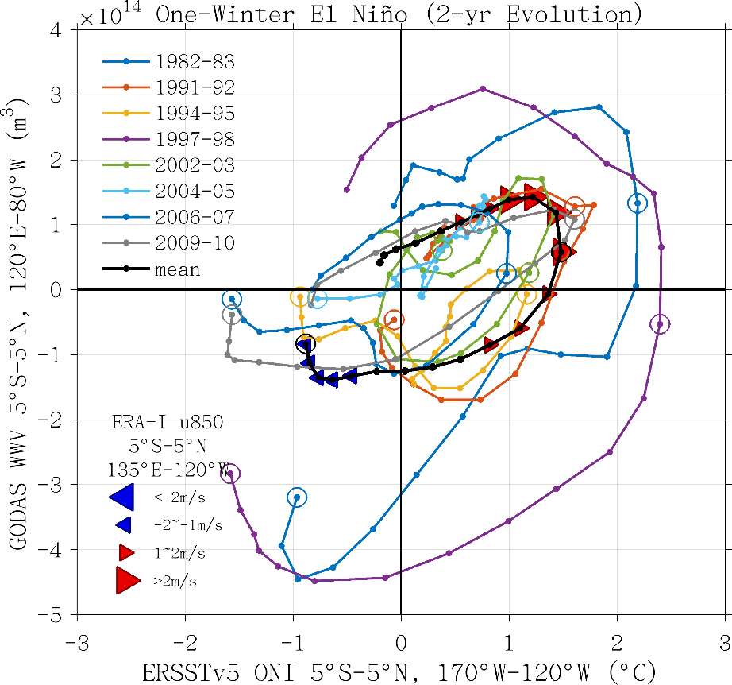
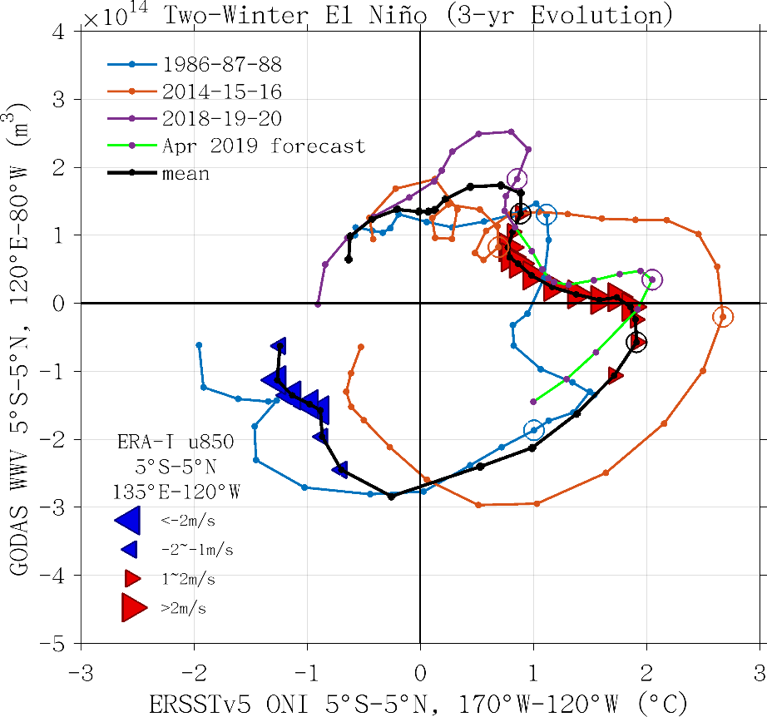
Historical WWV and SST phase diagram
Statistically, peak correlation of Nino3 with WWV occurs at 7 month lag
Increase (decrease) of WWV indicates recharge (discharge) of the equatorial ocean heat content.
ONI largely increases in the second July-October but the basin wide WWV anomaly is nearly zero/negative
The decrease of WWV is slower in the 2nd year and the 2nd peak is higher than the 1st
One-winter
Two-winter
Recharge
Year 0
Discharge
ONI>0.5°C a season late with weak anomalous westerly in the first boreal summer/autumn
Notes:
The WWV-ONI phase diagram for (left) single-winter El Niño and (right) double-winter El Niño from 1980-2019. The evolution of two (three) years is plotted for the single- (double-) winter events. The 850-hPa anomalous westerly (easterly) over 5°S-5°N, 135°E-120°W in composite is denoted by a red (blue) triangle. Each dot represent a month, and the open circle denotes December.
ONI largely increases in the second July-October but the basin wide WWV anomaly is nearly zero/negative
The decrease of WWV is slower in the 2nd year and the 2nd peak is higher than the 1st
ONI>0.5°C a season late with weak anomalous westerly in the first boreal summer/autumn

Slide 23
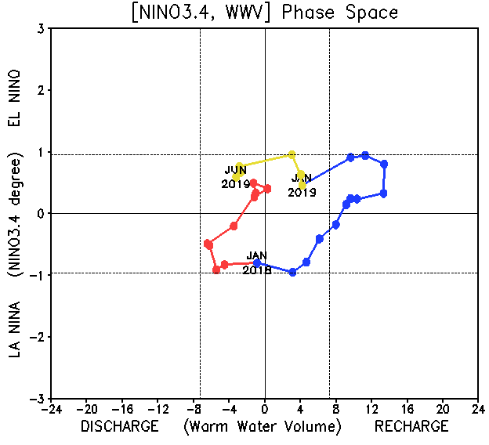
2017-2019 WWV and SST phase diagram
Equatorial WWV switched to a discharged phase since Apr 2019.
Notes:
https://origin.cpc.ncep.noaa.gov/products/GODAS/ocean_briefing_new/wwv_n3.gif
Fig. P3. Phase diagram of Warm Water Volume (WWV) and NINO 3.4 SST anomalies. WWV is the average of depth of 20ºC in [120ºE-80ºW, 5ºS-5ºN] calculated with the NCEP's global ocean data assimilation system. Anomalies are departures from the 1981-2010 base period means.

Slide 24
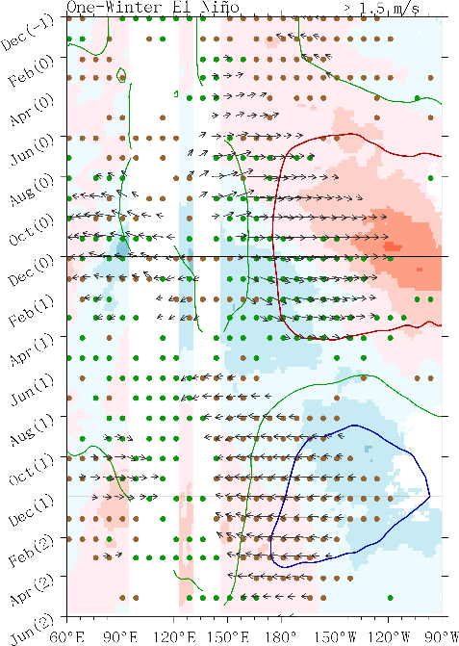
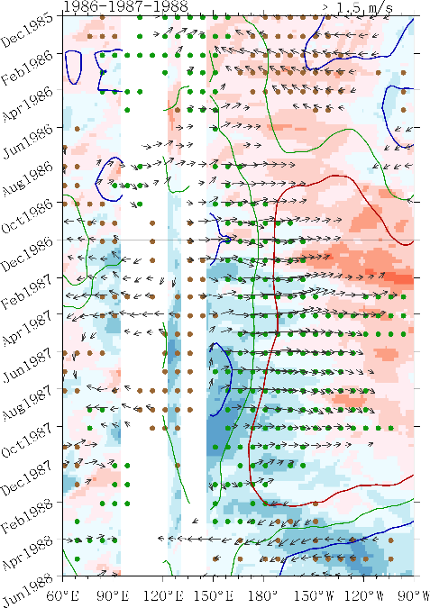
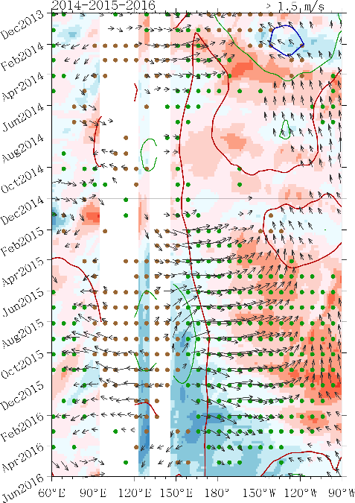
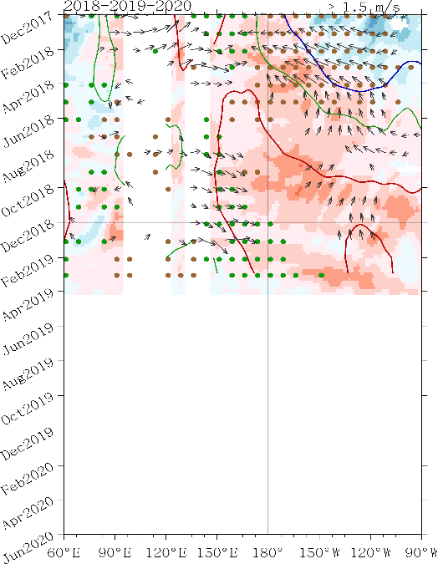
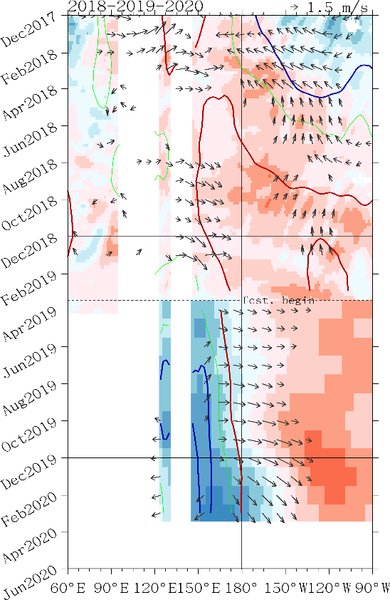
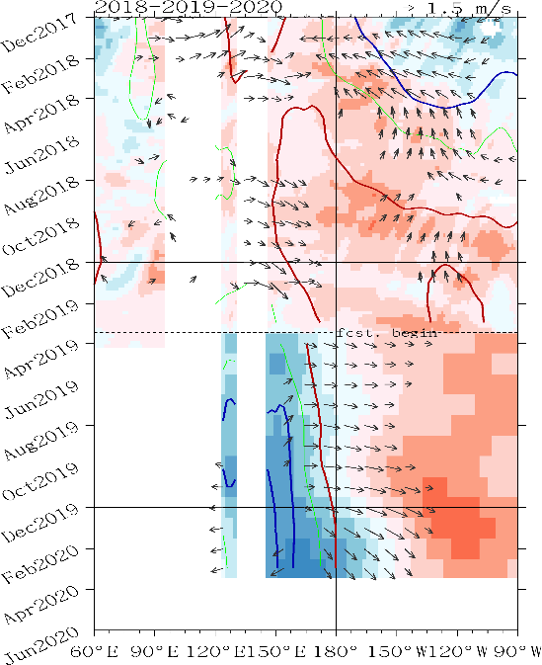
Hovmöller diagram-D20, SST and 850 hPa wind anomalies
Enhanced southerlies in 2014/15 and 2018/19
(a) One-Winter El Niño Composite
(b) 1986-87-88
(c) 2014-15-16
(d) 2018-19-20
Poor air-sea coupling
Change to “tilt” mode later
D20 (shading), SST (contour), rainfall (dotted) and 850-hPa wind (vector)
Notes:
The longitude-time diagram for D20 (shading), SST (contour), and 850-hPa wind (vector) anomalies averaged over 5°S-5°N. The SSTA and winds are smoothed with 3-month running mean. The SSTA are plotted at -0.5°C, 0°C, and 0.5°C with the blue, green, and red contours, respectively. The minimum vector shown is 1m/s.
Enhanced convection and westerly anomalies are over western to central Pacific as the SSTA over central to eastern Pacific reaches 0.5°C

Slide 25
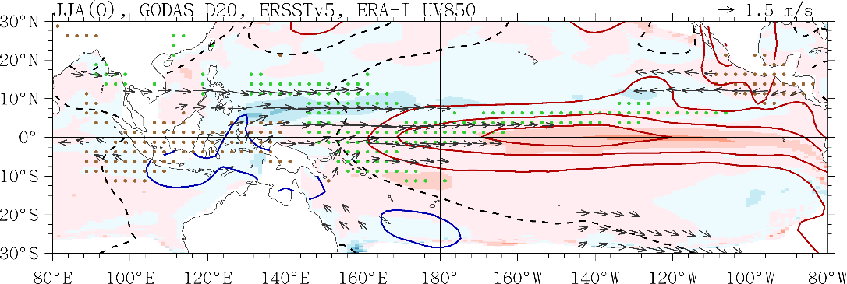
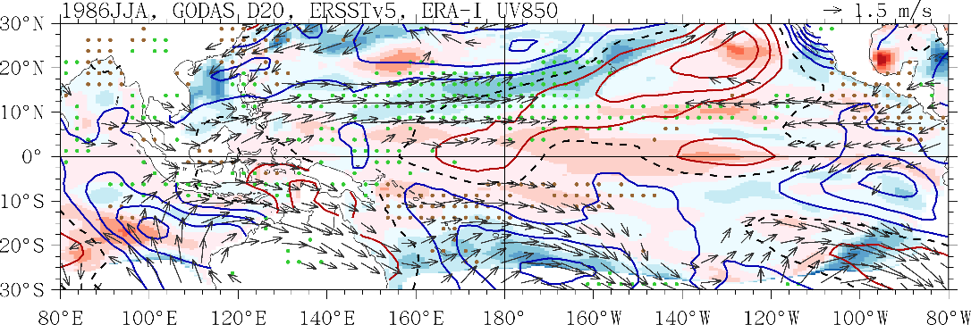
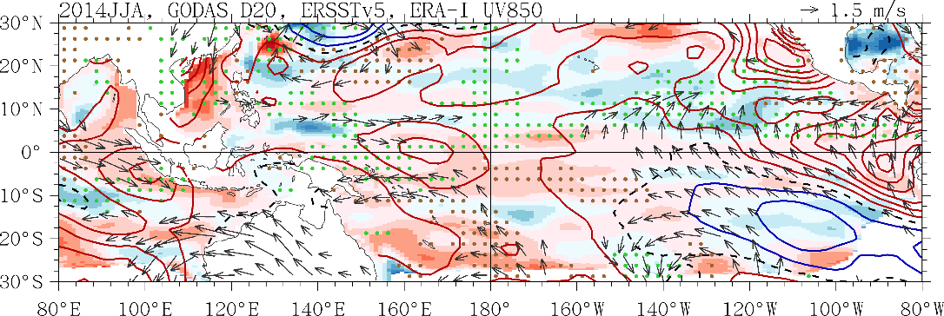
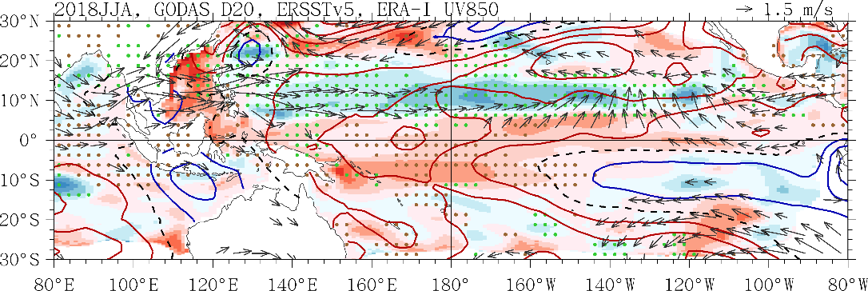
One-Winter El Niño Composite JJA(0)
Symmetric wrt the EQ
1986 JJA
Strong VM impacts on ENSO (SFM)
Luck of equatorial westerlies and convection anomalies
Convection is enhanced at north (active ITCZ)
2014 JJA
→ SST Dipole (eastern Pacific)
2018 JJA
D20 (shading), SST (contour), rainfall (dotted) and 850-hPa wind (vector)
Notes:
The seasonal D20 (shading), SST (contour), rainfall (dotted) and 850-hPa wind (vector) anomalies for the double winter event in the first developing JJA. The red (blue) contours are positive values at 0.25°C interval, and the black dashed is 0°C contour. The minimum vector shown is 1m/s. The green (brown) dots denotes where rainfall anomaly is larger (smaller) than 1 mm/day (-1 mm/day).

Slide 26
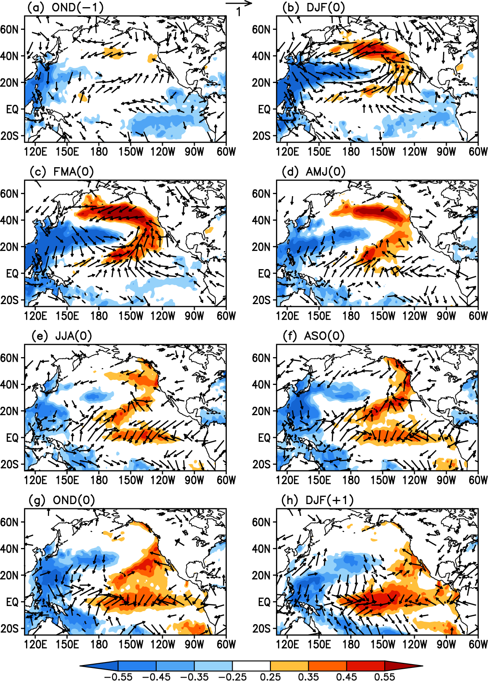
NPO develops
How VM affects ENSO?
Corr. maps of the FMA(0)-averaged VMI with averaged SST and surface wind anomalies
NPO ->VM
PMM
Previous proposed mechanisms
SFM
PMM
TWC
Zonal tropical SST grad increases -> WWB
-> Bjerknes feedback
Ding et al. (2015a)
Notes:
SFM: SST footprint induced by winter NPO persists until late spring and summer when its subtropical portion (0-20N) forces the overlying atmosphere, resulting in zonal wind stress anomalies that favor the ENSO initiation (Vimont et al., 2001; 2003a,b)
PMM: anomalous north-south SST gradient and anomalous surface circulation in the northeasterly trade regime force energetic equatorially trapped oceanic waves to occur in Central Western Pacific through thermodynamic air-sea coupling (Chiang and Vimont, 2004; Chang et al., 2007)
TWC: trade wind charging mechanism: NPO-induced variations in NP trade winds can force subsurface temperature anomalies across the central equatorial Pacific that are conducive to ENSO initiation.
The strengthened NPO can then force a dipole-like SSTA pattern in the North Pacific N of 20°N and a subtropical positive SSTA band lying in 5°-20°N. During DJF(0), ~2 months before the VM peaks, a meridional tripole-like SSTA pattern can be clearly seen in the NP N of 5°N (Figure 7b). As expected, this tripole-like SSTA pattern reaches a peak during FMA(0) (Figure 7c). At this time the SSTA pattern associated with the VM in the tropical central–eastern Pacific closely resembles a PMM pattern [Chiang and Vimont, 2004; Chang et al., 2007], with positive SSTAs in the subtropical central–eastern North Pacific (10°−30°N) and negative SSTAs in the tropical eastern Pacific. Note that in addition to the PMM pattern, there are significant negative SSTAs associated with the VM in the WNP.
As the VM peaks during FMA(0), the significant positive SSTA band in the subtropical central–eastern NP extends toward the central equatorial Pacific (Figure 7c). At the same time, anomalous surface wind associated with the VM also extend across the entire equatorial Pacific. Anomalous southeasterlies occur in the tropical eastern Pacific, while anomalous southwesterlies occur in the tropical western Pacific. The westerly (easterly) component of anomalous southwesterlies (southeasterlies) causes convergence in the central equatorial Pacific, favoring the development of positive SSTAs there. During AMJ(0), significant positive SSTAs begin to establish in the central equatorial Pacific (Figure 7d). At this time, significant positive and negative SSTAs still persist in the subtropical central–eastern North Pacific and WNP, respectively. The positive SSTAs in the subtropical central–eastern North Pacific and central equatorial Pacific, combined with negative SSTAs in the WNP, lead to an increase in the zonal SST gradient across the western–central tropical Pacific, which then strengthens the anomalous westerlies over the western–central equatorial Pacific. After JJA(0), air–sea interaction through a positive feedback process in turn amplifies the zonal wind and SST anomalies along the equator [Bjerknes, 1969], driving continued growth of these anomalies. During DJF(+1), about 10 months after the VM peaks, a warming pattern is well developed in the central–eastern equatorial Pacific (Figure 7h).
Different from SFM: different lag response of the equatorial wind and SSTA to the NP extratropical forcing.
SFM: significant SSTAs induced by the NPO persist until late spring and summer when they subsequently influence the equatorial wind fields and hence the underlying SSTs
VM: anomalous surface winds associated with the VM extend across the entire equatorial Pacific in late winter and early spring [FMA(0), see Figure 7c], which subsequently play an important role in triggering the warming in the central equatorial Pacific. They extend further toward the equator than those with NPO.
Consequently, the SST and surface wind responses in the equatorial Pacific to the VM are stronger and more immediate.
At this point, the VM is similar to the PMM, which also peaks in late winter and spring and affects the SST and surface winds in the tropical Pacific immediately at its peak phase. However, as mentioned above, the VM, as a basin-scale North Pacific SST pattern, combines the active role of SSTAs in both the central–eastern North Pacific and the WNP, different from the PMM pattern that mainly emphasizes the critical role of SSTAs in the central–eastern North Pacific as a precursor to ENSO but considers less the independent contribution of SSTAs in the WNP to the initiation of ENSO events.

Slide 27
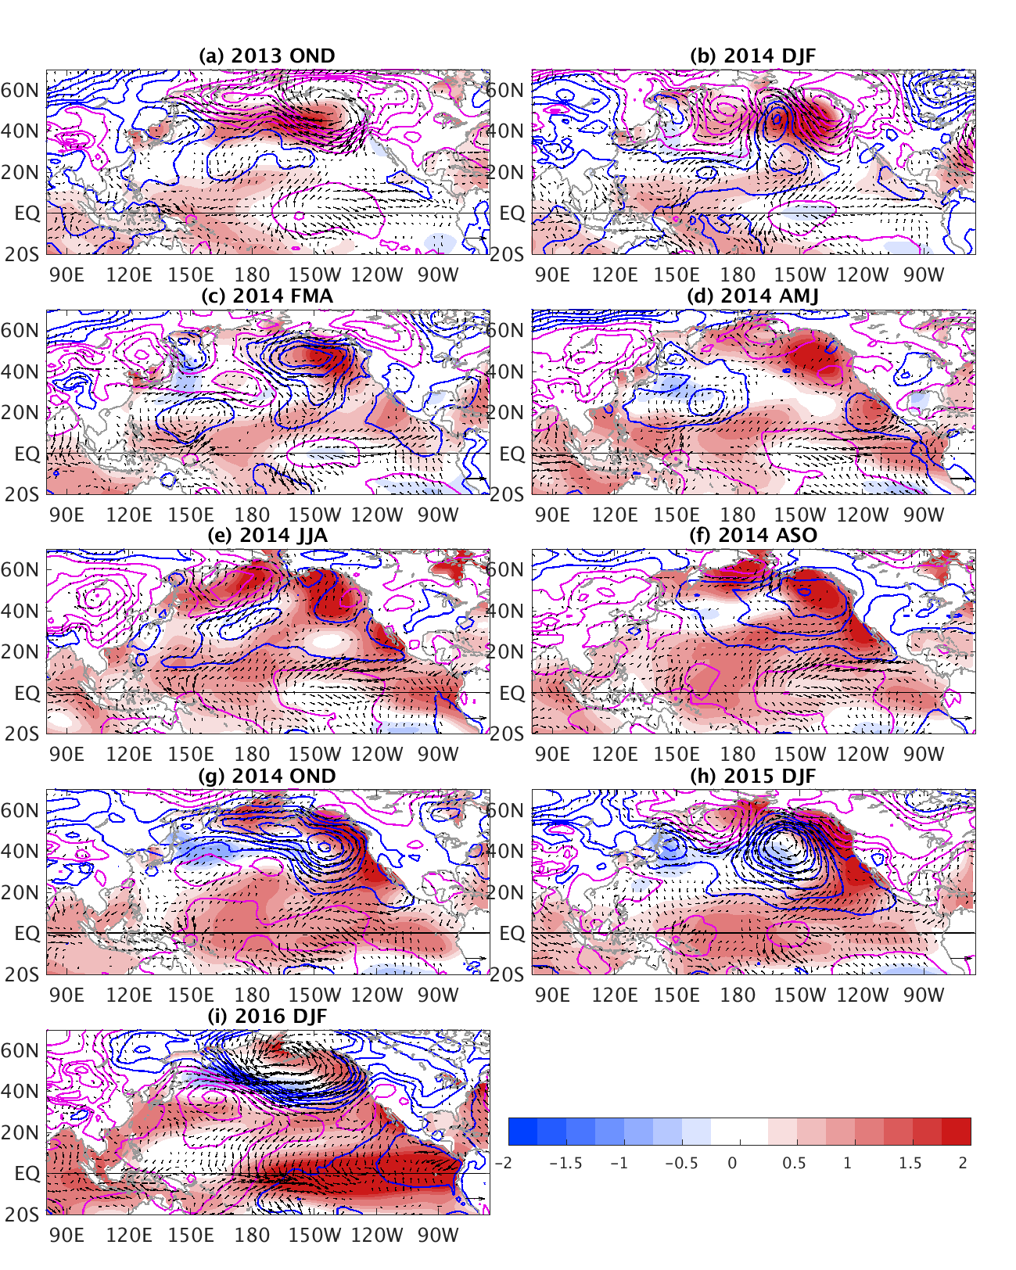

3-mon-averaged
SST (shaded),
SLP (contours) and
surface wind anomalies in 2014.
Warm Blob and El Niño are related!
Medium to strong ENSO events (bold: the SSTa in the Blob region >1std preceding the ENSO)
El Niño | 1965/66, 1972/73,1982/83,1986/87, 1987/88, 1991/92, 1997/98, 2002/03, 2009/10, 2015/16
La Niña | 1970/71, 1973/74, 1975/76, 1988/89, 1998/99. 1999/00, 2007/08, 2010/11
Tseng et al. (2017)
Notes:
Figure 1: Three-month averaged SST (shading), SLP (contours), and the near-surface wind vector anomalies after 2013 November. The interval is 0.2˚C for SST, and 1 hPa for SLP (magenta is positive and blue is negative). The anomalous wind has the unit of m s⁻¹.

Slide 28
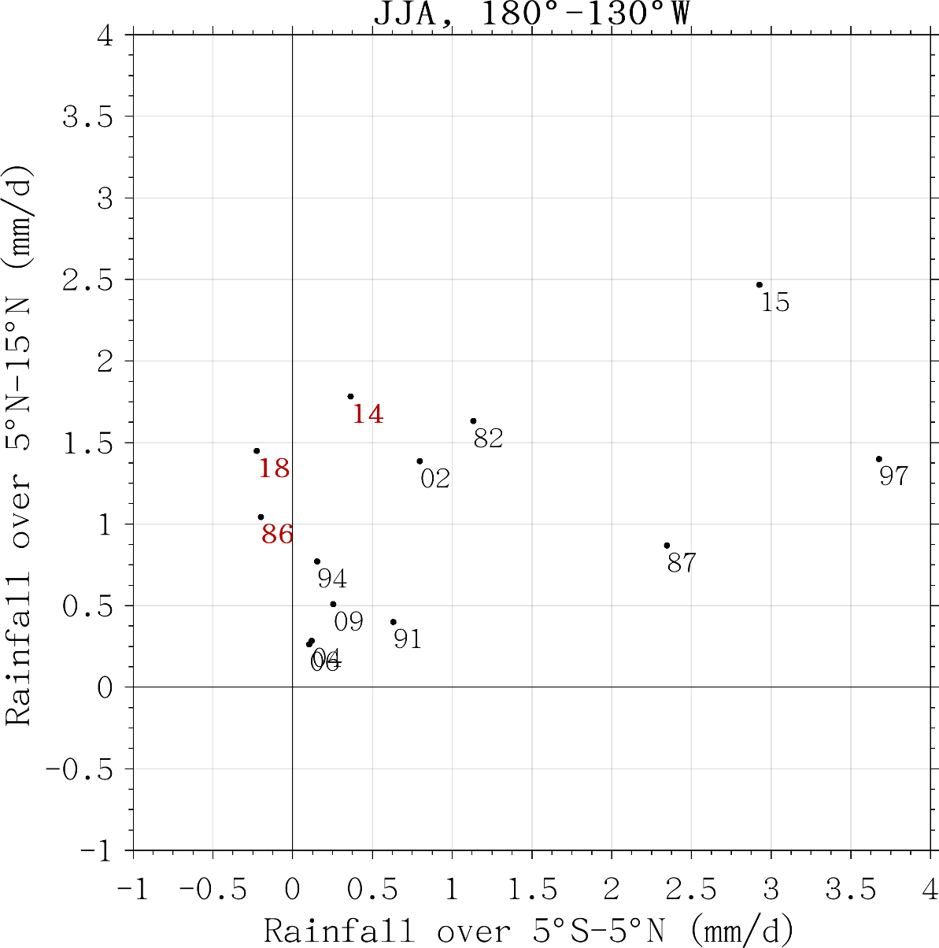
Rainfall relation between the tropic and the northern SFM band
R_{north}-R_{eq}=1
Enhanced convection in SFM band
Suppressed equatorial convection
Tropic: 180°-130°W, 5°S-5°N
SFM band: 180°-130°W, 5°-15°N
Notes:
suppressed equatorial convection and a relatively strong off-equatorial enhanced convection in the north. Since the enhanced convection anomalies are located off the equator, the associated equatorial westerly is weaker than the one-winter El Niño, thus weaker atmosphere-ocean coupling.

Slide 29
Bjerknes Feedback before and after 2000
Bjerknes Feedback shifts northward after 2000
Shading: 2000-2016
Contours: 1979-1999
Hu et al., 2017
Notes:
Simultaneous regressions of zonal wind stress anomalies onto the Niño3.4 index. Contours are for the regressions in Jan 1979-Dec 1999, and shadings for Jan 2000-Dec 2016. The unit is N/(10³ m² ºC) and the contour interval is 3. Figure is generated by GrADS (http://cola.gmu.edu/grads/).

Slide 30
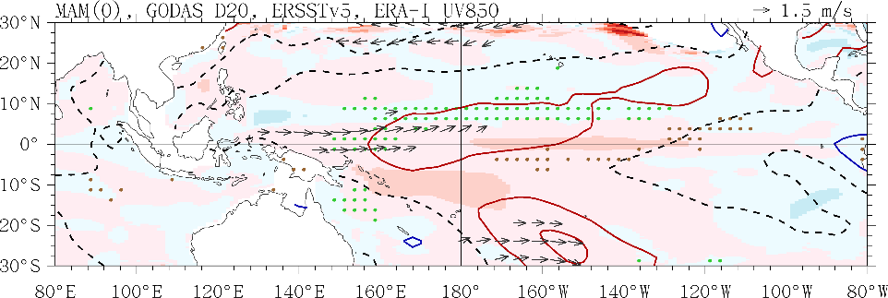
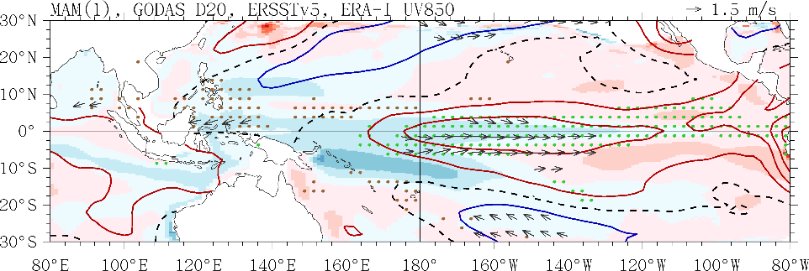
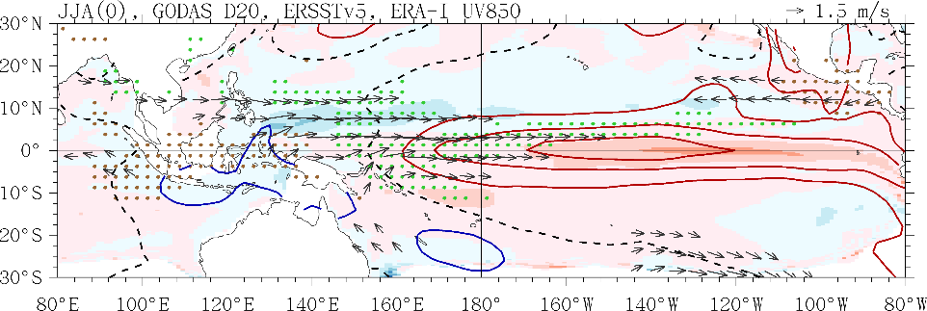
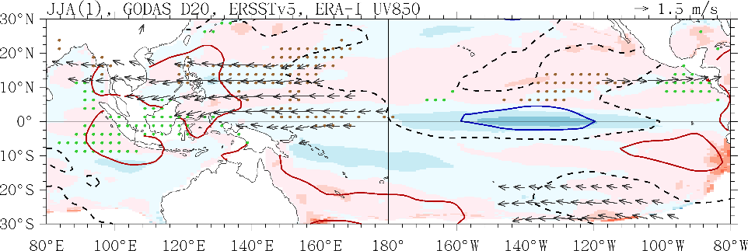
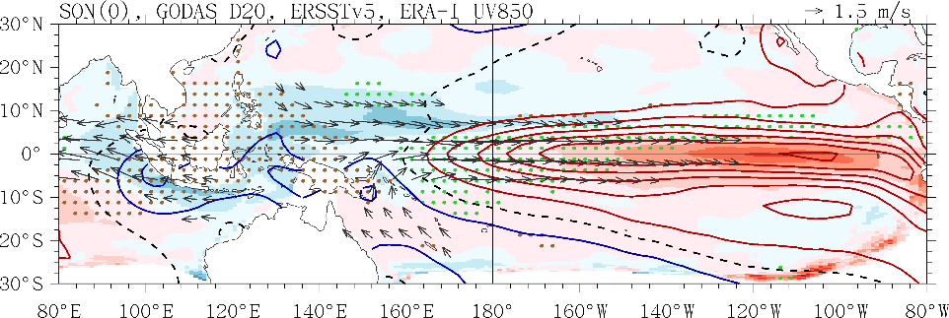
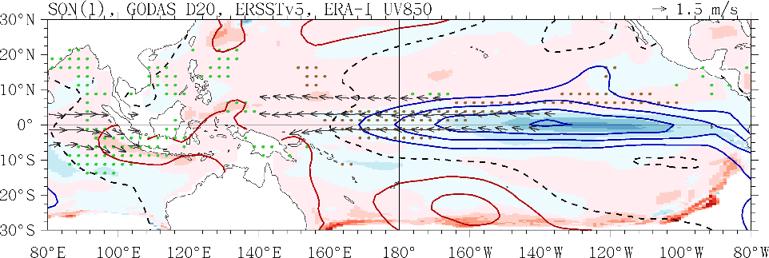
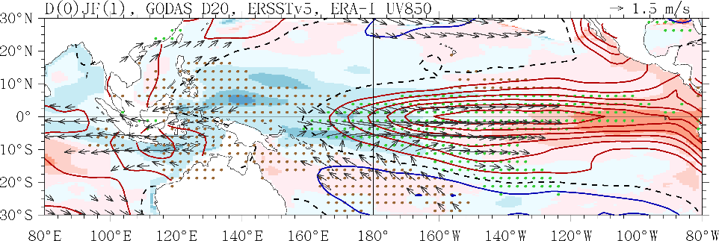
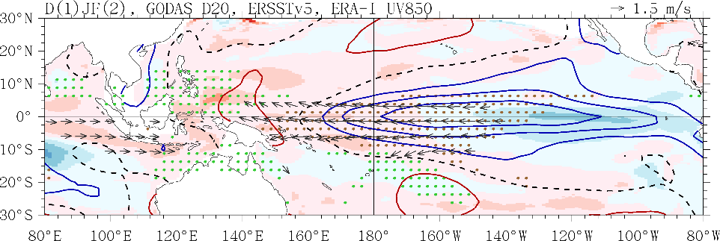
one-winter El Niño evolution
MAM(0)
MAM(1)
Terminate El Niño
JJA(0)
JJA(1)
SON(0)
SON(1)
D(0)JF(1)
D(1)JF(2)
Notes:
one-winter El Niño evolution after 1980

Slide 31
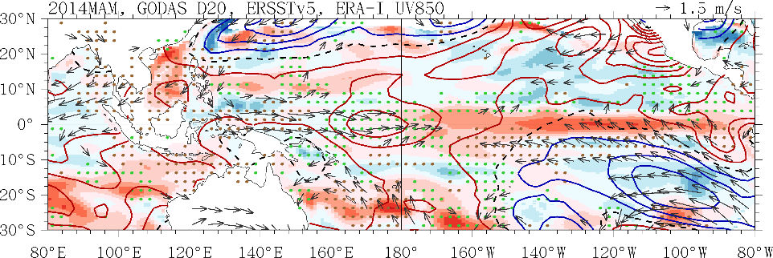
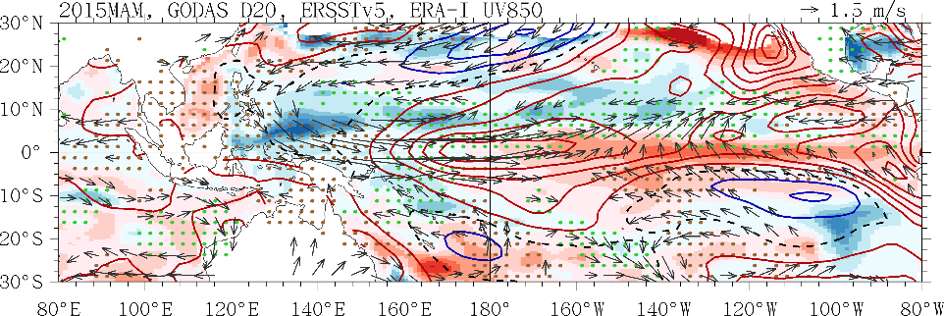

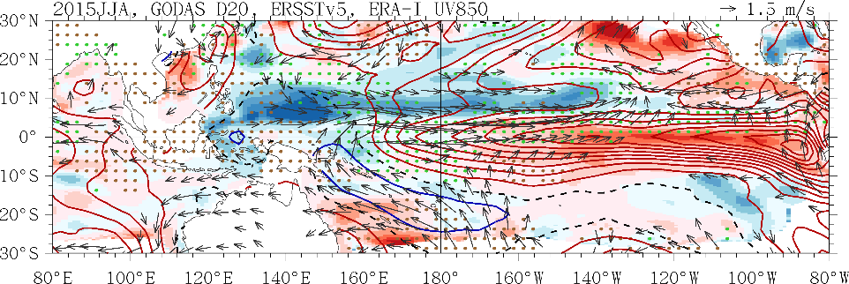




2014 MAM
2015 MAM
2014 JJA
2015 JJA
2014 SON
2015 SON
2014 D 2015 JF
2015 D 2016 JF

Slide 32
Conclusion
Yes, it seems the 2017/18 El Niño will continue…… (let’s wait and see)
Characteristics:
The prolonged El Niño accounts for 1/4 El Niño events and may become more common in the 21st century due to the shift of Bjerknes Feedback
The 1st year poor ocean-atmosphere coupling with insufficient discharge mechanism contributes to the prolonged El Niño
The 1st year equatorial convection and westerlies are disrupted by a coupled meridional mode over Eastern Pacific
Resulting from the shift of summer tropical ITCZ and SST dipole-induced southerlies

Slide 33


Thank you very much

