Slide 1



Understanding the Driving Mechanisms behind Triple-Dip
La Niñas: Insights from the Prediction Perspective
Yu-Heng Tseng¹
In collaboration with Han-Ching Chen², and Jo-Hsu Huang¹
¹National Taiwan University (NTU)
²Nanjing University of Information Science and Technology (NUIST)

Slide 2
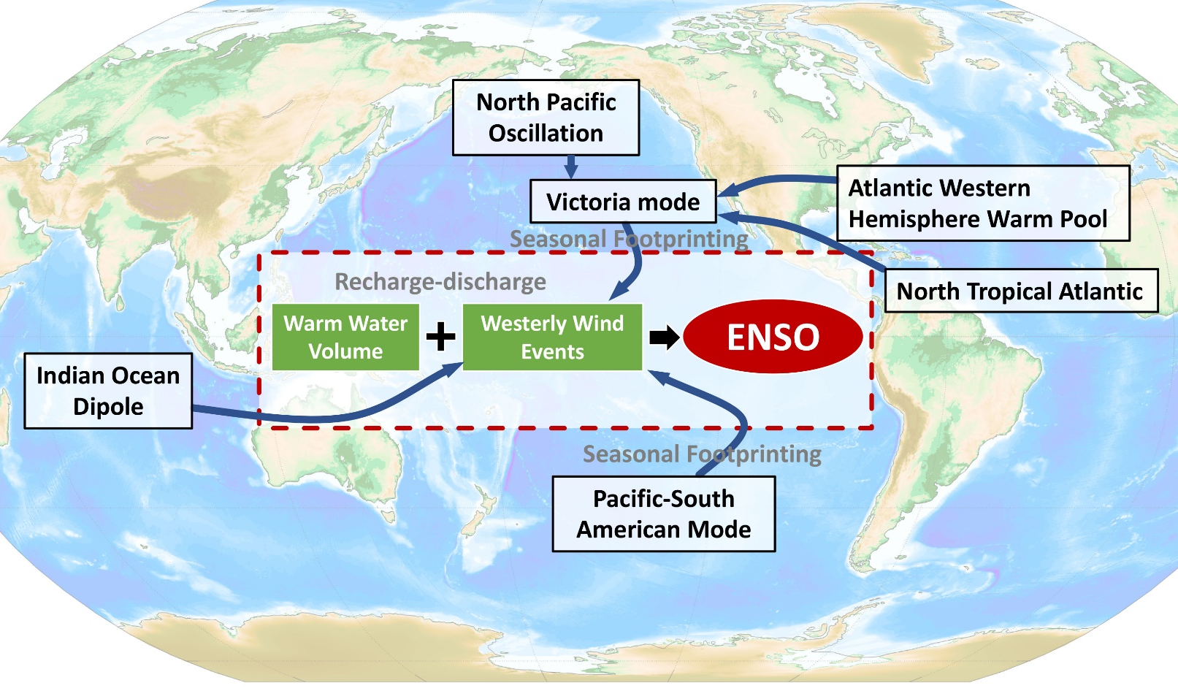
Background-New Pacific climate Paradigm
Ding et al. (2015a); Tseng et al. (2017b; 2020)
Tropical-extratropical interaction (Miller et al., 2017)
Ding et al. (2017a; 2019; 2023)
Ding et al. (2015b)
Tseng et al. (2020); Ji et al. (2023)
Hu et al. (2017a; 2017b)
Chen et al. (2015, 2018); Tseng et al. (2017a)
Ding et al. (2017b; 2019; 2020)
Ding et al. (2015c; 2016)

Slide 3
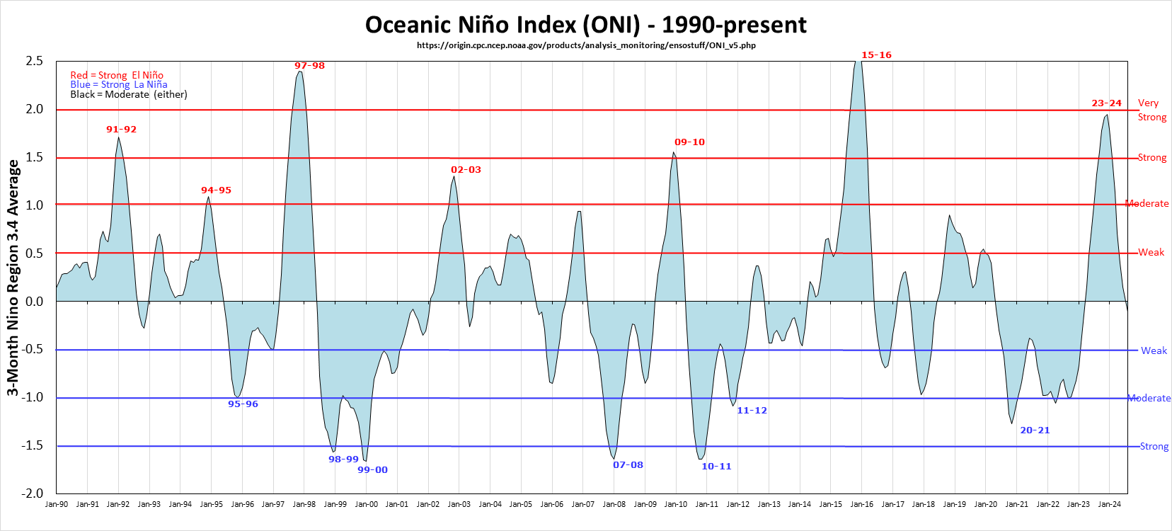
Triple-Dip La Niña events
1998-1999
1999-2000
2000-2001
2020-2021
2021-2022
2022-2023
https://ggweather.com/enso/oni.htm
Since 1980, only two significant triple-dip La Niña events have been documented.

Slide 4
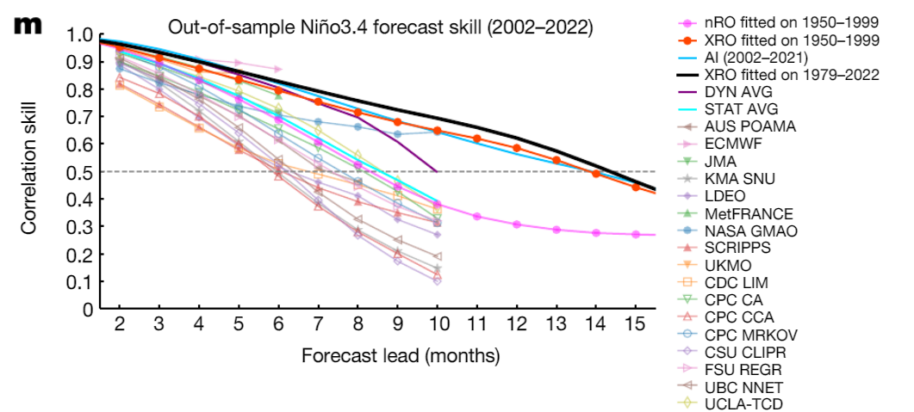
ENSO prediction skills
Correlation Skill
Zhao et al. 2024
(Nature)
In general, most of the ENSO prediction models have good perdition skill in 6-10 months, and AI or XRO can even extend the effective forecast time to more than one year.

Slide 5
ENSO prediction skills
Most models predict neutral conditions in the DJF in 2021, with only two predicting a second La Niña in the winter of 2021
https://iri.columbia.edu/our-expertise/climate/forecasts/enso/current/
In some specific ENSO events, the model performance may be worse than expected.
Notes:
連續的La Nina 關鍵就在第二年!

Slide 6
ENSO prediction skills
Most models predict neutral conditions in the DJF in 2021, with only two predicting a second La Niña in the winter of 2021
https://iri.columbia.edu/our-expertise/climate/forecasts/enso/current/
Why most models failed to predict the second La Niña in DJF 2021?

Slide 7
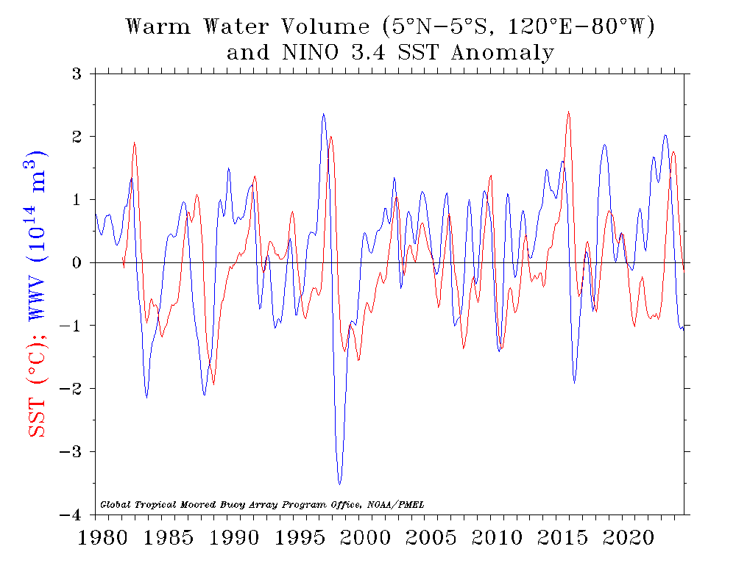
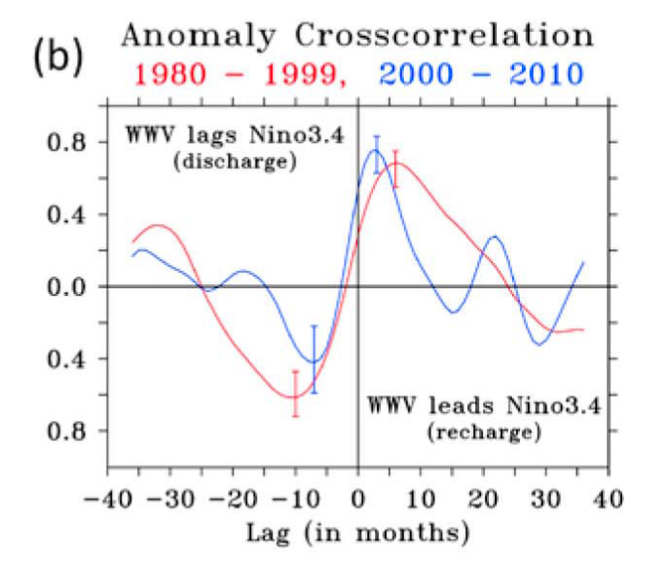
ENSO predictors-WWV
The predictability of ENSO comes mainly from the wind-driven ocean dynamics (Recharge-Discharge)
Inclusion of upper ocean temperature data in ENSO prediction schemes significantly improves forecast skill.
https://www.pmel.noaa.gov/elnino/upper-ocean-heat-content-and-enso
But…… other factors also influence the evolution of ENSO
McPhaden 2012

Slide 8
ENSO prediction model
Tropical predictors
Extra-tropical predictor
$$\begin{matrix}EPM=\frac{σ_{O}}{σ_{P}}\left[ β_{1}{EP}_{SST}+β_{2}{EP}_{WWV} +β_{3}{EP}_{OA}\right. \left.+{ β}_{4}{EP}_{EX−N}+β_{5}{EP}_{EX−S} \right] \\ \end{matrix}$$
Persistence
Heat content
Air-sea inter.
Extratropical precursor
{
$$\begin{aligned}&{EP}_{SST}=Nino3.4\#\end{aligned} index$$
$$\begin{aligned}&{EP}_{WWV}=α_{1}{D20a}_{180°}\left(t−25d\right)+α_{2}{D20a}_{170°W}\left(t−10d\right)+α_{3}{D20a}_{155°W}\left(t\right)\#\end{aligned}$$
$${EP}_{OA}=sign\left(event\right)∙dH$$
$${EP}_{EX}=({SLPA}_{N1}−{SLPA}_{N2})+({SLPA}_{S2}−{SLPA}_{S1})$$
$β_{1}, { β}_{2}$ and${ β}_{3}$ are defined by a linear regression model
Physical-based statistical model
Notes:
這裡你可以提到其實就跟現在AI 深度學習預報一樣的explainable AI (可解釋的AI) 當AI 加入某些已知的知識內他就會學得更快更準!

Slide 9
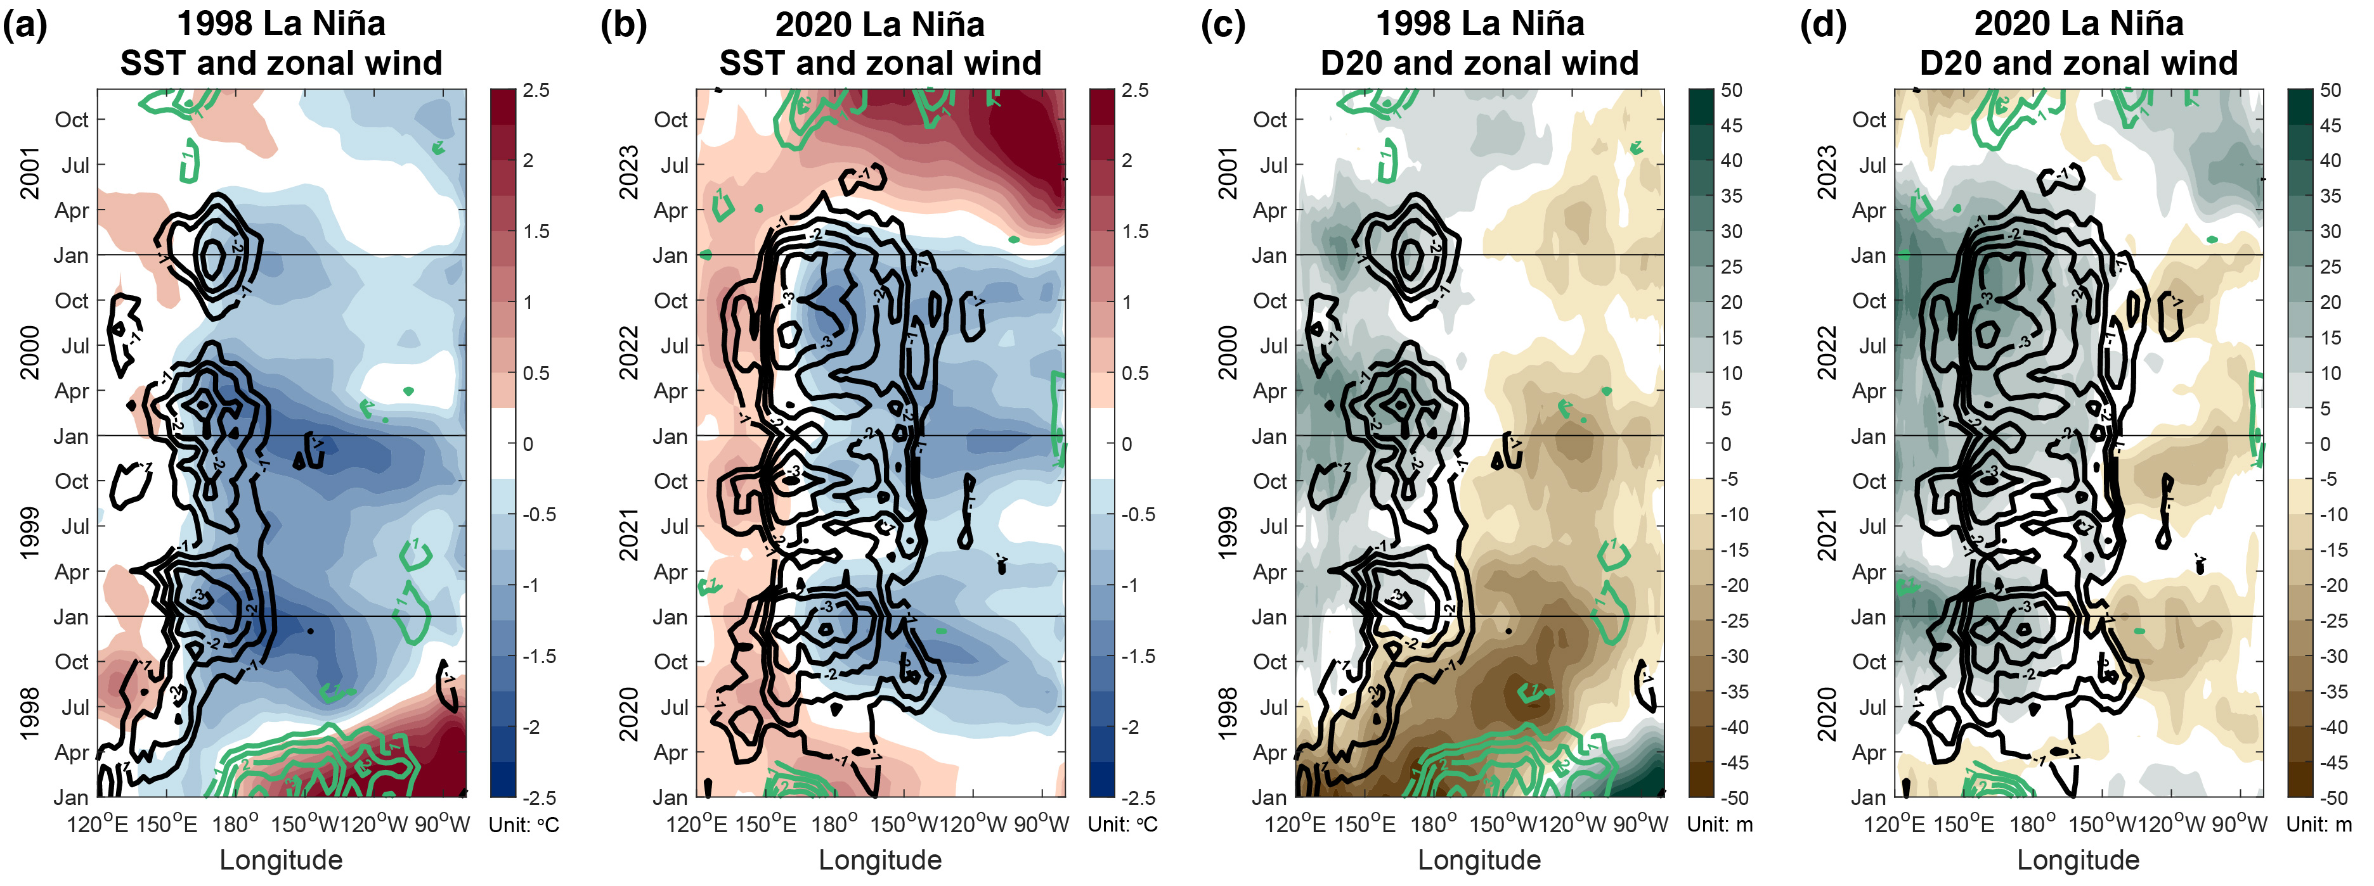


Characteristics of Triple-Dip La Niña
SST & Wind
D20 & Wind
$$\text{1998−2001}$$
2020-2023
$$\text{1998−2001}$$
2020-2023
1998-2001: Followed a very strong 1997-1998 El Niño, leading to sufficiently negative heat content anomalies through a significant recharge process.
2020-2023: Characterized by weak negative heat content anomalies during its evolution but persistent and strong easterly anomalies.

Slide 10
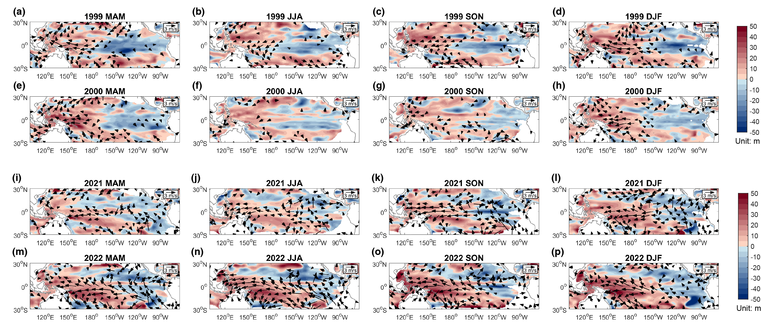
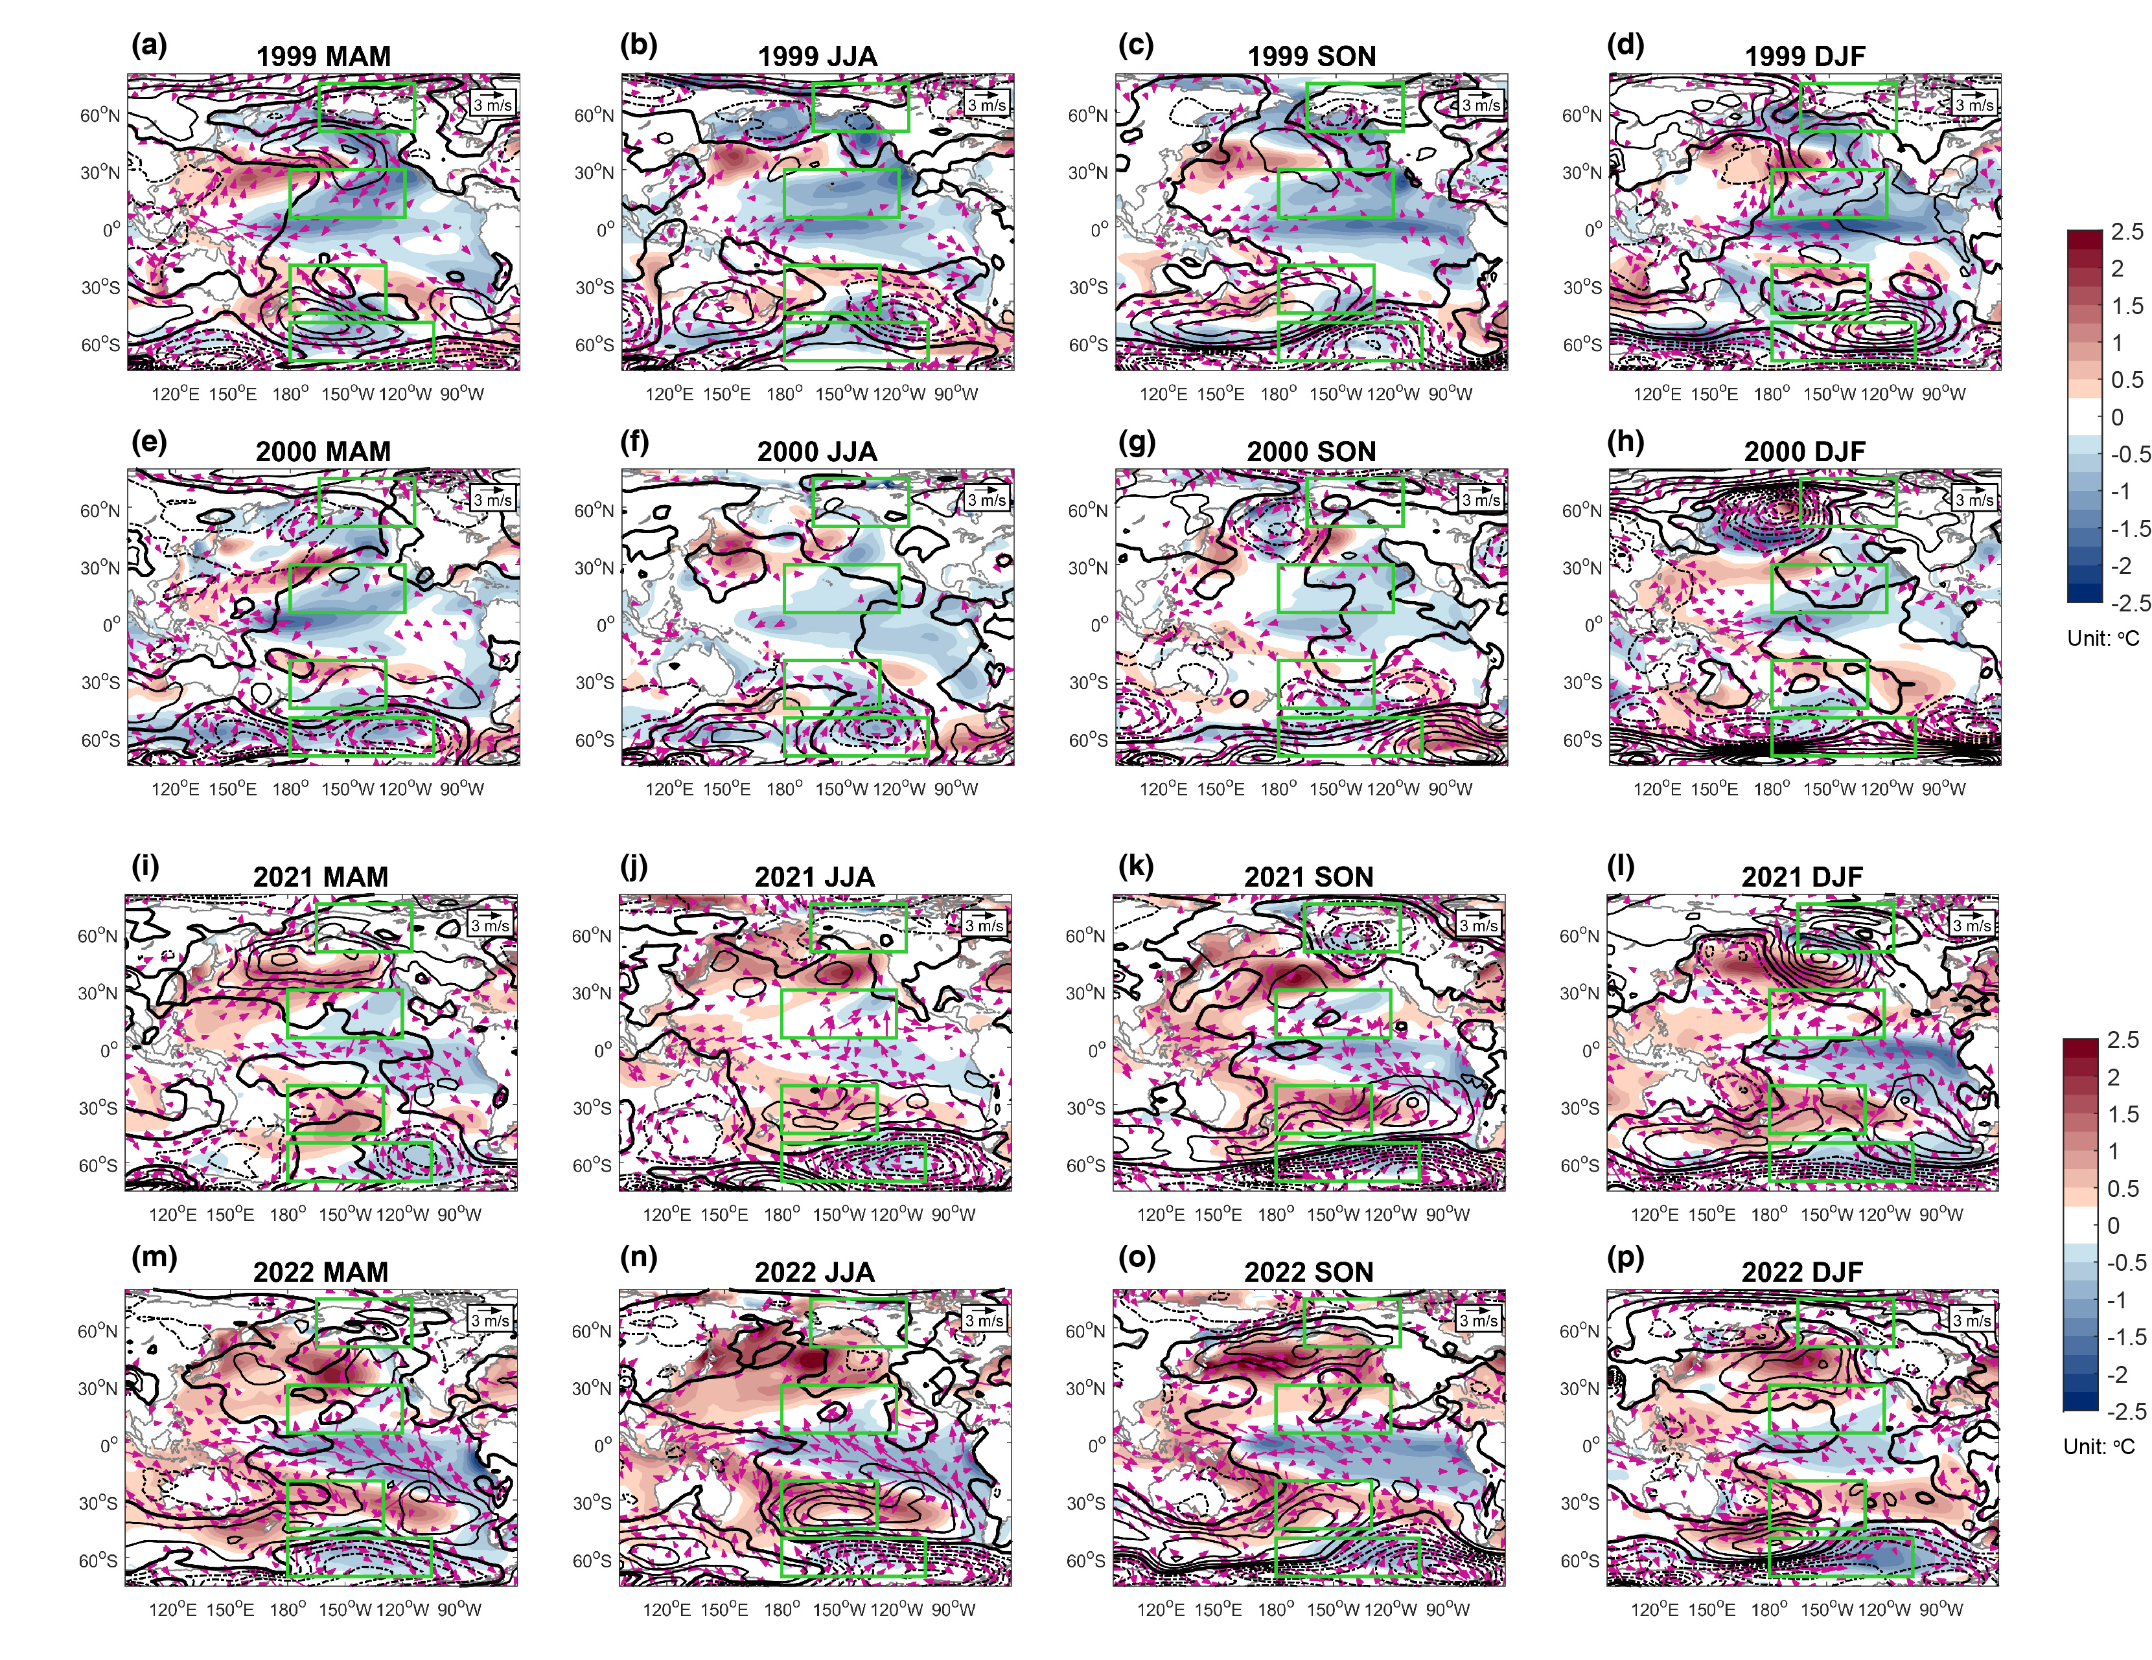
Characteristics of Triple-Dip La Niña
1998-2001
D20 & Wind
SST & HGT & Wind
Characterized by substantial negative heat content anomalies in the central-eastern Pacific.
In the spring, a significant north-south dipole pattern of the SLPA was observed in the North Pacific.

Slide 11
Characteristics of Triple-Dip La Niña
2020-2023
D20 & Wind
SST & HGT & Wind
Lacked significant negative heat content anomalies in the central-eastern Pacific.
A robust high-pressure pattern developed in the southern extratropical Pacific, between 20°S and 50°S, particularly during 2021 JJA/SON and 2022 MAM/JJA.

Slide 12
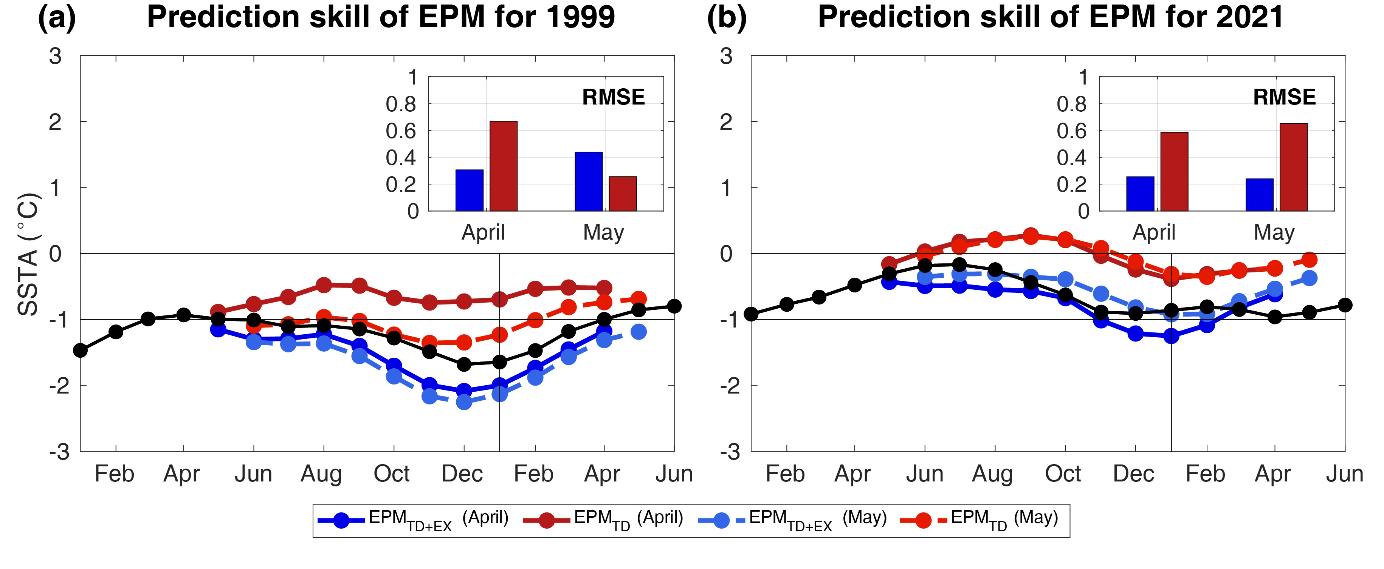
Predicability for Triple-Dip La Niña
Tropical predictors
Extra-tropical predictor
$$\begin{matrix}EPM=\frac{σ_{O}}{σ_{P}}\left[ β_{1}{EP}_{SST}+β_{2}{EP}_{WWV} +β_{3}{EP}_{OA}\right. \left.+{ β}_{4}{EP}_{EX−N}+β_{5}{EP}_{EX−S} \right] \\ \end{matrix}$$

Slide 13
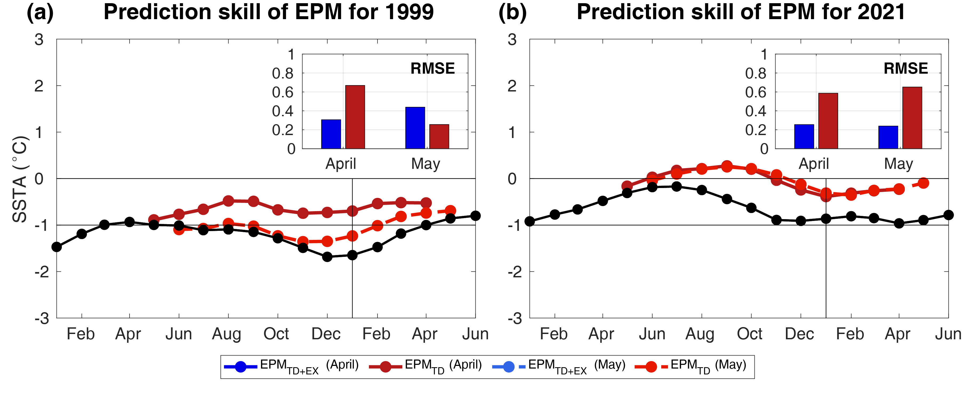
Predicability for Triple-Dip La Niña
Tropical predictors
热带外预报因子
$$\begin{matrix}EPM=\frac{σ_{O}}{σ_{P}}\left[ β_{1}{EP}_{SST}+β_{2}{EP}_{WWV} +β_{3}{EP}_{OA}\right. \left.+{ β}_{4}{EP}_{EX−N}+β_{5}{EP}_{EX−S} \right] \\ \end{matrix}$$

Slide 14
Prediction skill for Triple-Dip La Niña
Tropical predictors
Extra-tropical predictor
$$\begin{matrix}EPM=\frac{σ_{O}}{σ_{P}}\left[ β_{1}{EP}_{SST}+β_{2}{EP}_{WWV} +β_{3}{EP}_{OA}\right. \left.+{ β}_{4}{EP}_{EX−N}+β_{5}{EP}_{EX−S} \right] \\ \end{matrix}$$
1998-2021: Considered only tropical processes, accurately predicted the subsequent La Niña of 1999 after May.
2020-2023: Failed to accurately forecast the La Niña event when only considering tropical processes.

Slide 15
Prediction skill for Triple-Dip La Niña
Tropical predictors
Extra-tropical predictor
$$\begin{matrix}EPM=\frac{σ_{O}}{σ_{P}}\left[ β_{1}{EP}_{SST}+β_{2}{EP}_{WWV} +β_{3}{EP}_{OA}\right. \left.+{ β}_{4}{EP}_{EX−N}+β_{5}{EP}_{EX−S} \right] \\ \end{matrix}$$

Slide 16
Prediction skill for Triple-Dip La Niña
Tropical predictors
Extra-tropical predictor
$$\begin{matrix}EPM=\frac{σ_{O}}{σ_{P}}\left[ β_{1}{EP}_{SST}+β_{2}{EP}_{WWV} +β_{3}{EP}_{OA}\right. \left.+{ β}_{4}{EP}_{EX−N}+β_{5}{EP}_{EX−S} \right] \\ \end{matrix}$$
1998-2001: In early spring (April), while tropical processes remained critical, incorporating extratropical processes significantly enhanced prediction skill.
2020-2023: By incorporating extratropical influences, the model accurately predicted the subsequent 2021 La Niña in spring.

Slide 17
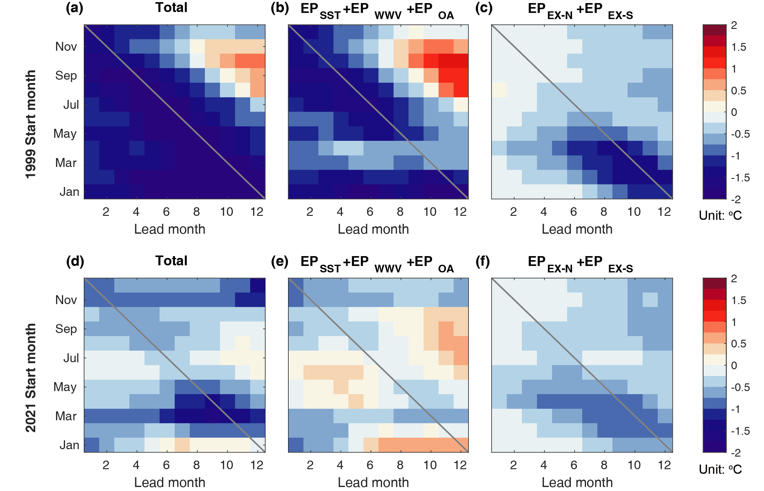
Individual contribution of each predictor
Tropical predictors
Extra-tropical predictor
$$\begin{matrix}EPM=\frac{σ_{O}}{σ_{P}}\left[ β_{1}{EP}_{SST}+β_{2}{EP}_{WWV} +β_{3}{EP}_{OA}\right. \left.+{ β}_{4}{EP}_{EX−N}+β_{5}{EP}_{EX−S} \right] \\ \end{matrix}$$
1998-2021: Considering only tropical processes is sufficient to forecast the subsequent cold SSTA
热带+热带外
热带
热带外
2020-2023: Accurate forecasting can only be achieved by incorporating extratropical processes.
热带+热带外
热带
热带外

Slide 18
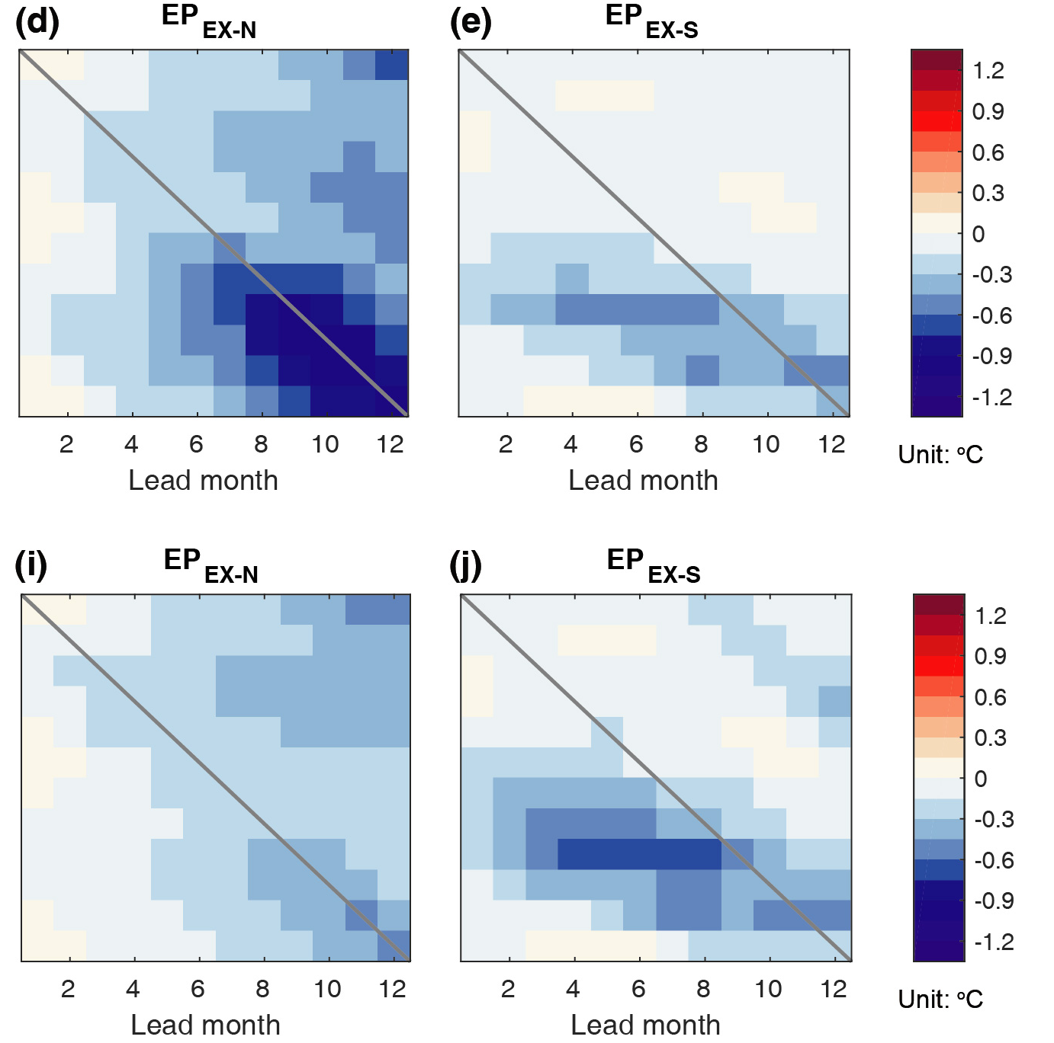
Individual contribution of each predictor
Tropical predictors
Extra-tropical predictor
$$\begin{matrix}EPM=\frac{σ_{O}}{σ_{P}}\left[ β_{1}{EP}_{SST}+β_{2}{EP}_{WWV} +β_{3}{EP}_{OA}\right. \left.+{ β}_{4}{EP}_{EX−N}+β_{5}{EP}_{EX−S} \right] \\ \end{matrix}$$
热带+热带外
热带
热带外
北半球
南半球
热带+热带外
热带
热带外
北半球
南半球

Slide 19

Reference
Chen, H.-C.*, Y.-H. Tseng*, J.-H. Huang, P.-H. Juang, 2024: Understanding the Driving Mechanisms of Triple-Dip La Niñas: Insights from the Prediction Perspective, npj Clim. Atmos. Sci., in press
Tseng, Y.-H.*, J.-H. Huang and H.-C. Chen*, 2022: Improving the Predictability of Two Types of ENSO by the Characteristics of Extratropical Precursors. Geophys. Res. Lett., doi: 10.1029/2021GL097190
Tseng, Y.-H.*, Z.-Z. Hu, R.-Q. Ding, H.-C. Chen, 2017: An ENSO prediction approach based on ocean conditions and ocean–atmosphere coupling. Clim. Dyn., doi: 10.1007/s00382-016-3188-2
Notes:
以上就是目前我們對於ENSO锁相的研究，如果想知道如何在觀測和模式中檢驗基本的ENSO動力過程與表現，可以參考我們剛出的這篇文章

Slide 20
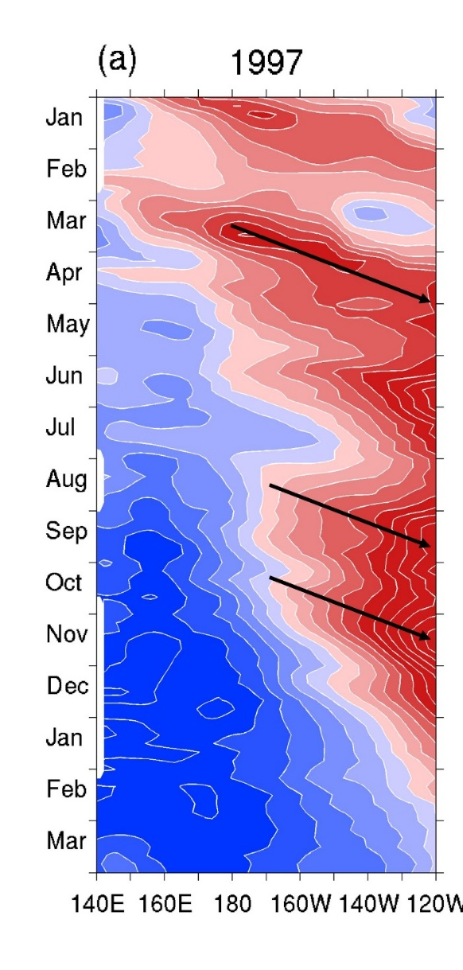
ENSO统计预测模式
海洋热含量东传信号
D20a
$$\begin{aligned}&{EP}_{WWV}=α_{1}{D20a}_{180°}\left(t−25d\right)+α_{2}{D20a}_{170°W}\left(t−10d\right)+α_{3}{D20a}_{155°W}\left(t\right)\#\end{aligned}$$
The chosen longitudes and timings in the ${EP}_{WWV}$ trace the influence of the eastward Kelvin wave propagation
Phase speed: 30º/month
180º
170ºW
155ºW
t-25
t-15
t
α₁–α₃: weighting coefficient
Phase speed: 30°/month

Slide 21
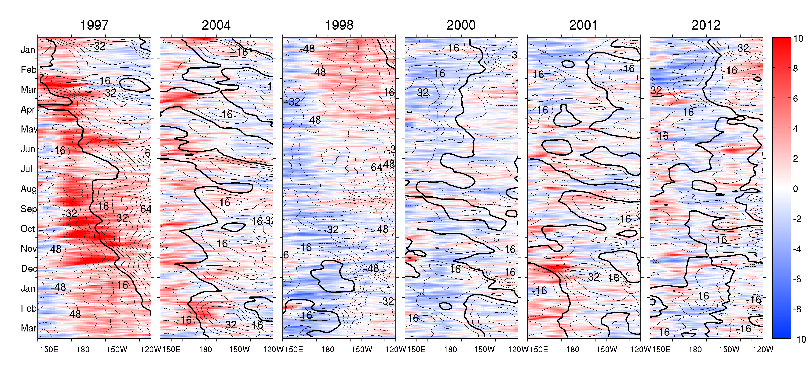
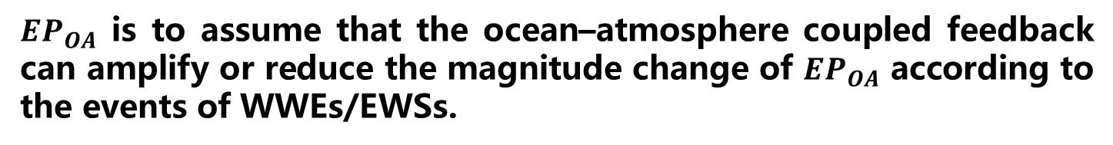

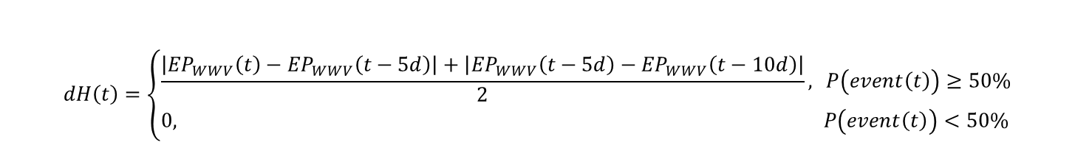
ENSO统计预测模式
海气相互作用高频风
Wind
$${EP}_{OA}=sign\left(event\right)∙dH$$
$$event\left(t\right)=\left\{\begin{aligned}positive uwind in \left[t−50d,t\right] \\ negative uwind in \left[t−50d.t\right]\end{aligned}\right.$$
$$\begin{aligned}\#\end{aligned}$$
$$\begin{aligned}dH\left(t\right)=\left\{\begin{aligned}&\frac{\left|{EP}_{WWV}\left(t\right)−{EP}_{WWV}\left(t−5d\right)\right|+\left|{EP}_{WWV}\left(t−5d\right)−{EP}_{WWV}\left(t−10d\right)\right|}{2},& P\left(event\left(t\right)\right)≥50\% \\ &0,& P\left(event\left(t\right)\right)<50\%\end{aligned}\right.\#\end{aligned}$$
${EP}_{OA}$ is to assume that the ocean–atmosphere coupled feedback can amplify or reduce the magnitude change of ${EP}_{OA}$ according to the events of WWEs/EWSs.

Slide 22
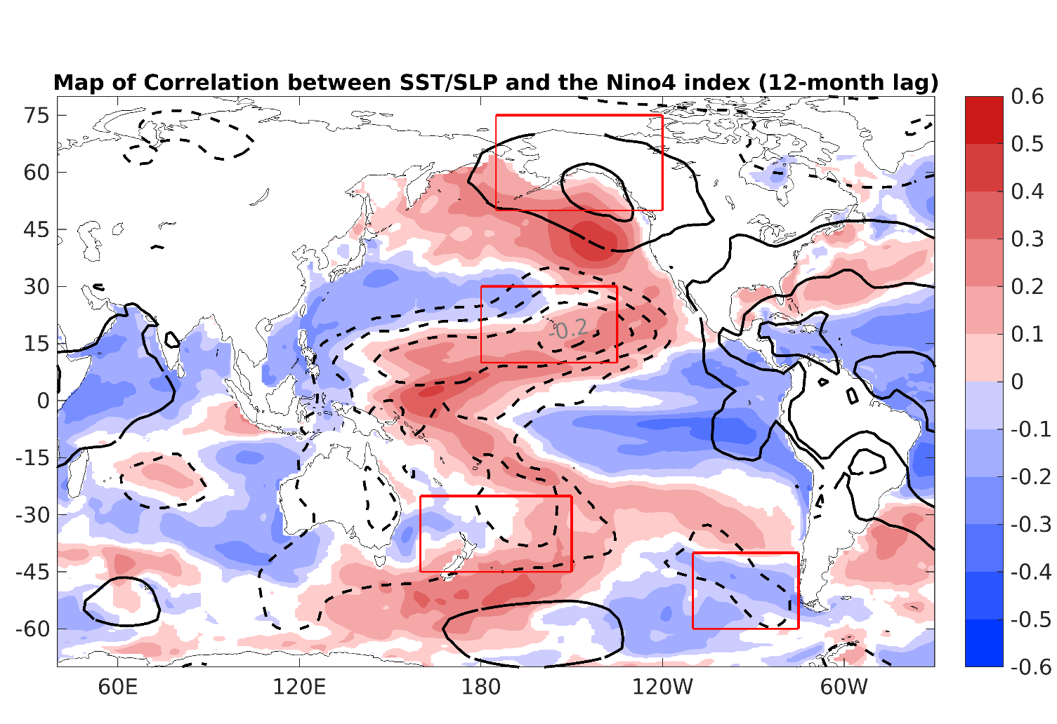




ENSO统计预测模式
南北半球热带外信号
$${EP}_{EX}=({SLPA}_{N1}−{SLPA}_{N2})+({SLPA}_{S2}−{SLPA}_{S1})$$
The subtropical and extratropical SLP anomalies over both the North and South Pacific are significantly related to the ENSO state in the following boreal winter (Ding et al. 2016)
$${SLPA}_{N1}$$
$${SLPA}_{N2}$$
N1 165°–115°W, 50°–75°N
N2 180°–120°W, 5°–30°N
S1 180°–130°W, 20°–45°S
S2 180°–105°W, 50°–70°S
$${SLPA}_{S2}$$
$${SLPA}_{S1}$$

Slide 23
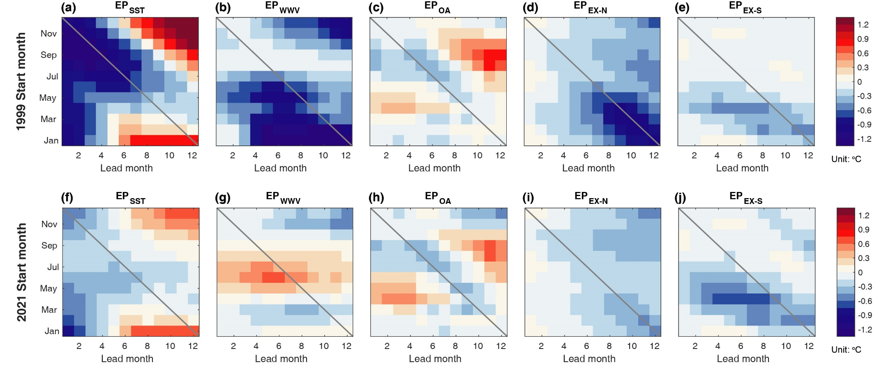
预报因子的相对贡献

Slide 24
热带外预报因子

