Slide 1
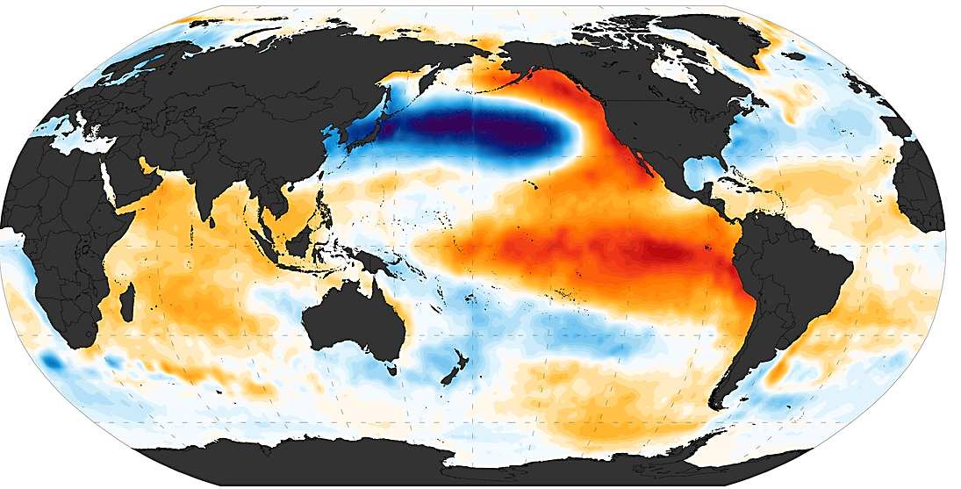
Dynamics of Interdecadal Climate Variability
Presenter: San Sieu Cuong (陳紹強)
Supervisor: Prof. Yu-Heng Tseng
2017/12/14

Slide 2
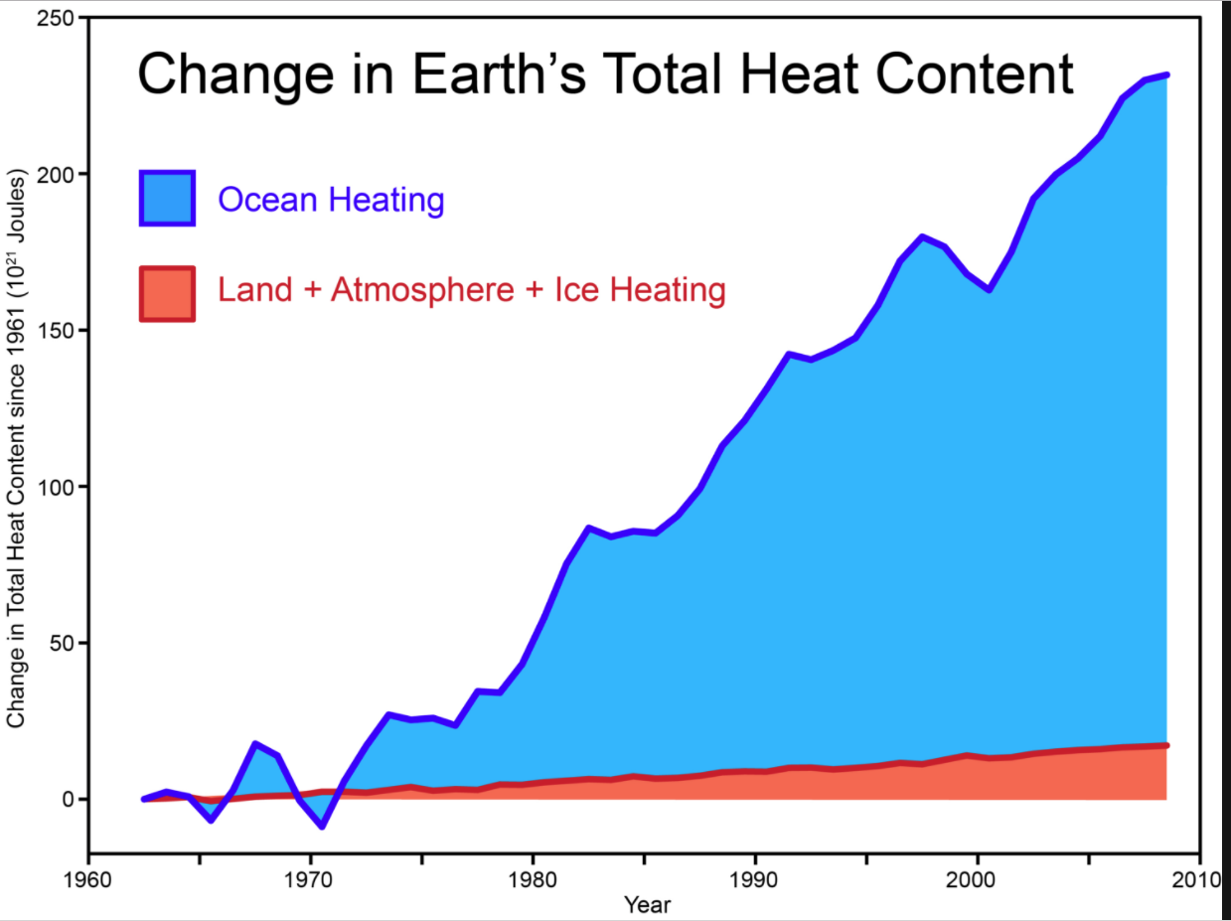
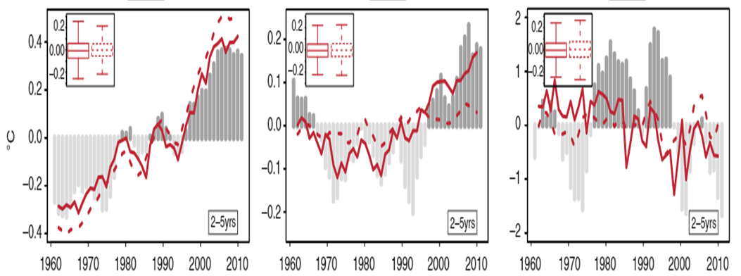
Decadal Predictability lies in the Oceans
Introduction
Decadal climate prediction lies in the ocean
Doblas-Reyes et al. 2013
IPO
SAT
AMV
Notes:
1. The upper figure shows the change in Earth’s total heat content and the lower figure shows the time series of the ensemble-mean forecast anomalies of the global-mean near-surface air temperature (SAT), the AMV and IPO with model’s initialization(red solid line) and without initialization (red dashed line). Most heat content is trapped within the ocean.
2. The AMV and IPO are the dominant decadal ocean surface temperature variations over the North Atlantic and Pacific Oceans. They are sensitive to prediction model’s initialization. Small changes of initialization condition can lead to totally different decadal trends.
3. Decadal variability whose long-term memory lying within the ocean is a complicated process that has not been resolved thoroughly so far under present state-of-the-art climate models. Therefore, better understanding of the decadal scale variability in the ocean is important. We will attempt to address issues related to decadal variability such as its prominent patterns, generation mechanism, preferred time scale as well as the role of ocean dynamics and ocean-atmosphere interaction. Should we move this to the last page?(YH)
The upper figure shows the ocean is the main source of accumulating Earth’s total heat content, thus providing long-term memory for the changing climate system. In addition, the lower figures show time series of the ensemble-mean forecast anomalies averaged over the forecast years 2–5 (solid, Init) and the accompanying non-initialized (dashed, No Init) experiments of the global-mean near-surface air temperature (SAT), the AMV and IPO. These time series are sensitive to initialization though small changes of initialization have been made, especially at decadal scale prediction (AMV and IPO), the trend varies significantly and totally differ from one another. It should be point out that, decadal variability whose long-term memory lying within the ocean is a complicated process that has not been resolved thoroughly so far under present day state-of-the-art climate model. Therefore, understanding well decadal scale variability in the ocean is of vital interests and this presentation will attempt to address issues related to decadal variability such as its prominent patterns, generation mechanism, preferred time scale as well as the role of ocean dynamics and ocean-atmosphere interaction

Slide 3
Outline
Introduction
Evidence of Pacific interdecadal variability
Generation mechanisms and preferred time scales
Role of ocean dynamics
Pacific interdecadal variability: Tropical origin
Pacific interdecadal variability: Extratropical origin
Future research

Slide 4
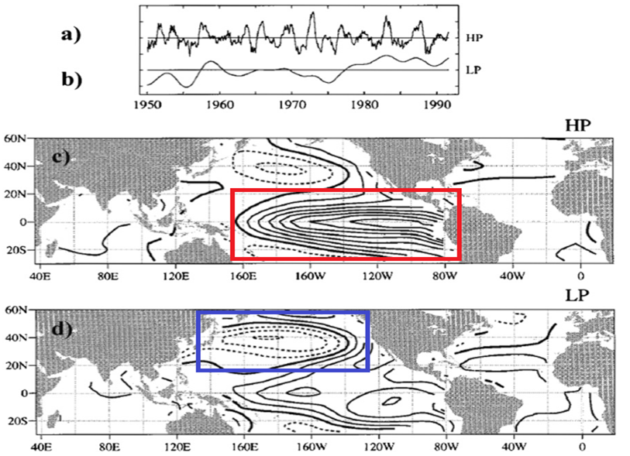
Evidence of Pacific interdecadal variability
Pacific decadal variability (PDV)
HP: ENSO pattern
LP: PDV pattern
Zhang et al. 1997
Notes:
Zhang et al. showed that there is a mode of decadal variability in the Pacific Ocean (PDV), as seen in the leading principal component of the 6yr low-pass SST and the associated regression map. The PDV pattern is similar to ENSO pattern, characterized by coherent variability over the Tropical Pacific with coherent variability in the midlattitude North Pacific. The PDV has a large amplitude in the midlatitude while ENSO is dominated by maximum variability in the tropics. In addition , PDV is centered toward the central Pacific while ENSO is centered toward the eastern Pacific
Zhang et al. showed that there is a mode of decadal variability in the Pacific Ocean. The data is based on the monthly mean fields on a 2⁰ lat X 2⁰ long grid. 6yr highpass and lowpass filter is applied on the SST field. The LP corresponds to PDV pattern while HP resembles ENSO pattern.
Figure Description:
The top panel shows the leading principal component (PC) time series based on the 6-yr highpass and lowpass-filtered SST fields over the Pacific domain, labeled as HP and LP, respectively. The interval between tick-marks on the vertical axis of the top panel corresponds to 1.0 standard deviation. The HP captures virtually all the variability associated with the ENSO cycle, whereas the LP shows oscillation at decadal timescales. The two series are weakly correlated with one another (r = 0.20, where r denotes the correlation coefficient)
The low panel shows the spatial signatures obtained by regressing the global SST field upon the highpass- and lowpass-filtered PC time series. Contour interval 0.1 K per standard deviation of the expansion coefficient time series. Negative contours are dashed; the zero contour is thickened. The HP pattern is similar to LP pattern, characterized by coherent variability over the Tropical Pacific with coherent variability in the midlattitude North Pacific. The LP tend to vary symmetrically with respect to the equator. The LP has a large amplitude in the midlatitude while HP is dominated by maximum variability in the tropics. In addition , LP is centered toward the central Pacific while HP is centered toward the eastern Pacific
The 6-yr lowpass-filtered time series were generated by successive applications of centered 25- and 37-month running means. Corresponding 6-yr highpass-filtered series were formed by subtracting the 6-yr lowpass-filtered time series from the original series.

Slide 5
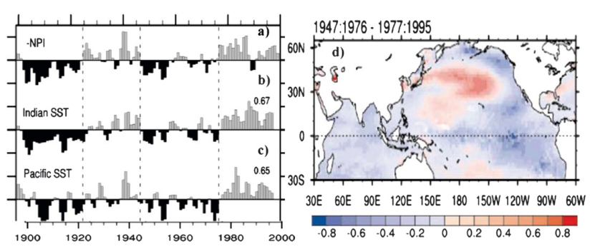
Evidence of Pacific interdecadal variability
Pacific multidecadal variability (PMV)
NPI: SLP averaged over 30-65N, 160-140W
Indian SST: 10S-20N, 50-125E
Pacific SST: 5-20S, 140-90W
Deser et al. 2004
Notes:
In addition, another mode of multidecadal variability (over 20 year time scale) in the North Pacific can be seen in the first PC of the annual mean sea level pressure in Deser et al. 2004’s study. This PMV shows coherent pattern through out the Pacific, especially in tropical Indian Ocean (r=0.67) and South Eastern tropical Pacific (r = 0.65)
In addition, some multidecadal variability modes (over 20 year time scale) in the North Pacfic can be observed in the fluctuation of sea level pressure anomaly in Deser et al. 2004’s study.
In their study, two different data sets were employed, which are the Comprehensive Ocean–Atmosphere Data Set (COADS) 2⁰ latitude X 2⁰ longitude grid squares over the global oceans dating back to 1854 with a minimum of processing (e.g., standard quality control procedures but no filling in of missing data) and the Lamont-Doherty Earth Observatory analyses (Kaplan et al. 1998) contains monthly data on a 5⁰ latitude X 5⁰ longitude grid over the global oceans dating back to 1871 with substantially more processing than in COADS.
Figure Description:
Left figure: The left figure show the climate anomaly records for boreal winter (December – March) during 1900-1997: the inverted NPI index, tropical Indian Ocean SST and southeastern tropical Pacific SST. Their computational domain can be seen in the right hand side. NPI is a index of the strength of the wintertime atmospheric circulation over the North Pacific calculated to identify interdecadal climate fluctuations. This ‘‘North Pacific Index’’ is the area-averaged sea level pressure (SLP) for the region 30–65N, 160–140W. Negative values correspond to a deeper-than-normal Aleutian low pressure system, accompanied by enhanced westerly winds across the central North Pacific and strengthened southerly (northerly) flow over the eastern (western) North Pacific; opposite conditions obtain for positive values.
In the figure, all records are normalized and smoothed with a three point binomial filter. The numeral to the right of each tropical index represents it correlation coefficient with the inverted NPI. From the figure, a striking feature of the NPI is the occurrence of extended periods, over two decades in duration, with predominantly positive (1900–24 and 1947–76) or negative values (1925–46 and 1977–2003). In addition, both SST anomaly records corresponding well with NPI, with correlations of 0.67 and 0.65 respectively.
Therefore, another mode of Pacific interdecadal variability is clearly observed by the application of the NPI index and we call this mode as Pacific multidecal variability.
Right figure: show the SST epoch difference between the high regime (1947:1976) minus low NPI regimes (1977:1995). From this figure, pattern of PMV is clearly observed in the central North Pacific. Also, negative values are found over most of the tropical Indo-Pacific in the epoch difference. These demonstrates that SST fluctuations in the tropical Indian Ocean and the SouthEast Pacific are associated with low-frequency variations in the NPI.
epochs of high sea level pressure over the North Pacific (1900–24 and 1947–76) and epochs of low pressure (1925–46 and 1977–97)
Method: monthly anomalies formed by subtracting the long-term monthly means from each calendar month’smean. Winter (December–March) means were computed from the monthly anomalies, requiring a minimum of 1 month to define a winter average. Linear interpolation (across gaps not exceeding three points in latitude and five points in longitude) and weighted binomial smoothing (three points in latitude and nine points in longitude) were applied to SLP to improved the readability of the map shown. Epoch difference maps formed requiring a minimum of 20% of the years within each period to have observations. All data were detrended prior to computation of the epoch difference maps
The SST anomaly time series for the tropical Indian (10⁰S–20⁰N, 50⁰–125⁰E) and southeast tropical Pacific (5⁰–20⁰S, 140⁰–90⁰W) are shown in Fig. 9, together with the NPI (the northeast tropical Pacific is similar to the southeast record, but is less highly correlated with the NPI, and the interdecadal regimes are less pronounced; not shown).
Both records correspond well with the NPI, with correlations of 0.67 and 0.65, respectively, based upon data smoothed with a three-point binomial filter (the correlations are a maximum at 0 lag). The interdecadal regimes evident in the NPI are apparent in the tropical SST time series except for the early portion of the first epoch in the southeast Pacific record.

Slide 6
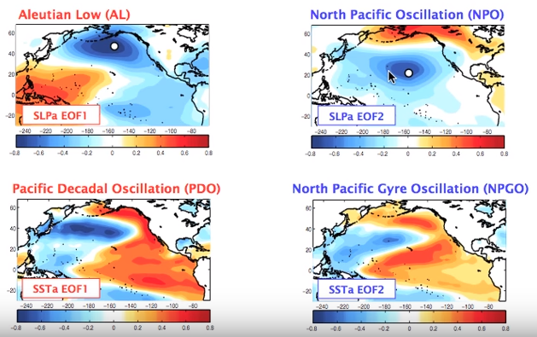
Mode of North Pacific Interdecadal Variability
The spatial character of PDV and PMV are robust in various analyses
Pacific Decadal Variability
Pacific Multidecadal Variability
Di Lorenzo et al. 2010
Notes:
The spatial characteristic of PDV and PMV is robust in various analyses. For example, the first and second EOFs of annual SST over the North Pacific (>20⁰N) have been called the Pacific decadal oscillation and the North Pacific gyre mode (NPGO). The first EOF resembles the PDV pattern and the second EOF resembles the PMV pattern. The PDO appears to be associated with the atmospheric variability of the Aleutian low while the NPGO is associated with the North Pacific Oscillation (NPO).

Slide 7

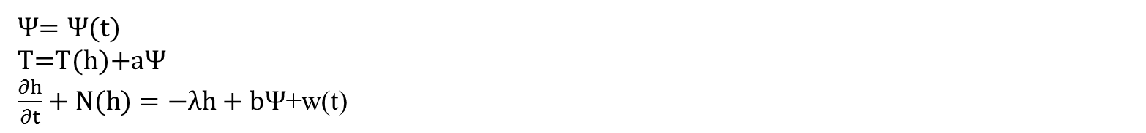
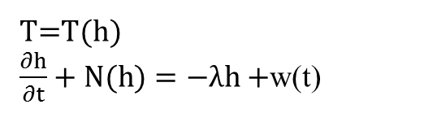


Generation mechanisms
Stochastic dynamics
Deterministic dynamics
OCN RES = ATM Forcing + Dissipation or Memory timescale
$$\frac{dT}{dt}=−λT+w(t)$$
Instabilities in the ocean (Weaver and Sarachilk 1991a, b)
OCN RES + Wave propagation/Current Advection = ATM Forcing
+ Dissipation timescale
$$\frac{∂T}{∂t}+C\frac{∂T}{∂x}=−λT+w(t)$$
Instabilities in coupled ocean-atmosphere system(Latif and Barnett 1994; Gu and Philander 1997)
OCN RES + Wave propagation/Current Advection =
Spatially Variable ATM Forcing + Dissipation timescale
$$\frac{dT}{dt}+C\frac{dT}{dx}=−λT+w(x,t)$$
Ocean dynamics + mode resonance
T=T(h)
$\frac{∂h}{∂t}+N(h)=−λh+$w(t)
Ocean feedback + coupled dynamics + coupled mode resonance
$Ψ$= $Ψ$(t)
T=T(h)+$aΨ$
$\frac{∂h}{∂t}+N(h)=−λh+bΨ$+w(t)
Notes:
1. There are two proposed mechanisms: stochastic dynamics and deterministic dynamics. Stochastically driven variability happens randomly due to internal atmospheric variability, while deterministically driven variability must associate with instabilities either in the ocean or in the coupled ocean–atmosphere system.
2. Recent model studies confirm that stochastic forcing is the major driving mechanism for interdecadal variability. I will move forward to the next slide to talk about the preferred time scale of interdecadal variability and then turn back to give detail information about how these stochastic models can or can not generate preferred time scale for interdecadal variability.
Continue from slide 8:
The simplest is the original stochastic climate model provided by Hasselmann (1976), this is a simple model involves local ocean-atmosphere interaction only and do not have any preferred time scale.
Next is the propagative stochastic climate model involving wave propagation or current advection that can vary from regions to regions, even under spatially uniform stochastic forcing. It also has no preferred time scale.
If the local forcing can act in phase with the downstream propagating variability, its magnitude can be reinforced. this model can generate variability with preferred time scale.
At the next level with the basinwide ocean dynamics included, the stochastic forcing can generate climate variability with preferred frequency simply as the resonance of ocean dynamic modes
Finally, the stochastic forcing can excite coupled climate modes with preferred time scales
There are two possible mechanisms have been proposed: stochastic dynamics and deterministic dynamics. Stochastically driven variability happens randomly due to internal atmospheric variability, while deterministically driven variability must associate with some determined processes within the ocean or in the coupled ocean-atmosphere system. The stochastic climate theory, although proposed long ago for general climate variability (Hasselmann 1976), was not appreciated in the study of interdecadal (and interannual) climate variability until the mid-1990s. While some studies examined variability in ocean models forced with stochastic forcing (e.g., Power et al. 1995), most early work on interdecadal variability tended to focus on deterministic dynamics and associated self-excited oscillation mechanisms. These latter studies attribute the origin of interdecadal variability to instabilities either in the ocean or in the coupled ocean–atmosphere system. This deterministic thinking is based on several historical reasons: the apparent success of studies in explaining ENSO as a selfexciting mode at that time; a lack of understanding of ocean–atmosphere interaction outside the tropics; inadequate analyses of the variability from a coupled perspective in CGCMs and observations; and limitations in most models employed for the study of interdecadal variability at that time. Most of the models used at the time were simplified models with highly simplified atmospheres, which underrepresented or neglected entirely stochastic atmospheric variability
However, more recent studies with advanced statistical analyses and sensitivity experiments using CGCMs tend to point to stochastic forcing as the major driving mechanism for interdecadal variability.
The stochastic theory for low frequency variability is organized as a hierarchy determined by the degree of complexity of the model, show in the lower left side. I will much move forward to the next slide to talk about the preferred time scale of interdecadal variability and then turn back to give detail information about how these stochastic models can or can not generate preferred time scale for interdecadal variability.
Continue from slide 8:
First is the original stochastic climate model provided by Hasselmann (1976), this is a simple model involves local ocean-atmosphere interaction only, that is the atmosphere forces the ocean, and the ocean will response with a damping rate$λ$. The low frequency variability is generated simply by the persistence of the anomaly competing against accumulated random variability. So there is maybe periodic evolution occur during a finite time window due to a few accidental swings of a certain period instead of a systematic oscillating mechanism with a preferred period in long time. Thus no preferred time scale for this category.
Next is the propagative stochastic climate model that involves wave propagation or current advection. In this class, climate can vary from region to region, even under spatially uniform stochastic forcing, because of the spatial accumulation of wave energy by wave propagation. In most studies so far, the propagation is provided by the first baroclinic planetary wave in the extratropics, which propagates westward across an ocean basin at interdecadal time scales due to the non-Doppler-shift effect. Even if the stochastic forcing does not vary with space, variability in different regions can exhibit different spectral peaks. Consequently, there is no single preferred oscillation time scale over the basin.
However, if the stochastic forcing exhibits a significant spatial variation of subbasin scale, with at least one cycle within the basin (tier 2b), the stochastic forcing can generate variability of a preferred period through the mechanism of spatial resonance. Spatial resonance occurs because the local forcing can act in phase with the downstream propagating variability, reinforcing its magnitude
At the next level with basinwide ocean dynamics included, stochastic forcing can generate climate variability with preferred frequency simply as the resonance of ocean dynamic modes
Finally and most generally, stochastic forcing can excite coupled climate modes with preferred time scales
(It should be pointed out that, although we tend to think of interdecadal variability with the paradigm of a damped oscillator (including the limiting case with zero frequency), it is generally difficult to unambiguously distinguish observed variability linked to a damped oscillator (tier 2 or 3) from variability associated with red noise (tier 1). This occurs because our time series are usually too short to contain sufficient interdecadal episodes, especially for multidecadal variability (Figs. 2a, 3a). Extreme caution is therefore needed in attributing the cause of interdecadal variability)

Slide 8
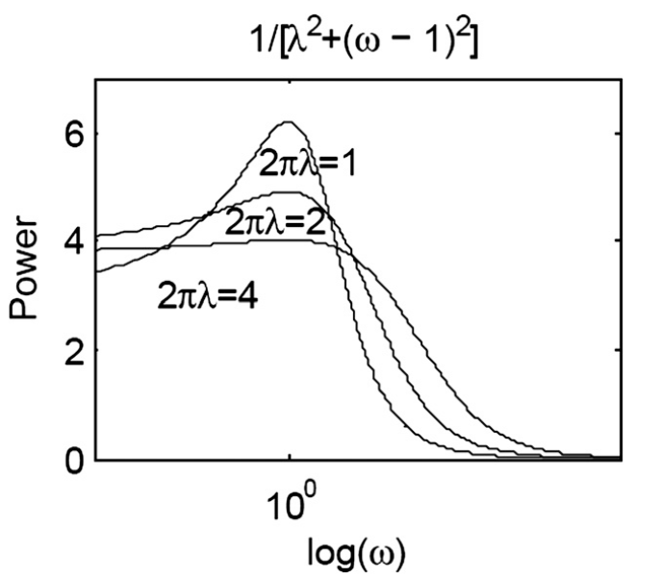

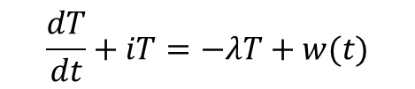


Preferred time scales of interdecadal variability
Atmosphere (fast process)
White noise forcing
Thermal damping time of upper-ocean heat content
$$τ≈ρC_{p}H\left|∂_{T}Q\right|$$
Ocean (slow process)
Damping timescale (persistence)
Red noise model (no preferred oscillation time scale)
$$≠$$
Variability with Significant spectral peaks
$$>$$
Oscillation timescale (period)
Dynamics of the system + spatial structure of the forcing
Certain oscillatory nature
Default damped oscillator paradigm
$$\frac{dT}{dt}+iT=−λT+w(t)$$
Notes:
1. Suppose the ocean’s integration of white noise forced by the atmosphere to generate its response oscillation behaviors, this response can have spectral peaks which are significantly different from a red noise model, we can assume this mode to be of a certain oscillatory nature.
(Red noise model: a model that has no preferred oscillation time scale).
2. In this case, the default paradigm will be a stochastic climate model of a damped oscillator with two relevant time scales: the damping time scale (persistence) and the oscillation time scale (period). The damping time scale determines how long an initial anomaly can stay above the noise level and also puts an upper bound on a meaningful oscillation time scale.
(because interdecadal variability can exhibit oscillatory behavior only if its oscillation time scale is shorter than the damping time scale).
3. Due to the relatively fast atmospheric processes, we can attribute the memory of interdecadal variability to the subsurface ocean where the damping time may be estimated crudely as a thermal damping time of the upper-ocean heat content.
4. The equation implies thermal dampling time scale is proportional to depth of the perturbed water. Therefore, the deep ocean may provide a key memory for interdecadal variability and contributes greatly to the spectrum of low frequency variability.
5. The oscillation time is important in determine the preferred time scale of interdecadal variability which is usually identified as a distinctive spectral peak. From the figure, low frequency variability has oscillation time scale only if the damping rate is very small, which mean that the integration of atmospheric forcing of the ocean will almost have to retain in the interior ocean with very small fraction of energy vanishes in order to have interdecadal variability
The oscillation time is important in determine the preferred time scale of interdecadal variability which is usually identified as a distinctive spectral peak. While the damping time scale does not necessarily need to involve ocean dynamics, the oscillatory time scale usually does involve ocean dynamics.
The figure show three theoretical (dimensionless) power spectra of damped oscillation with different damping rate$λ,$where the natural frequency is taken as 1 and w(t) is a white noise forcing. The spectral peak depends on the damping rate. The case of a strong damping rate$λ=\frac{2}{π}$shows little power spectrum peak; the modest damping rate $λ=\frac{1}{π}$ shows a weak power spectral peak, while the weak damping case$λ=\frac{1}{2π}$ shows a distinctive spectral peak.
So, low frequency variability has oscillation time scale only if the damping rate is very small, which mean that the integration of atmospheric forcing of the ocean will almost have to retain in the interior ocean with very small fraction of energy vanish in order to have interdecadal variability

Slide 9
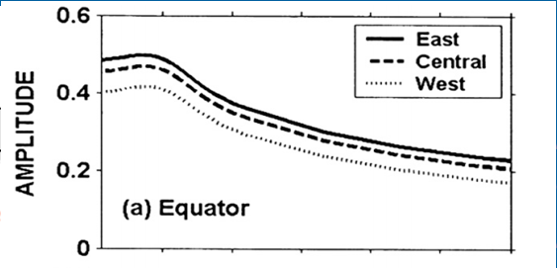
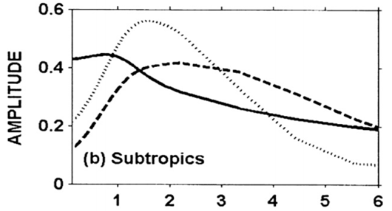



Role of ocean dynamics
Planetary wave propagation
The speed of Rossby wave: $C_{P}\sim βN^{2}/f^{2}$ → only applied in extratropical region
2. Planetary wave basin mode
→ Applied to Tropics
Extratropical Rossby wave
Coastal Kelvin waves
Extratropical stochastic wind
Weakly damped planetary wave basin (PB) modes in Tropics
Memory for interdecadal climate variability
Equatorial Kelvin waves
$$ω/ω_{P1}$$
$$ω/ω_{P1}$$
Liu 2003
Distinct spectral peak in the Tropics
No distinct spectral peak in the Extratropics
Notes:
1. Planetary wave propagation: Because the speed of the westward propagation of the first baroclinic planetary wave in the extratropics is proportional to the static stability, but inversely proportional to the f. Therefore, the planetary waves cross the basin in years to decades provides a natural time scale for interdecadal variability
2. Planetary wave basin mode: The planetary wave basin (PB) modes are formed by the interaction of extratropical planetary waves and coastal Kelvin waves, exhibiting periods of interannual to interdecadal timescales. However, planetary wave basin modes are heavily ‘‘damped’’ by the differential wave speed with latitude.
3. This damping is further enhanced by baroclinic instability. Therefore, planetary wave basin modes seem to be inefficient for generating distinctive spectral peaks on interdecadal time scales.
The figure shows the amplitude-frequency relation based on an idealized shallow water model simulation. On the equator, oceanic responses are dominated by a resonance peak at the frequency of the first PB mode in most portions. In the subtropics, the eastern boundary response (solid) is characterized by the same spectral peak as that on the equator, while the interior responses (in the midbasin and western boundary) no longer have a fixed frequency of resonant peak
4. This indicates planetary wave basin mode can generate decadal variability in the Tropics only
Figure Description:
A numerical solution of the full linear shallow water system with an additional very small linear momentum damping but without the long wave approximation. The model is solved using the finite difference scheme in C grid. The forcing is zonally uniform with the maximum Ekman pumping in the subtropics. Power spectra of the oceanic variability are shown along the (a) equator and (b) subtropics near the eastern boundary (solid line), midbasin (dashed line), and western boundary (dotted line). The forcing frequency $ω$ is normalized by the frequency $ω_{p}$. This latter frequency corresponds to the time for the baroclinic wave to cross the basin along the poleward boundary of the basin and is also the frequency of the first basin mode.
On the equator, oceanic responses are dominated by a resonance peak at the frequency of the first PB mode in the eastern boundary, midbasin, and western boundary. In the subtropics, the eastern boundary response (solid) is characterized by the same spectral peak as that on the equator, while the interior responses (in the midbasin and western boundary) no longer have a fixed frequency of resonant peak
This indicates this mode of ocean dynamics can generate decadal variability in the Tropics

Slide 10
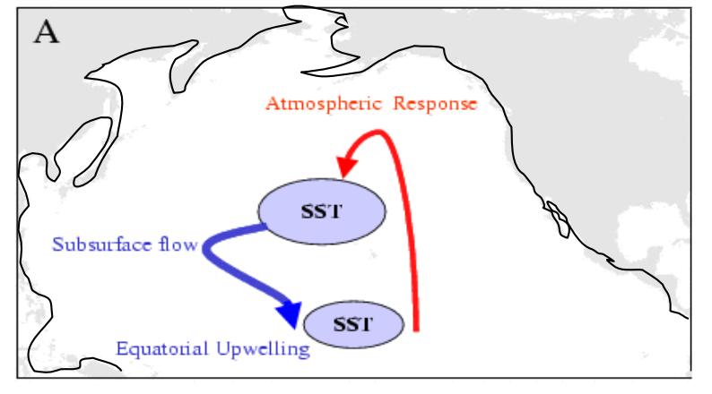
Role of ocean dynamics
3. Oceanic advection
4. Planetary wave instability
First baroclinic mode (Non-Doppler shift mode)
Westward propagation
Couple of the two mode due to same propagation speed
Planetary wave instability
Source for interdecadal variability
Second baroclinic mode (Advective mode)
Advective westward
Planetary wave instability occurs in South-Western part of subtropical gyre
→ applied to subtropical region only
Notes:
Oceanic ventilation of density anomalies provides another means of interdecadal time selection which is equivalent to the advection of high baroclinic modes of planetary waves. The passive ventilation of the spiciness also leads to interdecadal variability in the tropical Pacific. The spiciness refers to temperature and salinity anomalies with compensating effects on density,
The advection of subsurface temperature anomalies by the overturning circulation has also been proposed as a mechanism for driving interdecadal variability in the North Atlantic thermohaline circulation.
Planetary wave instability: If the westward propagation of the1st and 2nd baroclinic modes have thee same propagation speeds, the coupling between these two waves can lead to planetary wave instability., thus, providing a source for interdecadal variability. Planetary wave instability tends to occur in regions of westward shear, such as the southwestern part of a subtropical gyre.

Slide 11

Role of ocean dynamics
$$\frac{dT(t)}{dt}=aT\left(t\right)−bT\left(t−δ\right)−gT^{3}(t)$$
5. Thermohaline instability
Salinity transport poleward by overturning circulation
Increase high latitude density and convection
Strengthen overturning circulation
Subpolar region stratification
Convective instability
Excite interdecadal variability
Salinity variability
6. Positive ocean-atmosphere feedback and coupled instability
Positive ocean-atmosphere feedback
Delayed negative feedback
All nonlinear effects
Notes:
1. Thermohaline instability: The positive feedback between the poleward salinity transport and overturning circulation and the characteristic stratification of fresh cold water over saline warm water in the subpolar region can lead to significant convective instability, which can excite interdecadal variability. This process is sometimes referred to as the heat–salt oscillator mechanism
2. Positive ocean-atmosphere feedback and coupled instability: Finally, at the top level, ocean dynamics can be coupled actively with the atmosphere to produce the delayed oscillator paradigm (see formula). The oscillation is excited by a strong positive ocean–atmosphere feedback (a >0), and the cycle is caused by a delayed negative feedback with a delay time $δ$ associated with oceanic wave propagation. The stochastically forced delayed oscillator is a default paradigm for decadal variability.
So, a positive ocean–atmosphere feedback, even if insufficient to generate self-exciting variability, is still helpful in reducing the damping rate of the variability, sharpening the interdecadal spectral peak and, therefore, contributing toward a more distinctive interdecadal variability
Thermohaline instability: The interplay between temperature and salinity variability can also lead to thermohaline instability and is a potential mechanism for interdecadal variability. As far as ocean–atmosphere interaction is concerned, temperature is damped heavily through surface turbulent heat loss, while salinity is not. Therefore, the overturning circulation can transport salinity poleward near the surface more effectively than heat, leading to a basin-scale thermohaline instability associated with a positive feedback between the salinity transport and overturning circulation. Stronger overturning transports more salinity to high latitudes, which increases highlatitude density and convection and then strengthens the overturning circulation even more. Locally in the subpolar region, the characteristic stratification of fresh cold water over saline warm water also favors the role of salinity variability in the surface. This, in turn, leads to changes in convective instability, which can excite interdecadal variability. This process is sometimes referred to as the heat–salt oscillator mechanism
Positive ocean-atmosphere feedback and coupled instability: Finally, at the top level (level 6), ocean dynamics can be coupled actively with the atmosphere to produce the delayed oscillator paradigm (see formula). The oscillation is excited by a strong positive ocean–atmosphere feedback (a >0), and the cycle is caused by a delayed negative feedback with a delay time $δ$ associated with oceanic wave propagation. The delayed oscillator model can be generalized by combining the stochastic theory of Hasselmann (1976) as a stochastically forced model. The delayed oscillator paradigm, including the generalized version with stochastic forcing, has had a great influence on the study of interdecadal variability because of its conceptual simplicity. Indeed, often the stochastically forced delayed oscillator is becoming a default paradigm for decadal variability. In this regard, it should be pointed out that a positive ocean–atmosphere feedback, even if insufficient for generating self-exciting variability, is still helpful in reducing the damping rate of the variability, sharpening the interdecadal spectral peak and, therefore, contributing toward a more distinctive interdecadal variability

Slide 12

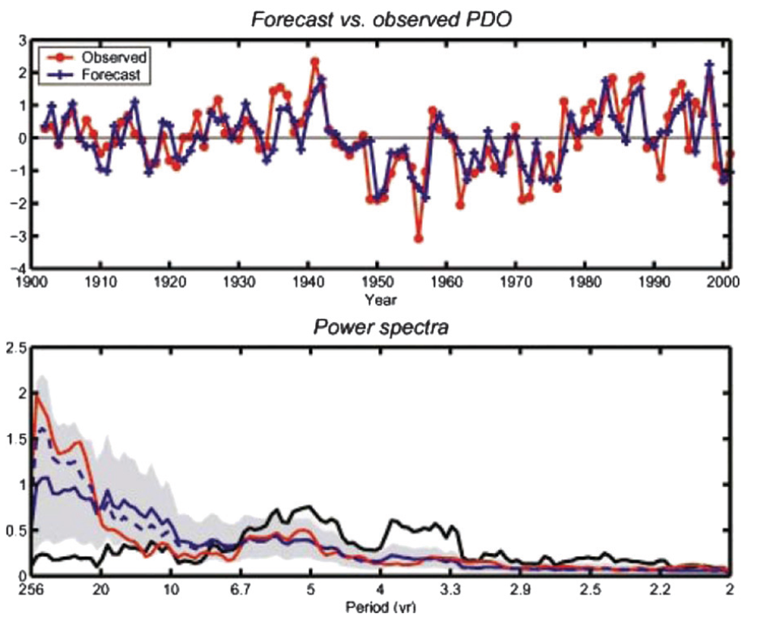
Tropical origin for the North Pacific interdecadal variability
NP SST Variability Statistical Model:
(Newman et al. 2003)
NP interdecadal variability = Local stochastic climate model + Remote forcing of ENSO
Tropical origin
PDO index:
>20N
ENSO index:
20N-20S, 120E-60W
Tropical PDV= random changes in ENSO, higher baroclinic modes of equatorial waves
Notes:
1. Tropical origin for North Pacific interdecadal variability:
Newman et al. (2003) showed that the North Pacific interdecadal SST variability can be simulated by the combination of the local stochastic climate model plus the remote forcing of ENSO. Using this model, the forecast can well capture the trend of observed PDO in the upper figure, however the forecasted PDO can only provide spectral peaks with much smaller amplitude in comparison with observed PDO in the lower figure. Note, however, that such models are linear, and any interdecadal variability in the North Pacific linked to ENSO requires decadal variability forcing in the tropical Pacific.
2. Tropical origin for tropical Pacific decadal variability: In the tropic, there is also decadal variability linked to random changes in ENSO activity. ENSO-like decadal patterns of variability in the tropics can be induced by the nonlinear modulation of ENSO or nonlinear asymmetry between El Nino and La Nina. Higher baroclinic modes of equatorial waves has also been proposed to account for decadal variability in the tropical Pacific.
In this section, I will now turn specifically to variability in the Pacific. In the Pacific, the study on interdecadal variability has developed along two major lines. One line largely follows the classical ENSO idea in which interdecadal variability is viewed as a self-exciting oscillation generated by a positive ocean–atmosphere feedback and a delayed negative feedback associated with extratropical oceanic Rossby waves. This ‘‘ENSO analog’’ reflects, in part, the early thinking of ENSO as a self-exciting oscillation; it also reflects the similarities of the observed patterns of Pacific interdecadal variability to ENSO variability. The other line adopts the stochastic climate theory (Hasselmann 1976) and considers interdecadal variability to be forced by stochastic atmospheric internal variability. Regardless of the generation mechanism, however, it is generally agreed that the preferred interdecadal time scale, if there is one, originates from ocean dynamics in the Pacific
Tropical origin for North Pacific interdecadal variability:
One important feature of Pacific interdecadal variability is a strong covariance between the tropics and extratropics. As shown previous, major episodes of decadal and multidecadal climate variability in the North Pacific can also be identified in the tropics. The pattern of interdecadal SST variability resembles that of the interannual variability of ENSO, characterized by two centers of opposite signs in the tropical and North Pacific, although the magnitude is stronger in the North Pacific than in the tropical Pacific for interdecadal variability. The strong negative correlation between tropical and North Pacific SSTs is caused by an effective atmospheric teleconnection from the tropics into the North Pacific through the Pacific–North America (PNA) teleconnection (Alexander 1990; 1992). The presence of strong ENSO variability in the tropical Pacific and the subsequent atmospheric teleconnection toward the extratropics have led to the hypothesis that Pacific interdecadal variability originates in the tropical Pacific
A tropical-origin mechanism, at first sight, appears to be supported by the statistical modeling of Newman et al. (2003), who showed that the North Pacific interdecadal SST variability can be simulated as a first-order auto-regression (AR1) process after including the remote forcing of ENSO. The upper figure show the time series of the observed PDO index and forecast PDO index provided by the statistical model and lower figure show spectra of observed PDO (red), ENSO index (black), ensemble mean model PDO (blue, 1000 100-yr samples) and the mean of the 20% of the model PDO (dashed blue, 200 100yr samples). The forecast can capture really well the trend of observed PDO in the upper figure. Also, the forecast PDO can also provide spectral peak similar to observed PDO but with much smaller amplitude.
Therefore, implying that the North Pacific SST variability can be generated largely by the local stochastic climate model plus the remote forcing of ENSO. Note, however, that such models are linear, and any interdecadal variability in the North Pacific linked to ENSO requires decadal variability forcing in the tropical Pacific. Nevertheless, one is still left with the question how interdecadal variability is generated in the tropical Pacific itself and, ultimately, what is the origin of the interdecadal variability
Tropical origin for tropical Pacific decadal variability: linked to random changes in ENSO activity from decade to decade. ENSO-like decadal patterns of variability in the tropics can be induced by the nonlinear modulation of ENSO or nonlinear asymmetry between El Nino and La Nina. This tropical decadal variability can then propagate into the extratropics through teleconnections, as suggested in the residual model (Newman et al 2003). However, robust differences between the interannual and decadal patterns seem to suggest that physics above the simple residual model is needed to explain the difference. Higher baroclinic modes of equatorial waves has also been proposed to account for decadal variability in the tropical Pacific

Slide 13

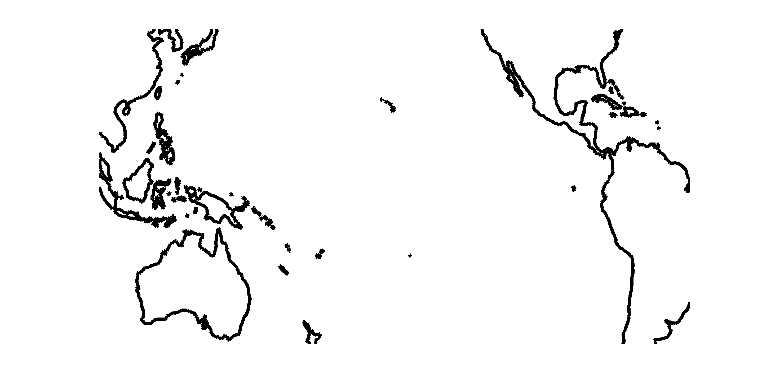
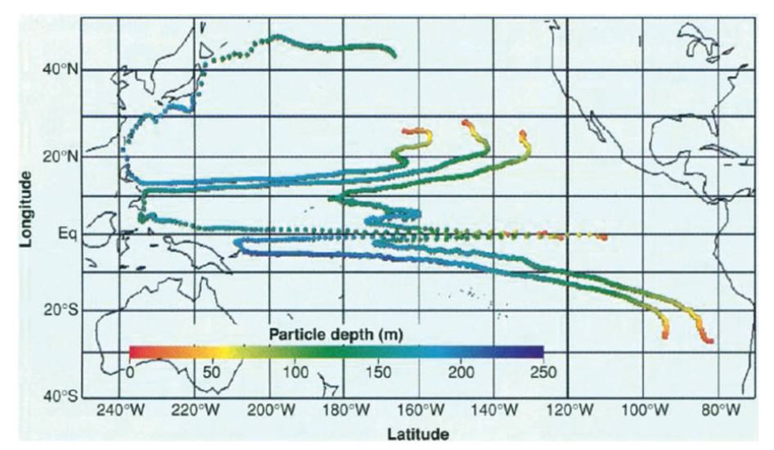
Tropical origin for Pacific multidecadal variability
Positive Bjerknes feedback in the equatorial Pacific
Equatorward
ventilation
All nonlinear effects
Ekman transport
Equatorial
Undercurrent
Interior pycnocline transport
(Gu and Philander 1997)
Notes:
Gu and Philander (1997) proposed a tropical-origin mechanism for multidecadal variability in which the slow time scale is derived from equatorward ventilation from the midlatitude North Pacific. This Gu–Philander hypothesis is basically a delayed oscillator paradigm, with the positive feedback provided by the Bjerknes feedback in the equatorial Pacific and the delayed negative feedback by the equatorward ventilation. This tropical-origin mechanism, however, was later questioned by Schneider et al. (1999) because the equatorward ventilation of North Pacific warm water (Deser et al. 1996) does not seem to reach the equator
The paths of water parcels over a period of 16 years after subduction off the coasts of California and Peru as simulated by means of a realistic oceanic general circulation model forced with the observed climatological winds (8). From the colors, which indicate the depth of parcels, it is evident that parcels move downward, westward, and equatorward unless they start too far to the west off California, in which case they join the Kuroshio Current. Along the equator they rise to the surface while being carried eastward by the swift Equatorial Undercurrent
Gu and Philander (1997) proposed a tropical-origin mechanism for multidecadal variability in which the slow time scale is derived from equatorward ventilation from the midlatitude North Pacific. Warm North Pacific surface water reaches the equator in $\sim$20 yr through the equatorward subduction, upwelling along the equator, and warming of the surface equatorial ocean; this surface warming reduces local easterlies, further warming the surface through the positive Bjerknes feedback. The warm equatorial Pacific forces deep atmospheric convection that then propagates into the North Pacific through the PNA teleconnection, intensifying the Aleutian low, midlatitude surface westerlies, and, in turn, turbulent heat flux loss—thus cooling the North Pacific. This forms a delayed negative feedback on the North Pacific SST, which eventually leads to a Pacific multidecadal variability of $\sim$50 yr. This Gu–Philander hypothesis is basically a delayed oscillator paradigm, with the positive feedback provided by the Bjerknes feedback in the equatorial Pacific and the delayed negative feedback by the equatorward ventilation. This tropical-origin mechanism, however, was later questioned by Schneider et al. (1999) because the equatorward ventilation of North Pacific warm water (Deser et al. 1996) does not seem to reach the equator
In short, despite various hypotheses for the tropical origin of interdecadal variability, the proposed mechanisms are difficult to confirm with observations and have not been tested thoroughly in CGCMs.

Slide 14
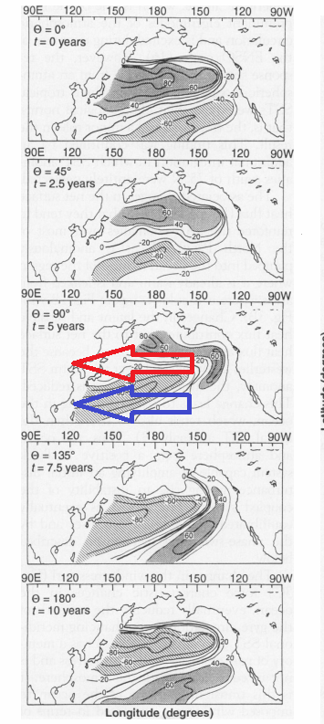
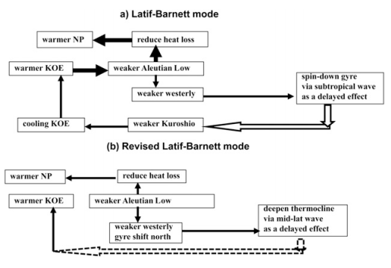
Extratropical origin for Pacific decadal variability
Positive midlatitude air-sea feedback
Spindown of the subtropical gyre
Rossby wave in the midlatitude (Schneider et al. 2002)
Extratropical origin
Latif and Barnett (1994)
Notes:
1. Latif and Barnett (1994) first proposed a mechanism that attributed the origin of the North Pacific decadal variability to the extratropics,
2. but later it is found to be largely invalid. The main differences between the original and modified modes are: the warming of SST in the central Pacific is caused by stochastic atmospheric variability associated with the Aleutian low in the revised mode while the original mode attributes the warming due to atmospheric response to the warming in the KOE region.
3. This modified Latif–Barnett mode essentially describes a stochastically driven oceanic mode, rather than a coupled mode as described in the original hypothesis. In short, the CGCM suggests the modified, non-coupled Latif–Barnett mechanism is responsible for some North Pacific decadal variability. In this mechanism, stochastic forcing is important for the generation of the variability, and midlatitude planetary waves determine the decadal time scale.

Slide 15
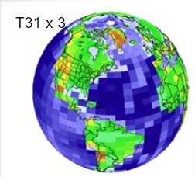
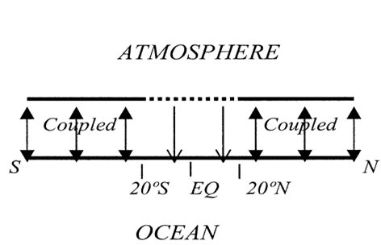
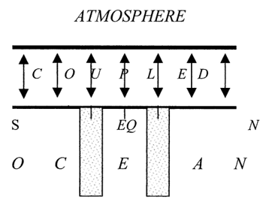

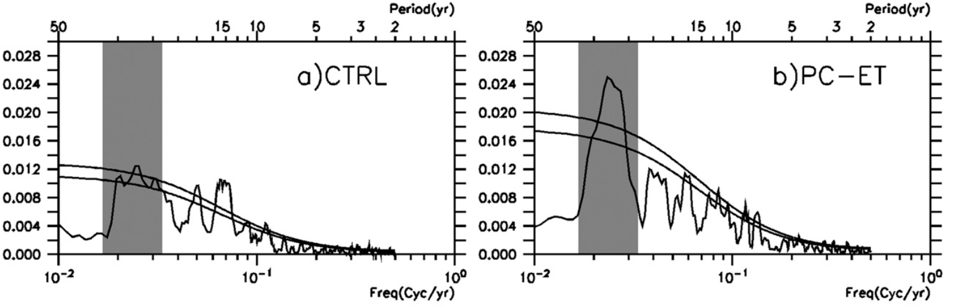
Extratropical origin for Pacific multidecadal variability
CTRL: Std integration of CCSM3
PC-ET: applied to the tropics equatorward of 20⁰
PB-CTRL: applied to the extratropical–tropical oceanic in the latitudinal band of 15⁰–25⁰
PC-ET
PB-CTRL
CCSM3 Std Configuration
Effects of O-A interaction
The generation of PMV is confined to the North Pacific coupled ocean–atmosphere system
Multidecadal spectral peak
Zhong et al. (2008) and
Zhong and Liu (2009)
Notes:
The extratropical origin hypothesis was examined using several coupled model experiments. To isolate the key region of ocean–atmosphere feedback, a partially-coupling (PC hereafter) sensitivity experiment is performed in which ocean–atmosphere coupling is suppressed in the tropics. The coupling is suppressed by replacing the SST using the climatological values.
The distinctive North Pacific multidecadal variability in the control run (Fig. a) remains (Fig. b) although the SST variability has been suppressed in the tropics.
They also performed another experiment in which the ocean–atmosphere interaction is suppressed in the extratropics, the North Pacific multidecadal mode disappears completely although tropical variability remains largely unchanged (not shown). These two PC experiments demonstrate that although tropical O-A interaction is essential to ENSO variability, the tropical ocean–atmosphere interaction is unnecessary for the multidecadal variability in the North Pacific.
To further isolate the role of ocean dynamics in decadal variability, a partialblocking (PB) sensitivity experiment is performed in which ocean wave propagation between the tropics and extratropics is blocked using a vertical sponge wall in the ocean. Within the sponge walls, temperature and salinity are restored toward the annual cycle of the CTRL run. Despite the presence of this sponge wall, Pacific multidecadal variability continued (not shown). These experiments demonstrate that the origin and the process that generate the multidecadal time scale of the variability is confined to the North Pacific coupled ocean–atmosphere system
In order to identify the origin of the North Pacific multidecadal variability, sensitivity experiments have been performed in CCSM3. CCSM3 is a state-of-art global climate model consisting of four components of the atmosphere, ocean, sea ice, and land surface, which are linked through a flux coupler. The control simulation (CTRL) is integrated under the present-day climate conditions for 880 yr without flux adjustment. Analyses of CTRL are based on the last 580 yr of simulation. Then a series of sensitivity experiments are performed to explore the mechanism of the PMV using the modeling surgery approach of partial coupling (PC) and partial blocking (PB). All experiments were started from the CTRL at year 651 and integrated for 400 yr without flux correction
To isolate the key region of ocean–atmosphere feedback a partial-coupling (PC hereafter) sensitivity experiment is performed in which ocean–atmosphere coupling is suppressed in the tropics with the PC surgery: equatorward of 20⁰, the SST to condition the atmosphere is replaced with that of the seasonal cycle of the climatology from CTRL such that the atmosphere sees SST variability only in the extratropics outside of 20⁰. The distinctive North Pacific multidecadal variability in the control run (Fig. a) remains (Fig. b) although the SST variability has been suppressed in the tropics. In contrast, in a complementary PC experiment in which ocean–atmosphere interaction is suppressed in the extratropics, the North Pacific multidecadal mode disappears completely although tropical variability, including ENSO, remains largely unchanged (not shown). These two PC experiments demonstrate that tropical ocean–atmosphere interaction, albeit essential to ENSO, is unnecessary for the multidecadal variability in the North Pacific
To further isolate the role of ocean dynamics in decadal variability, a partialblocking (PB) sensitivity experiment is performed in which ocean wave propagation between the tropics and extratropics is blocked using a vertical sponge wall in the ocean. Within the sponge walls, temperature and salinity are restored toward the annual cycle of the CTRL run. Despite the presence of this sponge wall, Pacific multidecadal variability continued (not shown). These experiments demonstrate unambiguously that the origin of the PMV, that is, the process that generates the multidecadal time scale of the variability, in this model is confined to the North Pacific coupled ocean–atmosphere
system

Slide 16
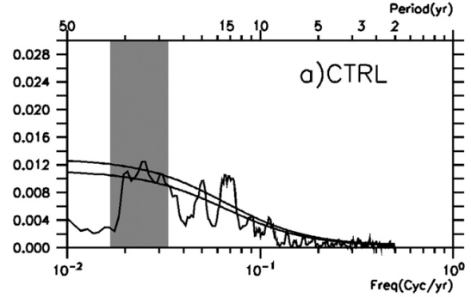
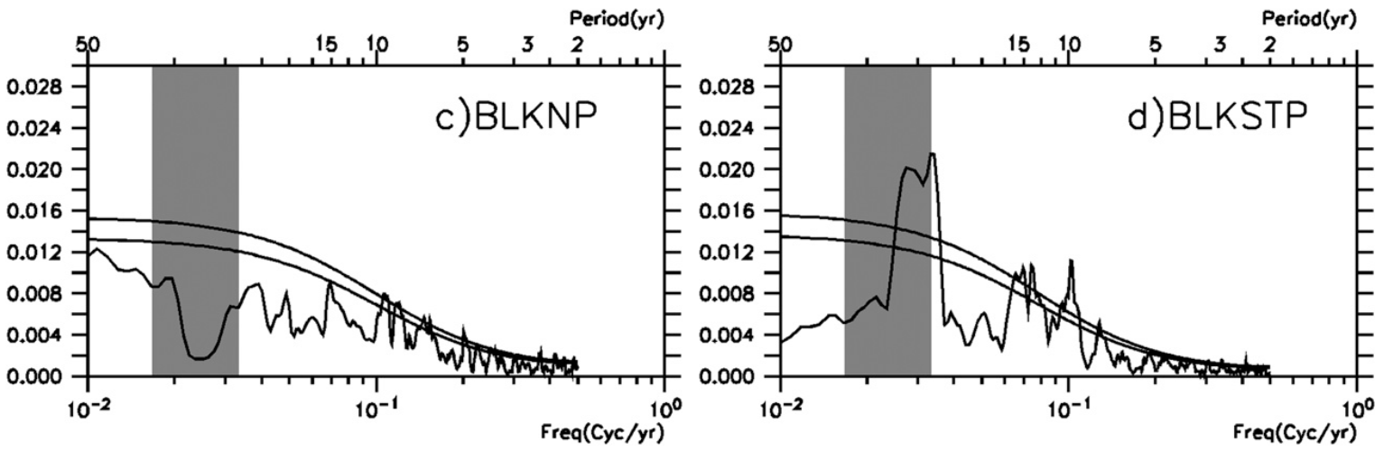
Extratropical origin for Pacific multidecadal variability
ATMOSPHERE
W
CTRL: Std integration of CCSM3
BLKNP: PC-ET+ PB
At North Pacific at
10⁰–60⁰N
BLKSTP: PC-ET+PB
at 10⁰–35⁰N
Multidecadal spectral peak
Coupled
Coupled
S
N
20⁰S EQ 10⁰N 20⁰N 60⁰N
180⁰
OCEAN
Effects of Planetary waves
E
PMV originates from wave propagation in the subpolar gyre
Zhong et al. (2008) and
Zhong and Liu (2009)
Notes:
1. To further understand the role of planetary waves at multidecadal time scales, two other sensitivity experiments are performed to examine the westward propagation of Rossby waves in the midbasin. The westward proppaagation is blocked by a wall at 180E. Ocean temperature and salinity are also estored toward the climatological seasonal cycle of CTRL. In one experiment (BLKNP), the sponge wall extends from 10N to over 60N such that Rossby wave propagation is blocked in the midbasin across the entire North Pacific Ocean. In the other experiment (BLKSTP), the sponge wall extends only from 10 to 35N such that Rossby wave propagation is blocked only in the subtropical ocean.
2. In Fig. c, the North Pacific multidecadal variability disappears over the entire basin when the sponge wall blocks the North Pacific. Note that the multidecadal variability disappears not only west of the sponge wall, but also east of the wall. This suggests an active role of the planetary wave in the formation of the multidecadal variability.
3. In contrast, the variability remains similar to the variability in the control run when the sponge wall is confined to the subtropics south of 35⁰N (Fig. d). These experiments demonstrate that the multidecadal variability originates from wave propagation in the subpolar gyre. Planetary waves are slow in the subpolar gyre because of both large Coriolis parameter and weak stratification. In fact, such waves take more than 20 yr to cross the basin. This provides a sufficiently long time scale for the role of planetary waves in driving multidecadal variability.
To further understand the role of planetary waves at multidecadal time scales, two new sensitivity experiments are performed based on PC-ET-with the westward propagation of Rossby waves blocked in the midbasin using the PB surgery by inserting a sponge wall of 10⁰ width (below 100 m) into the ocean model component along the midbasin at longitude of 180⁰—in which ocean temperature and salinity are restored toward the climatological seasonal cycle of CTRL. In one experiment [namely, partial blocking in the North Pacific (BLKNP)], the sponge wall extends from 10N to over 60N such that Rossby wave propagation is blocked in the midbasin across the entire North Pacific Ocean. In the other experiment [namely, partial blocking in the subtropical North Pacific (BLKSTP)], the sponge wall extends only from 10 to 35N such that Rossby wave propagation is blocked only in the subtropical ocean
In Fig. c, the North Pacific multidecadal variability disappears over the entire basin when the sponge wall blocks the North Pacific. Note that the multidecadal variability disappears not only west of the sponge wall, but also east of the wall. This suggests an active role of the planetary wave in the formation of the multidecadal variability.
In contrast, the variability remains similar to the variability in the control run when the sponge wall is confined to the subtropics south of 40⁰N (Fig. d). These two PB experiments demonstrate that the multidecadal variability originates from wave propagation in the subpolar gyre. Planetary waves are slow in the subpolar gyre because of both large Coriolis parameter and weak stratification. In fact, such waves take more than 20 yr to cross the basin. This provides a sufficiently long time scale for the role of planatary waves in driving multidecadal variability.
Further analysis found that a warm KOE SST induces a ridge response and, in turn, downward Ekman pumping in the subpolar gyre. The downward Ekman pumping forces a southward Sverdrup flow and, in turn, a cold anomaly in the thermocline. This cold anomaly appears to migrate westward and is eventually transported southward by the Oyashio toward the KOE region, generating a delayed negative feedback. This analysis shows evidence of a positive ocean–atmosphere feedback associated with the atmospheric response to the KOE SST, although it remains unclear if the net ocean–atmosphere feedback in the midlatitudes is positive or not. Therefore, this mode is likely to be stochastically driven, with ocean–atmosphere feedback only modifying the variability.

Slide 17
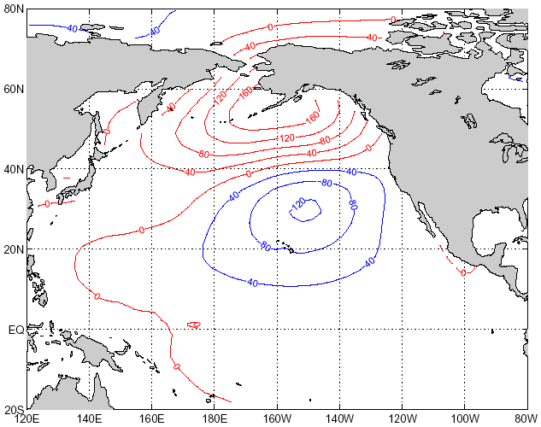
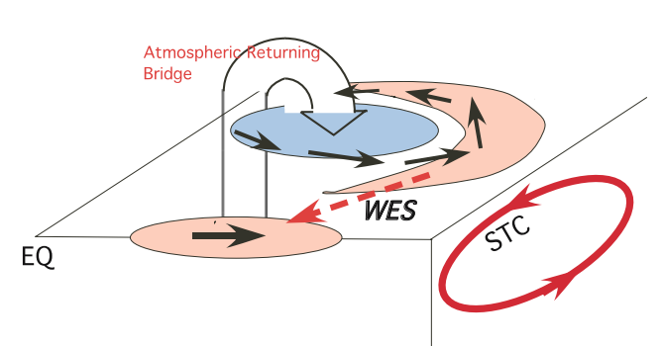
Extratropical origin for Tropical Climate Variability
Extratropics
Seasonal Foot Printing Mechanism (SFM)
Wu et al. 2007
Vimont et al. 2001, 2003a&b
NPO in NDJ (-1)
⇓
Wind⇓s & Heat Flux
SST in MAM (0)
⇓
Tropical Winds
⇓
Bjerknes Feedback
⇓
El Nino in NDJ(0)
Atmospheric transport of latent and sensible heat
Tropics
Notes:
Extratropical climate variability can affect tropical climate through the atmospheric transport of latent and sensible heat.
Boundary layer ocean–atmosphere coupling through the wind speed–evaporation–SST (WES) feedback can generate a rapid equatorward propagation in the trade wind regime, enabling extratropical climate variability to affect the tropics in the so-called seasonal footprinting mechanism. These fast atmospheric and coupled teleconnections apply not only to multidecadal variability but also to decadal, interannual and even seasonal variability in the Pacific and the other oceans. These equatorward teleconnections are particularly important at the decadal time scale because they can transmit the long-term variability signal from the extratropics into the tropics, generating a long-lasting impact. At the interdecdal time scale, tropical variability can be further affected by the extratropical climate changes through the equatorward (STC) oceanic ventilation
Right Figure: shows the seasonal footprint mechanism that can module ENSO variation
Extratropical climate variability can also impact the tropics through teleconnections via atmospheric, oceanic, and coupled processes. Extratropical climate variability can affect tropical climate through the atmospheric transport of latent and sensible heat. Boundary layer ocean–atmosphere coupling through the wind speed–evaporation–SST (WES) feedback can generate a rapid equatorward propagation in the trade wind regime, enabling extratropical climate variability to affect the tropics in the so-called seasonal footprinting mechanism. These fast atmospheric and coupled teleconnections apply not only to multidecadal variability but also to decadal, interannual and even seasonal variability in the Pacific and the other oceans. These equatorward teleconnections are particularly important at the decadal time scale because they can transmit the long-term variability signal from the extratropics into the tropics, generating a long-lasting impact. At the interdecdal time scale, tropical variability can be further affected by the extratropical climate changes through the equatorward (STC) oceanic ventilation
Left Figure: Schematic diagram of the extratropical–tropical relay teleconnection. A persistent strengthening (weakening) of the Aleutian Low creates cooling (warming) in the western-central North Pacific and warming (cooling) in the eastern subtropical Pacific; the latter rapidly propagates to the tropics through the WES feedback to create warming (cooling) in the equatorial region nearly synchronously; this fast surface coupled process operates annually and creates persistent westerly (easterly) anomalies in the subtropics, leading to a weakening (strengthening) of the STC to further sustain the warming (cooling) in the tropics. As a result, the warming (cooling) in the tropics can further intensify (reduce) the Aleutian Low through return atmospheric bridge, forming a positive feedback loop
Right Figure: shows the seasonal footprint mechanism that can module ENSO variation

Slide 18
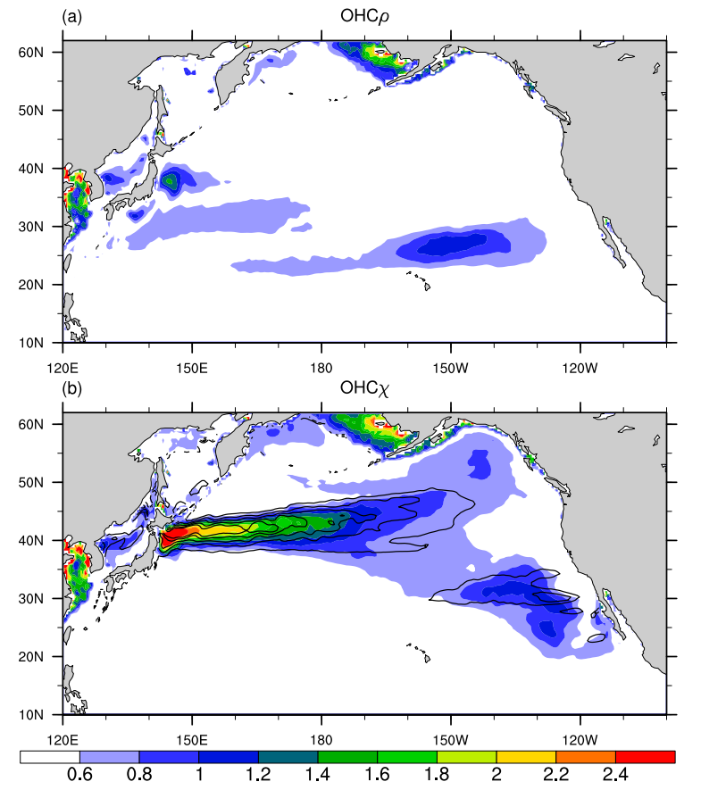
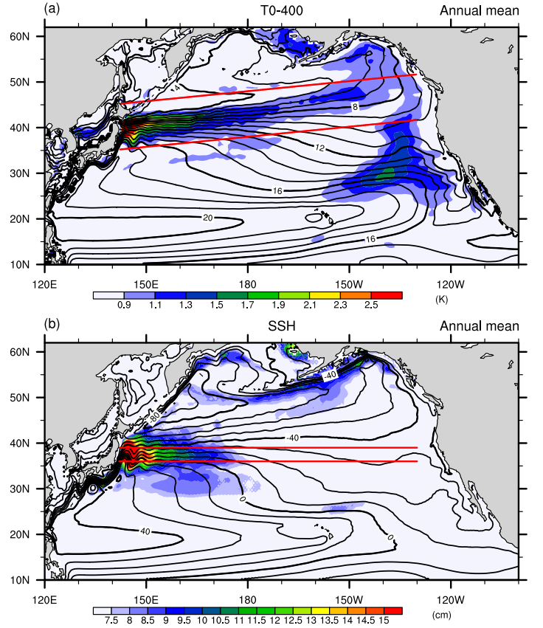
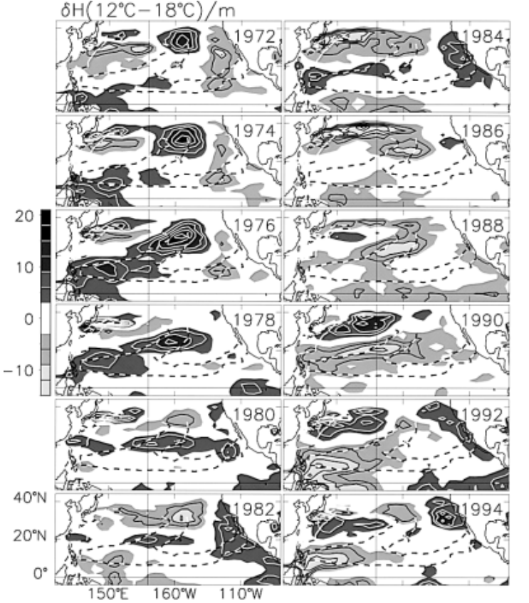
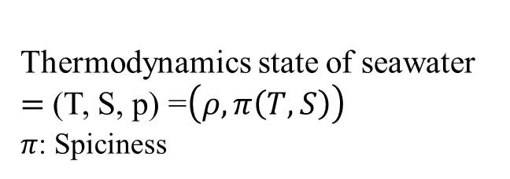
Future Research
Thermodynamics state of seawater
$=$ (T, S, p) =$\left(ρ, π\left(T, S\right)\right)$
$π$: Spiciness
Schneider et al. 1998
Taguchi and Schneider 2014
How to quantify the role of eddy fluxes to eastern NP spiciness anomalies? Can it further advect southward and affect equatorial climate?
Can mesoscale eddy affect meridional gradients in T and S fields across SAFZ? What is the link between the Rossby wave (at higher baroclinic mode) and spiciness in the NP? How it affect the mode water variability?
Are the thermal anomalies salinity-compensated or higher mode baroclinic waves?
How can we link the interdecadal subsurface variability in the North Pacific with tropical Pacific?
Notes:
1. In order to track the decadal variability in the ocean and understand the mechanisms, we propos to use spiciness to quantify the anomalous variability in the ocean. Spiciness: used as a independent variable to describe the thermodynamic state of seawater apart from density, therefore it is “orthogonal” or “perpendicular” to the constant density curves in the (T, S) diagram. So spiciness can be viewed as potential temperature and salinity of seawater at a given isopycnals surface. Correspondingly, density-compensated isopycnal temperature and salinity variability is referred to as spiciness variability. Positive (warm, salty) and negative (cold, fresh).
2. Schneider et al.1998’s study showed that anomalies which are originated from the central North Pacific can transport to the western subtropical Pacific along isopleths of average potential vorticity.
3. In addition, the study also provide no evidence that the thermal anomalies further reach the equator or return to the midlatitudes via the western boundary current. This, however, might be due to the optimal interpolation used in preparation of the dateset (White 1995) that discriminates against small spatial scales such as might be expected from changes of temperature and transport of the western boundary current
Taguchi and Schneider 2014’s study showed that the eastward propagation of temperature anomalies are dominated by the spiciness contribution. This spiciness can be formed because of the the arrival of wind-forced, westward-propagating equivalent barotropic Rossby waves at the western boundary causes a meridional shift of the gyre boundary in the Kuroshio–Oyashio Extension (KOE) region and large meridional spiciness gradients in the subarctic frontal zone. (Central and right figure)
From the two studies above, further intensive study should be performed to clarify and thoroughly solve the issues remain:
How to quantify the role of eddy fluxes to eastern NP spiciness anomalies? Can it further advect southward and affect equatorial climate?
Can mesoscale eddy affect meridional gradients in T and S fields across SAFZ? What is the link between the Rossby wave (at higher baroclinic mode) and spiciness in the NP? How it affect the mode water variability?
Are the thermal anomalies salinity-compensated or higher mode baroclinic waves?

Slide 19
Future Research
Proposed Research
Analysis of observational data:
  ARGO floats observation
  Reanalysis product (e.g., ECMWF ORA3, SODA 2.2.6 ensemble, GODAS, ECCO)
2. Ensemble ocean-only simulation:
separate the atmospherically-forced (deterministic) low-frequency variance from the ocean’s internally-driven
diagnose the forcing dynamics that modulate low-frequency changes in eddy-resolved circulation and water mass anomalies
3. Coupled simulation:
characterize and diagnose the completed processes involved in the interdecadal variability in the Pacific Ocean
Examine the role of atmosphere and ocean separately
Notes:
diagnose and characterize the decadal variability of subsurface anomalies associated with spiciness

Slide 20
Thanks for your attention

