Slide 1
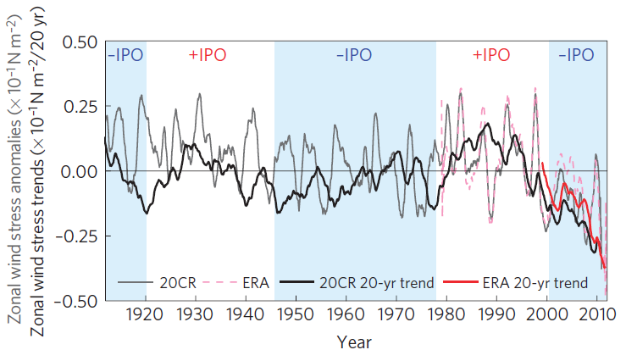
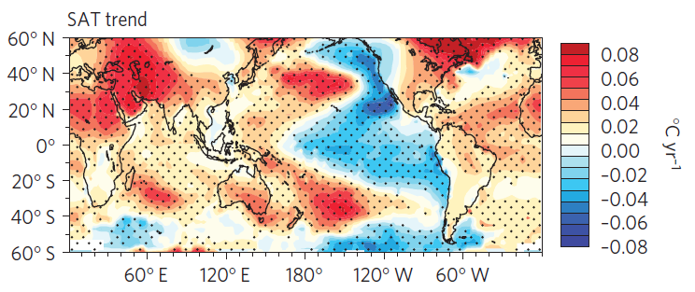
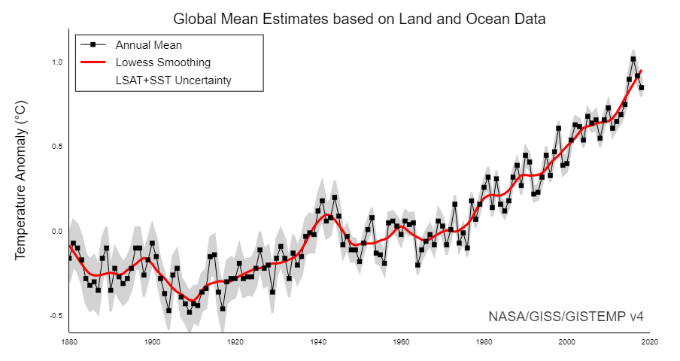
Zonal wind stress and trends
Trend during 1992-2011
Global warming hiatus
England et al. (2014)
Notes:
However, it is possible that the STC is just a part of the ocn-atm interaction.
Also, STC is directly correlated with equatorial SST changes at both interannual and decadal scales.
Jerry talked about the decadal changes. Here, we want to emphasize on the interannual scale.
The structure of the STCs can be an important factor that controls ENSO.

Slide 2
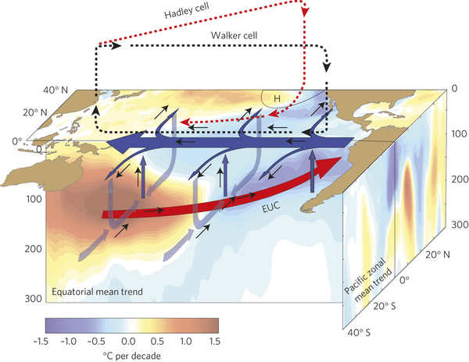
=>Increased trade wind
=>Strengthened STG and Ekman pumping
=>Spin-up STC
=>Enhanced EUC
=>Increased equatorial upwelling
=>Negative SSTA (warming hiatus)
England et al. (2014)
A figure showing the linear trend+natural variability
Notes:
However, it is possible that the STC is just a part of the ocn-atm interaction.
Also, STC is directly correlated with equatorial SST changes at both interannual and decadal scales.
Jerry talked about the decadal changes. Here, we want to emphasize on the interannual scale.
The structure of the STCs can be an important factor that controls ENSO.

Slide 3
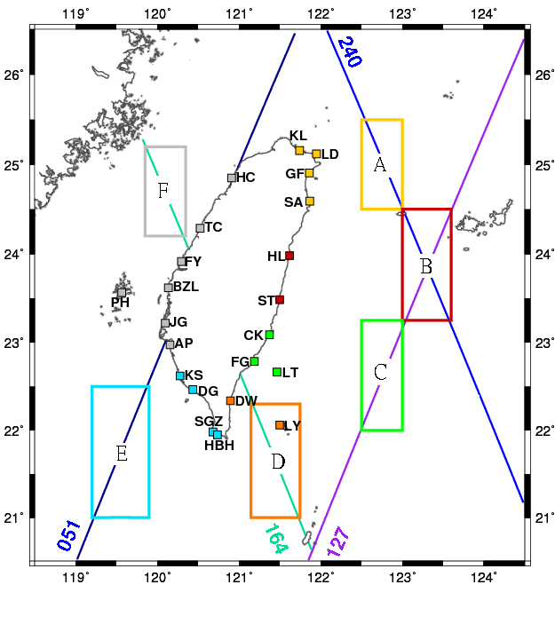
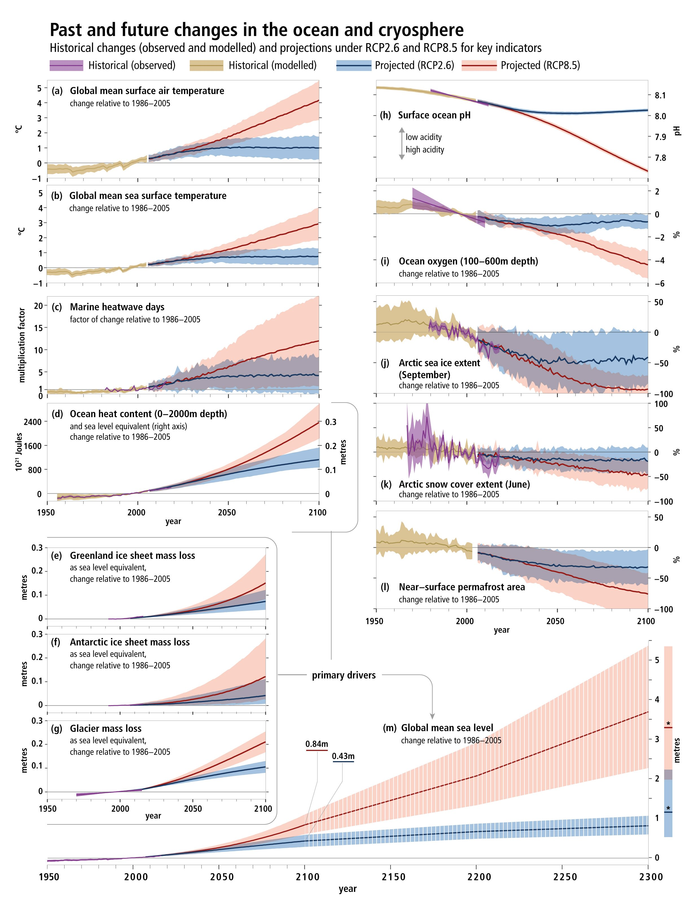
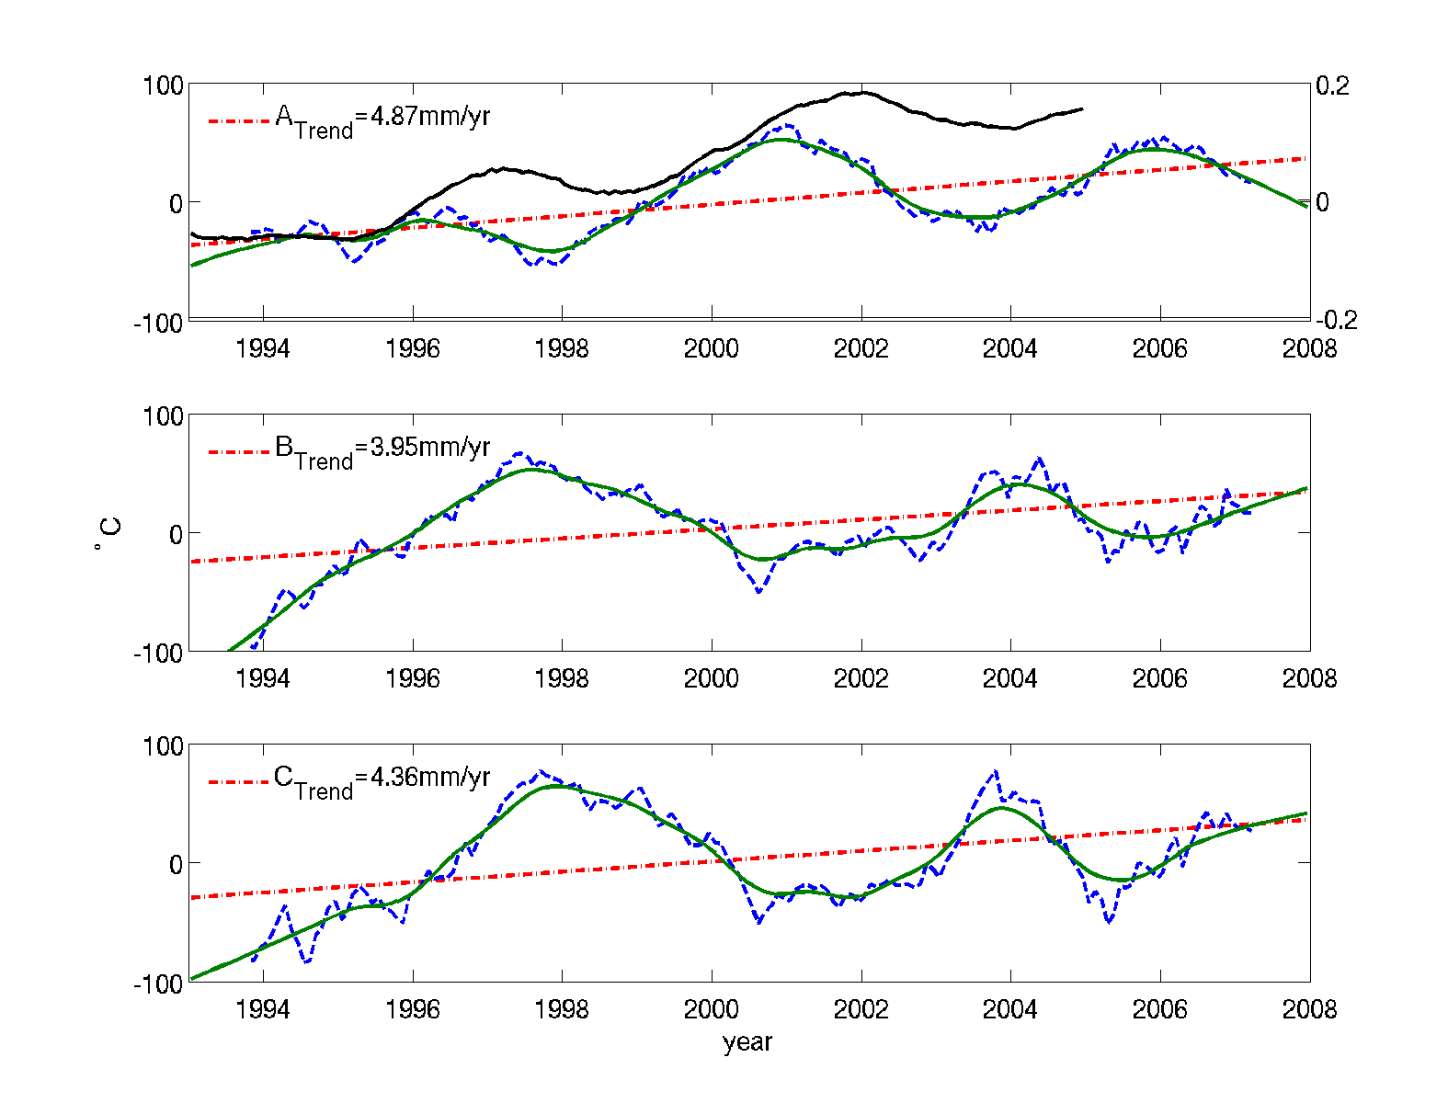
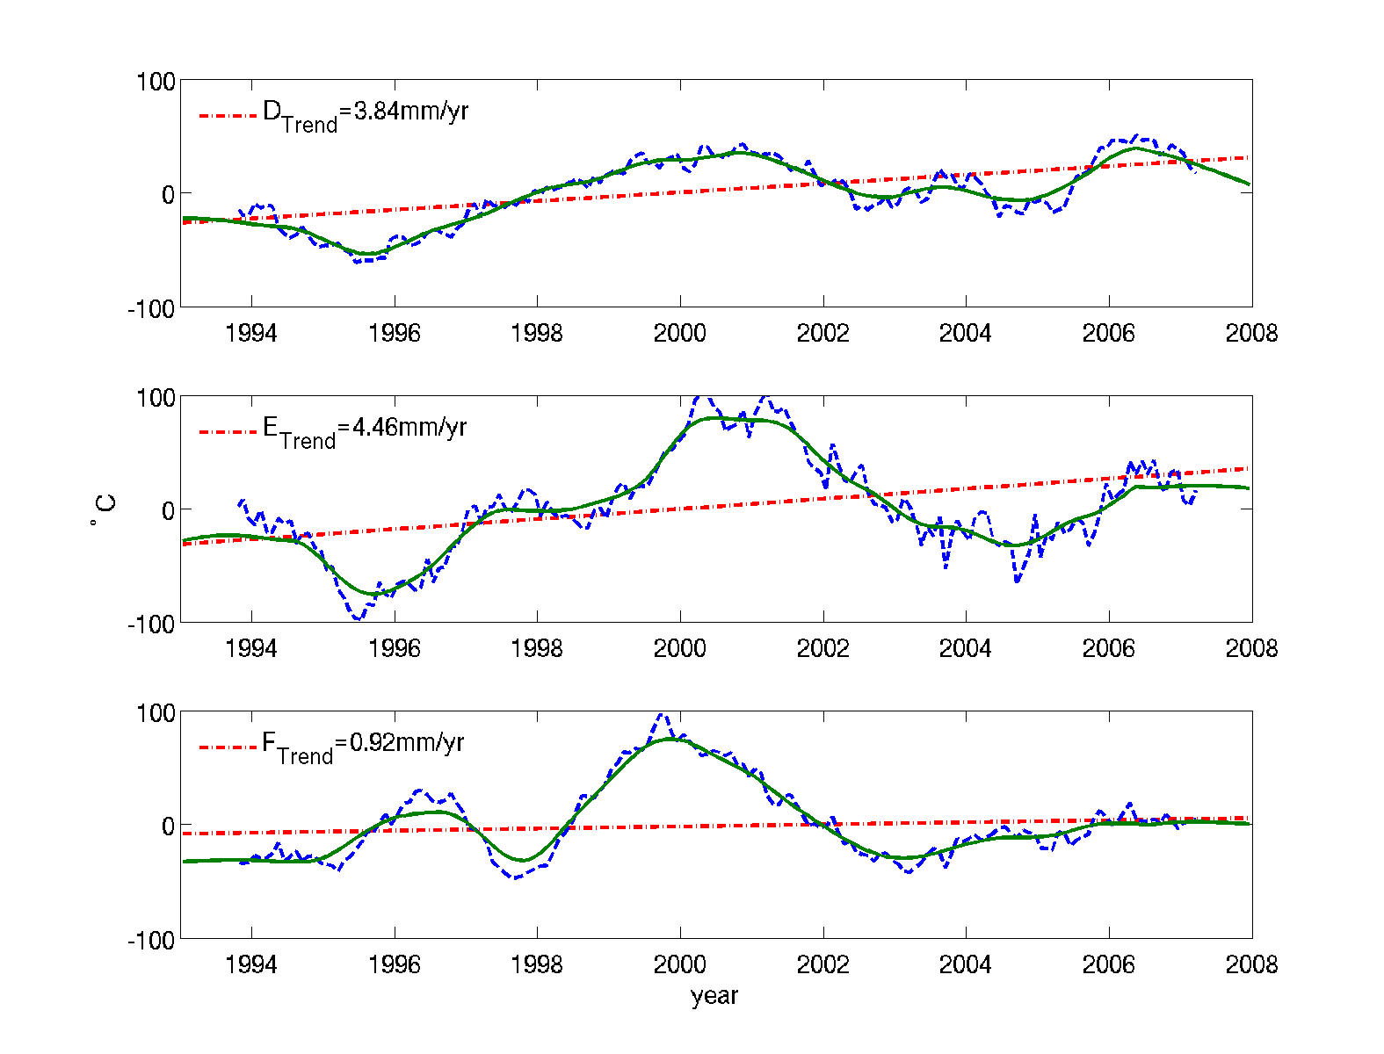
Global sea level changes
Satellite altimetry time series
14°C isotherm temperature anomaly (Palmer et al., 2007)
Tseng et al. (2010)

