Slide 1
Overview of a North Pacific Climate Paradigm and the Teleconnection of Indo-Pacific Warm Pool
Yu-heng Tseng¹, Chun-hoe Chow² and Huang-Hsiung Hsu²
¹Climate and Global Dynamics Division
National Center for Atmospheric Research
² RCEC, Academia Sinica

Slide 2
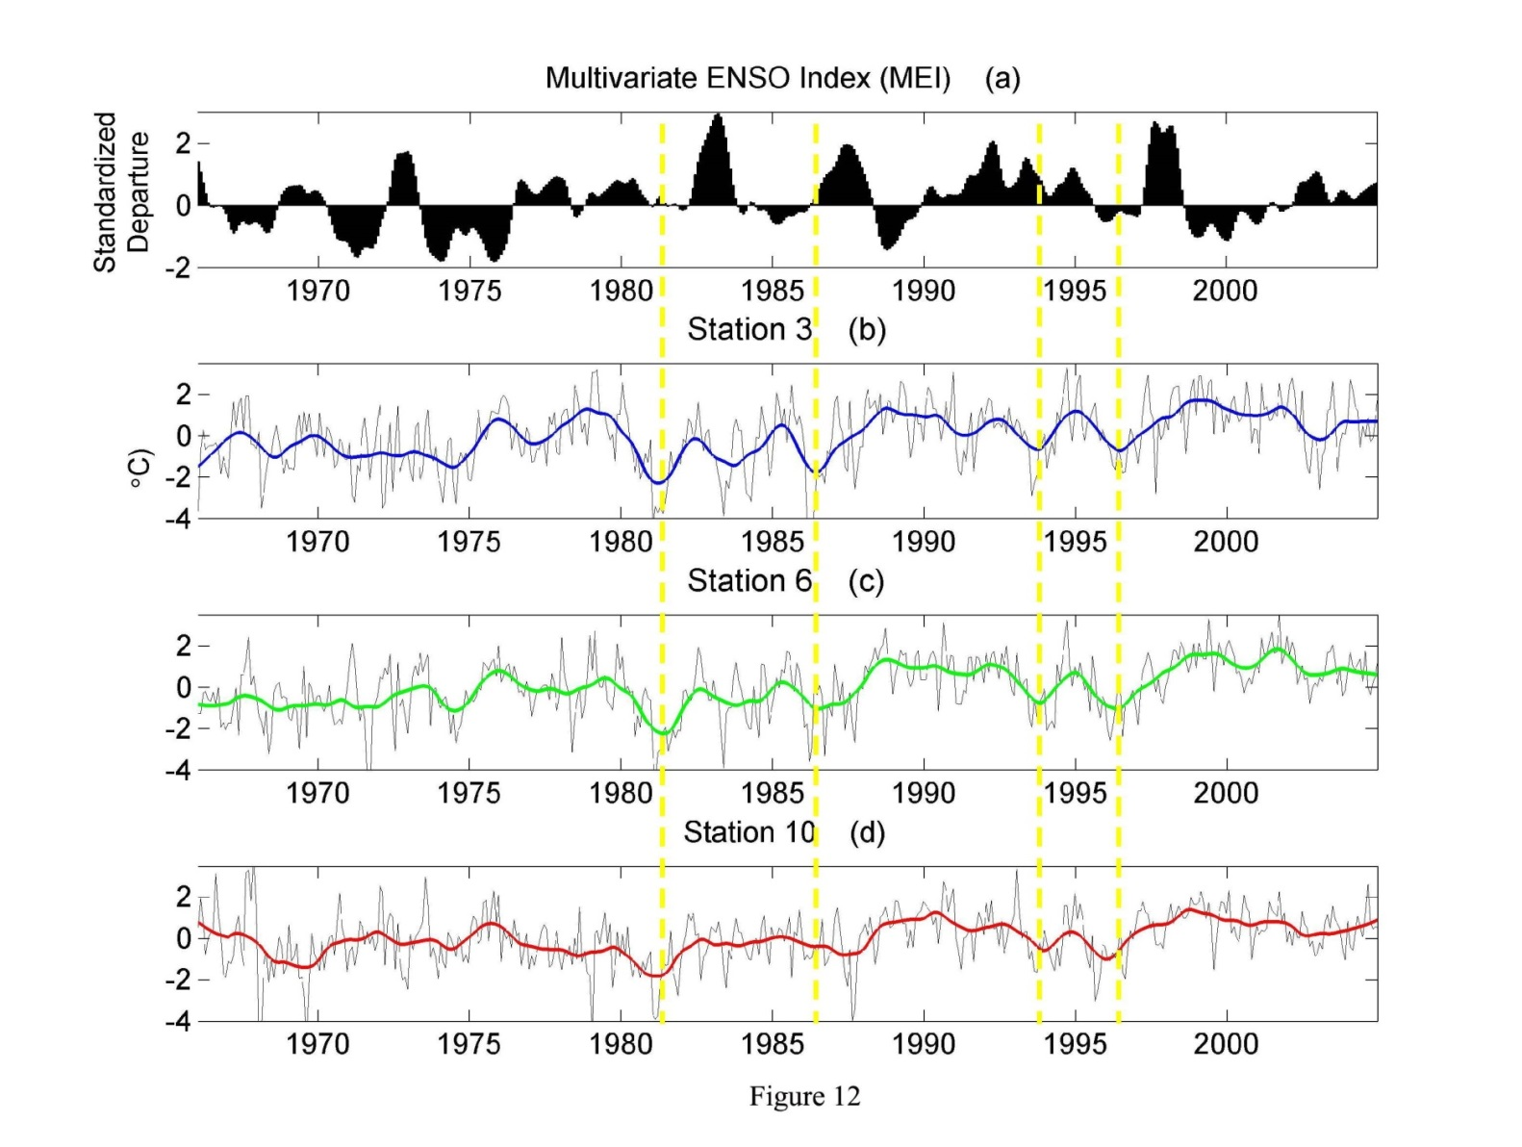
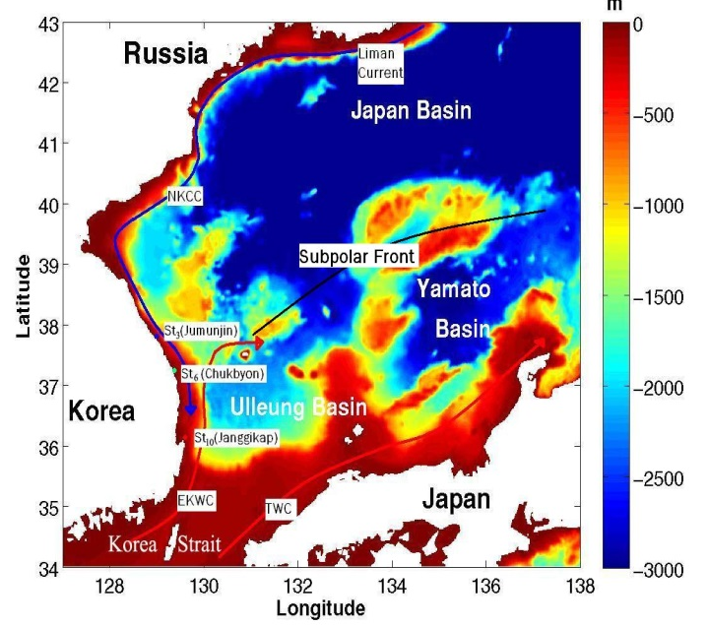
ENSO precursor: WNP
Western North Pacific
DJF
Jo, Breaker and Tseng (2013) TAO
Cold SSTA occurs in WNP before El Nino.

Slide 3
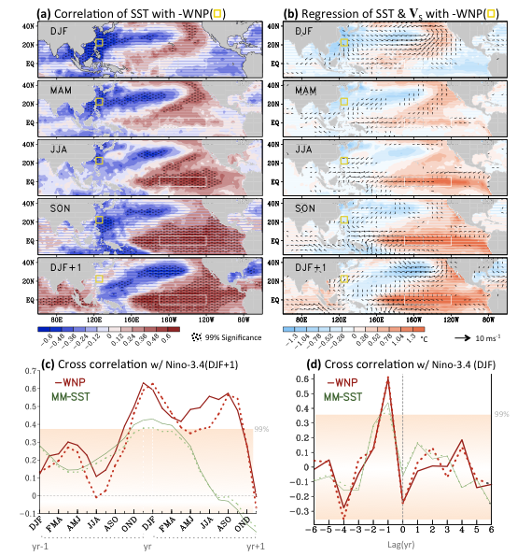
ENSO precursor: WNP
Western North Pacific
DJF
Wang et al. (2012)-GRL

Slide 4
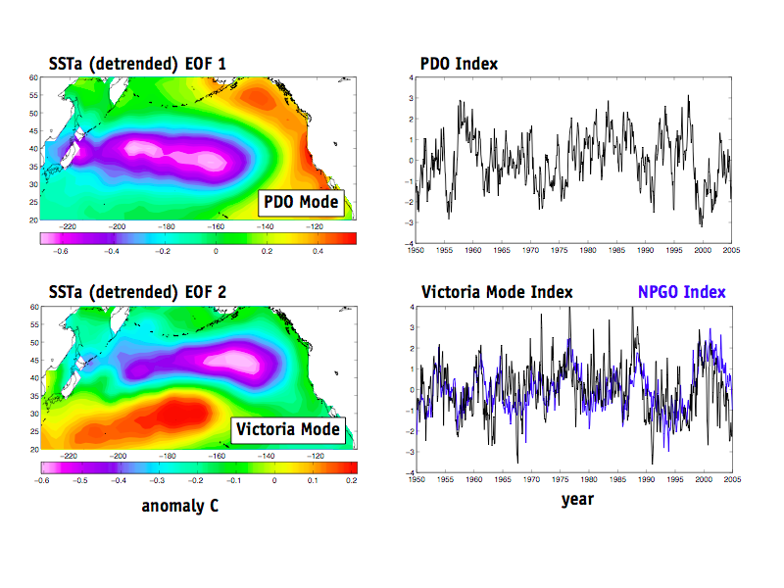
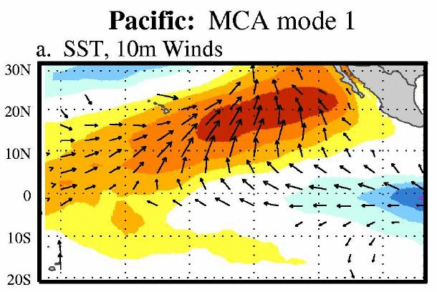
ENSO precursor: WNP
Western North Pacific
NPO
Other forcing
mechanisms:
SFM
PMM

Slide 5
ENSO precursor: WNP
Western North Pacific
NPO
Other forcing
mechanisms:
SFM
PMM

Slide 6
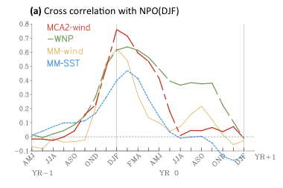
ENSO precursor: WNP
Western North Pacific
Other forcing
mechanisms:
SFM

Slide 7
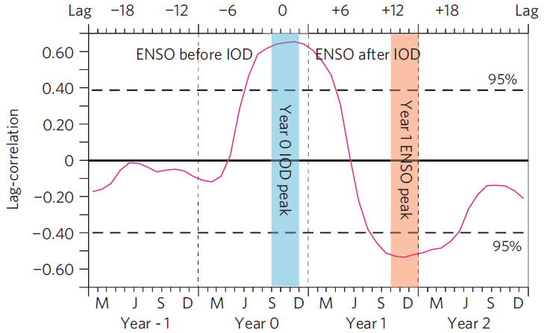
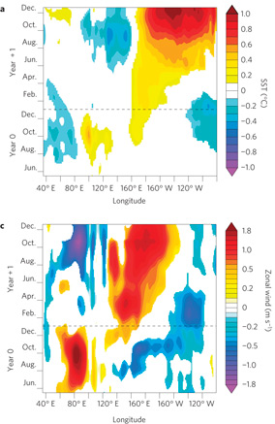
ENSO precursor: Indian Ocean Dipole (IOD)
Positive phase of IOD tend to co-occur with ENSO
Izumo et al., Nature Geoscience, 2010
SSTa
Zonal wind
Negative phase of IOD lead ENSO (~14 months).
What happens here?
Notes:
a, Lag-correlation between IOD (in September–November of year 0) and ENSO indices (dashed lines indicate the 95% confidence limit).
Observations and model analyses give insights into the mechanism responsible for the influence of IOD phase on the subsequent year’s ENSO conditions, discussed here for the case of El Niño development. Figure 2 shows the observed Indo-Pacific signature of a negative IOD (the synchronous ENSO influence has been regressed out, see the Methods section). During a negative IOD, the southeast Indian Ocean experiences a warming peaking in October (Fig. 2a). At the time of the IOD peak, the western and central Pacific also experiences increased easterly winds (Fig. 2c). These easterly anomalies favour the build-up of warm water^{11, 12, 13, 16, 17} in the western Pacific (Fig. 2b), providing an efficient preconditioning for El Niño to develop. After November, the eastern pole of the IOD quickly recedes⁴ (Fig. 2a–c). This induces a quick collapse of the anomalous easterlies in the central Pacific (Fig. 2c) followed by El Niño development (Fig. 2a–c).

Slide 8
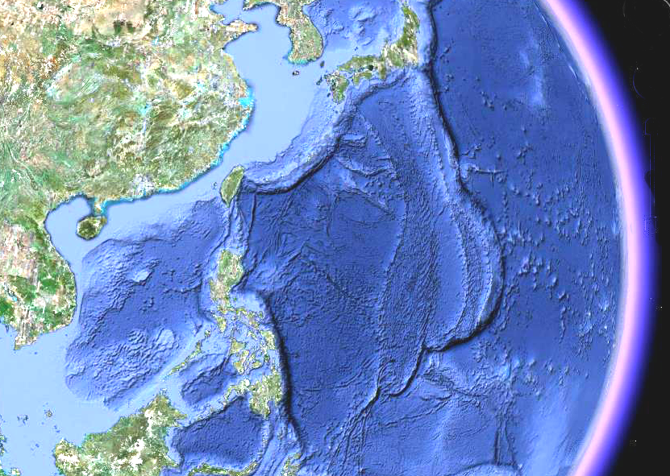


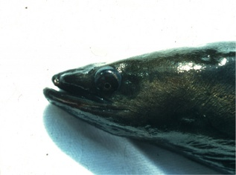
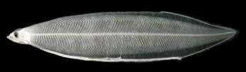


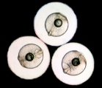
Migration of the Japanese eel
El Niño
Less recruitment to coast. habitats in Japan
[Kim et al., 2007]
China
Korea
Japan
Growth Habitat
Kuroshio Current
Taiwan
El Niño
Transport to Kuroshio
<< to Mindanao Curr.
[Kim et al., 2007]
Silver eel
Breeding Habitat
West Mariana Ridge
North Equatorial Current
(NEC)
El Niño
NEC bifircates more northward, Kuroshio: smaller transport
Mindanao Curr. : larger transport
[Qiu and Lukas, 1996]
Mariana Trench
Mindanao Current
[Tsukamoto, 2009])
Notes:
8
8
The eel loop is not complete. Where the eel eggs come from?

Slide 9
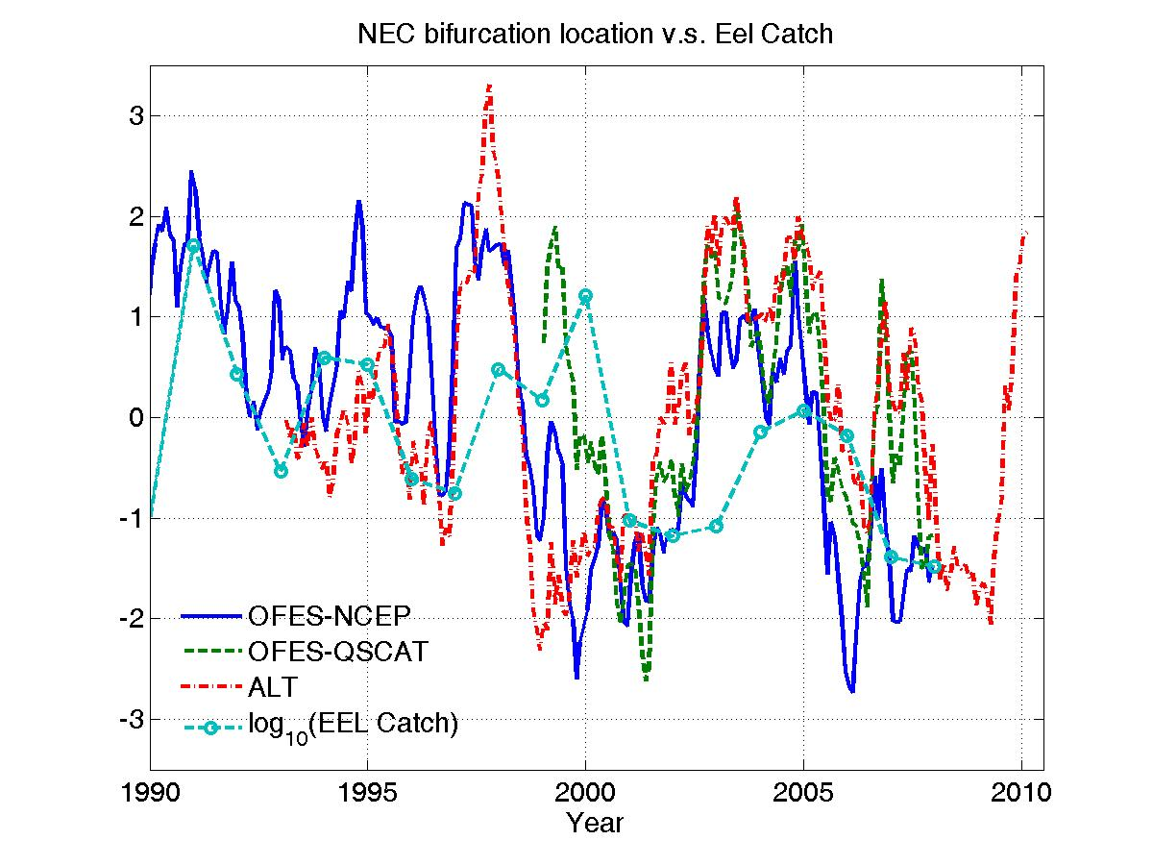
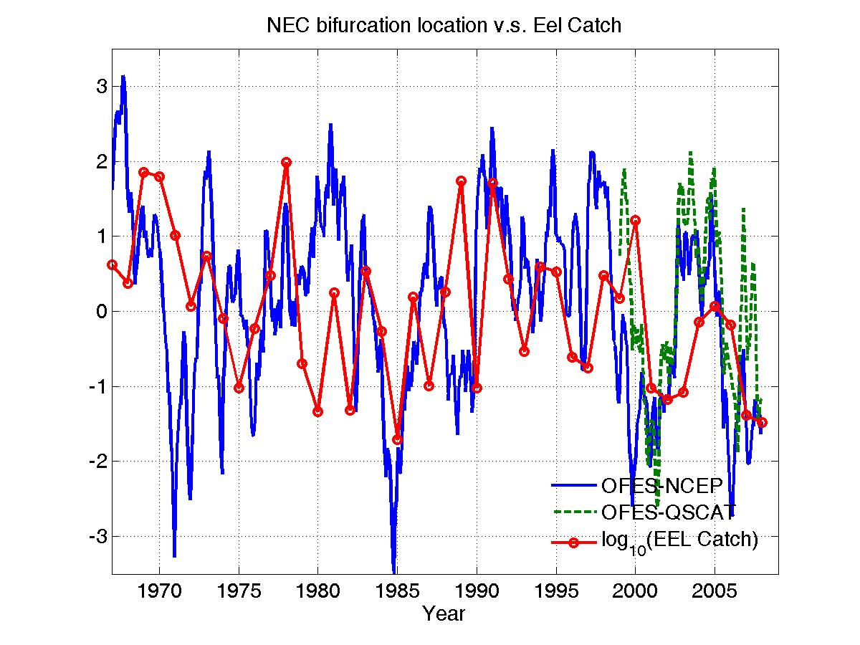
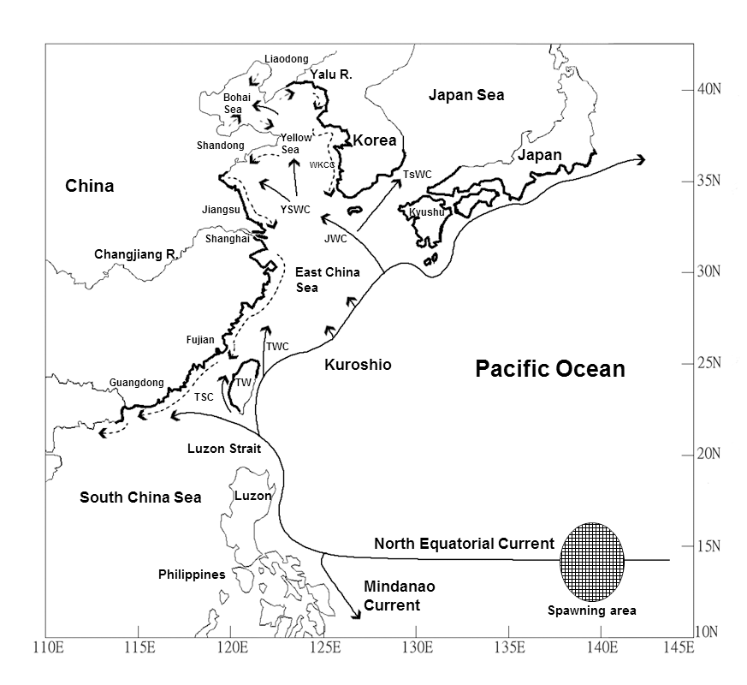
Recruitment of the Japanese eel
Tzeng et al. (2012); Han et al. (2012)

Slide 10
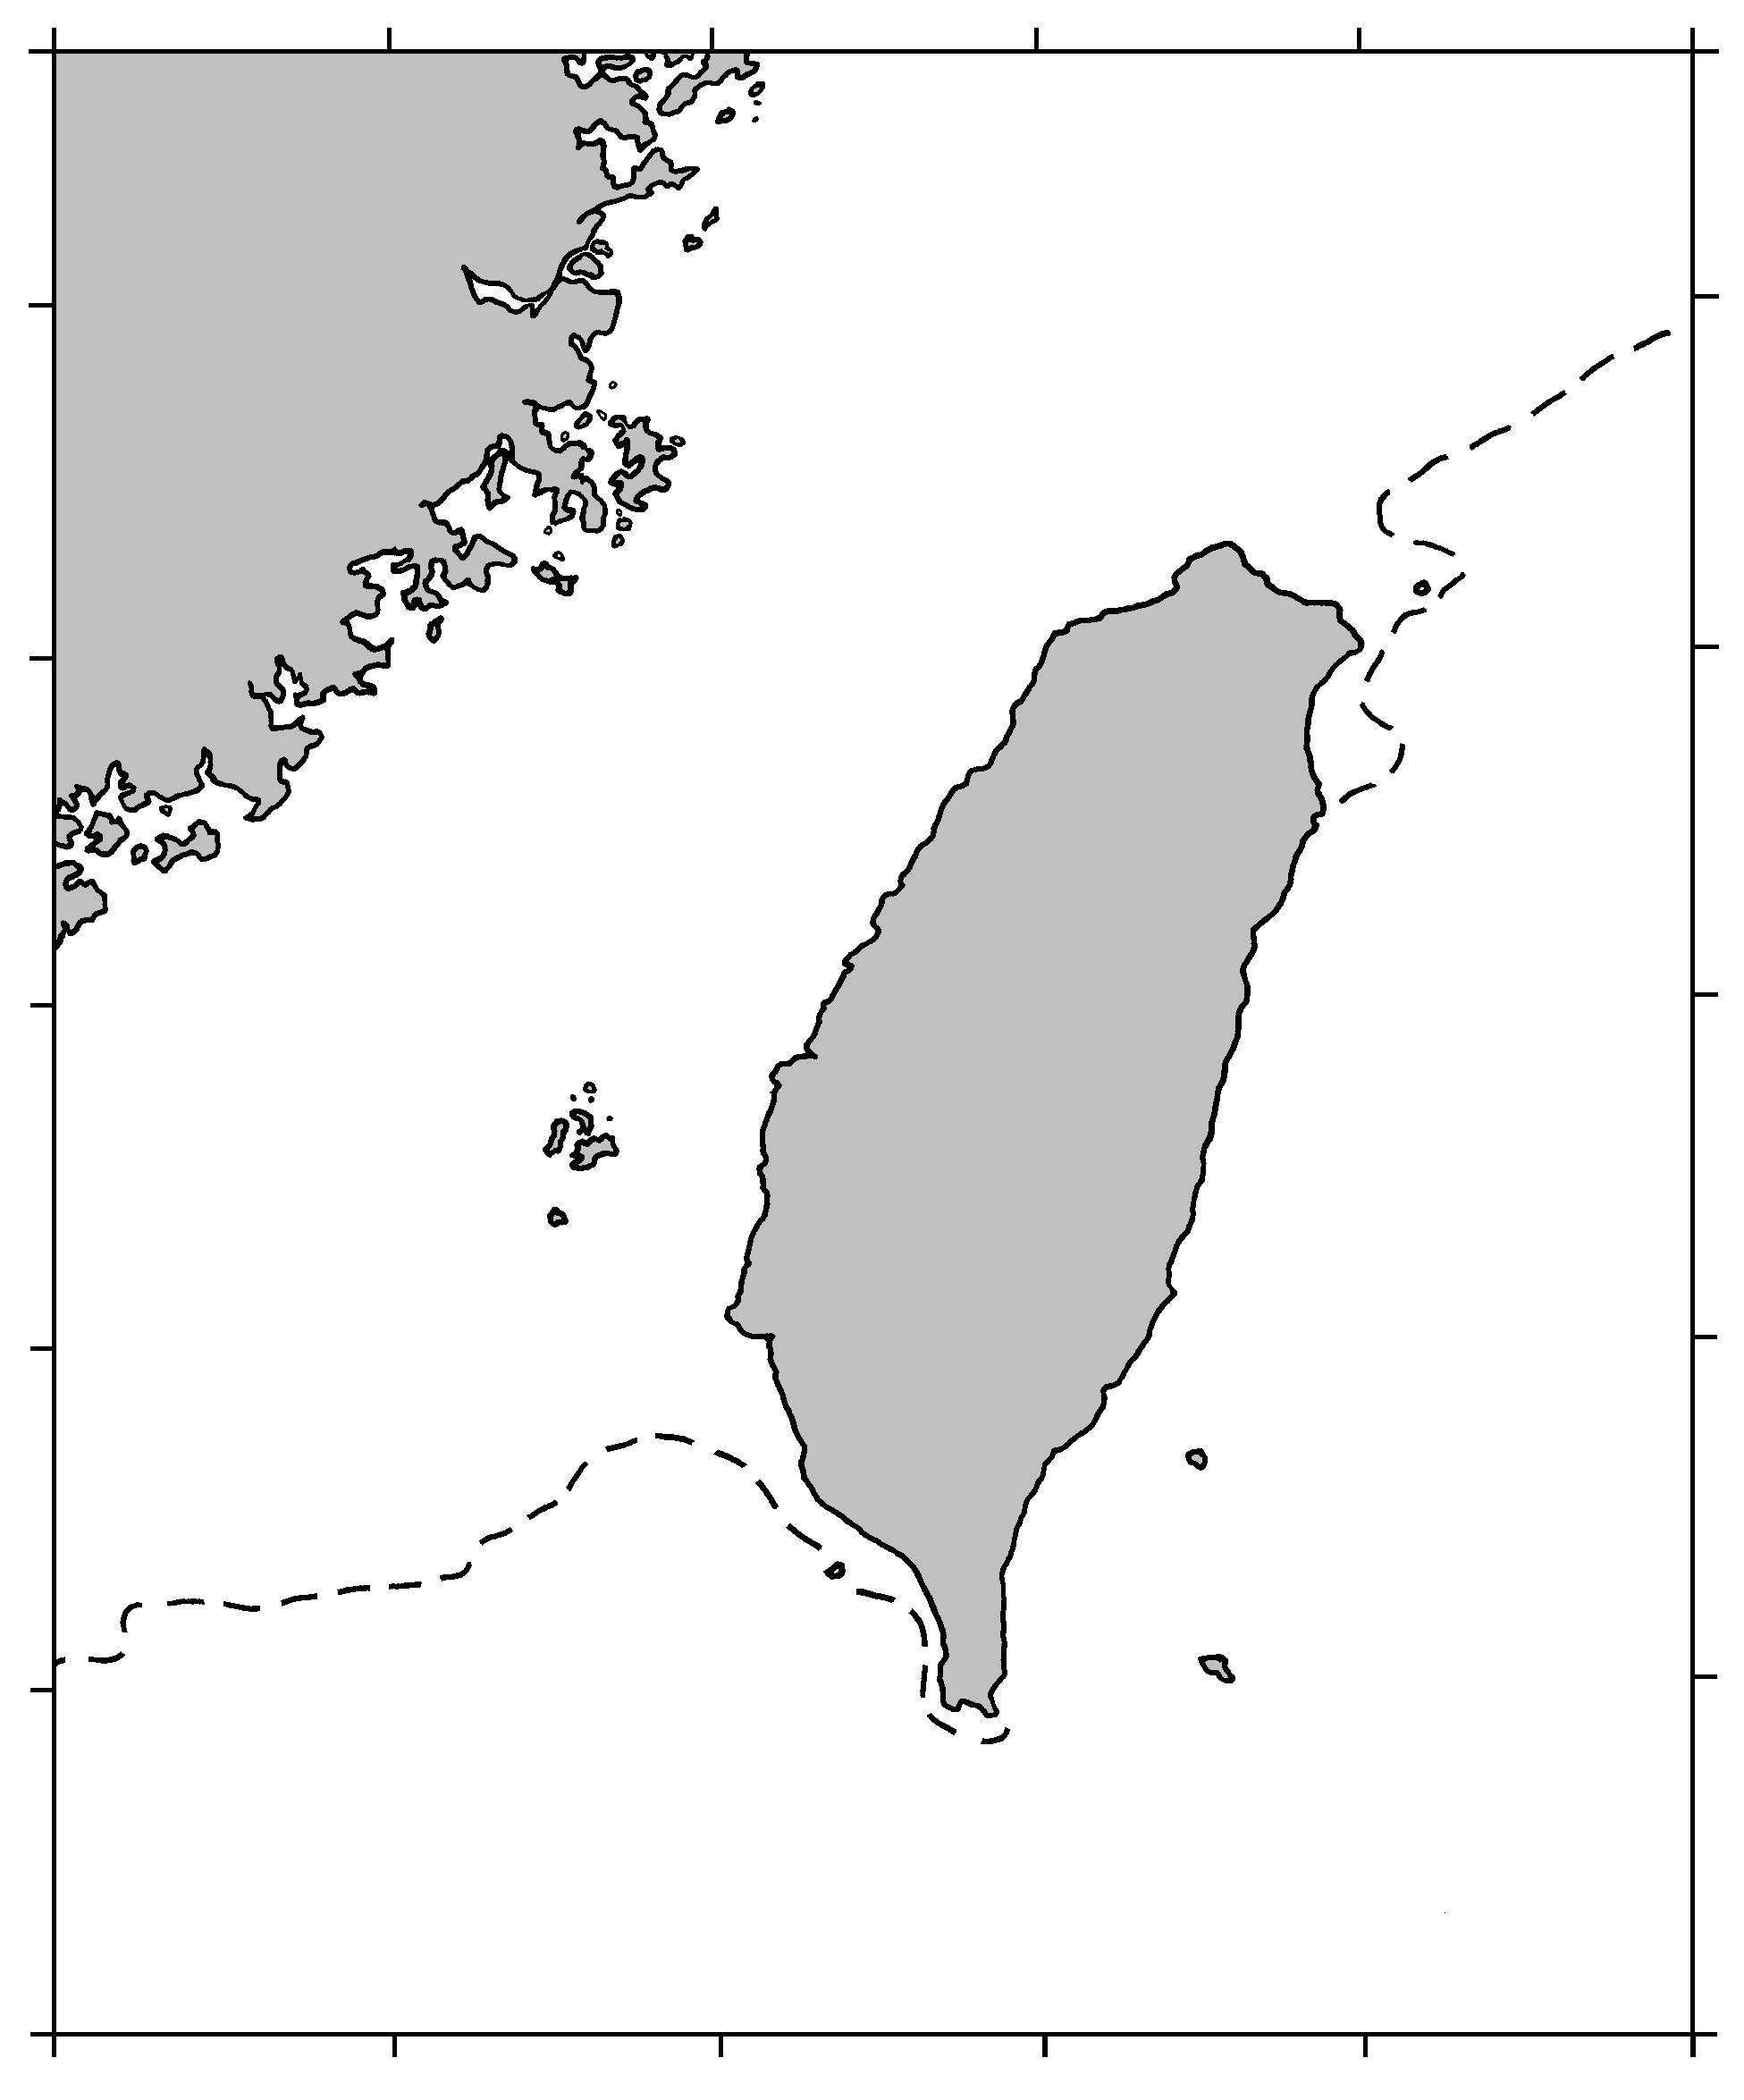

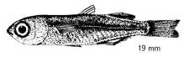
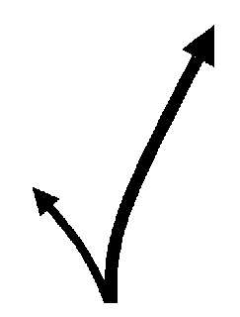
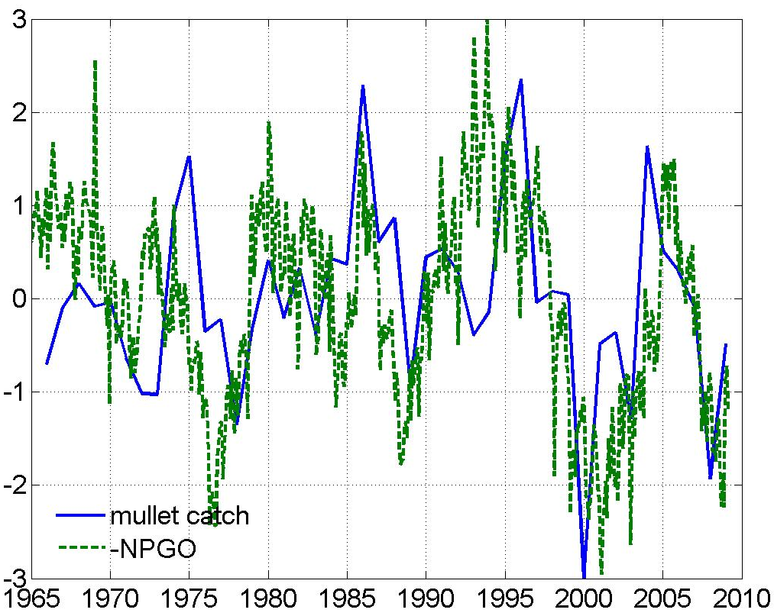
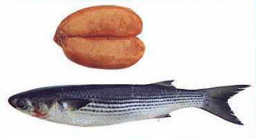
Mugil cephalus (Coastal fishes)
Life cycle and migration
Good correlation between interannual mullet catch and NPGO
Feeding ground
China
Coastal
Nursery gr. (Oct ~ Mar)
Current
TAIWAN
Spawning gr.
(Oct. ~ Jan.)
Kuroshio
current
550 mm
Aquaculture
Notes:
?

Slide 11
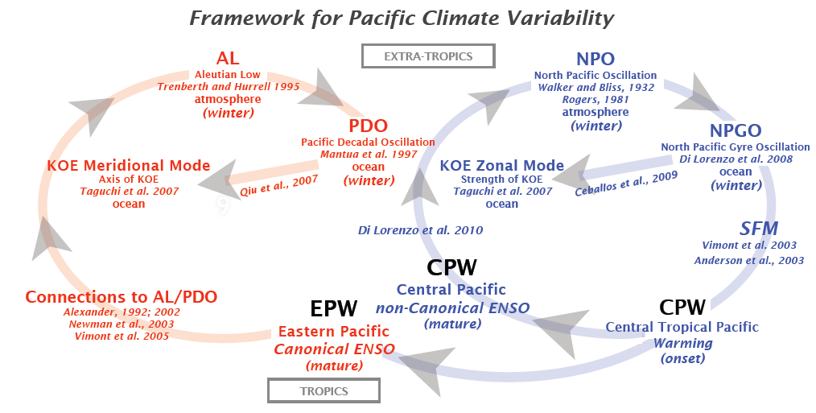
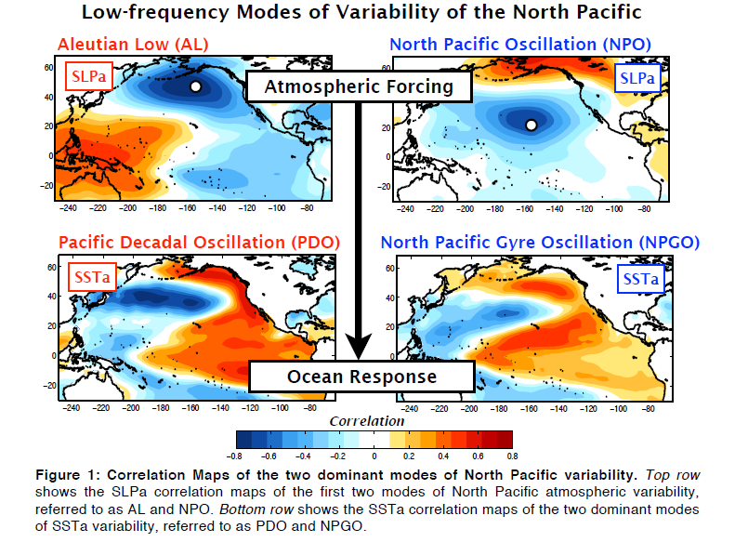
An overview of Pacific Climate Variability
by E. Di Lorenzo et al.
Is this completed and correct?
Warm SSTa propagate into the central tropical Pacific (SFM)
then initiates an ENSO response in the tropics.
[http://www.o3d.org/npgo/docs/Decadal-Intro.pdf]
Notes:
the Seasonal Footprinting Mechanism: boreal winter-time variability in the NPO drives warm SST anomalies in the North Pacific that
propagate into the central tropical Pacific by end of spring/summer through the
wind/evaporation/SST (WES) feedback.

Slide 12
Scientific Issues
Are they really independent?
1st mode
2nd mode
Is CPW really the onset?
What’s the link between CPW and EPW? (i.e., links between two types of ENSO)
Notes:
The dynamic process linking CPW→NPO (atmosphere), or CPW→NPGO (ocean), is unsure in the Western North Pacific.
Our hypothesis is that, the process from “CPW →South China Sea (or Tropical Warm Pool)→NPGO (or NPO) ” should play an important role in the Pacific Climate Variability also.
A major Key: To find the ENSO precursor.

Slide 13
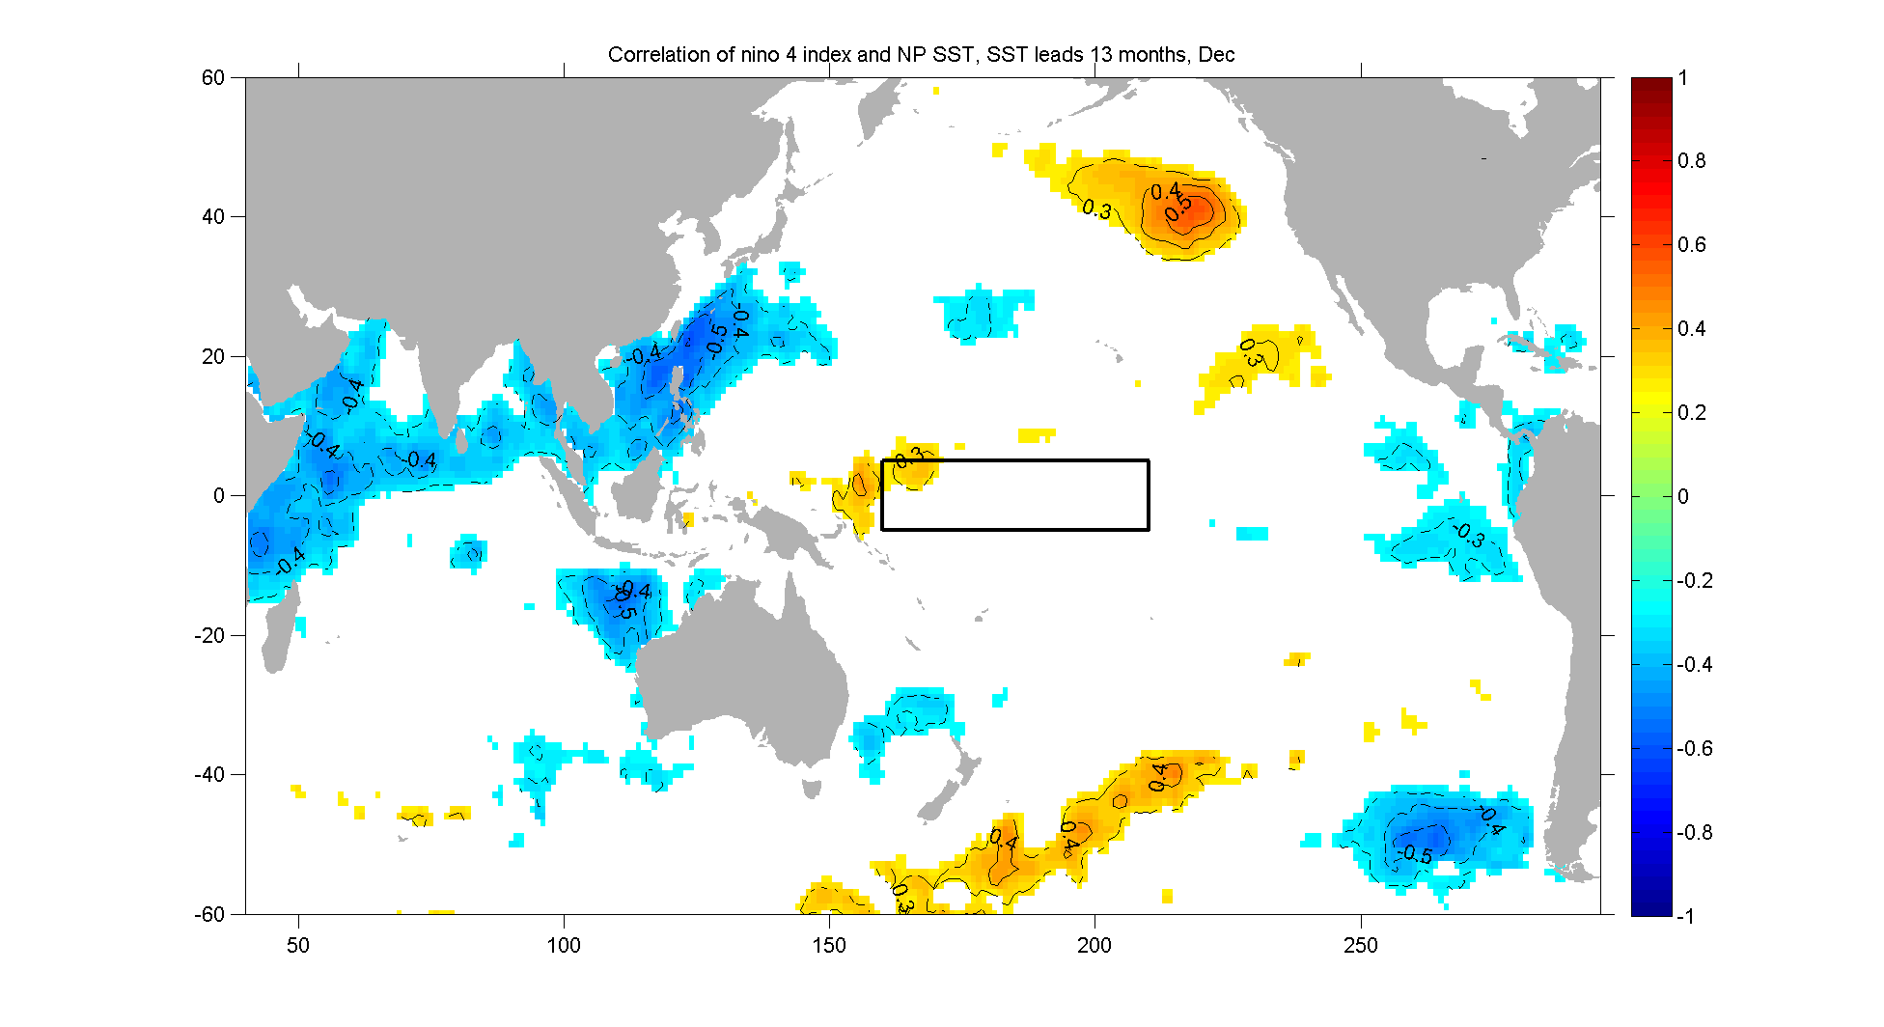
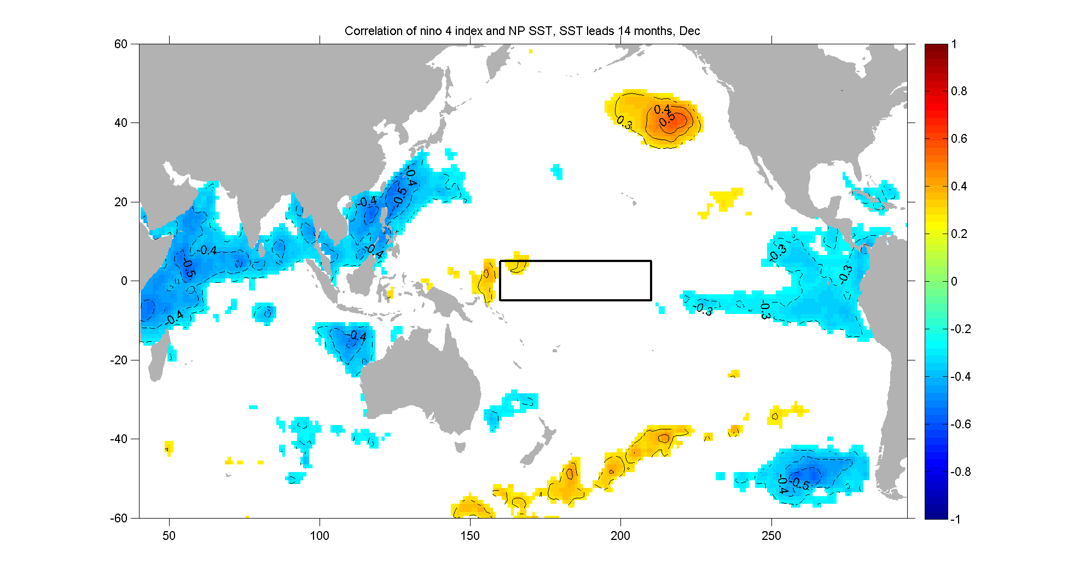
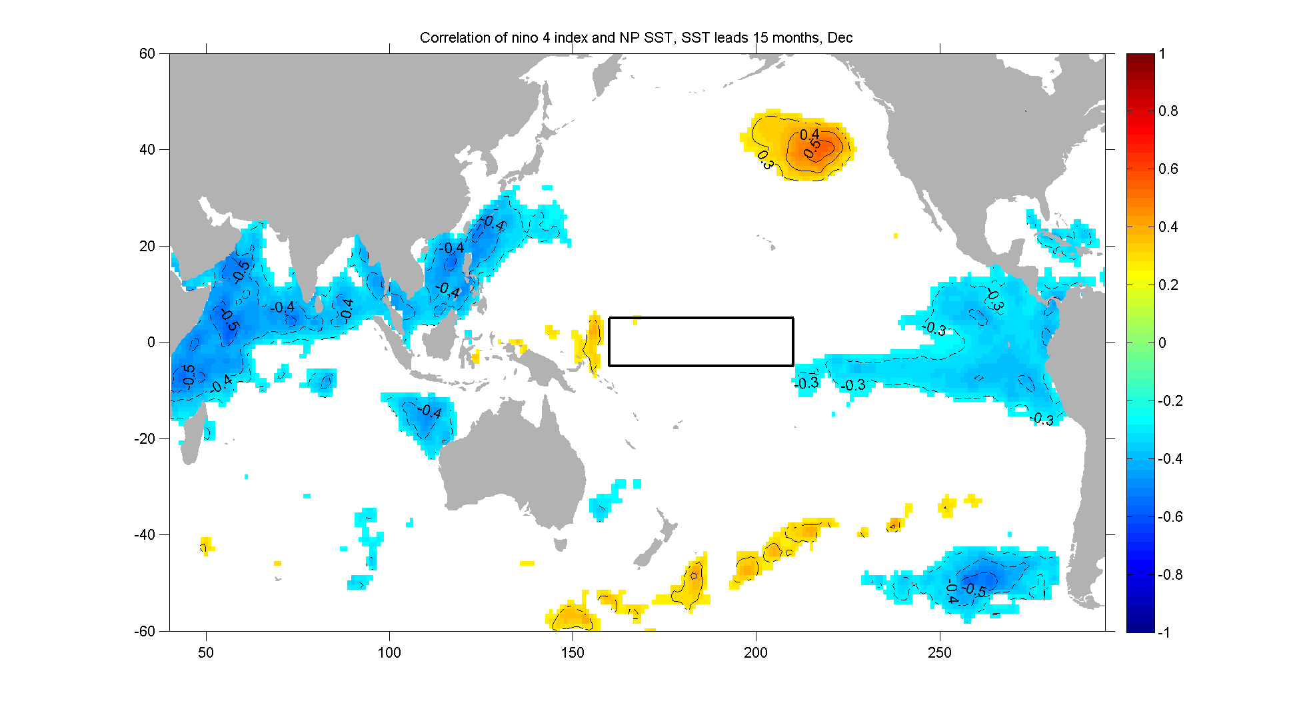
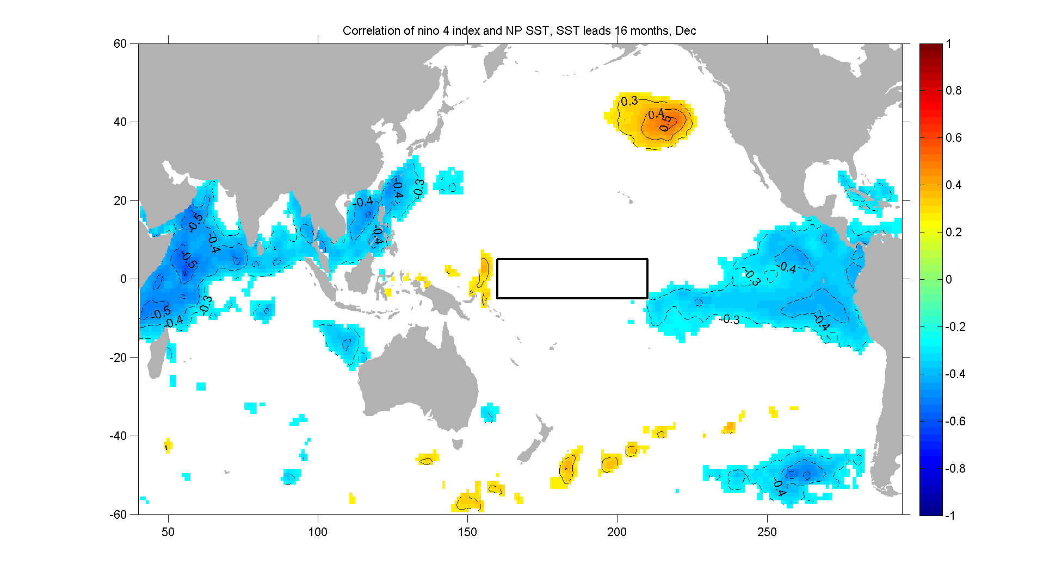
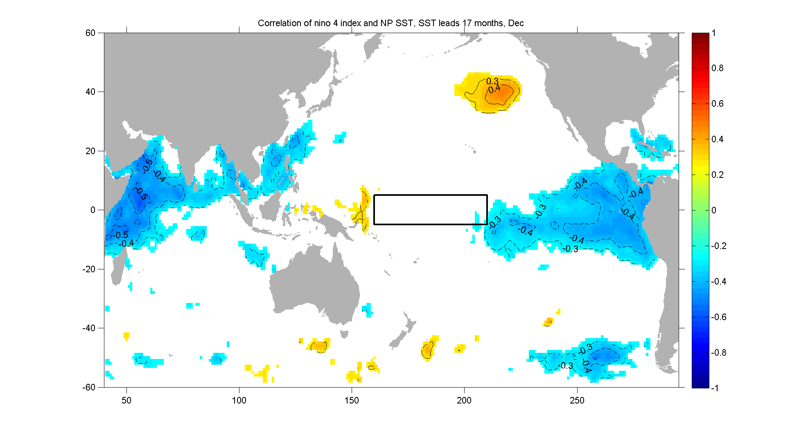
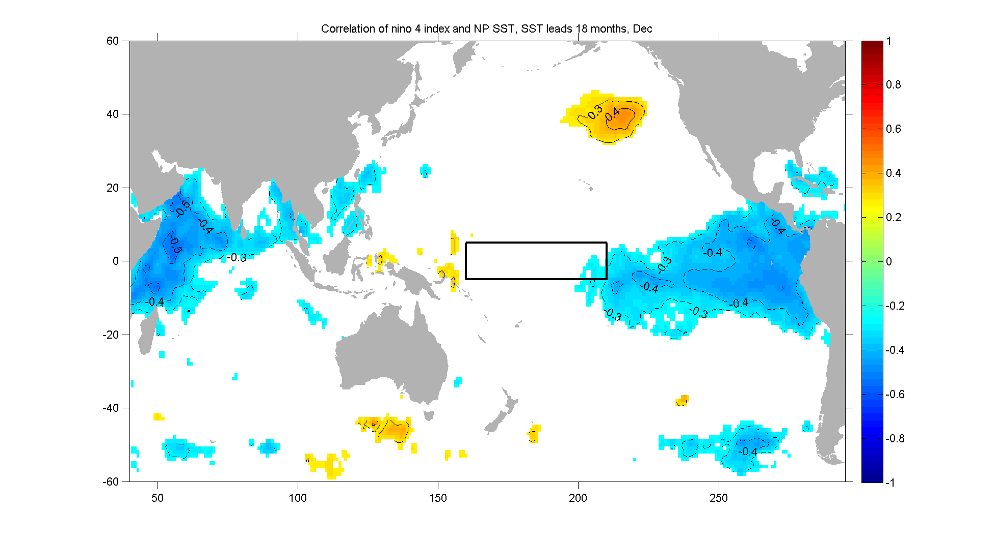
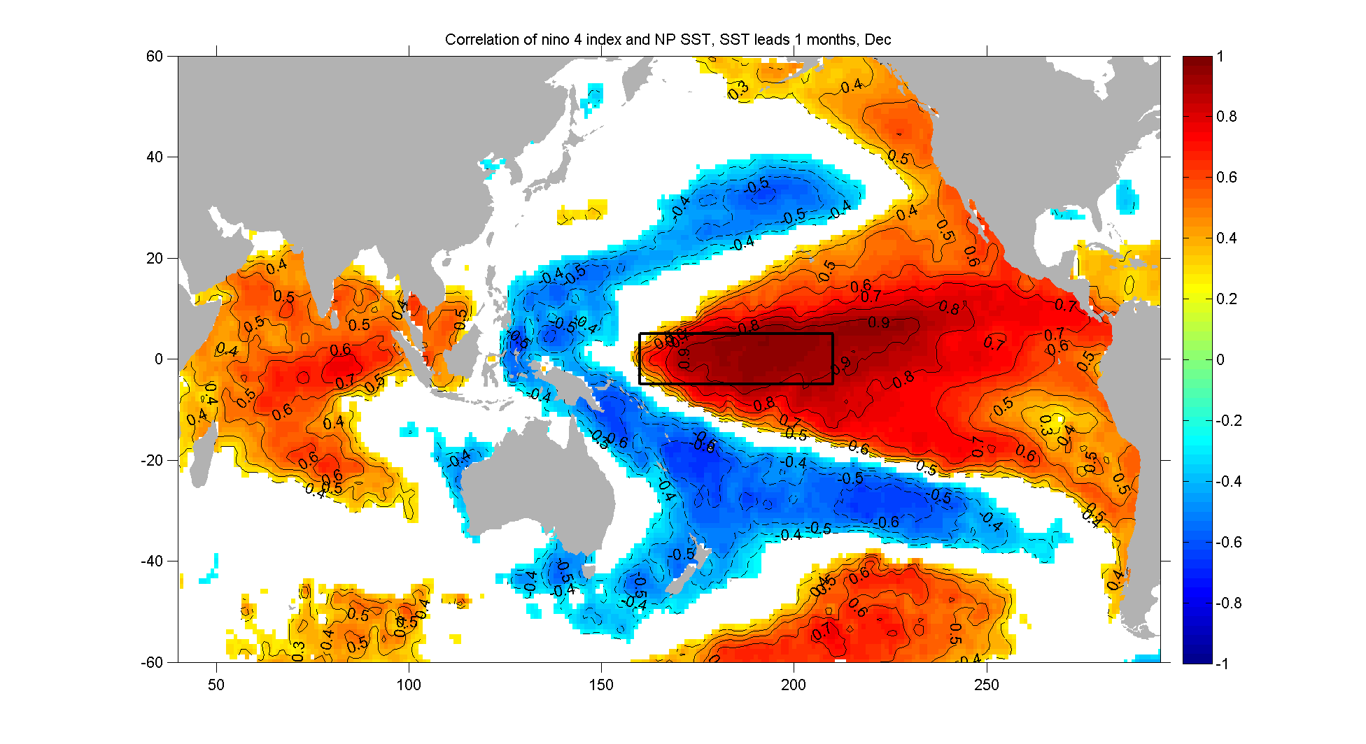
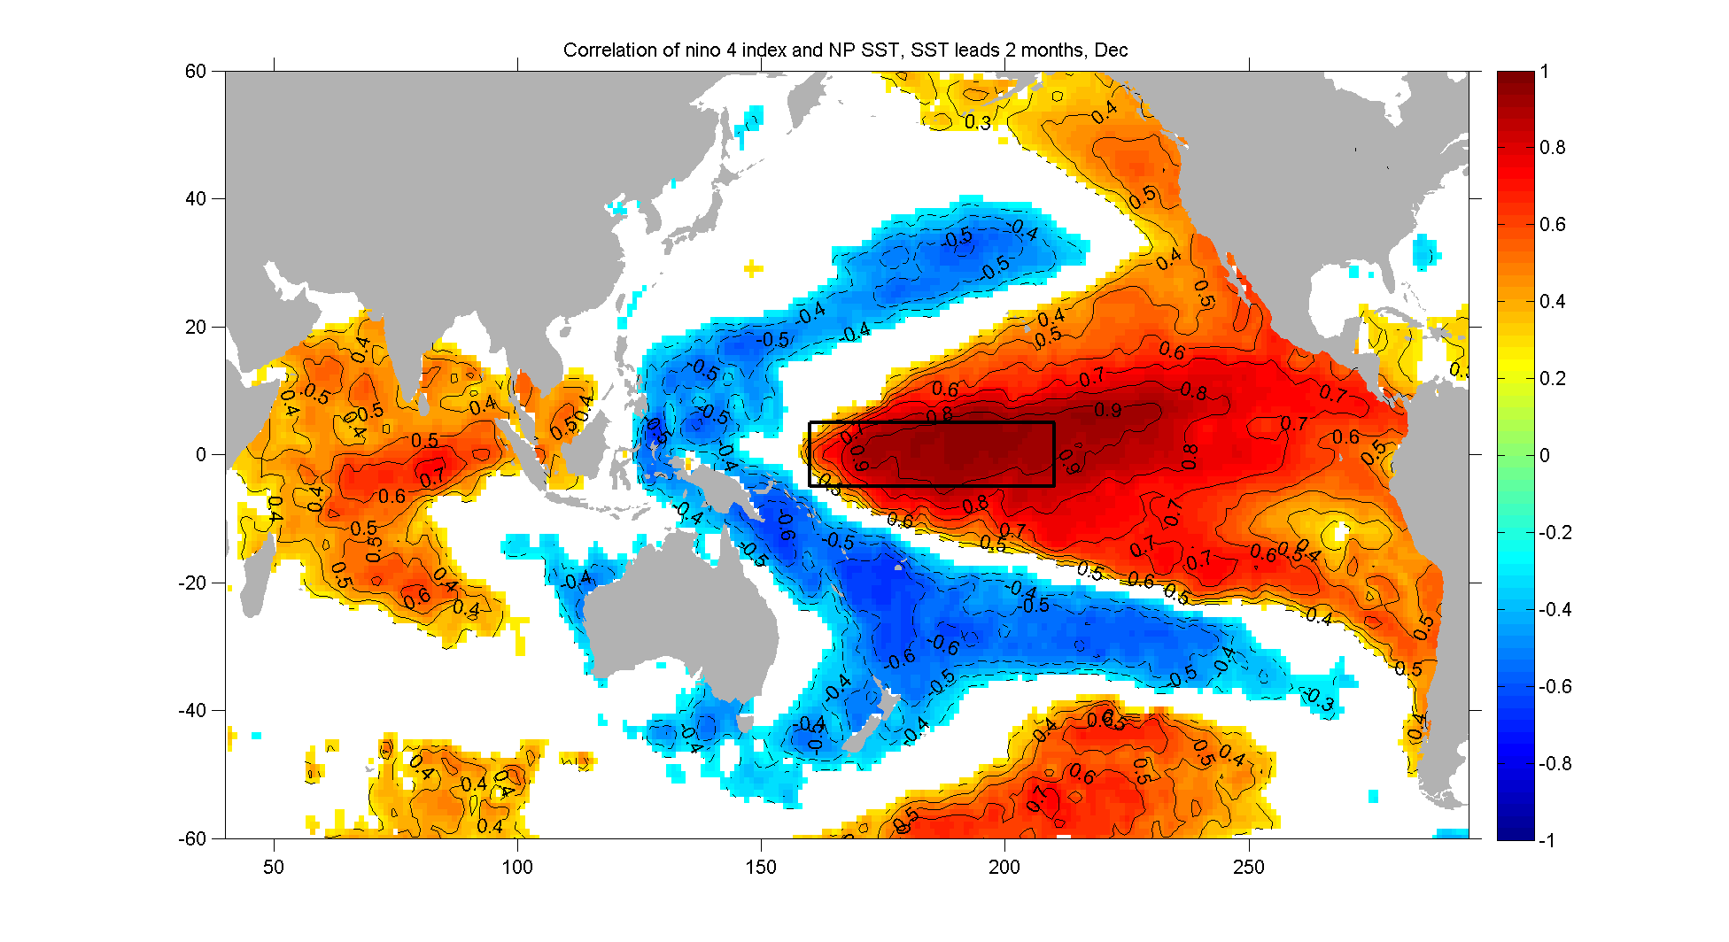
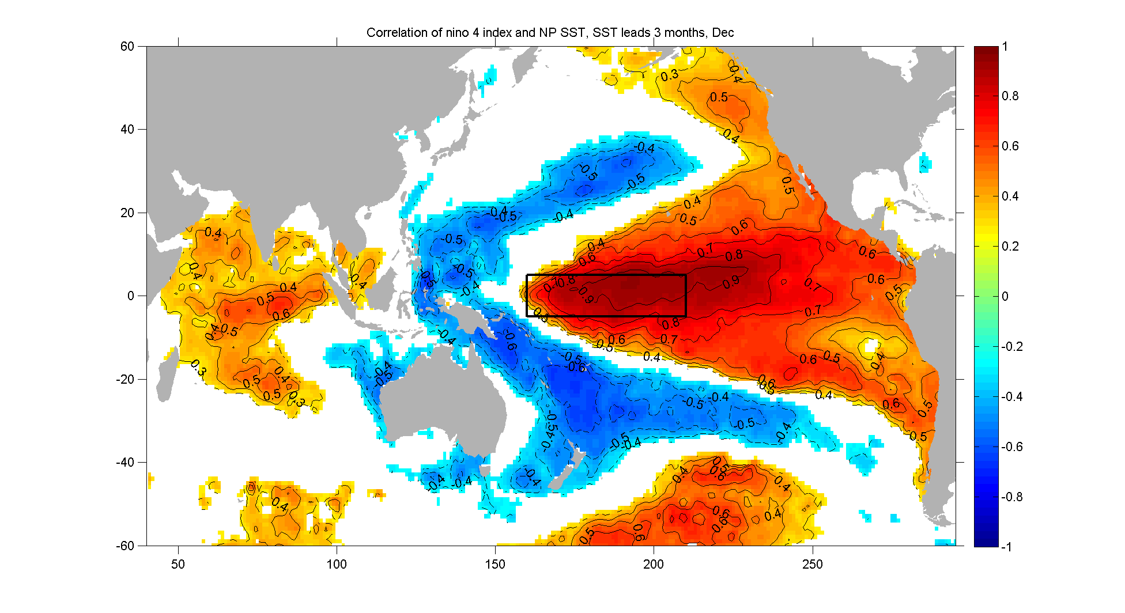
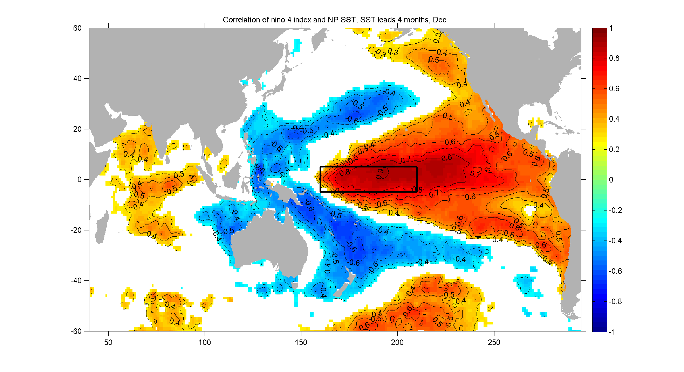
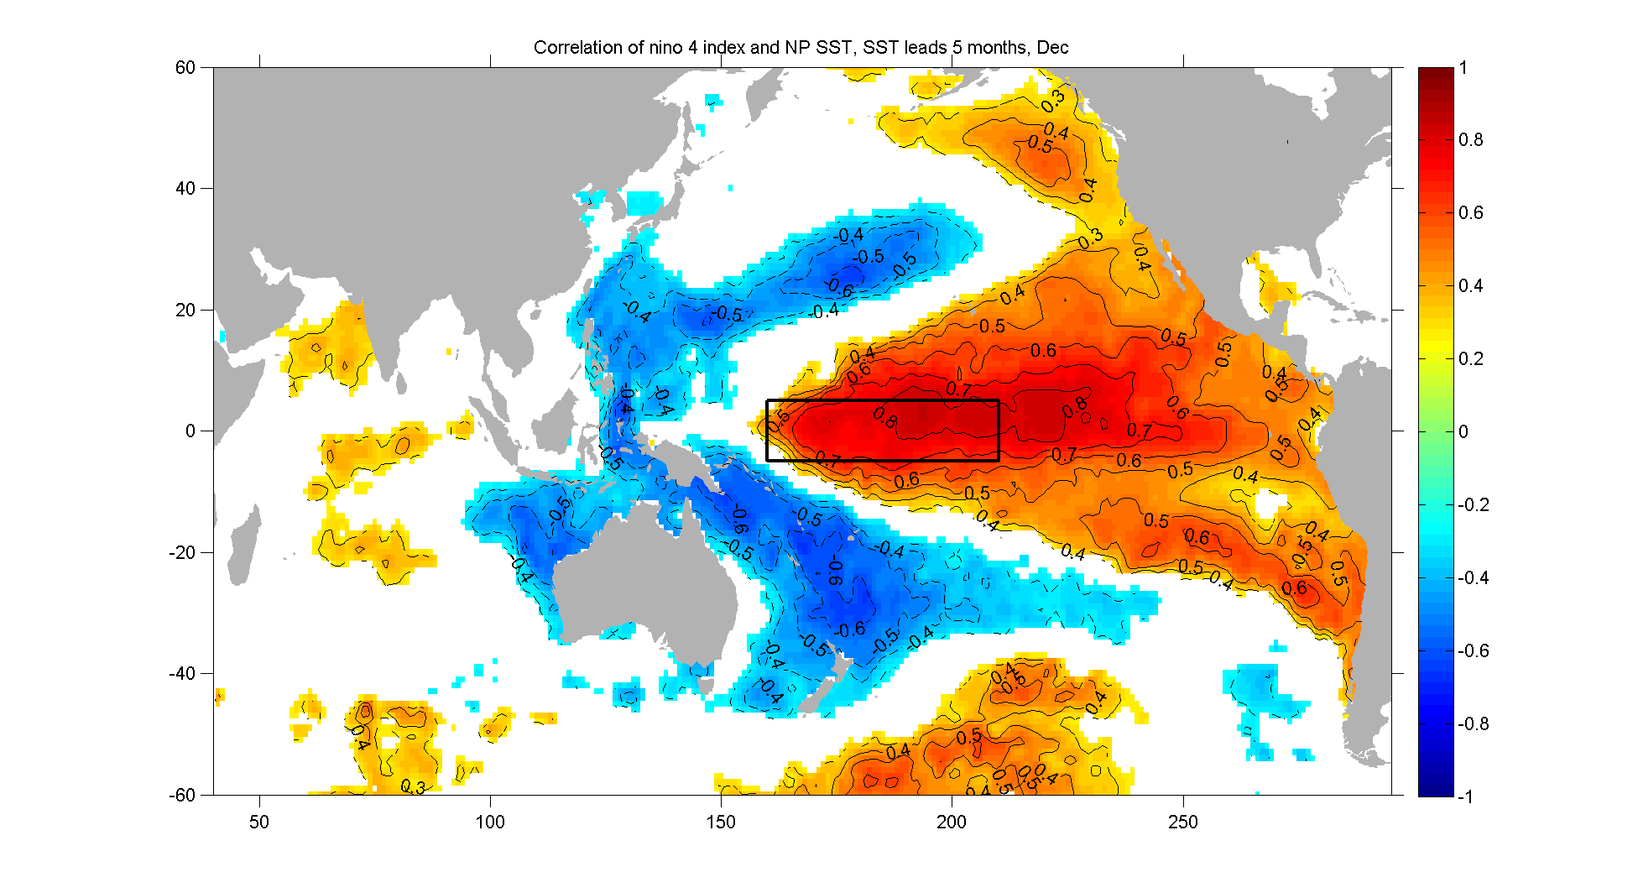
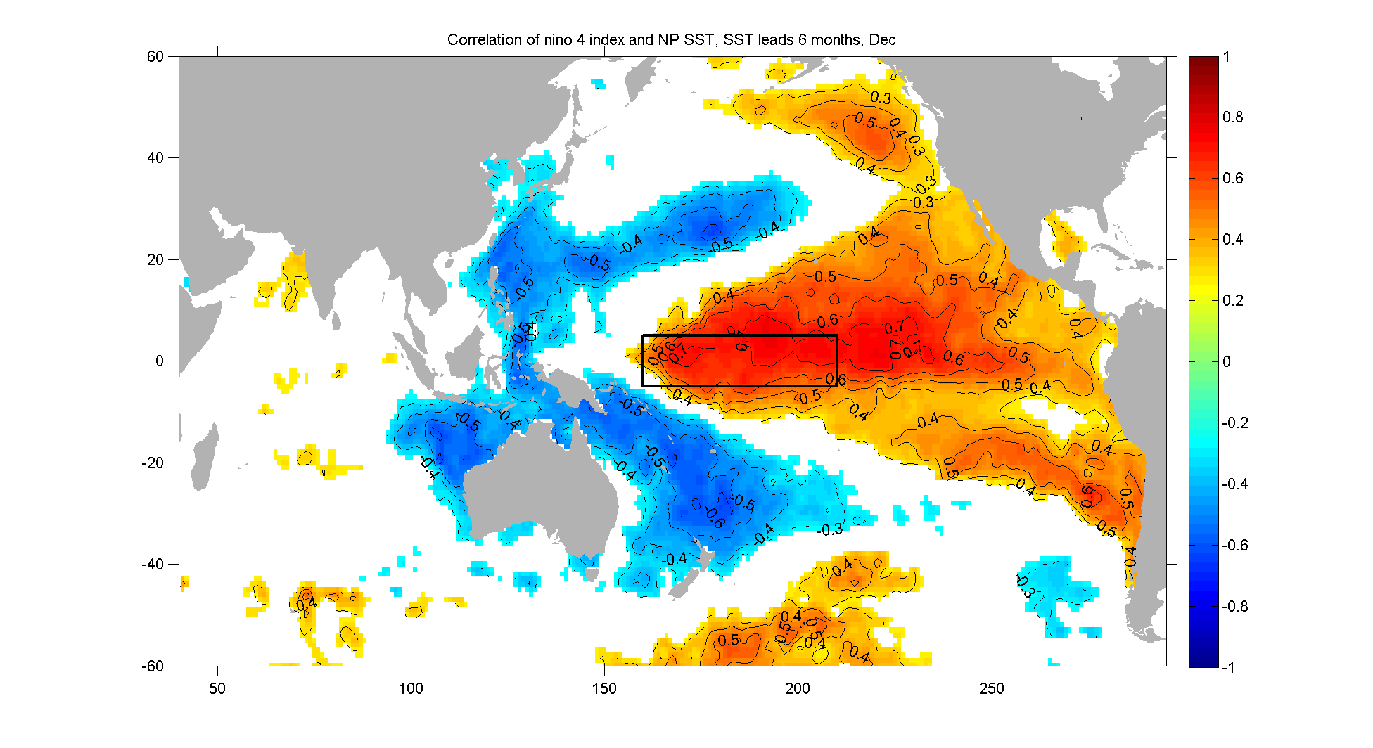
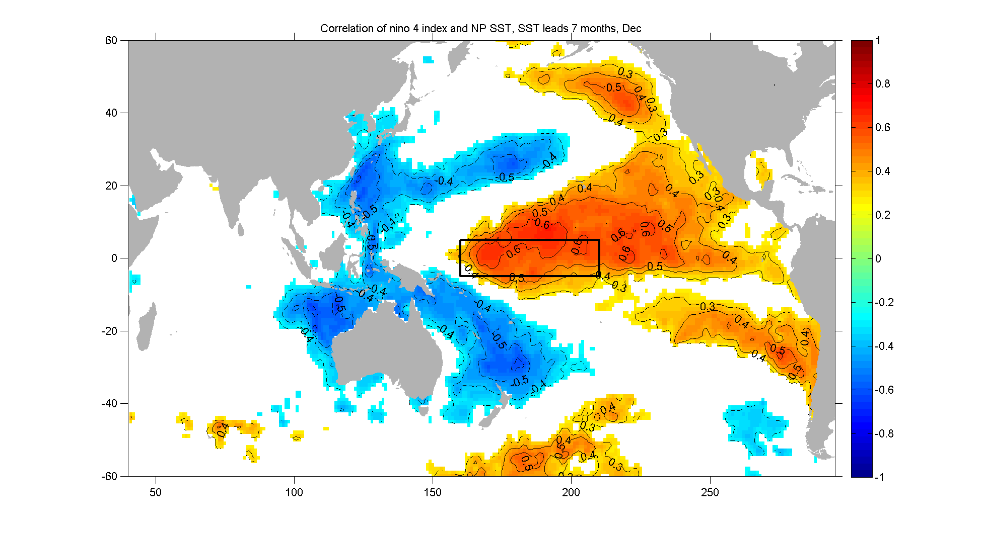
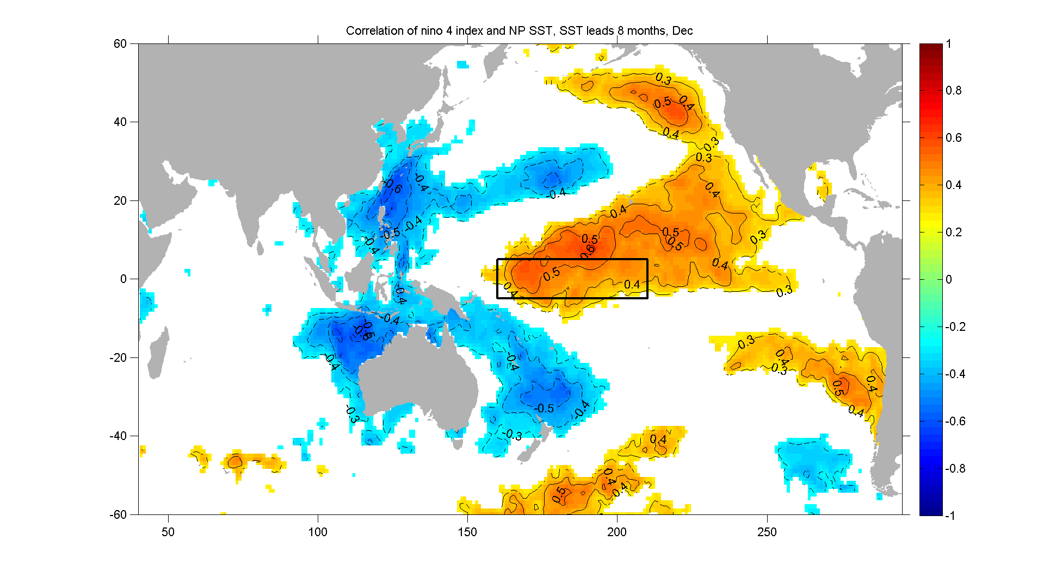
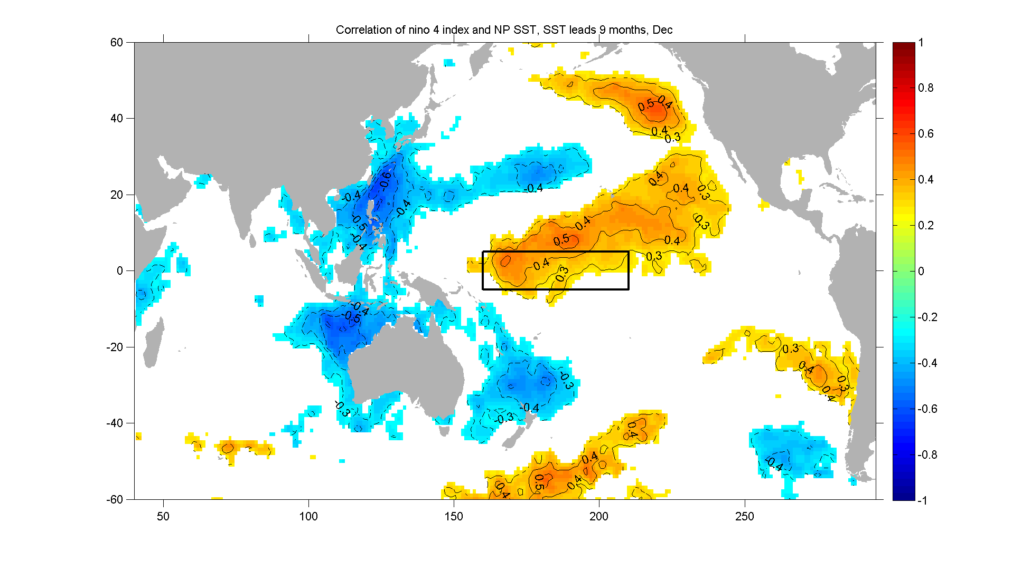
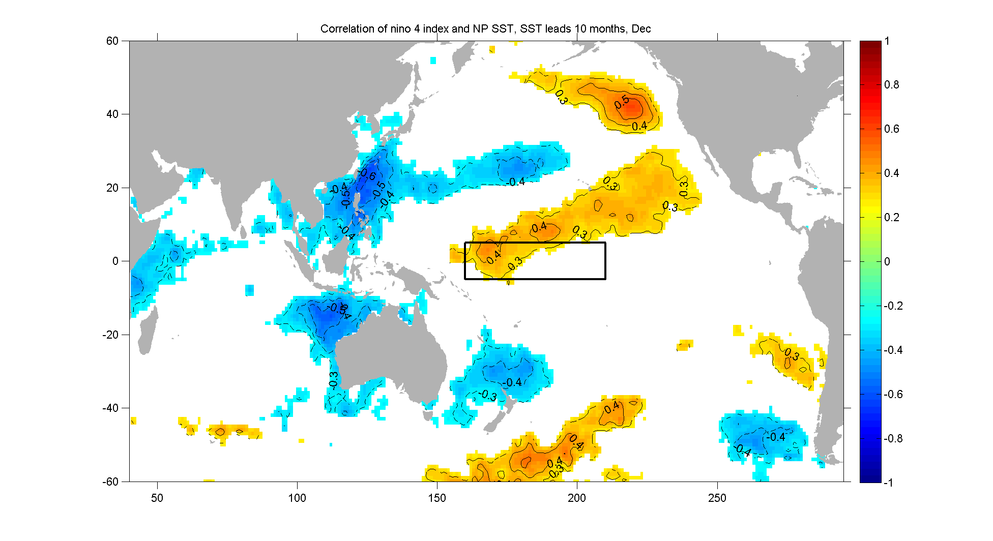
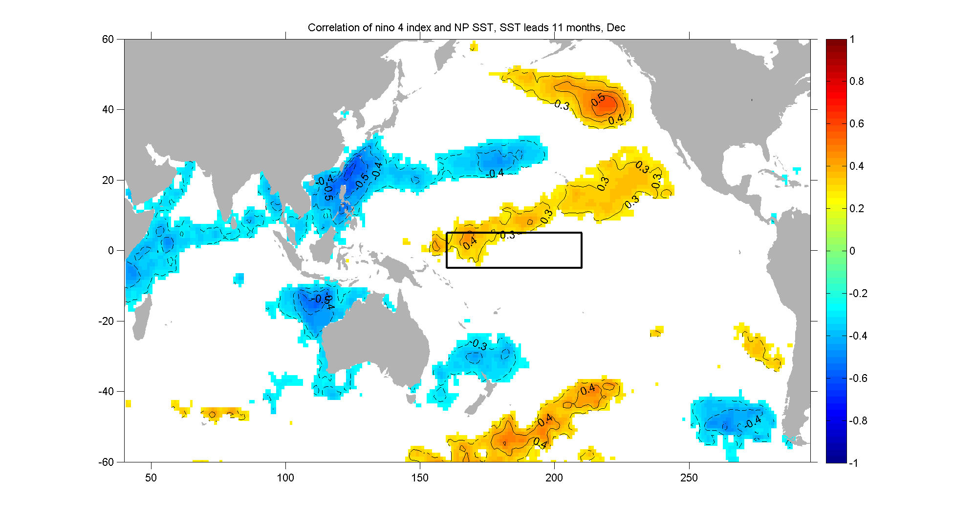
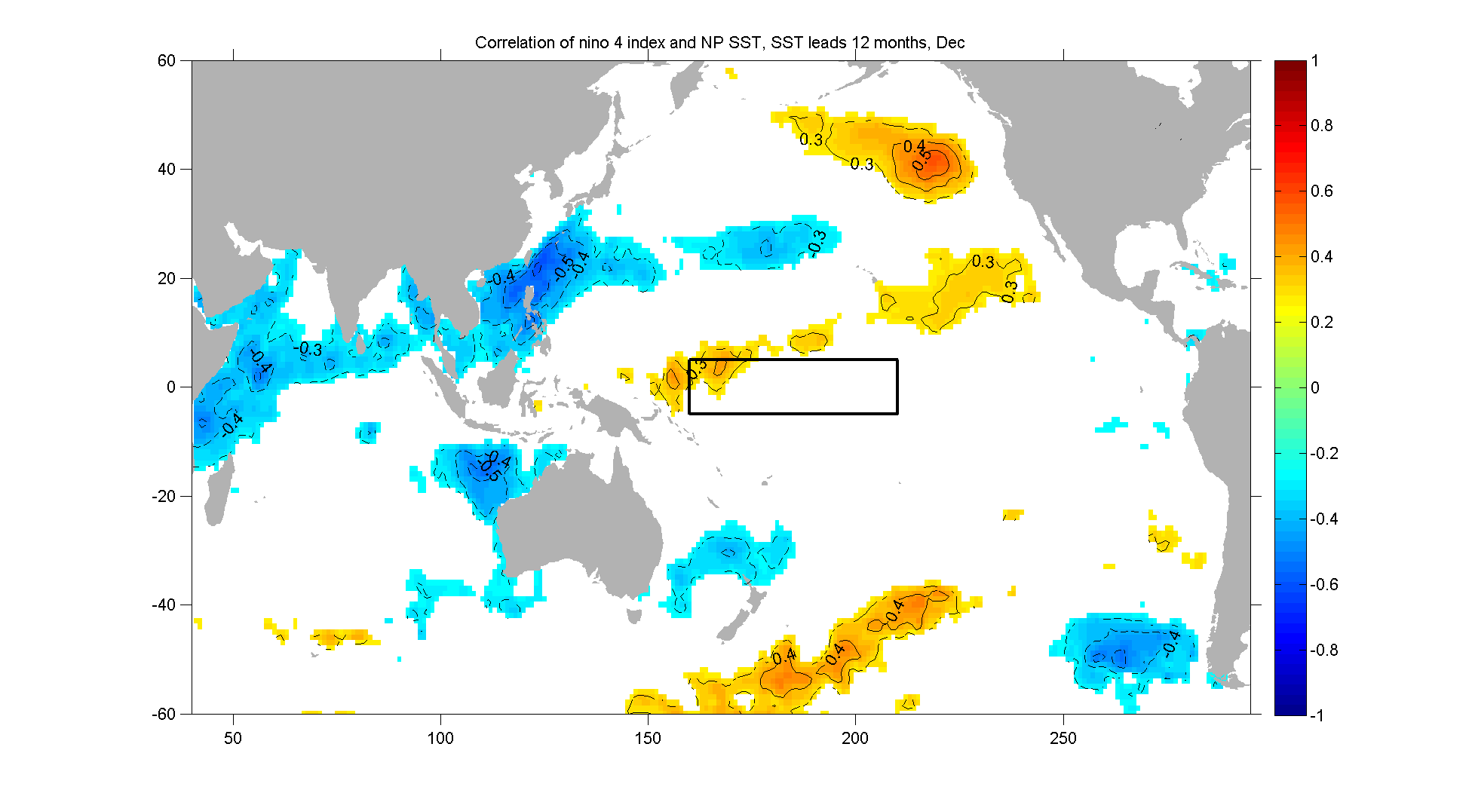
Correlation Maps of Nino 4 index v.s .
SST in Dec (Pacific and Indian Oceans)
Nino 4 region
How and why?
Notes:
Two type of ENSO

Slide 14
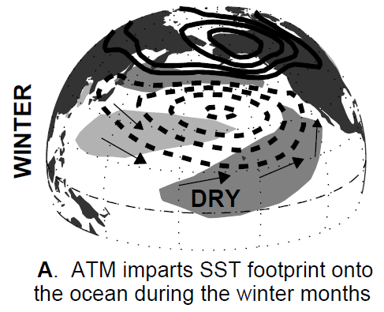
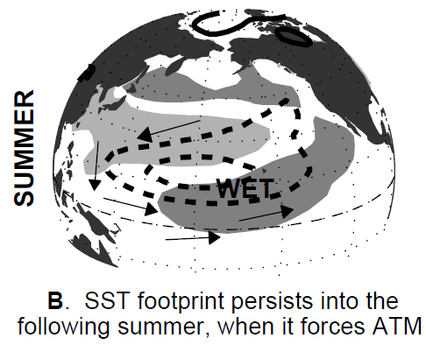
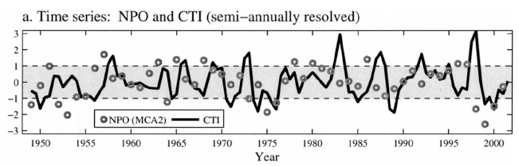
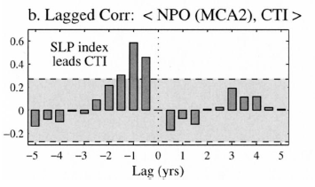
Seasonal Footprinting Mechanism
[Vimont et al., 2001, 2003]
Notes:
圖5.10 (a)在北半球冬季時，北太平洋震盪(NPO)使北太平洋具氣旋式環流風場，加強阿留申低壓和中緯度的西風，改變太平洋的海溫分布，使北太平洋海表面溫度場西冷東暖，東邊較暖的海表面溫度南端會因為異常的西南風減少此區表面淨熱通量，使此區海溫增加(b)在接下來的春夏，暖海溫距平延伸至更低緯地區，透過Bjerknes’s feedback，使赤道地區海溫更暖。(Vimont et al., 2001)
圖5.11 冷舌指數(CTI, cold tongue index)與北太平洋震盪指數(NPO index)的(a)時間序列(b)相關性。(Vimont et al., 2003)

Slide 15
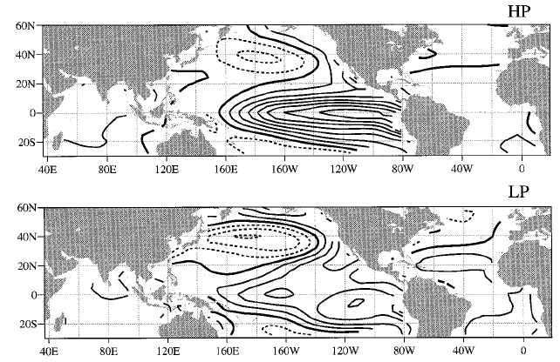
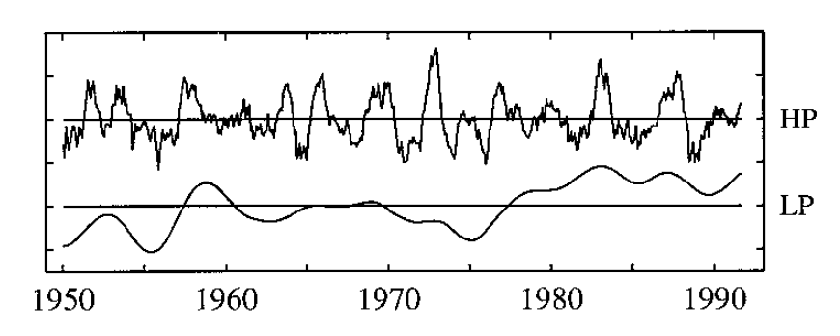
Leading (normalized) PCs of SST
Zhang et al. [1997]
6-yr highpass-filtered SST
ENSO pattern
6-yr lowpass-filtered SST
Decadal pattern
ENSO-like pattern
or
Notes:
Zhang在1997年研究利用濾波的方式分出ENSO和年代際pattern
HP呈現出ENSO的pattern，主要中心在赤道部分；LP呈現出年代際的特徵，他在空間上的特徵非常類似ENSO，所以又被稱為ENSO-like，但是他的主要中心在北太平洋區域
從時間序列可以看到HP表現出ENSO cycle，LP表現出低平的年代際變化。

Slide 16
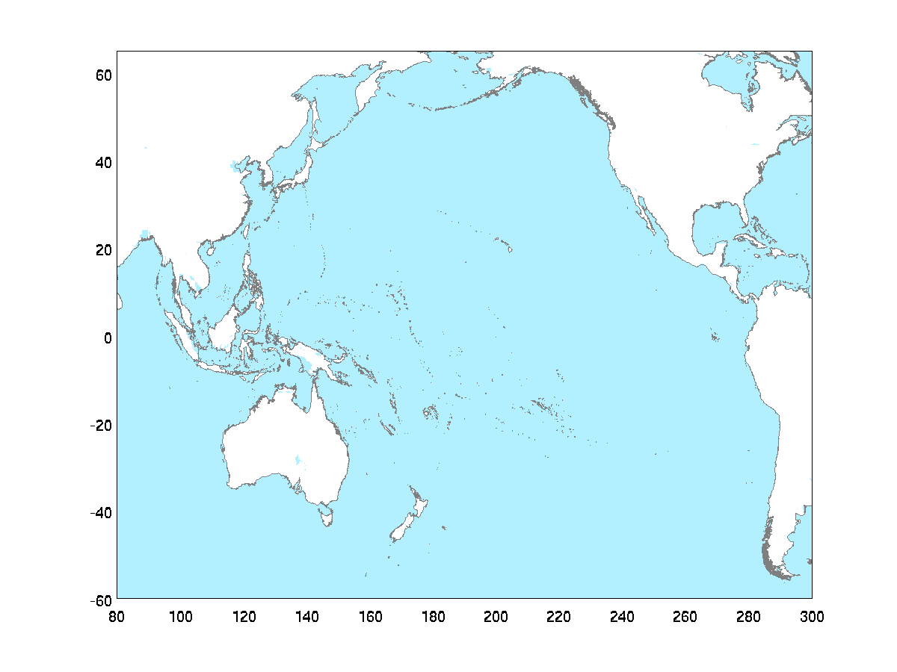
Dyn. proc. from ENSO precursor to ENSO
Equatorial winds may
affect the western eq. Pacific Kelvin wave.
[Wang et al., 2012]
NPT/NPO/NPGO
Tropical-extratropical Interact. (ATM-OCN)
WNP
cold SSTa
??
SFM [Vimont et al., 2003]
Perturb. (heat source) in the Indo-Pac. (e.g., SCS)
CP ENSO
EP ENSO
IOD
Ocean Dynamics
Indian Ocean Equat. Kelvin waves
→ western equat. Pacific.
[e.g., Yuan et al, 2011; Jin, 1997]

Slide 17
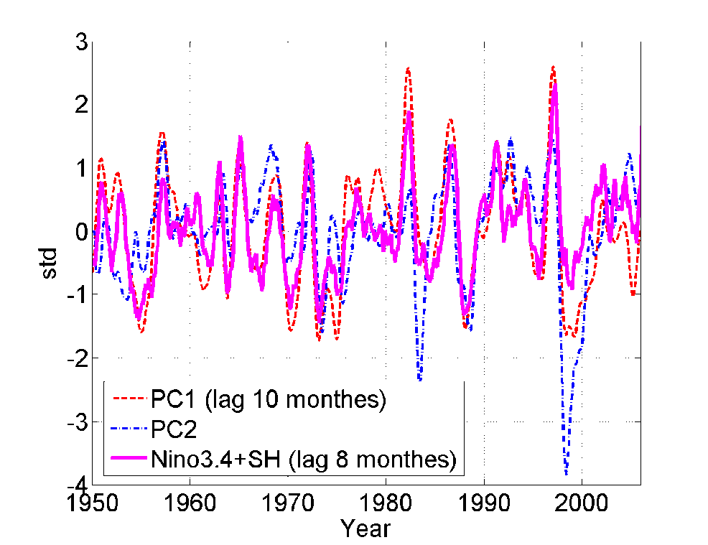
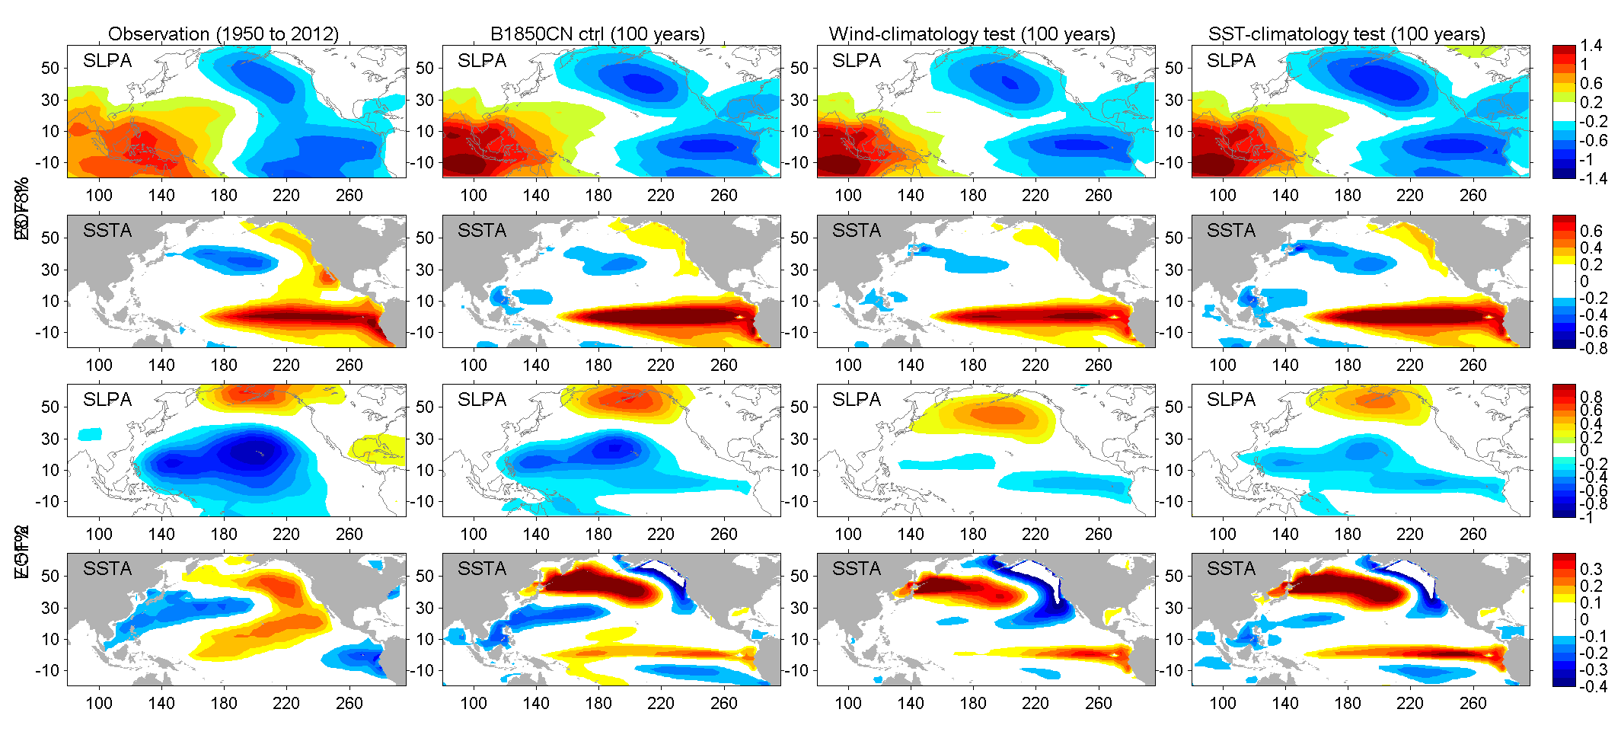
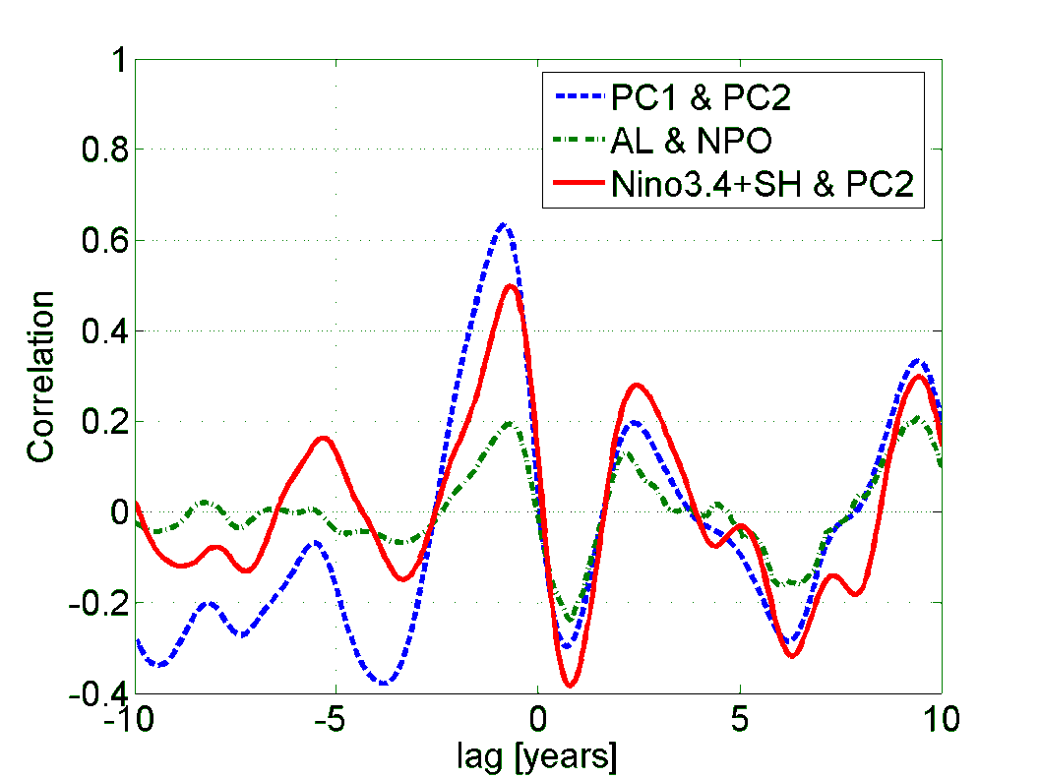
ENSO precursor: 2nd mode of NP SSTa+SLPa
CEOF1
CEOF2
Notes:
SSTa (PC2) is associated with El Nino-Modoki or CP ENSO
SSTa patterns (PC2) leads ENSO anomalies by ~8 months
SSTa patterns (PC2) leads SSTa patterns (PC1) by ~10 months

Slide 18


CESM EXPERIMENTS
100-year CESM coupled simulation
Preindustrial control
No interannual variability of wind on the ocean
No interannual variability of SST on the atmosphere
Control
Wind-variability removed
SST-variability removed
Notes:
Wind-stress magnitude std is 0.02 for all.

Slide 19
CESM EXPERIMENTS
Comparison of the two dominant modes in the obs. and models
Large missing structures
Notes:
This is used for interpretting PC2 → C index at the back. I suggest that the EOF of the two test should not be presented, or it will raise up a lot of confusing.
NP mode1 and mode 2 (observation v.s. model) spatial distribution. Try SST, SLP and combined SST SLP (like what Di Lorenzo did). Maybe we need to do 13 month running {we have used 9 month, but we are using 3-mon now} average for the time series.
The spatial patterns of the 1st and 2nd modes of the combined EOF of SLPA and SSTA, based on the observation (1st column), CESM B1850CN CTRL-RUN (2nd column), B1850CN wind-climatology test (3rd column) and B1850CN SST-climatology test (4th column). The 1st and 2nd rows are the 1st mode of SLPA and SSTA, respectively. The 3rd and 4th rows are their 2nd mode.

Slide 20



CESM EXPERIMENTS
Scatter plot for the bjerknes feedback in the obs. and models
Obs.
Control
Wind-clim.

Slide 21

CESM EXPERIMENTS
Wavelet analysis of PC1 in the obs. and models
Large energy spectrum in 3-5 year variability (ENSO).
ENSO spectrum is enhanced in the sensitivity exp while low frequency spectrum is reduced
Notes:
3-5 year variability has large energy in all results.
But, 3-5 year variability are increased in the tests. (similar to that of PC2)
So, the tests will increase 3-5 year variability in both PC1 and PC2.

Slide 22

CESM EXPERIMENTS
Wavelet analysis of PC2 in the obs. and models
Low freq. variability (>7 years) are decreased in the sensitivity exp.
But, 3-5 year variability are increased (back to the property of PC1)
Notes:
3-5 year variability has large energy in all results.
But, 3-5 year variability are increased in the tests. (similar to that of PC2)
So, the tests will increase 3-5 year variability in both PC1 and PC2.

Slide 23




CESM EXPERIMENTS
Redefine CP/EP ENSO using Takahashi et al. (2011)
Notes:
redo the way we separate the two mode. Can you check the attached paper. We should use this approach to redefine ENSO
(EOF1, EOF2 and the the rotational C and E shown in the paper). Then, use this to do the regression to SLP, SST again. But still keep the original Figures 1 and 2 because we want to say this is a link to the whole NP basin.
We introduce two new uncorrelated indices (E and C), based on the leading EOFs, that respectively account for extreme
warm events in the eastern and cold/moderate warm events in the central equatorial Pacific, corresponding to regimes with
different evolution. Recent trends in ENSO can be described as an increase in the central Pacific (C) variability that is
associated with stronger cold events, as well as a reduction in the eastern Pacific (E) variability within the cold/moderate
warm regime, consistent with model projections.

Slide 24

C index
PC2
Signal from mid-lat.

Slide 25
Short Summary
Two dominant modes of NPCV are ENSO/PDO and NPT/NPO/NPGO.
The two dominant modes of NPCV are non-stationary and correlated in both obs. and models.
The 1st mode: the ENSO spectrum is enhanced in the sensitivity exp. while low frequency spectrum is reduced.
The 2nd mode: low frequency variability is significantly affected.
What about the dynamical process?

Slide 26


Frankignoul et al. (2010) suggested the KE/OF affect the atmospheric circ.
KE-SSTa PC2 leads NPO by 3 month
KE-SSTa pc2 > 1 std

Slide 27



Wu’s approach
DJFM, winter
The
Wu and Kinter, JGR 2010
Well-known ENSO
All shown coefficients (colors) are significant based on the 95% confidence level
Notes:
Renguang WU DJFM ocean affects atmosphere in the Kuroshio region. THF but atmospheric ->ocean (eastern Pacific bottom). NPO center of action locates
65°N, 170°E
25°N, 165°E

Slide 28


JJAS, summer
Still unclear about this??

Slide 29
Summary
A modified North Pacific climate paradigm connects and explains the observed ENSO precursor (CP/EP).
Two dominant modes of NPCV are linked
ENSO/PDO: the zonal variability in tropic and mid-latitude
NPT/NPO/NPGO: a footprint of the meridional variability through the tropic-extratropical teleconnection
The coupled CESM experiments verify the influences of the two dominant modes and confirm the large scale impacts of Indo-Pac heating source on NPCV
Origin of the two-types of ENSO
Pathways and time scales
Western Pacific oceanic forcing to the atmospheric circulation plays an important role

Slide 30
Dyn. proc. from ENSO precursor to ENSO
Equatorial winds may
affect the western eq. Pacific Kelvin wave.
[Wang et al., 2012]
NPO/NPGO
Tropical-extratropical Interact. (ATM-OCN)
WNP
cold SSTa
??
SFM [Vimont et al., 2003]
Perturb. (heat source) in the Indo-Pac. (e.g., SCS)
CP ENSO
EP ENSO
IOD
Ocean Dynamics
Indian Ocean Equat. Kelvin waves
→ western equat. Pacific.
[e.g., Yuan et al, 2011; Jin, 1997]
ACW/ACC
Notes:
Antarctic Circumpolar Current/

Slide 31

Possible interaction with ACC/ACW
(White and Annis, 2004)
Notes:
南極繞極環流和全球聖嬰波動路徑示意圖，線條為海平面氣壓距平相位速度流線圖，灰色粗線條為主要路徑。(a)1968到1977年平均，代表1977年前的情況(b)1980到1989年平均，代表1977年後的情況。(White and Annis, 2004)。

Slide 32
Future Work:
Detailed dynamical processes in the Western Pacific
Southern Ocean tropical-extratropical teleconnection
Equatorial ocean dynamics: effects of EUC (ocean tunnel)
Impacts (or links) of EAWM on the NPCV through the tropical-extratropical teleconnection
Future shifting of NPCV and the role of Indo-Pacific warm pool.

Slide 33
Possible Source of the KT
Subtropical
West Pacific pattern
STCC
NEC
ENSO
Tropical
[Vianna and Menezes, 2010, JGR]
Notes:
33

Slide 34
Different KT Phases
mean
std
mean
std
Huge NEC transport
mean
std
KT vs. -WP
KT vs. ENSO
Limit NEC transport
Shen et al. (2013)
Notes:
34

Slide 35


But:
Trenberth et al. (1998)

Slide 36
Future Work:
Detailed dynamical processes in the Western Pacific
Southern Ocean tropical-extratropical teleconnection
Equatorial ocean dynamics: effects of EUC (ocean tunnel)
Impacts (or links) of EAWM on the NPCV through the tropical-extratropical teleconnection
Future shifting of NPCV and the role of Indo-Pacific warm pool.

Slide 37


Liu & Alexander, 2007

