Slide 1
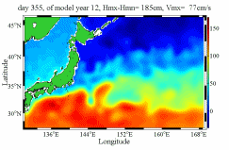
Development of a 1/16° Eddy-resolving Global Ocean Simulation within an Earth System Model Framework
An international collaborative effort for Multi-scale Ocean Circulation System (MUSOC)
Yu-Heng Tseng, Luc Vandenbulcke, Chih-Chieh Young, Wen-ien Yu, Rui Caldeira, Mu-hua Chien, Yu-Chiao Liang
Notes:
1
1. It’s my great pleasure to provide an update of our recent development of multiple grids, fully coupled ocean modeling system in Taiwan. The is an collaborative work with my colleagues David and Jan Sen.
2. I would like to thank ME to give me the opportunity to present my work here.
3. Thanks!
Thanks a lot for all of your coming!
The sponsors are NSF, CTR. Thanks my advisors Joel and Bob.
Thanks for my committee Jeff, Steve, and Paul.
This is a beautiful overview of Monterey Bay taken from the sky.

Slide 2
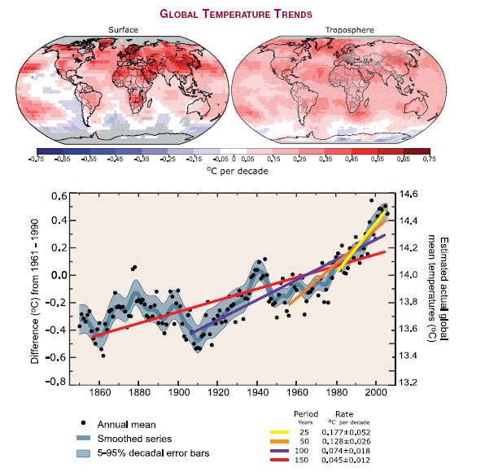
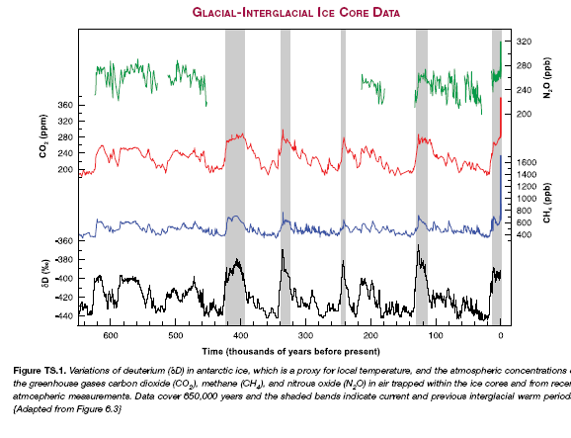
Climate change and ocean
IPCC AR4 WG1 Technical Summary
Notes:
Climate change is the most essential issue all over the world. IPCC AR4 shows the significant warming of the atmosphere.
Particularly the ocean plays an important role on modulating the warming trend of the earth because the ocean has a large heat capacity.

Slide 3
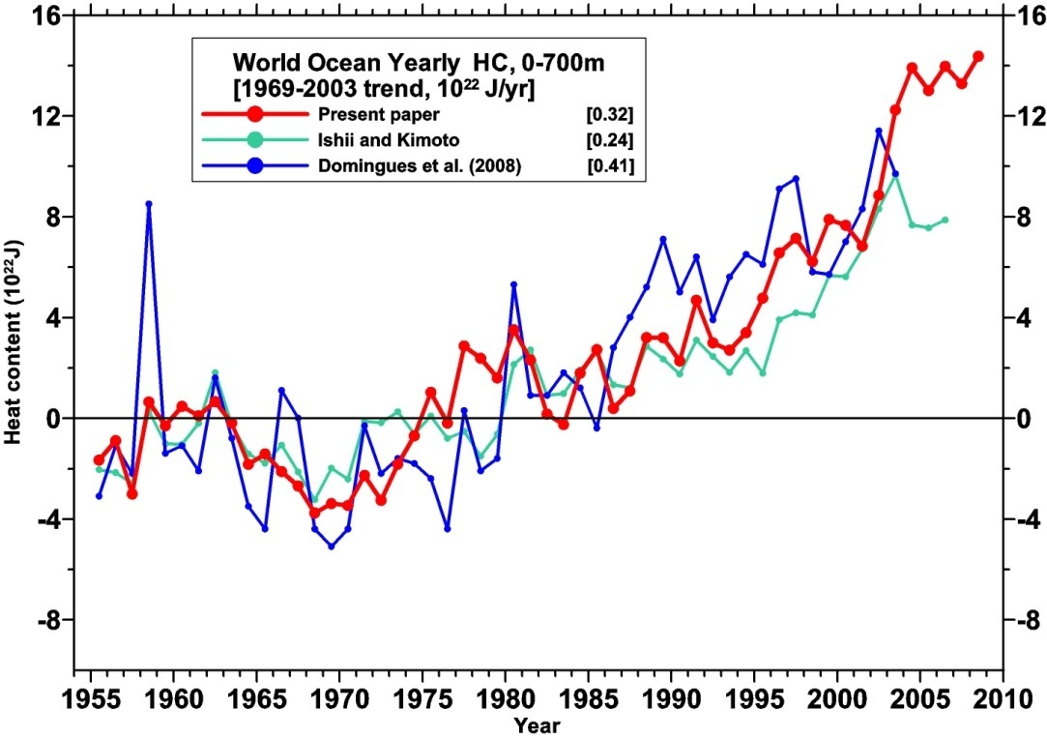
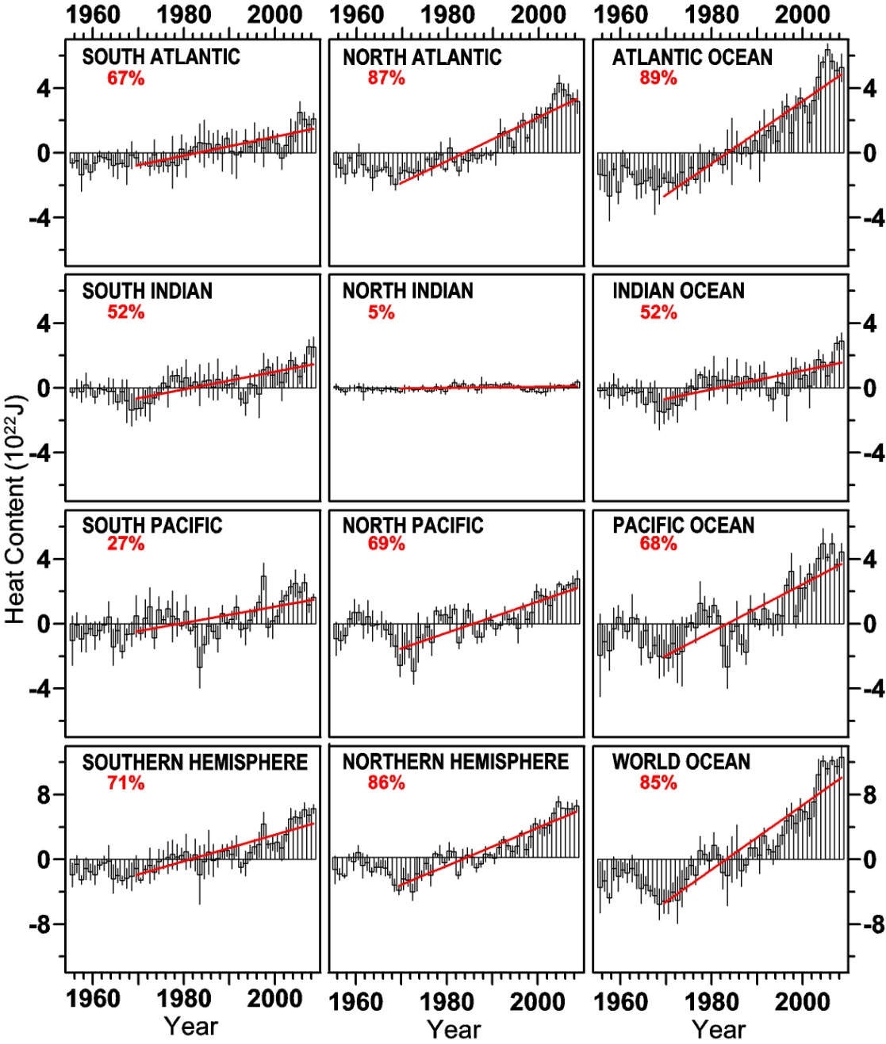
Global ocean variation
(long term warming trend)
Levitus et al. (2009)
Notes:
However, even the ocean shows a more rapid warming in the last few decades.

Slide 4
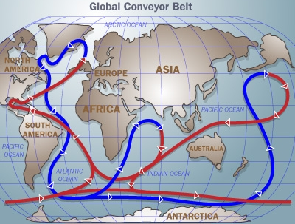
Global Thermohaline Circulation:
1, thermal forcing, when water is cooled and sinks, and
2, haline forcing, when excess precipitation makes water less dense, and thus resistant to sinking.
Driven by the sinking of cold, saline water
No deep water formation
The heat transport associated with “Atlantic deep circulation”
plays an important role in the present climate.
http://science.howstuffworks.com/ocean-current3.htm
Notes:
The most important role of the ocean on the long term climate variability is the TC.

Slide 5
Objectives
Build and redesign a new ocean community model to resolve multi-scale dynamics with the most efficient two-way coupling in high accuracy
Provide a scalable high-resolution global ocean circulation model (targeting at 1/60) for global ocean climate study in an Earth System Model Framework
Operational and forecast capability while maintaining the simplest system structure
International collaborative effort
Notes:
The main objective of this work is to build an efficient global ocean model which can simulate multi-scales dynamics using the latest multiple-grids technique. All grids are coupled together through a unique fully two-way coupling approach. No sponge or buffer layer is used. The short-term objective is … The long-term forecasting system.

Slide 6
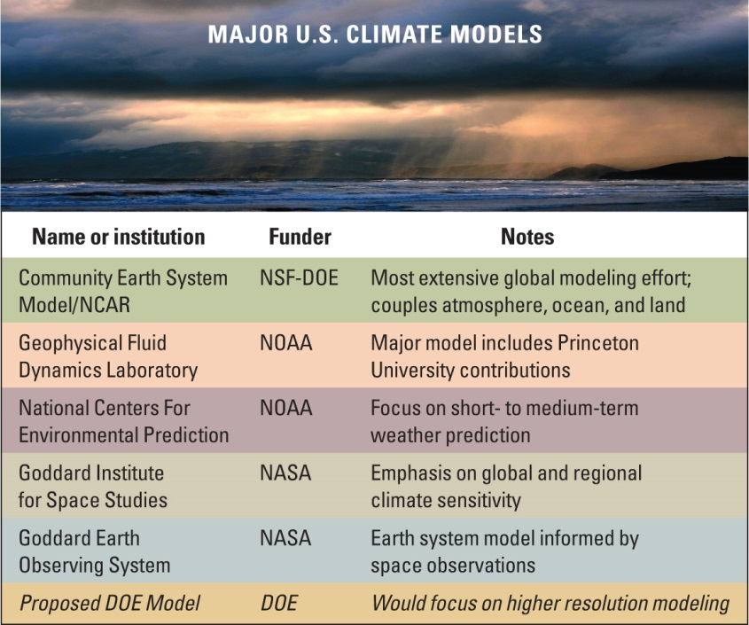

Slide 7
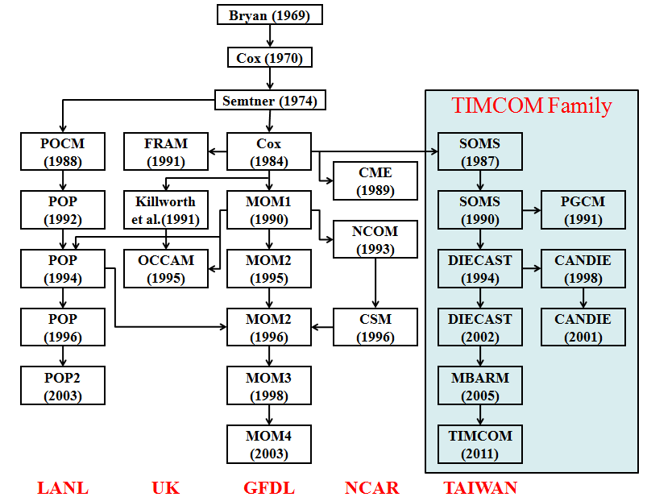
Multi-Scale Ocean Circulation System (PD-TIMCOM)
Tseng et al. (2012), Prog. Ocean
Tseng and Chien (2011), Comp. Fluids
Shen et al. (2011), J. Mar. Sys.
Shen et al. (2013), Prog. Ocean
Young et al. (2012), Env. Modell. Soft.
Young et al. (2013) MWR
http://140.112.66.144/research/timcom
Notes:
The parallel version of the OGCM is called PD-TIMCOM. It is actually a cousin of POP2. These models originate from the Bryan-Cox-Semtner type of model.
7

Slide 8

ECHAM/Taiwan Earth System Model
Land Ecosystem Carbon Cycle Process
Atmospheric Chemistry (Ozone) Model
Aerosol Model
European Centre/Hamburg Model (ECHAM)
Land Ecosystem Carbon Cycle Process
Land
Lake
Atmosphere
Ice Sheet Model
River
Sea Ice
Biogeochemical Carbon Cycle Process
Biogeochemical Carbon Cycle Process
TaIwan Multi-scale Community Ocean Model (TIMCOM)
Notes:
The Earth System model we design is mainly based on ECHAM. Note that this is different from the approach based on the coupler.

Slide 9
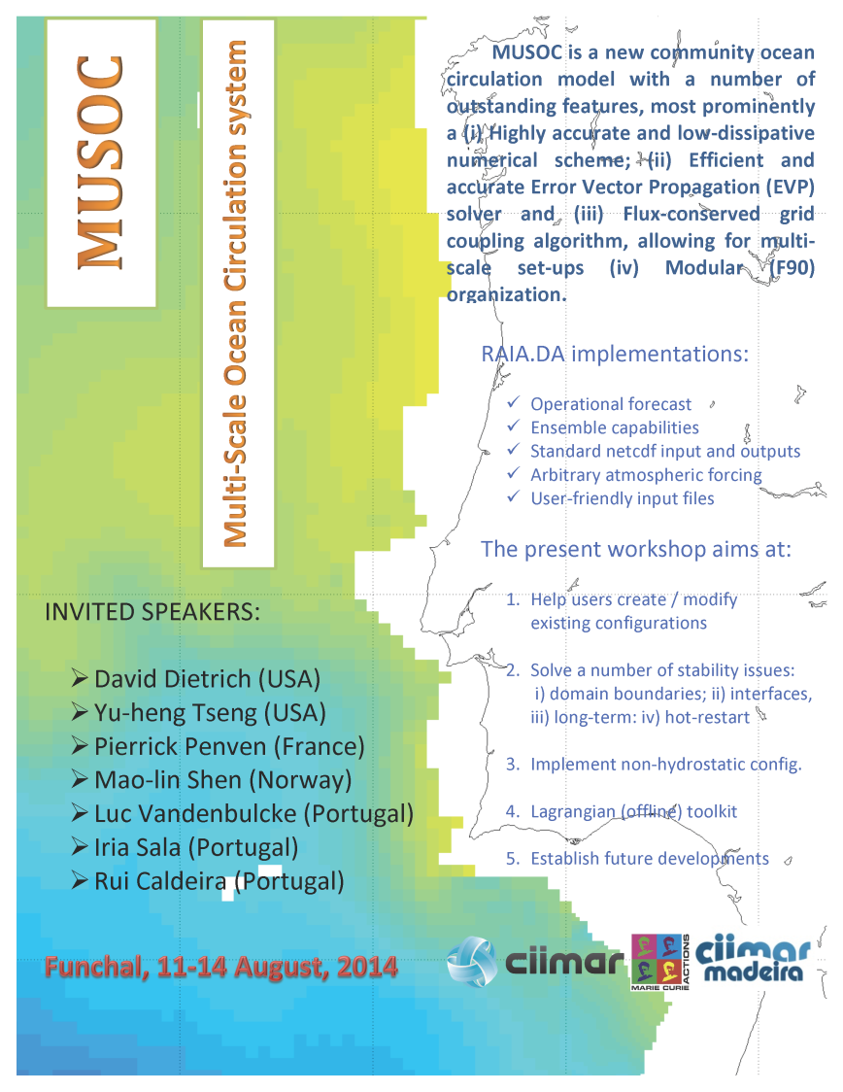

Slide 10
ECHAM/TWESM (ECHAM5/SIT/TIMCOM)
TIMCOM
(30)
SIT
(41)
z
x
T₀,S₀,U₀
0
h₀
ECHAM (AGCM)
19 levels
T31-T213
T₁,S₁,U₁
0.0005
SIT (Air/Snow/Ice/Thermocline)
2snow+2ice+41 water levels
T₂,S₂,U₂
1
nfl (=12)
layers
5.36
…..
2
10.97
T₁₁,S₁₁,U₁₁
10
TIMCOM(OGCM)
31 Levels (T31x n-T213x n)
16.84
T_{k2},S₁₂,U₁₂
16.84
…..
…..
z_{nle+1}=-D
4607
Improved MJO
Better diurnal cycle
Improved cool-skin simulation (Tu and Tsuang, 2005)
T_{n},S_{n},U_{n}
4607
T_{g},S_{g},U_{g}
grid system (m)
Notes:
In our design, the OGCM is embedded in the ECHAM framework, similar to the hydrology or land component within ECHAM. The data transfer is based on a so-called SIT (Snow/Ice/Thermocline) model. It has very thin layer in the upper layer. The depth-averaged heat and salinity fluxes are converted to the flux feeding into the ocean model. SIT is a one-column snow/ice/ocean model with 41-level ocean+ 2-level ice + 2-level snow. It reads surface energy fluxes and wind stress from AGCM, and reads below surface (> 10 m depth) water temperature, salinity, current from OGCM. Then, it computes SST. Then, it passes SST to drive AGCM and OGCM. It has 12 layers in the upper 10 m of ocean. (Tu and Tsuang, GRL, 2005; Lan et al., TAO, 2010)

Slide 11
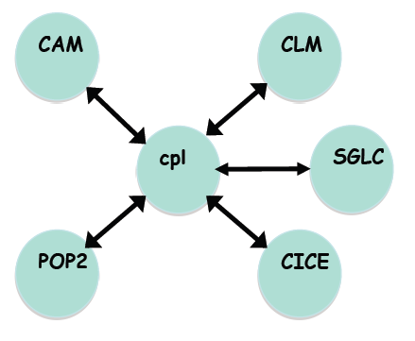
CESM framework--Drivers
atmosphere
land
land ice
coupler
TIMCOM
Drivers: coupler interface to each models/component
ocean
sea ice

Slide 12
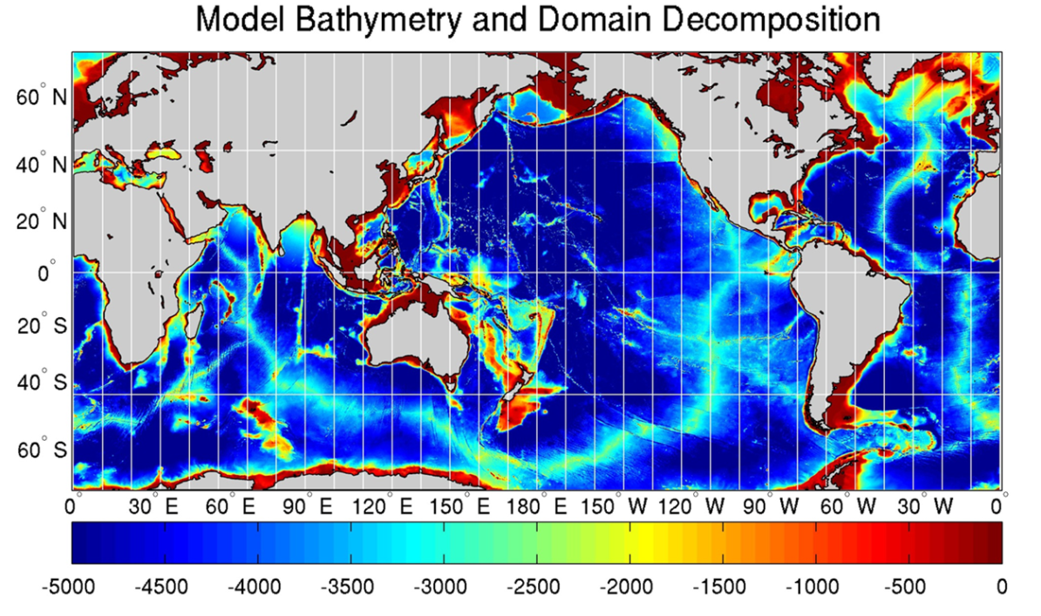
Parallel Domain-Decomposed Taiwan Multi-Scale Community Model (PD-TIMCOM)
Tseng and Chien (2011)
Bathymetry from 1-min Etopo1
Pacanowski and Philander Vertical mixing (1982) and Smagorinsky horizontal mixing (1993).
Initial Temperature and Salinity from NOAA WOA 09.
Surface wind forcing from Hellerman and Rosenstein (1983)
1/16°and 1/4° horizontal resolution, latitudes covers from 72°S to 72°N. with 51 linear exponential levels vertically. (1440x792x51)
Primitive, hydrostatic equation
Fourth-order numerics combined Arakawa A and C-grid (1977)
Rid-lid approx. and Free surface are used (Yang et al., in preparation).
Notes:
12
Here, we will focus more on the results based on the pure OGCM simulation.
12

Slide 13
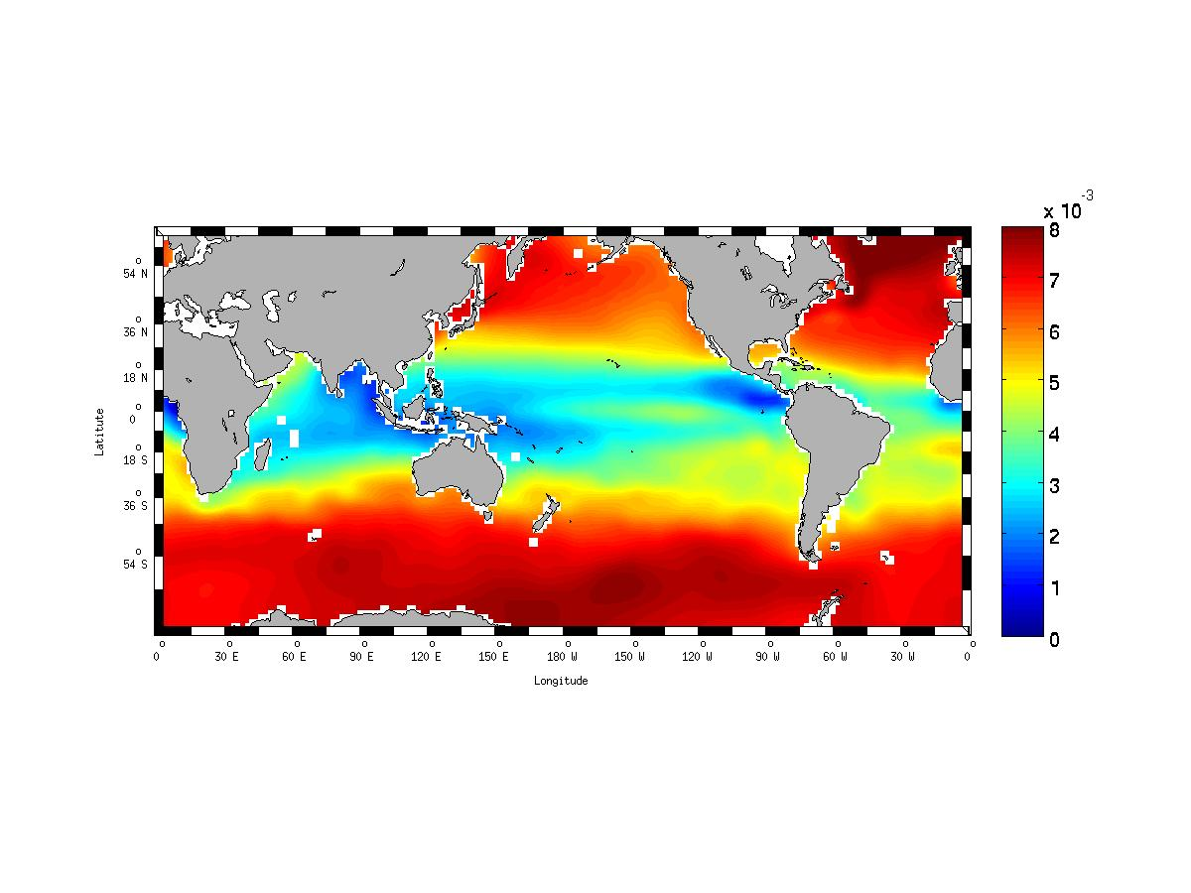

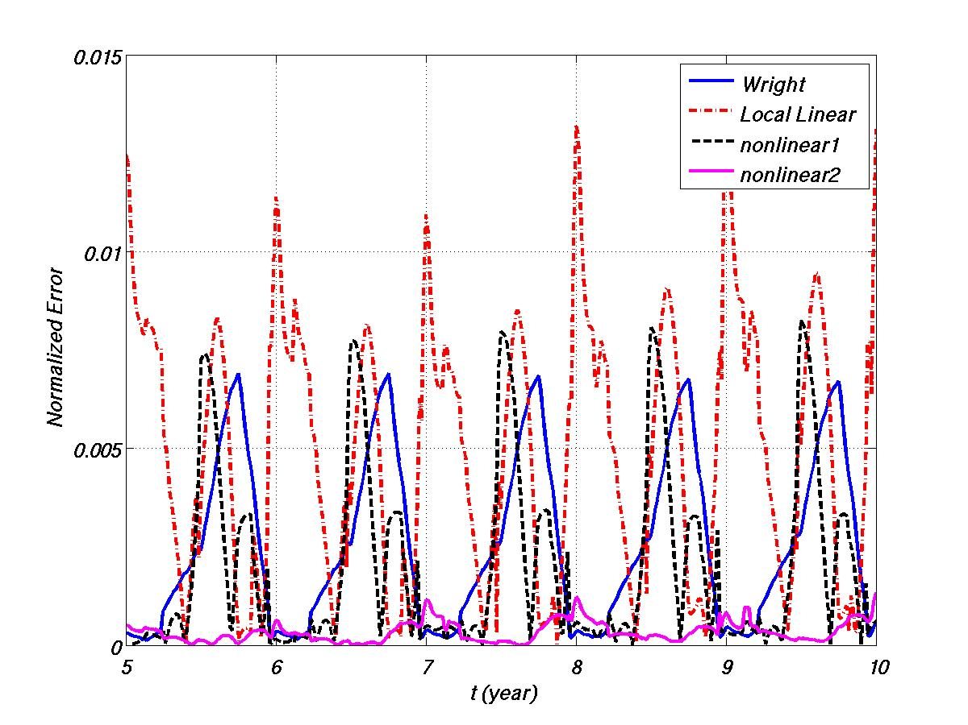
EQUATION OF STATE
Wright’s:
Polynomial fit:
[Sanderson et al., 2001]
UNESCO: standard solution.
Error is normalized.
Largest error of Wright’s in autumn.
Largest error of Local Linear in winter.
Largest error of nonlinear1 in summer.
Largest error of nonlinear2 in winter.

Slide 14
RAW-FILTER
｛
3rd-order accuracy in Amp.
reduce time-splitting instability.
easy to implement.
low computational cost.
Young et al. (MWR in press)
0.05 <ν< 0.2
α = 0.53
ν = 0 -> Leap-frog
α = 1 -> RA-Filter
[Williams, 2009]
Coastal trapping Kevin wave
Notes:
Robert-Asselin-Williams (Paul Williams). Kill two birds with one stone. Has been used in SPEEDY model and ECHAM. In ocean models,…..not sure.

Slide 15
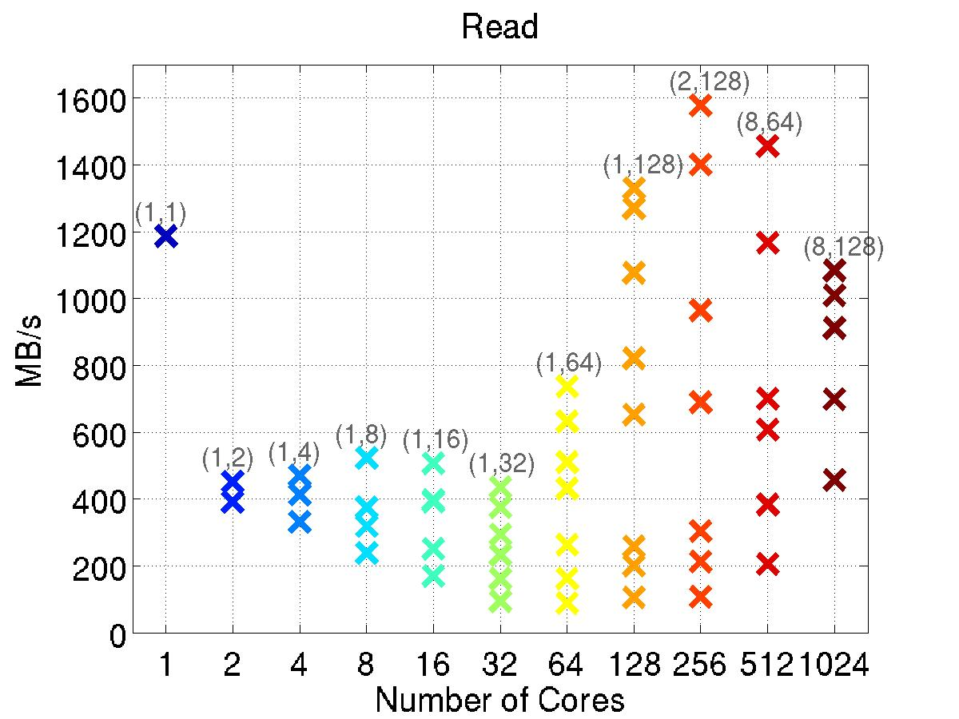
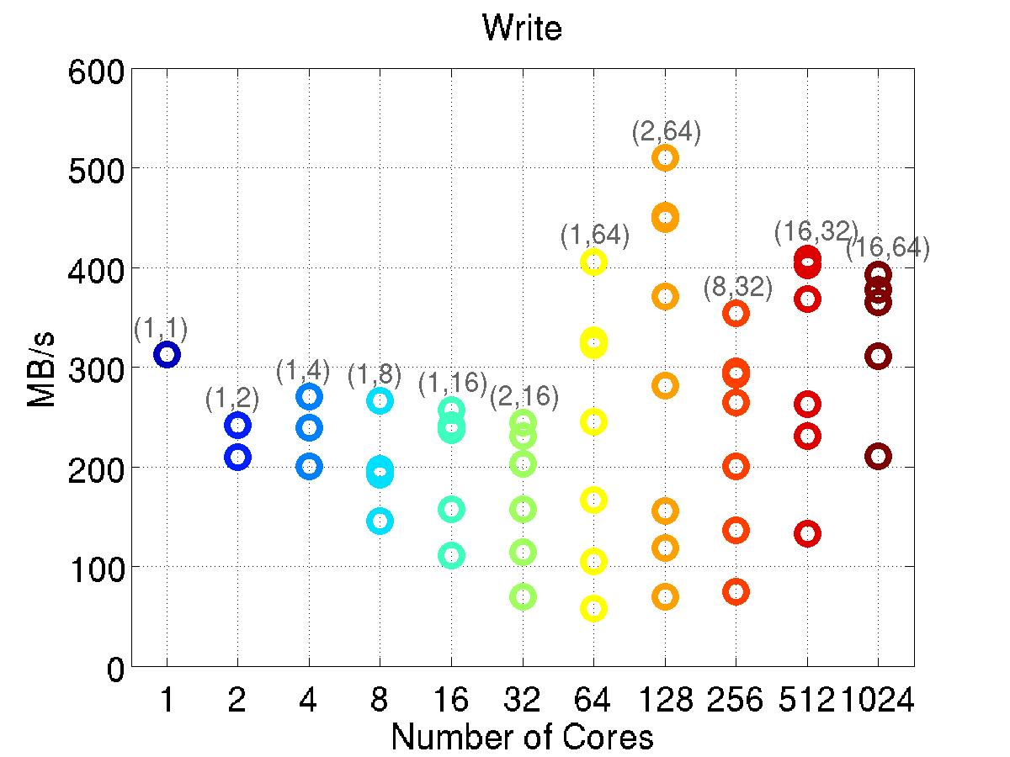
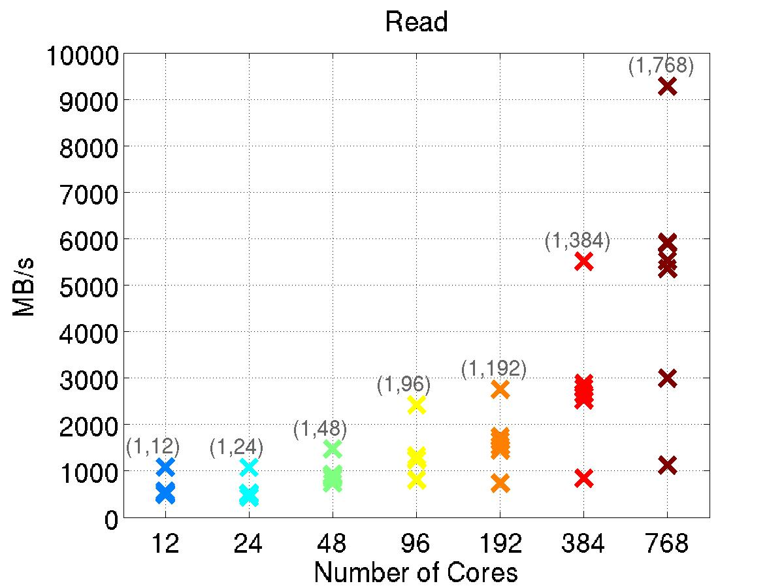
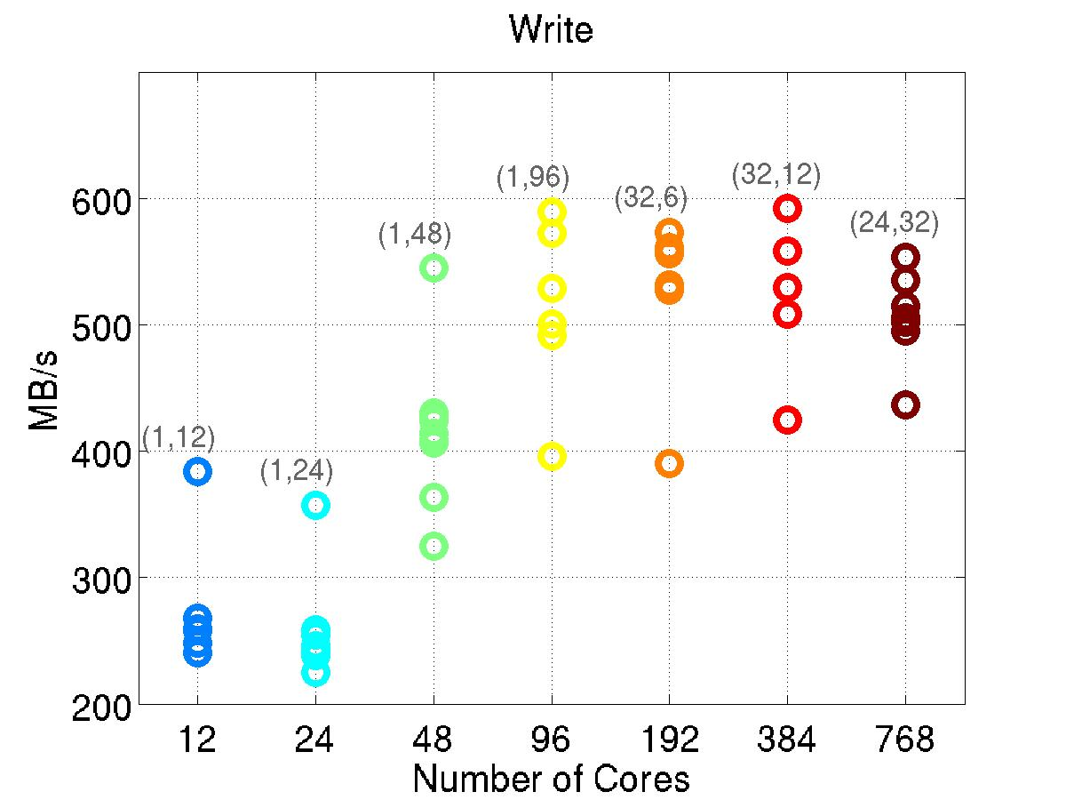
Parallel I/O (Pnetcdf)
Size: 256x256x256
Size: 5760x3168x50 (1/4° global)

Slide 16

Tseng and Chien, 2011
 | Comp. | Comm.
384 | 2673.4 | 95.9
768 (24) (12) | 1624.0 1045.6 897.4 | 87.7 38.7 26.0
1024 (24) | 1183.5 843.8 | 62.7 28.2
1536 (24) | 1109.5 558.3 | 28.3 13.0
2048 | 941.9 | 34.8
3072 | 829.6 | 26.1
 | 1 | 2 | 6 | 12 | 24 | 48 | 96 | 192 | 384
Comp. | 295.83 | 139.03 | 55.11 | 31.34 | 20.05 | 14.41 | 6.88 | 3.91 | 2.27
Comm. | 0 | 0.49 | 0.29 | 0.26 | 0.35 | 0.65 | 0.42 | 0.55 | 0.36
Notes:
16
16

Slide 17
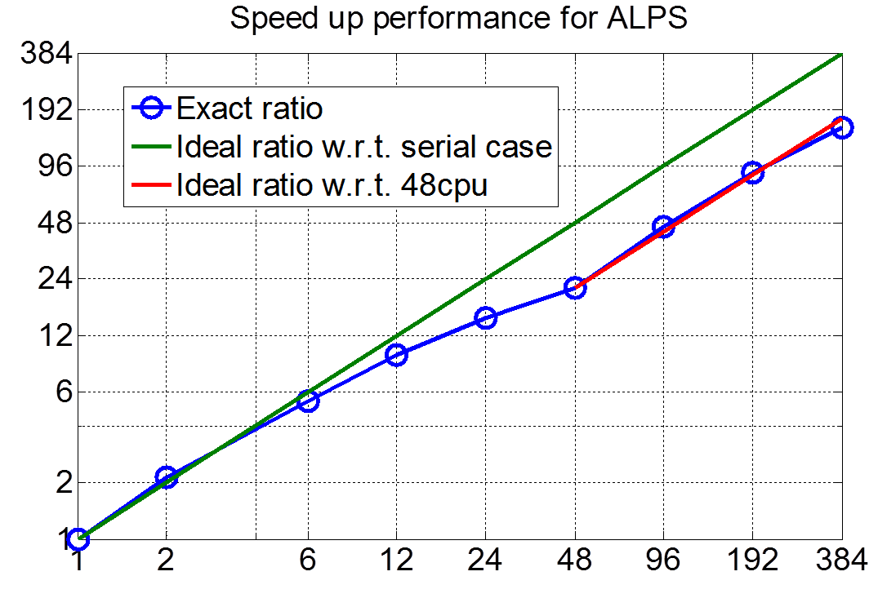
Speed-up Ratio
Ideal Ratio | 1 | Ideal Ratio | 48
2 | 2.13
6 | 5.40
12 | 9.5
24 | 15.0
48 | 21.5 | 1 | 1
96 | 45.8 | 2 | 2.13
192 | 88.2 | 4 | 4.01
384 | 154 | 8 | 7.17
Speed-up ratio
Number of cores
Notes:
We are pretty sure the model has very good speed-up as long as we use the right hardwire. Each node has 4 cpus and each cpu has 12 cores. Infinite-band. The poor behavior is mainly due to the node architecture.
17

Slide 18
Numerical Experiments
1. 50 years TIMCOM 1/4° global simulation with WOA (2009) and HR (1984) wind forcing (rerun). 2. 50 years TIMCOM 1/4° global simulation with WOA09 and Scatterometer Climatology of Ocean Winds (SCOW, 2008) wind forcing (rerun). 3. 2004-2010 TIMCOM 1/4° global hindcast with NOGAPS daily forcing (in prep.). 4. 1960-2010 TIMCOM 1/4° global hindcast with ECMWF monthly forcing (in prep.).
5. 30 years TIMCOM 1/16° global simulation with Levitus (1994) and HR (1984) wind forcing (in proc.). 6. 30 years TIMCOM 1/16° degree global simulation with WOA09 and Scatterometer Climatology of Ocean Winds (SCOW, 2008) wind forcing (in prep.). 7. 2004-2010 TIMCOM 1/16° degree global hindcast with NOGAPS daily forcing (in prep.). 8. 1960-2010 TIMCOM 1/16° degree global hindcast with ECMWF monthly forcing (in prep.).

Slide 19
Current status http://140.112.66.144/wiki/index.php/Timcom_Wiki
Focus mainly on the MEDINA and GLOBAL configurations
For historical (climatological) studies of processes along the interface between Mediterranean Sea and Atlantic Ocean: promising (we see Meddies) but slow (not parallelized yet)
For operational forecasts: being implemented now (not very much manpower to do it, so it's taking some time)
Doesn't really need parallel version for it (ensemble runs are parallel by themselves)

Slide 20
Recent additions
Enhanced data input capacity (free-format ascii files, can read scalars, vectors, or load from netcdf files)
Numbered models : input and output (000 to 999) for future ensemble runs
Basic river runoff influences
More flexible nudging configuration (incl. 3D coeffs.)
Support for real time atmospheric forcing instead of climatological time: the model keeps track of the “modified julian day” (days after 18/november/1858).
Thus years have their exact number of days rather than 12*30=360 days

Slide 21
Recent additions
Surface fluxes for heat, momentum and freshwater
Fluxes computed from atmospheric fields using bulk formulae (based on code from GETM model)
or
Fluxes read from netcdf files
The module is initialized, data is read from netcdf files and interpolated in space during the model startup; and interpolated in time during model integration
Tested with data from NCEP, ECMWF and CORE-2

Slide 22
Data assimilation
Data assimilation independent from TimCOM
Bash scripts alternatively run the model and the data assimilation code
The data assimilation code modifies the TimCOM restart file
The data assimilation code we plan to use is OAK
(modb.oce.ulg.ac.be/mediawiki/index.php/Ocean_Assimilation_Kit )
multi-grid, multi-variate, 3D, reduced-rank Kalman filter. The state-vector error covariance matrix can be obtained from a historical run ( “fixed-base SEEK filter” ) or from an ensemble (EnKF)

Slide 23
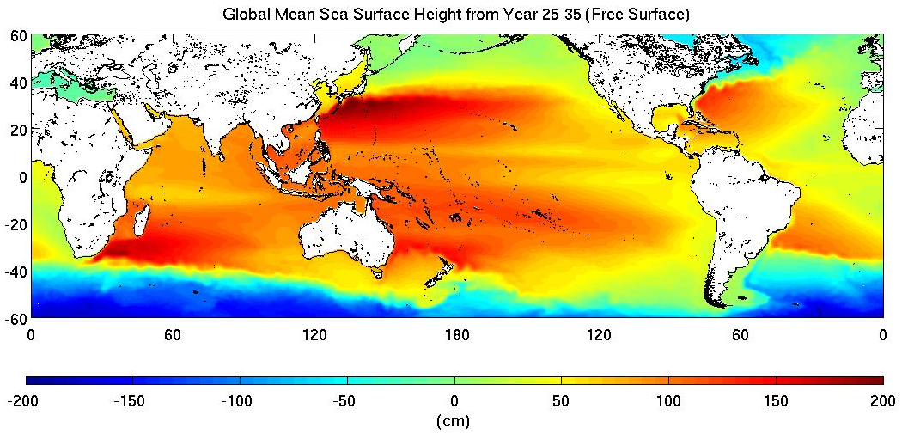
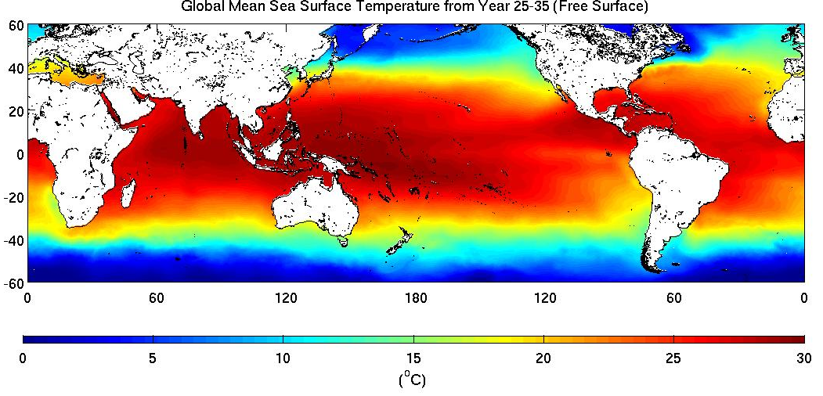
Mean SSH and SST

Slide 24
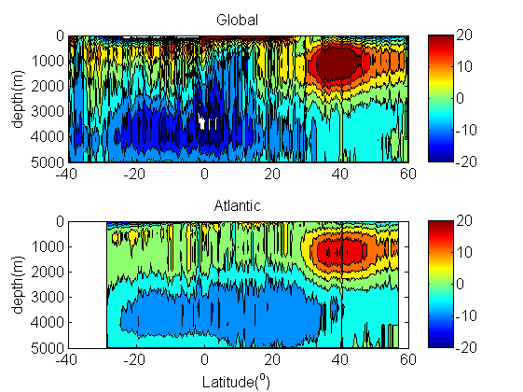
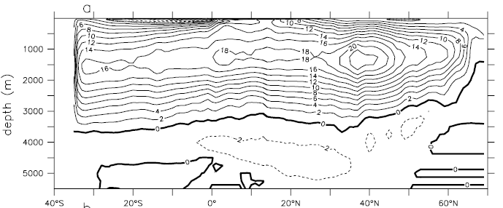
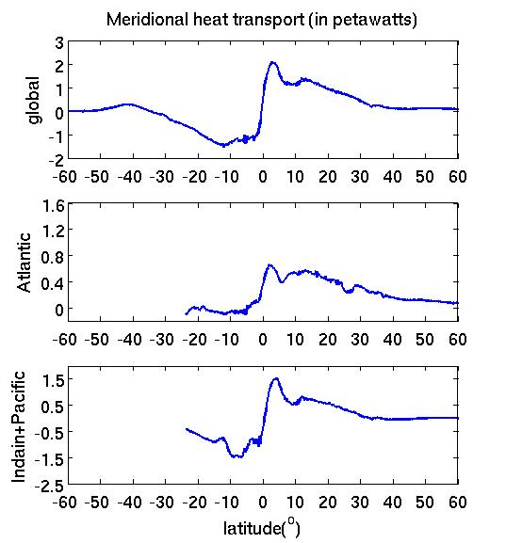
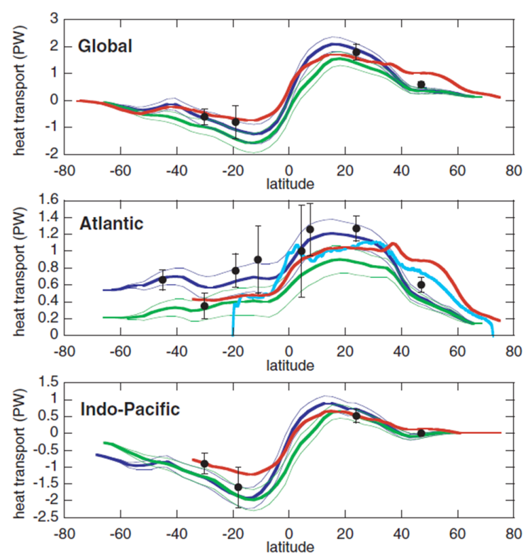
Meridional overturning streamfunction (MOC) and global heat transport
POP
NCEP
ECMWF
Maltrud and McClean (2005)

Slide 25
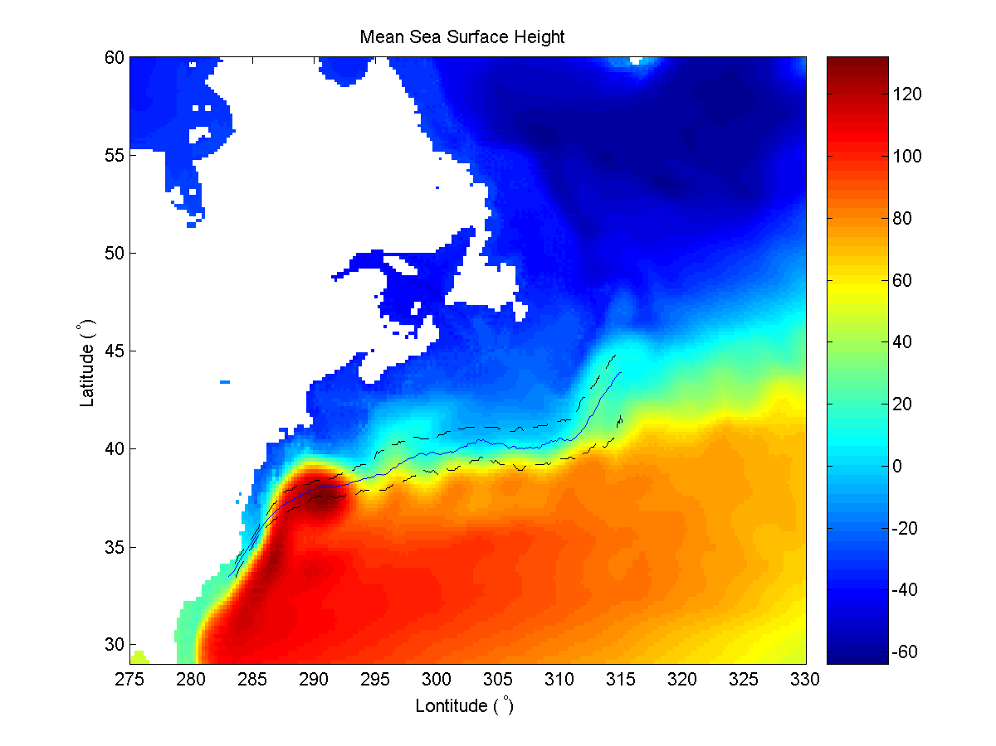
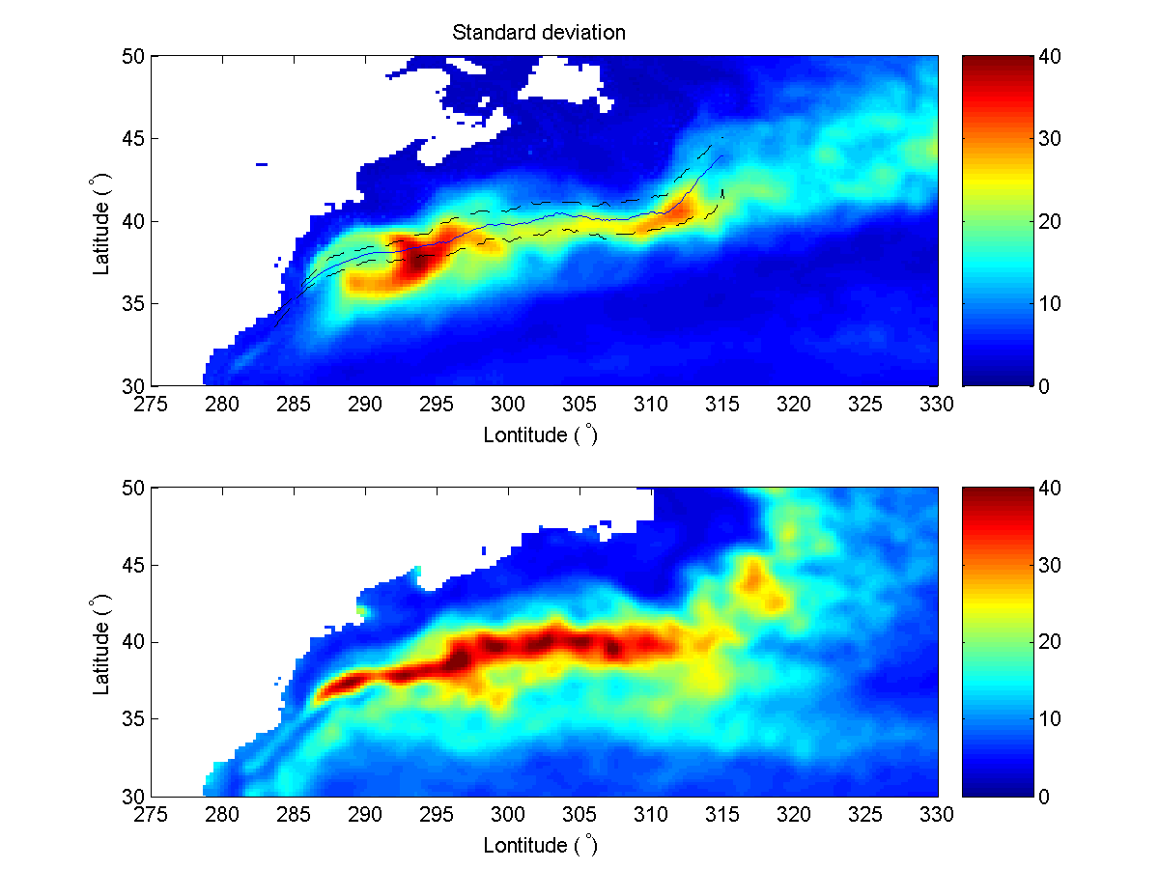
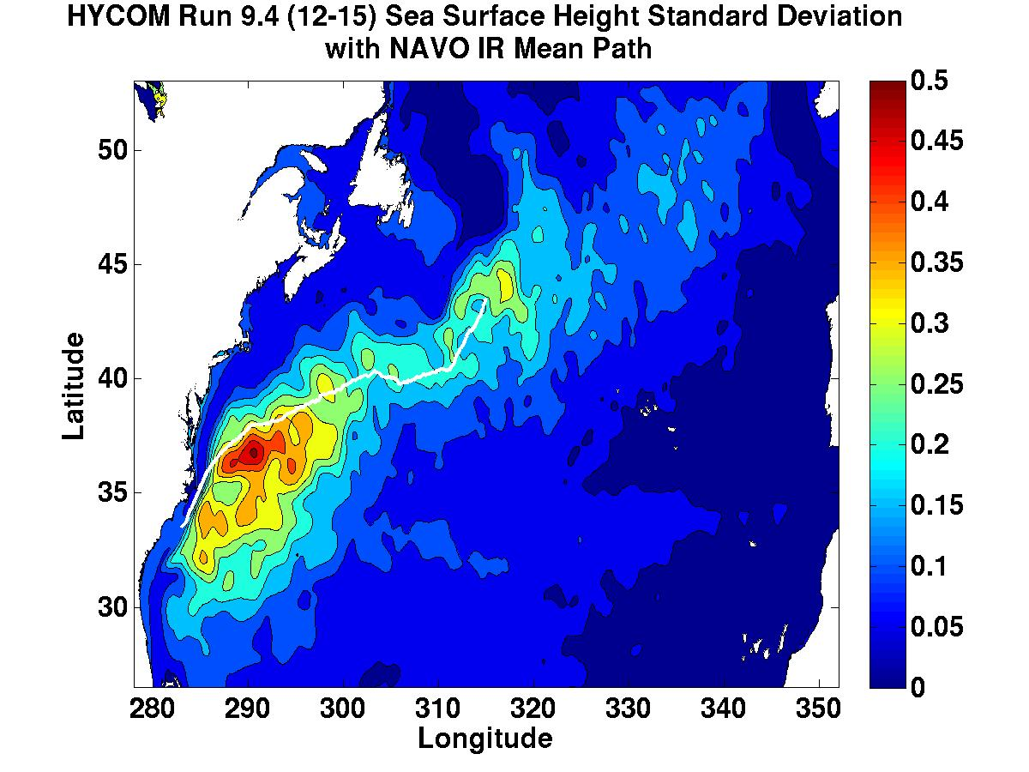
Gulf Stream
The mean Gulf Stream IR northwall pathway ±1σ (standard deviation) by Cornillon and Sirkes
modelled ten-year standard deviation (year 41-50) of equivalent sea surface height (in cm)
Courtesy of Jim Richman (NRL)

Slide 26
1/4° Global Ocean Simulations

Slide 27
1/16° Global Ocean Simulations

Slide 28
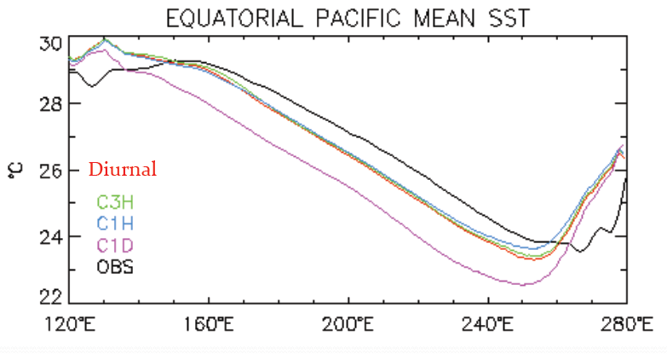
Future Plans
Atmosphere
Land
Sea-Ice
Land-Ice
Coupler
0 hr
24 hr
Ocean

Slide 29
Future plan
Establish ocean diagnostic metrics (2012.1-2012.2 Yu-chiao, wenien)
PD-TIMCOM production runs finalization (2012.3-2012.4 Jay)
Sea-level variability in PD-TIMCOM (2012.5-2012.7 Jay)
2012.8-2013.7 North Pacific Climate Variability in CESM (Chun-hoe)

Slide 30

Thank You
Customized By EFDL

Slide 31
Possible Source of the KT
Subtropical
West Pacific pattern
STCC
NEC
ENSO
Tropical
[Vianna and Menezes, 2010, JGR]
Notes:
31

Slide 32
Different KT Phases
mean
std
mean
std
Huge NEC transport
mean
std
KT vs. -WP
KT vs. ENSO
Limit NEC transport
Notes:
32

Slide 33
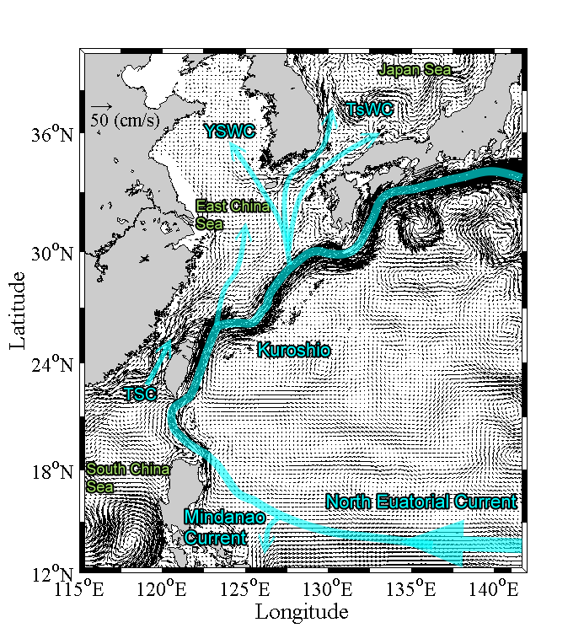
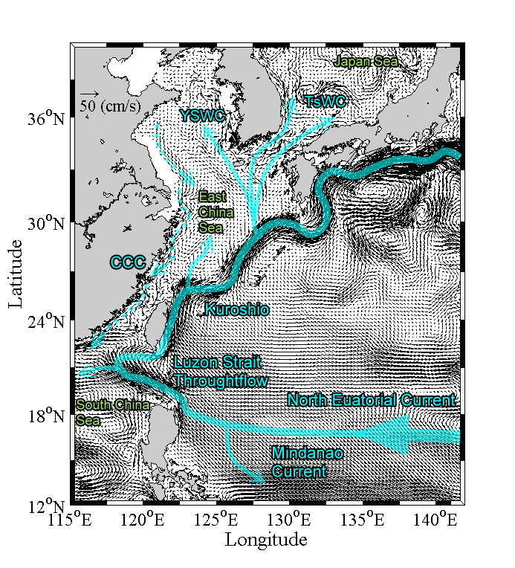
General seasonal circulation pattern-DUPOM
Summer
Winter

Slide 34
Framework for Pacific Climate Variability
Southern hemisphere forcing
Di Lorenzo et al, ENSO and the North Pacific Gyre Oscillation: an integrated view of Pacific decadal dynamics

Slide 35
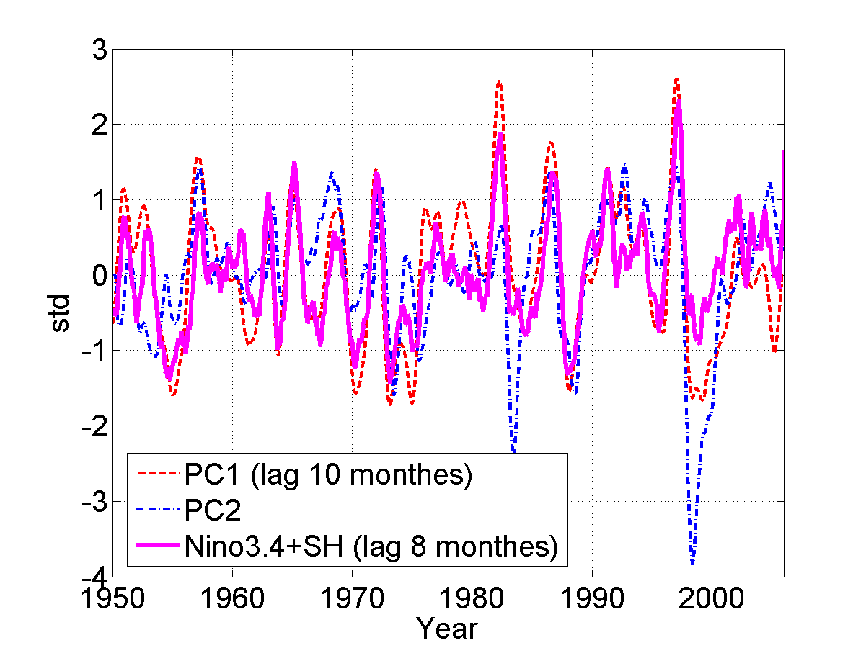
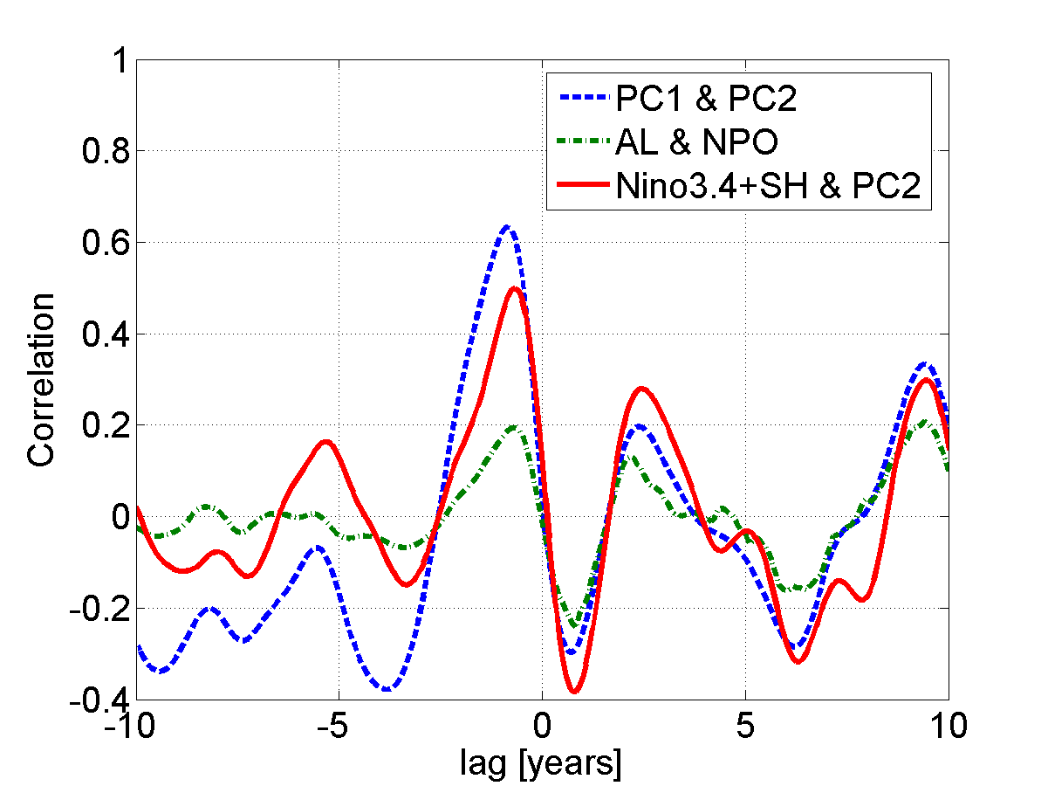
SSTa is associated with El Nino-Modoki
SSTa patterns (PC1) leads ENSO anomalies by ~8 months
PC1 (ENSO) lags PC2

Slide 36
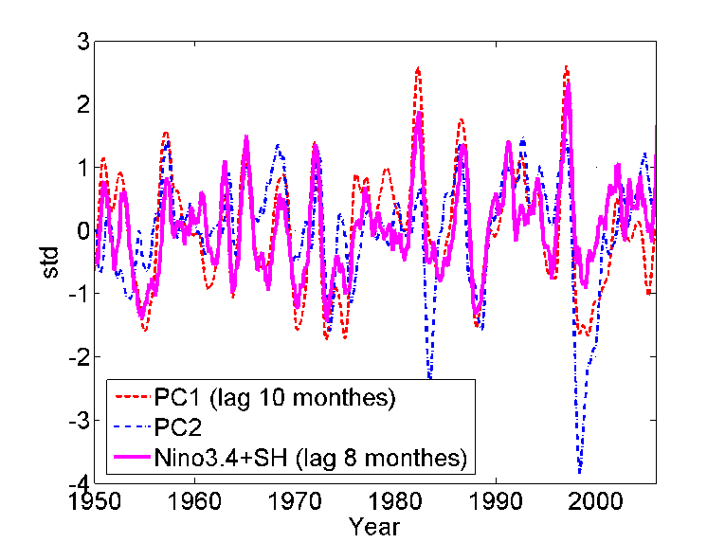
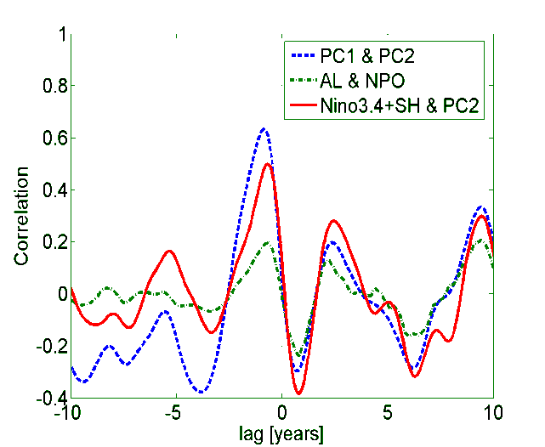
SSTa is associated with El Nino-Modoki
SSTa patterns (PC1) leads ENSO anomalies by ~8 months
PC1 (ENSO) lags PC2
nino3 (90°W-150°W, 5°S-5°N)
NINO3 = [SSTA]nino3
C
A
EMI = [SSTA]A - 0.5*[SSTA]B - 0.5*[SSTA]C
B
A (165°E-140°W, 10°S-10°N)
B (110°W-70°W, 15°S-5°N)
C (125°E-145°E, 10°S-20°N)
Weng et al. 2008

Slide 37
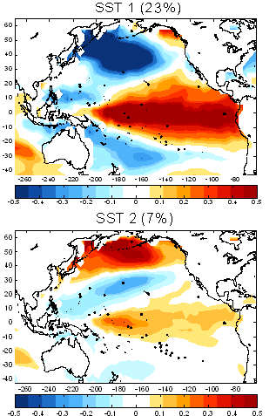
Observation
Model

Slide 38
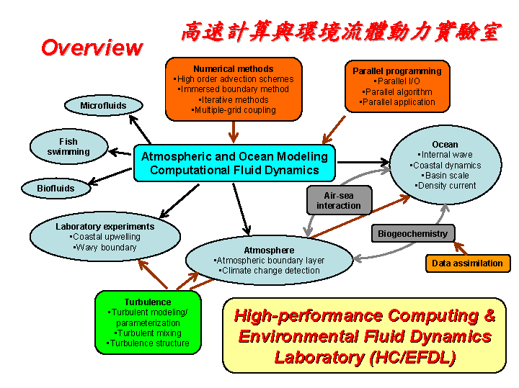
Questions……?

Slide 39
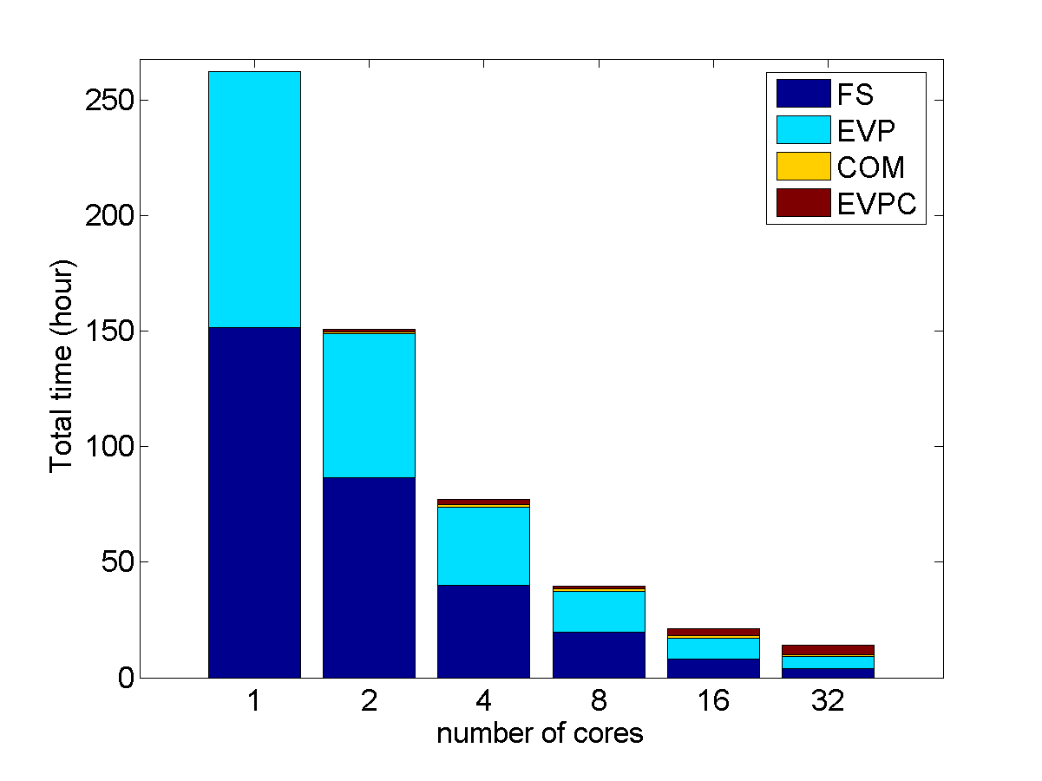
Parallel performance
FS: simulation time COM: Other Communication
EVP: pressure solver time EVPC: Communication in EVP solver

Slide 40
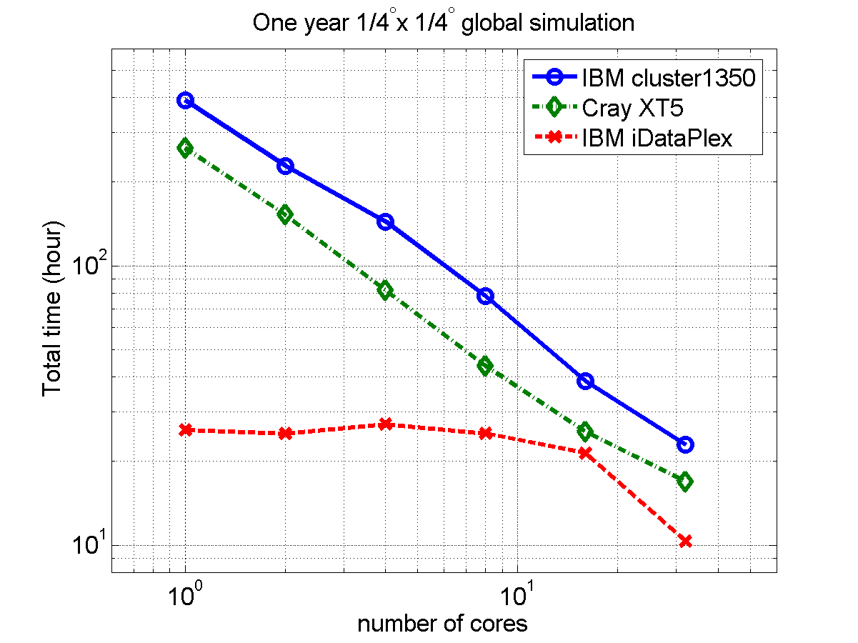
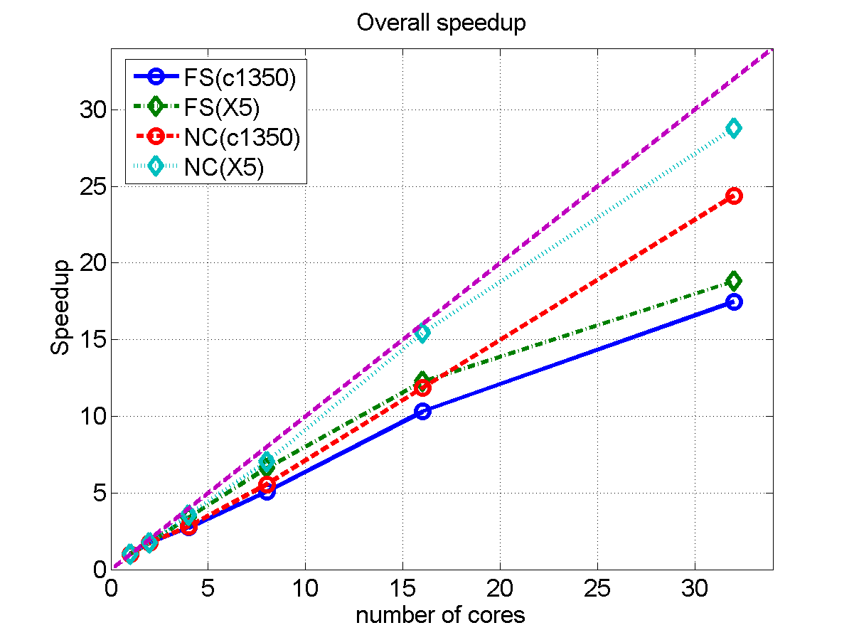
Parallel speedup
FS: all computation
NC: full computation without the communication
Roughly 10 CPU hrs/per simulation year

Slide 41
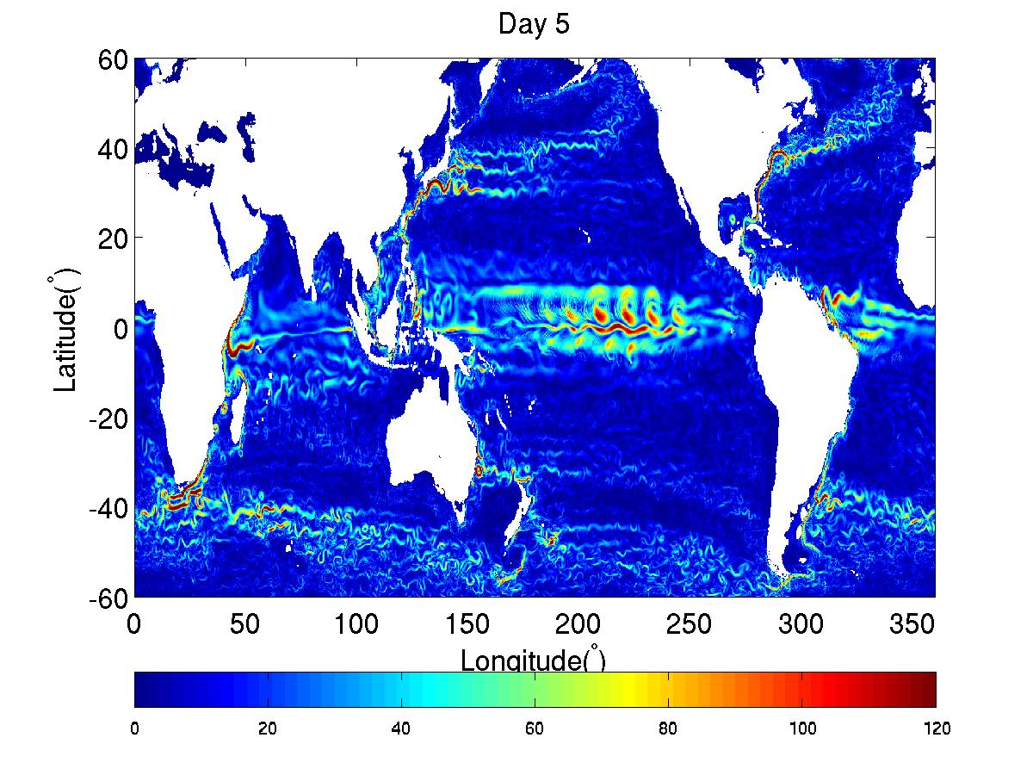
1/4° x 1/4° global resolution (domain 1442x720x26)
Tropical instability waves
Global velocity speed field (day 5, Year 49)

Slide 42
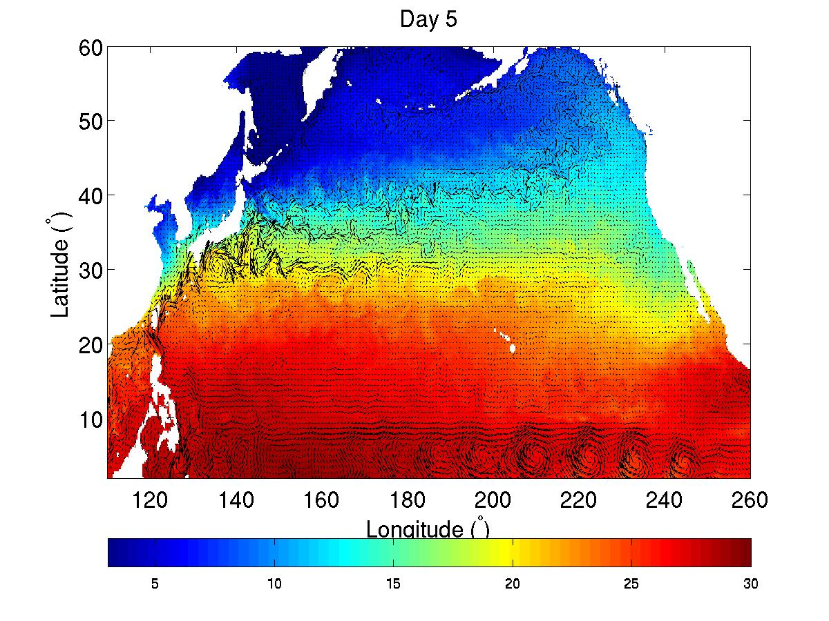
1/4° x 1/4° global resolution (domain 1442x720x26)
North Pacific temperature and velocity field (day 5, Year 49)

Slide 43
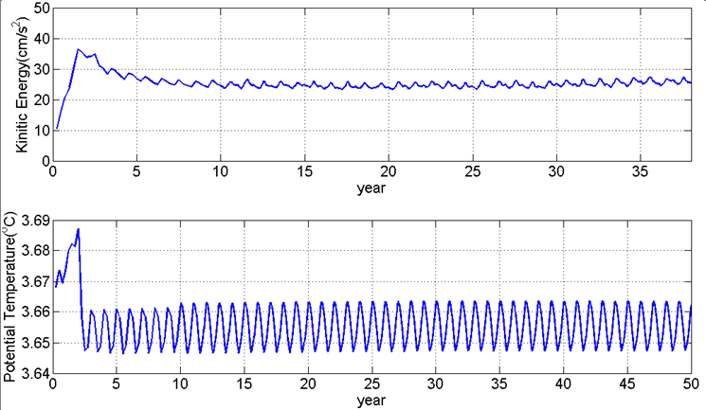
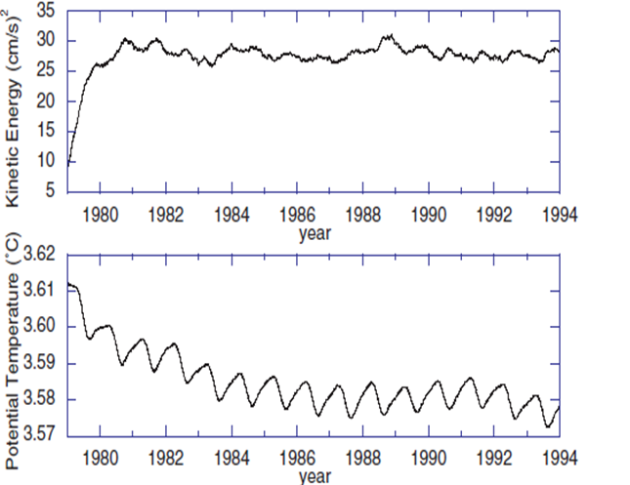
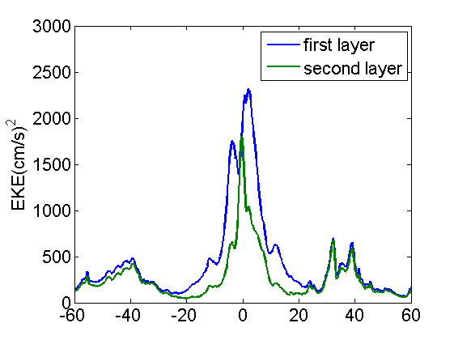
Time evolution of globally averaged Total Kinetic Energy and potential temperature
Maltrud and McClean (2005)
Near-surface Eddy Kinetic Energy

Slide 44
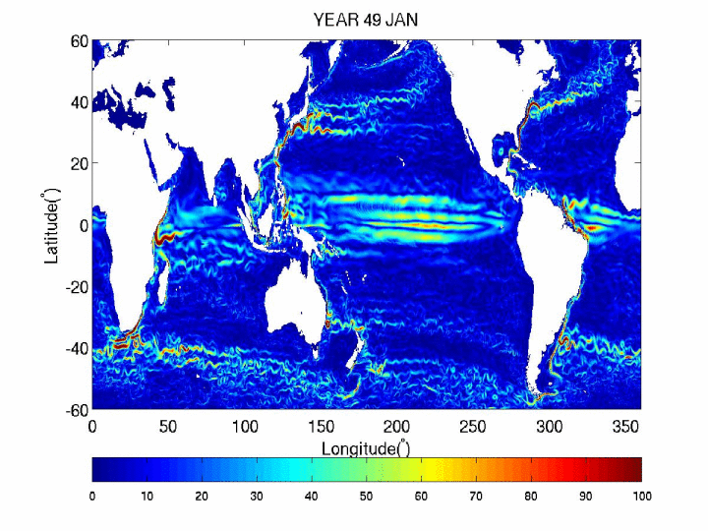
Animation of global surface velocity speed

Slide 45
Gulf Stream
The mean Gulf Stream IR northwall pathway ±1σ (standard deviation) by Cornillon and Sirkes
modelled ten-year standard deviation (year 41-50) of equivalent sea surface height (in cm)
Courtesy of Jim Richman (NRL)

Slide 46
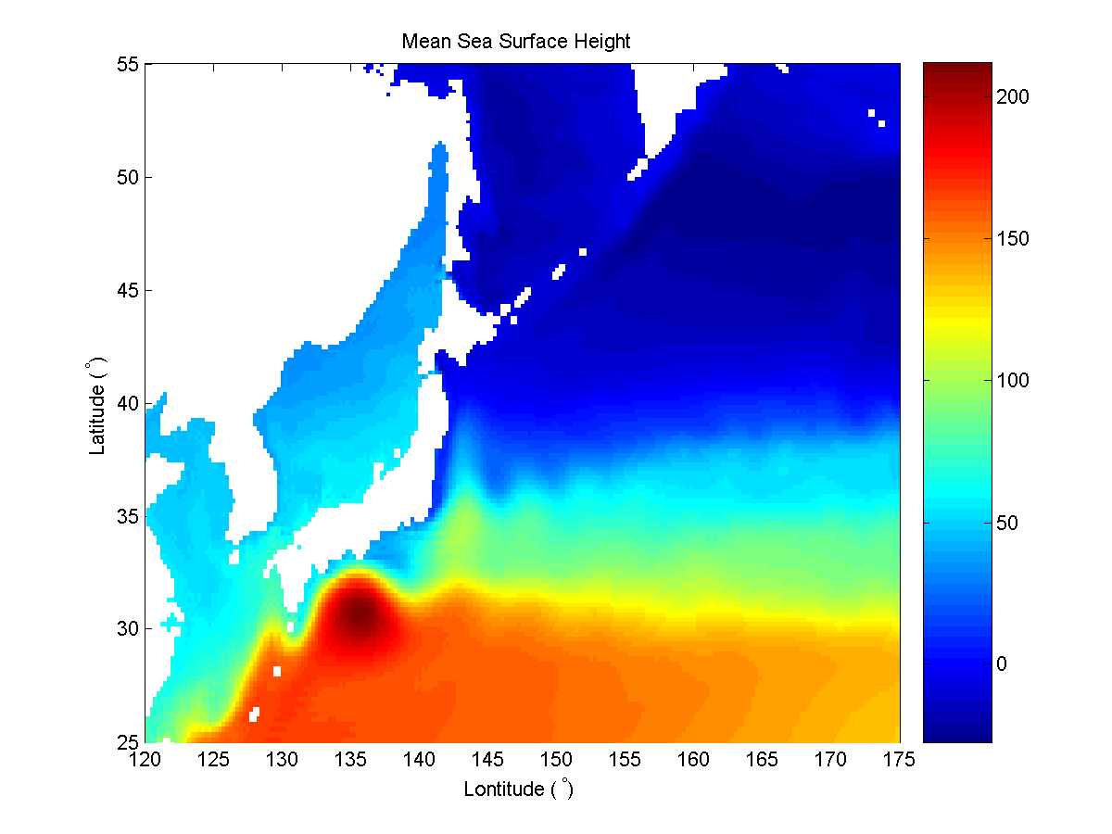
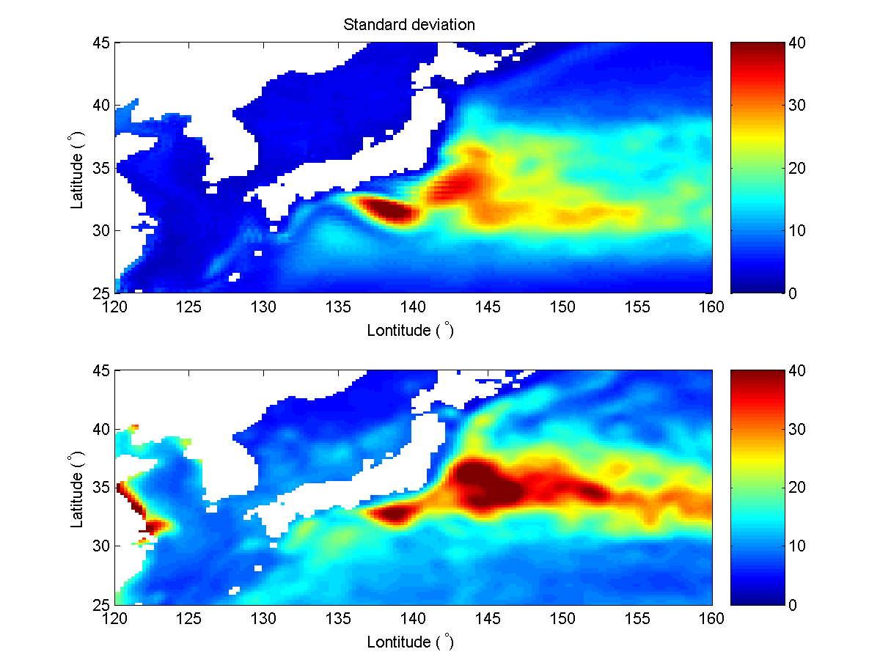
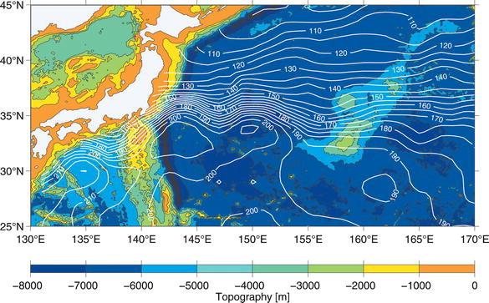
Kuroshio Current System
Qiu and Chen (2005)

Slide 47
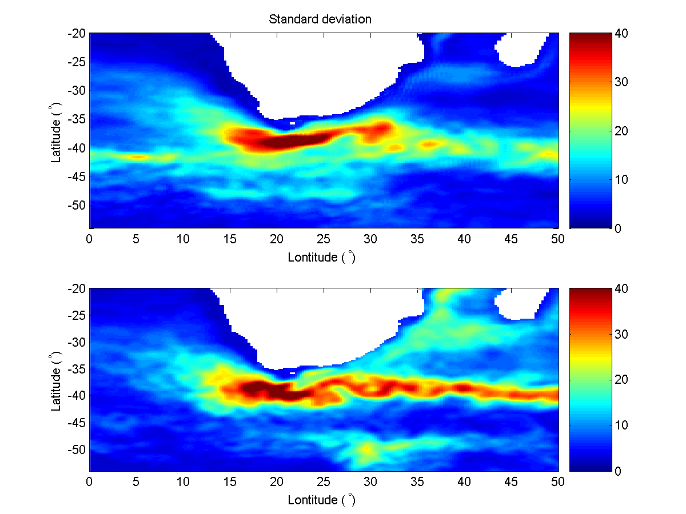
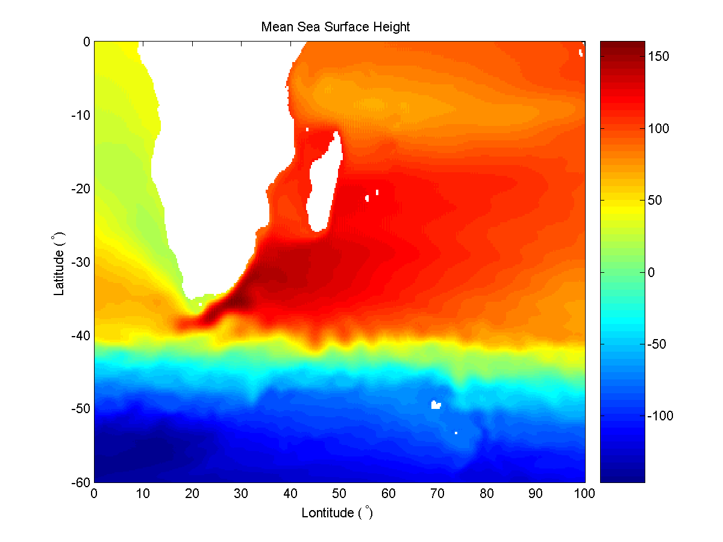

Agulhas Current System
5-day averaged surface current speed (cm/s) in Cape Basin
Retroflection of the Agulhas Current

Slide 48
Summary
High-resolution Parallel Domain-decomposed TaIwan Multi-scale Community Ocean Model (PD-TIMCOM) is developed
Based on TIMCOM
Based on an efficient parallel EVP solver
Ideal (scalable) for parallel domain-decomposition
Reasonable mean, standard deviation and skewness states
Eddy-resolving global circulation patterns
Fifty year simulation is almost completed
Further validations and extremely high-resolution (1/16°) in Global Oceans and investigate the global ocean climate

Slide 49





Governing Equations
Continuity eqn.
Momentum eqn.
Conservation eqn. for temperature and salinity
Eqn. of State
Hydrostatic Eqn.

Slide 50
Parallel domain-decomposed Taiwan Multi-scale Community Ocean Model (PD-TIMCOM)
Yu-Heng Tseng, Chih-Chieh Young, Wen-ien Yu, Mu-hua Chien, Yu-Chiao Liang
High-performance Computing & Environmental Fluid Dynamics Laboratory (HC/EFDL)
Department of Atmospheric Sciences
National Taiwan University
http://efdl.as.ntu.edu.tw
Acknowledgement: computing resources from NCHC, Taiwan and NERSC, USA
Notes:
1. It’s my great pleasure to provide an update of our recent development of multiple grids, fully coupled ocean modeling system in Taiwan. The is an collaborative work with my colleagues David and Jan Sen.
2. I would like to thank ME to give me the opportunity to present my work here.
3. Thanks!
Thanks a lot for all of your coming!
The sponsors are NSF, CTR. Thanks my advisors Joel and Bob.
Thanks for my committee Jeff, Steve, and Paul.
This is a beautiful overview of Monterey Bay taken from the sky.

