Slide 1
The link between Pacific Subtropical Cell and Tropical Climate Variability
Yu-heng Tseng¹, Han-Ching Chen², Chung-Hsiung Sui²
¹Climate and Global Dynamics Division , National Center for Atmospheric Research
² Dept Atmospheric Sciences, National Taiwan University

Slide 2
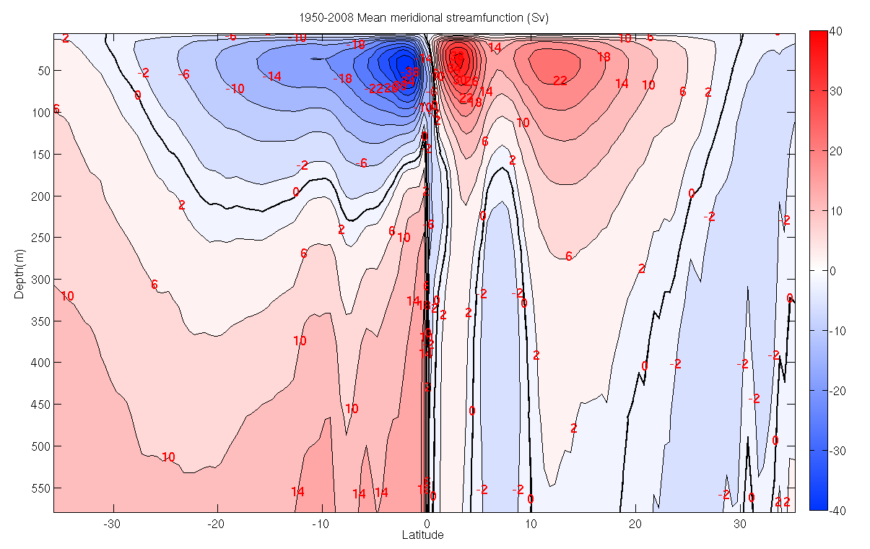
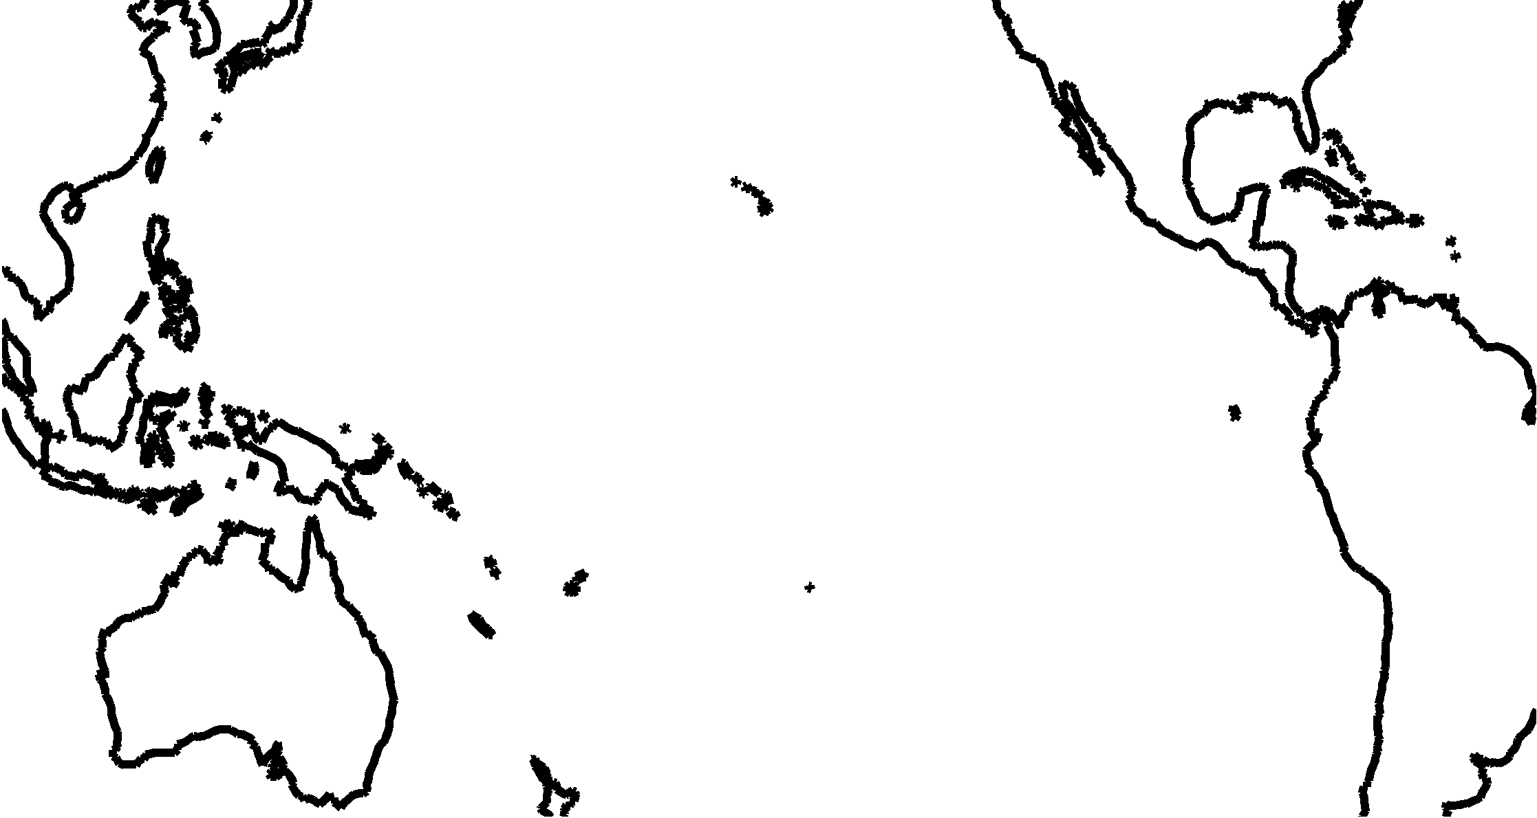
Subtropical Cells (STCs)
Mean meridional streamfunction
shallow meridional overturning circulations
Ekman transport
Equatorial
Undercurrent
Interior pycnocline transport

Slide 3
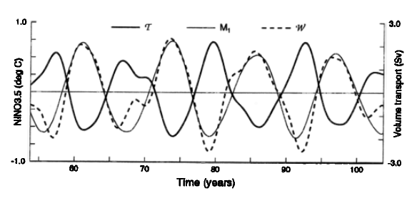
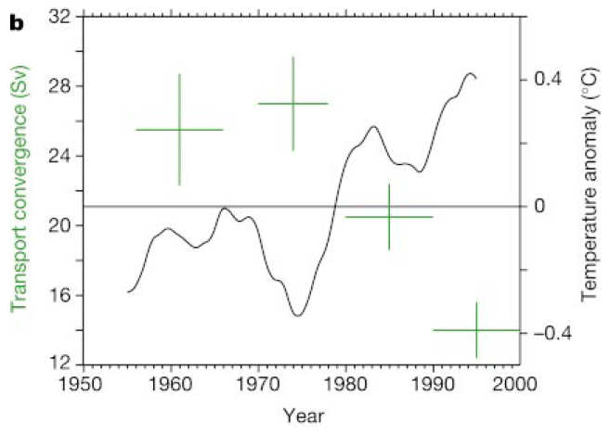
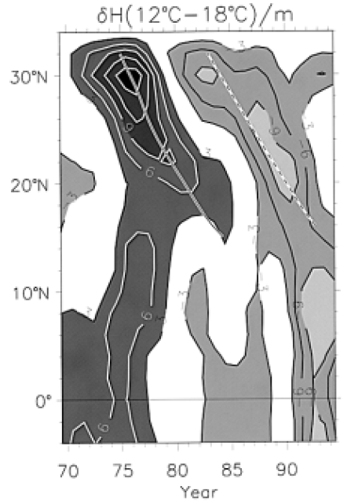
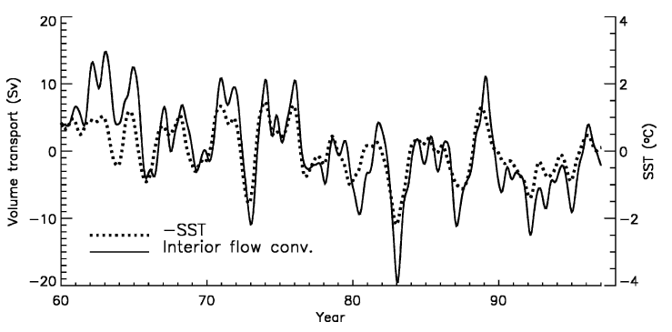
Gu and Philander (1997)
Kleeman et al (1999)
The variation of the STCs has been proposed as a possible pathway to drive the climate variability in the tropics.
McPhaden and Zhang (2002)
Schneider et al. (1999)
Capotondi et al. (2005)

Slide 4
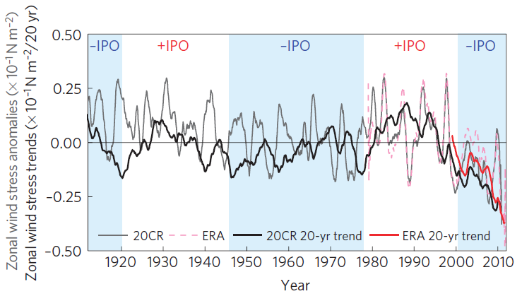
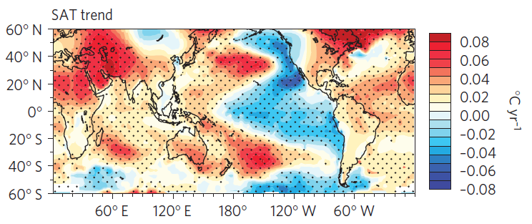
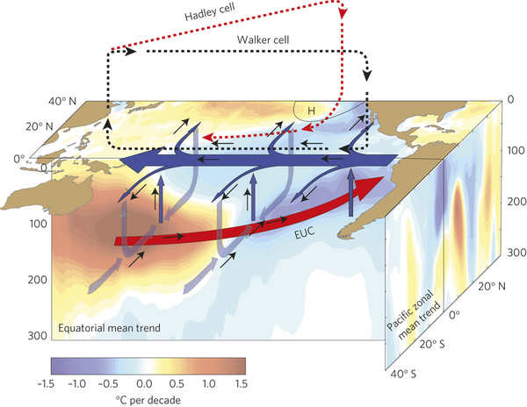
Zonal wind stress and trends
Trend during 1992-2011
=>Increased trade wind
=>Strengthened STG and Ekman pumping
=>Spin-up STC
=>Enhanced EUC
=>Increased equatorial upwelling
=>Negative SSTA (warming hiatus)
England et al. (2014)

Slide 5
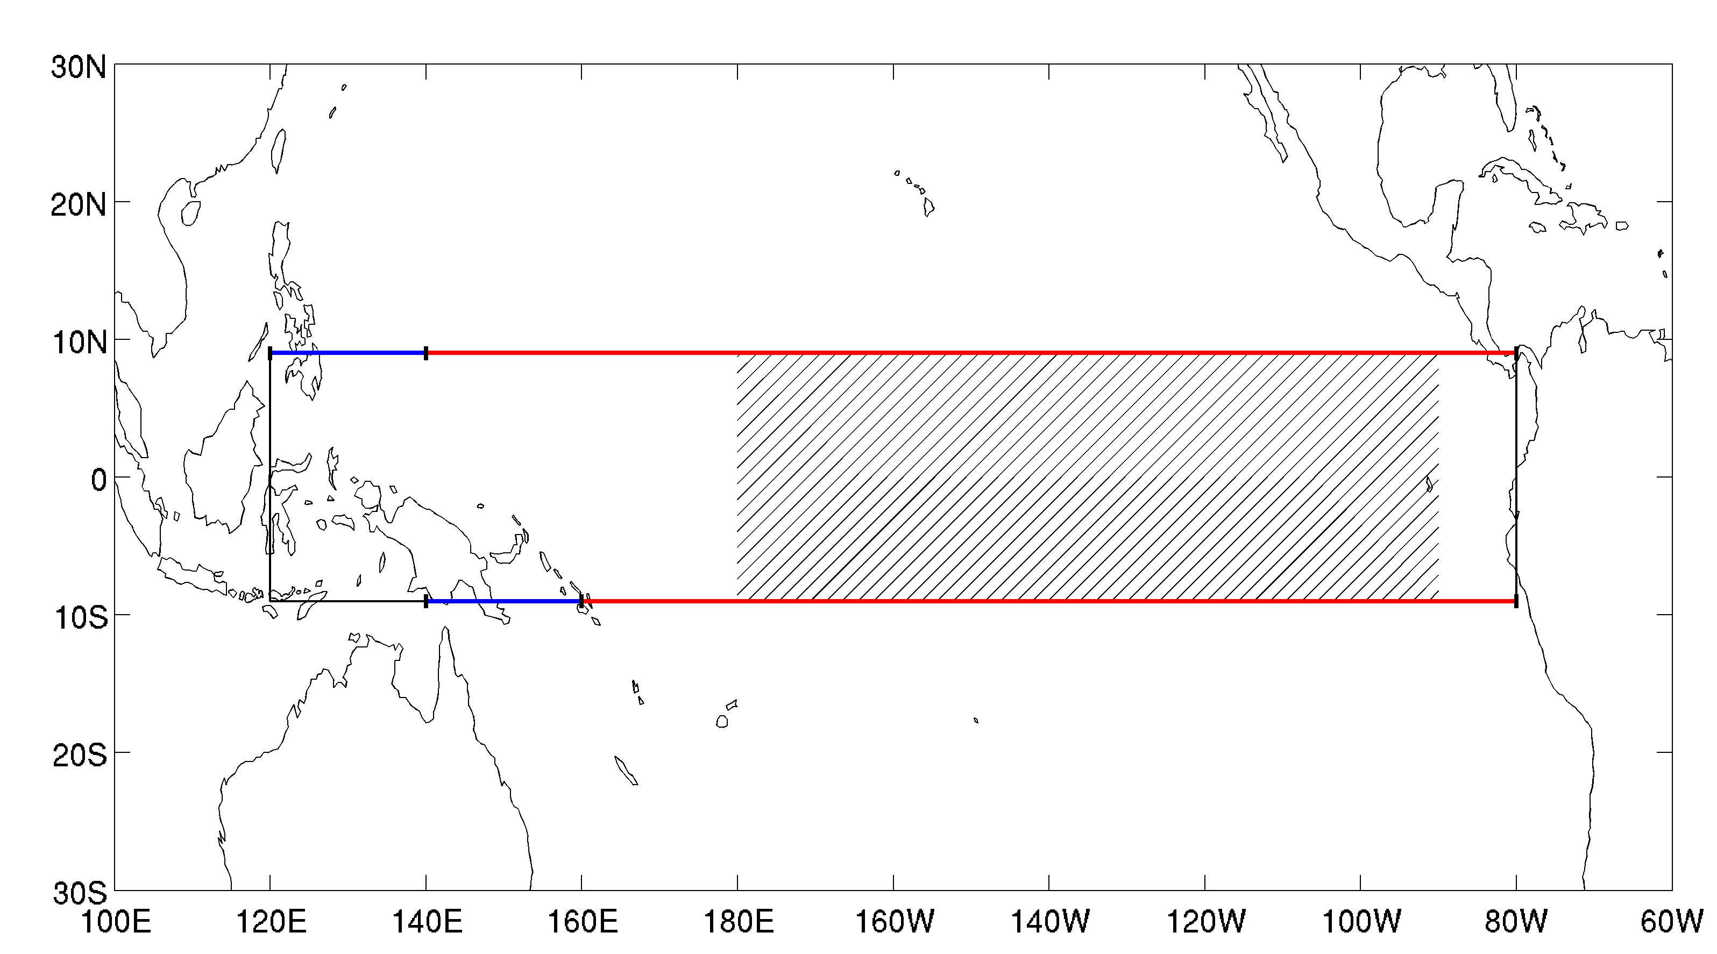
Interior STCs (Red line)
140°E-80°W, 9°N
160°E-80°W, 9°S
50m–26σ_{θ} isopycnal
WB (Blue line)
120°E-140°E, 9°N
140°E-160°E, 9°S
50m–26σ_{θ} isopycnal
WWV
120°E-80°W, 9°S-9°N
Surface–26σ_{θ} isopycnal
SST
180°-90°W, 9°S-9°N,
Zonal Wind Stress Curl
140°E-80°W, 5-9°N
160°E-80°W, 5-9°S
Causal relation between the interior transport and SST in the tropical Pacific
Notes:
We using SODA data to analyze STCs.

Slide 6
Simple Ocean Data Assimilation
Version: v2.2.4
Time: 1960-2010
Horizontal resolution: 0.5°x0.5°
Vertical resolution: 40 levels
Interannual time scale : 2-8yr bandpass filter
Notes:
Sections of mean meridional velocity at 9°N and 9°S
Ekman transport is poleward and interior pycnocline transport is equatorward.
The interior pycnocline transport is estimated by integrating the meridional velocity vertically from 50 m to the depth of 26σ_{θ} isopycnal and integrating zonally from the eastern edge of the western boundary current to the eastern boundary

Slide 7
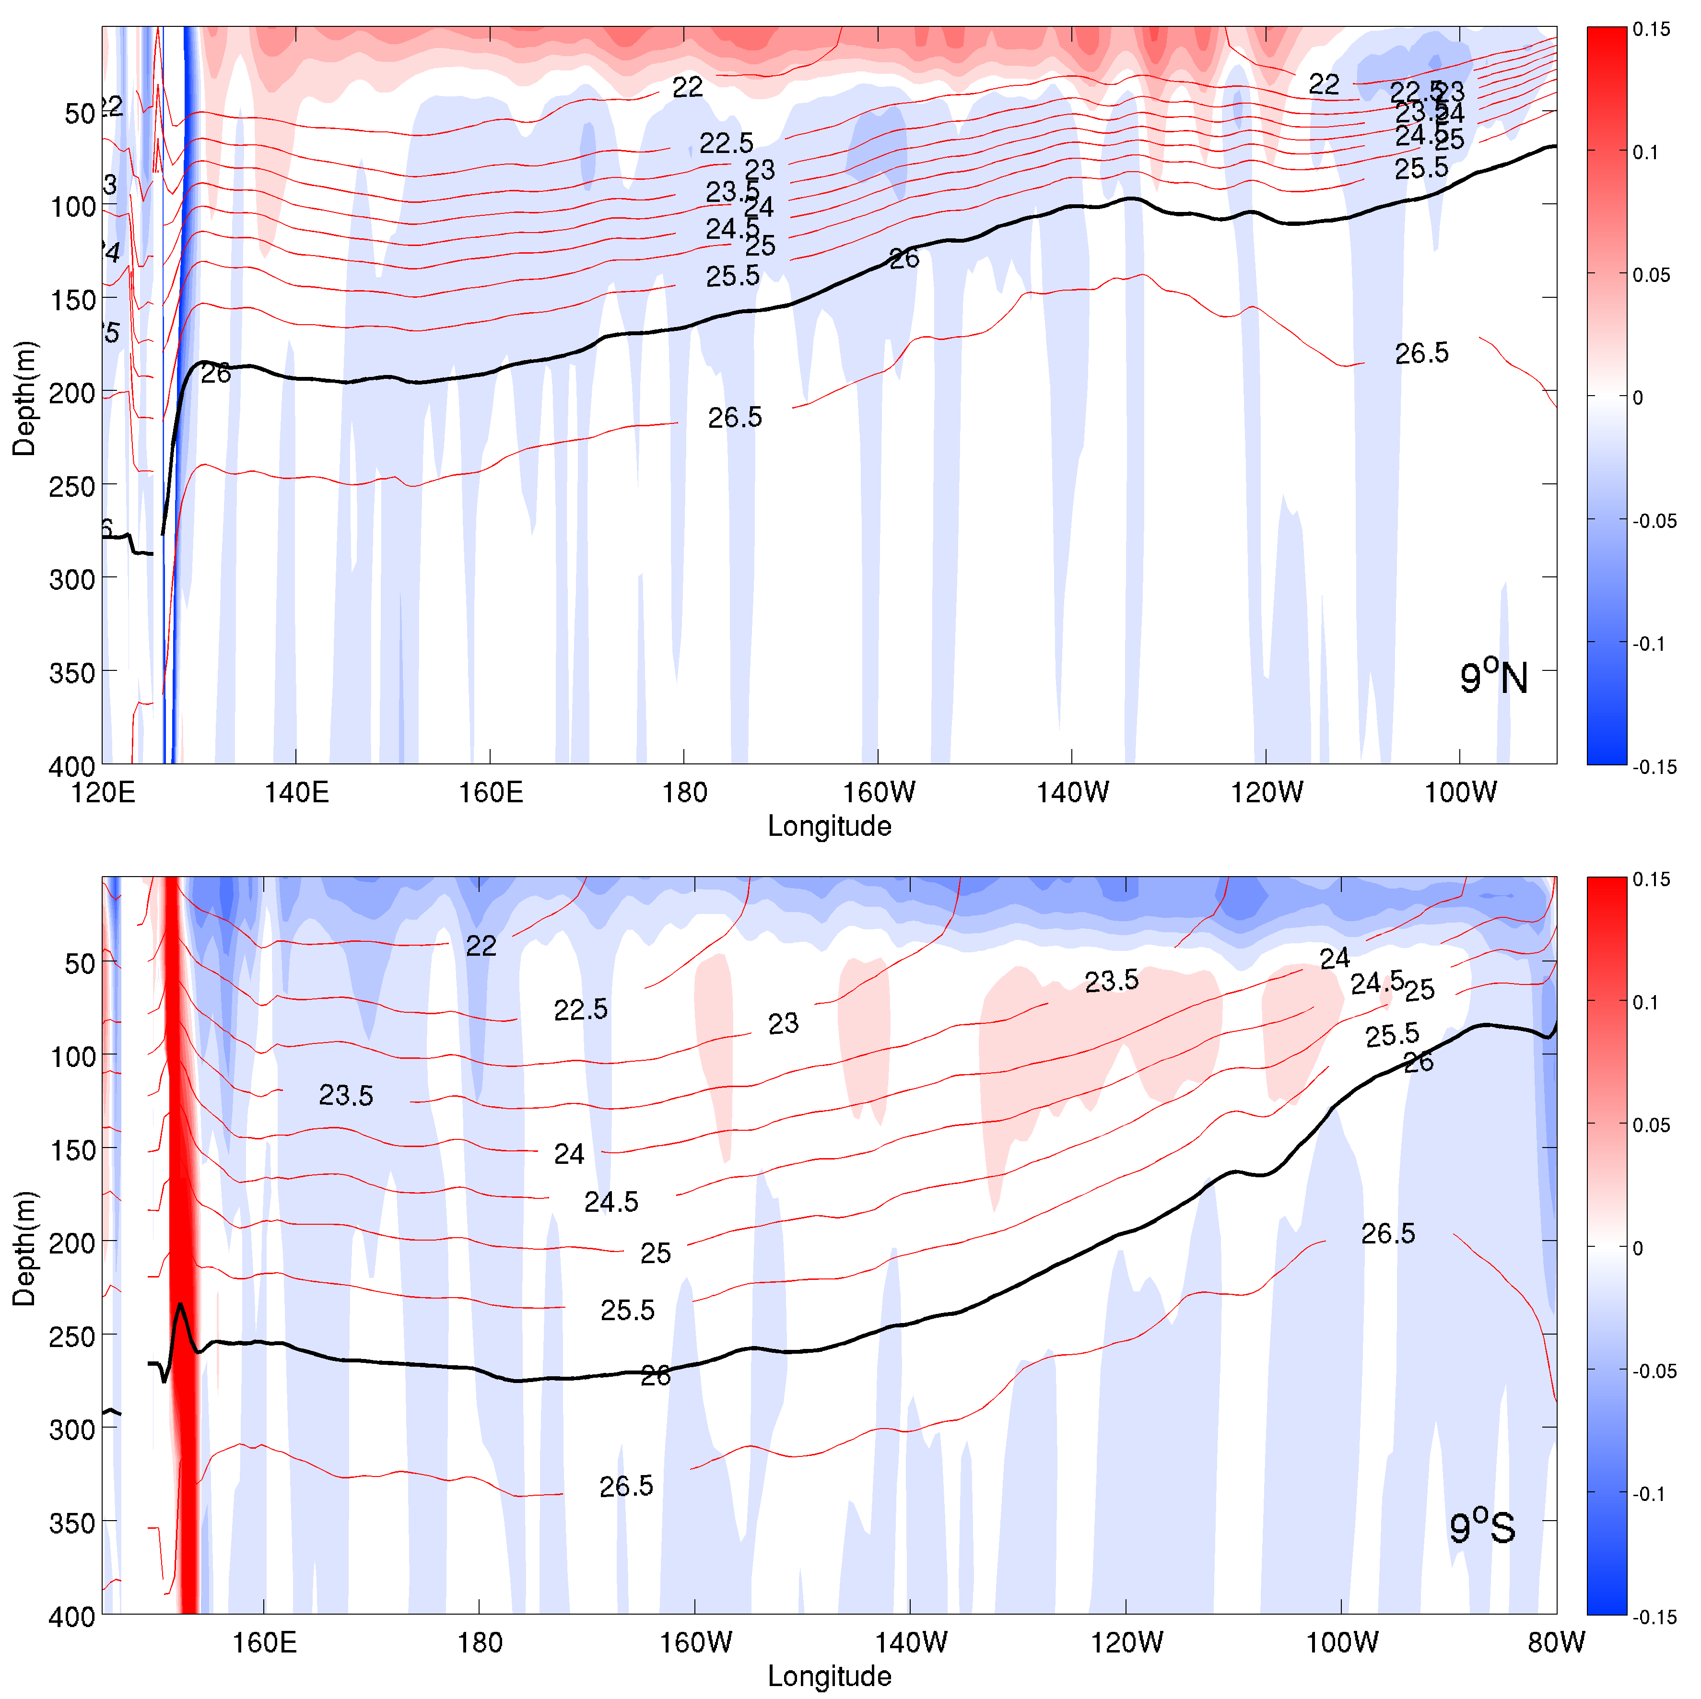

Ekman transport
Meridional Current
WB
Interior
Pycnocline
Interior pycnocline:
depth < 50m
σ_{θ} > 26 km m⁻³
$$STC=\int_{E}^{W}{\int_{26σθ}^{50m}{v dz dx}}$$
Ekman transport
WB
Interior
Pycnocline
Notes:
Sections of mean meridional velocity at 9°N and 9°S
Ekman transport is poleward and interior pycnocline transport is equatorward.
The interior pycnocline transport is estimated by integrating the meridional velocity vertically from 50 m to the depth of 26σ_{θ} isopycnal and integrating zonally from the eastern edge of the western boundary current to the eastern boundary

Slide 8
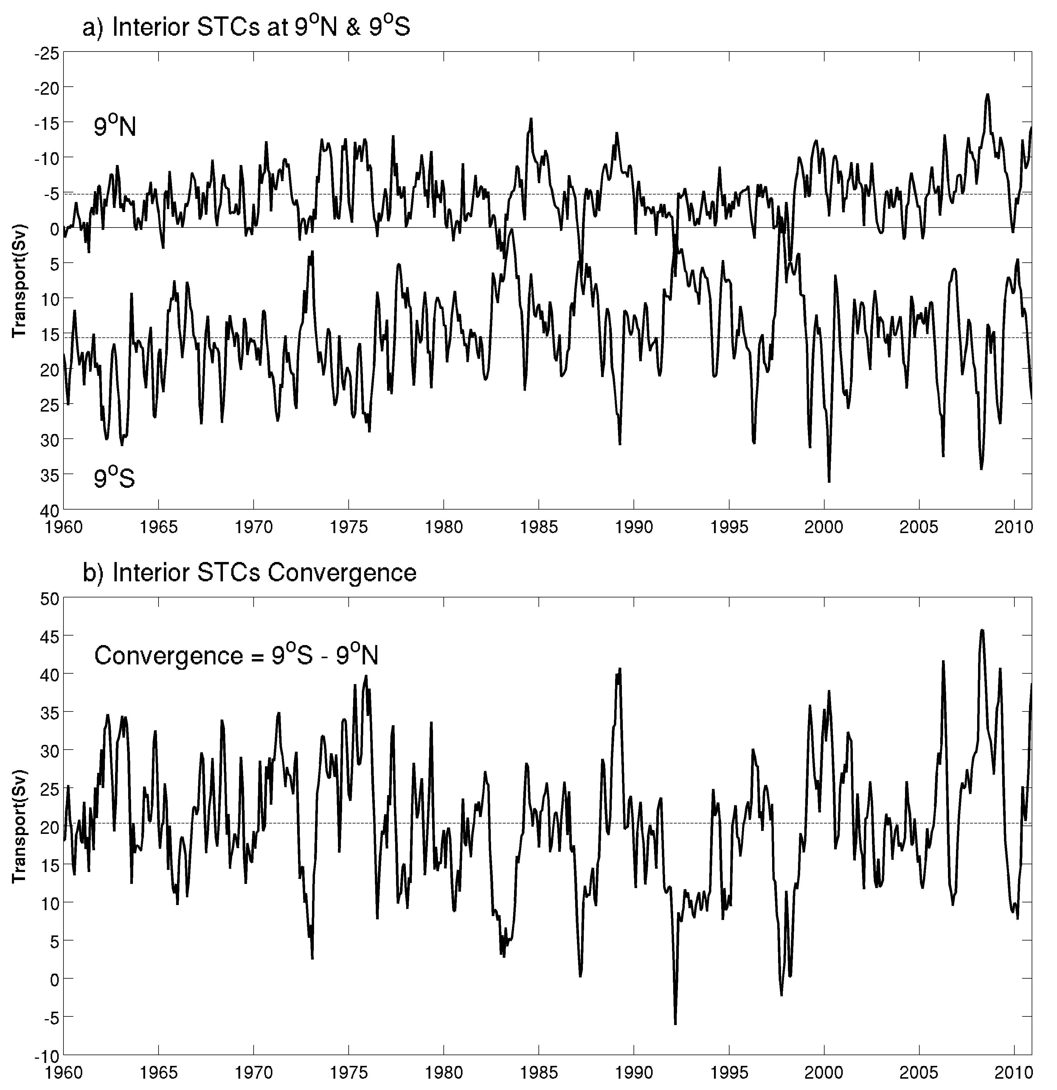

Interior pycnocline
-7.8 Sv
+15.5 Sv
$$STC=\int_{E}^{W}{\int_{26σθ}^{50m}{v dz dx}}$$
+20.2 Sv
Notes:
Here we show the time series of interior pycnocline transport at 9S and 9N and convergence of transport define as S minus N.
The transport is negative at 9N and positive at 9S, and the magnitude of transport at 9S is larger than 9N
The convergence transport is positive value, and we compare interior pycnocline transport with SST.

Slide 9
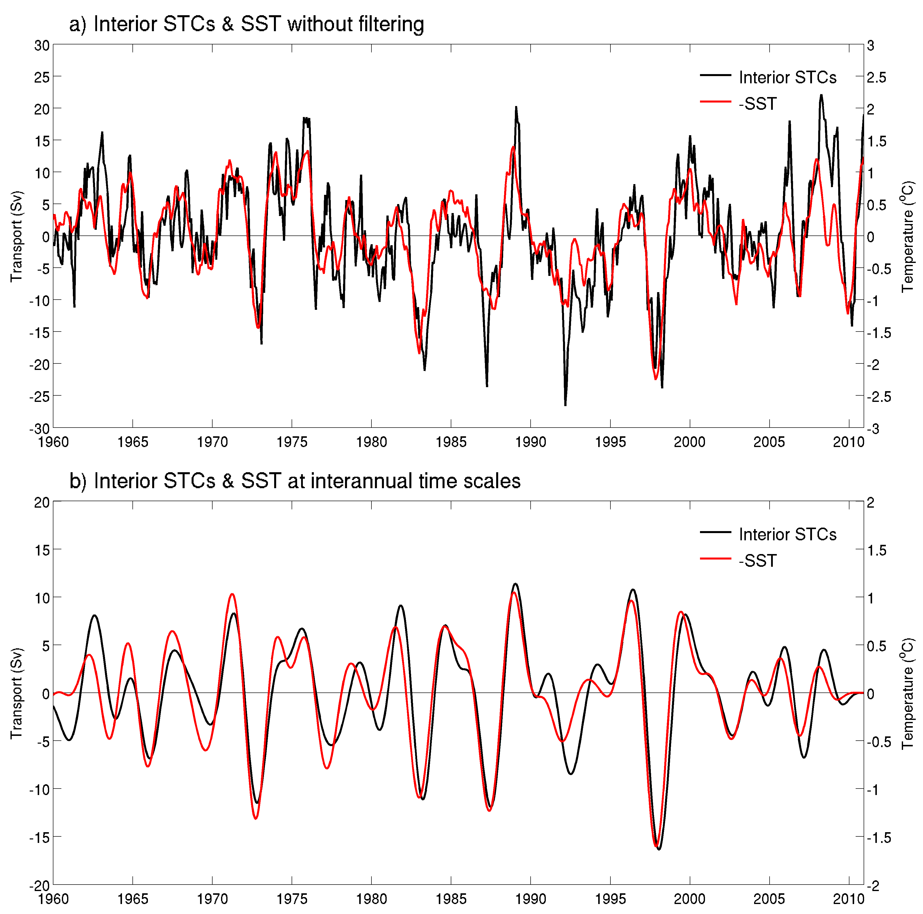
R=-0.93 (SST leads 3 months)

Slide 10
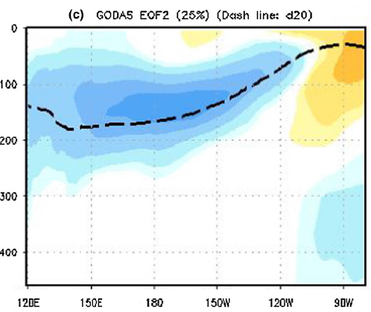
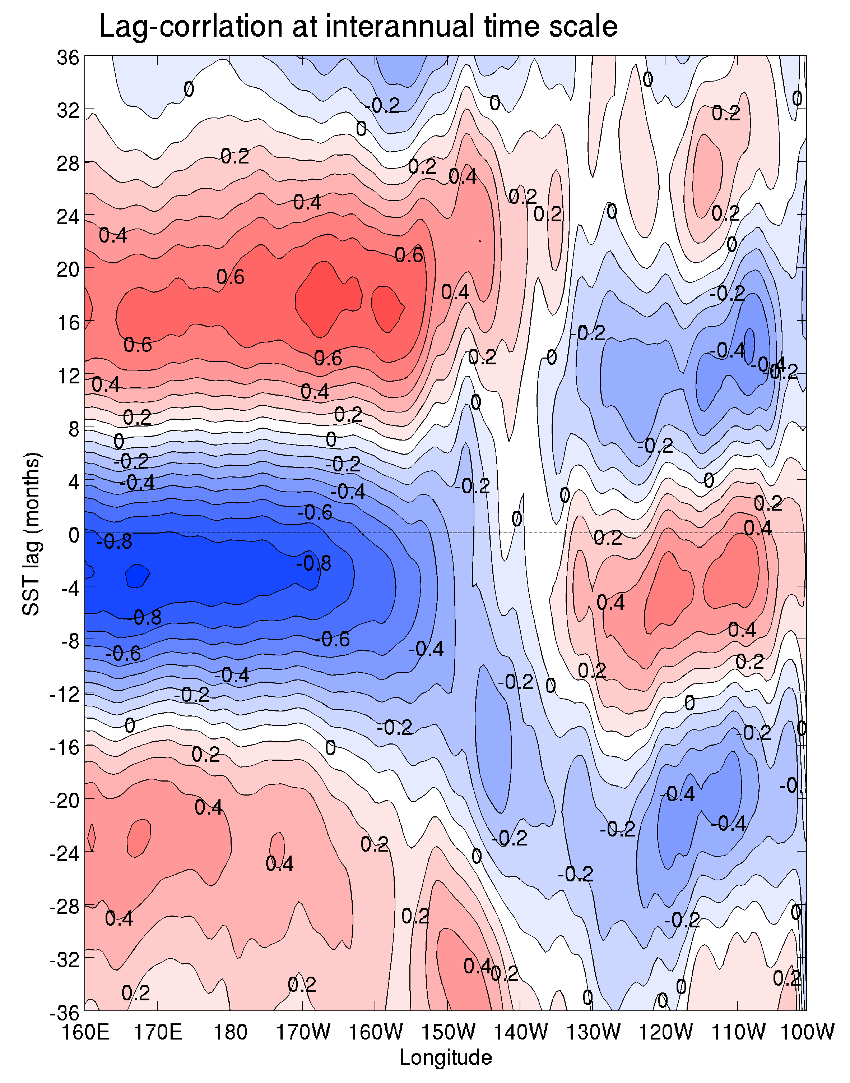
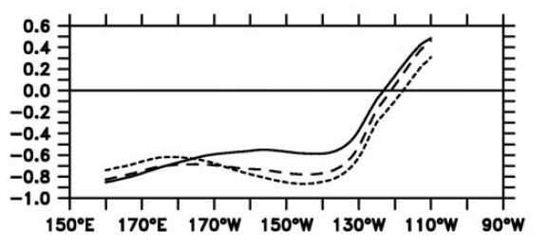

SST and STCs lag-correlation
Kumar and Hu, 2014
SST lag STC
3.3 y
$$STC(L)=\int_{100oW}^{L}{\int_{26σθ}^{50m}{v dz dx}}$$
SST lead STC
Bosc and Delcroix, 2008
Notes:
We calculate lag-correlation between SST anomalies and the convergence of transport anomalies in the interior pycnocline zonally accumulated from 100ºW westward to varying longitudes.
Positive lags mean SST lags the STCs, and negative lags mean SST lead STC
At interannual time scale, the maximum negative correlation appears when the interior transport is zonally averaged across the basin with negative lag values. In the eastern part, the interior transport is positively correlated with SST with negative lag values. We separate this two different response by 130W. Western part as 160E-130W and eastern part as 130W-100W.
At decadal time scale, the maximum negative correlation appears uniformly from west to the east.

Slide 11
Recharge-discharge theory
Geostrophic
(Jin 1997; Meinen & McPhaden 2000, 2001)
Ekman
τ_{a}
SSTa(+)
τ_{a} ~ 0
SSTa ~0
Depth anomaly
Depth anomaly
Geostrophic
Ekman
τ_{a}
τ_{a} ~ 0
SSTa ~0
SSTa(-)
Depth anomaly
Depth anomaly

Slide 12
Interior STCs (Red line)
140°E-80°W, 9°N
160°E-80°W, 9°S
50m–26isopycnal
WB (Blue line)
120°E-140°E, 9°N
140°E-160°E, 9°S
50m–26isopycnal
WWV
120°E-80°W, 9°S-9°N
Surface–26isopycnal
SST
180°-90°W, 9°S-9°N,
Zonal Wind Stress Curl
140°E-80°W, 5-9°N
160°E-80°W, 5-9°S
Causal relation between the interior transport and SST in the tropical Pacific
Notes:
We using SODA data to analyze STCs.

Slide 13
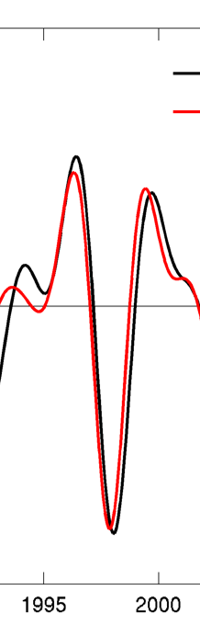
18
R=-0.93 (SST leads 2 months)
R=+0.59 (SST lags 18 months)
2

Slide 14
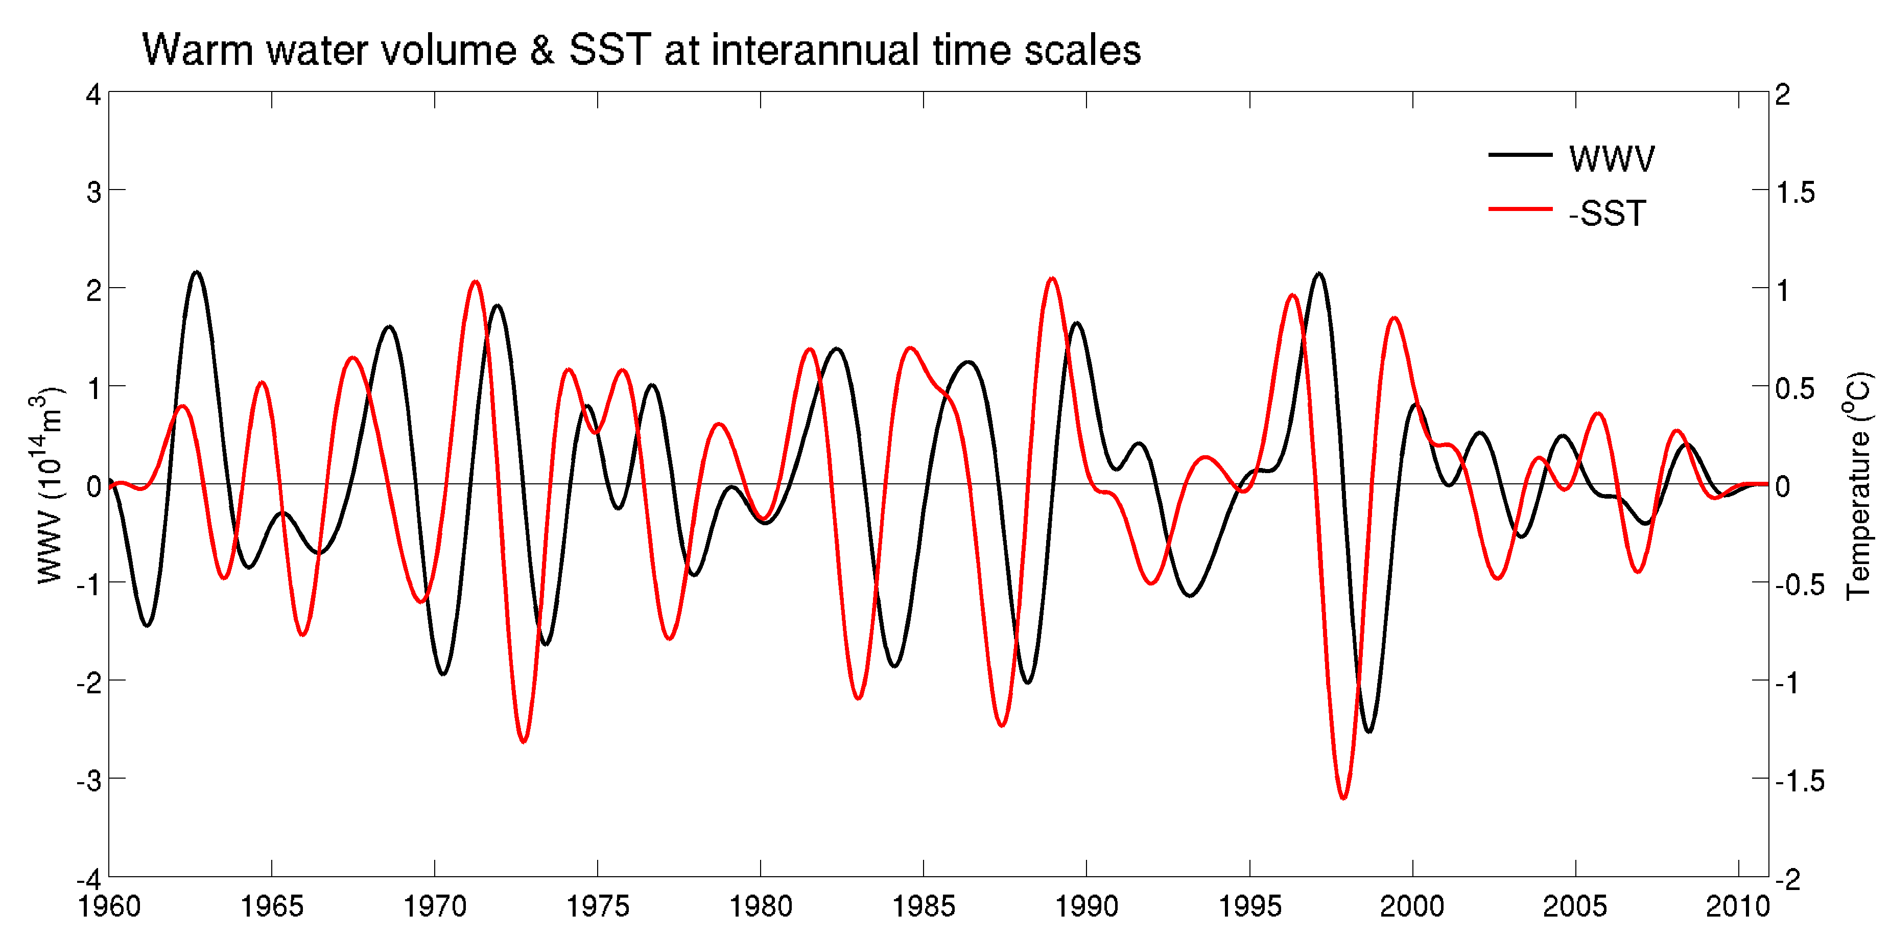
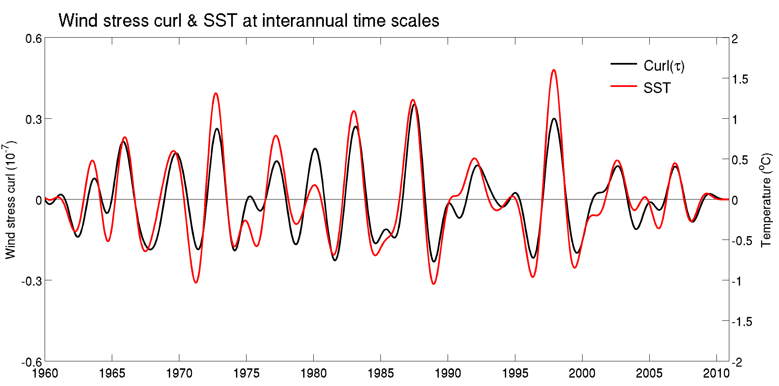
R = -0.84 (SST leads 10 mons)
R = +0.73 (SST lags 10 mons)

Slide 15
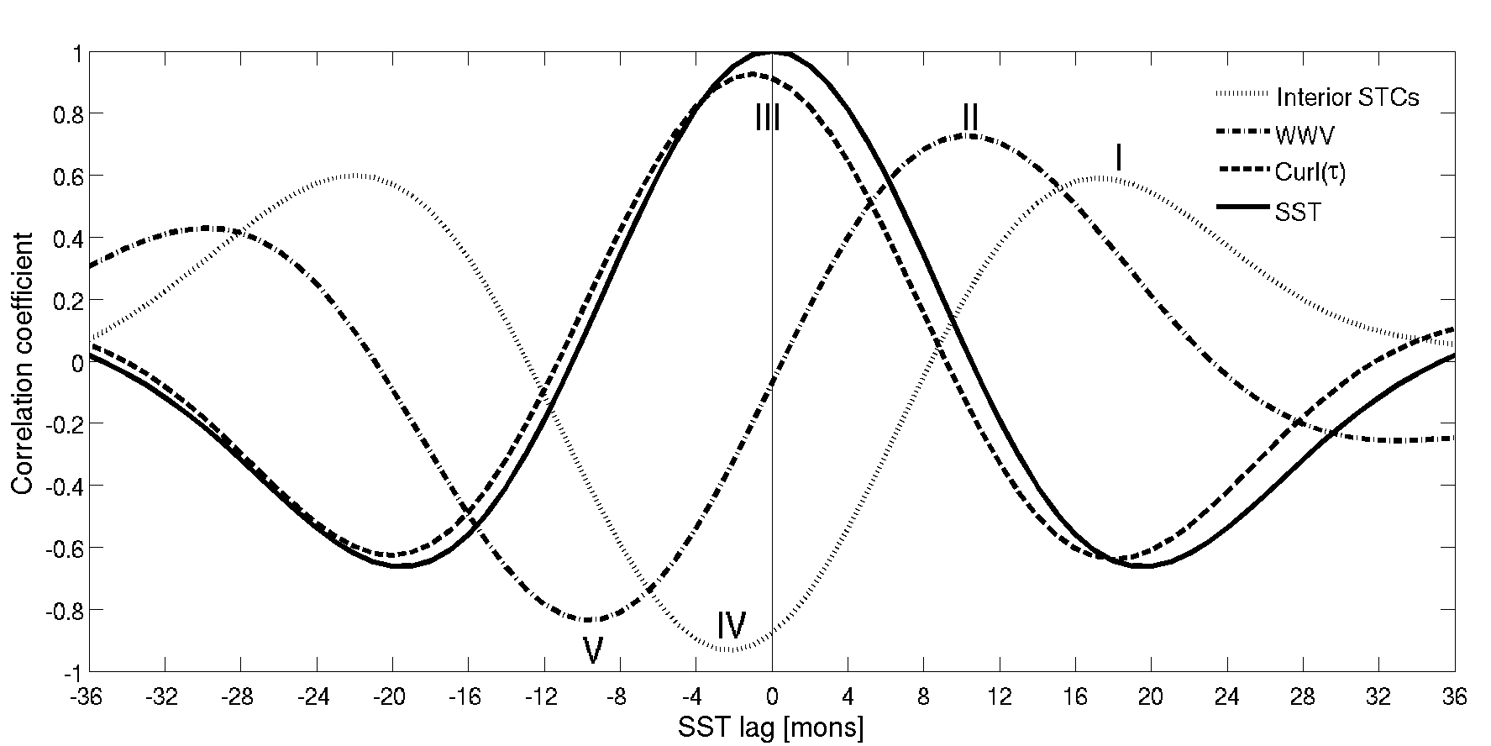
SST lead
SST lag

Slide 16
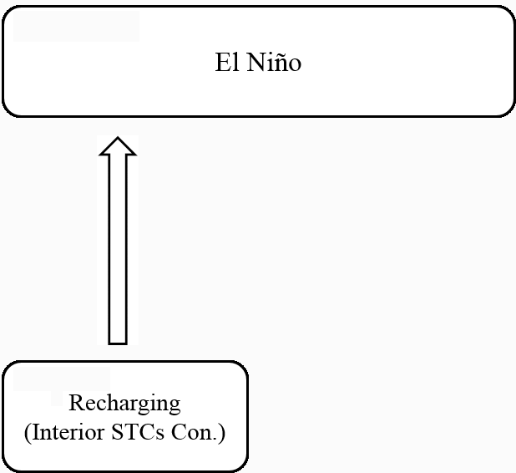
Geostrophic
τ_{a}
SSTa(-)
Depth anomaly
18
18

Slide 17
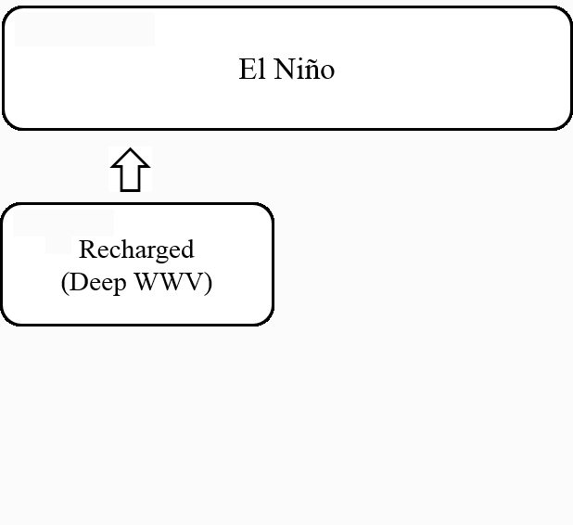
τ_{a} ~ 0
SSTa ~0
Depth anomaly
10
10

Slide 18
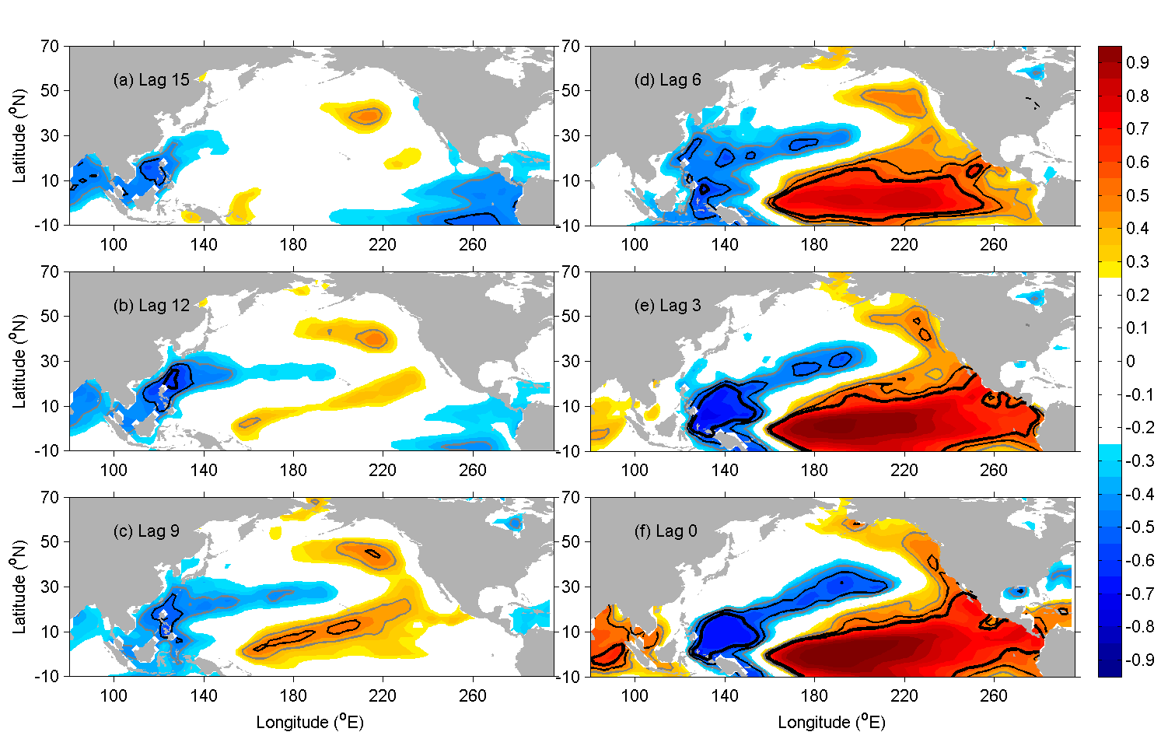
ENSO precursor: WNP
Western North Pacific

Slide 19
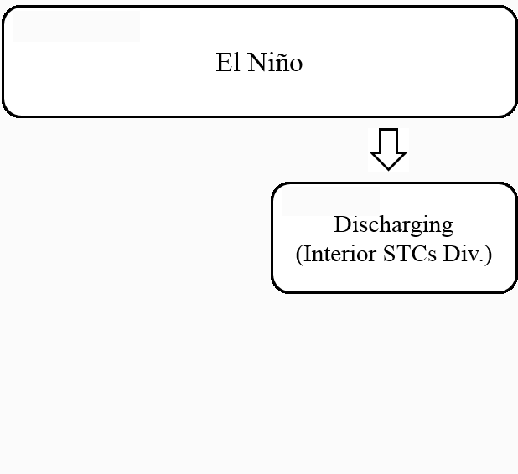
Geostrophic
τ_{a}
SSTa(+)
Depth anomaly
-2
2

Slide 20
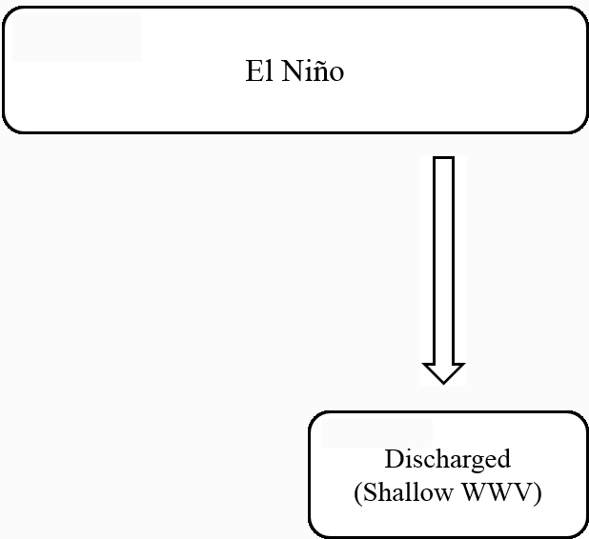
τ_{a} ~ 0
SSTa ~0
Depth anomaly
-10
10

Slide 21
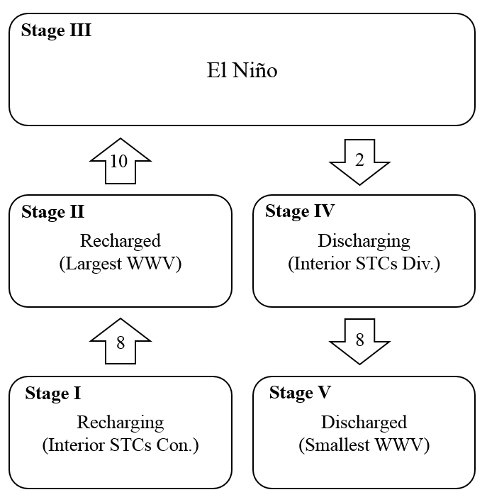
The corresponding timescales for the completed process (from a recharging stage to a discharged stage) are 8, 10, 2 and 8 months, respectively.

Slide 22
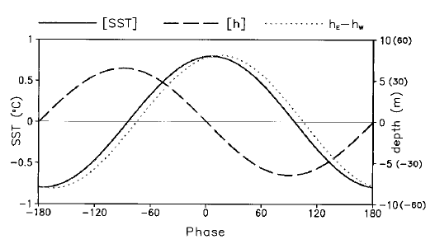
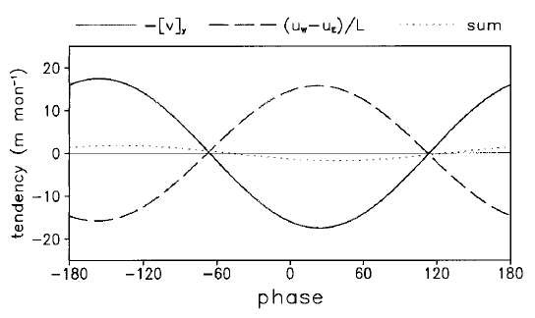

- 90º => 10 months
+90º => 10 months
$\frac{∂WWV}{∂t}=$ WB + IN $\sim SST$
- 160º => 17.7 months
+20º => 2 months
An and Kang (2000)

Slide 23
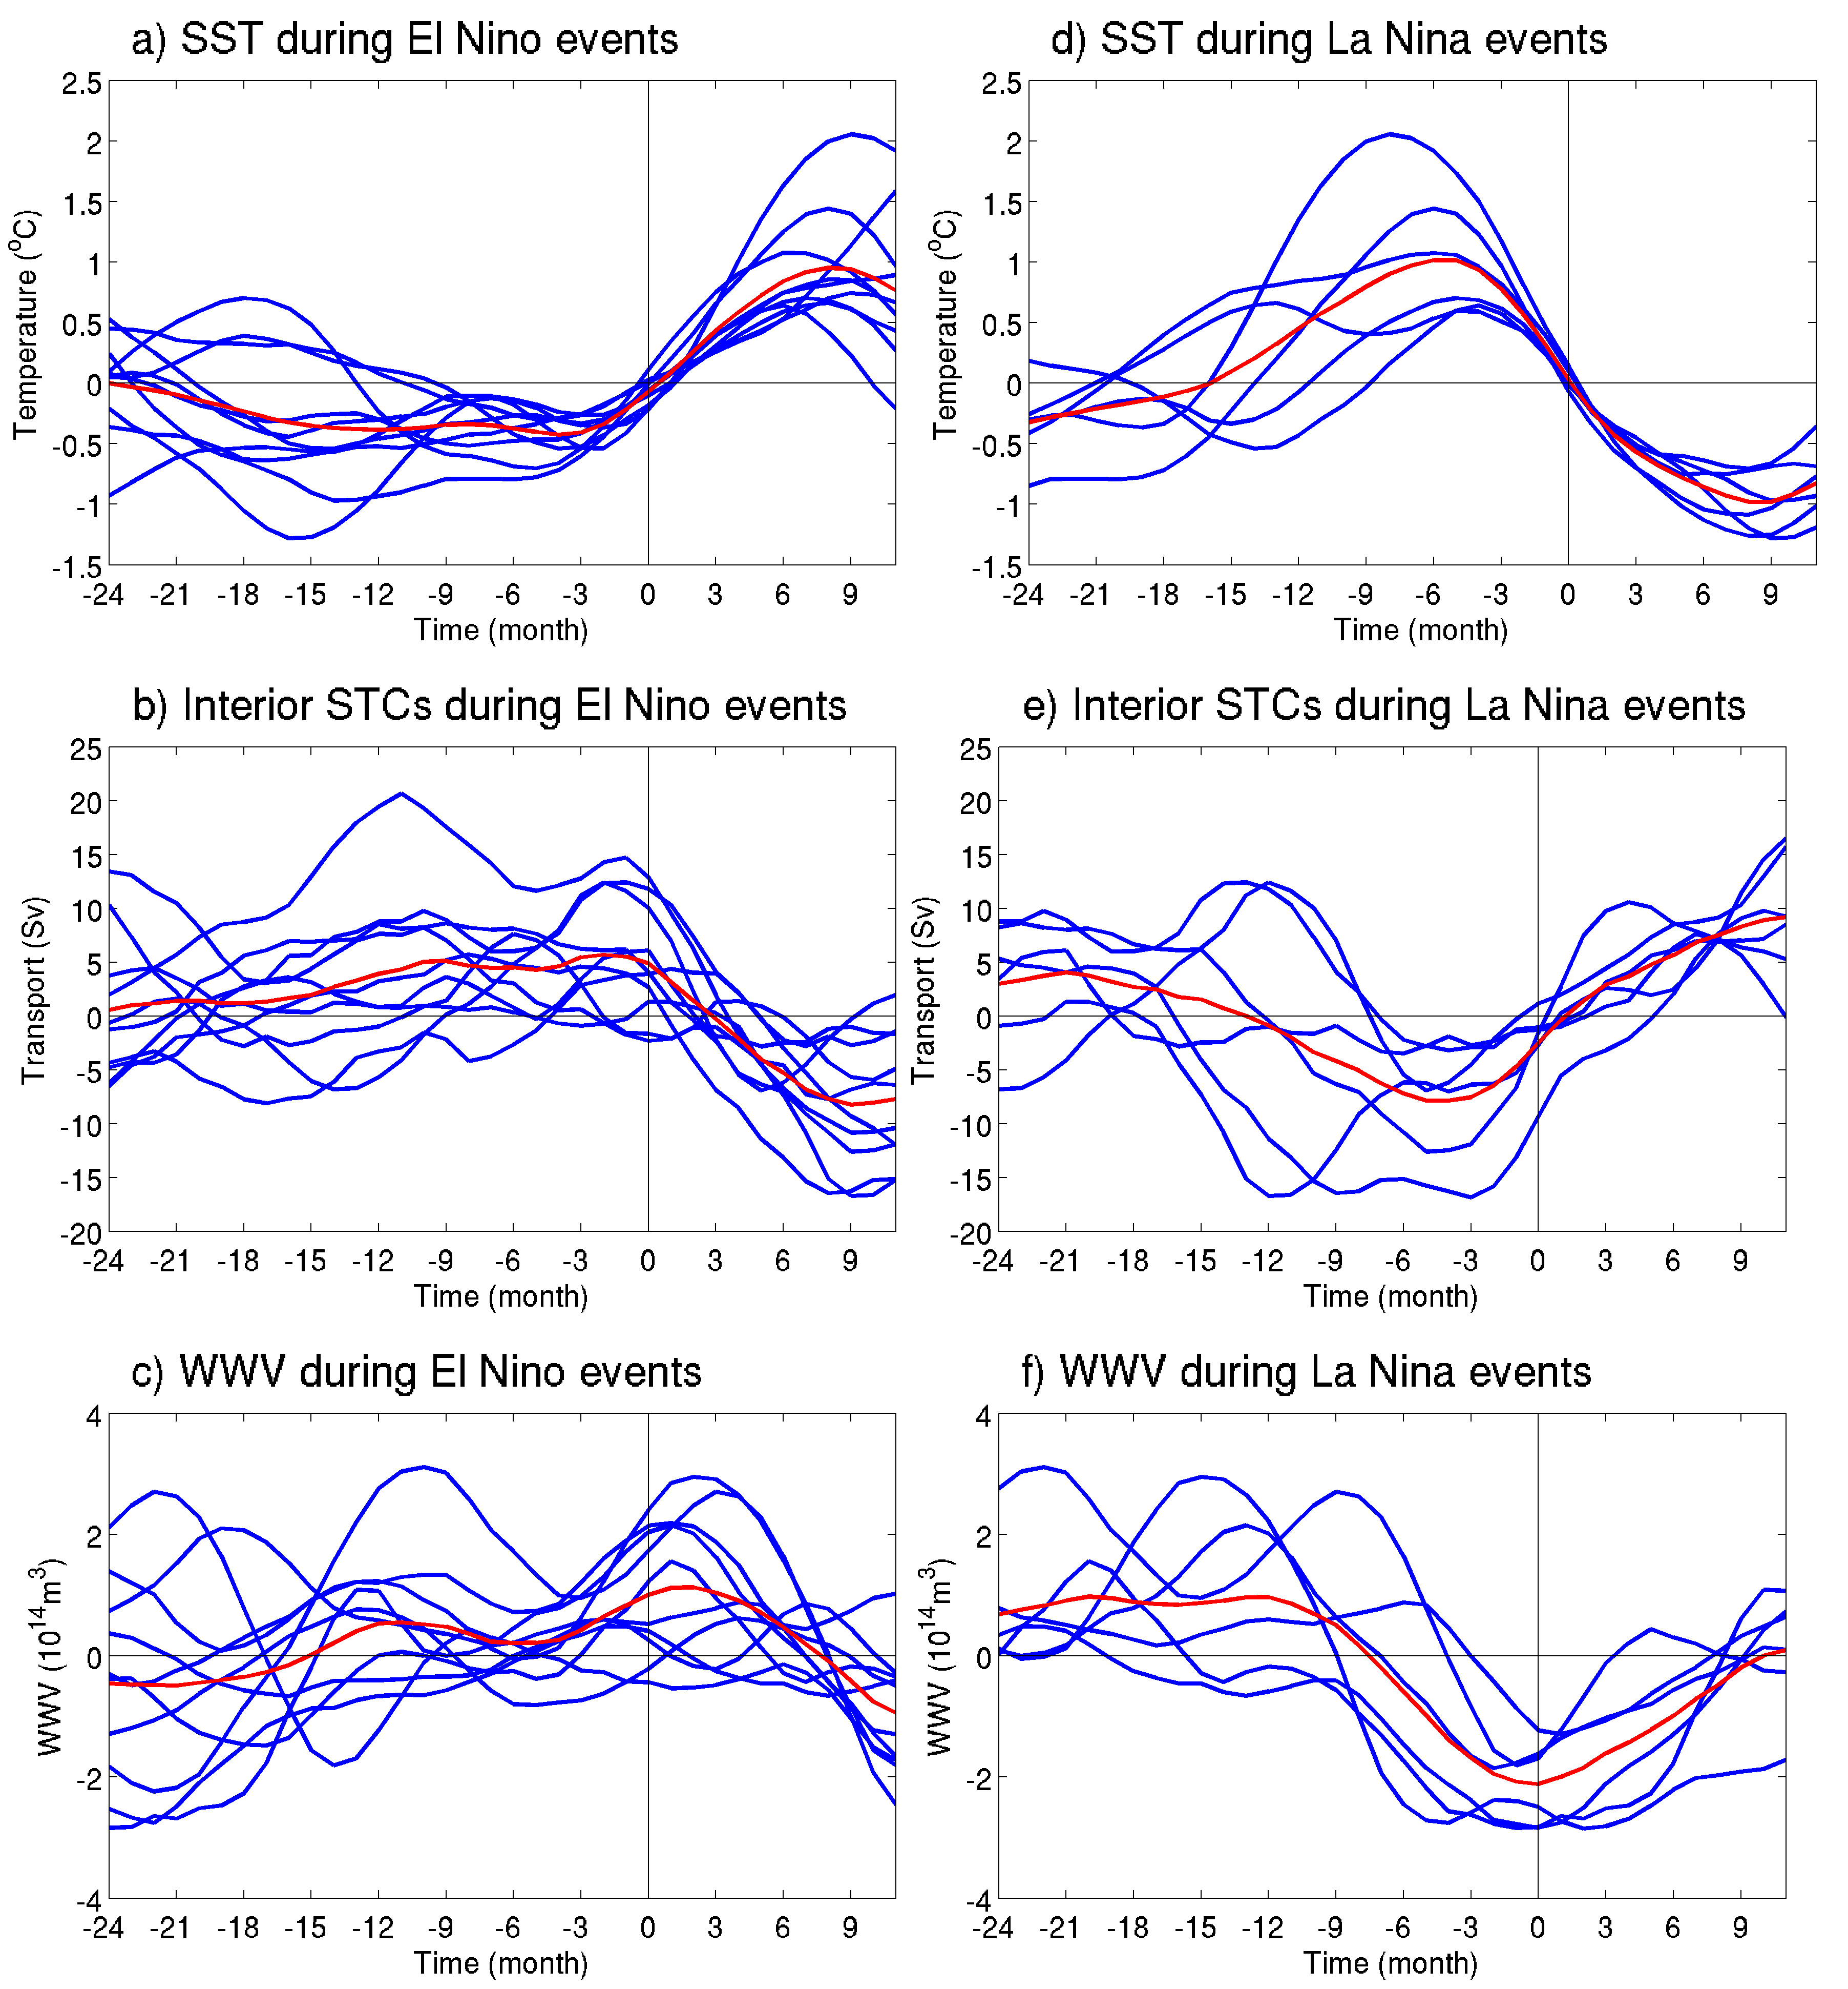
weaker SSTa
longer cold phase
El Niño
1963/64, 1965/66, 1968/69, 1972/73, 1982/83, 1987/88, 1997/98, 2002/03, 2006/07, 2009/10
stronger SSTa
Shorter warm phase
La Niña
1964/65, 1970/71, 1973/74, 1988/89, 1998/99, 2007/08
(Hu et al. 2014)
Notes:
SSTA in the cold phase generates persistent convergence of interior STCs transport (b). The transition of the composite interior STCs transport from convergence to divergence occurs 2-3 months after the SST phase transition.
the transition of the SSTA from warm phase to cold phase lags the transition of interior STCs transport from divergence to convergence two months (e).
The discharging of interior STCs transport in the warm phase leads to the decrease of WWV before the peak of La Niña (f).
The convergence of interior STCs transport recharges the tropical upper ocean to increase the WWV before the peak of El Niño (c). In most El Niño developing events, the WWV shows two peaks corresponding to the double peaks in SSTA and interior STCs transport in the cold phase.
The minimum in the composite WWV cycle corresponds to the zero SSTA in the composite SST cycle, the quarter-cycle phase difference is about 8 months.

Slide 24
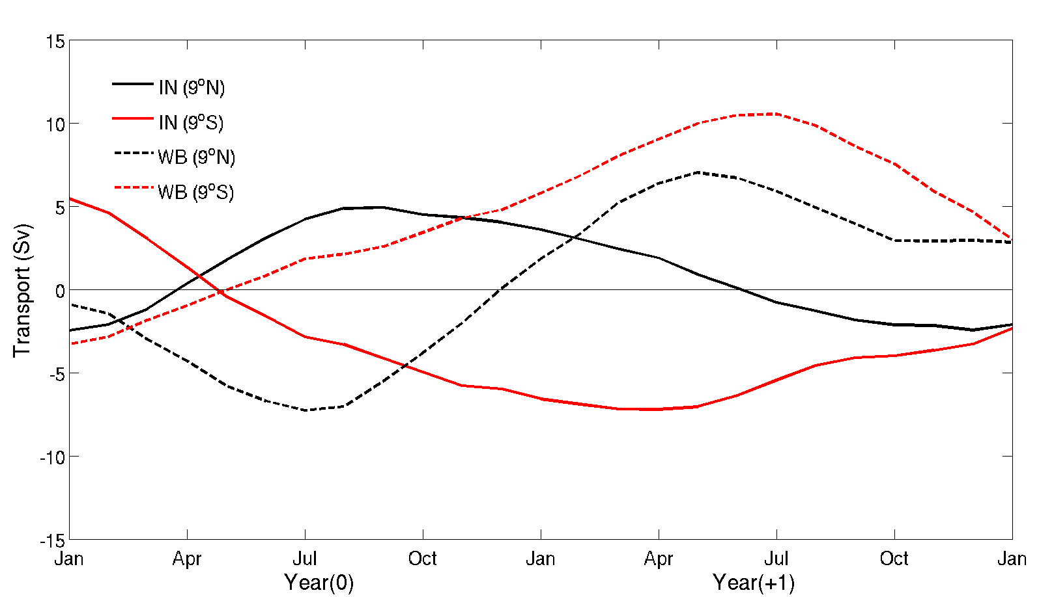
Time series of the composite interior STCs and WB transport of the El Niño events for 1972/73, 1976/77, 1982/83, and 1997/98.
Notes:
strong asymmetry of the interior STCs transport in the southern and northern hemispheres, i.e., the magnitude of transport anomalies at 9°S is more than three times larger than that at 9°N.
These four events are selected because of the clear southward shift of westerly wind anomaly.
The north-south asymmetry of the transport is related to the southward migration of westerly wind, when El Niño events reach their peak amplitude
the interior STCs transport was compensated by the western boundary transport in the southern hemisphere but not in the northern hemisphere. The non-compensation in the northern hemisphere was caused by the phase-lag of the interior STCs transport and western boundary transport as mentioned in the study by Ishida et al. (2008).
In the northern hemisphere, the western boundary transport turns northward near the end of Year (0), about six months after the interior STCs transport turns northward near Apr (0). In contrast, the interior STCs transport in southern hemisphere is well compensated by the western boundary transport.
the discharge at 9°N turns to recharge in the year (+1) summer, while the discharge at 9°S persists beyond year (+1).

Slide 25
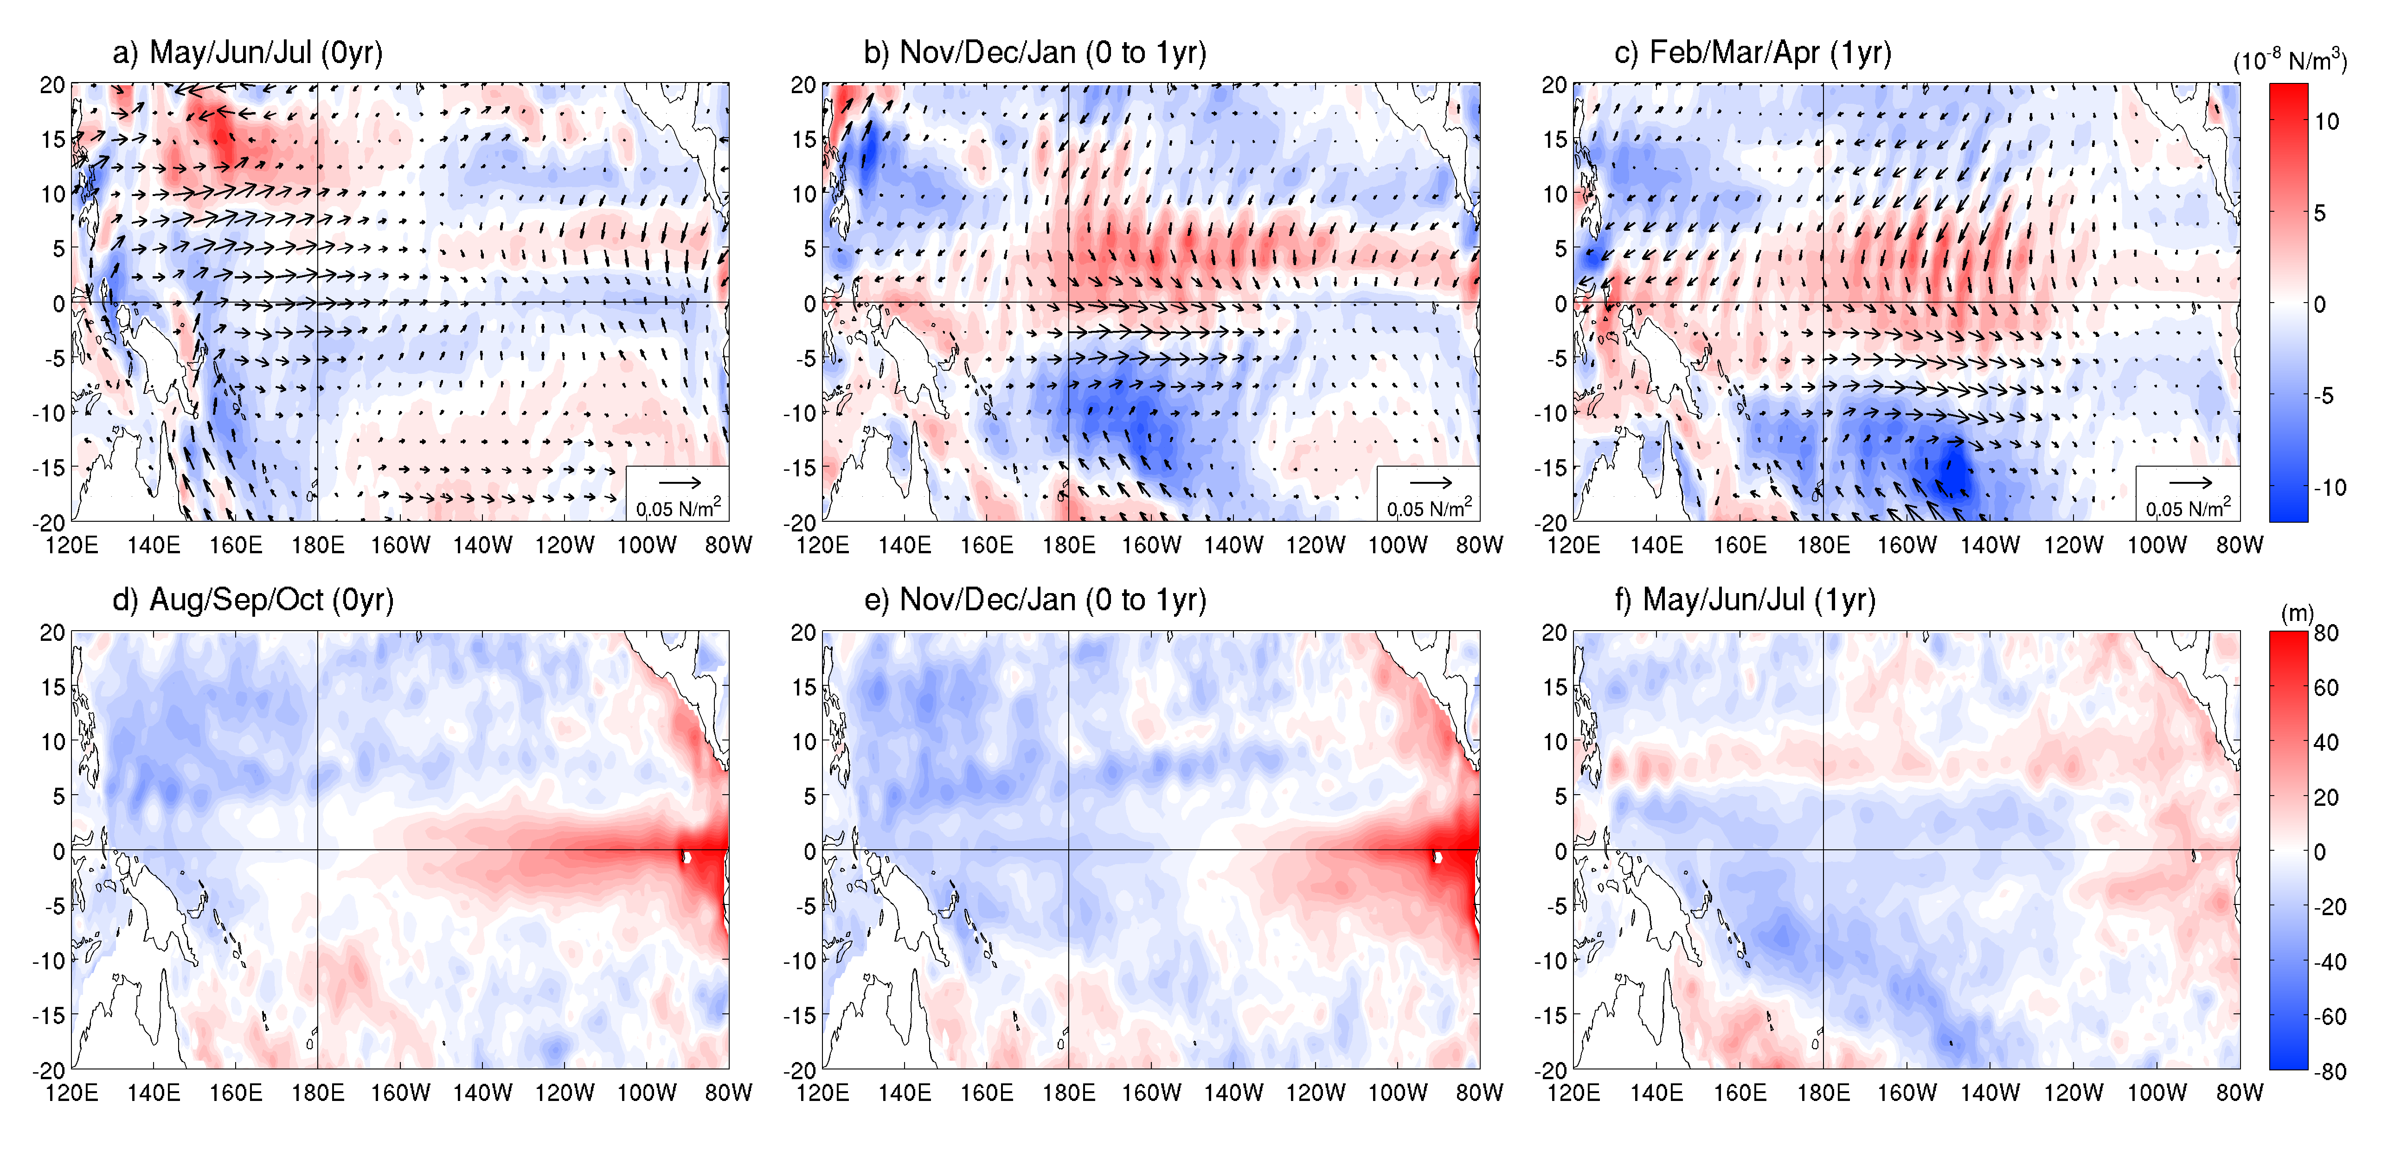
Developing
Mature
Decaying
Composite maps of Wsa, WSCs and the depth of 26σ_{θ}a
Notes:
This is based on the time-lagged response of interior STCs transport (and WWW) to SST (and wind forcing) in the El Niño developing and decaying phases (Fig. 14). A near in-phase relation is found between SST and interior STCs transport in the mature phase of El Niño.
During the developing stage of El Niño, westerly wind anomalies in the western Pacific, and the associated positive wind stress curl in northwestern Pacific can be seen (a). The wind forcing induces anomalous shallow interior pycnocline in the western and central north Pacific (d).
As El Niño matures, westerlies develop in the central equatorial Pacific and the wind stress curl field is symmetric about the equator (b). There are symmetric structures in the depth of 26σ_{θ} with two shallow regions located north and south of the equator in the western equatorial Pacific and a deep region in the eastern equatorial Pacific (e). This structure corresponds to northward interior STCs transport at 9°N, southward interior transport at 9°S, and northward transport in western boundary at 9°S.
(c) westerlies move slightly southward along with the corresponding wind stress curl. The wind forcing shoals the equatorial thermocline except the eastern boundary and deepens the thermocline north of the equatorial wave guide. The thermocline anomaly pattern corresponds to a northward transport in western boundary and near zero interior STCs transport at 9°N due to a phase transition. At the same time, the shoaling of depth of 26σ_{θ} still locates in south Pacific and corresponds to the southward interior transport and northward western boundary at 9°S (Fig. 15). The above-stated evolution of transport in Fig. 15 is speculated as a response to the wind forcing, which shows that the northward western boundary transport is generated after the northward interior STCs transport at 9°N by half a year. It also explains the termination of discharging of the interior STCs transport in year (+1) at 9°N, and persistent discharging of the interior STCs transport at 9°S.

Slide 26
Summary
Interior STCs transport convergence anomaly across 9ºS and 9ºN is highly correlated with equatorial SST anomaly such that every one Sv STC transport convergence corresponds to 0.1ºC SST increase
Correlation between SST and STC is primarily contributed by the interior transport into the central equatorial zone (160ºE-130ºW), and in contrast, the interior transport into the eastern part (130-100ºW) is weakly correlated with SST
Corresponding timescales for the completed process of ENSO evolution (from a recharging stage to a discharged stage) are 8, 10, 2 and 8 months, respectively.
Southward shift of westerly wind anomalies during large El Niño events contributes to asymmetry between northern and southern interior STCs.

Slide 27
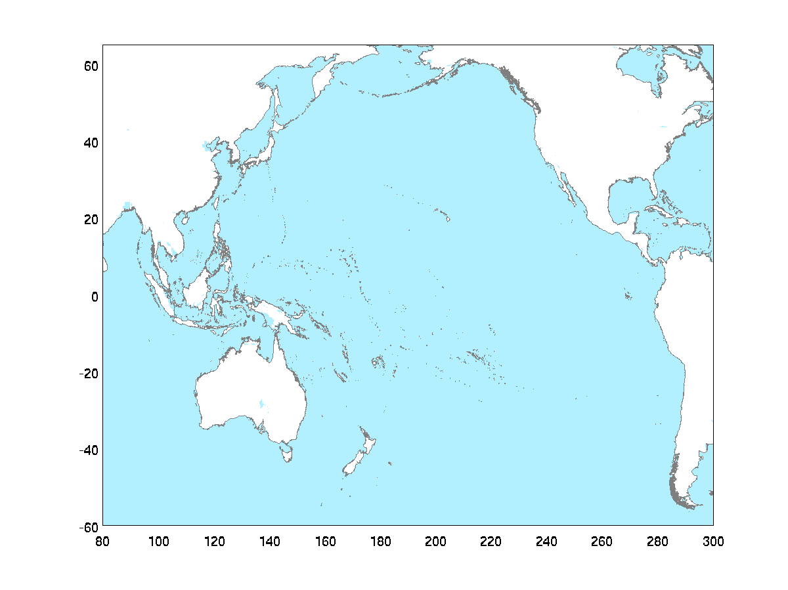
Dyn. proc. from ENSO precursor to ENSO
Equatorial winds may
affect the western eq. Pacific Kelvin wave.
[Wang et al., 2012]
NPO/NPGO
Tropical-extratropical Interact.
(ATM-OCN)
WNP
cold SSTa
??
SFM [Vimont et al., 2003]
Perturb. (heat source) in the Indo-Pac. (e.g., SCS)
CP ENSO
EP ENSO
IOD
Ocean Dynamics
Indian Ocean Equat. Kelvin waves
→ western equat. Pacific.
[e.g., Yuan et al, 2011; Jin, 1997]
ACW/ACC
Notes:
Antarctic Circumpolar Current/

