Slide 1
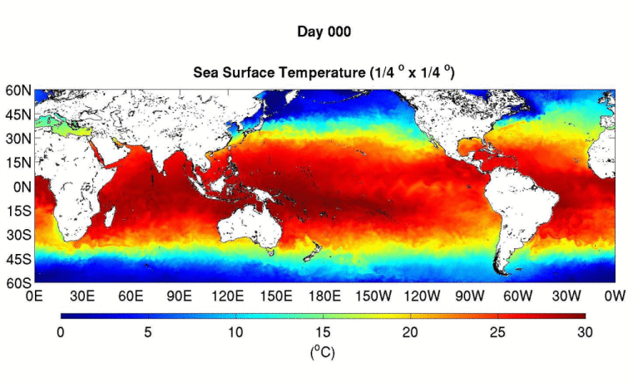
doi:10.22033/ESGF/CMIP6.16323
doi:10.22033/ESGF/CMIP6.14336
TIMCOM model datasets for CMIP6 Ocean Model Intercomparison Project
Yu‑heng Tseng, Shao-En Tsao, Yi-chun Kuo
Institute of Oceanography, National Taiwan University, Taiwan
Acknowledgement: Huang-Hsiung. Hsu, Hsin-Chien Liang, Chia-ying Tsai, Chun Hoe Chow, Wen-yen Yu
Notes:
1. Hi 大家好 我今天要跟各位分享的是我們最近這幾年在台灣利用台灣本土發展的海洋模式參與CMIP6下OMIP的實驗結果!在中研院氣候模式團隊的協助下我們已經將模擬資料成功上傳至CMIP的資料網站，並且撰寫相關論文!利用這會議讓大家知道歡迎台灣有使用OMIP全球海洋資料的同學老師都能夠下載使用!若懶得下載的，也可以直接跟我說!
Good morning, thank you very much for your coming for the first talk today!
What I am going to present is

Slide 2
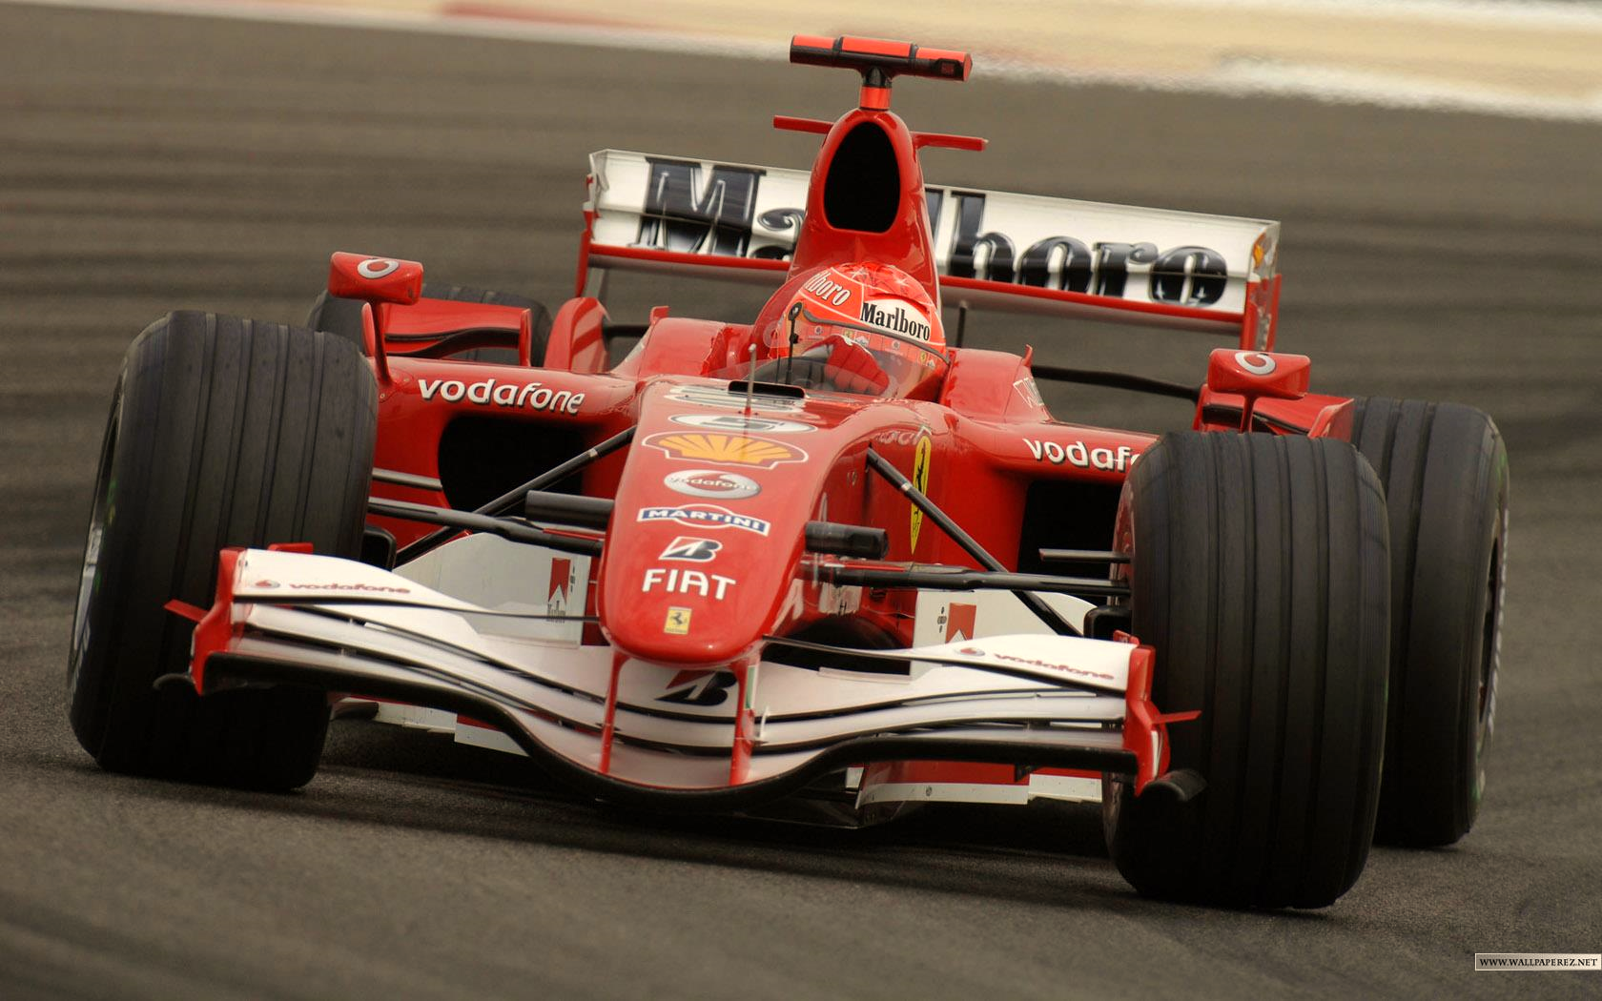
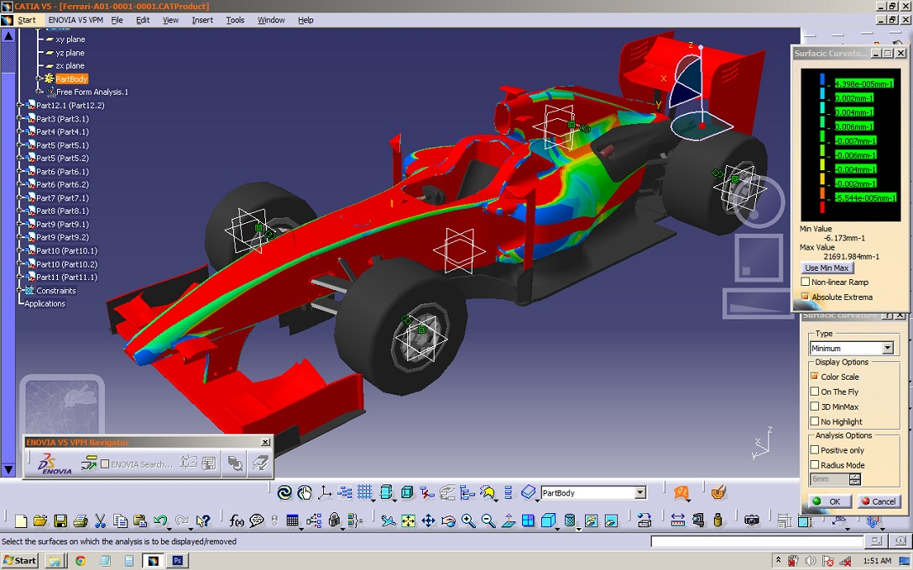
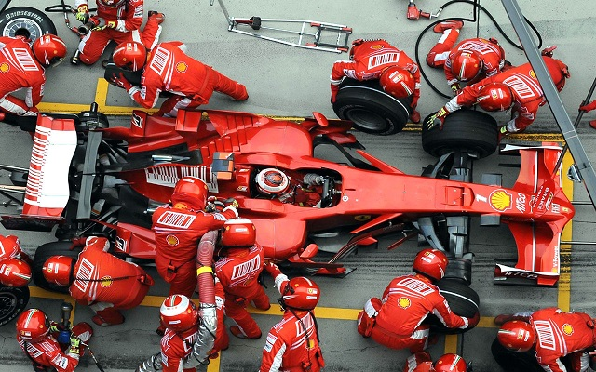
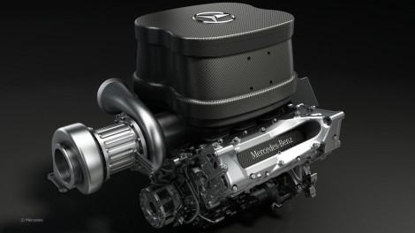
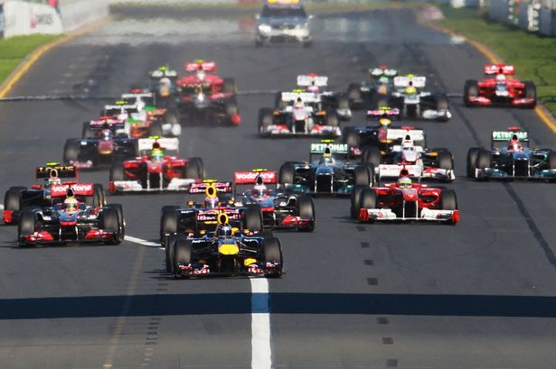
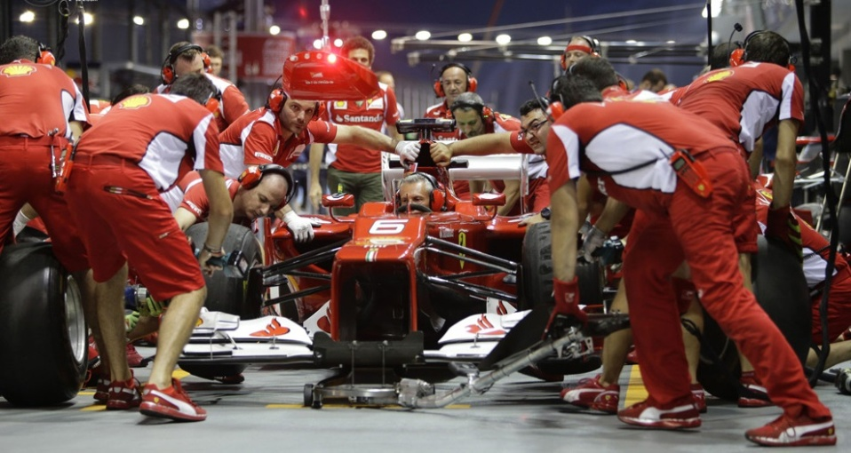
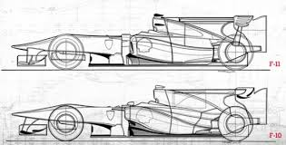
1. Design
4. Test drive
TIMCOM Activity at NTU
2. Replace a new engine
5. Competition (Evaluation)
3. Assembly
6. Feedback (future projection)
Notes:
首先跟大家報告一個海洋模式的發展，

Slide 3
OUTLINES
Ocean Model Intercomparison Project (OMIP) experiments
Mean biases of TIMCOM
Atlantic Meridional Overturning Circulation (AMOC)
Key to simulate AMOC variability
Summary

Slide 4
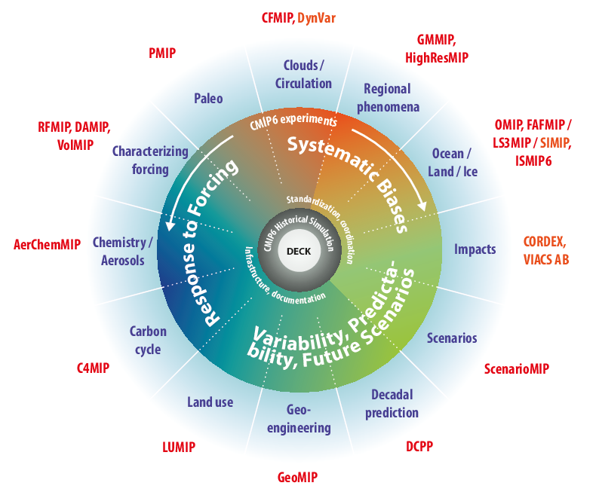
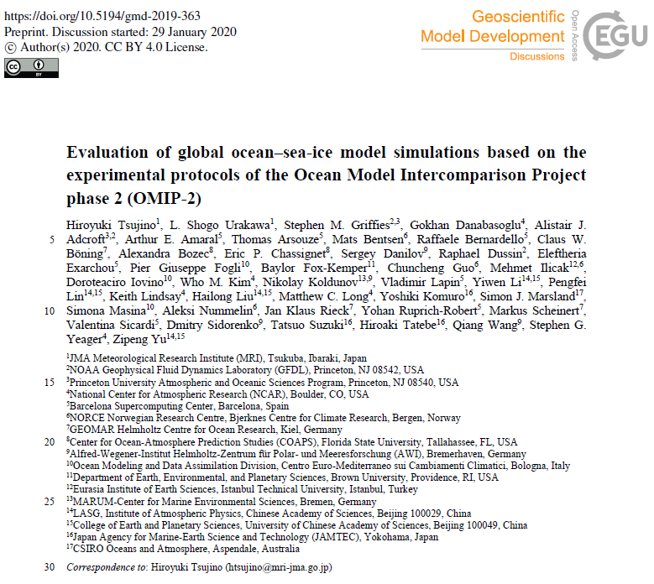
CMIP6-Endorsed MIPs
Tsujino et al. (2020)
☺Best Cost/Performance ratio
Notes:
OMIP 是CMIP6 endorsed 的MIP，2020 ，我們的第一個版本也在2020年底release 出來，第二版在去年也進行了修正，主要是修正了高緯度極區附近的鹽度偏差!
Ocean is the most important component in the ESM. Long-memory, low frequency.

Slide 5
OMIP1 (CORE-IAF) and OMIP2 (JRA55-do)
JRA55-do is higher resolution, self-consistent, and near real-time
 | JRA55-do (~55km) | CORE-IAF (~200km)
Atmospheric state T, q, U, SLP | JRA55 (3-hr) | NCEP (6-hr)
Radiation^{Q}SW ^{& Q}LW | JRA55 (3-hr) | GISS ISCCP-FD (daily)
Precipitation | JRA55 (3-hr) | GPCP/CMAP/Serreze (monthly)
Runoff | JRA55-based (daily)* | Dai et al. (2009) (monthly climatology)
Available Period | 1958-persent | 1948-2009#
IAF: 372 years (1948~2009 x 6 cycles)
JRA: 366 years (1958~2018 x 6 cycles)
*Suzuki et al. (2017), includes solid & liquid runoff from Greenland (Bamber et al., 2012) & Antarctica (Depoorter et al., 2013)
#interannually varying only after 1979 & 1983 for precip. & rad., respectively
Notes:
the Seasonal Footprinting Mechanism: boreal winter-time variability in the NPO drives warm SST anomalies in the North Pacific that propagate into the central tropical Pacific by end of spring/summer through the wind/evaporation/SST (WES) feedback.
Both PDO and NPGO are to 1st order the oceanic expressions of the atm. Forcing associated with AL and NPO.
EPW->AL->PDO (Alexander 1992; 2002; Newman et al., 2003).
CPW->NPO->NPGO (Di Lorenzo 2010)

Slide 6
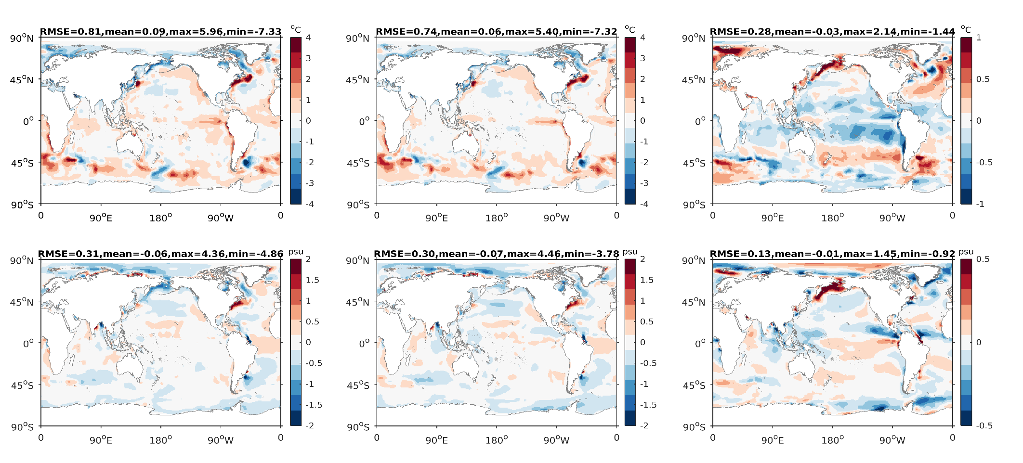
SST and SSS biases
(a) SST OMIP1 - Obs
(b) SST OMIP2 - Obs
(c) SST OMIP2 - OMIP1
(d) SSS OMIP1 - Obs
(e) SSS OMIP2 - Obs
(f) SSS OMIP2 - OMIP1
Modelled SST and SSS are close to the obs. Larger biases appear in the eddy-rich WBC system due to limitation of grid resolution.
Salinity biases in the arctic are reduced compared to other modelling groups (Tsujino et al, 2020)

Slide 7
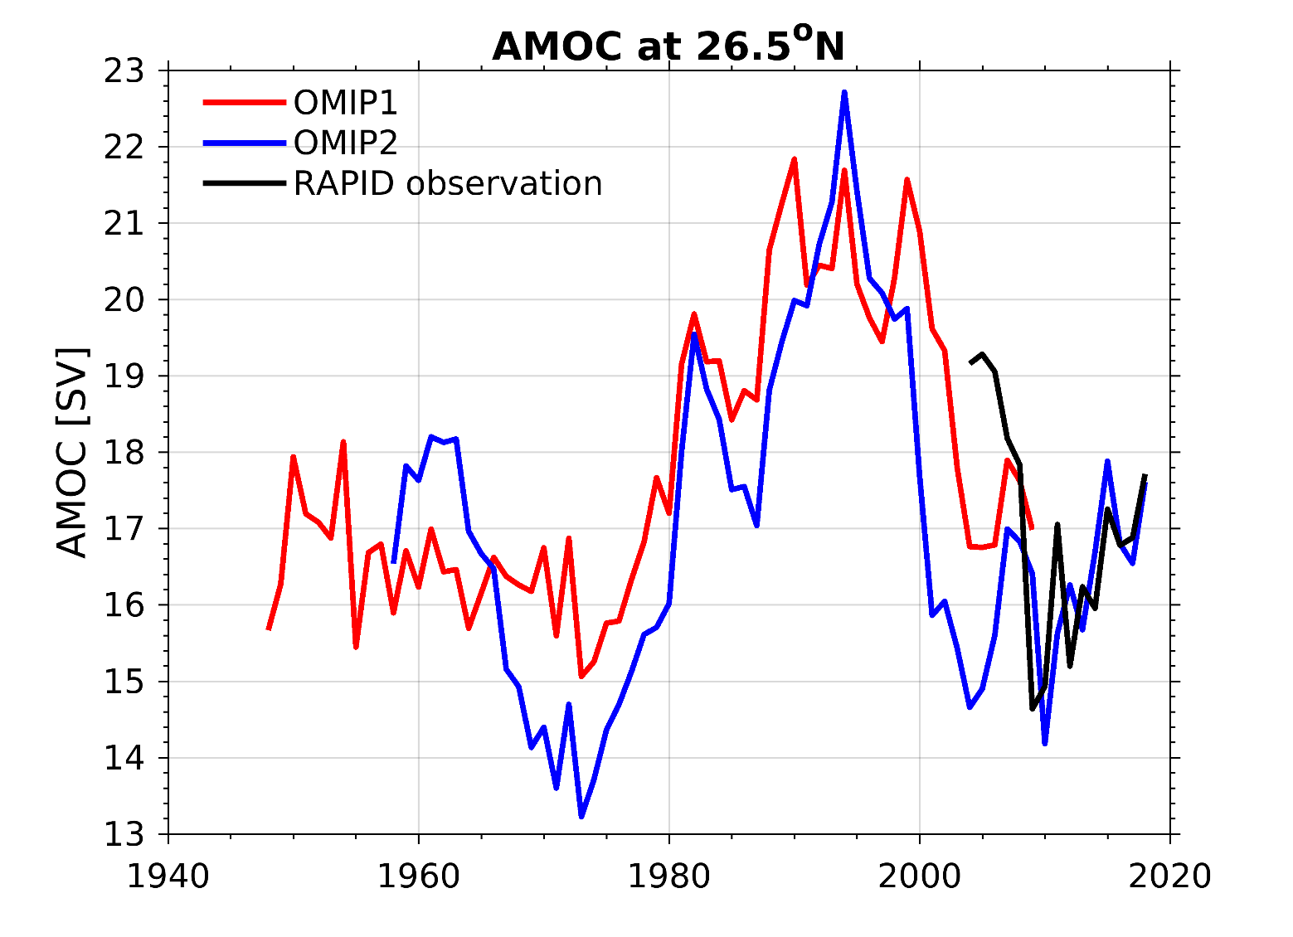
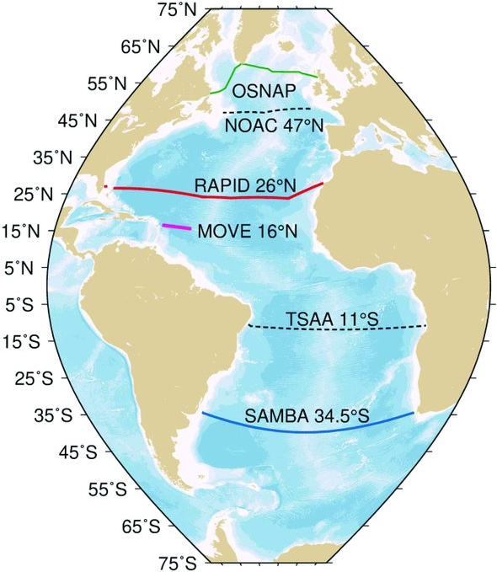
AMOC time series (26.5˚N)
TIMCOM successfully resolve a recent AMOC increase since 2010s, matching observation from the RAPID array.
Notes:
受限於本次報告時間只有，我只呈現AMOC ，其他結果有興趣可以再討論
長期的變化我們可以發現1980年後AMOC 的增加與其他模式類似這是受到全球暖化的影響
而2010年後

Slide 8
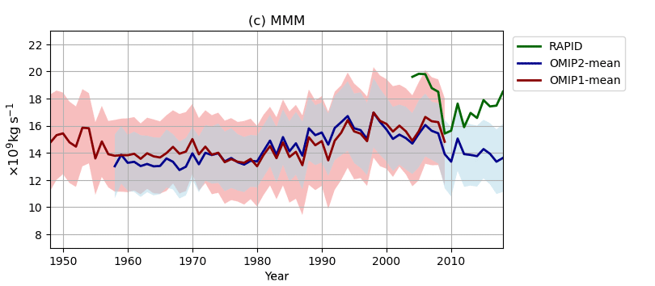
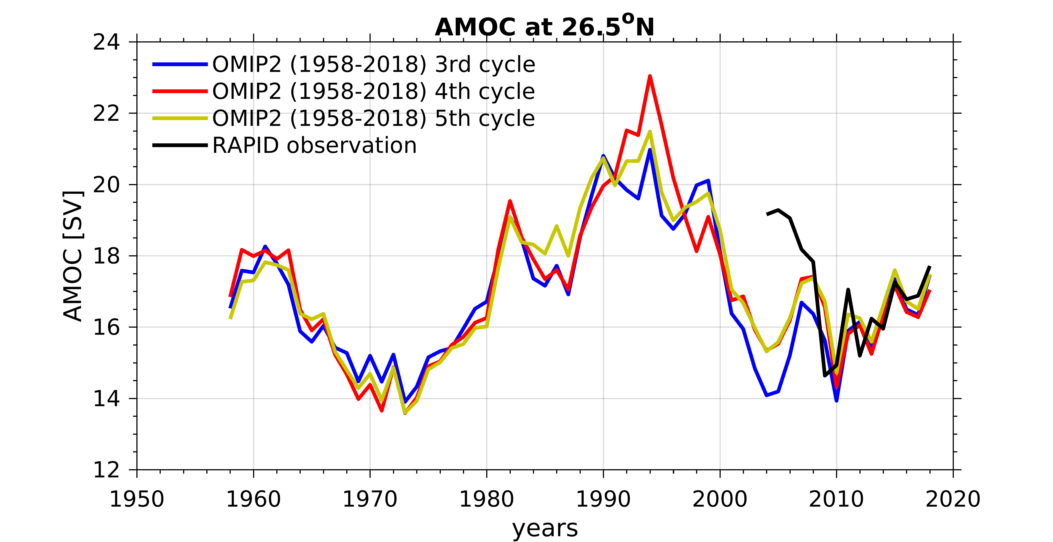
AMOC time series (26.5˚N)
We confirm that the recent increase in AMOC since 2010 appears in all cycles of the experiment, a unique feature not found in other modelling groups (Tsujino et al, 2020)

Slide 9
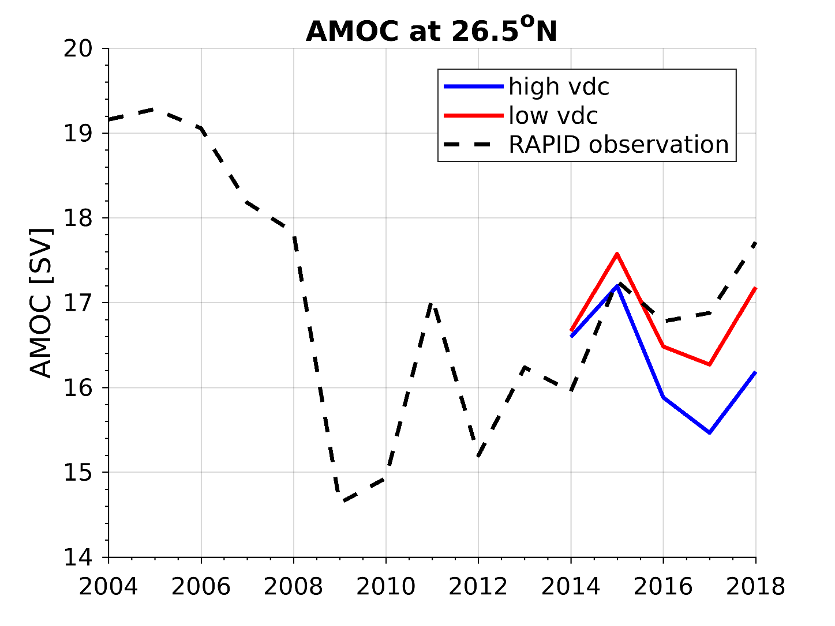
Key to simulate AMOC variability
A lower surface vertical mixing (VDC) for salinity is the key to reproduce the AMOC increase in the recent years
Comparison between High VDC (10 times larger) and Low VDC
Notes:
Level 2: 0.3 (high) Level 2: 0.05 (low)
Level 3: 1 Level 3: 0.05

Slide 10
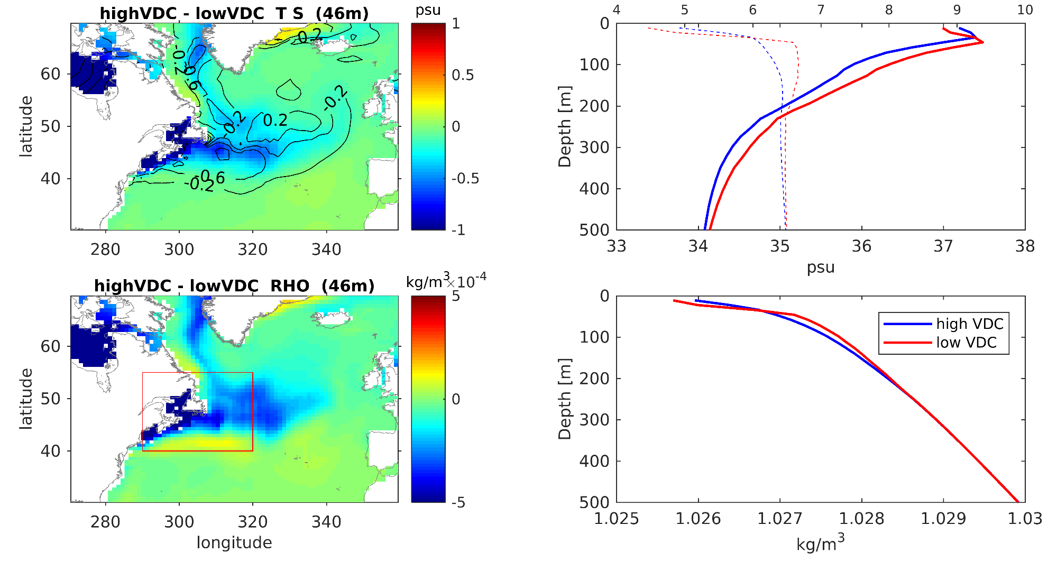
Key to simulate AMOC variability
Weaker VDC for salinity isolates surface from mixing with subsurface layers, to keep the signals of temperature variability during the cold event in the recent five years.
Decreased AMOC in high VDC due to lower density

Slide 11
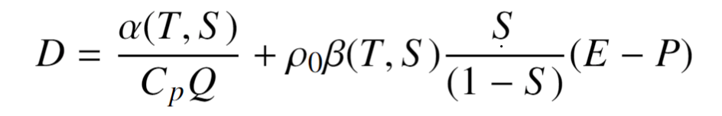
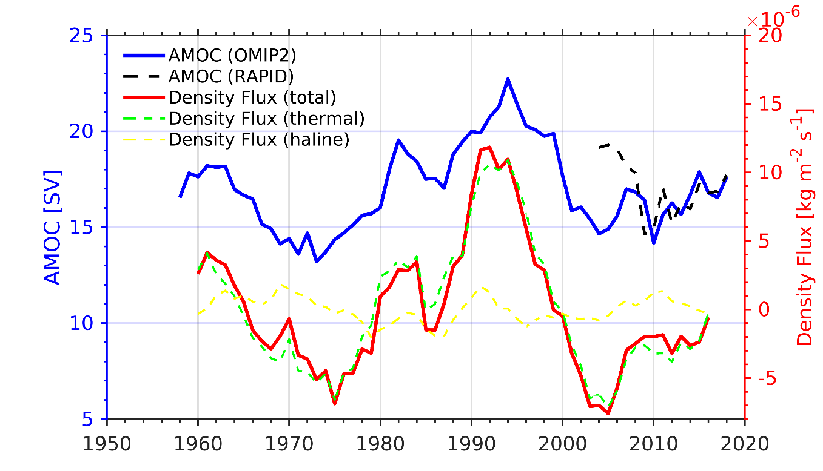
Recent driver of AMOC increase
Strength of AMOC primarily driven by density anomalies in deep water formation sites (Danabasoglu et al., 2012).
The recent increase in AMOC is primarily controlled thermally by the surface cooling in the high latitude of North Atlantic (Josey et al., 2018)
(thermal effect)
(salinity effect)

Slide 12

Conclusion
We present CMIP6 contribution from TaiESM-TIMCOM
1st version doi.org/10.22033/ESGF/CMIP6.14323
2nd version doi.org/10.22033/ESGF/CMIP6.16323
Reproduce reasonable mean and global evolution
Successfully capturing recent AMOC increase.
and reducing arctic salinity bias.
Slight biases in shallower AMOC, smaller SIC extent, and stronger Drake transport, possibly interlinked
Future work
OMIP2 diagnostic metrics (biases reduction)
TaiESM1-TIMCOM evaluation and retuning (budget)
Additional submission for continuous CMIP6

