Slide 1
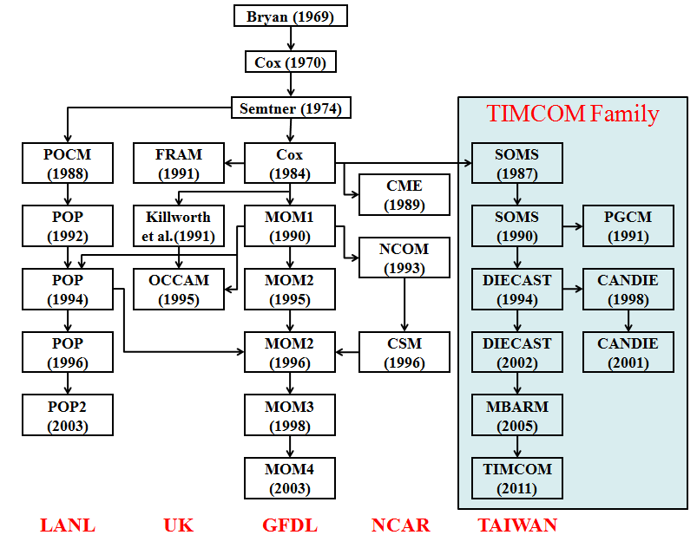
Parallel Domain-Decomposed Taiwan Multi-Scale Community Model (PD-TIMCOM)
Tseng et al. (2011a), Prog. Ocean (in press)
Tseng and Chien (2011), Comp. Fluids
Shen et al. (2011a), J. Mar. Sys.
Shen et al. (2011b), J. Clim. (submitted)
Young et al. (2011), Env. Modell. Soft. (submitted)
http://efdl.as.ntu.edu.tw/research/timcom

Slide 2
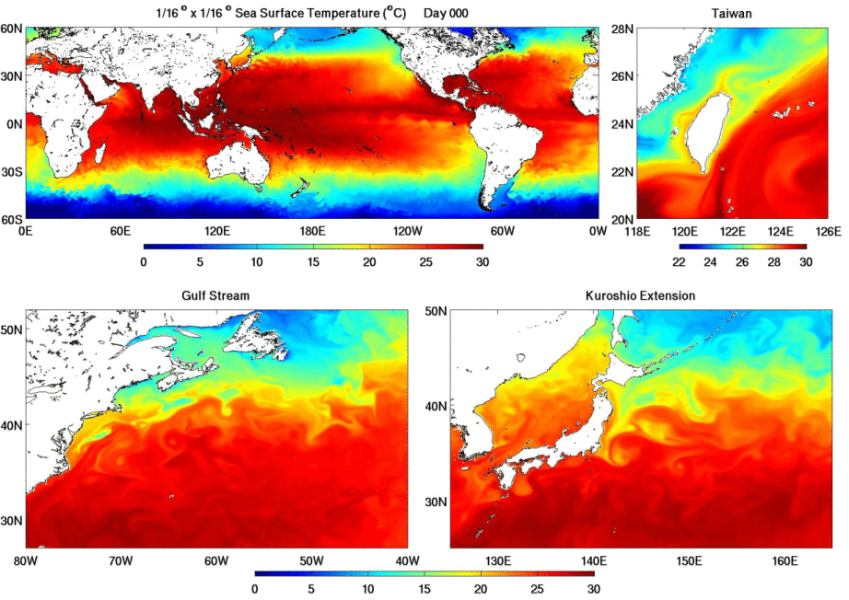

Slide 3
Future Plans
CESM components : all active components, pre-industrial, with CN (Carbon Nitrogen) in CLM
CPL7
CLM
CAM
POP2
CICE
Los Alamos Sea Ice Model version 4.0 (CICE)
Community Land Model version 3.0 (CLM3)
Coupler version 7.0
TIMCOM
TaIwan Multi-scale Community Ocean Model (TIMCOM)
Parallel Ocean Program version 2.0 (POP)
Community Atmosphere Model version 5 (CAM) featuring finite volume dynamical core
Notes:
Initialization: CAM and CLM start from rest. POP is initialized with temperature and salinity from World Ocean Circulation Experiment (WOCE) climatology. Ice cover initialization is latitude and SST dependent with ice extent limits 70N and 60S and nonlinear ice thickness distribution.
4x5_gx3v7

