Slide 1
Accelerated barotropic solver for the high-resolution ocean model component in the Community Earth System Model v2.0
Yu-heng Tseng
Institute of Oceanography and Ocean Center, National Taiwan University
Acknowledgement: Xiaomeng Huang, Qiang Tang, Yong Hu
Notes:
Huang*, X., Tang, Q., Tseng*, Y., Hu, Y., Baker, A. H., Bryan, F. O., Dennis, J., Fu, H., and Yang, G. (2016), “P-CSI v1.0, an accelerated barotropic solver for the high-resolution ocean model component in the Community Earth System Model v2.0,” Geosci. Model Dev., 9, 4209-4225. [article]

Slide 2
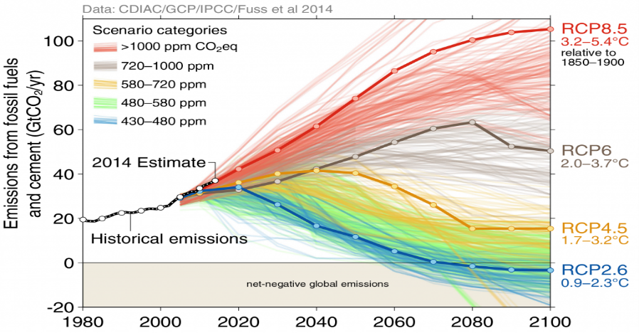
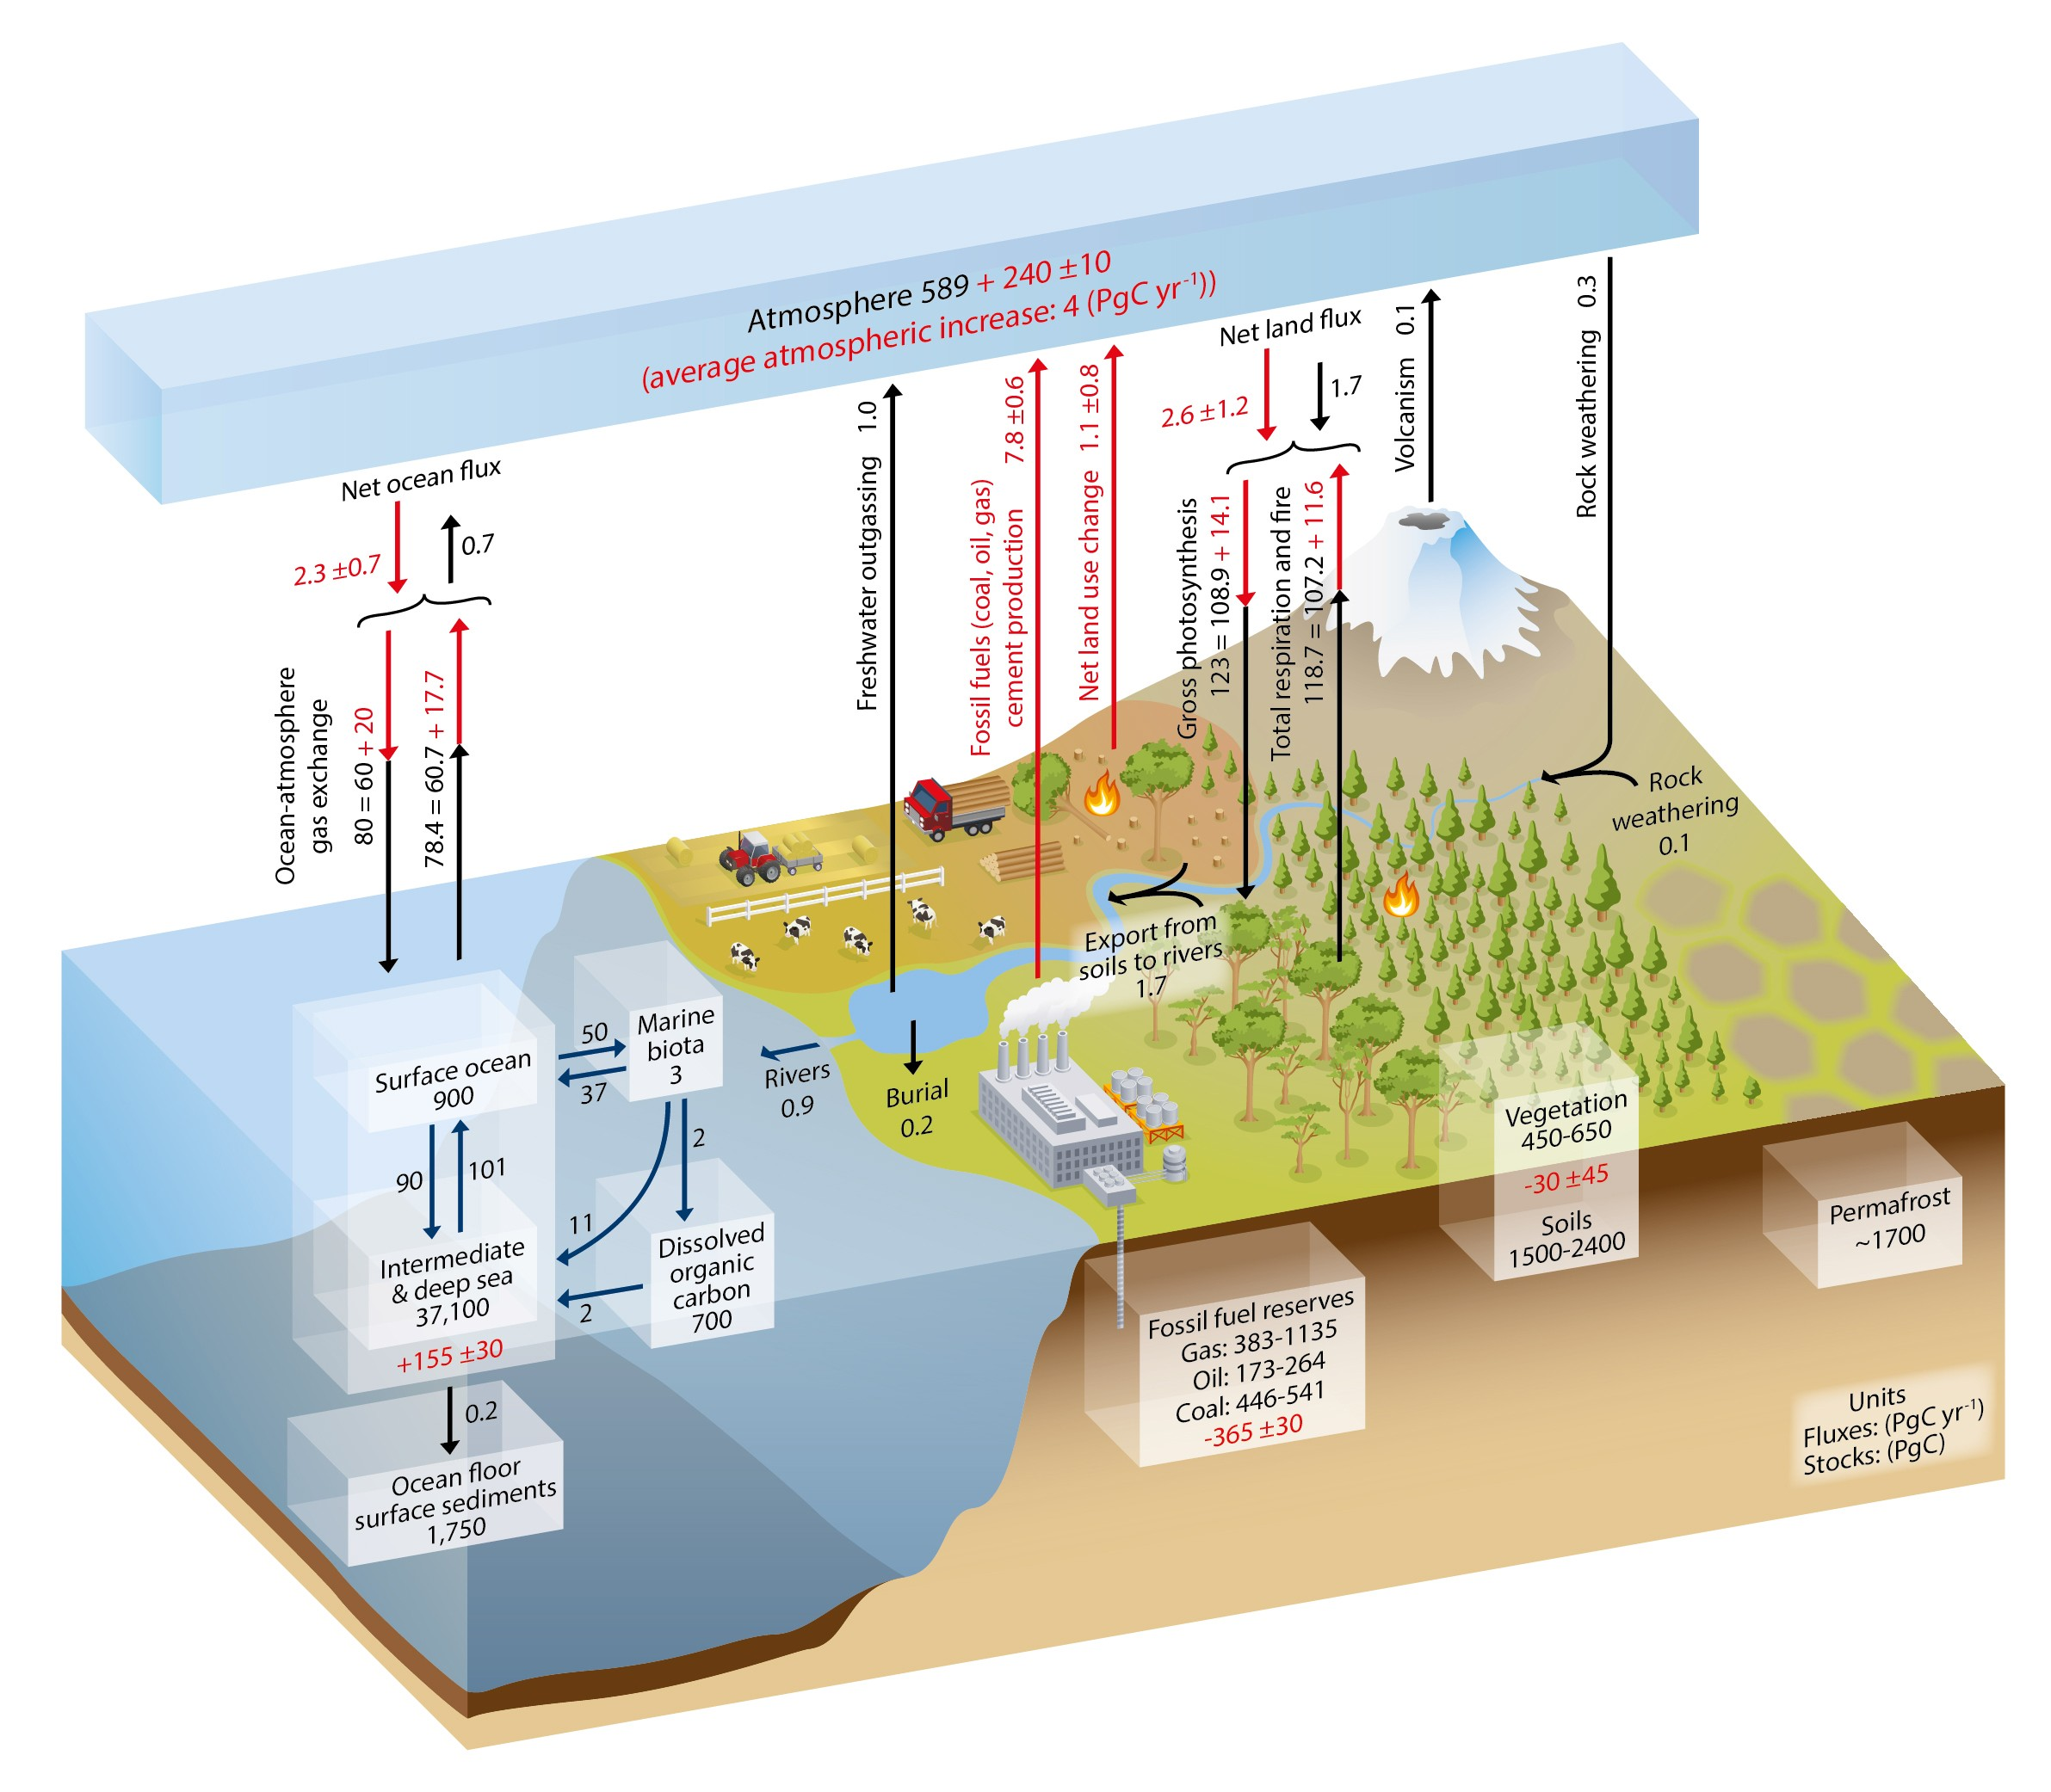
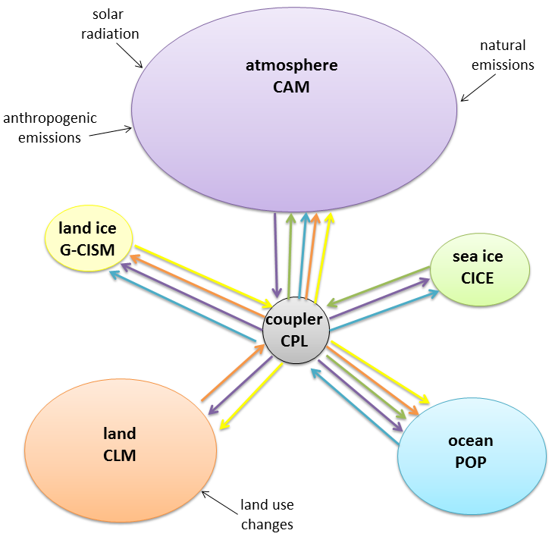
Earth System Model (ESM)
Perform climate projections
Carbon cycle in the Earth System
to simulate and understand climate changes in response to the emission of GHS and aerosols.
Model building
IPCC AR5 Ch.6
Intergovernmental Panel for Climate Change (IPCC) Assessment Report
Climate Simulation
Notes:
未來氣候變遷情境下，像是這幾周台灣超級悶熱，超過38, 40度的高溫，就是極端天氣系統發生頻率增加的一個例子! Many climate models have been developed to perform climate projections, i.e. to simulate and understand climate changes in response to the emission of greenhouse gases and aerosols. In addition, models can be formidable tools to improve our knowledge of the most important characteristics of the climate system and of the causes of climate variations. Obviously, climatologists cannot perform experiments on the real climate system to identify the role of a particular process clearly or to test a hypothesis. However, this can be done in the virtual world of climate models. For highly non-linear systems, the design of such tests, often called sensitivity experiments, has to be very carefully planned. However, in simple experiments, neglecting a process or an element of the modelled system (for instance the influence of the increase in CO₂concentration on the radiative properties of the atmosphere) can often provide a first estimate of the role of this process or this element in the system.
A mathematical representation of a complete ESM in the form of equations/computer code describing physical, biological and chemical processes

Slide 3
Ocean model (POP2) dominates the computational time in high-resolution CESM
resources : 58% to 66%
efficiency : 42% to 58%
Computational performance of ultra-high-resolution capability in the
Community Earth System Model. John Dennis, et al. HPCA’12

Slide 4
Scalability of 0.1° POP2
(baroclinic mode, barotropic model and 3D-update)
Baroclinic mode time dominates on a small number of cores
Barotropic mode time dominates in a large number of cores (>5000)
Kraken, 99,072 core Cray XT5 system at the National Institute
for Computational Science (NICS). Andrew Stone. 2011

Slide 5

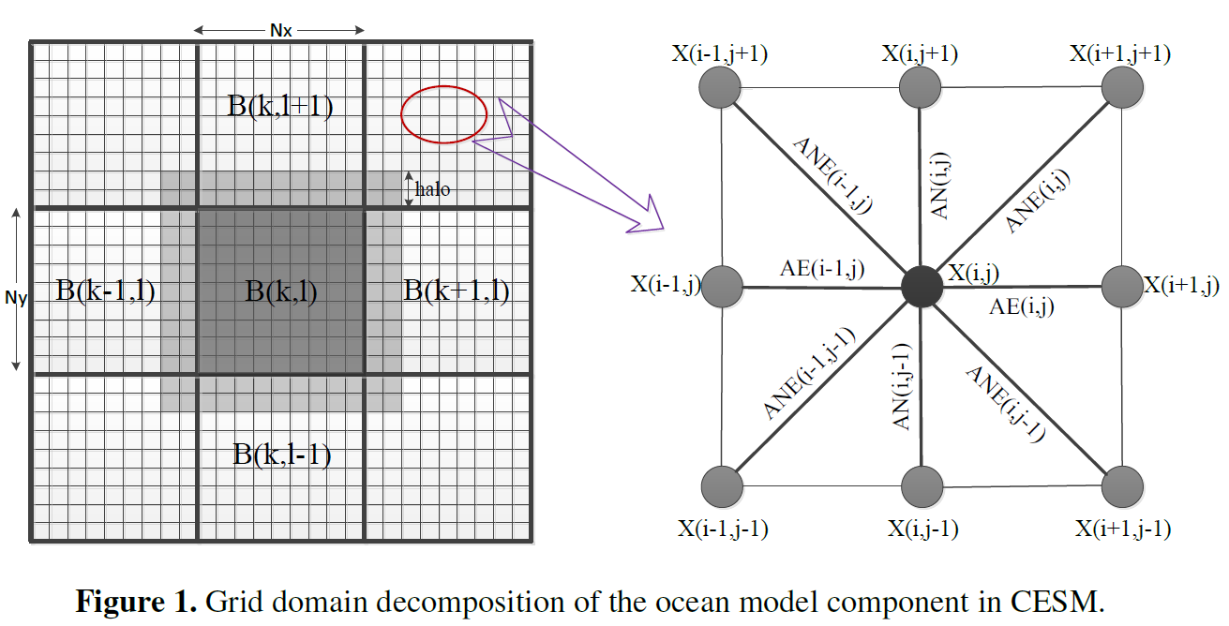
Barotropic mode in POP2
Require to solve an elliptic system for SSH in the barotropic mode.
The elliptic problem is approximated as a linear system.
PCG (ChronGear) is used to solve this linear system.

Slide 6
Scalability of 0.1° POP2 on Yellowstone
ChronGear Solver does not scale well on large number of processes.
Notes:
Number of unknowns per processor and percentage of execution time in 0.1 POP using the default diagonal-preconditioned ChronGear solver on Yellowstone.

Slide 7
ChronGear Solver
Computation O(N²/p)
θ : time unit per floating-point operation
N² : number of grids
p : number of processors

Slide 8

ChronGear Solver
Boundary
Communication O(N/sqrt(p))
α : communication latency
β : transfer time per byte

Slide 9
ChronGear Solver
Global
Reduction
Time increases as p increases

Slide 10
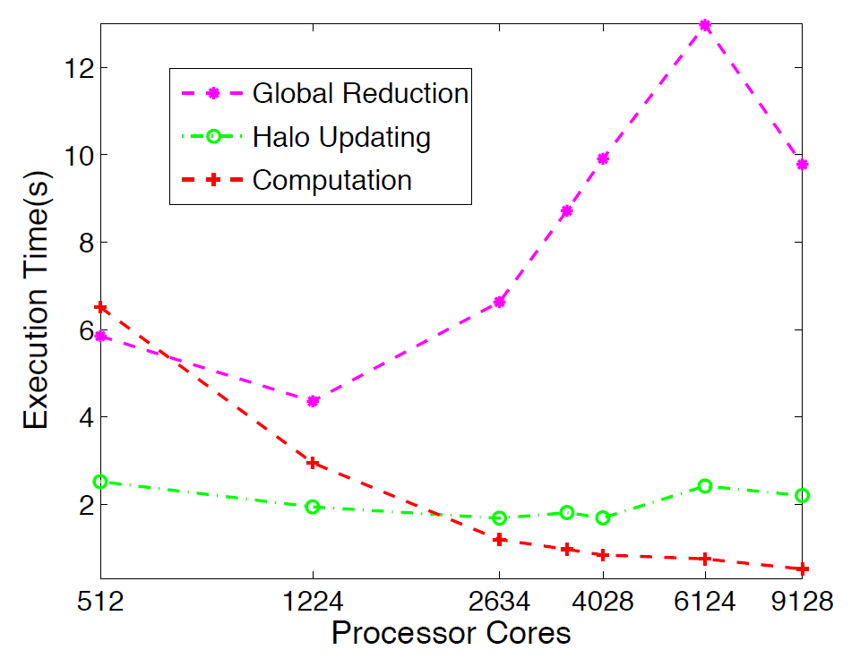
ChronGear Solver Components
Global reduction is the bottleneck of the ChronGear Solver in 0.1° POP.

Slide 11
A new Preconditioned (Classical Stiefel Iteration) P-CSI Solver
no global reduction

Slide 12
P-CSI .vs. ChronGear
Unlike ChronGear, P-CSI has no global reduction
P-CSI needs slightly more iterations, but less computation in each iteration
P-CSI requires two extreme eigenvalues
ChronGear
P-CSI
Notes:
在「最後發表的paper」中，沒有看到這兩張圖。

Slide 13
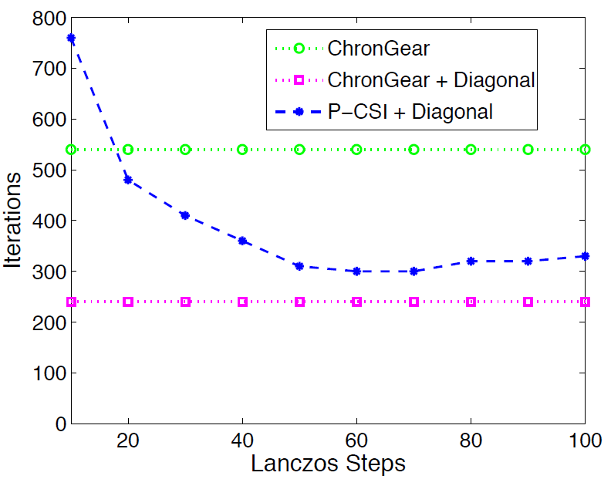
Eigenvalue Estimation in P-CSI
Lanczos method to construct a tridiagonal matrix T
T has eigenvalues close to M⁻¹A
Estimation needed only once, extra overhead less than one barotropic step.
Notes:
P-CSI requires approximations of the largest (µ) and smallest (ν) eigenvalues of the preconditioned matrix M−1A. Coefficient matrix A and its diagonal preconditioner M = Λ(A) are real symmetric positive definite matrices in POP, therefore these extreme eigenvalues can be estimated inexpensively. As in [20] for A, here we use the the Lanczos method [28] for M−1A, constructing a series of tridiagonal matrices whose largest and smallest eigenvalues converge to those of M−1A. In experiments, we found that setting the Lanczos convergence tolerance to 0.15 works efficiently in both 1◦ and 0.1◦ POP with both diagonal preconditioning and our new block preconditioner. Figure 3 indicates that only a small number of Lanczos steps are necessary to generate eigenvalue estimates of M−1A that result in near-optimal P-CSI convergence. In practice, the cost of the Lanczos method is similar to calling ChronGear solver a few times. In contrast with the ChronGear iteration, the P-CSI iteration requires no global reduction except for checking convergence. We note that P-CSI requires a larger number of iterations than ChronGear (Kpcsi > Kcg) in order to obtain the same convergence criteria. We expect that this will translate into a higher execution time for P-CSI than ChronGear at smaller core counts when global reductions are not an issue. However, for high-resolution grids when many cores are required, P-CSI should be notably faster than ChronGear per iteration (see Equations (2) and (3)), which would result in a reduction in time to convergence.

Slide 14
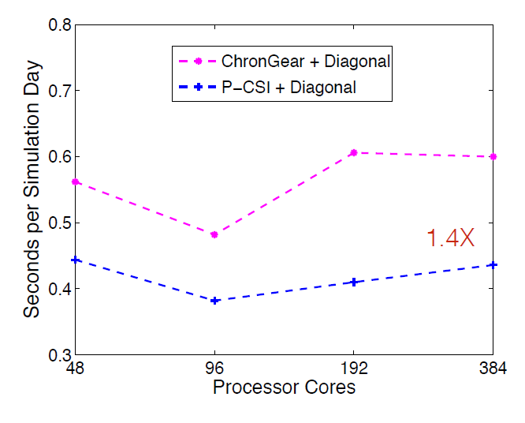
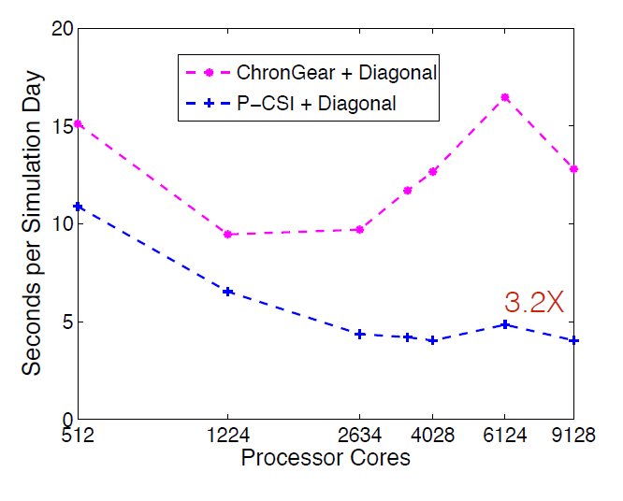
Scalability on Yellowstone
1 degree POP
0.1 degree POP
Improvement is more significant in high resolution
Notes:
。

Slide 15

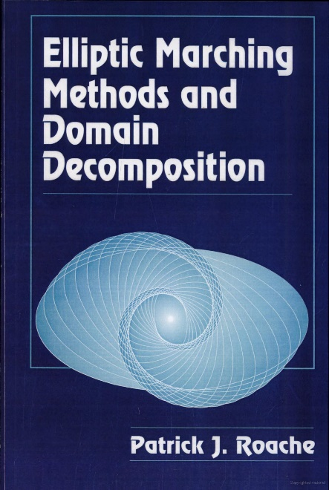
Block Error Vector Propagation (EVP) Preconditioning
Hu et al. (2015)
Roache 1995, Elliptic marching methods and domain decomposition.
Notes:
Block preconditioning is quite promising in the POP because parallel domain decomposition is ideal for the block structure. A block preconditioning based on the EVP method is proposed and detailed in Hu et al. (2015); it improves the parallel performance of the barotropic solver in the POP. To the best of our knowledge, the EVP and its variants are among the least costly algorithms for solving elliptic equations in serial computation (Roache, 1995).
The standard EVP is actually a direct solver, which requires two solution steps: preprocessing and solving. In the preprocessing stage, the influence coefficient matrix and its inverse are computed, involving a computational complexity of Cpre = (2n−5)·9n2 +(2n−5)3 =O(26n3), which is intensive but computed only once at the beginning. The solving stage is computed at every time step and requires only Cevp = 2·9n2+(2n−5)2 =O(22n2)(Huetal.,2015),which is a much lower computational cost than those of other direct solvers, such as LU.

Slide 16
Preconditioning and Iterations
Block EVP preconditioning reduces the iteration number to about one-third

Slide 17
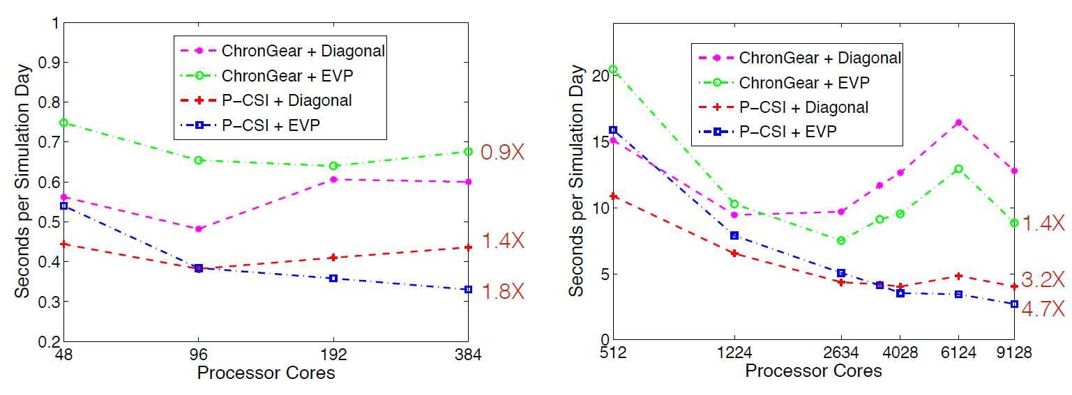
Scalability on Yellowstone
1 degree POP
0.1 degree POP

Slide 18
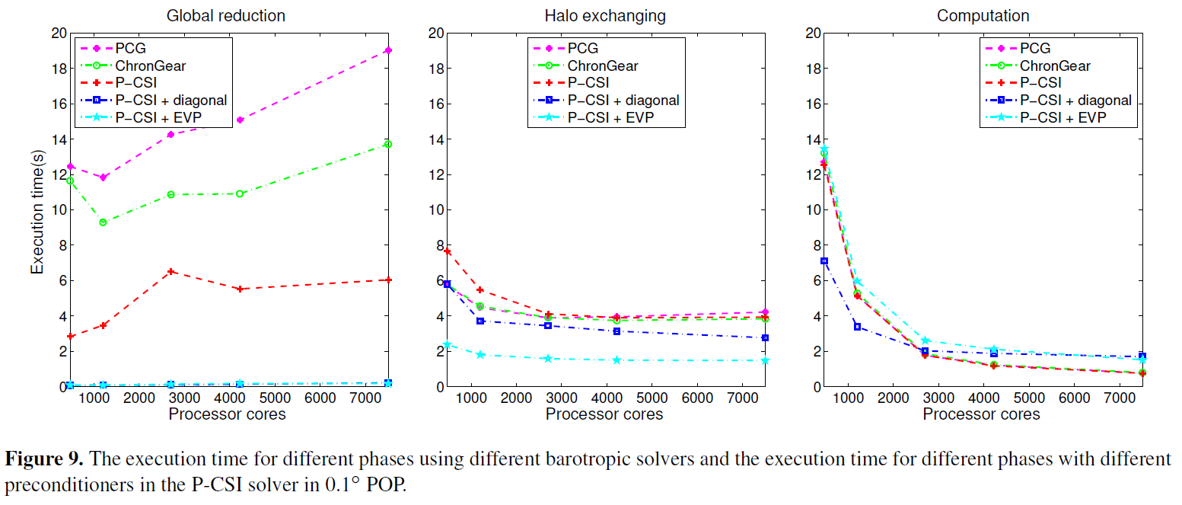
Solver Component

Slide 19
Simulated Years for Solver Per wall-clock Day
Simulation rate without considering the I/O and initialization in 0.1 degree POP.
percentage of time for barotropic mode (P-CSI+EVP)
Notes:
The simulated speed of the 0.1 ocean model component using different barotropic solvers. The numbers on the dotted line represent the percentage of execution time spent in barotropic mode with P-CSI(EVP) using different numbers of processor cores.

Slide 20

Summary
Intensive computation for high-resolution CESM (bottleneck in ocean barotropic solver)
New P-CSI solver (NO MORE global reduction)
block EVP preconditioning
Performance can still be improved at very high number cores
10.5 simulated years per wall-clock day on 16875 cores.

