Slide 1
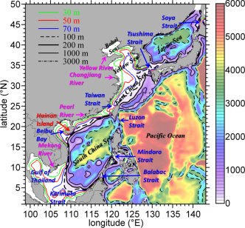
Ocean-atmospheric interaction in the South China Sea
Yu-heng Tseng and Yi-chun Kuo
Institute of Oceanography,
National Taiwan University
Notes:
What I am going to present is

Slide 2
Distinct ocean-atmospheric interaction between northern and southern SCS
Impacts of river discharge parameterization in the global coupled model system
Operational nowcast/forecast system in the Western Pacific

Slide 3
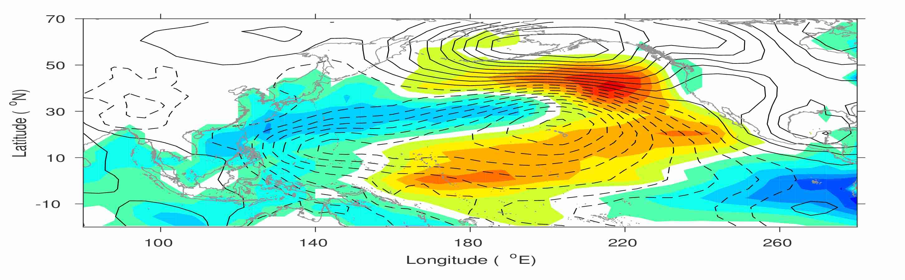
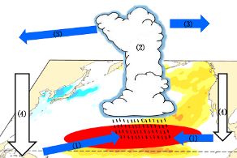
New North Pacific climate paradigm
Ding et al. (2015a)
Tropical-extratropical interaction
Ding et al. (2015b)
SFM (Vimont et al.,2003)
Chen et al. (2015)
Tropical-extratropical interaction
Ding et al. (2015c); Ding et al. (2016), Zhang et al. (2014a,b)

Slide 4
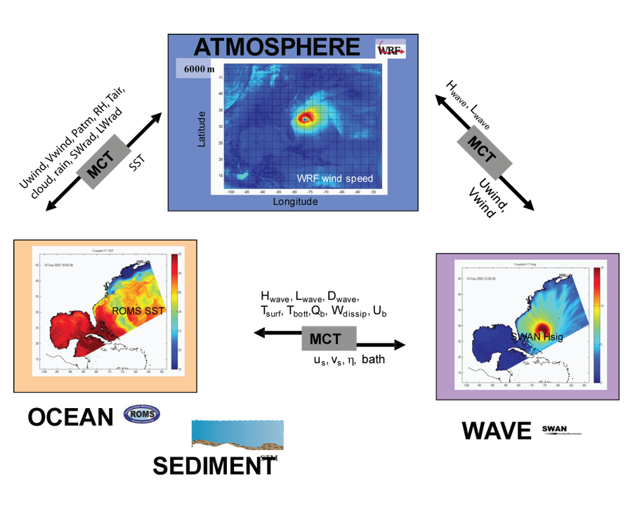
Distinct ocean-atmospheric interaction between northern and southern SCS
d01_wrf
_wrf
d01_ROMS
d01_ROMS
Model ran for 1 year (2016)
Weather Research and Forecasting Model (WRF)
Horizontal Resolution: Domain 1 =36km, Domain 2 =12km
Vertical : 36 levels
Data:
Geography: http://www2.mmm.ucar.edu/wrf/src/wps_files/geog_complete.tar.bz2
Initial and boundary : NCEP FNL Operational Model Global Tropospheric Analyses, continuing from July 1999 (ds083.2)
Regional Ocean Modeling System (ROMS)
Horizontal Resolution:
Domain 1 : 26~27 km
Domain 2 : 8~9 km
Vertical : 36 levels
Data:
geography : ETOPO2
Initial and boundary : HYCOM

Slide 5
Atm. dominates SST variation
$∂SST/∂t$= heat flux + other source(adv)
time lag
SST
SST dominates heat flux change
$∂SST/∂t$= heat flux + other source(adv)
heat flux =f(SST)

Slide 6
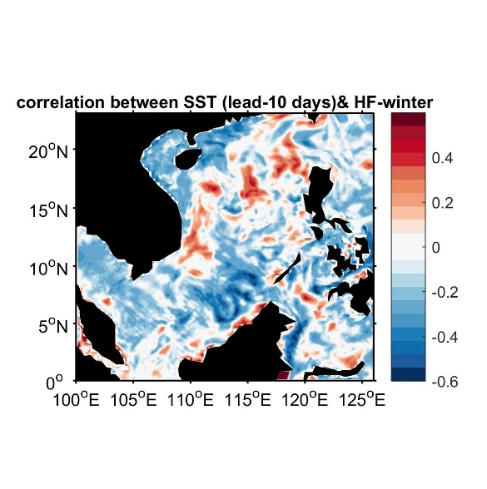
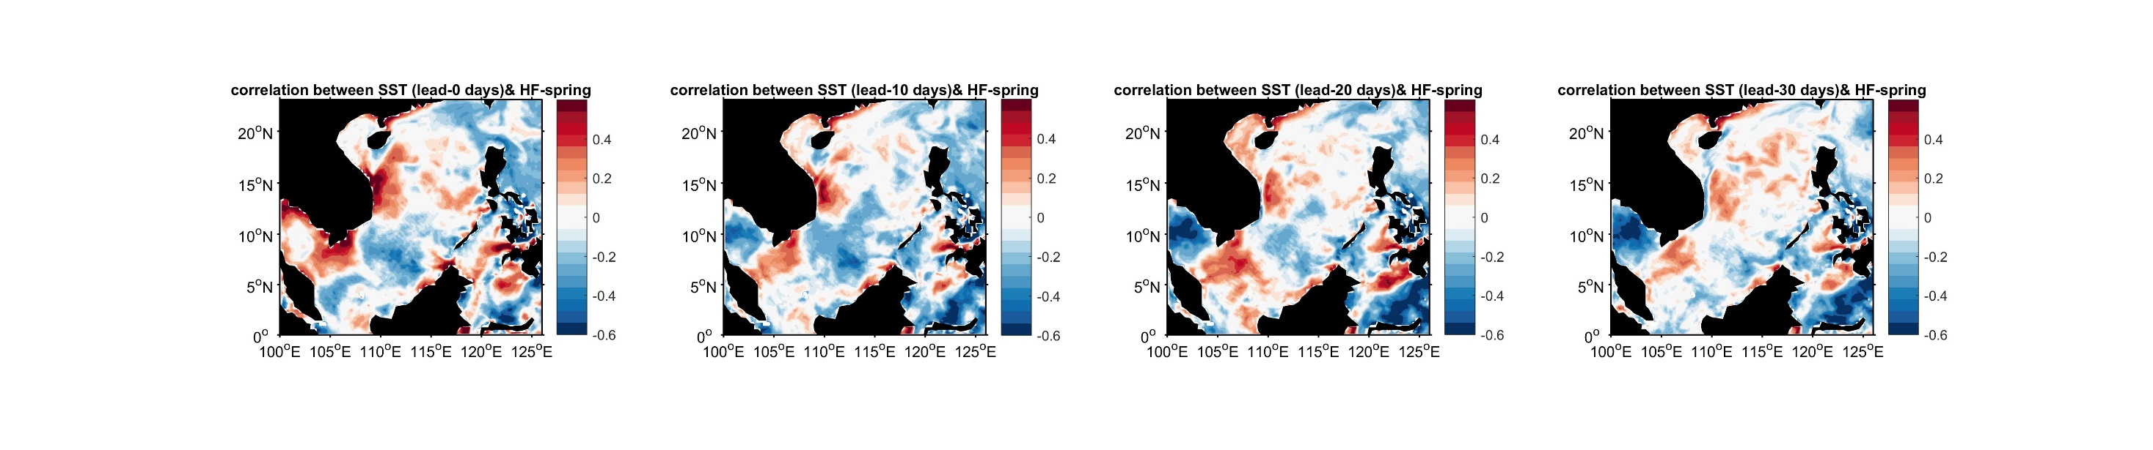
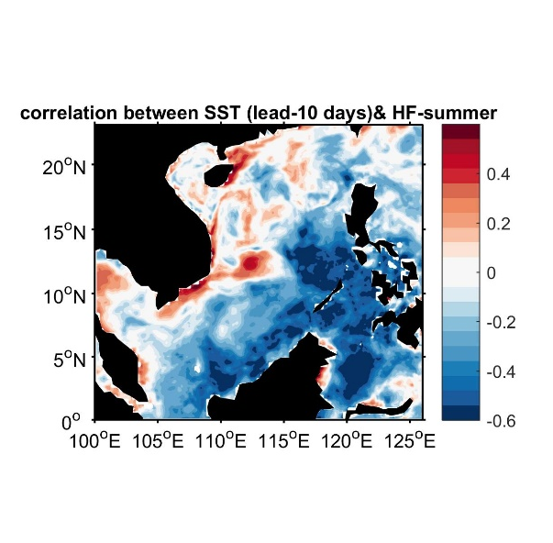
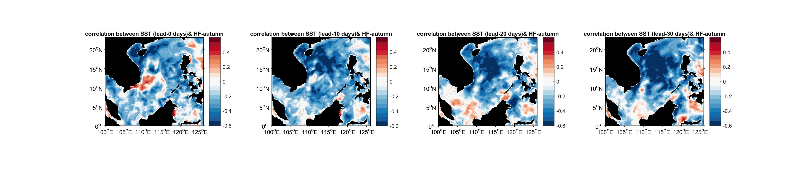
Correlation _ SST lead
winter
spring
summer
autumn

Slide 7
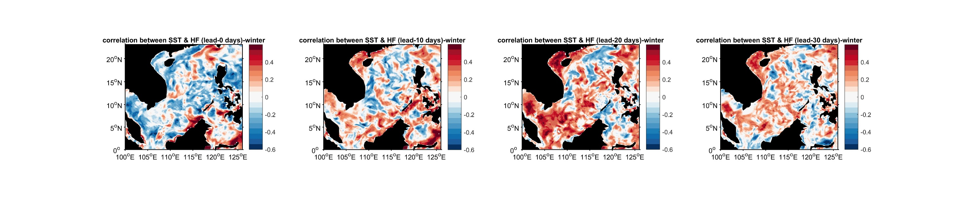
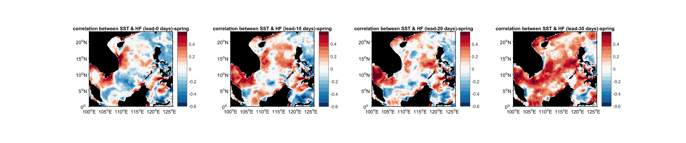
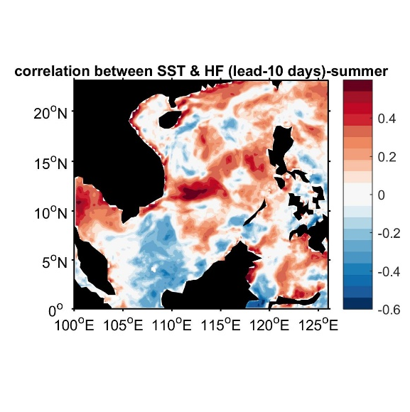
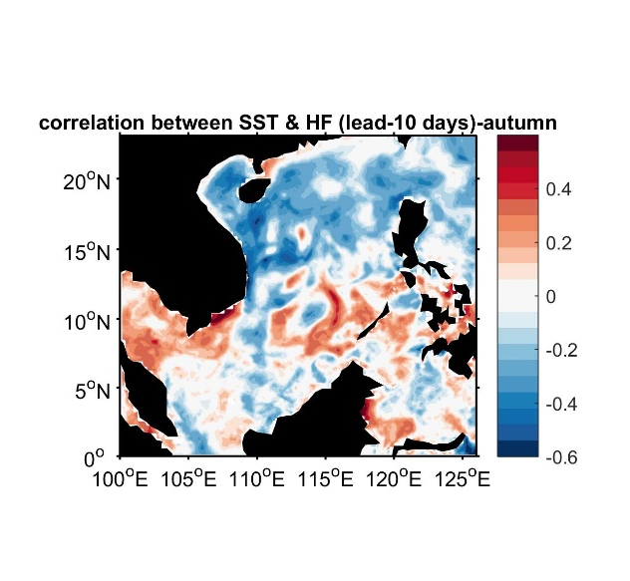
Correlation _total heat flux lead
winter
spring
summer
autumn

Slide 8
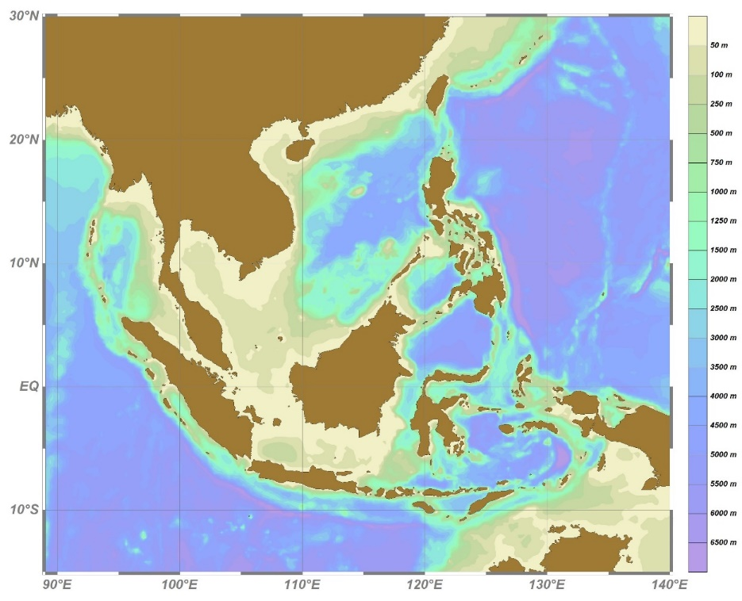
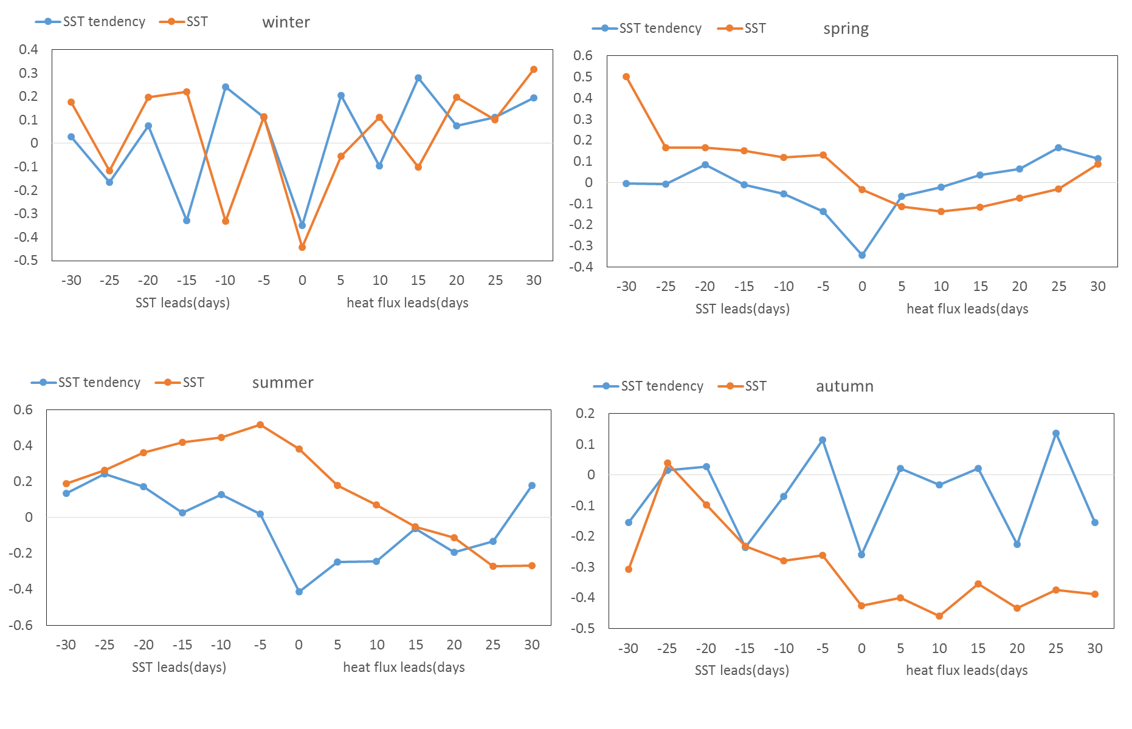
Region 1 (off southeast Vietnam)
lat_r1s=10; lat_r1n=12; lon_r1w=110; lon_r1e=113;
Region1
Atm. dominates SST variation
SST dominates heat flux change

Slide 9
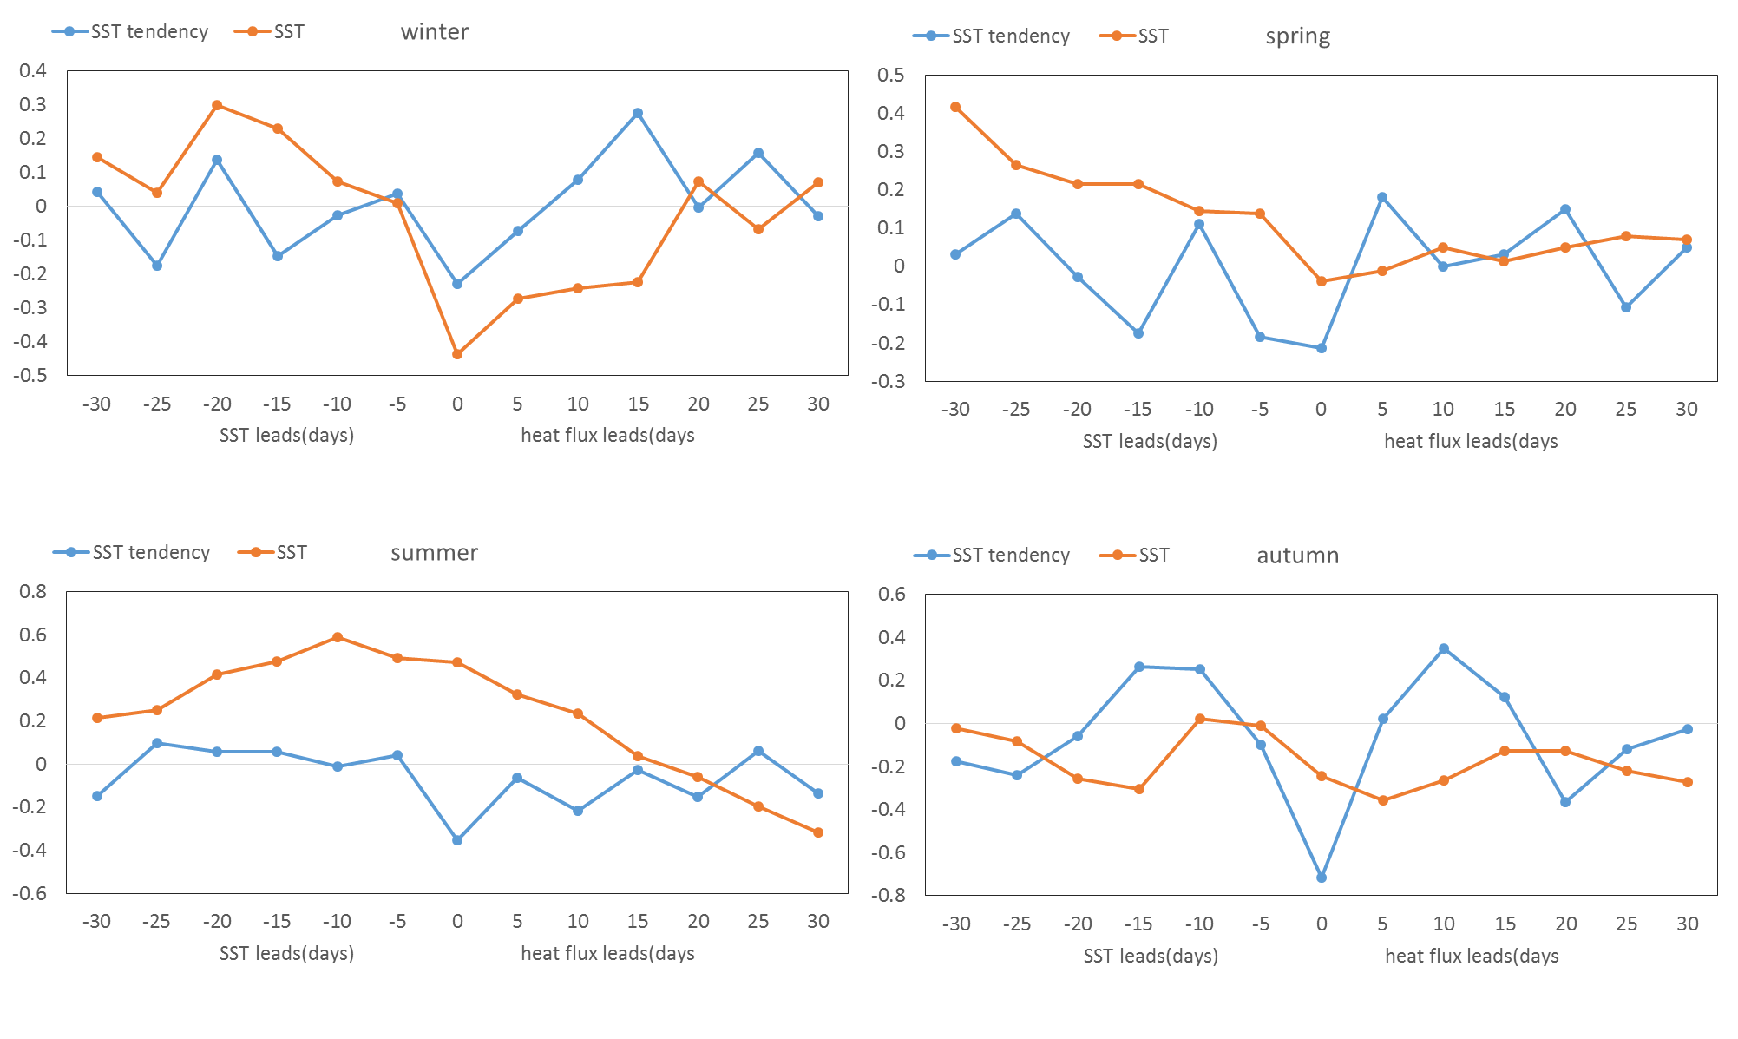
Region 2 (off southeastern China coast)
Region2
lat_r2s=22; lat_r2n=23; lon_r2w=113; lon_r2e=117;
Atm. dominates SST variation
SST dominates heat flux change
Atm. dominates SST variation

Slide 10
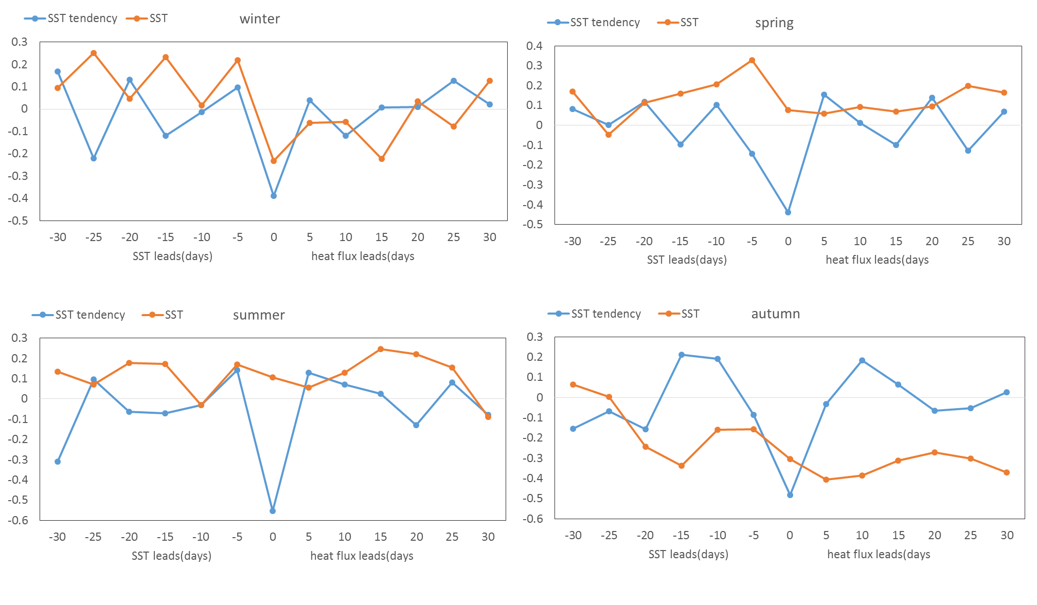
Region 3 (northern SCS)
Region3
lat_r3s=18; lat_r1n=20; lon_r3w=115; lon_r3e=117;
Atm. dominates SST variation
Atm. dominates SST variation

Slide 11
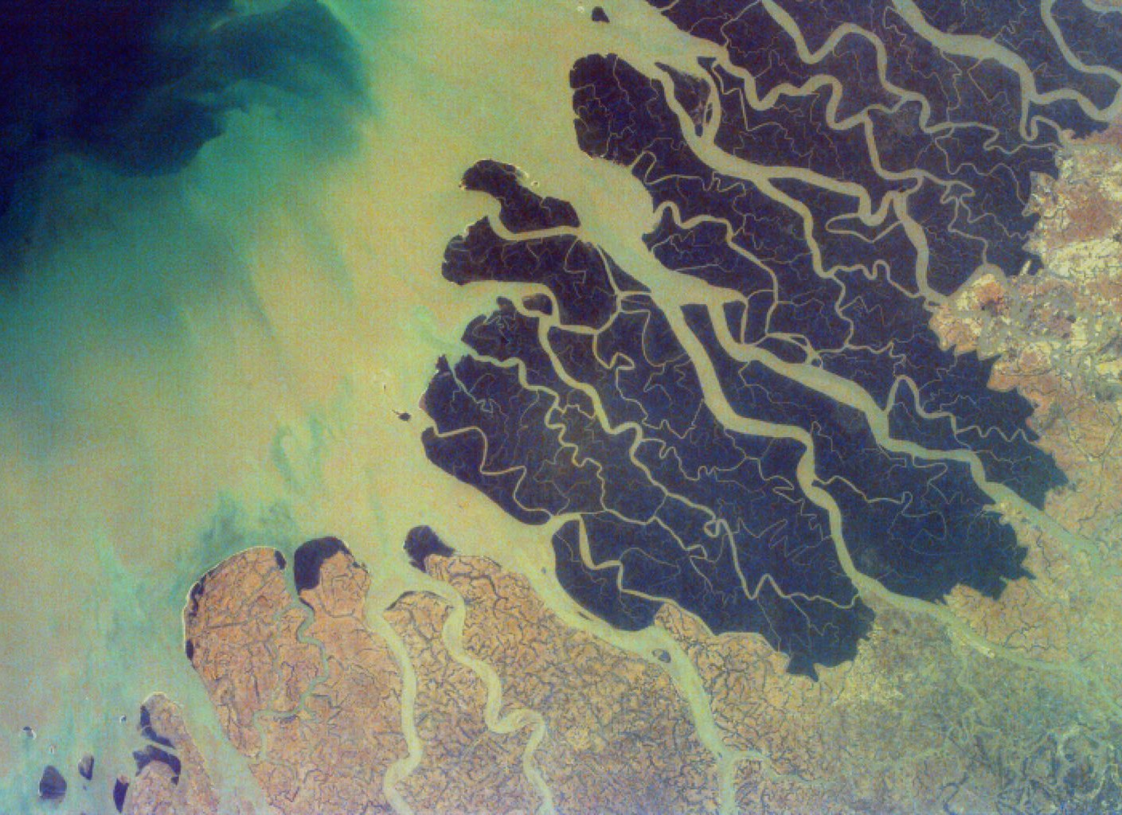



Interactions of river discharge parameterizations with the Madden-Julian oscillation in the CESM
Charlotte A. DeMott¹ Yu-heng Tseng² Frank Bryan²
¹Colorado State University, Fort Collins CO USA
²National Center for Atmospheric Research, Boulder CO USA
American Geophysical Union Fall Meeting, 2016 San Francisco CA

Slide 12
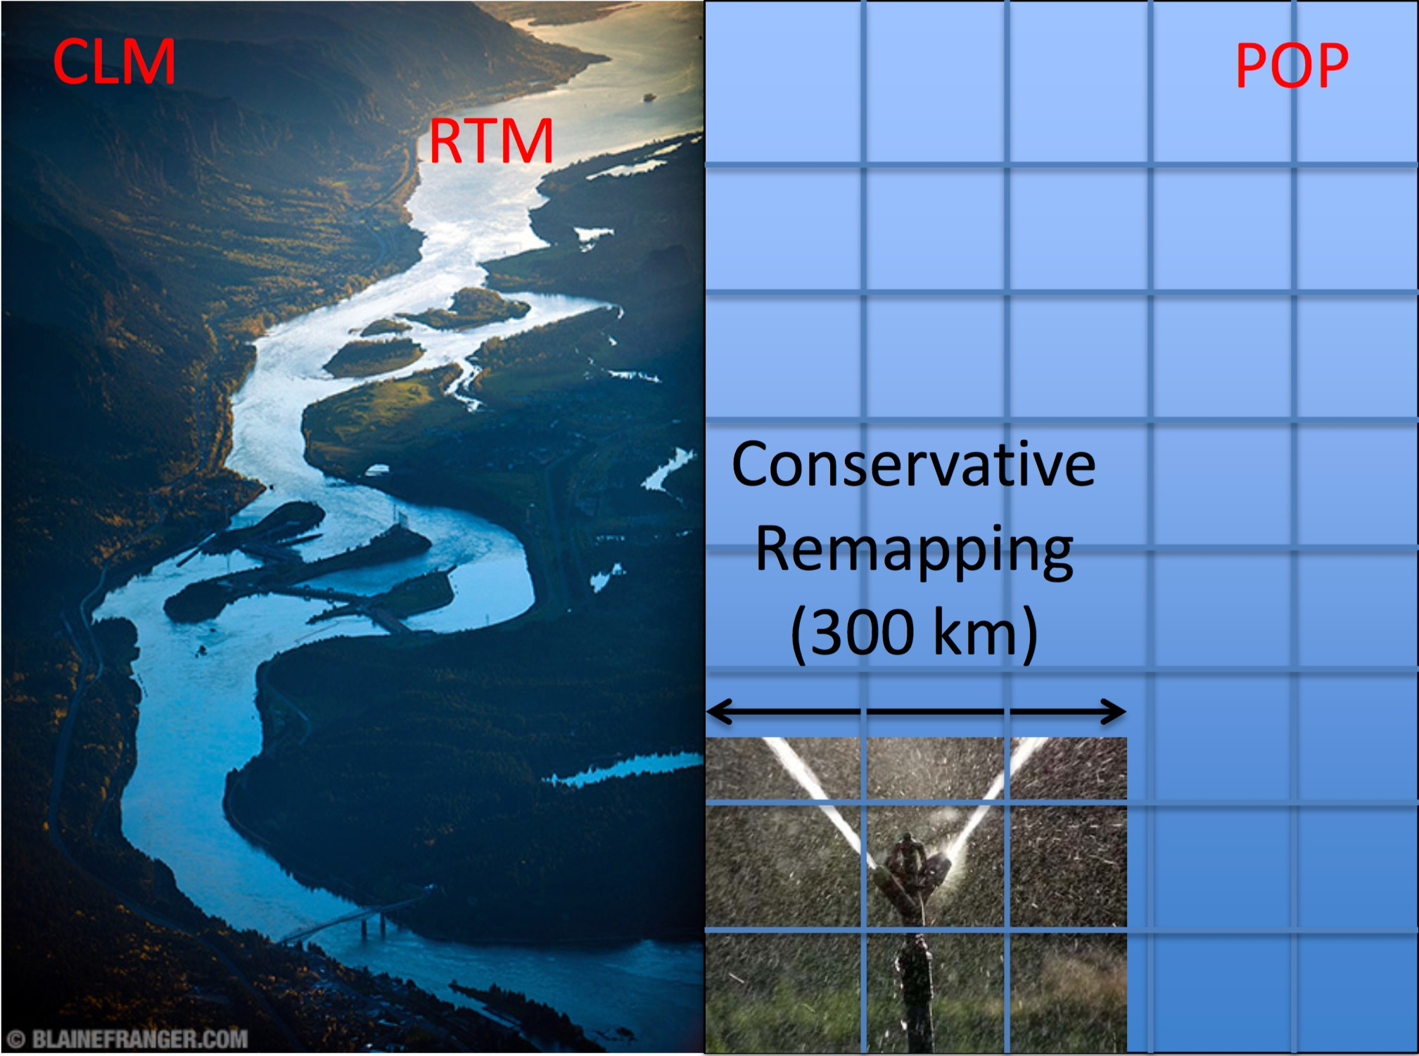
River discharge in CESM
virtual salt flux
•
•
river discharge is spread uniformly over ocean surface (300 km x 300 km area adjacent to river delta).
no vertical mixing.

Slide 13
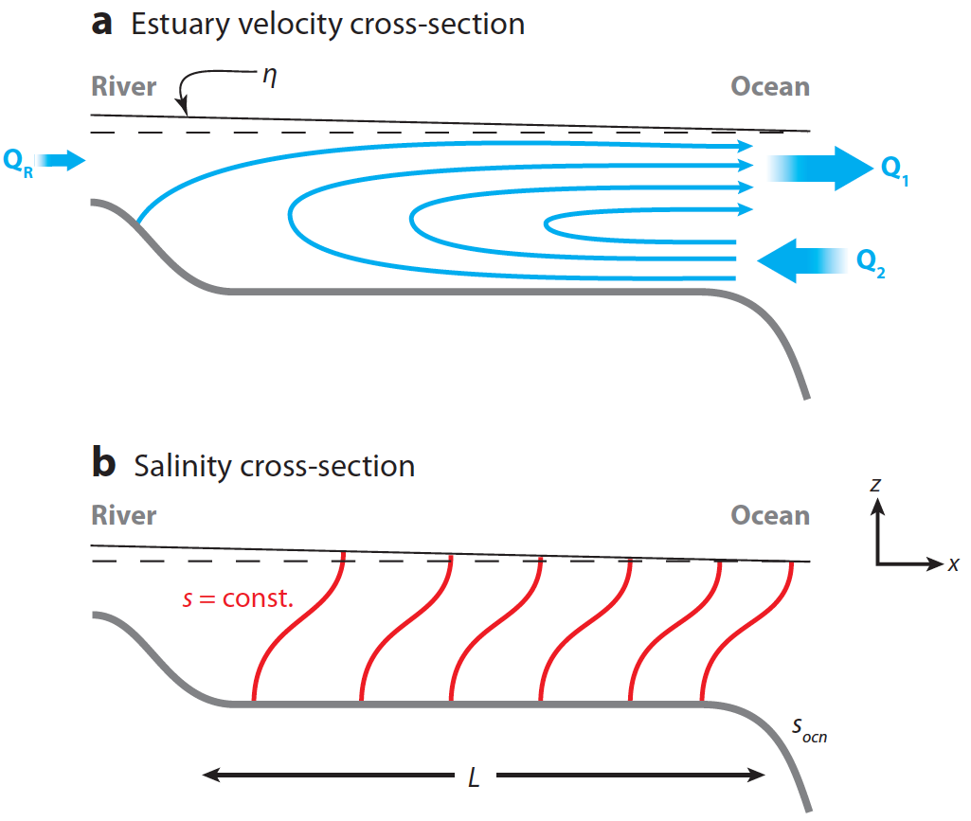
River discharge in CESM
virtual salt flux
estuary box model
adapted from: MacCready and Guyer (2010)
•
•
river discharge is spread uniformly over ocean surface (300 km x 300 km area adjacent to river delta).
no vertical mixing.
•
•
river discharge is mixed with adjacent ocean water at river delta grid point.
delta-specific geometry for 20 largest deltas (~65% global
drainage); generic geometry for other deltas.

Slide 14


River discharge in CESM
virtual salt flux
estuary box model
adapted from: MacCready and Guyer (2010)
•
•
river discharge is spread uniformly over ocean surface (300 km x 300 km area adjacent to river delta).
no vertical mixing.
•
•
river discharge is mixed with adjacent ocean water at river delta grid point.
delta-specific geometry for 20 largest deltas (~65% global
drainage); generic geometry for other deltas.

Slide 15






















salinity-MJO interactions
mixed layer
thermocline

Slide 16
















salinity-MJO interactions
mixed layer
fresh water lens
thermocline

Slide 17














salinity-MJO interactions
mixed layer
fresh water lens
thermocline

Slide 18













salinity-MJO interactions
mixed layer
fresh water lens
thermocline

Slide 19



















river discharge-convection interactions
Madden and Julian (1970) Matthews et al. (2013)
Cronin and McPhaden (2002)
rainfall river discharge
salinity advection
Woolnough et al. (2000) DeMott et al. (2016)
convection
surface fluxes
fresh water lens
warm SST
heating
buoyancy flux, stabilization
Anderson et al. (1996) McPhaden (2002)
Hendon and Glick (1997) Shinoda et al. (1998)
shallow ML

Slide 20
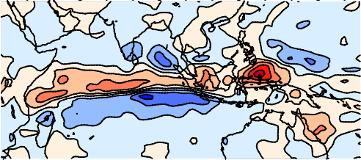


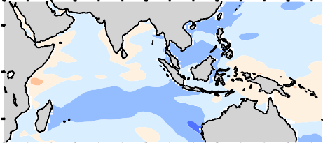
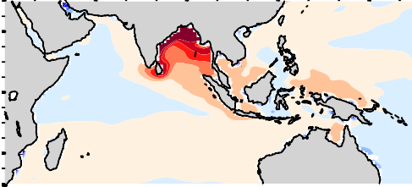


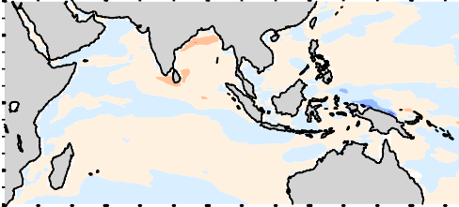
mean fields: EBM - VSF
rain
surface fluxes
rainfall river discharge
salinity advection
SST
EBM > VSF
SSS
EBM < VSF
heating
buoyancy flux, stabilization
MLD

Slide 21
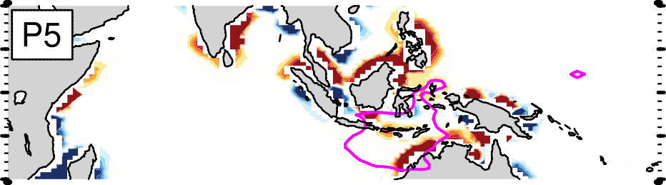
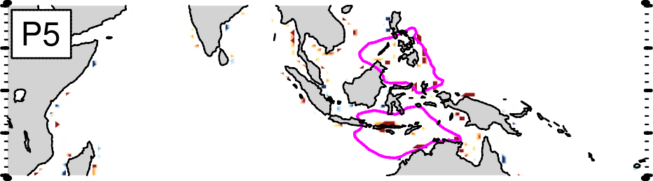

anomalous runoff in VSF vs EBM
VSF EBM
₁₀-5 _{kg m}-2 _{s}-1

Slide 22
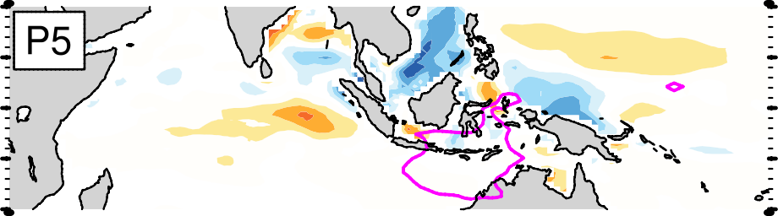
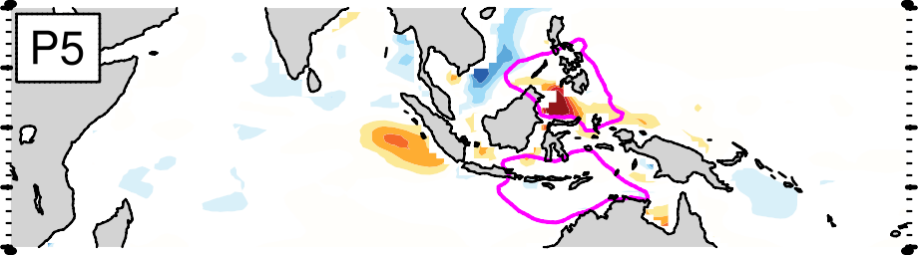
anomalous runoff in VSF vs EBM
VSF EBM
₁₀-5 _{kg m}-2 _{s}-1
runoff in EBM is hard to see! easier to infer from salinity anomalies…

Slide 23
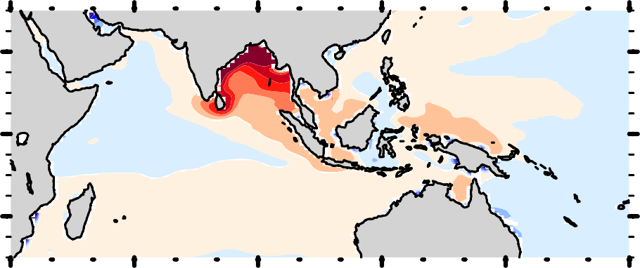
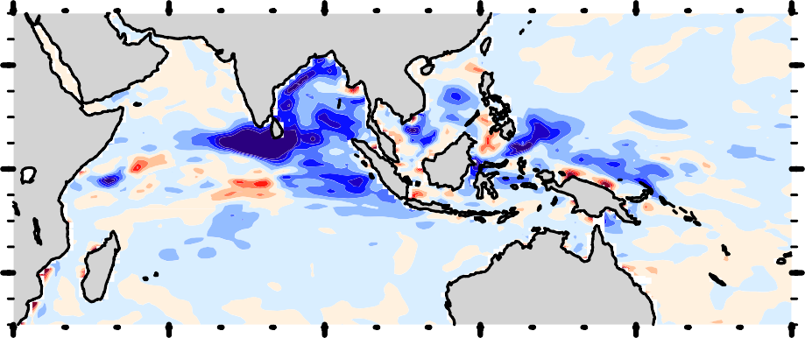
salinity impacts: EBM - VSF
SSS
mean
5-100 day stdev

Slide 24
salinity impacts: EBM - VSF
SSS
mean
5-100 day stdev
VSF: salinity advection originating from Ganges River discharge

Slide 25
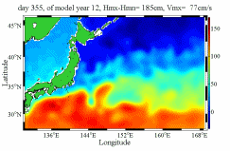
Real time ocean nowcast system
http://140.112.68.33/

Slide 26
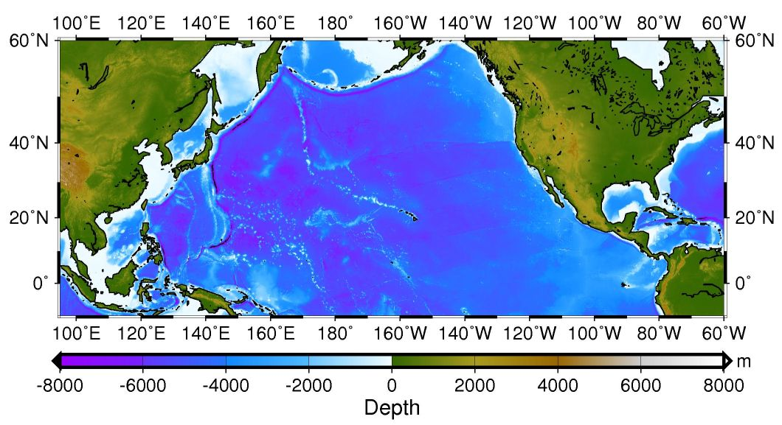
Taiwan Multi-scale Community Ocean Model (TIMCOM)
NPB (North Pacific Basin) Domain:
30°S to 60°N and 150°E to 80°W
grid resolution 1/4°
TAI Domain:
0° to 50°N and 100°E to 150°E
grid resolution 1/8°
Japan Sea
East China Sea
1/8^{O}x1/8^{O}
1/4^{O}x1/4^{O}
South China Sea
Extended to 30^{O}S

Slide 27
4th order accurate, Z-level, free surface
Mixed Arakawa “a” and “c” grids
The control volume equations include fluxes of the conservation of momentum, heat and salt across control volume faces.
Bathymetry:
  Interpolated from unfiltered ETOPO2 depth data
The vertical resolution ~ linear-exponential stretched grid, 26 layers
Varying latitude and uniform longitude grid (Mercator grid).
Surface forcing:
  NCEP GFS atmospheric state
  Use 1/12° HYCOM global model for the initialization.
The northern boundary is closed. Insulated bottom, with non-slip conditions parameterized by a nonlinear bottom drag.
Sub-grid scale vertical mixing is parameterized by eddy diffusivity/viscosity using a modified Richardson number based approach based on Pacanowski and Philander (1982)

Slide 28
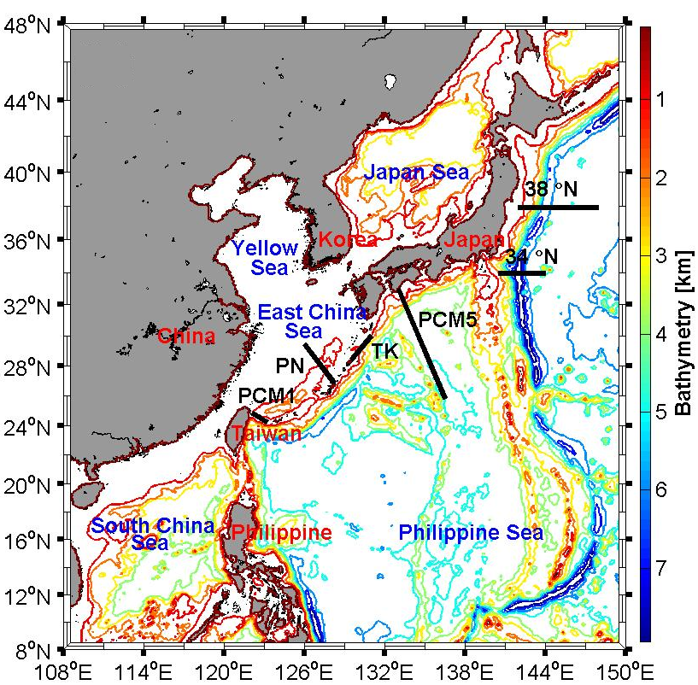
TAI domain bathymetry and observations
(ASUKA line)
The Luzon and Taiwan Straits, the SCS
Notes:
Kuroshio and Oyashio current system.

Slide 29
Multiple-domain Coupling
NPB : The eastern domain North Pacific Basin (coarser)
TAI : The western domain Taiwan Area (finer)

Slide 30
TAI to NPB
UTAI: the cell face velocity U of the TAI domain.
UWNPB: the intermediate cell face velocity U at west interface for the boundary cell (purple square) in the NPB domain
U_{NPB} (1,127,K): the final cell face velocity U at west interface for the boundary cell (purple square) in the NPB domain
FLT1/FLT2 : time filter, where FLT1=FLT2-1
U2TAI: the cell center velocity U of the TAI domain.
U2WNPB: the intermediate cell center velocity U in the NPB domain
where dU=U2NPB(2,K)-U1NPB(2,127,K)
U2_{NPB} (1,127,K): the final cell center velocity U in the NPB domain

Slide 31
NPB to TAI
U_{NPB}: the boundary face velocity U of the NPB domain.
UETAI: the intermediate cell face velocity U at east interface for the boundary cell (purple square) in the TAI domain
U_{TAI} (I1,2,K): the final cell face velocity U at east interface for the boundary cell (purple square) in the TAI domain. It is essentially the same as UETAI but the land masks are imposed to ensure conservation.
UIOTAI: the intermediate cell center velocity U in the TAI domain
U2TAI: the final cell center velocity U in the TAI domain

Slide 32
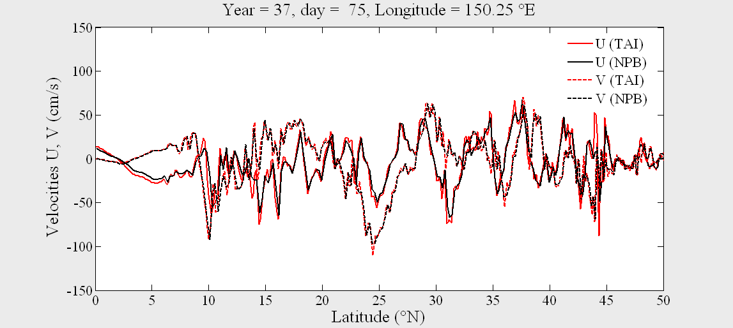
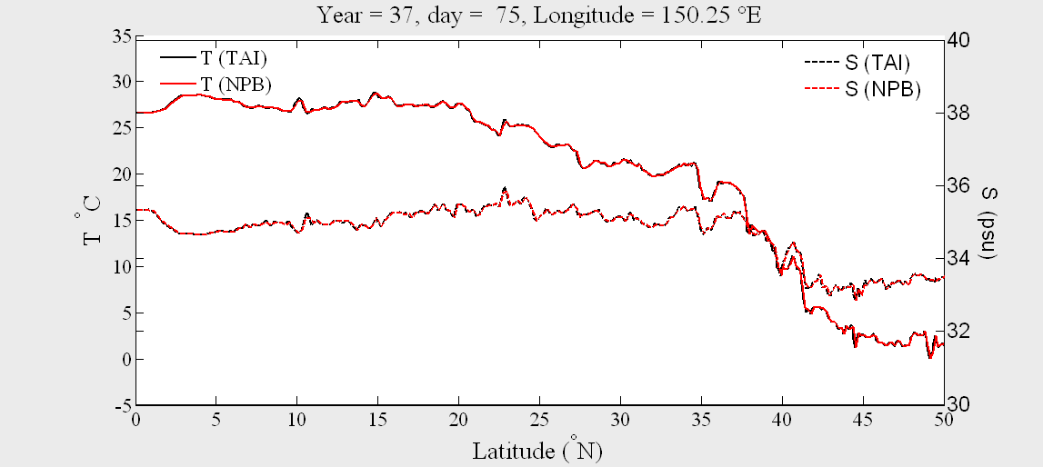
Comparison of the surface
(a) velocities and (b) temperature/salinity at the interface of TAI and NPB
(a)
(b)

Slide 33
Young, C.C., Liang, Y.C., Tseng*, Y. H. and Chow, C. H. (2014), “Characteristics of the RAW filtered Leapfrog time-stepping scheme in the ocean general circulation model,” Mon. Weather Rev., 142, 434-447.
Shen, M. L., Tseng*, Y. H., Jan, S., Young, C.C. and Chiou, M. D. (2014), “Long-term variability of the Kuroshio transport east of Taiwan and the climate it conveys,” Prog. Oceanogr., 121, 60-73.
Tseng*, Y. H., Shen, M.L., Jan, S., Dietrich, D.E. and Chiang, C.P. (2012), “Validation of the Kuroshio current system in the dual-domain Pacific Ocean model framework,” Prog. Oceanogr., 105, 102-124
Young, C.C., Tseng*, Y.H., Shen, M.L., Liang, Y.C., Chien, M.H. and Chien, C.H. (2012), “Software development of the TaIwan Multi-scale Community Ocean Model (TIMCOM),” Environ. Modell. Softw., 38, 214-219.
Tu*, C. Y., Tseng, Y. H., Chiu, T. S., Shen, M. L. and C. H. Hsieh (2012), “Using coupled fish behavior-hydrodynamic model to investigate spawning migration of Japanese anchovy, Engraulis japonicas, from East China Sea to Taiwan,” Fish. Oceanogr., 21, 255-268.
Han*, Y.-S., Zhang, H., Tseng, Y. H. and Shen, M. L. (2012), “Larval Japanese eel (Anguilla japonica) as sub-surface current bio-tracers on the East Asia continental shelf”, Fish. Oceanogr., 21, 281-290.
Shen, M.-L., Tseng*, Y. H., and Jan, S. (2011), “The formation and dynamics of the cold-dome off northeastern Taiwan,” J. Marine Syst., 86, 10-27.
Jiang*, L., Yan, X.-H., Tseng, Y. H. and Breaker, L. (2011), “A numerical study on the role of wind forcing, bottom topography, and nonhydrostacy in coastal upwelling,” Estuar. Coast. Shelf Sci., 95, 99-109.
Tseng*, Y. H., Jan, S., Dietrich, D. E., Lin, I.-I., Chang, Y. T. and Tang, T. Y. (2010), “Modeled oceanic response and sea surface cooling to typhoon Kai-Tak,” Terr. Atmos. Ocean. Sci., 21, 85-98.
Jan*, S., Tseng, Y. H., and Dietrich, D. E. (2010), “Sources of water in the Taiwan Strait,” J. Oceanogr., 66, 211-221.

