Slide 1
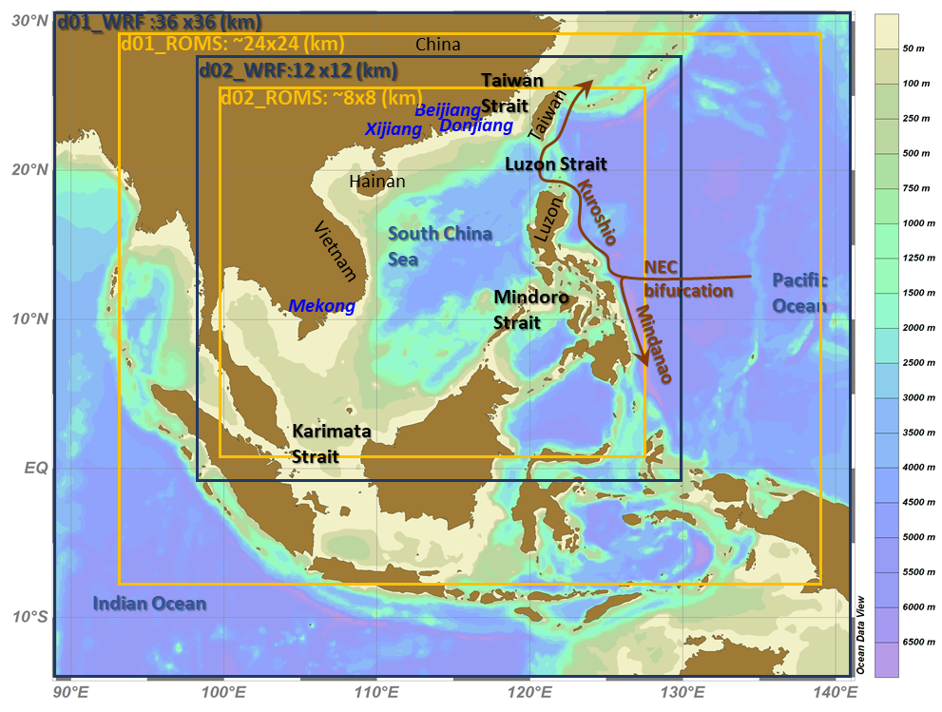
Mesoscale ocean response and air-sea interaction in the South China Sea during ENSO decaying winter-spring modelled by a regional coupled model
Yi-Chun Kuo and Yu‑heng Tseng
Institute of Oceanography, National Taiwan University, Taiwan
Notes:
Good morning, thank you very much for your coming for the first talk today!
What I am going to present is

Slide 2
Motivations and outlines
Provide physical background to support SCSTIMX or other field experiments
  Ocean mesoscale structure, air-sea interaction
Validation (Ocean/Atmosphere)
ENSO impacts on the South China Sea
  Ocean mesoscale feedback
  Change of circulation
  Change of the throughflow
  Air-sea interaction
See the poster S04-P01

Slide 3
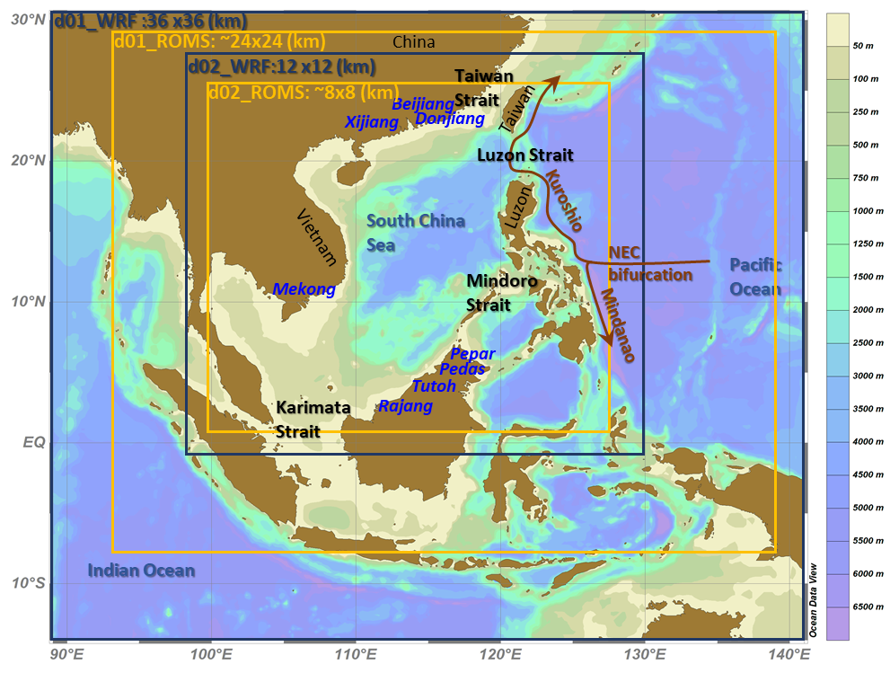
Weather Research and Forecasting Model (WRF)
Domain 1 : 36x36(km)
Domain 2 : 12x12(km)
Vertical : 36 levels
Initial/lateral BC: NCEP FNL Operational Model Global Tropospheric Analyses
Regional Ocean Modeling System (ROMS)
Domain 1 : 24x24 (km)
Domain 2 : 8x8 (km)
Vertical : 25 levels
Initial/lateral BC: HYCOM + NCODA Global 1/12° Reanalysis
EXP1 2015/11-2016/6 El Niño
EXP2 2011/11-2012/6 La Niña

Slide 4
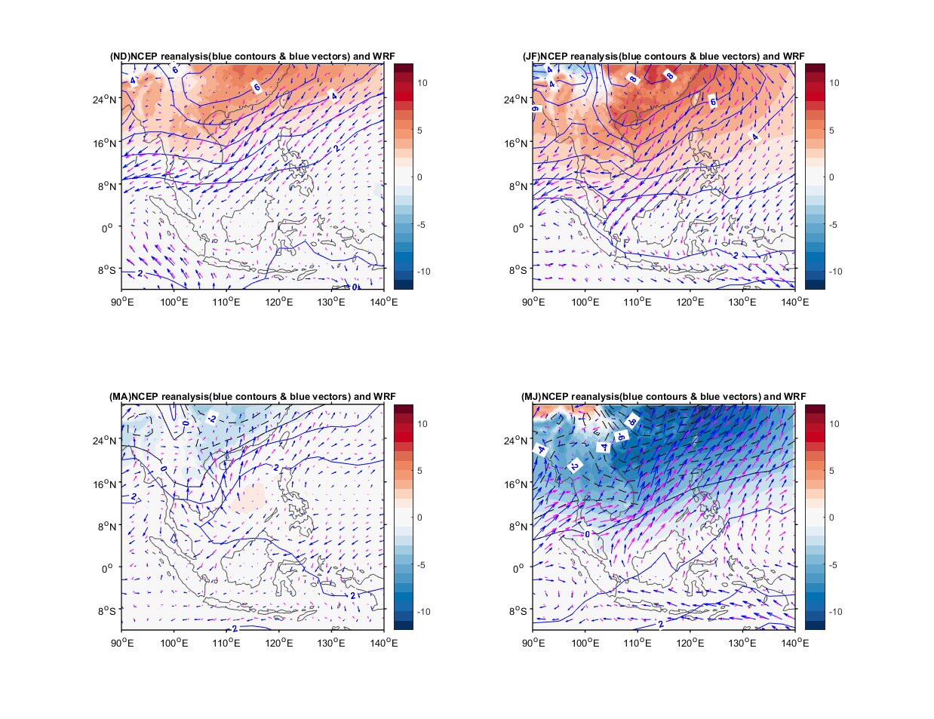
Model validation-the low level circulation
Blue contours and vectors: NCEP reanalysis.
Shaded color and pink vectors: RCM
The El Niño case (2015/11-2016/6)
Nov-Dec
Jan-Feb
(hpa)
(hpa)
(hpa)
Mar-Apr
May-Jun
(hpa)
(hpa)
Notes:
During wintertime (Nov-Feb), the northeasterly wind prevail in the SCS with positive SLP anomaly(from the 8-month mean) centered in the mainland China.
During Mar-Apr, the southwesterly grows. Later the southerly wind replaced the northeasterly wind in May-Jun.
(a) 8-month averaged (2015/11-2016/6) SLP (hpa) and surface wind vectors from the model results (shaded colors and magenta vectors) and NECP Reanalysis (blue contours and blue vectors). (b)-(e) 2-month averaged (Nov-Dec, Jan-Feb, Mar-Apr, May-Jun) SLP (hpa) and surface wind vectors deviated from the average shown in (a).

Slide 5
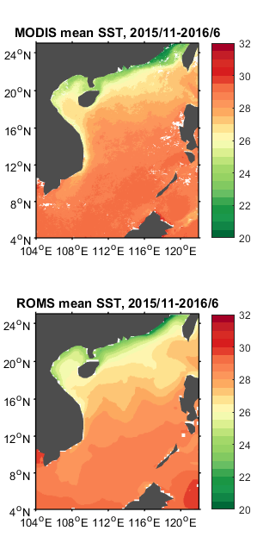
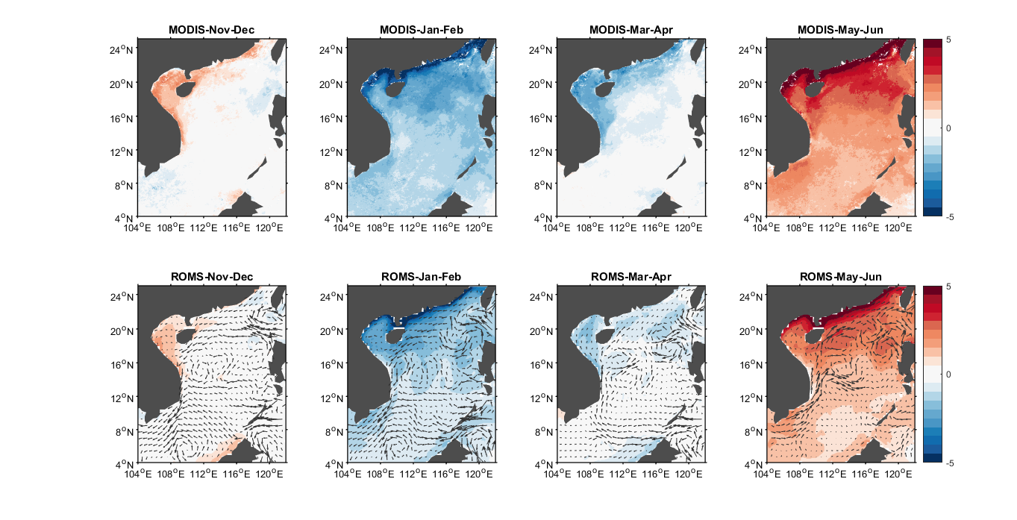
Model validation-SST (2015/16)
8-month mean SST pattern
consecutive 2-month averaged SST deviation
Nov-Jun
Nov-Dec
Jan-Feb
Mar-Apr
May-Jun
MODIS
model
Cyclonic eddy
Notes:
The modeled SSTs are slightly lower than the MODIS SSTs, but the general pattern agrees reasonably with the MODIS data.
The mean-SST distribution decreases from the southeast toward the northwest. In the Luzon Strait, the Kuroshio intrusion into the SCS results in a warm tongue formation.
Both MODIS and modeled SSTs confirm that the SCS SSTs are the coolest during Jan-Feb and then gradually warm throughout May-Jun with a faster warming in the northern SCS than the rest regions.

Slide 6
Model validation-TS profiles vs Argo Floats
R1
R1
R2
R2
R3
R3

Slide 7
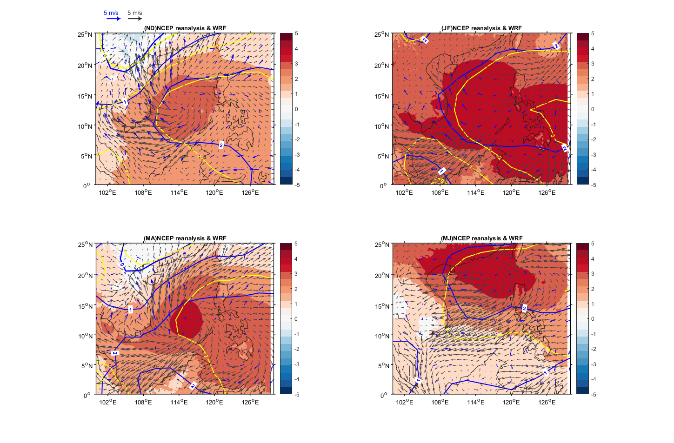
2015/16 minus 2011/2
Low-level atm. circulation between El Niño & La Niña
Blue contours and vectors: NCEP reanalysis
Yellow: mean SLP diff. from recent 6 strongest ENSO (3 El Niño and 3 La Niña)
Nov-Dec
Jan-Feb
North SCS:
Weaker EAWM
South SCS:
Stronger EAWM
Mar-Apr
May-Jun
Notes:
1.These features in the coupled model results are consistent with the NCEP reanalysis data.
2. Similar patterns of SLP differences suggest that the anticyclone strengthens in winter and then decays until March-Apr. Subsequently, the anticyclone moved northward.
3. The anomalous southwesterly/northeasterly in the northern/southern SCS associated with the anomalous anticyclone indicate weaker/stronger monsoon during winter of the El Niño year.
To further examine the appropriateness of these two selected ENSO years as a general ENSO response in the SCS region, the mean SLP differences in the recent 6 strongest ENSO years (El Niño:1997-98 2009-10 2015-16, La Niña: 1999-2000, 2007-08, 2011-12) using the NCEP reanalysis data are included in Fig. 5 for comparison.
The formation of this anomalous anticyclone was due to the remote ENSO forcing.
The local ocean response to this low-level circulation anomaly and the regional coupled air-sea interaction is discussed in the following slides.

Slide 8
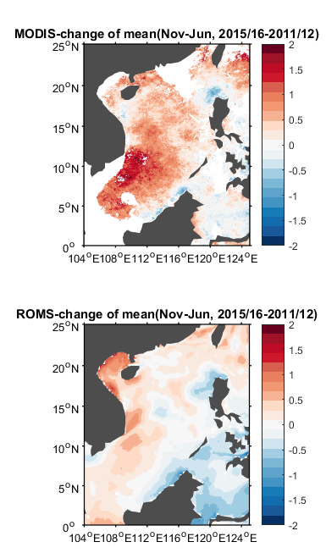
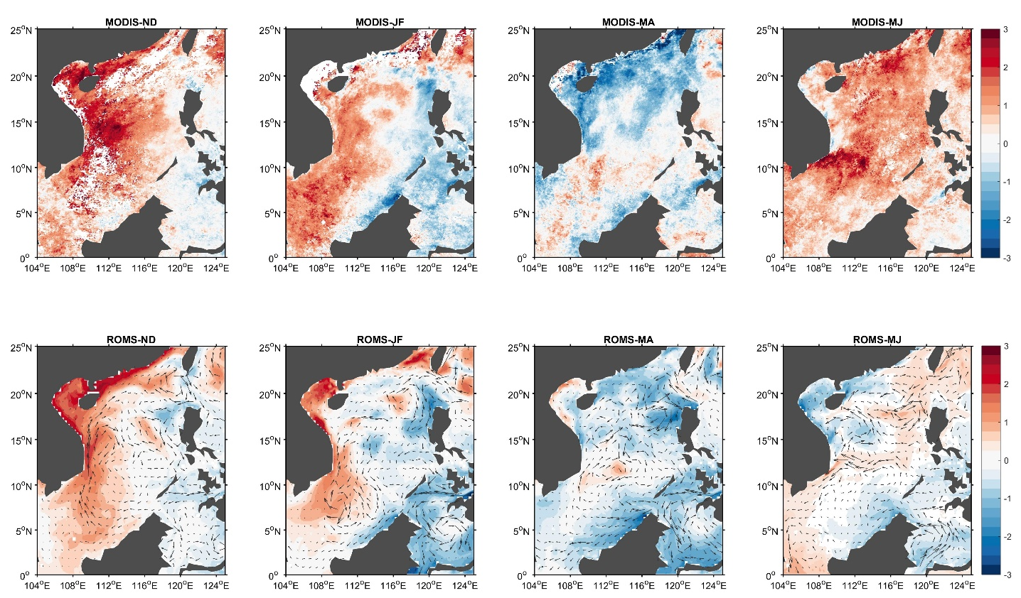
Surface SCS response to ENSO (El Niño-La Niña)
averaged SST diff.
Nov-Jun
Nov-Dec
Jan-Feb
Mar-Apr
May-Jun
MODIS
model
Notes:
1. The positive SST difference decreased in Jan-Feb. During Mar-Apr, the difference became negative in the northern SCS.
2. During wintertime (Nov-Feb) of the El Niño year, the southward western boundary current was weaker as compared with the La Niña year.
3. An anomalous anticyclonic eddy occurred in the southern SCS, indicating the weakening/strengthening of the cyclonic eddy in this region. 4. An anomalous anticyclone occurred to the west of the Luzon Strait, where the Kuroshio loop taken place. This anomaly infers enhancement of the Kuroshio intrusion.
The model shows a smaller SST difference as compared with the MODIS data. But the general patterns is alike.
The SST difference is mainly positive in the SCS, with stronger values in the western boundary region.
The 2-month averaged patterns show the seasonal variation.
The positive SST difference decreased in Jan-Feb. During Mar-Apr, the difference became negative in the northern SCS.
During this time , the northerly wind weakened and gradually replaced by southerly and the western boundary current became northward.
The decreasing SST difference, from positive in winter to negative in spring could attributed to two factors, surface heat flux and oceanic heat advection. This issue will be clarified later.

Slide 9
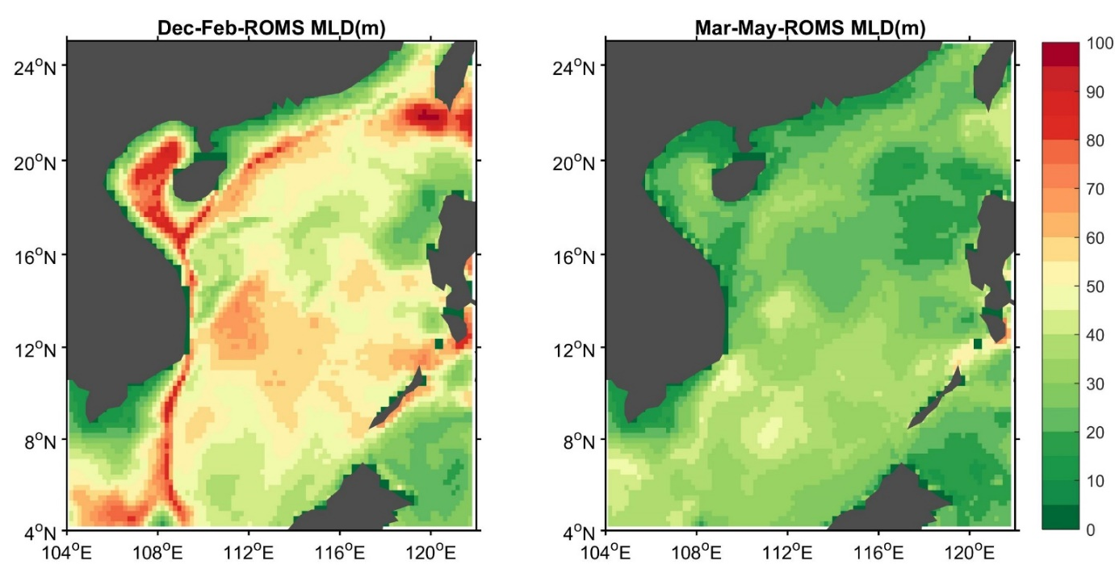
Subsurface SCS response to ENSO (MLD)
Winter
Spring
Thicker MLDs in WBCs (stronger downward momentum flux enhances the vertical mixing)
Notes:
During winter, the regional western boundary current in the SCS has thicker MLDs. The stronger downward momentum flux enhances the vertical mixing and increases the MLDs. In the central SCS, a slightly deep MLD region is associated with an anticyclonic circulation located between the two cyclonic circulations in the northern and southern SCS, respectively .
These circulation patterns are commonly found in the winter SCS (Hu et al., 2000).

Slide 10
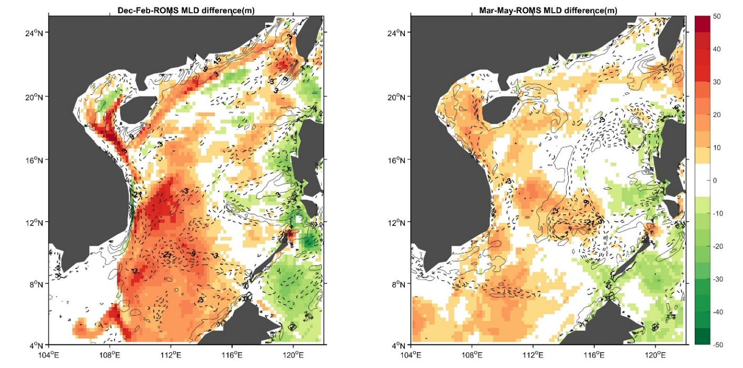
Subsurface SCS response to ENSO (MLD, El Niño-La Niña)
Winter
Spring
Contours: WSC diff
Wind direction
weaker onshore flow (weaker EAWM)
coast
2015/16 El Niño
Thicker ML
stronger onshore flow
coast
drive more bottom cooler water offshore
2011/12 La Niña
Thinner ML
Notes:
The stronger horizontal convergence off the southern coast of China, owing to the anomalous wind stress and its resulting Ekman flow, during La Niña drove more bottom cooler water flowing offshore which cooled the subsurface in the offshore region.
The MLDs are defined as the depth at which the temperature is changed 0.5 °C lower than the surface (Levitus, 1982)
During winter, the regional western boundary current in the SCS has thicker MLDs. The stronger downward momentum flux enhances the vertical mixing and increases the MLDs. In the central SCS, a slightly deep MLD region is associated with an anticyclonic circulation located between the two cyclonic circulations in the northern and southern SCS, respectively .
These circulation patterns are commonly found in the winter SCS (Hu et al., 2000).

Slide 11
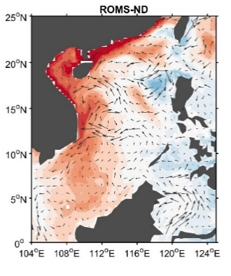
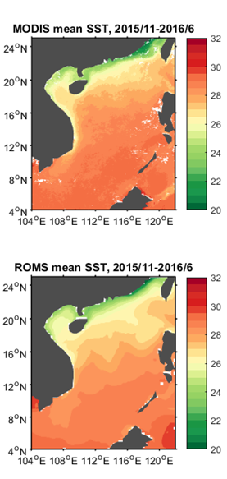
Nov-Dec
Heat budget
2015/16 El Niño
Spring: SST warming contributed by advection and surface heat flux
Anomalous Ekman transport causes the cooler water to move toward the southeast
Anomalous wind during El Nino
Winter: both SST cooling contributed by SHF (but weaker HF diffusion in El Niño)
Heat flux diffusion
Anomalous Ekman transport
2011/12 La Niña
Winter: upward SHF causes cooler SST during La Niña and El Niño
Spring: the advection causes cooler SST during the El Niño than La Niña
Heat flux diffusion
Heat flux diffusion
Notes:
Comparing the two ENSO years showed that during winter (spring), the negative (positive) diffusion term in the El Niño is weaker (larger) than La Niña.
The advection term plays a key role to bring the warmer water from the south to the north to compensate the heat loss. The difference in the advection term can also be viewed as an anomalous Ekman drift transport toward the southeast in the northern SCS during El Niño, triggered by the southwesterly wind anomaly, resulting in the spread of the cooler water in the northwestern coastal region toward the eastern SCS.
(heat flux diffusion term : net surface heat flux - turbulent flux at the bottom of surface layer)

Slide 12


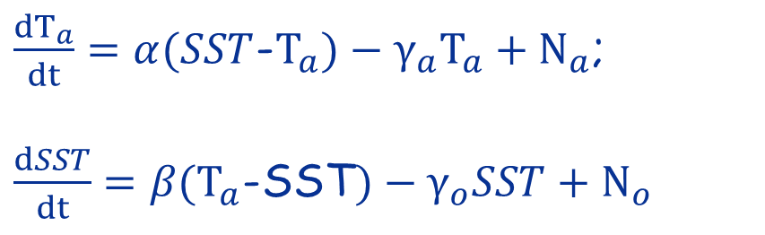
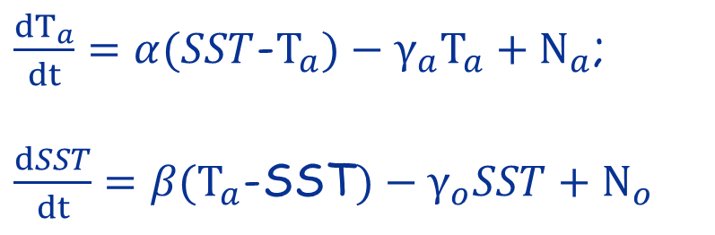
SST and SHF relation in the simple stochastic models (Wu et al. 2006)
Atmosphere forces ocean
Positive: upward SHF
$\frac{dT_{a}}{dt}=α(SST$-$T_{a})−γ_{a}T_{a}+N_{a}$;
$\frac{dSST}{dt}=β(T_{a}$-SST$)−γ_{o}SST+N_{o}$
0
$$\frac{dSST}{dt}is negatively correlated with SHF$$
Positive: upward SHF
$\frac{dT_{a}}{dt}=α(SST$-$T_{a})−γ_{a}T_{a}+N_{a}$;
$\frac{dSST}{dt}=β(T_{a}$-SST$)−γ_{o}SST+N_{o}$
0
$$SST is positively correlated with SHF$$
Ocean forces atmosphere
Notes:
($α, β$) are the exchange coefficients associated with heat capacity of atmosphere and ocean and $α≫ β$. ($γ_{a}, γ_{o}$) are the radiative damping coefficient. ($N_{a}, N_{o}$) are the stochastic forcing. [Bishop et al. 2017]

Slide 13
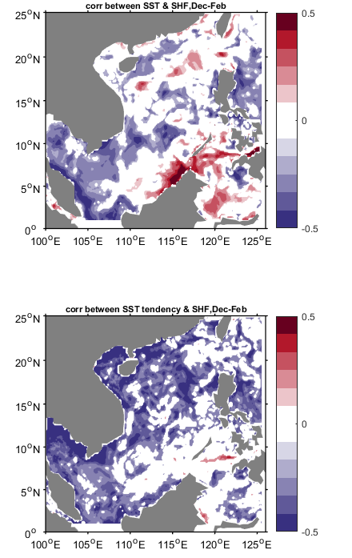
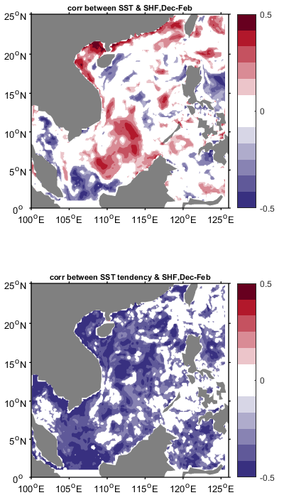

Correlation between SST/SST tendency and SHF anomaly
2015 El Niño winter
2011 La Niña winter
SST forces the anom. air-sea heat flux
SST & SHF
ATM forcing dominates the anom. SHF in the northern SCS
$\frac{dSST}{dt}$ & SHF
the monthly clim. is removed by subtracting NCEP reanalysis mean (1979-2009)
Notes:
The cold China coastal current intensified the cool water advection in the northern SCS. In addition, the atmospheric ascending motion is enhanced in the tropical region where an anomalous cyclonic circulation in the upper ocean provides a relatively strong advective ocean heat flux from the south, resulting in an SST-forced atmosphere feedback in the southern SCS.

Slide 14
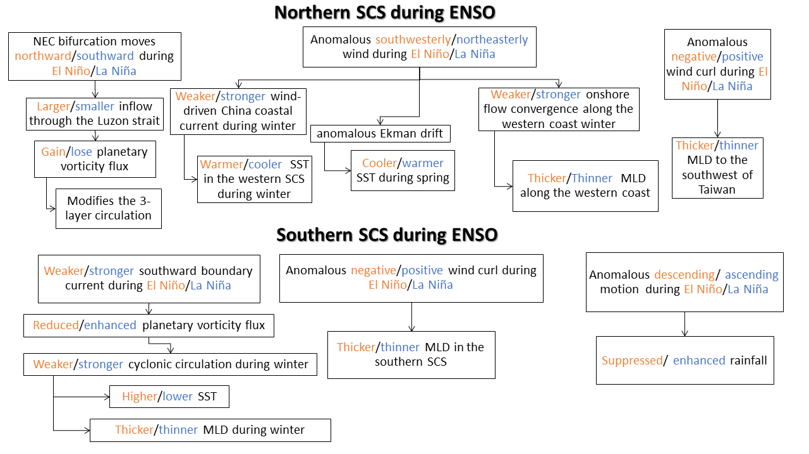

Conclusion

Slide 15
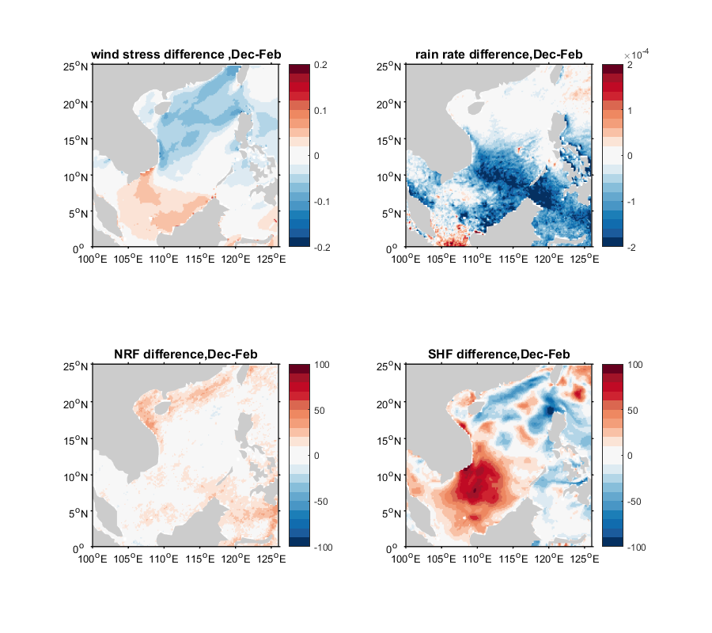
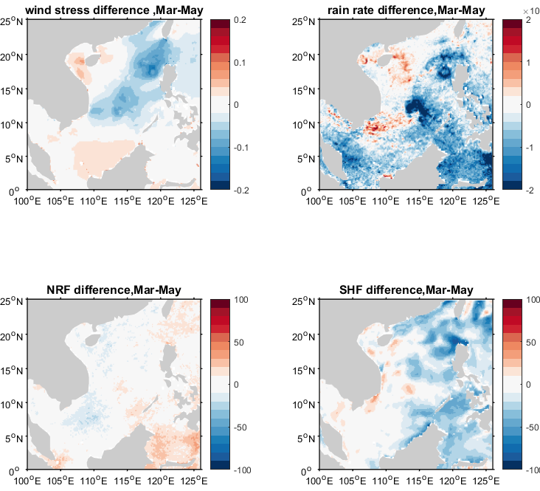
Air-sea heat exchange
seasonal mean diff. (El Niño-La Niña)
Winter(Dec-Feb)
Spring (Mar-May)
Anomalous wind
Winter monsoon
Wind stress
Rain rate
Wind stress
Rain rate
Net radiative HF
SHF
Net radiative HF
SHF
Positive: upward heat flux

Slide 16
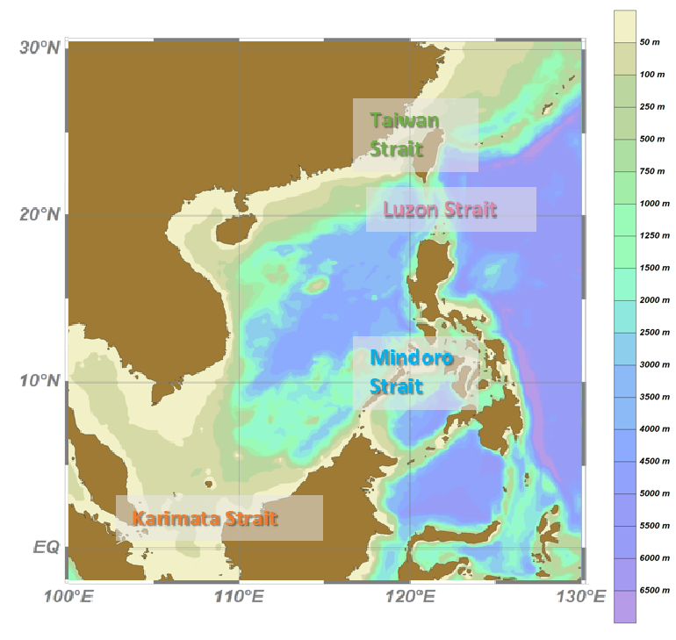
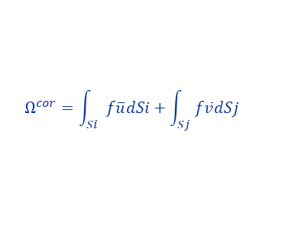
Water exchange in the SCS
inflow
El Niño
During El Niño
During La Niña
outflow
inflow
outflow
La Niña
Dominant vorticity source through LS
anomalous inflow from the LS brings positive planetary vorticity flux due to a higher latitude of the LS (larger f)
$$Ω^{cor}=\int_{Si}{f\overline{u}dSi+\int_{Sj}{f\overline{v}dSj}}$$
Gan et al. (2016)
𝑆𝑖 and 𝑆𝑗 are the positive inward of the enclosed SCS$.$
Notes:
The Luzon Strait locate at the north of the SCS region, hence the inflow through the Luzon Strait resulting in positive planetary vorticity influx (higher latitude). The planetary vorticity influx accompanying with the enhanced Kuroshio intrusion into the SCS is the major source for the anomalous cyclonic circulation in the middle-layer during the decaying El Niño phase (winter to spring).
Since the approximately three-layer structure may be treated independently [Gan et al, 2016] and the Luzon strait is the only channel deep enough to connect the SCS’s middle layer to the Pacific, the middle-layer transport of the Luzon Strait is crucial to the circulation anomaly in the middle-layer of the SCS.
Gan et al. (2016) used a divergence theorem to express the dominant vorticity source$Ω^{cor}$ as

Slide 17
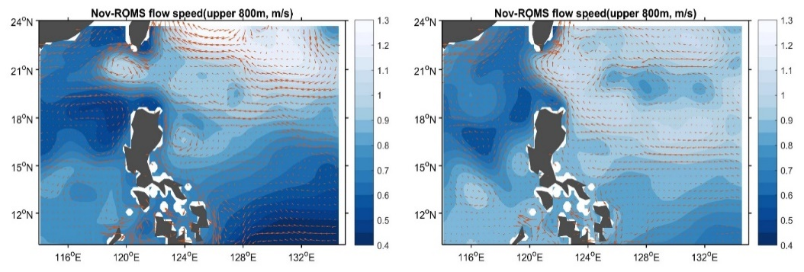
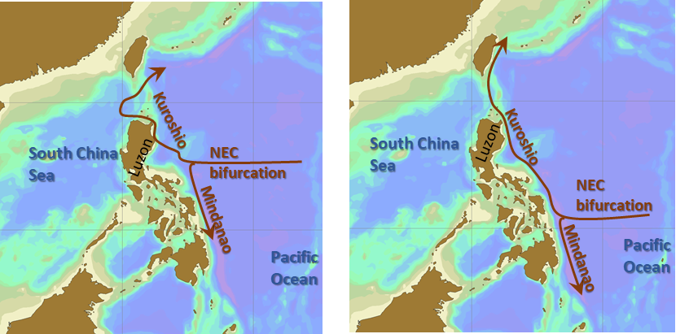
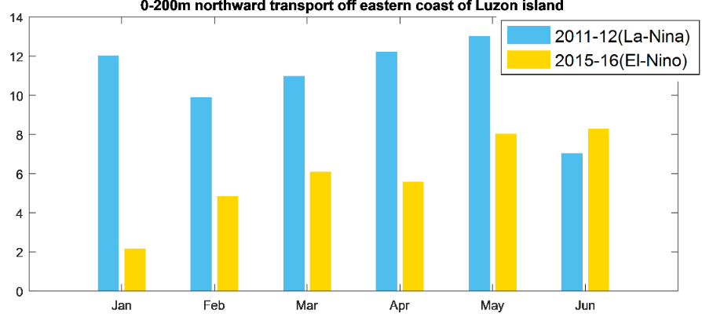
2015-16 (El Niño)
2011-12(La Niña)
El Niño
La Niña
NEC bifurcation latitude
gray line: monthly value;
black line: 12-month moving ave.
Blue: Niño3.4 index
Notes:
For a western boundary current encountering a boundary gap, such as Kuroshio in the Luzon Strait, the vorticity balance is dominated by the advection and β term [Sheremet and Kuehl 2007; Kuehl and Sheremet 2009]. When the upstream Kuroshio speed is small enough such that the β effect dominates the flow motions, the Kuroshio Current tends to intrude westward into the northern SCS and drastically return, forming an intense loop that preserved the potential vorticity with a strong curved flow.
(The method in Qiu and Chen (2010) was used to identify the location of NEC bifurcation.
AVISO Data: Mean dynamic topography(mdt_cls2013_global)+monthly SLA)

