Slide 1
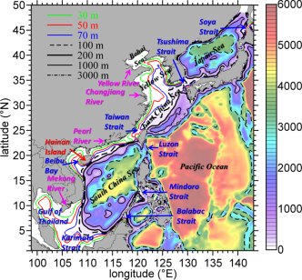
High Resolution Modeling of the South China Sea Circulation
Yu-heng Tseng and Yi-Chun Kuo
Institute of Oceanography, National Taiwan University

Slide 2
Overview
Characteristics of the mean ocean circulation in the South China Sea (SCS)
Monsoon wind stress
Seasonal circulation
SCS throughflow (SCSTF)
Taiwan Strait
Luzon Strait Intrusion
Ocean-atmosphere interaction relevant to the SCS

Slide 3
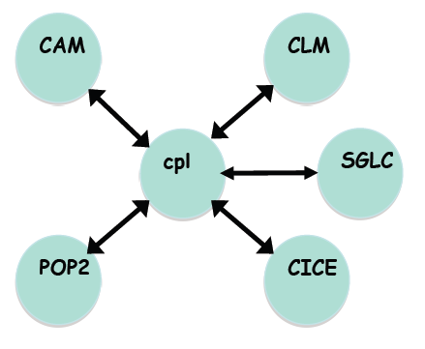





Community Earth System Model (CESM) high resolution simulations
atmosphere
land
land ice
coupler
ocean
sea ice
Notes:
External forcing, Initial Condits, coupling – “Present day” (year 2000) conditions – Short (1 year) ocean-ice spin up from Gouretski and Koltermann (2004) climatology of WOCE and other data, forced by CORE – 6 hour ocn-atm coupling

Slide 4
Global ocean-sea ice simulation
POP2 and CICE: global 0.1°, 62 levels
10 year COREII forced, ocean-ice runs (normal year, year 21-30)
Global coupled simulation
Ocean-sea ice+CAM5 (spectral element ne120, 0.25°) and CLM4
15 years simulations (year 46-60)
Small et al. (2014)

Slide 5
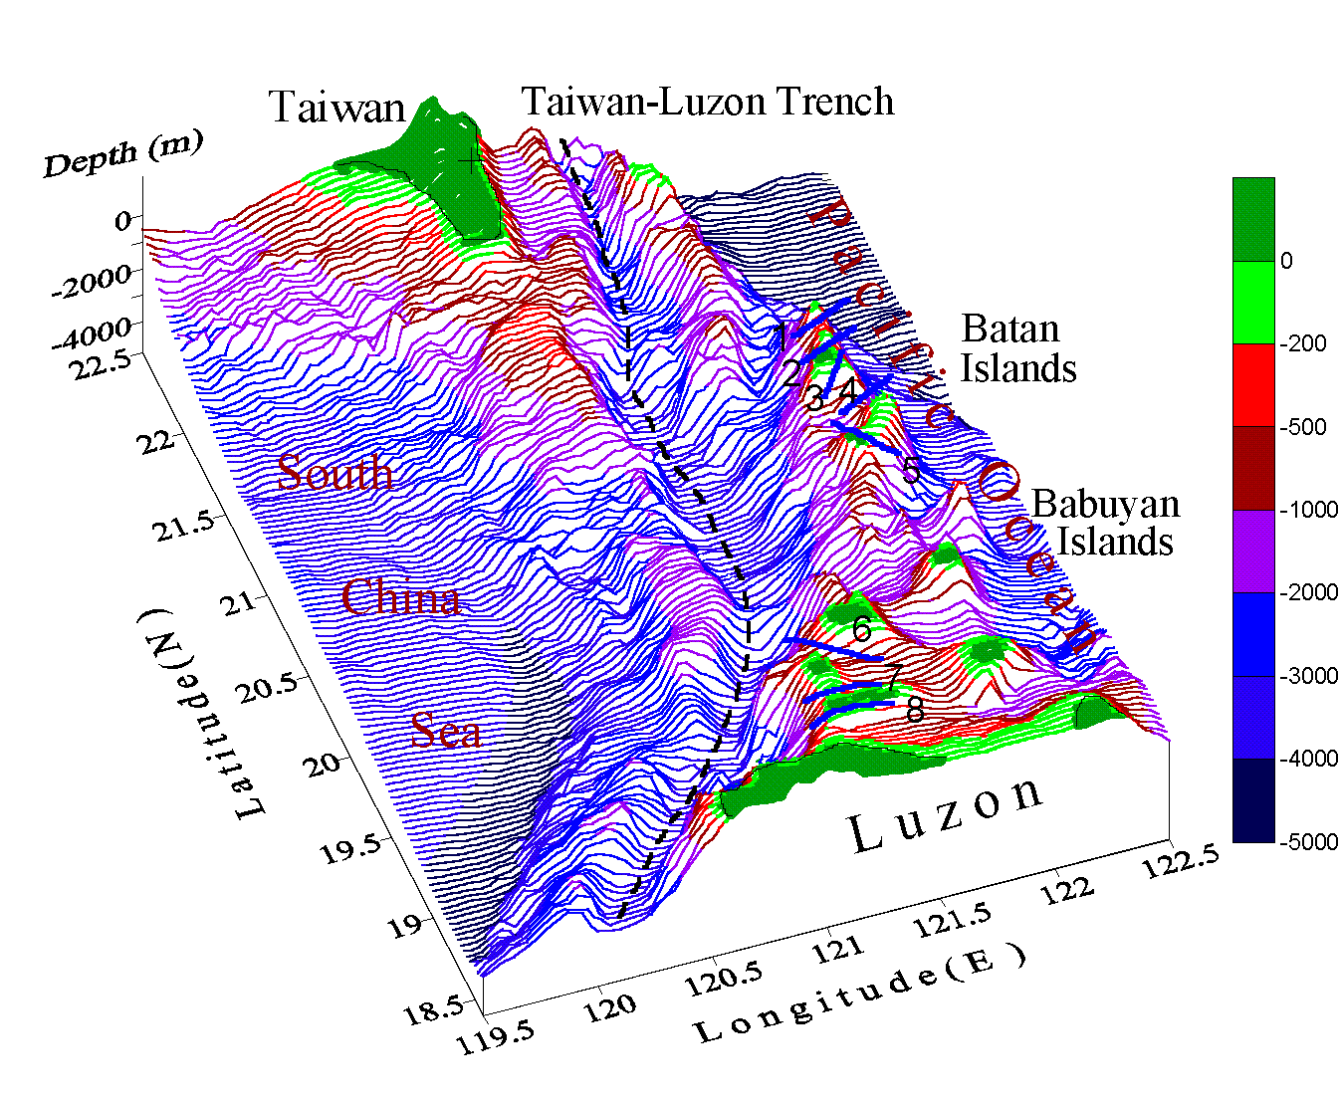
Overview of SCS
Largest marginal sea in Western Pacific Ocean (3.5x10⁶ km²)
Large shelf regions & deep basins
Sill depth ~2600m
Deepest water confined to a bowl-type trench
South of 5°N, depth drops to 100m

Slide 6
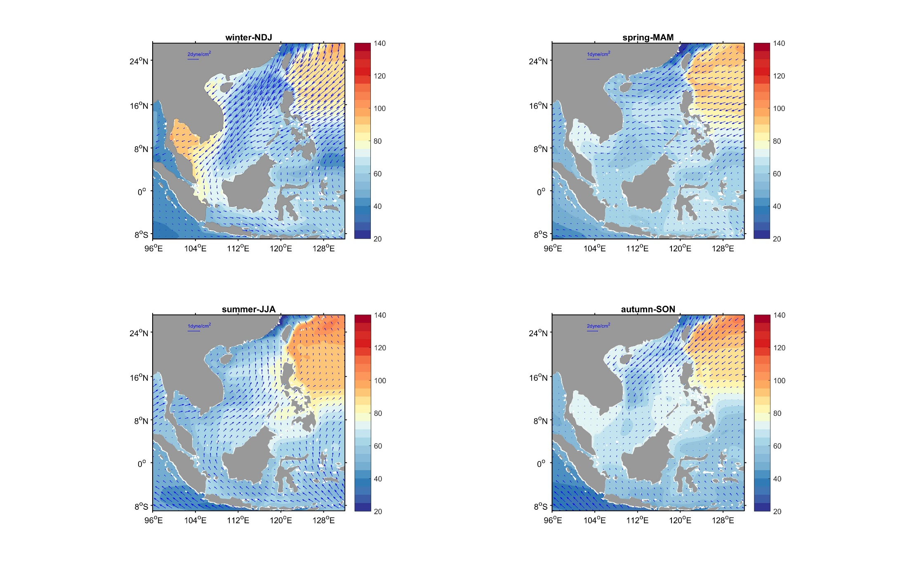
Seasonal monsoon system
Subjected to seasonal monsoon system
Summer: SW monsoon (0.1 N/m²)
Winter: NE monsoon (0.3 N/m²)
Transitional periods: highly variable winds & currents
Climatological wind stress

Slide 7
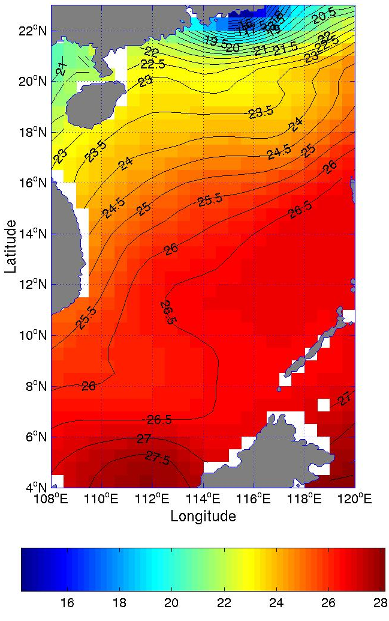
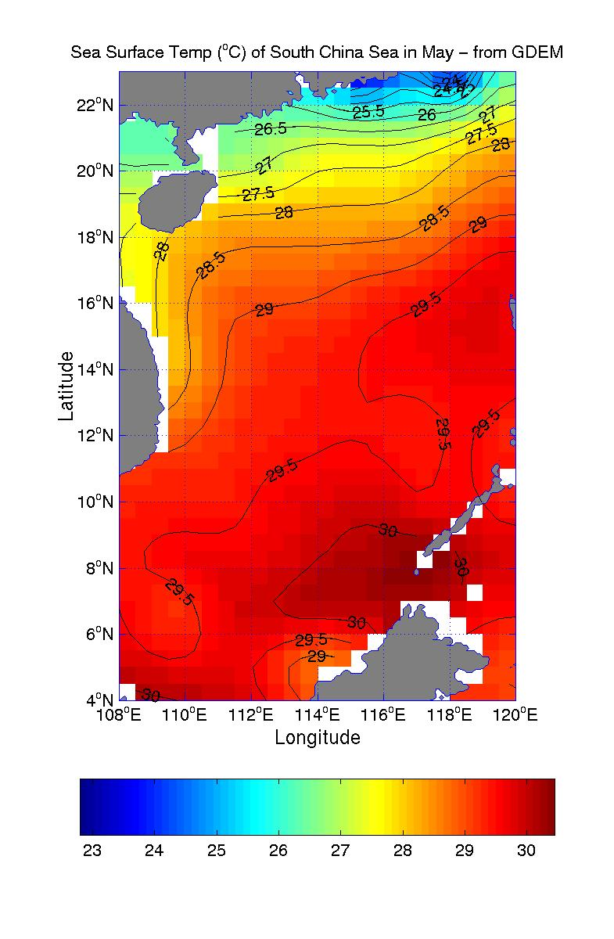
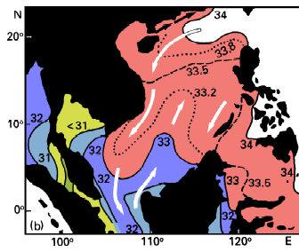
Surface temperature and salinity
North: Cold, saline
Annual variability of salinity small
South: Warmer & fresher
Summer: 25-29°C (> 16°N)
29-30°C (< 16°N)
Winter: 20-25°C (> 16°N)
25-27.5°C (< 16°N)
Winter
Summer

Slide 8
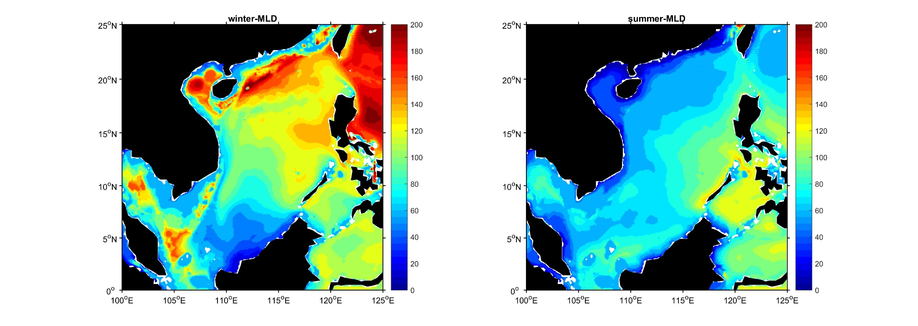
Mean mixed layer depth
Deepening due to northeastly monsoon (wind+Ekman pumping+ surface cooling)
Summer
(MJJA)
Winter
(DJFM)
Deepening due to southwestly monsoon
Temp. criteria (0.5°C)
Notes:
Kuo : I do vertical interpolation first(dz=5m), then calculate the MLD.
In January, when the northeast monsoon fully develops, wind stirring, downward Ekman pumping, and surface cooling work together generating a seasonal maximum of ID (>70 m) near the continental slope south of China.
Ventilation of the thermocline occurs in the northern South China Sea because of the deep thermocline at this season, incorporating with enhanced western boundary current. The ID decreases toward the south, falling below 40 m in the southeastern corner of the basin. As the northeast monsoon diminishes, wind stress cannot provide enough TKE to maintain the deep ID created in winter, and as a result, the ID shoals over the entire basin of the South China Sea. In March, the ID remains deeper than 50 m only in a small region off southwest Taiwan, and is dominated by a bowl-shaped distribution elsewhere, deeper (>45 m) in the central part of the basin and shallower (<35 m) near the boundary. This distribution is consistent with earlier observations of sea level [Shaw et al., 1999], suggesting an anticyclonic circulation in the upper ocean during this period of the year [Wu et al., 1998].
As summer monsoon develops, the mixed layer starts to deepen in the south. In June, the maximum ID exceeds 40 m off the southeast tip of Vietnam (Figure 10). This ID maximum corresponds well with a negative wind stress curl (Figure 11). Xie et al. [2003] noted that, as the southwest monsoon wind impinges on the north–south running maintain range on the east coast of Vietnam, a strong wind jet occurs at its southeastern tip, resulting in a cold filament that spreads northeastward offshore. To the south of the cold filament, an anticyclonic circulation develops (Figure 11), generating a local ID maximum (Figure 10). The ID continues to deepen in July (>50 m), and reaches its seasonal maximum (>55 m) in August–September, around the end of the season when wind stress curl is negative.

Slide 9
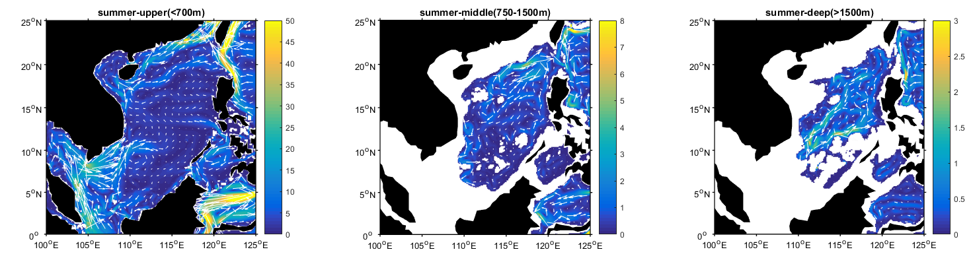
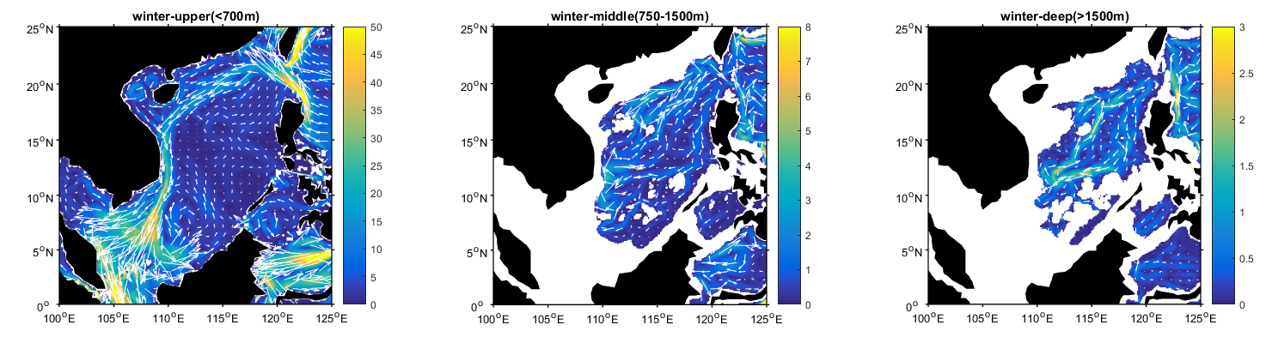
Depth-averaged flow fields
North (cyclonic circulation): Controlled by WSC, balance of influx/outflux-induced upwelling and a positive vort. source fed from the Kuroshio
Resulting from the seasonal deepwater overflow through the Luzon Strait (Lan et al., 2015)
Notes:
Northern SCS: persistent cyclonic gyre
Southern SCS: cyclonic in winter and anticyclonic in summer.
Dynamics associated with the SCS mean circulation can be categorized into three components.
Wind stress curl: main cause of the cyclonic mean circulation (Shaw and Chao, 1994; Chu et al., 1999, Chern and Wang, 2003).
Positive relative vorticity generated from the Kuroshio left wing as it loops across the LS is a positive source of the cyclonic gyre.
The deep water ventilation-induced vortex stretching may also support the cyclonic gyre (Chao et al., 1996)
Kuroshio intrusion into the LS accompanying with the change of southwesterly and northeasterly monsoon. The seasonal intrusion is attributed to the northwestward Ekman transport induced by winter monsoon. Anticyclonic intrusion may be a transient instead of a persistent circulation pattern.
The previous studies show that the SCS deep circulation is featured by a basin-scale cyclonic gyre. On the basis of the Hybrid Coordinate Ocean Model (HYCOM) and the Simple Ocean Data Assimilation (SODA), this study attempts to examine its seasonal variability and to investigate the driving mechanism. During summer season, the basin-scale cyclonic gyre is dominant and strong, corresponding to higher value of the deepwater overflow transport. During winter season, the basin-scale cyclonic gyre can hardly be identified, corresponding to lower value of the deepwater overflow transport. The control run and the SODA show the similar results. Two sensitivity experiments are designed to investigate what could be possible responsible for the seasonal variation in the SCS deep circulation. The results reveal that the deepwater overflow through the Luzon Strait contributes to the seasonal variability of the SCS deep circulation, and the seasonal variation of the surface forcings have less influence on that. The mechanism is related to the potential vorticity flux by the deepwater overflow (Lan et al., 2015, http://onlinelibrary.wiley.com/doi/10.1002/2014JC010413/full).

Slide 10
Major SCSTF
Taiwan Strait
Luzon Strait
Mindoro Strait
Karimata Strait
Notes:
The South China Sea (SCS) throughflow (SCSTF) involves inflow of cold, salty water through the deep Luzon Strait and outflow of warm, fresh water through the shallow Karimata and Mindoro Straits [e.g., Qu et al., 2005; Fang et al., 2005; Yu et al., 2007]. Balanced by an excess of precipitation over evaporation in the SCS, the SCSTF acts as a heat and freshwater conveyor and is believed to play an important role in the heat and fresh water budget of the SCS and its adjacent waters [Qu et al., 2006a; Tozuka et al., 2007]. As part of the SCSTF, water of Pacific origin enters the Sulu Sea through the Mindoro Strait and returns to the Pacific through the Sibutu Passage, having a direct influence on the western Pacific circulation [e.g., Metzger and Hurlburt, 1996].
Upwelling induced by the inflow and outflow volume transport balance in the SCS: LS inflow ranges from 0.5-6.5Sv from the Pacific Ocean to the SCS. In order to meet the conservation of volume in the SCS, this net westward LST (inflow) must be balanced by transports out of the SCS (outflow) via Taiwan Strait and the Karimata Strait. TS and KS are ahallow passages with depths ~50m, suggesting the outflow should be mostly fed by the upper layer flow in the SCS. In turn, the associated upward compensation water from the lower layer results in an upwelling in the deep central SCS. The upwelling-induced vortex stretching then causes the SCS cyclonic gyre (Chao et al., 1996).

Slide 11
Taiwan Strait throughflow

Slide 12
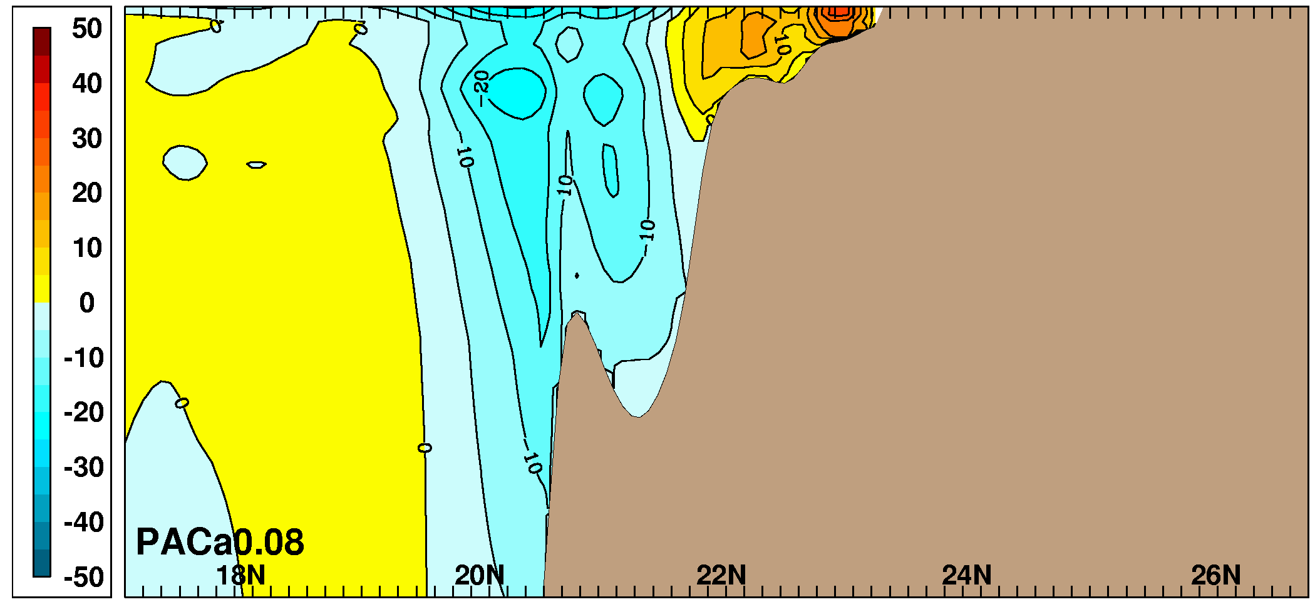
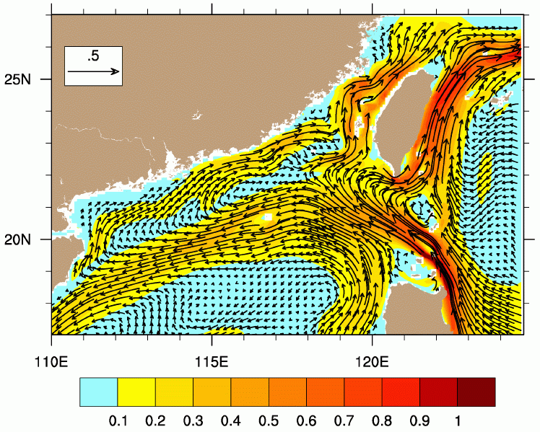
South China Sea Warm Current (SCSWC) Feeding the Taiwan Strait
SCSWC flows counter to the prevailing monsoon winds
Mean Zonal Velocity vs. Depth (top 500m) Along 117°E
Mean Surface Layer
Currents & Speed
100 m
South China Sea
Warm Current
200 m
300 m
South China Sea
Branch off the Kuroshio
400 m
blue = westward, orange = eastward
Results from a 1/12° Pacific HYCOM simulation forced with climatological ECMWF winds and heat fluxes
m/s
Notes:
The Kuroshio enters the SCS via Luzon Strait where the majority of it retroflects and continues northward off the east coast of Taiwan. A branch off the Kuroshio enters the SCS and continues southwestward along the shelf break. The SCSWC in HYCOM is a northeastward directed shelf current that flows counter to the prevailing monsoon winds (that blow toward the southwest in the annual mean) and, along with the Kuroshio, it feeds into the Taiwan Strait. There is considerable debate over the existence of the SCSWC in the scientific community. HYCOM offers the ability to study the dynamics of this shelf current and contribute to this debate. The SCSWC was never seen in NLOM because it excluded the shelf.
Illustrates remote littoral forcing (shelf current counter to the wind) and the influence of flow through straits (Taiwan Strait and quite likely Luzon Strait between the Philippines and Taiwan).
In a 6.1 LLWBC journal article, Metzger and Hurlburt (1996; JGR-O) discovered that the SCS branch off the Kuroshio is part of a circuitous 2nd pathway for the low latitude western boundary currents that close the Pacific-wide northern tropical gyre. The primary pathway is the Mindanao Current east of the southern Philippines. This journal article has over 50 citations listed in the SCI.

Slide 13
Luzon Strait throughflow
winter
Winter
Summer
Notes:
Luzon Strait (0.65-6.5Sv)
4-10Sv (Gan et al., 2016-cite Wyriki, 1961; Chen and Huang, 1996; Qu etal., 2000, 2004; Xue et al., 2004; Tian et al., 2006)
0.5-10Sv (e.g. Xue et al., 2004; Hsin et al., 2012)

Slide 14
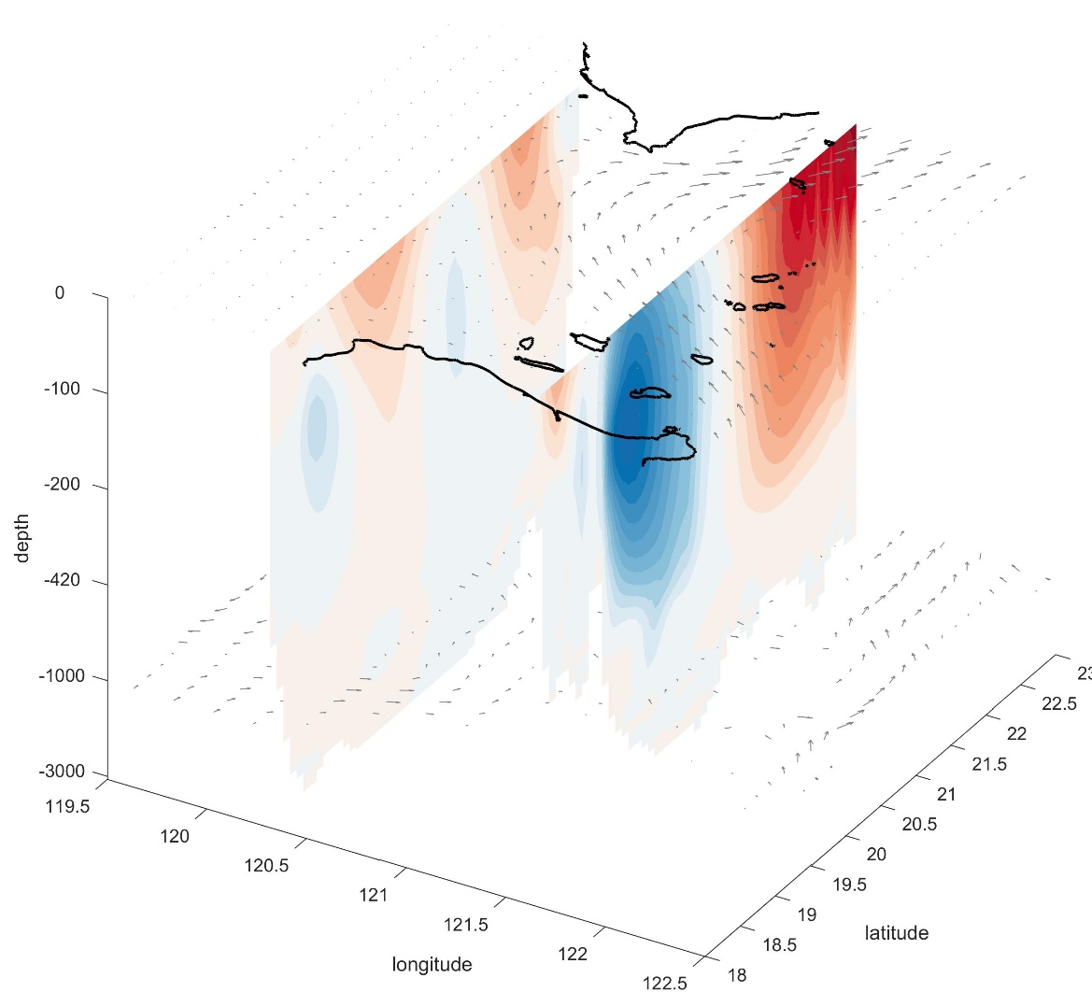
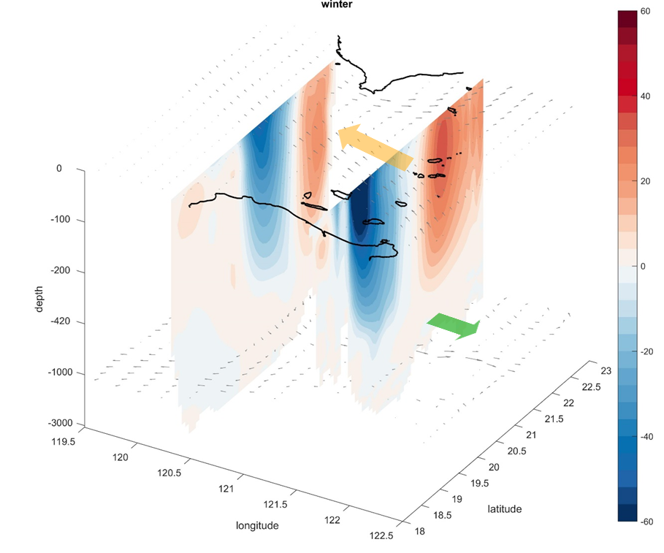
Luzon Strait throughflow
Observed 50m-300m averaged current
(20°40′ N, 120°38′ E)
Summer (U, cm/s)
Winter (U, cm/s)

Slide 15
Luzon Strait throughflow
Monthly volume transport through the Luzon strait (120.8E)
upper(<500m)
lower(700-1200m)

Slide 16
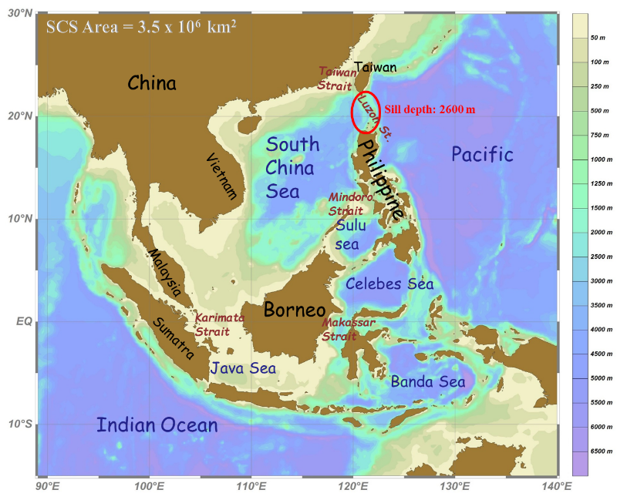
Karimata Strait & Mindoro Strait
Climatologically volume transport
Mean transport ~2.4 Sv (Qu and Song, 2009)
Wyriki, 1961: -3 to 4.5 Sv
Annual: 1.6 Sv (Tozuka et al., 2009); 1.2 Sv (Fang et al., 2009)
Boreal winter: ~1.3-4.4 Sv
Notes:
The analysis reveals the existence of a persistent baroclinic pressure gradient that drives a deepwater overflow from the South China Sea into the Sulu Sea. The application of hydraulic theory combined with the “geostrophic control” formula yields a mean transport estimate of about 2.4 Sv (1 Sv = 10⁶ m³ s⁻¹) through the Mindoro Strait and about 2.8 Sv through the Sibutu Passage. Most of this water enters the Sulu Sea through the bottom layer of the Mindoro Strait and exits the Sulu Sea in the upper layer of the Sibutu Passage. The analysis also provides the first satellite-based observational evidence on the seasonal and interannual variation of the Mindoro Strait and Sibutu Passage transports for the period from January 2004 to December 2007.
The seasonal variability in the Karimata Strait transport can exceed 5 Sv. It is proposed that the Karimata Strait throughflow plays a double role in the total Indonesian Throughflow transport, which is especially evident in boreal winter. The negative effect of the double role is reducing the Makassar Strait volume and heat transports; the positive effect is that the Karimata Strait throughflow itself can contribute volume and heat transports to the total Indonesian Throughflow.

Slide 17
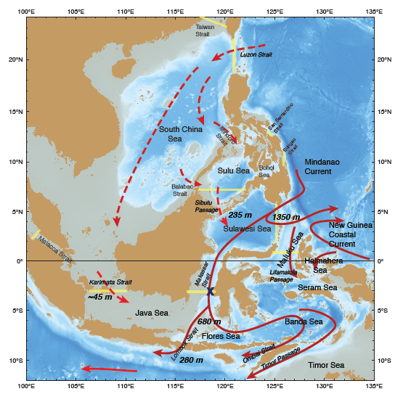
Indonesian Throughflow [ITF]
Pacific Ocean Entry Portals:
• South China Sea via Luzon Strait
to Karimata and Sibutu;
• Tropical Pacific via Mindanao &
Halmahera Eddies [Retroflections];
[Torrie Strait]
Indian Ocean Exit Portals:
Sunda Archpeligo passages:
Lombok, Ombai, Timor,
[Sunda Strait, Malacca Strait]
Interior Seas [the mix-master]:
Makassar Strait: western boundary,
primary inflow pathway;
Eastern seas: Banda ‘cyclonic gyre’,
Seram/Halmahera/Maluku Seas puzzle

Slide 18
Ocean-atmosphere interaction
Notes:
At longer time scales, the SST–precipitation (SST–P) relationship in observations varies markedly with oceanic regions where correlation is highly positive (e.g., in the tropical eastern Pacific) versus regions where correlation is either near zero or is even slightly negative (e.g., over the western Pacific and Indian Oceans).
The former corresponds to regions where slow ocean variability controls the atmospheric variability, and this relationship is well simulated with atmosphere-only models forced with observed SST. For the latter, it is generally argued that the negative SST–P correlation is because the atmospheric variability is the controlling mechanism for the SST variability (Wu et al. 2006). For this case, AMIP simulations, where evolution of SSTs is specified and may not be consistent with air–sea fluxes, by design cannot replicate the observed SST–P relationship (Kumar and Hoerling 1998).

Slide 19
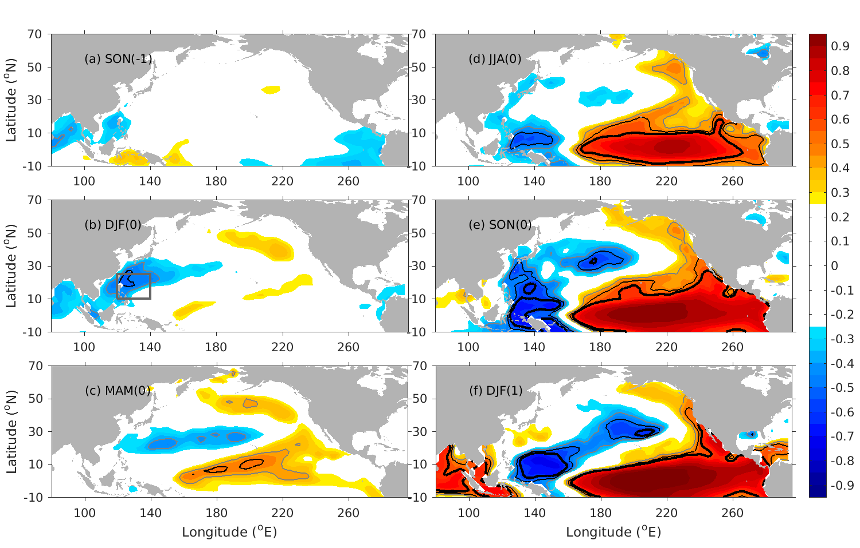
Western North Pacific-Basin scale
Correlation of Pacific SSTa (3-month running mean) and Jan.(1) Niño3.4 at different lags from 1948–2012
Victoria Mode

Slide 20
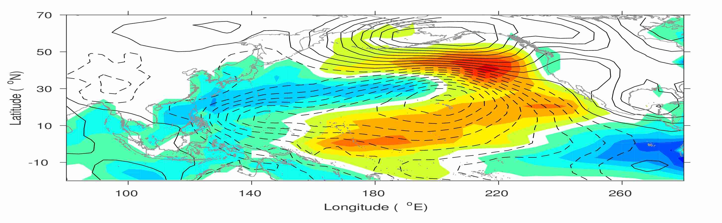
The VM: an ocean bridge connecting the NPO and ENSO
?
Ding et al. (2015)
SFM (Vimont et al.,2003)
Ocean Bridge
What dynamics trigger/modulate NPO variability?
SFM
LF
NPO [winter(0)]
VM [FMA(+1)]
El Nino [winter(+1)]
SF

Slide 21
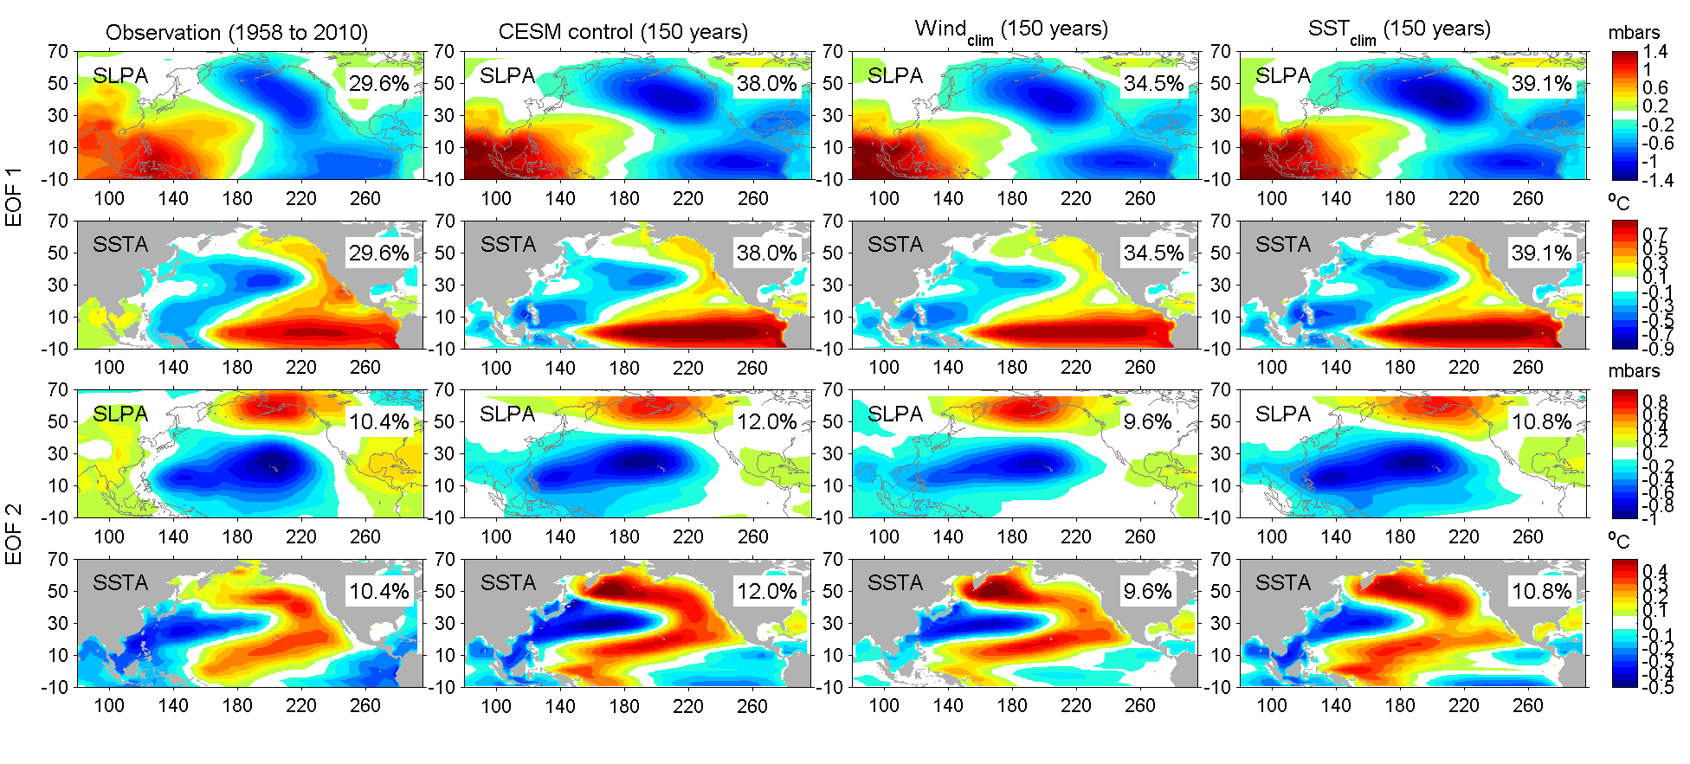
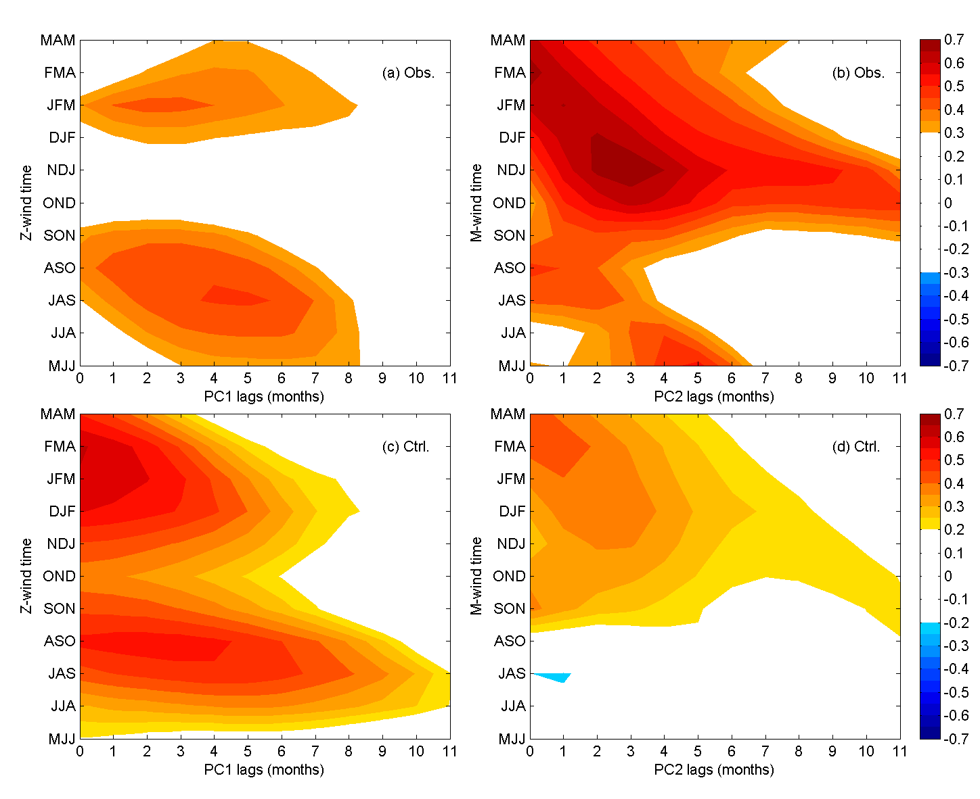
What modulates the NPO/VM?
Obs.
Lead-lag corr of -V_{10ps} in WNP and PC2
Suggest V_{10ps} leads PC2 2-3 months

Slide 22
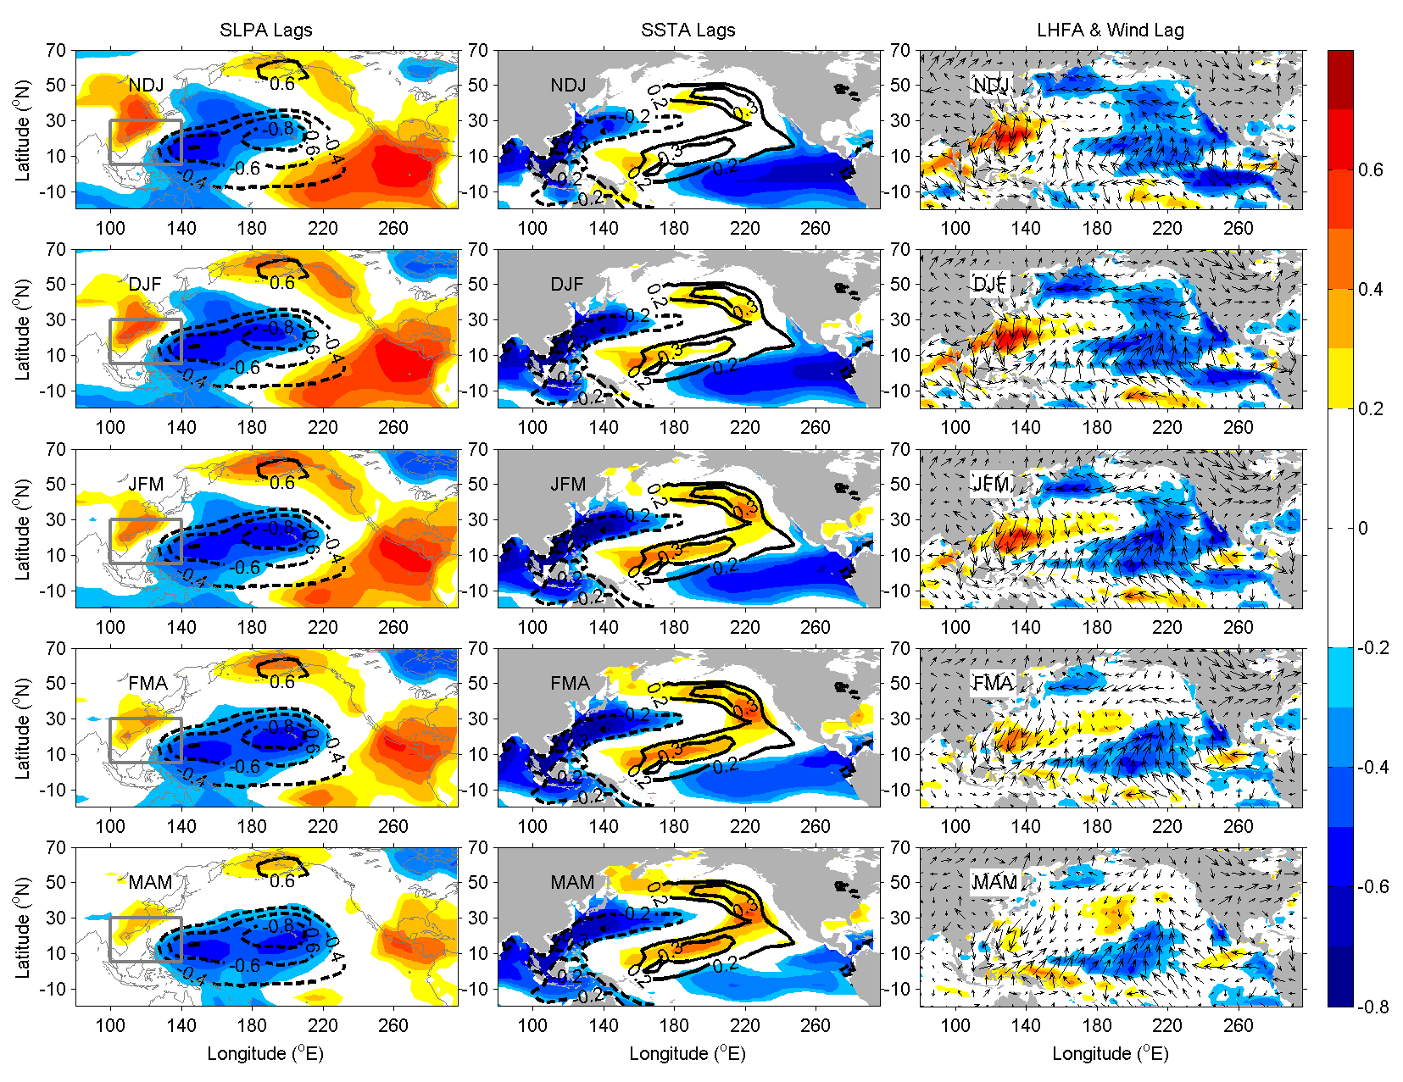
Correlation of NDJ –V_{wind} in WNP with several lags of SLPA, SSTA and LHFA

Slide 23
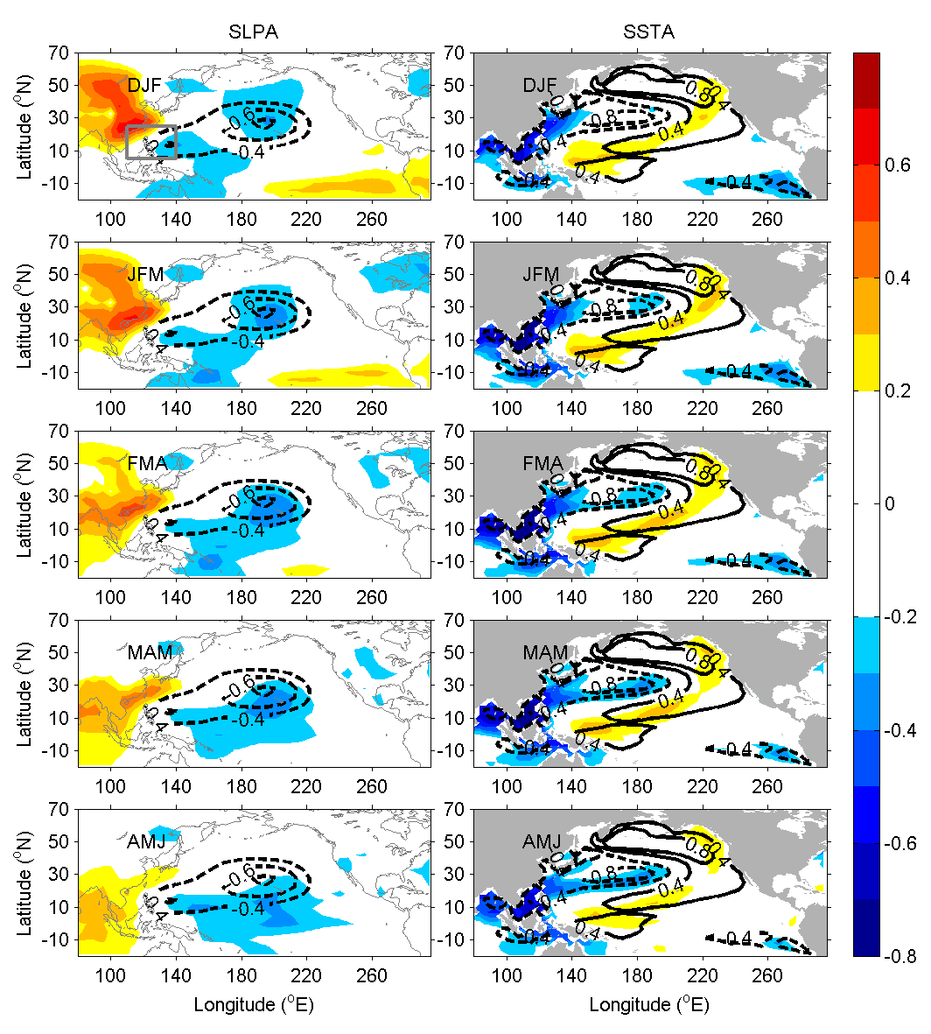
Correlation of NDJ –V_{wind} in WNP with several lags of SLPA, SSTA in CESM
Notes:
Correlation of the DJF-averaged meridional wind anomalies (-V_{10ps}) in PAMS (grey box in the top-left panel) with several lags (DJF, JFM, FMA, MAM, AMJ) of SLP anomalies (left) and SST anomalies (right) in the CESM simulation from year 50 to 150 (contours in the left and middle panels are the CEOF2 of SLP and SST anomalies in Fig. 5).

Slide 24
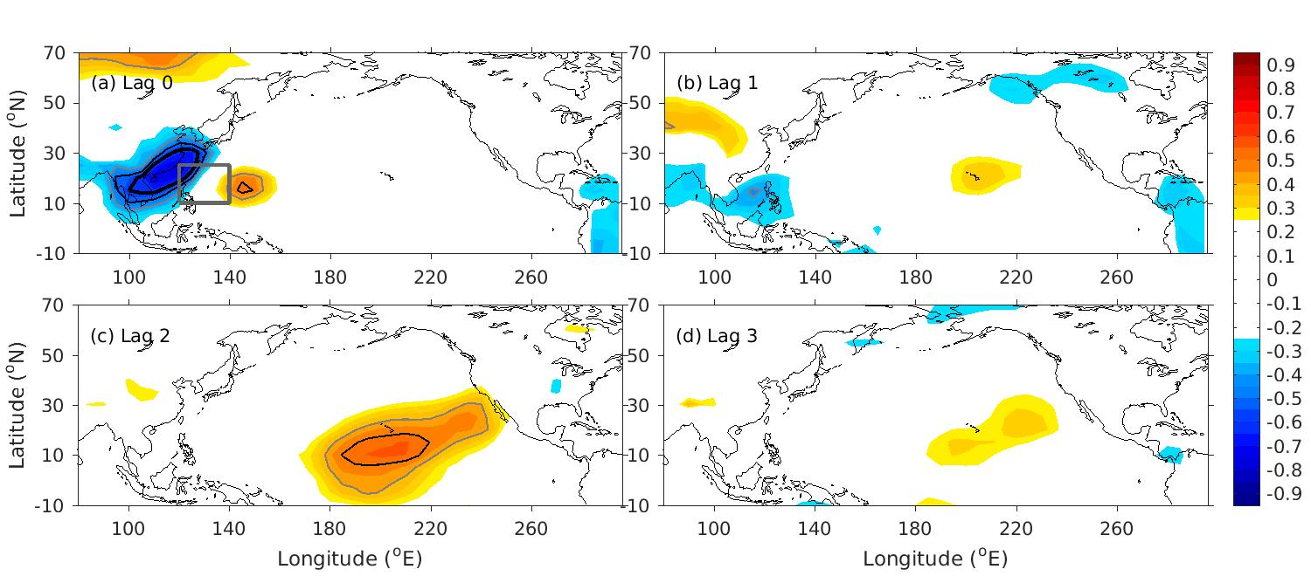
Correlation of SLPa with Nov. V_{10ps}
Southern lobe of the NPO

Slide 25
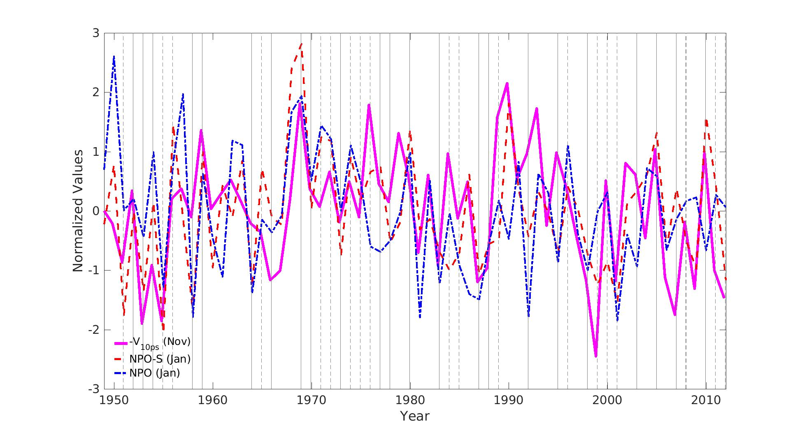
Time series of Nov. -V_{10ps} and Jan. NPO index
Correlation between Nov. -V_{10ps} and Jan. NPO-S >0.55

Slide 26
Rossby wave ray tracing-verification
Dispersion relation
Perturbed wave sources in the WNP (Zhao et al., 2015 J. Clim.;
Li et al., 2015 JAS)

Slide 27
Rossby wave ray tracing
Near surface
mid-troposphere

Slide 28
Rossby wave ray tracing
250 hPa
mid-troposphere
Notes:
Fig. 5. The stationary Rossby wave ray trajectories (green curves) with initialed zonal wavenumber k = 2, 4, 6 (upper, middle, bottom) under the NDJ (right panels) 500-hPa climatological flows (gray vectors) for the period of 1965-2012. Red forks over pink shadings denote wave source arrays over the PAMS region (110°E-140°E, 5°N-30°N).
Fig. 7. Same as Fig.5, but for the 250-hPa climatological flows

Slide 29
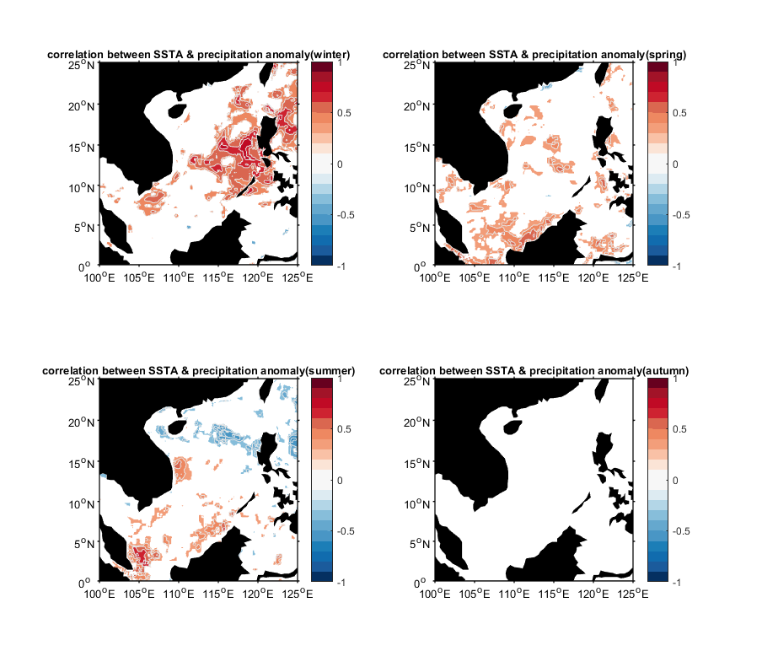
Correlation between the SST anomaly and precipitation anomaly
Positive SST-Prep: (ocean forces atm.)
Negative SST-Prep: (atm controls SSTa) Wu et al. (2006)
Winter
Summer
(only values within the 90% confidence are shown)

Slide 30
Conclusion
The circulation of SCS consists of three layer structure
Characteristics of the mean ocean circulation in the South China Sea (SCS)
Monsoon wind stress
Seasonal circulation
SCS throughflow (SCSTF)
Taiwan Strait
Luzon Strait Intrusion
Ocean-atmosphere interaction in the SCS
Modulating the NPO variability which favor the development of El Nino

